Slide 1


Slide 2



Slide 3


Let’s play game
Circle the pictures
Notes:
T says “Hello, everyone. How are you? How’s the weather? Is it sunny? Great! “
Split the class into 2 groups – “Today, we will have 2 groups – group 1 and group 2. You are group 1, you are Group 2.”
3. Warm up: game “ circle the pictures”. Students need to listen the word that is required to circle. Then choose the pictures to circle
T says: “I have an interesting game for all of you today”. The game “ circle the pictures”. Let’s start.”

Slide 4
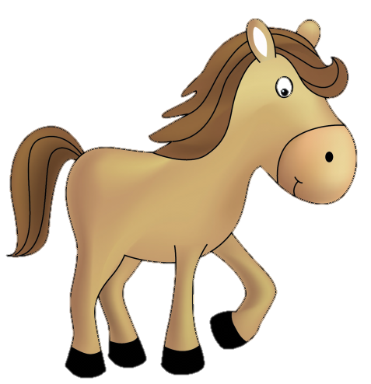


Circle the pictures
Circle the hippos
Notes:
First: Circle the hippos
Students choose the pictures that are hippos
T says: “please circle the hippos. Who can ? Raise your hands, please.
You, please. Where are the hippos? (click, click, click). Perfect.
How many hippos? – 3 – Good.”
With the correct answer, that team will have 1 point.

Slide 5

Circle the pictures
Circle the horses
Notes:
First: Circle the horse
Students choose the pictures that are horses
T says: “please circle the horse. Who can ? Raise your hands, please.
You, please. Where are the horses? (click, click, click, click). good.
How many horses? – 4 – Good.”
With the correct answer, that team will have 1 point.

Slide 6
Circle the pictures
Circle the goats
Notes:
First: Circle the goats
Students choose the pictures that are goats
T says: “please, circle the goats. Who can? Raise your hands, please.
You, please. Where are the goats? (click, click, click, click, click). Perfect.
How many goats? – 5 – Well done.”
With the correct answer, that team will have 1 point.

Slide 7



Slide 8



UNIT 9
LESSON 1
Notes:
T says” Welcome to Unit 9, lesson 1 today.”

Slide 9


Unit 9:
Lesson 1:
I i
1. Look, listen and repeat.
I i
i
ink
inkpot
Notes:
Part 1: Look, listen and repeat
-Teacher asks Sts to listen the audio file 2 – 3 times for each.
Then asks them to repeat
T says: “Now, we go to part 1: Look, listen and repeat”
Letter Ii – click the first sound icon 2 times , then T says: ““listen and repeat, please”. – Ii – good”
Sound /i/ – click the second sound icon 2 times , then T says: “listen and repeat, please” /i/ very good”
Ink – click the third sound icon2 times , then T says: “listen and repeat, please”. ink – excellent. What color is the ink? Purple. Good”
Inkpot– click the fourth sound icon 2 times , then T says: “listen and repeat, please”. inkpot – well done. “

Slide 10
Unit 9:
Lesson 1:
I i
1. Look, listen and repeat.
I i
i
Notes:
Part 1: Look, listen and repeat
Teacher asks Sts to listen the audio file 2 – 3 times for each.
Then asks them to repeat.
Letter Ii – click the first sound icon 2 times , then T says: “listen and repeat, please”. – Ii – good “
Sound /i/ – click the second sound icon 2 times , thenT says: “listen and repeat, please” /i/ very good”

Slide 11


Unit 9:
Lesson 1:
I i
1. Look, listen and repeat.
ink
inkpot
Notes:
Part 1: Look, listen and repeat
Teacher asks Sts to listen the audio file 2 – 3 times for each.
Then asks them to repeat
Ink – click the third sound icon 2 times , then T says: “listen and repeat, please”. ink – excellent. What color is the ink? Purple. Good “
Inkpot– click the fourth sound icon 2 times , then T says: “listen and repeat, please”. inkpot – well done. “

Slide 12
Unit 9:
Lesson 1:
I i
1. Look, listen and repeat.
What’s missing?
?
I i
i
Notes:
Game “ What’s missing?”
Work in groups
There is a missing picture. Students say aloud the missing picture.
T says: “What is missing? - /i/ (click) – Excellent.”
Teacher checks if it is right → That team gets 1 point.

Slide 13
Unit 9:
Lesson 1:
I i
1. Look, listen and repeat.
What’s missing?
?
Notes:
Game “ What’s missing?”
Work in groups
T says: “What is missing? - /ink/ (click) – Excellent.”
Teacher checks if it is right → That team gets 1 point.

Slide 14


Unit 9:
Lesson 1:
I i
1. Look, listen and repeat.
What’s missing?
I i
i
?
Notes:
Game “ What’s missing?”
Work in groups
T says: “What is missing? –inkpot (click) – Yes, it’s right.”
Teacher checks if it is right → That team gets 1 point.

Slide 15


Slide 16
Unit 9:
Lesson 1:
I i
Review after playing game
I i
i
ink
inkpot
Notes:
Review after playing game.
Play audio file and ask the students to repeat.
Letter Ii – T says: “listen and repeat, please”. – Ii – good”
Sound /i/ – T says: “listen and repeat, please” /i/ very good “
Ink – T says “listen and repeat, please”. ink – excellent. “
Inkpot– T says: “listen and repeat, please”. inkpot – well done. “

Slide 17
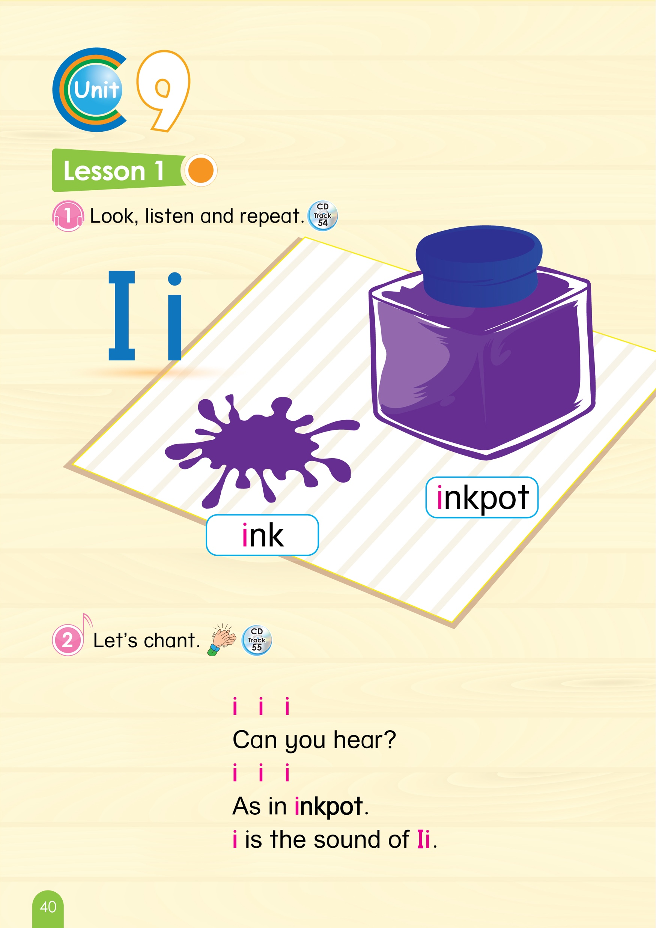
Look at your book, please
Page 40
Notes:
Book using: Look, point and say
Teacher guides the students use the book. Look, point and say
Work in pairs or in individual
The students can use their fingers point and say.
T says:” Look at your book page 40, please. Point and say with your friends.”

Slide 18
Unit 9:
Lesson 1:
I i
2. Let’s chant.
i i i
Can you hear ?
i i i
As in inkpot
i is the sound of I i
Notes:
Part 2: Let’s chant
-Teacher will play the audio file twice and asks the students to listen.(click the blue sound icon)
After that, The whole class will repeat sentence by sentence.(click the sound icon in each line)
Teacher can ask the students to chant in teams and put them in a competition.
Or Teacher can change the style of the chant, for example: Clap hands, using instruments.
2. T says: “Let’s go to part 2: Let’s chant”
Now we will listen the chant 2 times. Listen. (click blue icon 2 times) Ok
Now listen and repeat.
Click i i i -> i i i
Click Can you hear> -Can you hear ? Good.
Click i i i -> i i i
Click As in inkpot -> As in inkpot. Very good.
Click i is the sound of I i ->i is the sound of I i . Well done “

Slide 19





Unit 9:
Lesson 1:
I i
Game: Lucky numbers
Notes:
Game – Lucky numbers:
There are 4 pictures from 4 numbers.
When the students choose a number. Teacher will ask a question about that picture. If the students give a correct answer, they get 1 point.
There is a lucky number with smiley face. If the student get that number. They get 3 points.
T says: “It’s time for playing game. This game is called Lucky numbers. We have number 1, number 2, number 3, number 4, number 5. You can choose a number. When you see a picture and tell me what it is. You get 1 point. If you choose a number with a smiley face, you will get 3 points.
Are you ready? Ok, go.
Which number do you want? Number 1, Ok. ”(click)”
And keep doing that until all numbers are chosen.
Then, click on the arrow to the reviewing slide at the end.

Slide 20
Unit 9:
Lesson 1:
I i
Game: Lucky numbers
I i
Notes:
Game: Lucky numbers
T says: “Number 1: What letter is this? – Letter I. Good job.
1 point for your team.”
Click on the arrow to turn back to the slide of numbers

Slide 21

Unit 9:
Lesson 1:
I i
Game: Lucky numbers
Notes:
Game: Lucky numbers
1. T says: “Number 2: What is it? – ink. Excellent
1 point for your team.”
Click on the arrow to turn back to the slide of numbers.

Slide 22

Unit 9:
Lesson 1 : Ii
Game: Lucky numbers
Notes:
1. T says: “Number 3:
Wow, Lucky number – 3 points for your team. Yeah “
Click on the arrow to turn back to the slide of numbers

Slide 23
Unit 9:
Lesson 1:
I i
Game: Lucky numbers
i
Notes:
Game: Lucky numbers
1. T says: “Number 4: What sound of the letter Ii?– i . Yes, that’s right.
1 point for your team.”
Click on the arrow to turn back to the slide of numbers

Slide 24

Unit 9:
Lesson 1:
I i
Game: Lucky numbers
Notes:
Game: Lucky numbers
1. T says: “Number 5: What is it? – inkpot. Good
1 point for your team.”
Click the arrow to return the slide of numbers.

Slide 26
Unit 9:
Lesson 1:
I i
Review after playing game
I i
i
ink
inkpot
Notes:
Review after playing game.
Play audio file and ask the students to repeat.
Letter Ii – T says: “listen and repeat, please”. – Ii – good”
Sound /i/ – T says: “listen and repeat, please” /i/ very good “
Ink – T says “listen and repeat, please”. ink – excellent. “
Inkpot– T says: “listen and repeat, please”. inkpot – well done. “

Slide 27
Goodbye
Notes:
Sum up – It’s time to say good bye today”.
Count the points of each group.
Group having more points will be the winner.-“So the winner is group …. Group …, you also good, too.”
Say goodbye. “Goodbye class”

Slide 28


CÔNG TY CỔ PHẦN PHÁT TRIỂN GIÁO DỤC
VIỆT NAM VPBOX
Hà Nội
Biệt thự G2&G28, Làng Quốc Tế Thăng Long,
Quận Cầu Giấy, Hà Nội.
ĐT: (024) 3 3793 2405
phonics.hanoi@vpbox.edu.vn
Thành Phố Hồ Chí Minh
Số 29 Mai Thị Lựu, Quận 1, TP. HCM.
ĐT: (028) 3 820 5934
phonics.hcm@vpbox.edu.vn
www.vpbox.edu.vn

