Slide 1


Slide 2



Slide 3


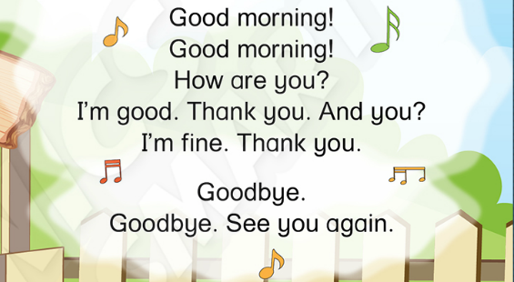

Notes:
Teacher says “Hello, everyone. How are you? How’s the weather? Is it sunny? Great! Now, let’s sing a song with me.”
Warm up: Sing “Good morning” – “Excellent! You sing very well.”
Divide class into 2 groups (optional) – “Today, we will have 2 groups – Group 1 and Group 2. You are Group 1, you are Group 2.”

Slide 4


Let’s review!
Game: Can you count?
Notes:
T ask students “Do you like playing game?”. Now we are going to play “Can you count” Game.

Slide 5
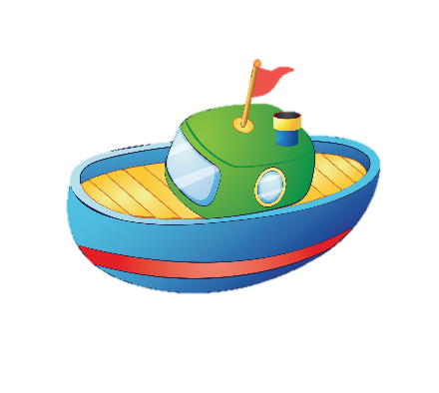




























Let’s review!
Game: Can you count?
Notes:
T shows the slide and asks students “How many boat?” Can you count?
T shows the answer and asks the whole class to repeat the answer.
T gives stars for the correct answers.
Continue showing the slide and asking the question until finishing the game.

Slide 6












Let’s review!
Game: Can you count?

Slide 7


Let’s review!
Game: Can you count?

Slide 8

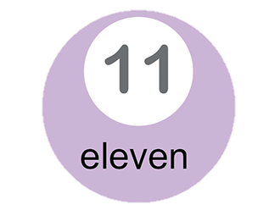
Let’s review!
Game: Can you count?

Slide 9
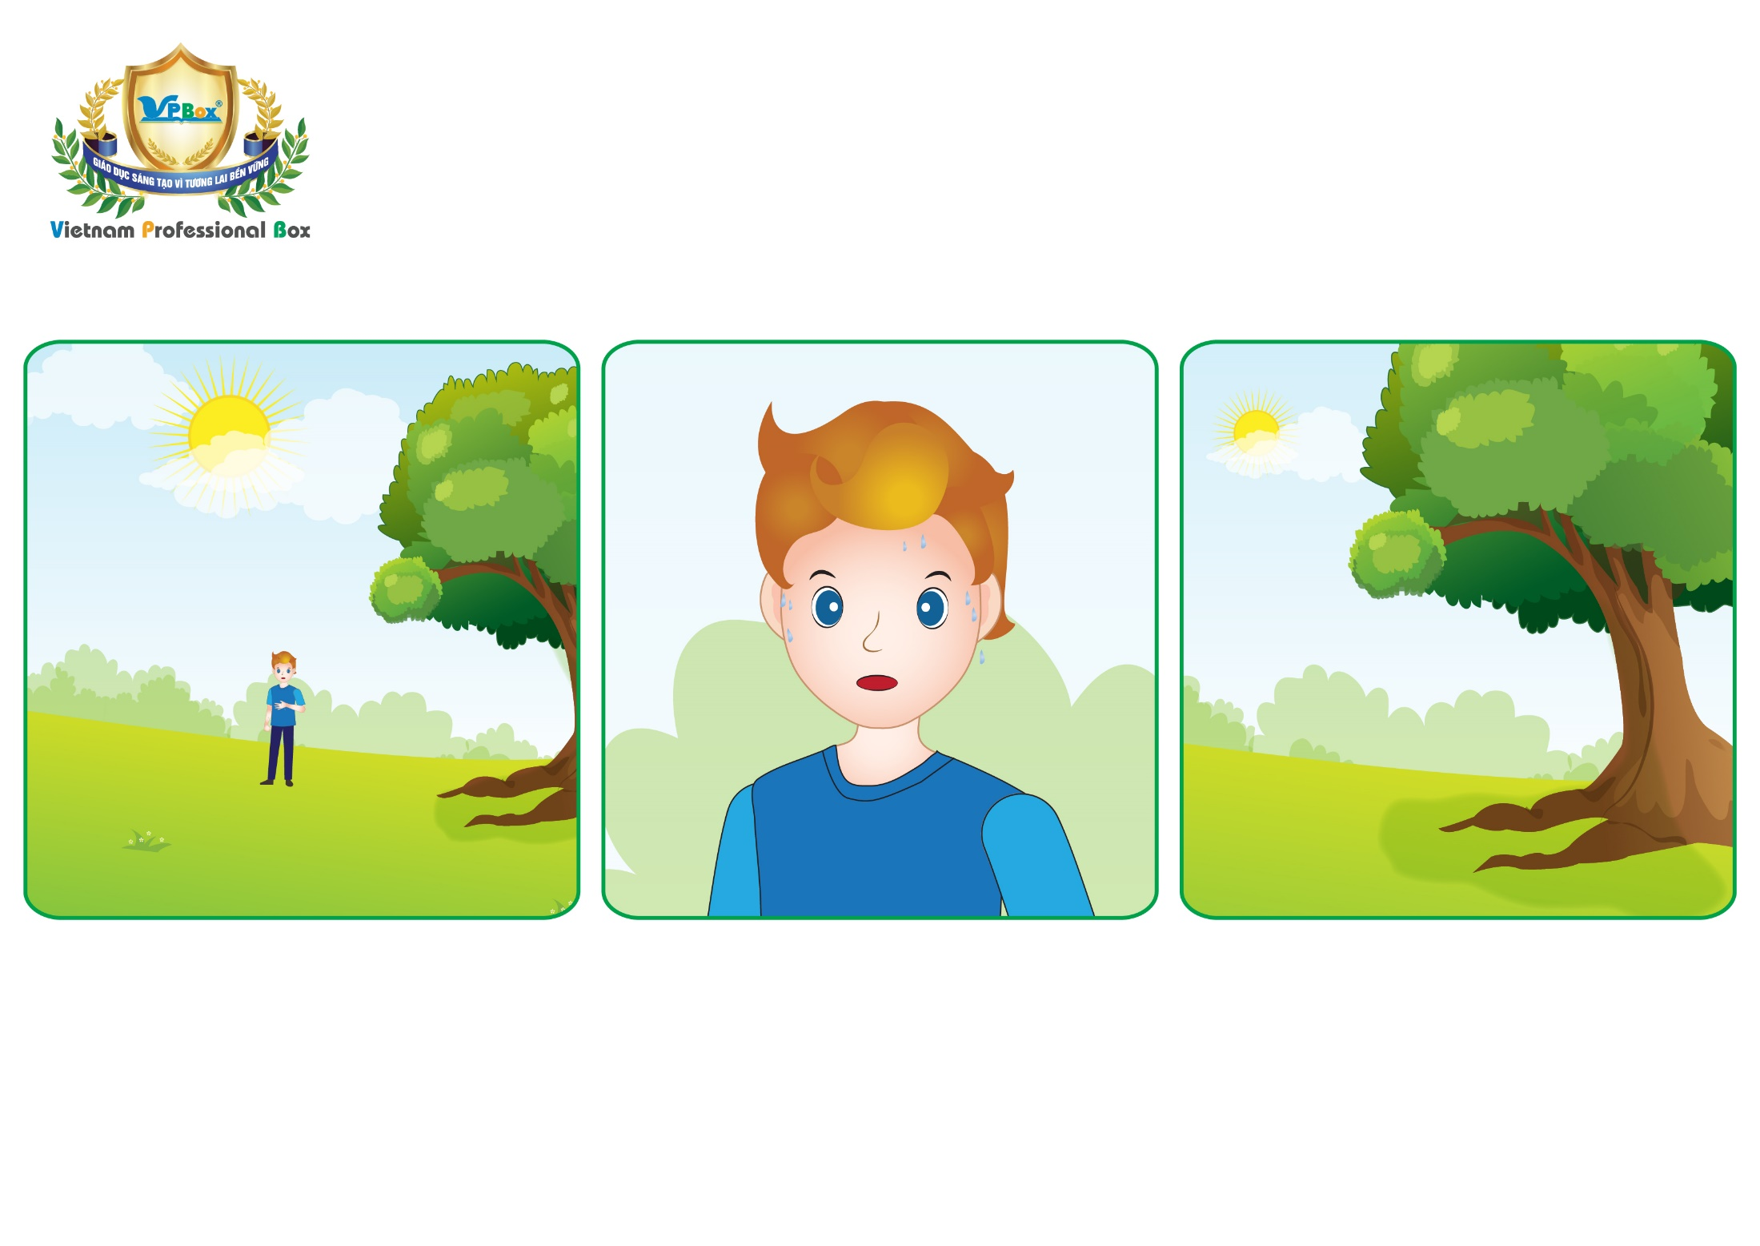
Unit 8: Lesson 1 Uu
Notes:
Teacher gives students some hints of today’s lesson by pointing man and the tree, possibly saying “Can you guess who he is?. And where is he?”

Slide 10


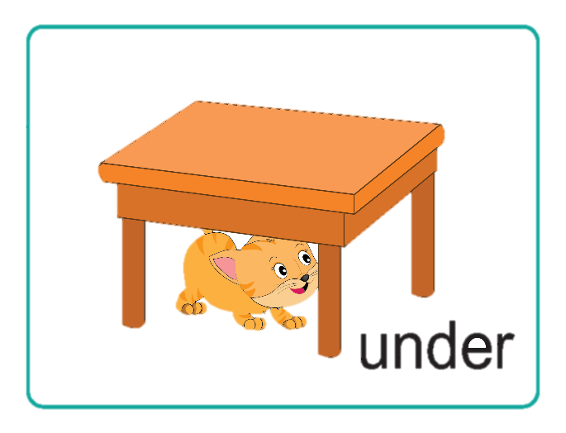
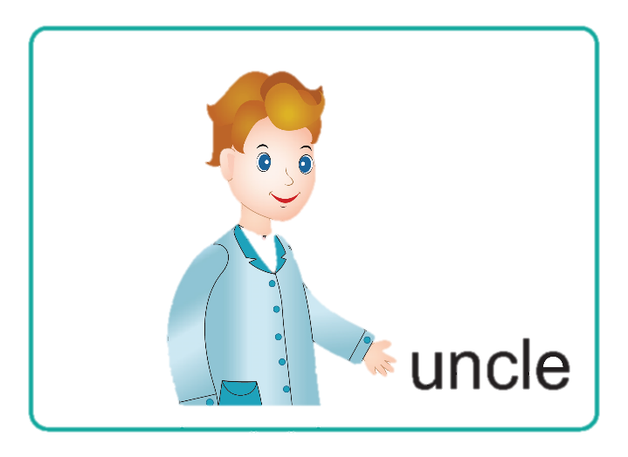
Unit 8:
Lesson 1
U u
1. Listen and repeat.
Uu
u
Notes:
Teacher asks students to listen twice for each letter, sound and words. “Listen 2 times”
Teacher asks students to repeat twice after one-by-one listening, and checks pronunciation. – ”Listen and repeat.”
Teacher does the gestures of the letter, sound and words, and has students do the same while repeating. – “Look at me, listen and repeat.”

Slide 11


Unit 8:
Lesson 1
U u
1. Listen and repeat.
Game:
Let’s guess!

Slide 12
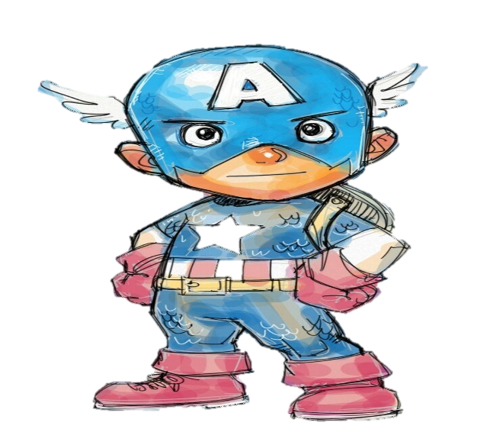







Notes:
Teacher introduce the game and gives instructions:
+ T removes a few bricks for students to guess what’s behind the wall.
+ T collects and confirm their answers, and shows the answer on the slide.
+ T asks students to repeat the answers.

Slide 13


Guess what’s behind the wall
by removing the fewer bricks.

Slide 14
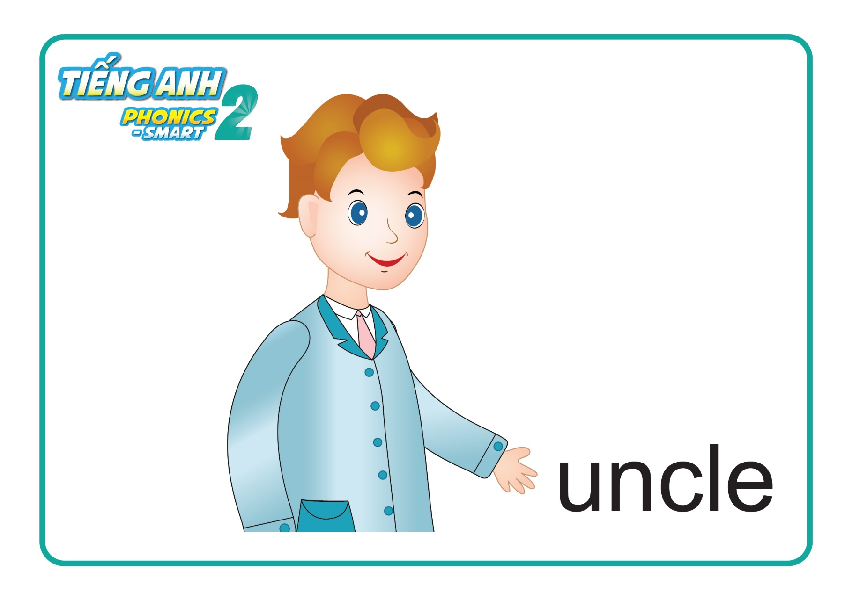
NEXT
CHECK

Slide 15

NEXT
CHECK

Slide 16
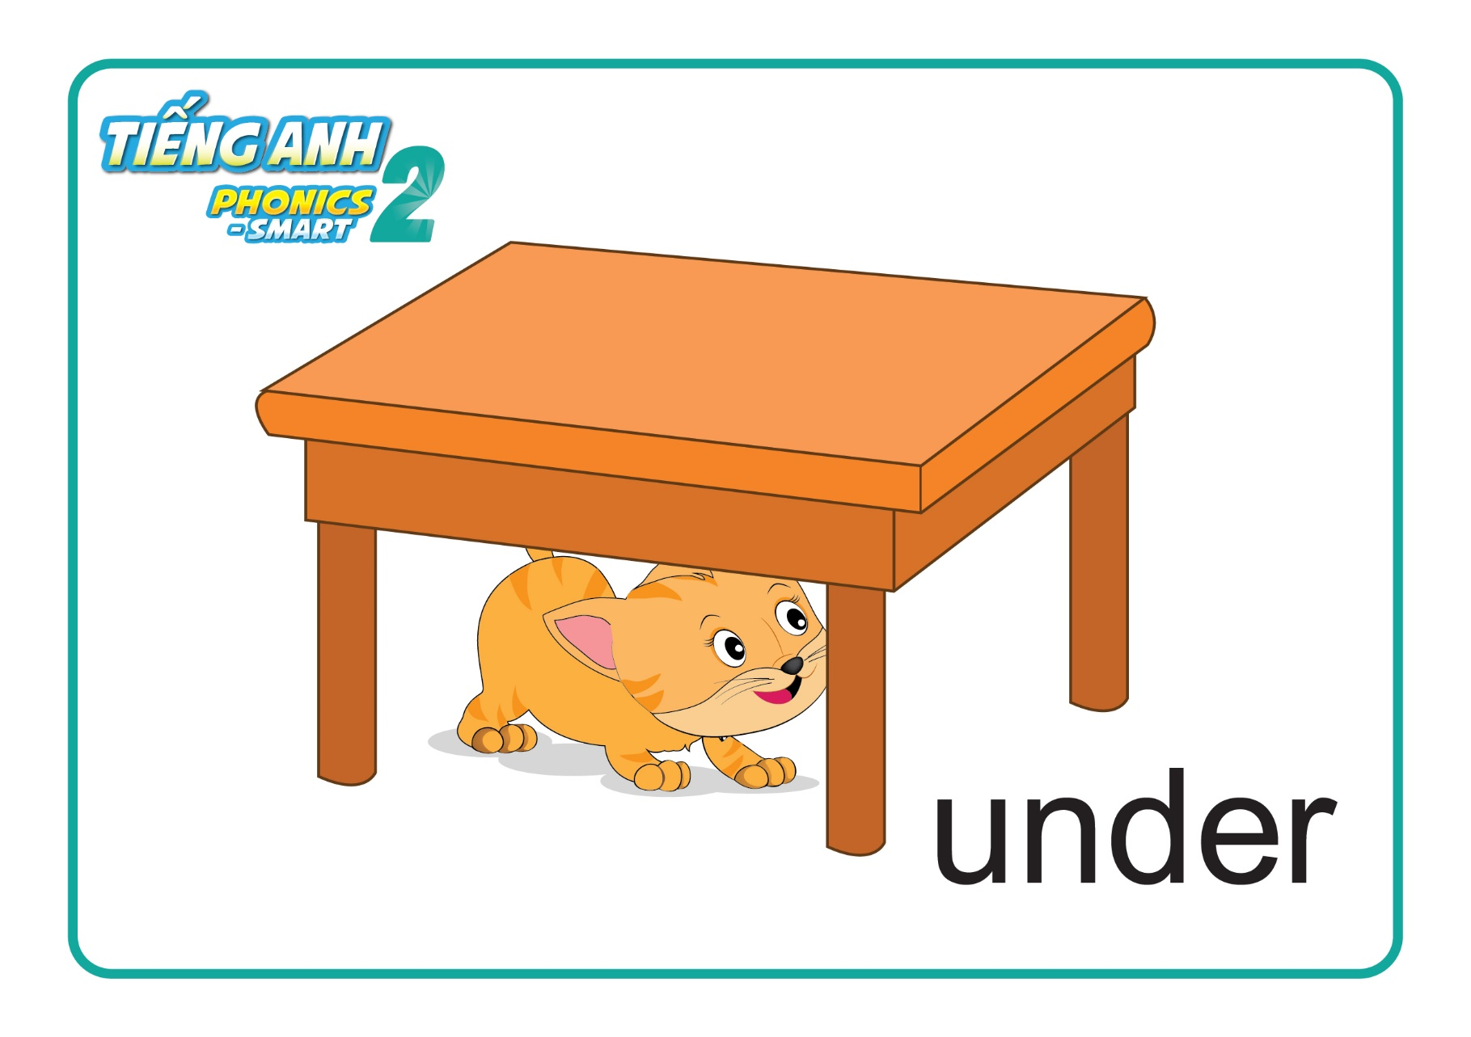
NEXT
CHECK

Slide 17

NEXT
CHECK
u

Slide 18

NEXT
CHECK

Slide 19

Unit 8:
Lesson 1
U u
1. Look, listen and repeat.
2. Let’s chant.
Notes:
Teacher leads in the chant. – “Let’s chant with me.”
Teacher asks students to listen twice, while teacher follows the chant with gestures. – “Look and listen 2 times”
Teacher asks students to listen and repeat each line of the chant. – “Listen and repeat.”
Teacher mutes the sound and have students say each line along by group. “Now, again please.”
Teacher groups students and ask them to sit face to face and practice chanting with gestures. Offer help if necessary. “Let’s chant with your friends.”
Teacher asks the class to chant along with music and do gestures. – “Class, let’s chant with me.”

Slide 20


Unit 8:
Lesson 1
U u
Let’s review!
Uu
1
A.
u
2
B.
Notes:
Teacher leads in the review section. - “Now, listen and choose the correct answer.”
Teacher asks students to listen to each audio for one time.
Teacher asks for answers, collects and confirms and shows the correct answer. “Listen, A or B. Great, B - h. Next, what is it? Good - H.”

Slide 21

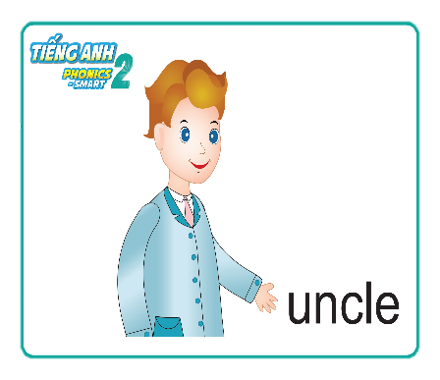
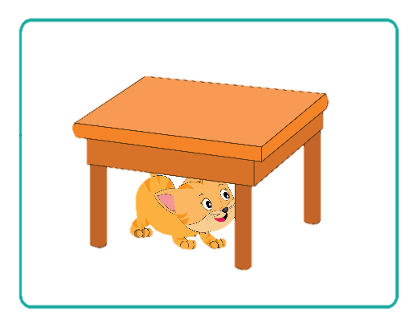
Unit 8:
Lesson 1
U u
Let’s review!
Who is it?
What is it?
under
uncle
Notes:
Teacher asks students to look at the picture and asks “What is it?”.
Teacher asks for answers, collects and confirms, and shows the correct answer.

Slide 22

Unit 8:
Lesson 2
Uu
Notes:
Teacher gives praises: “Good job.”

Slide 23


CÔNG TY CỔ PHẦN PHÁT TRIỂN GIÁO DỤC
VIỆT NAM VPBOX
Hà Nội
Biệt thự G2&G28, Làng Quốc Tế Thăng Long,
Quận Cầu Giấy, Hà Nội.
ĐT: (024) 3 3793 2405
phonics.hanoi@vpbox.edu.vn
Thành Phố Hồ Chí Minh
Số 29 Mai Thị Lựu, Quận 1, TP. HCM.
ĐT: (028) 3 820 5934
phonics.hcm@vpbox.edu.vn
www.vpbox.edu.vn

