Slide 1


Slide 2



Slide 3



Warm up
Chant the letter Uu
Notes:
Hello children, How are you doing?
I hope that you are good.
Let’s sing the “chant of letter Uu”.
Today, we will have 2 groups – group 1 and group 2. You are group 1, you are Group 2.

Slide 4

Unit 8: Lesson 1 Uu
Notes:
Teacher gives students some hints of today’s lesson by pointing man and the tree, possibly saying “Can you guess who he is?. And where is he?”

Slide 5


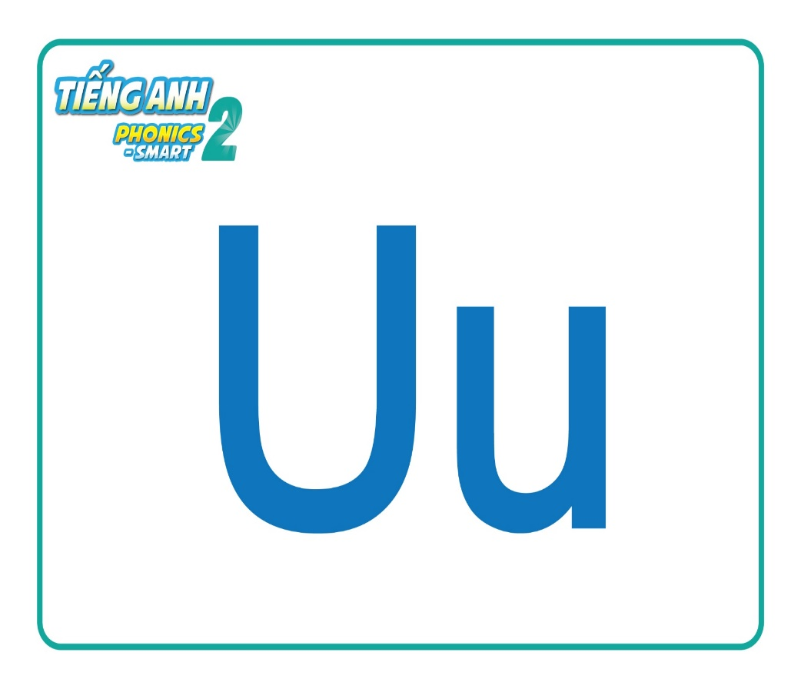
Game: Can you guess?
What is it?
Remove Box
Next Slide
Notes:
This is Guessing game,“I will remove the box one by one, and you guess what it is. OK?”. “Good”
“What is it?- Guess.”
After the picture is shown, ask SS to read again.
Good job. Letter U. 1 point for your group.

Slide 6
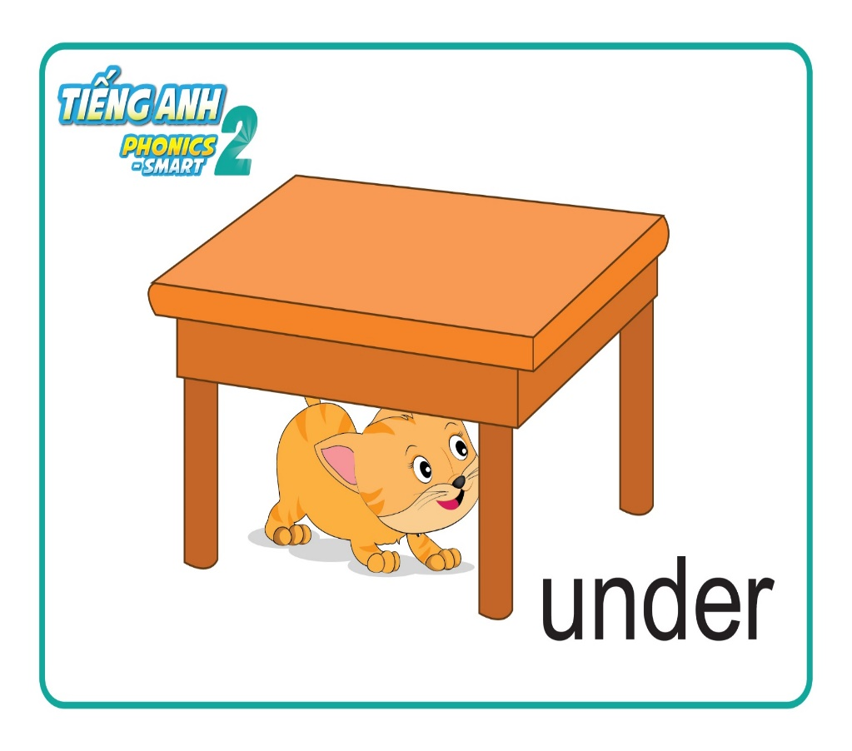
Game: Can you guess?
What is it?
Remove Box
Next Slide
Notes:
Can you guess this one?
Well done. under. Your group gets 1 point.

Slide 7

Game: Can you guess?
What is it?
Remove Box
Next Slide
Notes:
How about this one?
What is it?
You’re right.
uncle. 1 more point.

Slide 8

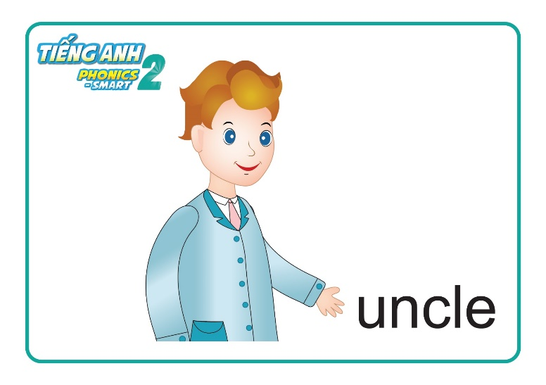

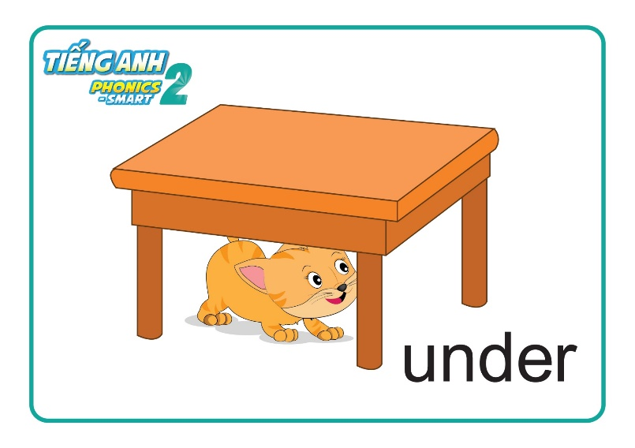
Unit 8 Lesson 2
Unit 8: Lesson 2 Uu
Review Lesson 1
Notes:
So, these are some cards, we learn in Lesson 1.
Let’s say them again.
Now, we move to Lesson 2.

Slide 9

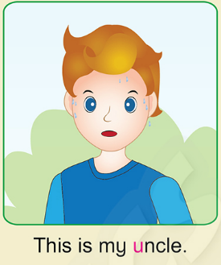

Unit 8: Lesson 2 Uu
1. Listen and repeat
1
2
3
Notes:
-Now, This is Part 1 – Listen and repeat.
You listen 2 times. Click number 1.
“ It is sunny”.
“This is my uncle”.
“My uncle is under the tree”.
- (The second time)
-Let’s listen and repeat.

Slide 10

Unit 8: Lesson 2 Uu
1. Listen and repeat
It is sunny.
Notes:
Look! Listen and repeat!
T asks students to repeat in groups, whole class and individual.

Slide 11
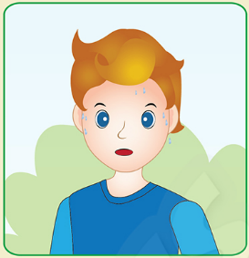
Unit 8: Lesson 2 Uu
1. Listen and repeat
This is my uncle.
Notes:
Look! Listen and repeat!
T asks students to repeat in groups, whole class and individual.

Slide 12

Unit 8: Lesson 2 Uu
1. Listen and repeat
My uncle is under the tree.
Notes:
Look! Listen and repeat!
T asks students to repeat in groups, whole class and individual.

Slide 13
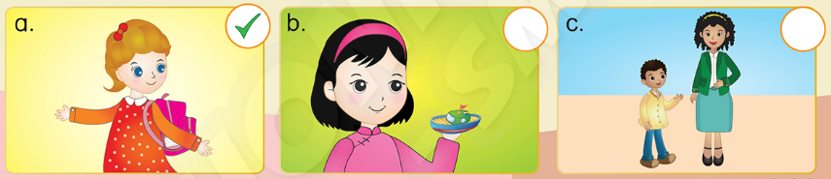
Unit 8: Lesson 2 Uu
1. Listen and repeat
2. Listen and tick (✓) or cross (✗)
Notes:
Well, we move to Part 2 – Listen and tick or cross.

Slide 14
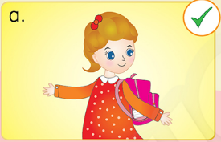
Unit 8: Lesson 2 Uu
2. Listen and tick (✓) or cross (✗)
Example
Notes:
Look at the example. Look at the girl and listen.
What can you hear?
This is my bag. Good!
Yes or No?
Yes! So we put a tick on the circle.

Slide 15
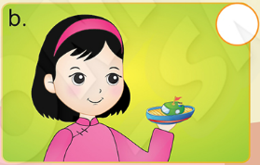
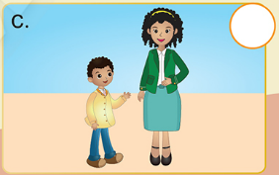
Unit 8: Lesson 2 Uu
2. Listen and tick (✓) or cross (✗)
Notes:
- Now, let’s listen.
You’ll listen 2 times.
Click the audio 2 times for students to listen and do the task.
Lick the audio again to check and correct the answers.

Slide 16
Unit 8: Lesson 2 Uu
2. Listen and tick (✓) or cross (✗)
✓
Notes:
- Now, let’s listen.
You’ll listen 2 times.
Click the audio 2 times for students to listen and do the task.
Lick the audio again to check and correct the answers.

Slide 17
Unit 8 Lesson 2 Uu
2. Listen and tick (✓) or cross (✗)
✗
Notes:
Lick the audio again to check and correct the answers.

Slide 18
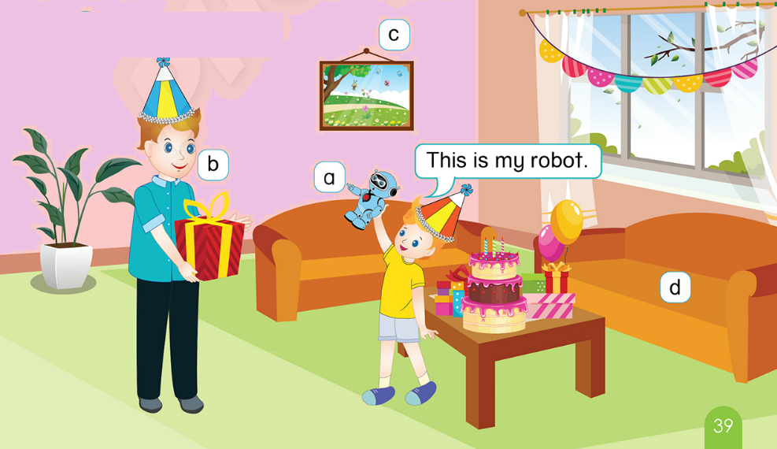
Unit 8: Lesson 2 Uu
3. Point and say
Notes:
T asks students to focus on the picture in their book.
Open your book, please!
Now, look at the picture.
What can you see?
T points to the items in the picture and asks the students to name the items.
T focus the students on the item a.
What is this?
Is this a doll?
No, this is not a doll.
Is this a robot?
Yes, this is my robot.
T continues pointing to items b, c, d and asks students the questions for them to say the sentence “This is my … .”
T asks students to work in groups, point to the picture and say.
This is my robot.
This is my uncle.
This is my picture.
This is my sofa.

Slide 19
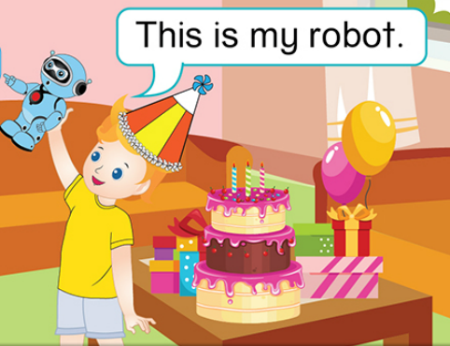
Unit 8: Lesson 2 Uu
3. Point and say
This is my robot.
Notes:
T asks students to focus on the picture in their book.
Open your book, please!
Now, look at the picture.
What can you see?
T points to the items in the picture and asks the students to name the items.
T focus the students on the item a.
What is this?
Is this a doll?
No, this is not a doll.
Is this a robot?
Yes, this is my robot.
T continues pointing to items b, c, d and asks students the questions for them to say the sentence “This is my … .”
T asks students to work in groups, point to the picture and say.
This is my robot.
This is my uncle.
This is my picture.
This is my sofa.

Slide 20

Unit 8: Lesson 2 Uu
3. Point and say
This is my uncle.
Notes:
T asks students to focus on the picture in their book.
Open your book, please!
Now, look at the picture.
What can you see?
T points to the items in the picture and asks the students to name the items.
T focus the students on the item a.
What is this?
Is this a doll?
No, this is not a doll.
Is this a robot?
Yes, this is my robot.
T continues pointing to items b, c, d and asks students the questions for them to say the sentence “This is my … .”
T asks students to work in groups, point to the picture and say.
This is my robot.
This is my uncle.
This is my picture.
This is my sofa.

Slide 21

Unit 8: Lesson 2 Uu
3. Point and say
This is my picture
Notes:
T asks students to focus on the picture in their book.
Open your book, please!
Now, look at the picture.
What can you see?
T points to the items in the picture and asks the students to name the items.
T focus the students on the item a.
What is this?
Is this a doll?
No, this is not a doll.
Is this a robot?
Yes, this is my robot.
T continues pointing to items b, c, d and asks students the questions for them to say the sentence “This is my … .”
T asks students to work in groups, point to the picture and say.
This is my robot.
This is my uncle.
This is my picture.
This is my sofa.

Slide 22

Unit 8: Lesson 2 Uu
3. Point and say
This is my sofa.
Notes:
T asks students to focus on the picture in their book.
Open your book, please!
Now, look at the picture.
What can you see?
T points to the items in the picture and asks the students to name the items.
T focus the students on the item a.
What is this?
Is this a doll?
No, this is not a doll.
Is this a robot?
Yes, this is my robot.
T continues pointing to items b, c, d and asks students the questions for them to say the sentence “This is my … .”
T asks students to work in groups, point to the picture and say.
This is my robot.
This is my uncle.
This is my picture.
This is my sofa.

Slide 23
Unit 8: Lesson 2 Uu
3. Point and say
Notes:
T asks students to focus on the picture in their book.
Open your book, please!
Now, look at the picture.
What can you see?
T points to the items in the picture and asks the students to name the items.
T focus the students on the item a.
What is this?
Is this a doll?
No, this is not a doll.
Is this a robot?
Yes, this is my robot.
T continues pointing to items b, c, d and asks students the questions for them to say the sentence “This is my … .”
T asks students to work in groups, point to the picture and say.
This is my robot.
This is my uncle.
This is my picture.
This is my sofa.

Slide 24
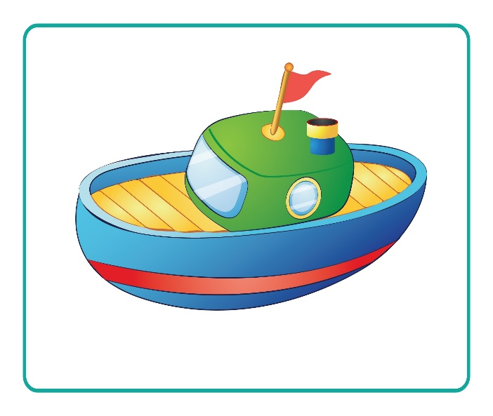
Unit 8: Lesson 2 Uu
Look and say.
This is my
Notes:
T Asks students to work in groups.
T shows the slide, asks students to look at the picture and say.
Students raise their hands to answer.
T give a star for the team has the correct answer.

Slide 25
Unit 8: Lesson 2 Uu
Look and say.
This is my
Notes:
The elephant – Is it on the farm? Or it is in the zoo.
Pause 3’’ then click to show the answer
“The elephant is in the zoo”.
With the correct answer, your group will have 1 point. Well done.
Next

Slide 26

Unit 8: Lesson 2 Uu
Look and say.
This is my
Notes:
The elephant – Is it on the farm? Or it is in the zoo.
Pause 3’’ then click to show the answer
“The elephant is in the zoo”.
With the correct answer, your group will have 1 point. Well done.
Next

Slide 27


CÔNG TY CỔ PHẦN PHÁT TRIỂN GIÁO DỤC
VIỆT NAM VPBOX
Hà Nội
Biệt thự G2&G28, Làng Quốc Tế Thăng Long,
Quận Cầu Giấy, Hà Nội.
ĐT: (024) 3 3793 2405
phonics.hanoi@vpbox.edu.vn
Thành Phố Hồ Chí Minh
Số 29 Mai Thị Lựu, Quận 1, TP. HCM.
ĐT: (028) 3 820 5934
phonics.hcm@vpbox.edu.vn
www.vpbox.edu.vn

