Slide 1


Slide 2



Slide 3

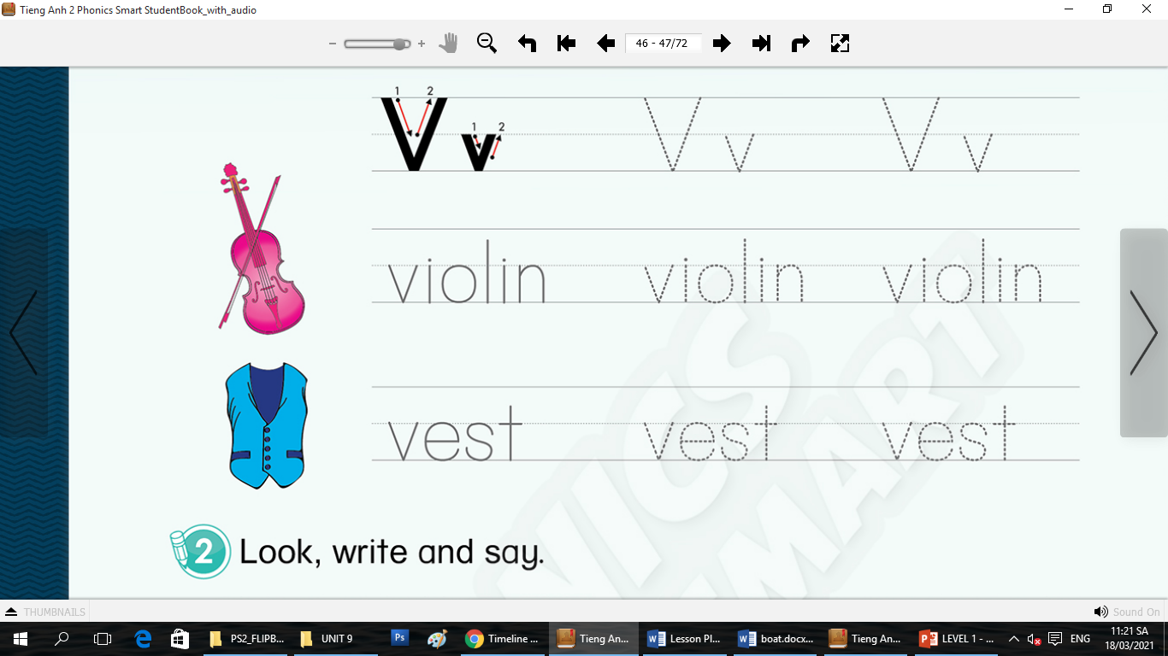
Game: Guessing game
Notes:
Guessing game
T says “I have some secret pictures. Can you guess what it is? Now, let’s play.”
Work in groups
T says “Group 1, what colour do you like? OK! Can you guess what it is? No, what colour do you want to open? OK! Can you guess?”
T takes the squares to show the picture – “Good job”
With no more 3 squares, each group will have 2 flowers for the correct answer. With more 3 squares, each group will have 1 flower.

Slide 4
Game: Guessing game
Notes:
T says “Group 2, what colour do you like? OK! Can you guess what it is? No, what colour do you want to open? OK! Can you guess?”
T takes the squares to show the picture – “Good job”
With no more 3 squares, each group will have 2 flowers for the correct answer. With more 3 squares, each group will have 1 flower.

Slide 5
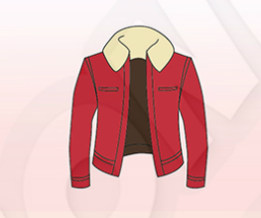
Game: Guessing game
Notes:
T says “Group 1, what colour do you like? OK! Can you guess what it is? No, what colour do you want to open? OK! Can you guess?”
T takes the squares to show the picture – “Good job”
With no more 3 squares, each group will have 2 flowers for the correct answer. With more 3 squares, each group will have 1 flower.

Slide 6

Game: Guessing game
Notes:
T says “Group 2, what colour do you like? OK! Can you guess what it is? No, what colour do you want to open? OK! Can you guess?”
T takes the squares to show the picture – “Good job”
With no more 3 squares, each group will have 2 flowers for the correct answer. With more 3 squares, each group will have 1 flower.

Slide 7

Notes:
“Great!”

Slide 8



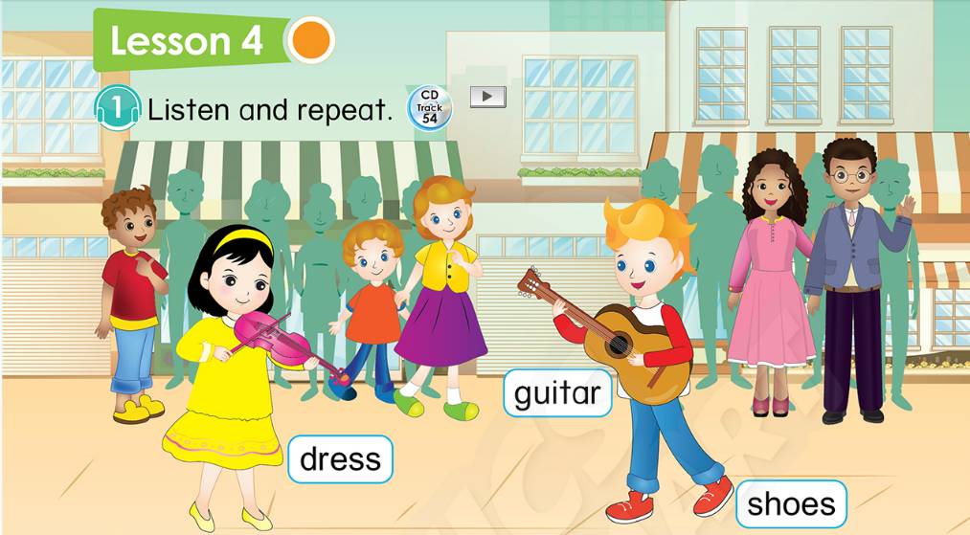
Unit 9: Lesson 4 Vv
45
Notes:
1. Introduce new lesson “Today, we will learn Unit 9 – Lesson 4. We will learn 3 new things. What are they? Now, look and listen.”

Slide 9


Unit 9: Lesson 4 Vv
1. Listen and repeat.
Notes:
Introduce picture “Class, what is it? OK! Now, listen 3 times”
Ask sts to listen 3 times
Ask sts to listen and repeat (class, group, individual) - “Listen and repeat. Class! Group 1, please! Group 2, please! You, you and you!
T can use body language to describe the word. - “Look at me and listen. Book! Class, what is it? Good!”
Click to make the word “book” disappear – Ask “What is it?”
T can use body language to check sts’ understanding - “Look and tell me what it is.”

Slide 10
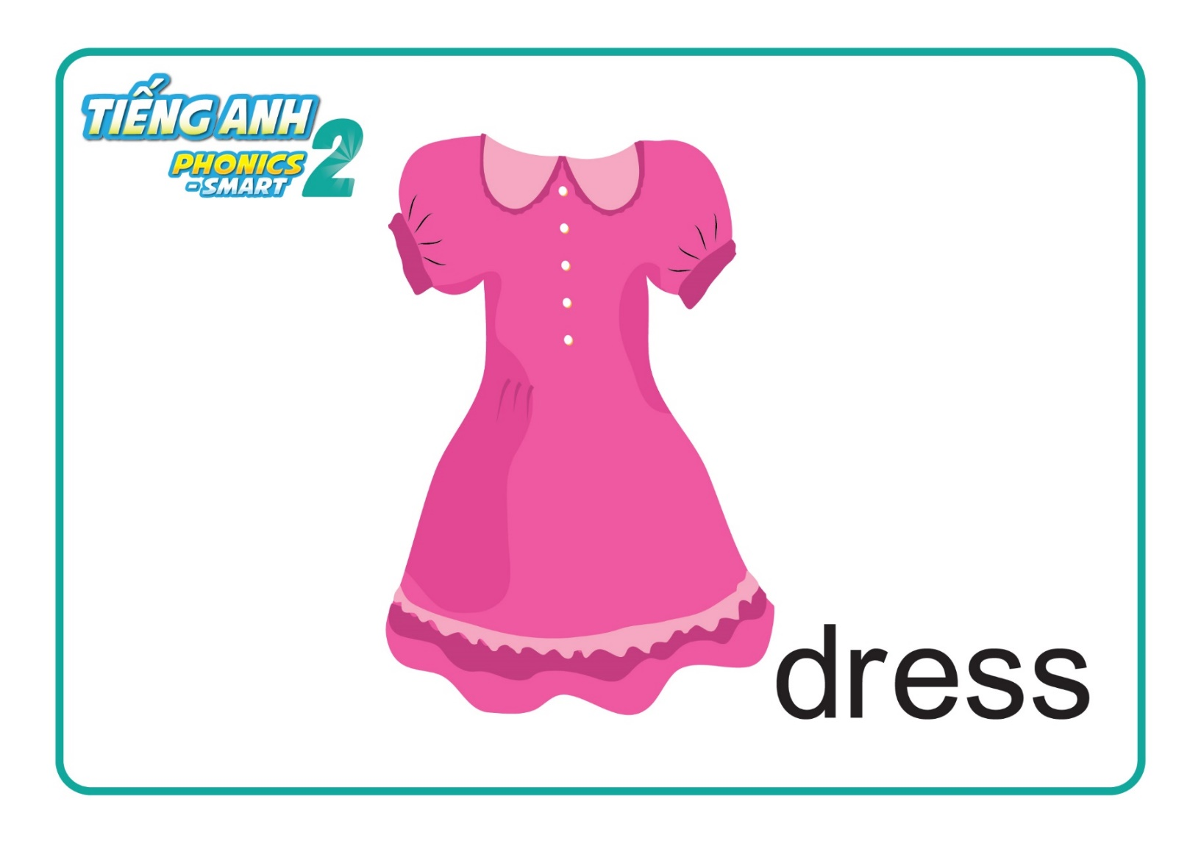
Unit 9: Lesson 4 Vv
1. Listen and repeat.
Notes:
Introduce picture “Class, what is it? OK! Now, listen 3 times”
Ask sts to listen 3 times
Ask sts to listen and repeat (class, group, individual) - “Listen and repeat. Class! Group 1, please! Group 2, please! You, you and you!
T can use body language to describe the word. - “Look at me and listen. Book! Class, what is it? Good!”
Click to make the word “book” disappear – Ask “What is it?”
T can use body language to check sts’ understanding - “Look and tell me what it is.”

Slide 11



Unit 9: Lesson 4 Vv
1. Listen and repeat.
Notes:
Introduce picture “Class, what is it? OK! Now, listen 3 times”
Ask sts to listen 3 times
Ask sts to listen and repeat (class, group, individual) - “Listen and repeat. Class! Group 1, please! Group 2, please! You, you and you!
T can use body language to describe the word. - “Look at me and listen. Bag! Class, what is it? Good!”
Click to make the word “bag” disappear – Ask “What is it?”
T can use body language to check sts’ understanding - “Look and tell me what it is.”

Slide 12
Unit 9: Lesson 4 Vv
1. Listen and repeat.
Notes:
Introduce picture “Class, what is it? OK! Now, listen 3 times”
Ask sts to listen 3 times
Ask sts to listen and repeat (class, group, individual) - “Listen and repeat. Class! Group 1, please! Group 2, please! You, you and you!
T can use body language to describe the word. - “Look at me and listen. Bag! Class, what is it? Good!”
Click to make the word “bag” disappear – Ask “What is it?”
T can use body language to check sts’ understanding - “Look and tell me what it is.”

Slide 13
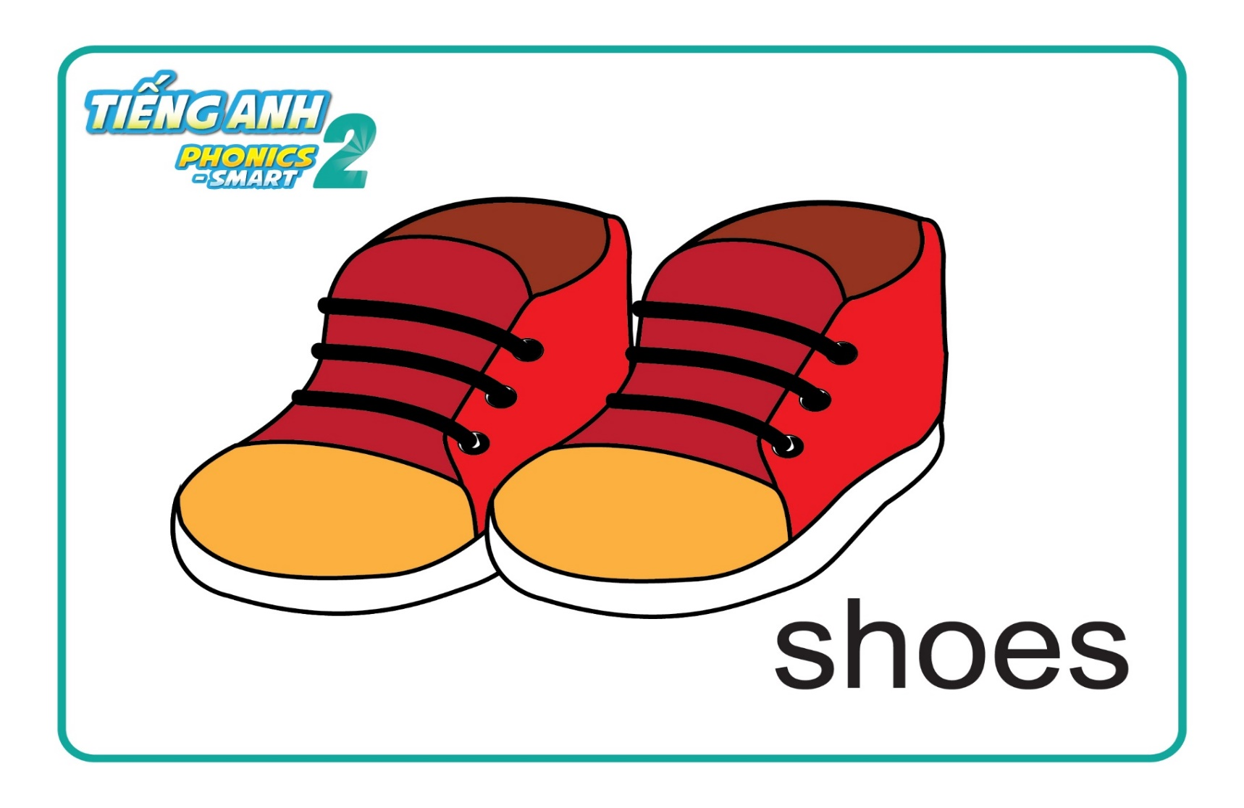


Unit 9: Lesson 4 Vv
1. Listen and repeat.
Notes:
Introduce picture “Class, what is it? OK! Now, listen 3 times”
Ask sts to listen 3 times
Ask sts to listen and repeat (class, group, individual) - “Listen and repeat. Class! Group 1, please! Group 2, please! You, you and you!
T can use body language to describe the word. - “Look at me and listen. Pen! Class, what is it? Good!”
Click to make the word”shose” disappear – Ask “What is it?”
T can use body language to check sts’ understanding - “Look and tell me what it is.”

Slide 14
Unit 9: Lesson 4 Vv
1. Listen and repeat.
Notes:
Introduce picture “Class, what is it? OK! Now, listen 3 times”
Ask sts to listen 3 times
Ask sts to listen and repeat (class, group, individual) - “Listen and repeat. Class! Group 1, please! Group 2, please! You, you and you!
T can use body language to describe the word. - “Look at me and listen. Pen! Class, what is it? Good!”
Click to make the word”shose” disappear – Ask “What is it?”
T can use body language to check sts’ understanding - “Look and tell me what it is.”

Slide 15
Unit 9: Lesson 4 Vv
Page 45
Notes:
Book using – Look, point and say
1. T says “Class, open your book page 45. Let’s look, point and tell me what it is.”
2. T points at the picture and asks “What is it?”
3. T gives 1 flower to each group -“Great! One flower for each group.”

Slide 16






Unit 9: Lesson 4 Vv
1. Listen and repeat.
Game: Memory game
Notes:
Memory game
T says “ I have got some pictures. Can you remember all of them? Now, let’s play with me.”
Work in groups.
T shows the pictures.
T asks sts to remember all pictures and the arrangement – “Look at these pictures and remember their place.”
T clicks to disappear all pictures
Sts say the name of each picture with the correct order (each group has 1 turn) – “Wow, it’s disappear. Group 1, tell me what are they?”
With the correct answer, each group will have 1 flower. – “Great! One flower for each group.”

Slide 17
Unit 9: Lesson 4 Vv
1. Listen and repeat.
Game: Memory game
Notes:
Memory game
T says “ I have got some pictures. Can you remember all of them? Now, let’s play with me.”
Work in groups.
T shows the pictures.
T asks sts to remember all pictures and the arrangement – “Look at these pictures and remember their place.”
T clicks to disappear all pictures
Sts say the name of each picture with the correct order (each group has 1 turn) – “Wow, it’s disappear. Group 1, tell me what are they?”
With the correct answer, each group will have 1 flower. – “Great! One flower for each group.”

Slide 18







Unit 9: Lesson 4 Vv
1. Listen and repeat.
Game: Memory game
Notes:
T shows the pictures
T asks sts to remember all pictures and the arrangement – “Look at these pictures and remember their place.”
T clicks to disappear all pictures
Sts say the name of each picture with the correct order (each group has 1 turn) – “Wow, it’s disappear. Group 2, tell me what are they?”
With the correct answer, each group will have 1 flower. – “Great! One flower for each group.”

Slide 19
Unit 9:
Lesson 4:
V v
1. Listen and repeat.
Game: Memory game
Notes:
T shows the pictures
T asks sts to remember all pictures and the arrangement – “Look at these pictures and remember their place.”
T clicks to disappear all pictures
Sts say the name of each picture with the correct order (each group has 1 turn) – “Wow, it’s disappear. Group 2, tell me what are they?”
With the correct answer, each group will have 1 flower. – “Great! One flower for each group.”

Slide 20

Notes:
“Well done. Let’s move to next part.”

Slide 21

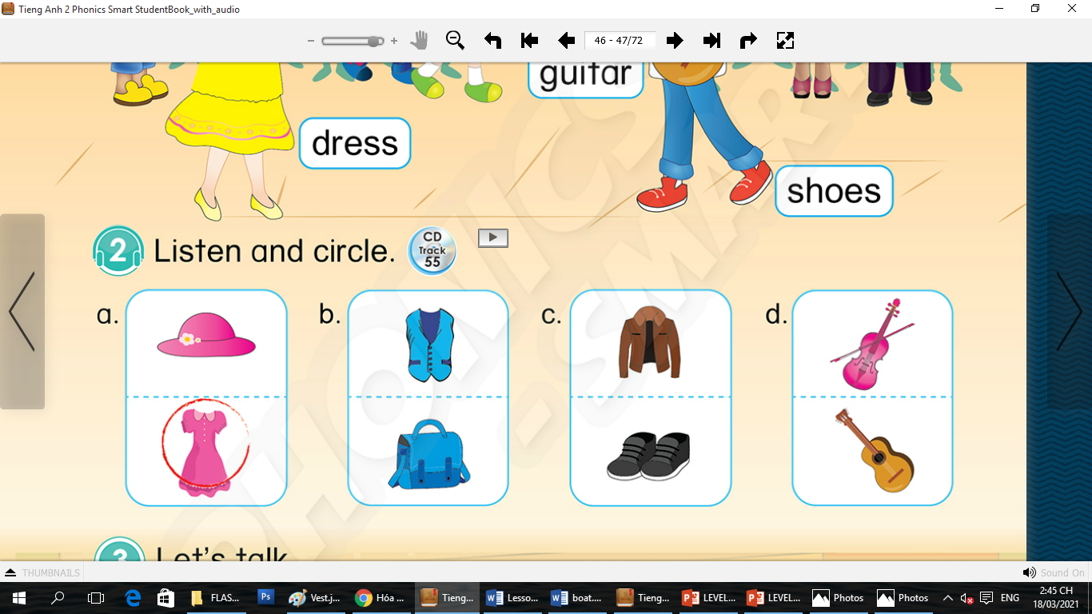

Unit 9: Lesson 4 Vv
1. Listen and repeat.
2. Listen and circle.
45
Notes:
T says “Let’s listen and number.”
T asks “What is it?” – (4 pictures)
T asks sts to listen 1 time, points at the example and asks “What is it?” – T clicks to show the answer of the example. – “Yes, number 1 – inkpot.”
T asks sts to listen 1 time and write the number. – “Now, listen again and number.”
T asks sts to listen again and check the answer – clicks to show the answer. – “Now, which is number 2? Number 3? Number 4? OK! Now, listen and check.”

Slide 22
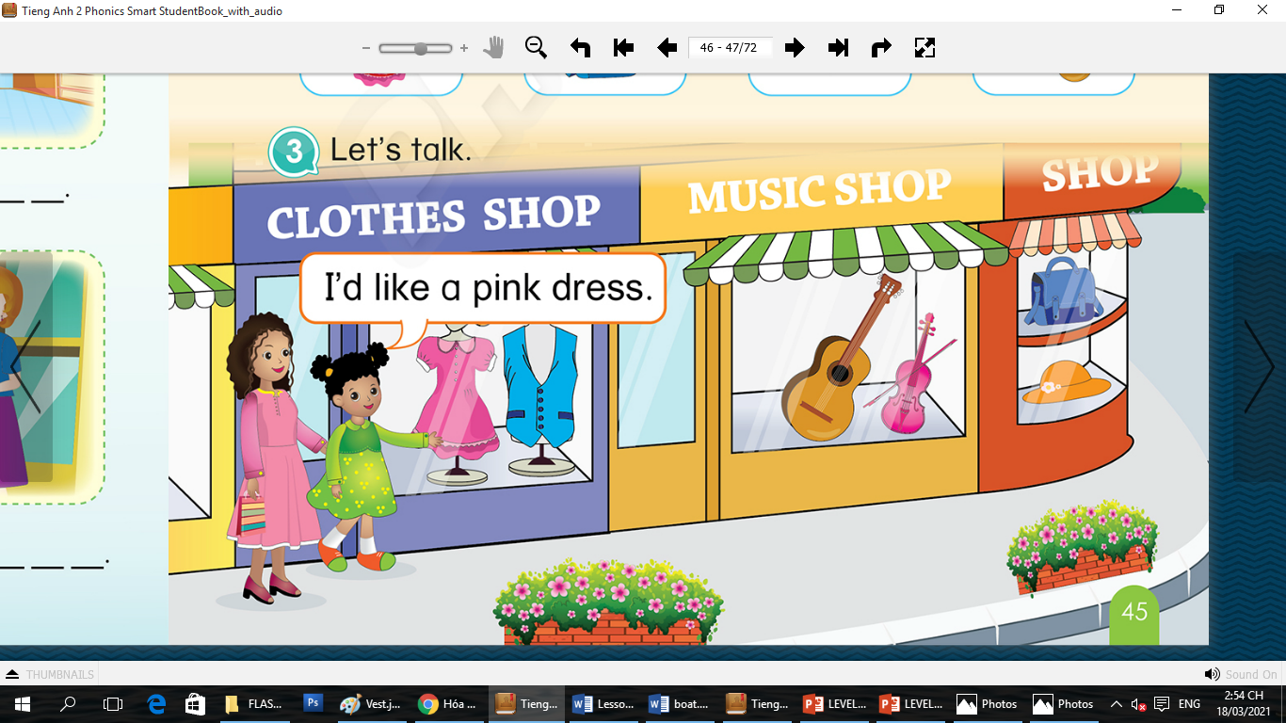
Unit 9:
Lesson 4
V v
1. Listen and repeat.
2. Listen and circle.
3. Let’s talk.
Notes:
T says “Let’s move to next part – Let’s talk.”
T asks “Where is it?” – 3 pictures.
Introduce structure “I’d like a …”
T points at the picture of “pink dress” and says “Now, listen. I’d like a pink dress.”
T points at the picture of “blue/new vest” and ask sts to say “So, I’d like a … . Well done.”
T give sts time to practice and check answers.

Slide 23
Unit 9:
Lesson 4
V v
3. Let’s talk.
I’d like a _ _
Notes:
T says “Let’s move to next part – Let’s talk.”
T asks “Where is it?” – 3 pictures.
Introduce structure “I’d like a …”
T points at the picture of “pink dress” and says “Now, listen. I’d like a pink dress.”
T points at the picture of “blue/new vest” and ask sts to say “So, I’d like a … . Well done.”
T give sts time to practice and check answers.

Slide 24
Unit 9:
Lesson 4
V v
3. Let’s talk.
I’d like a blue vest
Notes:
T says “Let’s move to next part – Let’s talk.”
T asks “Where is it?” – 3 pictures.
Introduce structure “I’d like a …”
T points at the picture of “pink dress” and says “Now, listen. I’d like a pink dress.”
T points at the picture of “blue/new vest” and ask sts to say “So, I’d like a … . Well done.”
T give sts time to practice and check answers.

Slide 25
Unit 9:
Lesson 4
V v
3. Let’s talk.
I’d like a _ _
Notes:
T says “Now we are going to a music shop.”
T says “Now, what do you want to buy first?”
Ex: Sts say “guitar”
T says “I’d like a new/ brown guitar.”
T says “ Your turn. Let’s practice with your friend.

Slide 26
Unit 9:
Lesson 4
V v
3. Let’s talk.
I’d like a new guitar
Notes:
T says “Now we are going to a music shop.”
T says “Now, what do you want to buy first?”
Ex: Sts say “guitar”
T says “I’d like a new/ brown guitar.”
T says “ Your turn. Let’s practice with your friend.

Slide 27
Unit 9:
Lesson 4
V v
3. Let’s talk.
I’d like a _ _
Notes:
T says “Now we are going to a music shop.”
T says “Now, what do you want to buy first?”
Ex: Sts say “guitar”
T says “I’d like a new/ brown guitar.”
T says “ Your turn. Let’s practice with your friend.

Slide 28
Unit 9:
Lesson 4
V v
3. Let’s talk.
I’d like a pink violin
Notes:
T says “Now we are going to a music shop.”
T says “Now, what do you want to buy first?”
Ex: Sts say “guitar”
T says “I’d like a new/ brown guitar.”
T says “ Your turn. Let’s practice with your friend.

Slide 29

Unit 9:
Lesson 4
V v
3. Let’s talk.
I’d like a _ _
Notes:
T shows the answer. “Yes, correct.”
T asks sts to say “ Class, so we will say …? Yes, I have got a bag.”

Slide 30
Unit 9:
Lesson 4
V v
3. Let’s talk.
I’d like a _ _
Notes:
T shows the answer. “Yes, correct.”
T asks sts to say “ Class, so we will say …? Yes, I have got a bag.”

Slide 31
Unit 9:
Lesson 4
V v
3. Let’s talk.
I’d like a blue bag
Notes:
T shows the answer. “Yes, correct.”
T asks sts to say “ Class, so we will say …? Yes, I have got a bag.”

Slide 32
Unit 9:
Lesson 4
V v
I’d like an orange hat
I’d like a new hat
Notes:
T shows the answer. “Yes, correct.”
T asks sts to say “ Class, so we will say …? Yes, I have got a bag.”

Slide 33
Notes:
“You are excellent. One flower for each group.”

Slide 34


CÔNG TY CỔ PHẦN PHÁT TRIỂN GIÁO DỤC
VIỆT NAM VPBOX
Hà Nội
Biệt thự G2&G28, Làng Quốc Tế Thăng Long,
Quận Cầu Giấy, Hà Nội.
ĐT: (024) 3 3793 2405
phonics.hanoi@vpbox.edu.vn
Thành Phố Hồ Chí Minh
Số 29 Mai Thị Lựu, Quận 1, TP. HCM.
ĐT: (028) 3 820 5934
phonics.hcm@vpbox.edu.vn
www.vpbox.edu.vn

