Slide 1


Slide 2

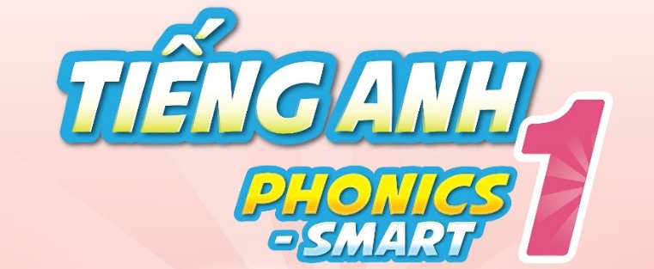

Slide 3
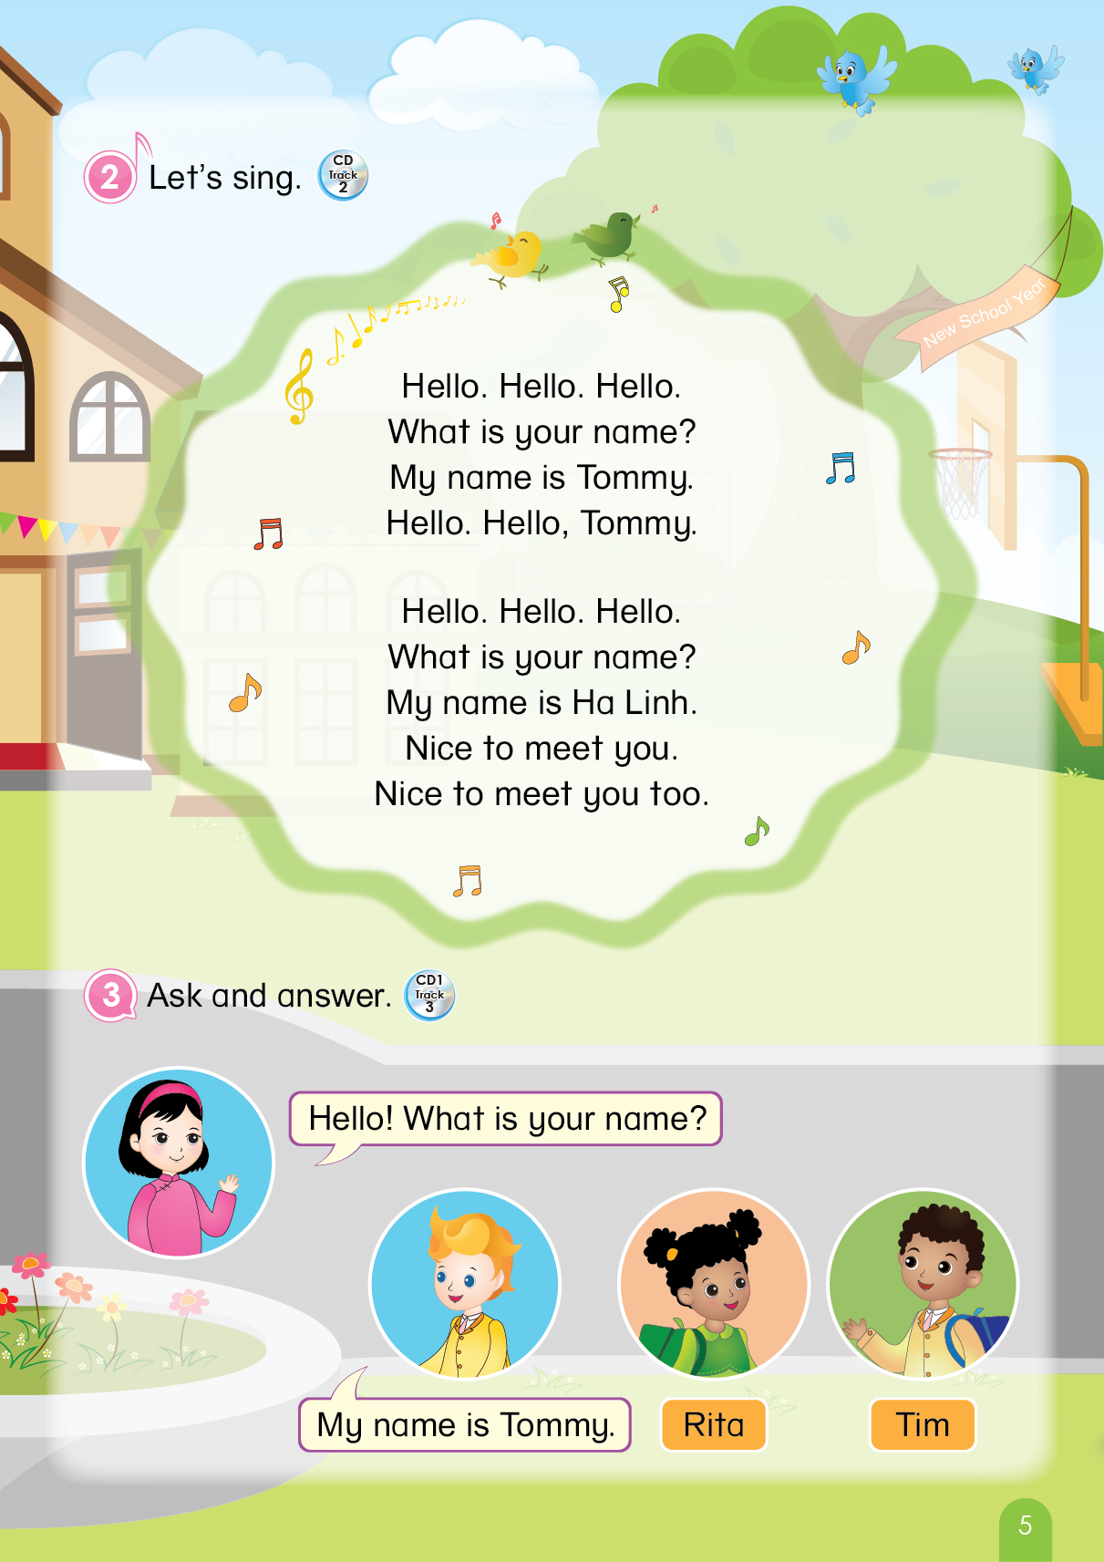

Notes:
Teacher says “Hello, everyone. How are you? How’s the weather? Is it sunny? Great! Now, let’s sing a song with me.”
Warm up: Sing “Hello song” – “Excellent! You sing very well.”
Divide class into 2 groups (optional) – “Today, we will have 2 groups – Group 1 and Group 2. You are Group 1, you are Group 2.”

Slide 4
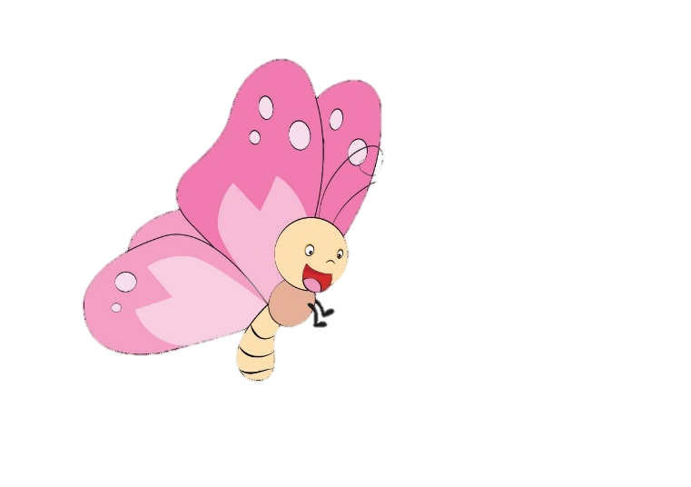
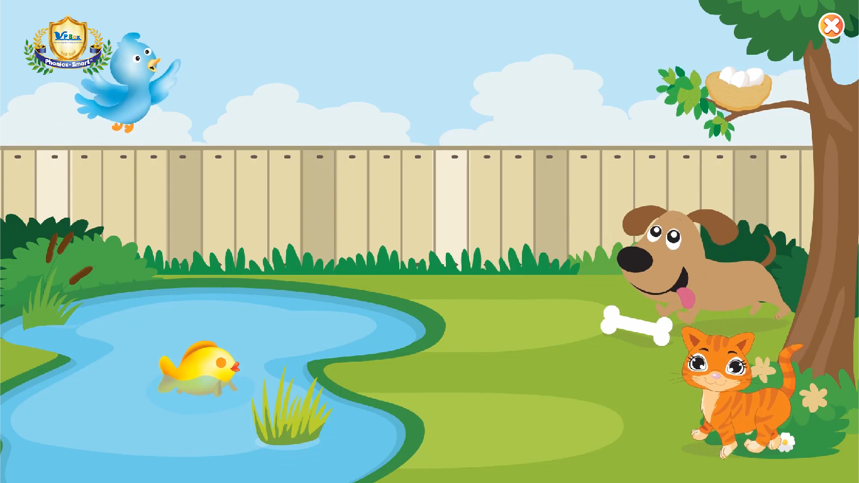
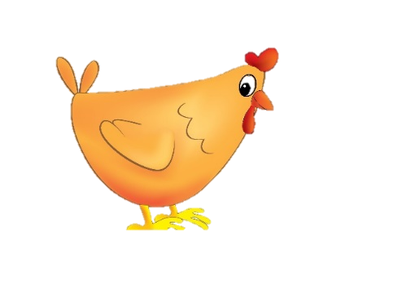
REVIEW 1
Notes:
Teacher leads to the lesson: “OK. From lesson 1 to lesson 6, we’ve met a lot of friends. Do you remember them? OK. We will meet all of them in today’s lesson. Are you excited?”. “Good. So let’s go to part A.”

Slide 5

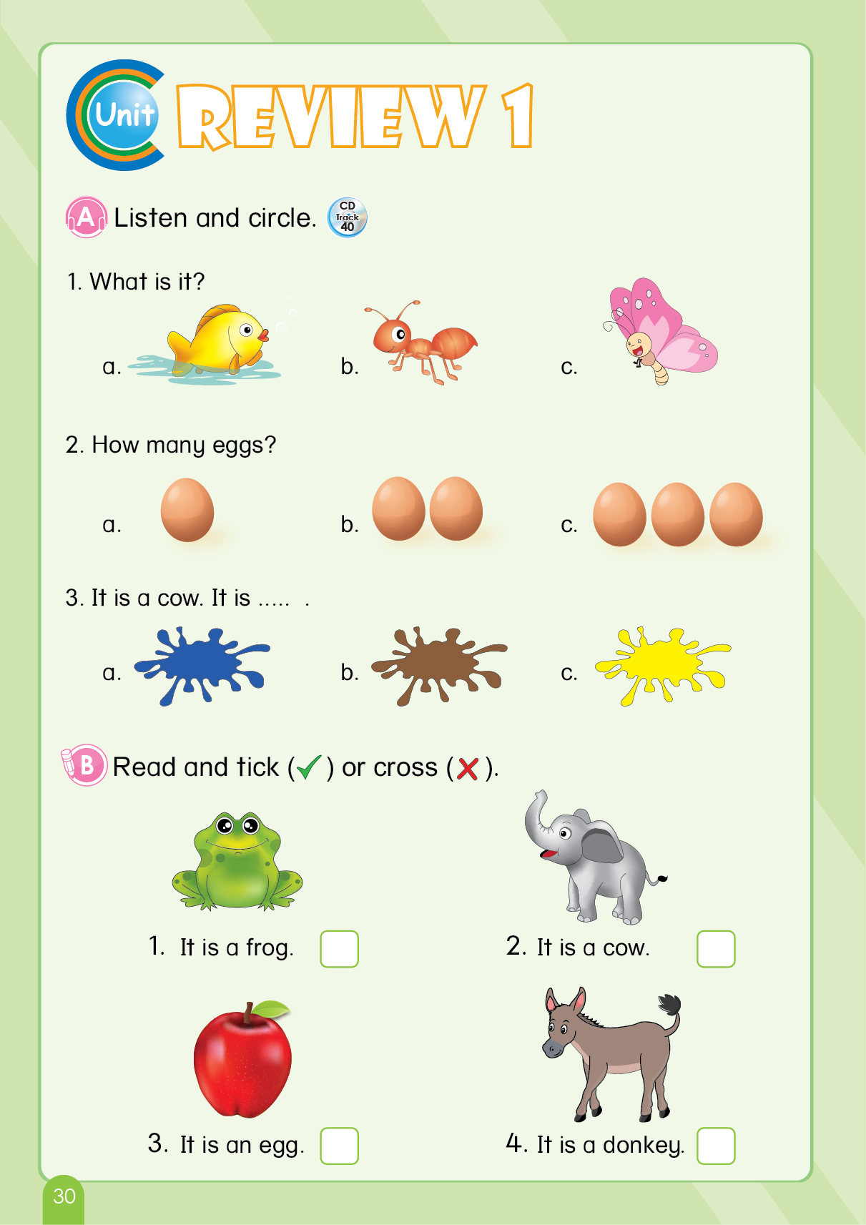
REVIEW 1
A. Listen and circle.
LOOK
AT
YOUR
BOOK!
Notes:
Teacher asks students some questions, which helps them to recognize the objects: “Can you see the animals?”, “Can you see the eggs?”, “Can you see the colours? Good.”
Teacher then asks students to open the book, and gives instructions: “Look at your book, page 30. Part A. Now you listen and circle.”
Teacher have students to listen twice: “Now, you listen again.”

Slide 6
REVIEW 1
A. Listen and circle.
Let’s correct!
c
Notes:
Teacher corrects the answers: “Let’s correct. Now, look at the screen. One. You listen.” “So, what is it?”. “Well done. It is a butterfly. Circle c.”

Slide 7
REVIEW 1
A. Listen and circle.
Let’s correct!
b
Notes:
Teacher corrects the answers: “Two. Listen!” “So, how many eggs?”. “Good job. Two eggs. Circle b.”

Slide 8
REVIEW 1
A. Listen and circle.
Let’s correct!
b
Notes:
Teacher corrects the answers: “Three. Listen!” “So, what is the colour of the cow?”. “Great. Brown. Circle b.”

Slide 9

REVIEW 1
A. Listen and circle.
Notes:
Teacher gives praises: “Well done. Now, we move to part B.”

Slide 10
REVIEW 1
B. Read and tick (✓) or cross (✗).
LOOK
AT
YOUR
BOOK!
Notes:
Teacher asks students to look at the book: “Look at your book, page 30. Part B. Can you see four animals? Good.”
Teacher gives instructions and asks them to do the task: “Now you read, tick or cross in 3 minutes.”

Slide 11
REVIEW 1
B. Read and tick (✓) or cross (✗).
Let’s correct!
✓
Notes:
Teacher corrects the answers: “Now it’s time to correct. Look at the screen. One. It is a frog. Tick or cross?”. “Well done. It is a tick. So tick it.”

Slide 12
REVIEW 1
B. Read and tick (✓) or cross (✗).
Let’s correct!
✗
Notes:
Teacher corrects the answers: “Two. It is a cow. Tick or cross?”. “No. It is not a tick. Again.” .”Yes, it is a cross. So cross it.”

Slide 13
REVIEW 1
B. Read and tick (✓) or cross (✗).
Let’s correct!
✗
Notes:
Teacher corrects the answers: “Three. It is an egg. Tick or cross?”. ”Yes, it is a cross. Let’s cross it.”

Slide 14
REVIEW 1
B. Read and tick (✓) or cross (✗).
Let’s correct!
✓
Notes:
Teacher corrects the answers: “Four. It is a donkey. Tick or cross?”. ”Good job, it is a tick. So tick it.”

Slide 15
REVIEW 2
B. Read and tick (✓) or cross (✗).
Notes:
Teacher gives praises: “Well done class. Now, let’s move to part C.”

Slide 16
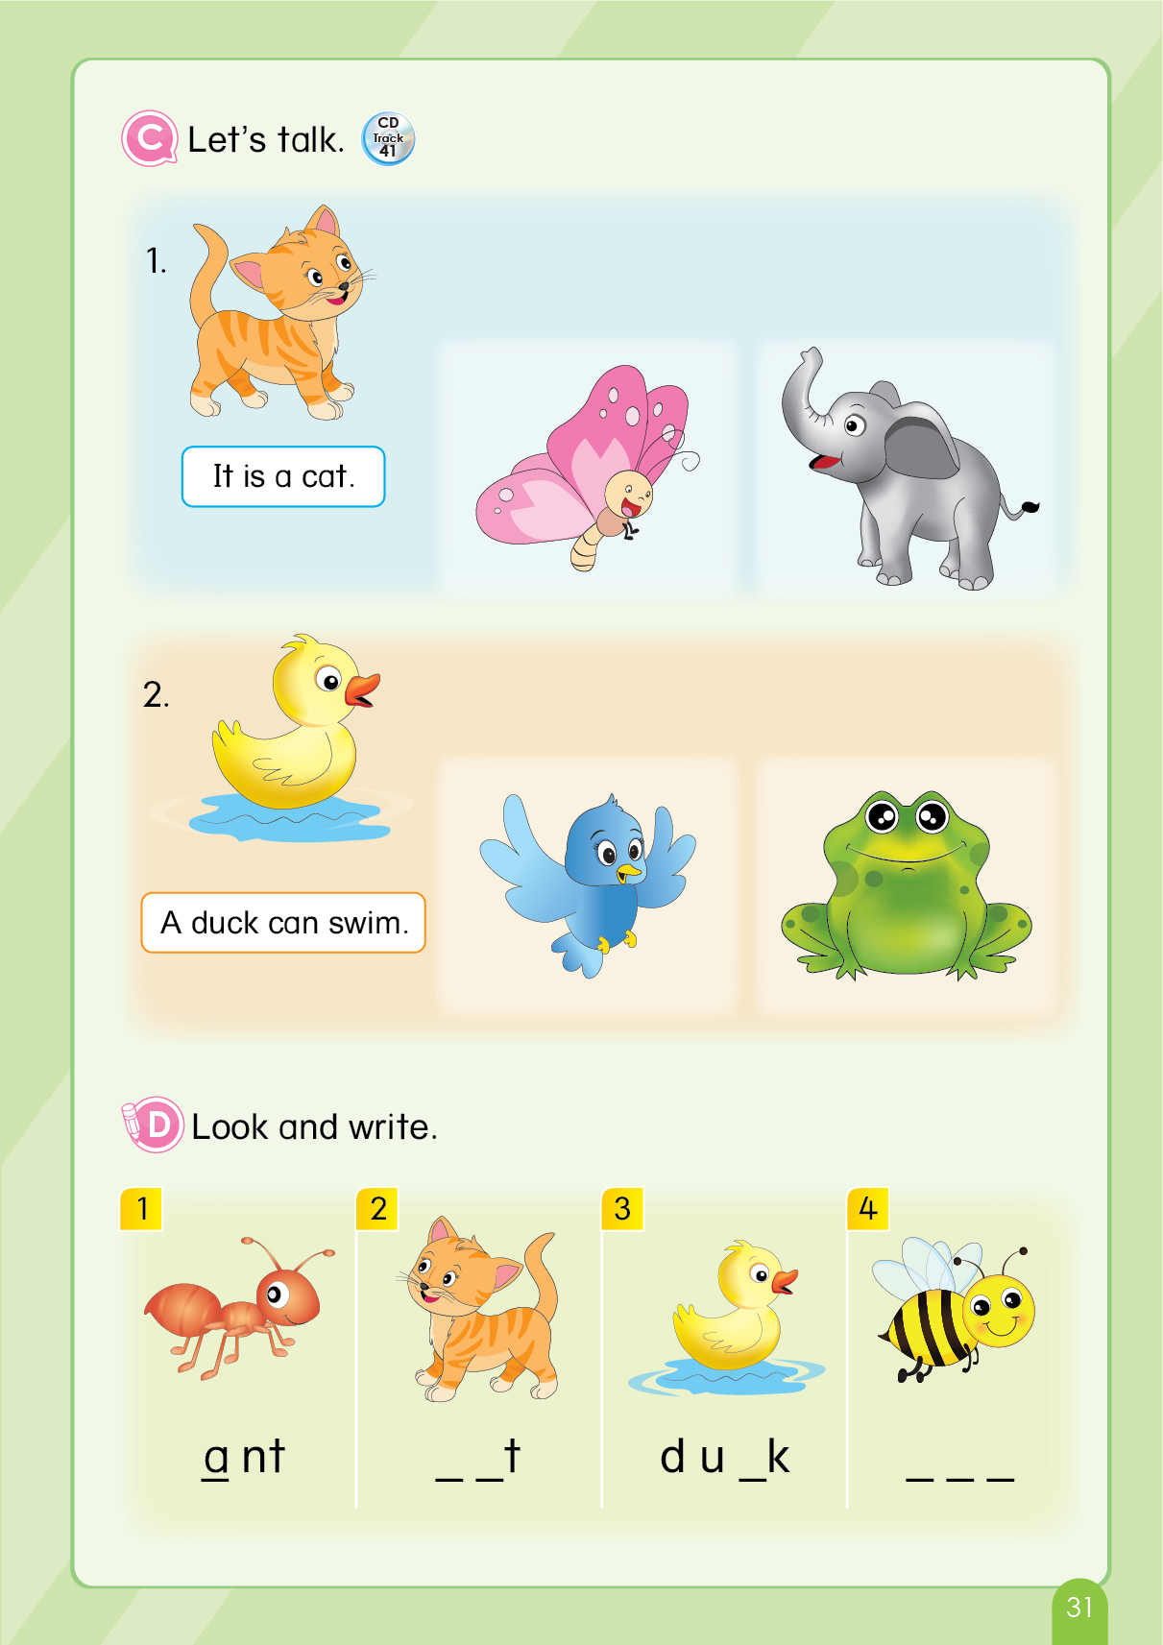
REVIEW 1
C. Let’s talk.
Notes:
Teacher gives instructions of the task: “Now, look! How many animals?”. “Good. Six animals.”. “So now listen.”
Teacher asks students to listen again: “Listen again.”
Teacher confirms students’ understanding: “So what is it?”. “Good job. It is a cat.”. “And do you know what can a duck do?”. “Great. A duck can swim. Well done.”
Teacher leads to the game: “Let’ play Guessing game. Are you ready?”. Teacher moves to the next slide.

Slide 17


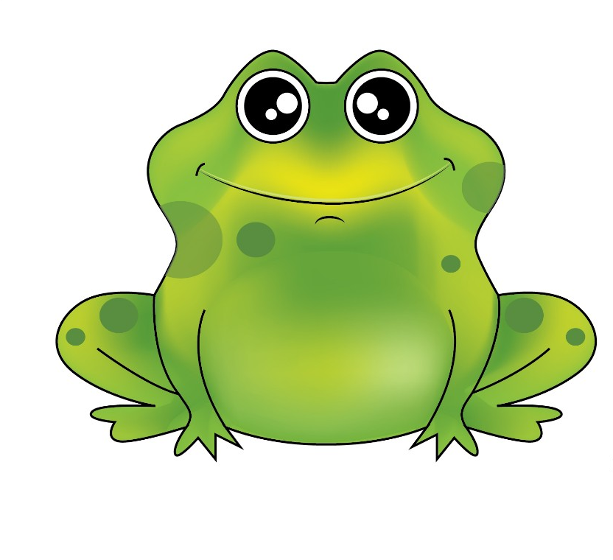
Game: Can you guess?
What can he do?
Remove Box
A frog can jump.
Next Slide
Notes:
Teacher gives instructions: “I will remove the box one by one, and you guess what it is. OK?”. “Good”
Teacher may say: “What is it? Do you know him? Guess.”
After the picture is shown, teacher asks: “So what can a frog do, class?”. “A frog can jump. Great.”. “Let’s meet another friend.”

Slide 18
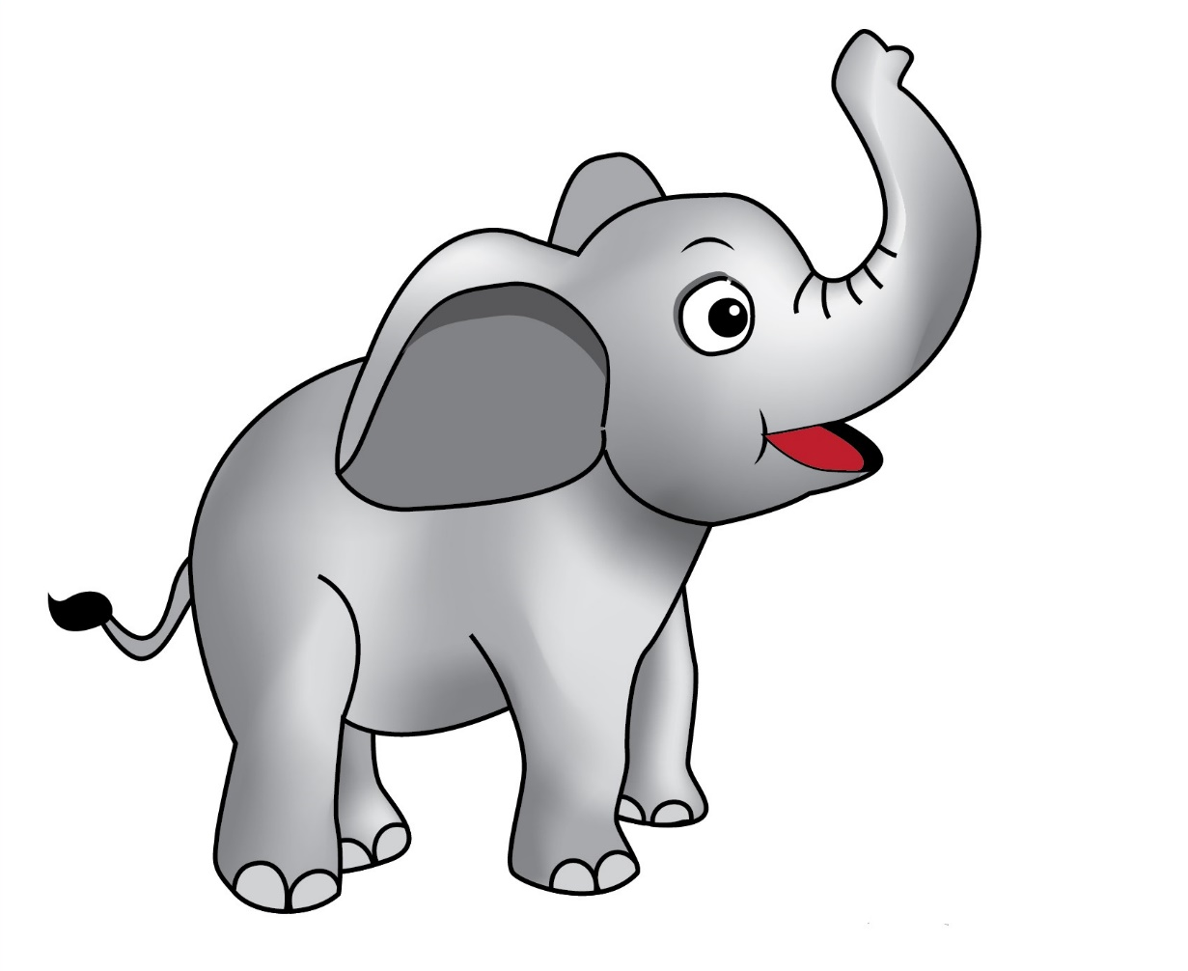
Game: Can you guess?
What
is it?
Remove Box
It is an elephant.
Next Slide
Notes:
Teacher may say: “What is it? Do you know him? Let’s guess.”
After the picture is shown, teacher asks: “So what is it, class?”. “It is an elephant. Good job.”. “The next one.”

Slide 19
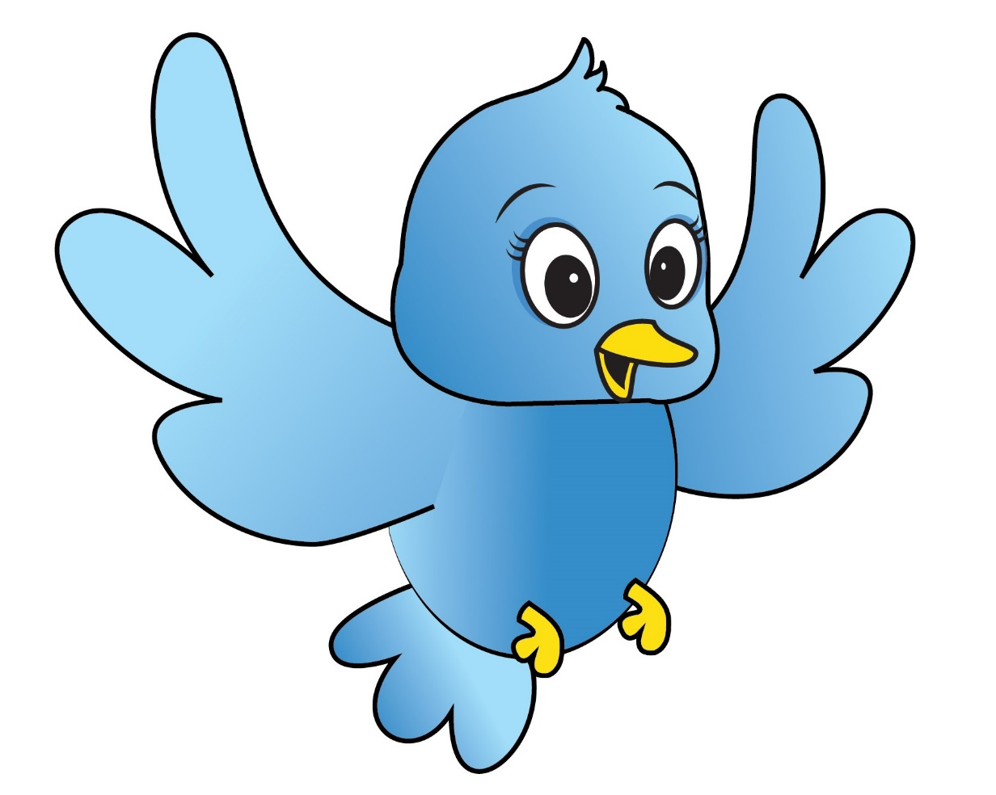
Game: Can you guess?
What can he do?
Remove Box
A bird can fly.
Next Slide
Notes:
Teacher may say: “What is it? Do you know him? Guess.”
After the picture is shown, teacher asks: “So what can a bird do, class?”. “A bird can fly. Well done.”. “OK the last one.”

Slide 20
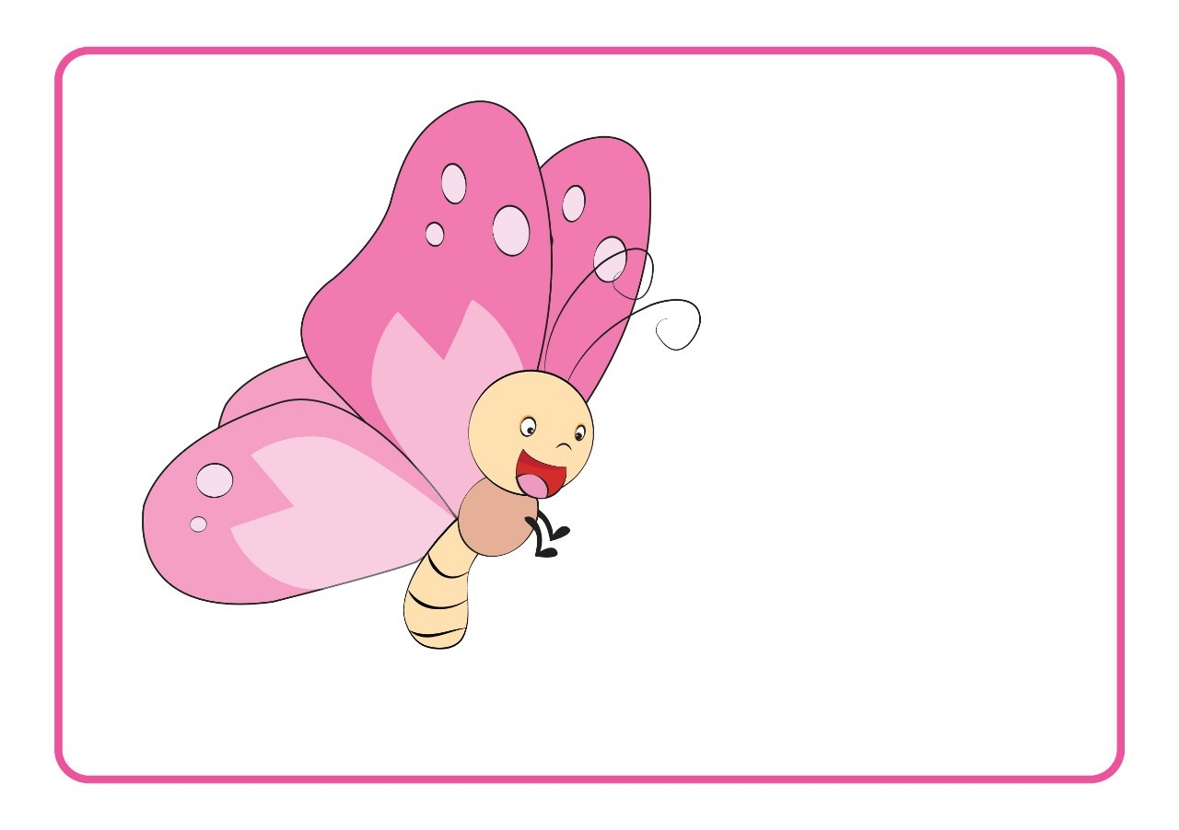
Game: Can you guess?
What
is it?
Remove Box
It is a butterfly.
Next Slide
Notes:
Teacher may say: “What is it? Do you know him? Guess.”
After the picture is shown, teacher asks: “So what is it, class?”. “It is a butterfly. Excellent.”.
Teacher moves to the next part: “Let’s move to part D.”

Slide 21
REVIEW 1
D. Look and write.
LOOK
AT
YOUR
BOOK!
Notes:
Teacher asks students to look at the book: “Now, look at your book page 31. Part D.” “Can you see the animals? Good.”
Teacher leads to the game: “Now, we have a game with the animals. Do you want to play? Are you excited? Great. Let’s go”. Teacher moves to the next slide.

Slide 22
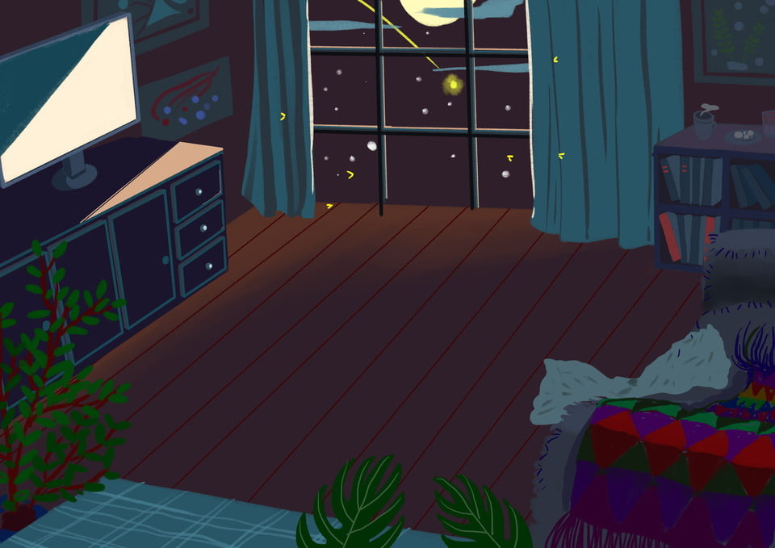

Game: Can you find it?
WHAT IS IT?
Notes:
Teacher may ask some background questions: “Look at the screen. What can you see?”. “Yes. There is a boy. So do you know is it in the morning or at night?”. “Good job, at night.”
Teacher leads to the game, and gives instructions: “So, what is he finding? Can you guess?”. “Ok, this is an example.” Teacher moves to the next slide.

Slide 23
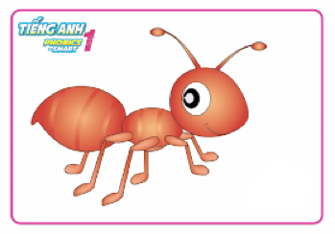
Game: Can you find it?
Yes
CLICK CLICK
nat
ant
tan
No
TIME’S UP
Notes:
Teacher does the example: “So what is it?”. “Yes, it is an ant. So I click to the word ant. That’s it”. “There is time for this game right here. So do it quickly, OK?, and choose the right word”. “Do you understand?”
Teacher calls one student: “OK. Team 1. Who volunteers? Raise your hands. Good, come here.”
Teacher starts the game: “Are you ready? Go.”

Slide 24
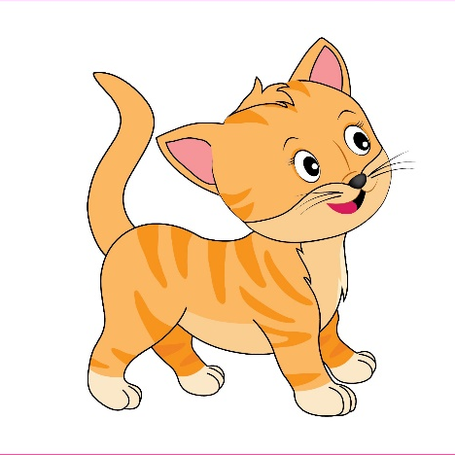

Game: Can you find it?
Yes
CLICK CLICK
cat
bat
fat
No
TIME’S UP
Notes:
Teacher have student to play, and may say: “What is it? Choose the right word. Quickly”. “Well done. CAT.”
Teacher calls another student to play: “Team 2. Who volunteers? Good. Come here”. Teacher moves to the next slide.

Slide 25
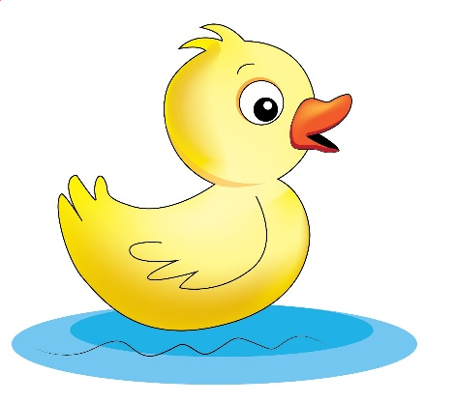
Game: Can you find it?
Yes
CLICK CLICK
deck
dack
duck
No
TIME’S UP
Notes:
Teacher have student to play, and may say: “What is it? Which is the right word? Quickly”. “Good job. Duck.”
Teacher calls another student to play: “Team 3. Who volunteers? Good. Let’s go”. Teacher moves to the next slide.

Slide 26
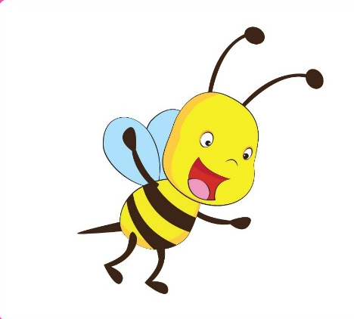
Game: Can you find it?
Yes
CLICK CLICK
big
bee
bet
No
TIME’S UP
Notes:
Teacher have student to play, and may say: “What is it? Choose the right word. Quickly”. “Great. BEE.”
Teacher calls another student to play: “Team 2. Who volunteers? Good. Come here”. Teacher moves to the next slide.

Slide 27
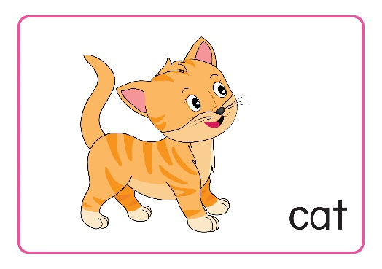
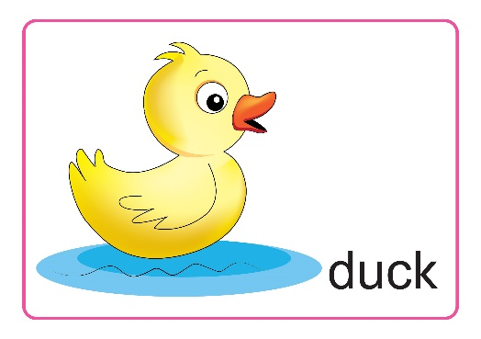
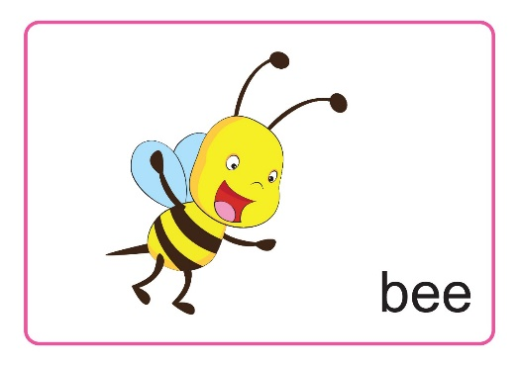
REVIEW 1
D. Look and write.
Notes:
Teacher gives praises, and asks students to write the words in their book: “Well done class. Now write the right words in your book.”

Slide 28

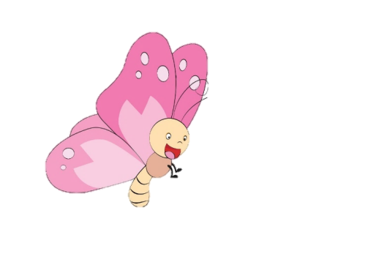
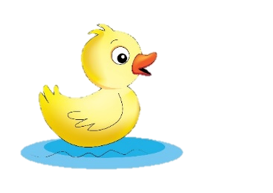

REVIEW 1
A. Listen and circle.
C. Let’s talk.
B. Read and tick (✓) or cross (✗).
D. Look and write.
Notes:
Teacher asks students to look at the picture and asks “What is it?”, “What can a duck do?’’
Teacher comments on the class’s performance: “You are excellent today.”

Slide 29

REVIEW 1
Notes:
Teacher says Goodbye. – “It’s time to say Goodbye. Goodbye, and see you.”

Slide 30


CÔNG TY CỔ PHẦN PHÁT TRIỂN GIÁO DỤC
VIỆT NAM VPBOX
Hà Nội
Biệt thự G2&G28, Làng Quốc Tế Thăng Long,
Quận Cầu Giấy, Hà Nội.
ĐT: (024) 3 3793 2405
phonics.hanoi@vpbox.edu.vn
Thành Phố Hồ Chí Minh
Số 29 Mai Thị Lựu, Quận 1, TP. HCM.
ĐT: (028) 3 820 5934
phonics.hcm@vpbox.edu.vn
www.vpbox.edu.vn

