Slide 1









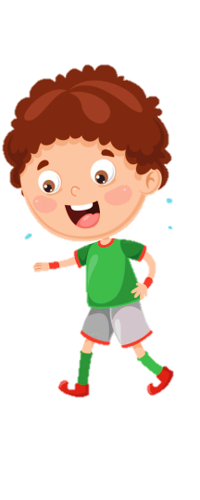
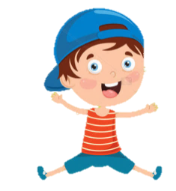
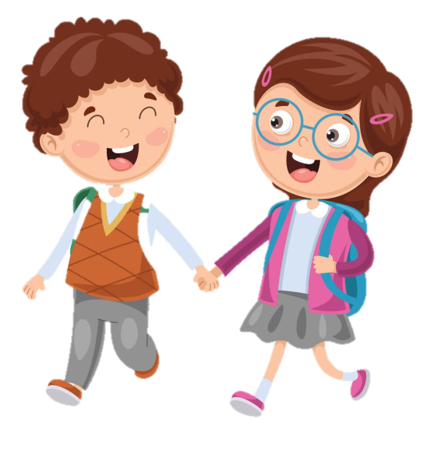
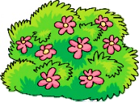
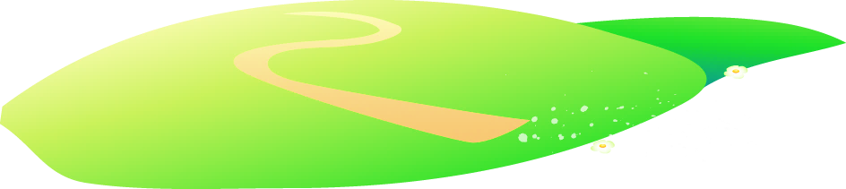





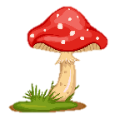
Teacher: Nguyen Thi Thanh Nhan
Class: 3C3
School: ToanThang- Tien Thang primary school

Slide 3
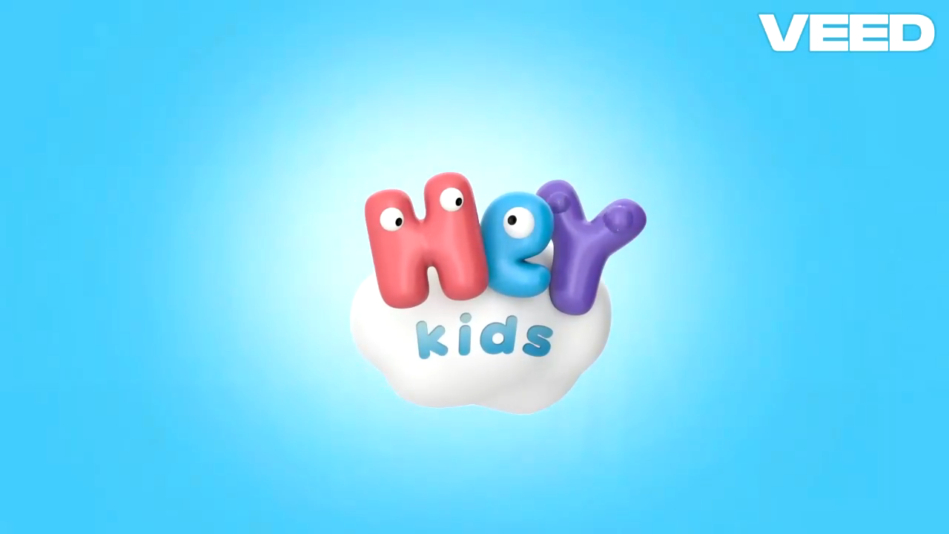

Slide 5
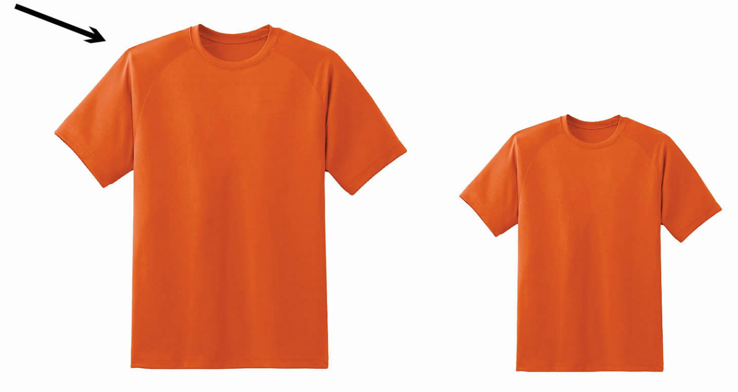
big

Slide 6
big

Slide 7
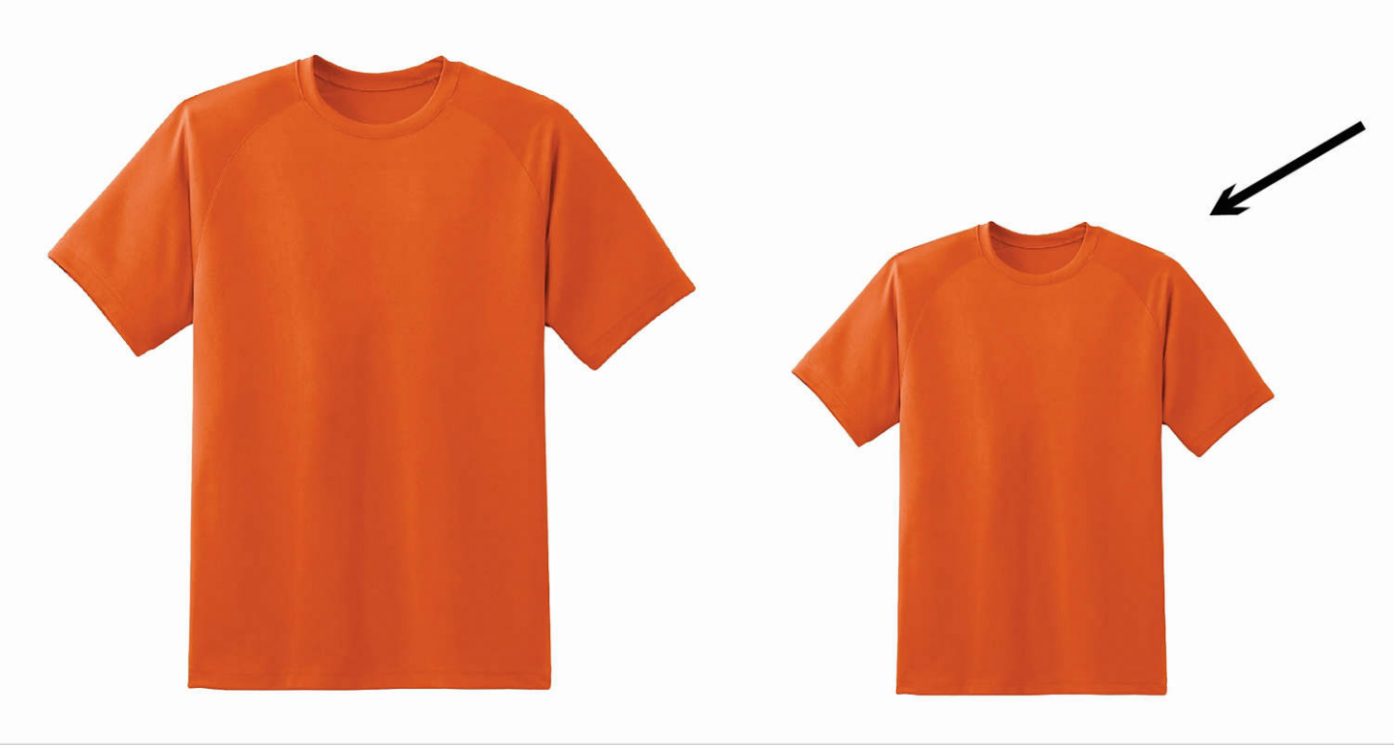
small

Slide 8
small

Slide 9
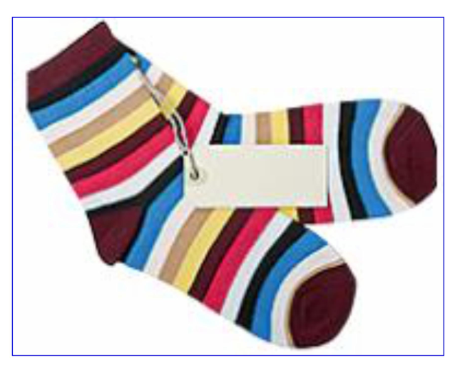
new

Slide 10
new

Slide 11
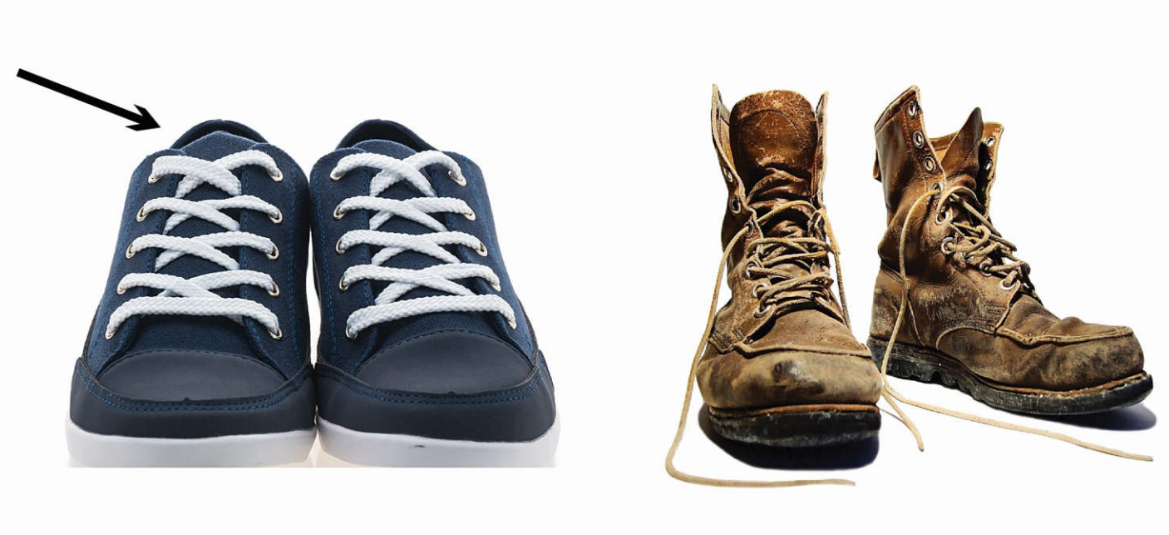
pretty

Slide 12
pretty

Slide 13
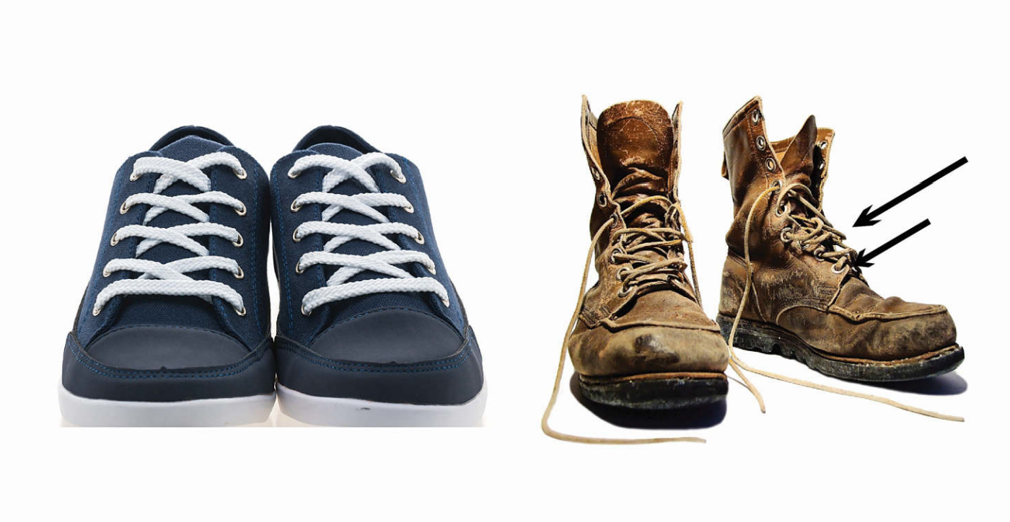
ugly

Slide 14
ugly

Slide 15
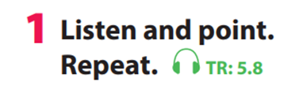


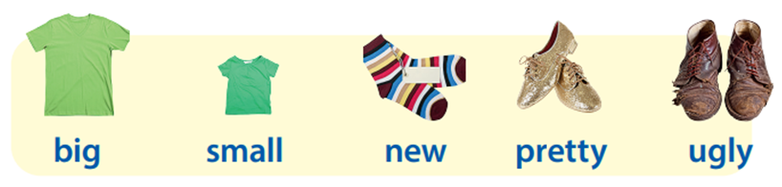

Slide 16
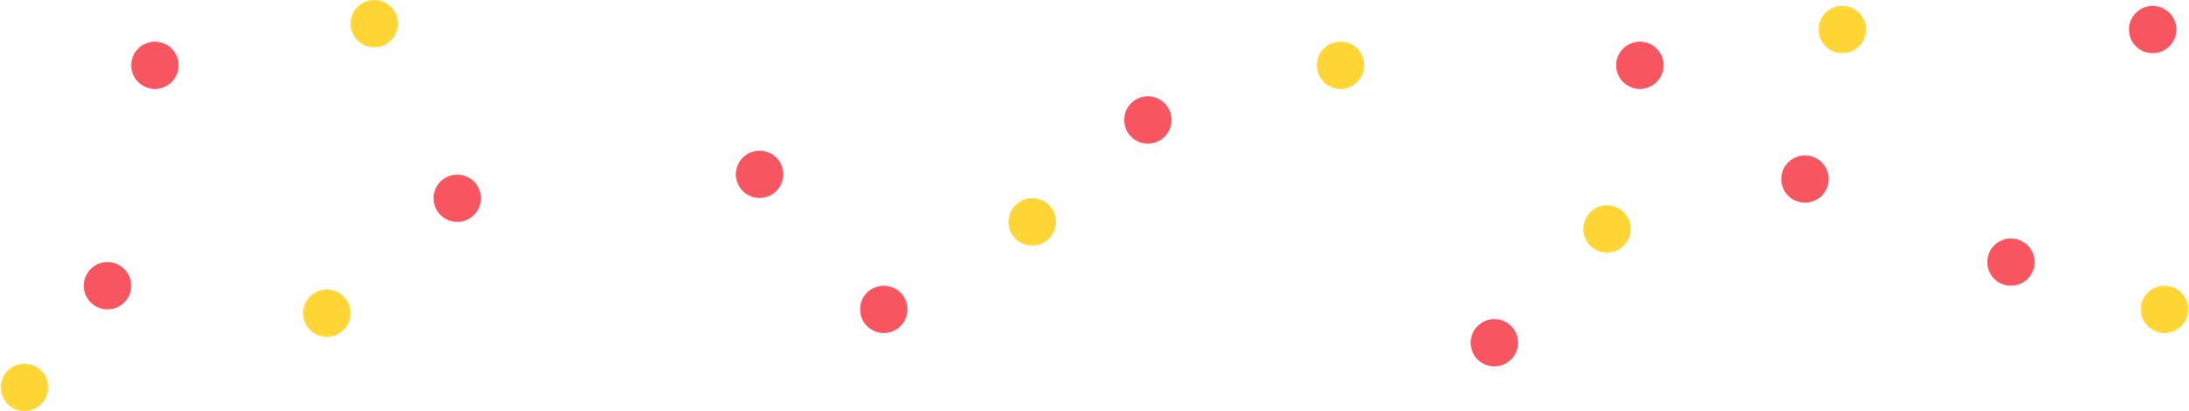
Game: Slap the board

Slide 18
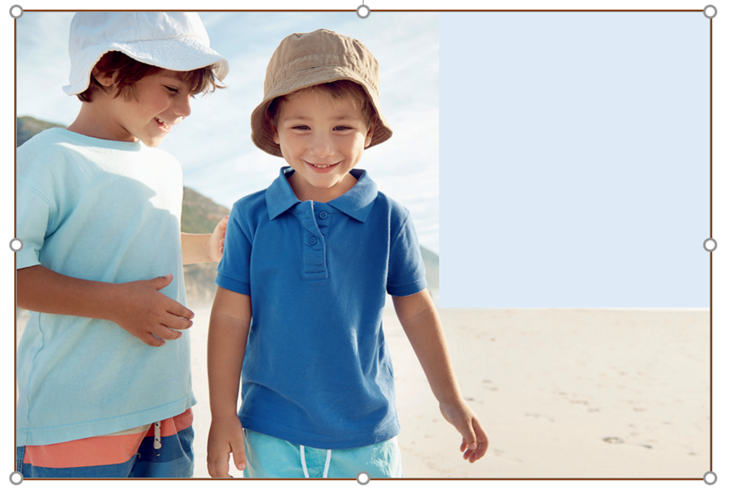
2. Listen and tick
Max: Nice white hat, Jae.
Is it a new hat?
Jae: Yes, that’s right.
My blue hat is too small.
I’ve got a green hat, too.
It’s big!
Max: You’ve got lots of hats. That’s funny!

Slide 19
Max: Nice white hat, Jae.
Is it a new hat?
Jae: Yes, that’s right.
My blue hat is too small.
I’ve got a green hat, too.
It’s big!
Max: You’ve got lots of hats. That’s funny!

Slide 20
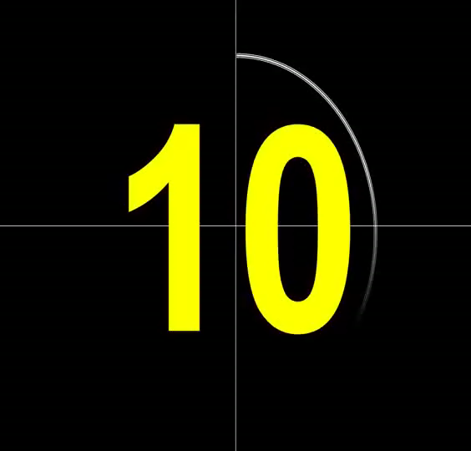
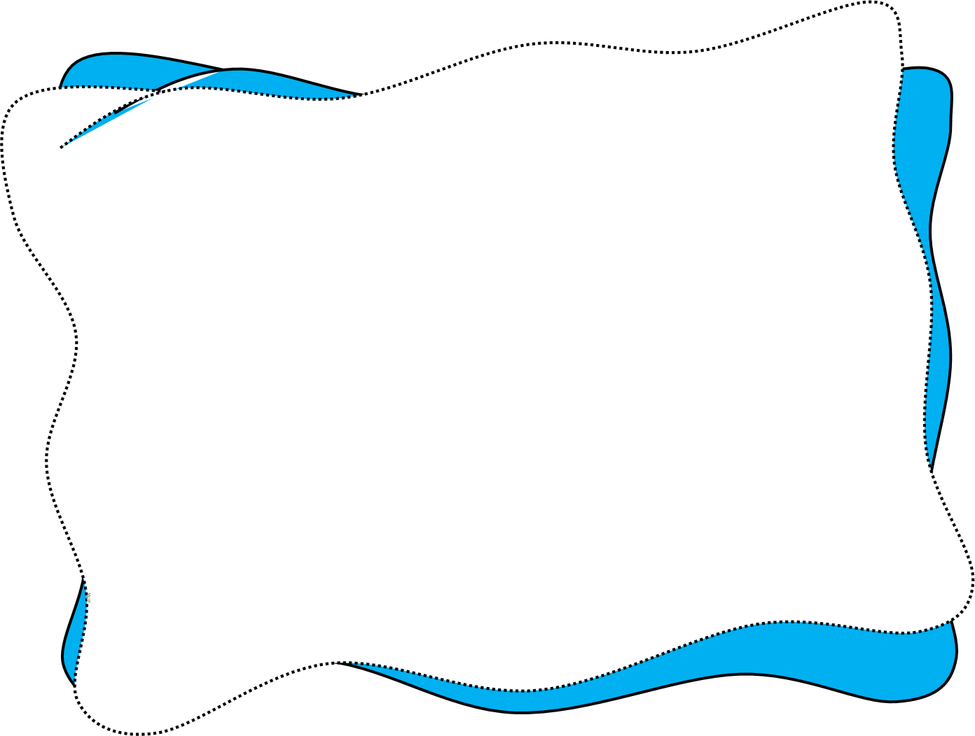
Jae has got a hat. His hat is
green and .........
a
new
b
small
c
big

Slide 22

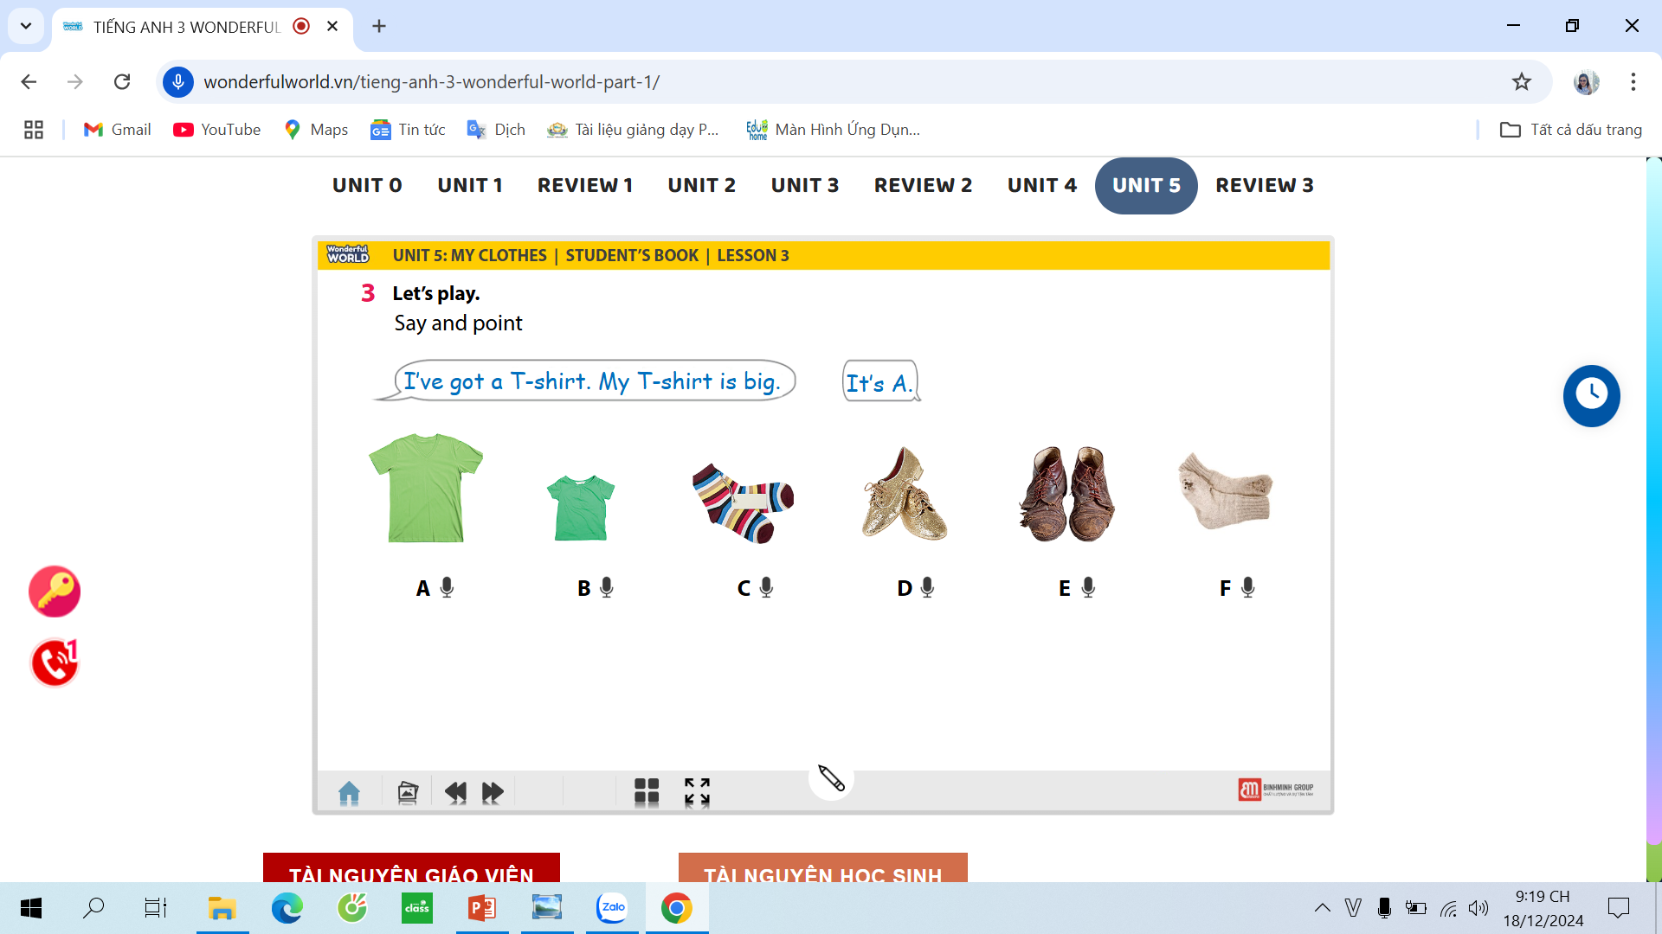
3. Let’s play!
A
B
C
D
E
F

Slide 23
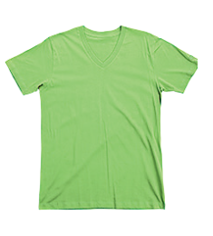
3. Let’s play!
I’ve got a T- shirt. My T- shirt is big.
It’s A

Slide 25
Memory game

Slide 27




Thank you!

