Slide 1

REVIEW 1
Period 1

Slide 2


01
Warm-up and Review

Slide 3

GUESS THE WORDS
C
A
B

Slide 4


Look and choose.
a. cat
b. dog
c. duck

Slide 5

a. desk
b. door
c. duck

Slide 6

a. desk
b. bag
c. hat

Slide 7

a. ball
b. door
c. dog

Slide 8

a. cake
b. hat
c. bag

Slide 9

a. red
b. pen
c. bag

Slide 10

a. apple
b. cake
c. can

Slide 11

a. cat
b. can
c. cup

Slide 12


Very Good!

Slide 13
02
Activity 1. Listen and repeat.

Slide 14


Listen and repeat.
Hi! I’m Phonic Phil!
And I’m Super Sue!

Slide 15


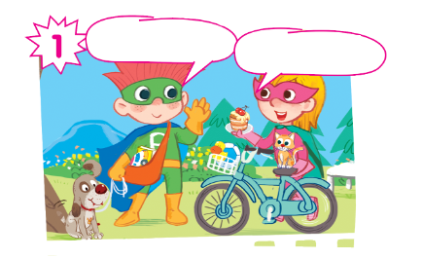

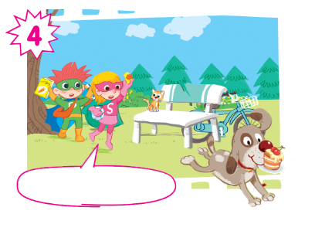
Oh, no! My cake!

Slide 16
Listen and repeat.
Hi! I’m Phil.
Hi! I’m Sue.

Slide 17
Listen and repeat.
Look! This is my dog.
And this is my cat.

Slide 18
Listen and repeat.
I have a car... and a book.
I have a ball... and a duck.

Slide 19
Listen and repeat.
Oh, no! My cake!

Slide 20
Listen and repeat.
Hi! I’m Phil.
Look! This is my dog.
Hi! I’m Sue.
And this is my cat.
I have a car... and a book.
I have a ball... and a duck.
Oh, no! My cake!
Oh, no! My cake!

Slide 21
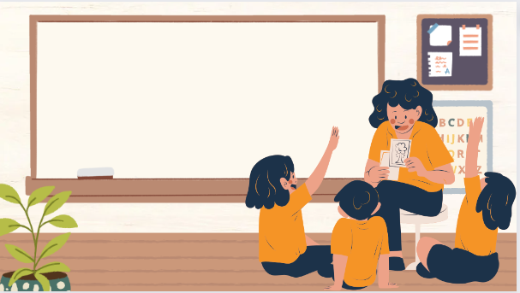
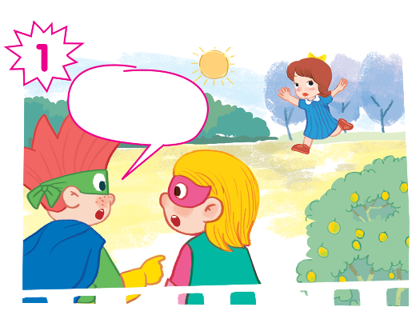
Play as a character

Slide 22
Hi! I’m Phil.
Look! This is my dog.
Hi! I’m Sue.
And this is my cat.
I have a car... and a book.
I have a ball... and a duck.
Oh, no! My cake!
Oh, no! My cake!

Slide 23
03
Activity 2. Look and circle.

Slide 24
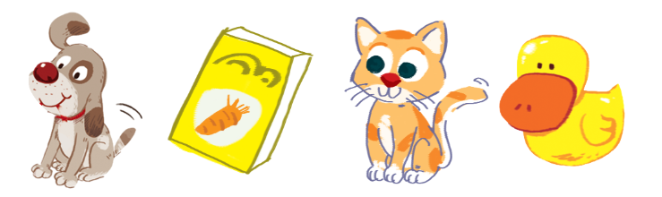
Look and circle.
dog cake cat duck book can car ball

Slide 25
Look and circle.
dog cake cat duck book can car ball

Slide 26
Look and circle.
cake cat duck book can car ball

Slide 27
Look and circle.
cake cat duck can car ball

Slide 28
Look and circle.
cake duck can car ball

Slide 29
Look and circle.
dog
book
cat
duck

Slide 30
04
Fun corner and Wrap-up

Slide 31
Website: hoclieu.vn
Fanpage: https://www.facebook.com/tienganhglobalsuccess.vn/

