Slide 1

REVIEW 1
Period 2

Slide 2

Let’s play.

Slide 3


I’m Bill.
I have a bag.

Slide 4



ball

Slide 5
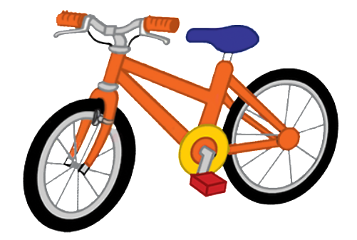
bike

Slide 6

book

Slide 7

car

Slide 8

cat

Slide 9

cup

Slide 10

cake

Slide 11

dog

Slide 12

duck

Slide 13

desk

Slide 14

door

Slide 15

hat

Slide 16

apple

Slide 17

can

Slide 18


Very Good!

Slide 19

02
Activity 1. Listen and tick.

Slide 20

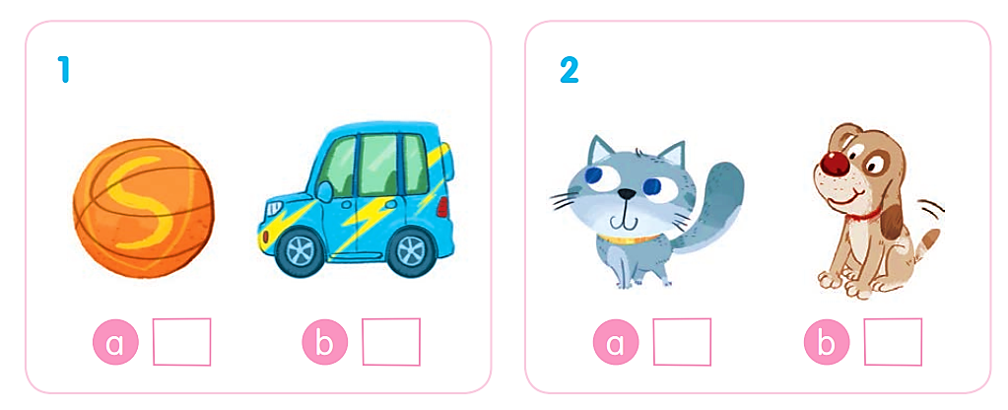
Listen and tick.

Slide 21
Listen and tick.
✓

Slide 22
Listen and tick.
✓

Slide 23
Listen and tick.
✓
✓

Slide 24
03
Activity 2. Listen and circle.

Slide 25
Listen and circle.
1 b d 2 a c
3 b c 4 c d

Slide 26
Listen and circle.
1 b d

Slide 27
Listen and circle.
2 a c

Slide 28
Listen and circle.
3 b c

Slide 29
Listen and circle.
4 c d

Slide 30
Listen and circle.
1 b d 2 a c
3 b c 4 c d

Slide 31
04
Activity 3.
Listen and tick or cross.

Slide 32
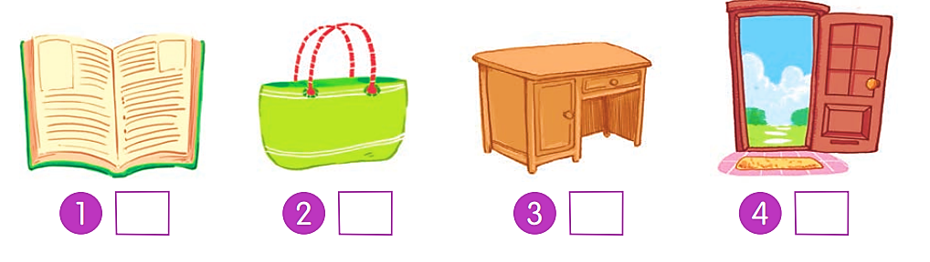
Listen and tick or cross.

Slide 33
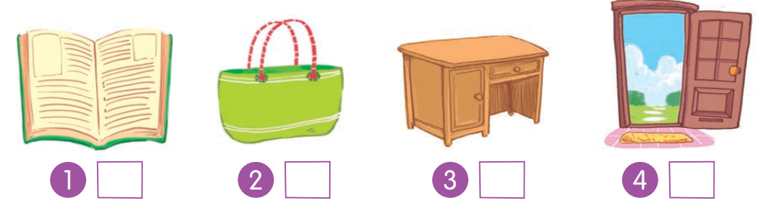
Listen and tick or cross.
✗

Slide 34
Listen and tick or cross.
✓

Slide 35
Listen and tick or cross.
✓

Slide 36
Listen and tick or cross.
✗

Slide 37
Listen and tick or cross.
✗
✓
✓
✗

Slide 38
05
Fun corner and Wrap-up

Slide 39
c
a
b
d

Slide 40
Website: hoclieu.vn
Fanpage: https://www.facebook.com/tienganhglobalsuccess.vn/

