Slide 1

REVIEW 1
Period 3

Slide 2


01
Warm-up and Review

Slide 3

Hand Game

Slide 4


1
2
a
5
c
3
4
b
d
Notes:
Nháy vào chữ cái để đến trang có hình ảnh tương ứng.

Slide 5


apple

Slide 6


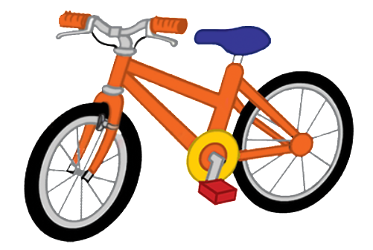
ball
bike
book

Slide 7





car
cat
cup
cake
can

Slide 8




dog
duck
desk
door

Slide 9
02
Activity 4. Read and tick.

Slide 10

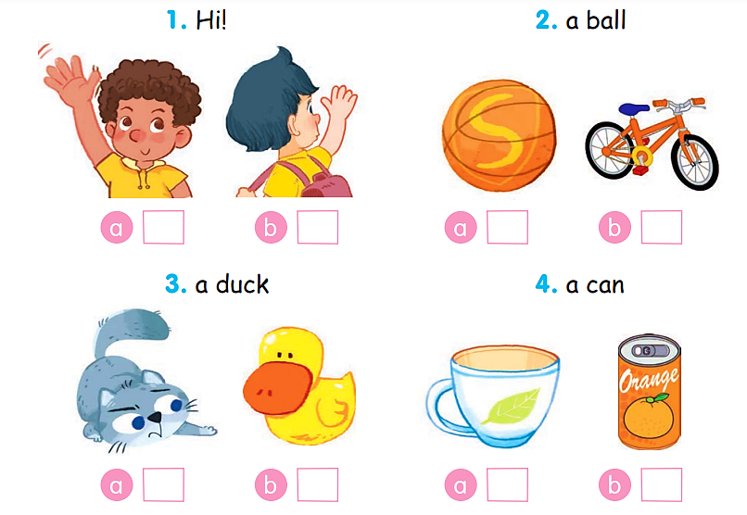
Read and tick.

Slide 11
Read and tick.
1. Hi!
✓

Slide 12
Read and tick.
2. a ball
✓

Slide 13
Read and tick.
3. a duck
✓

Slide 14
Read and tick.
4. a can
✓

Slide 15
Read and tick.
✓
✓
✓
✓

Slide 16
03
Activity 5. Colour the apple, the ball, the cat and the dog. Then point and say.

Slide 17



Colour the apple, the ball, the cat and the dog. Then point and say.
apple ball cat dog
Hi. I’m ______. This is my ______.

Slide 18








Colour the apple. Then point and say.
apple
Hi. I’m ______. This is my ______.

Slide 19















Colour the ball. Then point and say.
ball
Hi. I’m ______. This is my ______.

Slide 20











Colour the cat. Then point and say.
cat
Hi. I’m ______. This is my ______.

Slide 21










Colour the dog. Then point and say.
dog
Hi. I’m ______. This is my ______.

Slide 22
04
Fun corner and Wrap-up

Slide 23


Fill in the blanks.
This is ____ dog.
my

Slide 24

____ is my cat.
This

Slide 25

This is my ____.
ball

Slide 26

I have a ____.
cup

Slide 27


Very Good!

Slide 28
Website: hoclieu.vn
Fanpage: https://www.facebook.com/tienganhglobalsuccess.vn/

