Slide 1
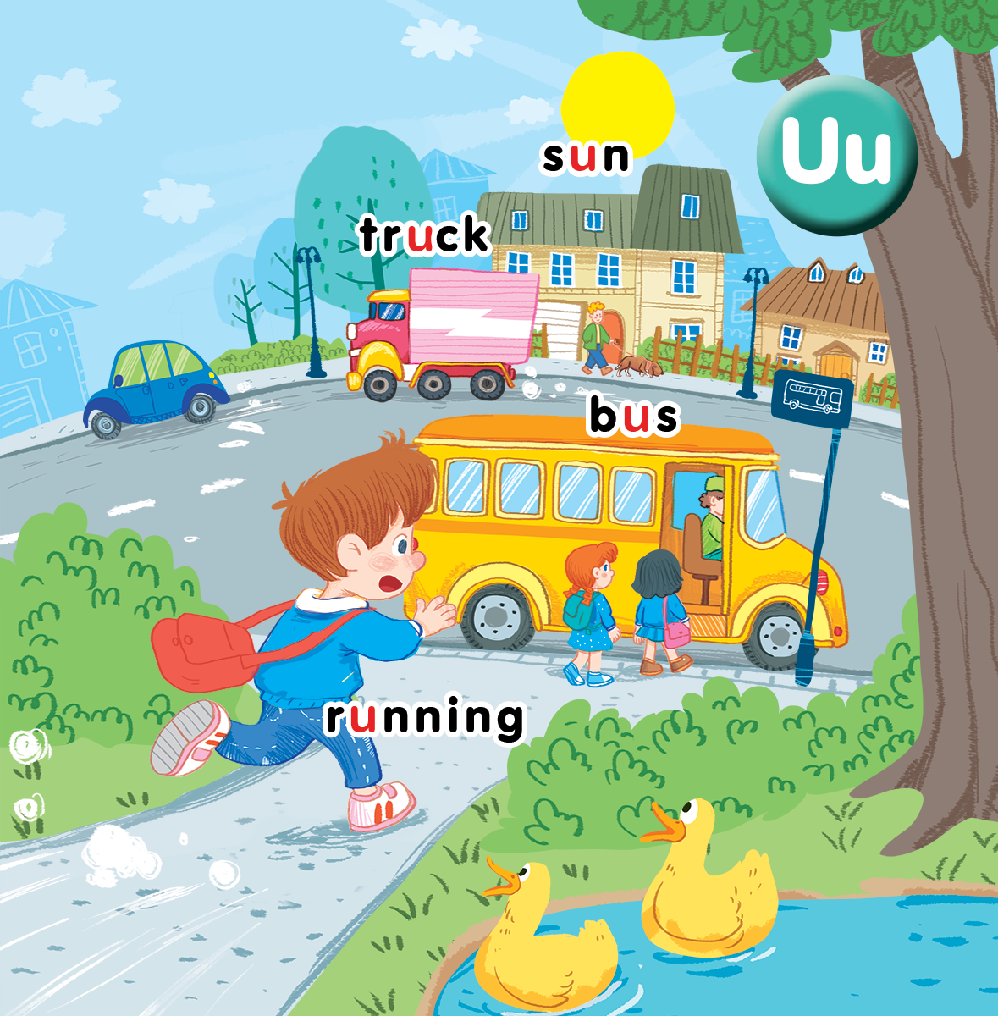
Unit 11
At the bus stop
Lesson 2
Notes:
Goals:
- Pupils will be able to say the sound of the letter U/u and the words sun, truck, bus, running in a chant.
- Pupils will be able to listen, recognize the words and tick the correct boxes.
- Pupils will be able to trace the letter U/u and complete the words b__s, tr__ck, s__n, r __nning.

Slide 2

Warm-up
Notes:
Miming
Goal: Warm up and revise the unit keywords.
Time: 5 minutes
Show the flashcard bus to a pupil.
The pupil does the TPR action for the word. Have other pupils guess the word.
After guessing the word, have the whole class repeat the word in chorus.
Do the same with truck, running, sun.

Slide 3


Listen and chant
Notes:
Listen and chant is divided into 3 steps.

Slide 4
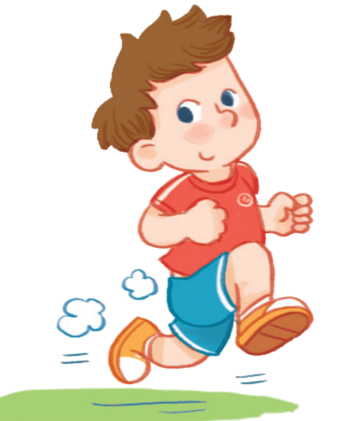



bus
running
sun
truck
Notes:
Step 1
Goal: Pupils will be able to say the sound of the letter U/u and the words having the sound.
Time: 5 minutes.
Have pupils listen and repeat the sound u.
Stand in front of group 1, do the TRP action for bus and say bus.
Repeat twice and say u (clap), u (clap), bus (TPR action).
Pupils in group 1 repeat with the TPR actions and say the words in pairs from desk 1, 2, 3 to the last desk.
Have pupils in group 2 do the same.
Do the same with other words running, sun, truck.

Slide 5



Listen and chant
Notes:
Step 2
Goal: Pupils will be able to read all the sentences of the chant.
Time: 3 minutes
Play the recording, have pupils listen and repeat sentence by sentence.
Don’t try to explain the meaning, support for students’ understanding by doing action.
Ex: Look at the truck (use hands to make the truck), the truck is moving (move)
(do the same with other sentences)
Step 3
Goal: Pupils will be able to read the chant and do TPR.
Time: 3 minutes
Have pupils read the chant in chorus for the 1st time.
Have pupils read the chant in chorus and do TPR for the 2nd time.
Have pupils read the chant in group and do TPR for the 3rd time.
(Teacher can have each group of pupils create their own TPR for the chant if possible. If the pupils are advanced, teacher can have pupils replace words of the chant to make a new chant)

Slide 6

Listen and tick

Slide 7
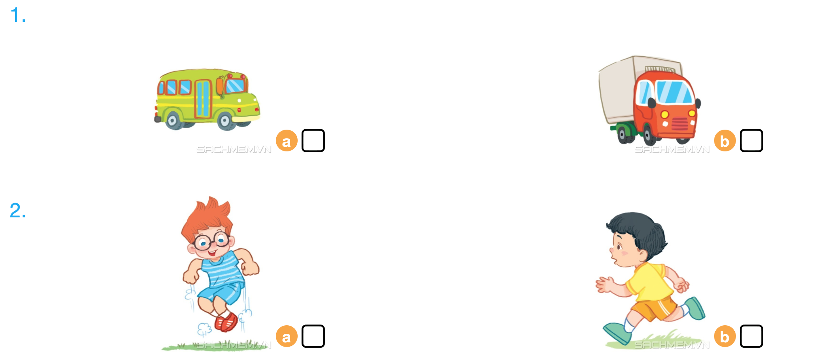

Listen and tick
Notes:
Listen and tick is divided into 2 steps.
Step 1
Goal: Pupils will be able to listen and choose the correct pictures.
Time: 5 minutes
Have students say all the words of the activity truck, bus, running and introduce the activity in picture 2.a (jumping) – can be in Vietnamese.
Play the recording twice and have pupils listen and choose the correct picture.
Step 2
Goal: Check.
Time: 3 minutes
Check the answer with pupils. Have pupils play the game slap the board to check the answer.
Have pupils read the correct answer.

Slide 8



Look, trace and write
Notes:
Goal: Pupils will be able to trace the letter.
Time: 5 minutes
Demonstrate by tracing in the air.
Have pupils write the word in the air and say the word.
Demonstrate by writing on board.
Have pupils trace the word with pencil on the book.

Slide 9
Game
Notes:
Whisper
Goal: Revise the words and chant.
Time: 5 minutes
Have pupils play the game Whisper in groups.
Stand in the line
One pupil in each group chooses a card with “The bus is running” and whispers to a pupil behind.
The last student in the line goes to the board, says the sentence and does action.

Slide 10
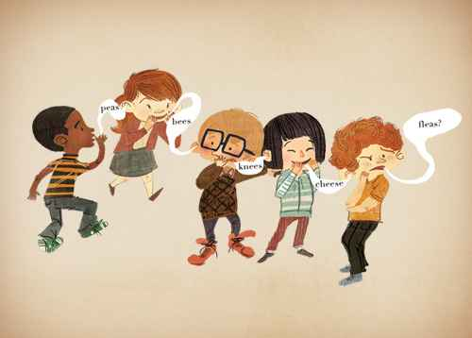

Slide 11
Goodbye
Notes:
Repeat the words with rhythm and say goodbye.

Slide 12
Goodbye

Slide 13

Goodbye

Slide 14

Goodbye

Slide 15
Website: hoclieu.vn
Fanpage: facebook.com/www.tienganhglobalsuccess.vn

