Slide 1


Listen and repeat
Notes:
Listen and repeat is divided in to 2 steps.
Step 1
Goals: Pupils will be able to listen to the structure He’s having…/She’s having….and understand the meaning.
Recognize the use of HE/SHE
Time: 4 minutes.
Introduce the structure and have pupils listen and repeat.
1.
Call 1 boy and 1 girl to the front to introduce He/ She
Point to the girl and say SHE and have pupils repeat the word 3 times.
Do the same with the word HE.
Vary the speed of pointing to make the class more fun.
2. Introduce the structure
Teacher whispers to the boy a sentence, the boy does the TPR action.
Teacher asks : What is he having?
Say: He’s having noodles. Have pupils repeat the sentence.
Do the same with the girl.
Step 2
Goal: Pupils will be able to recognize and repeat the structure She’s having/ He’s having….
Time: 4 minutes.
Have pupils open the book, listen and repeat in chorus, groups then individuals.

Slide 2


Let’s talk
Notes:
Let’s talk is divided into 2 steps.

Slide 3
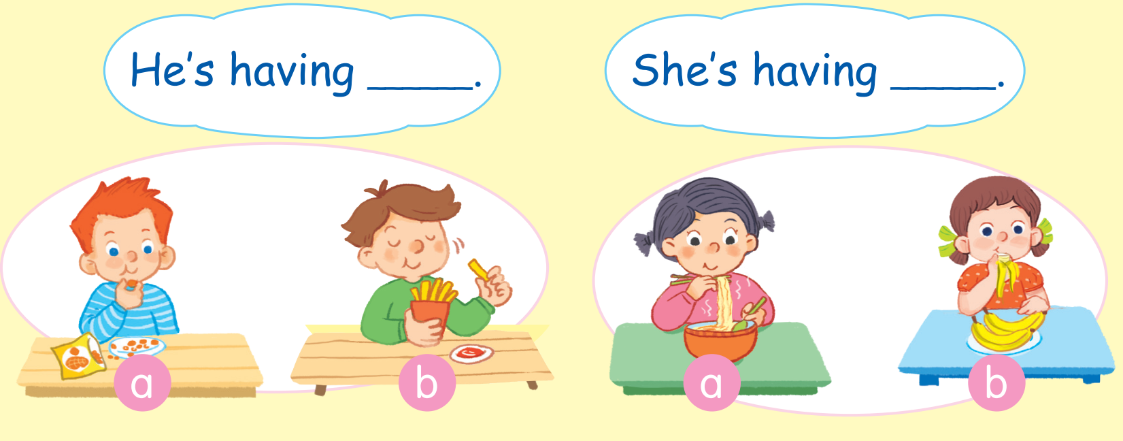
Notes:
Step 1
Goal: Pupils will be able to say the sentence with She’s/He’s having ….
Time: 3 minutes
Have pupil open the book, activity 7, page 59.
Point to the first picture and say: He’s having nut.
Have pupils repeat the sentences.
Have people work in pairs, point and say.

Slide 4










TEAM 1:
TEAM 2:
TEAM 3:
TEAM 4:
Notes:
Giáo viên click vào số bất kỳ, sẽ link sang câu hỏi.
Giáo viên cho Hs nhìn hình để đặt câu,
Giáo viên click để ra đáp án
Giáo viên click lần nữa để ra điểm.
Muốn quay trở lại slide này, Giáo viên click vào hình bông hoa màu tím ở góc dưới bên phải màn hình.
Giáo viên sửa điểm cho mỗi đội ngay trên slide powerpoint này trong khi đang trình chiếu

Slide 5
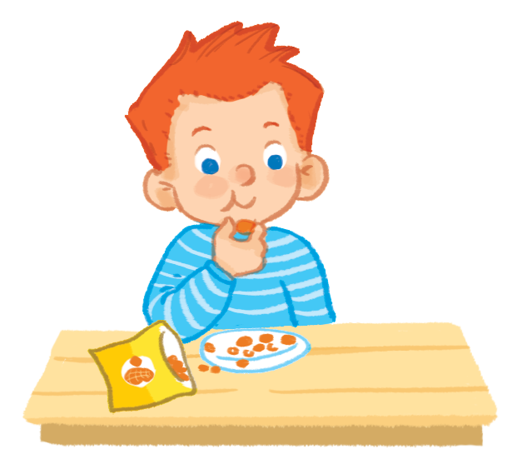


He’s having nuts..

Slide 6


He’s having chips..

Slide 7
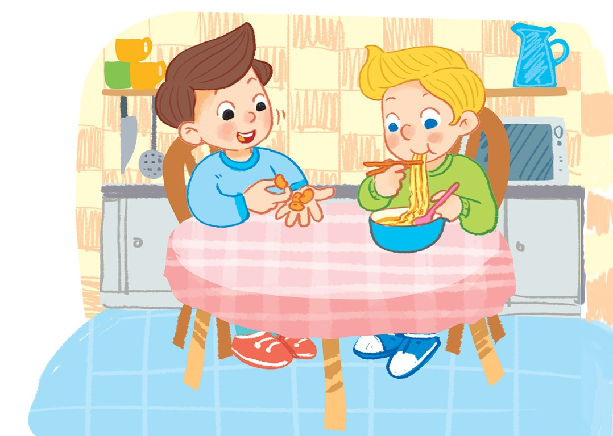
He’s having nuts..

Slide 8
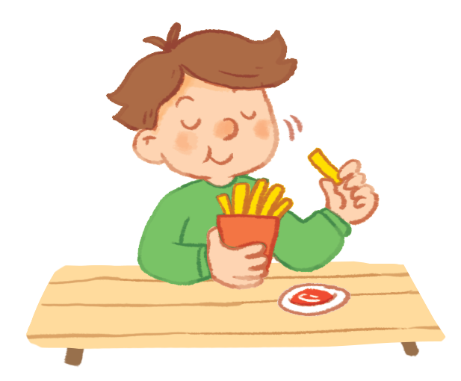
He’s having chips..

Slide 9

He’s having noodles..

Slide 10

She’s having an apple..

Slide 11
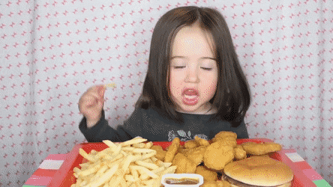
She’s having fish and chips..

Slide 12
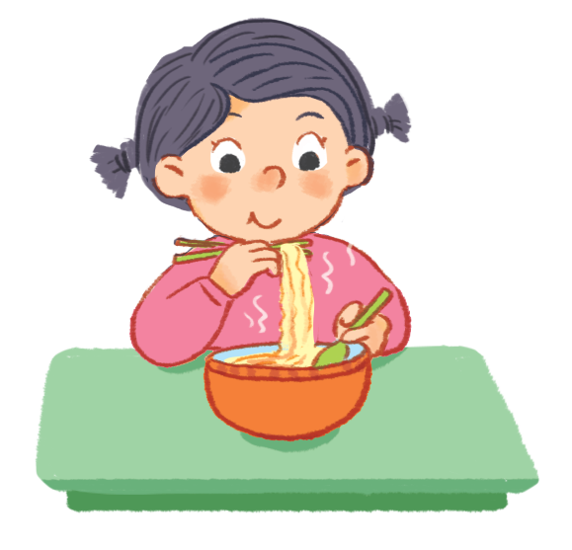
She’s having noodles..

Slide 13

She’s having a cake..

Slide 14

He’s having chicken..

Slide 15
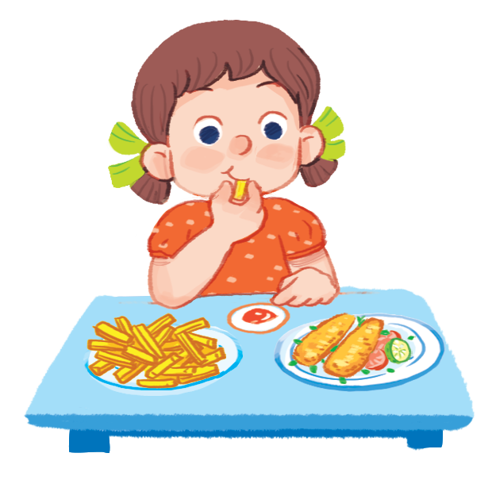
She’s having fish and chips..

Slide 16

He’s having an apple..

Slide 17
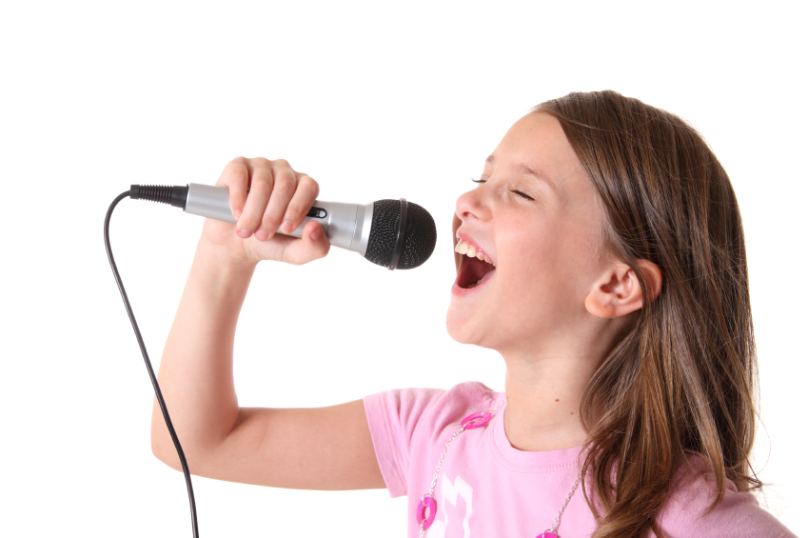

Let’s sing
Notes:
Let’s sing is divided into 3 steps.
Step 1
Goal: Pupils will be able to read the song lyrics.
Time: 3 minutes
Have pupils read the song lyrics in chorus then in groups.
Step 2:
Goal: Pupils will be able to sing a long the song with TPR.
Have pupils listen and sing a long the song in chorus then in groups.
Have groups create their own TPR for the song then present.
Finish the song with the TRP for High five and fist bump.

Slide 18
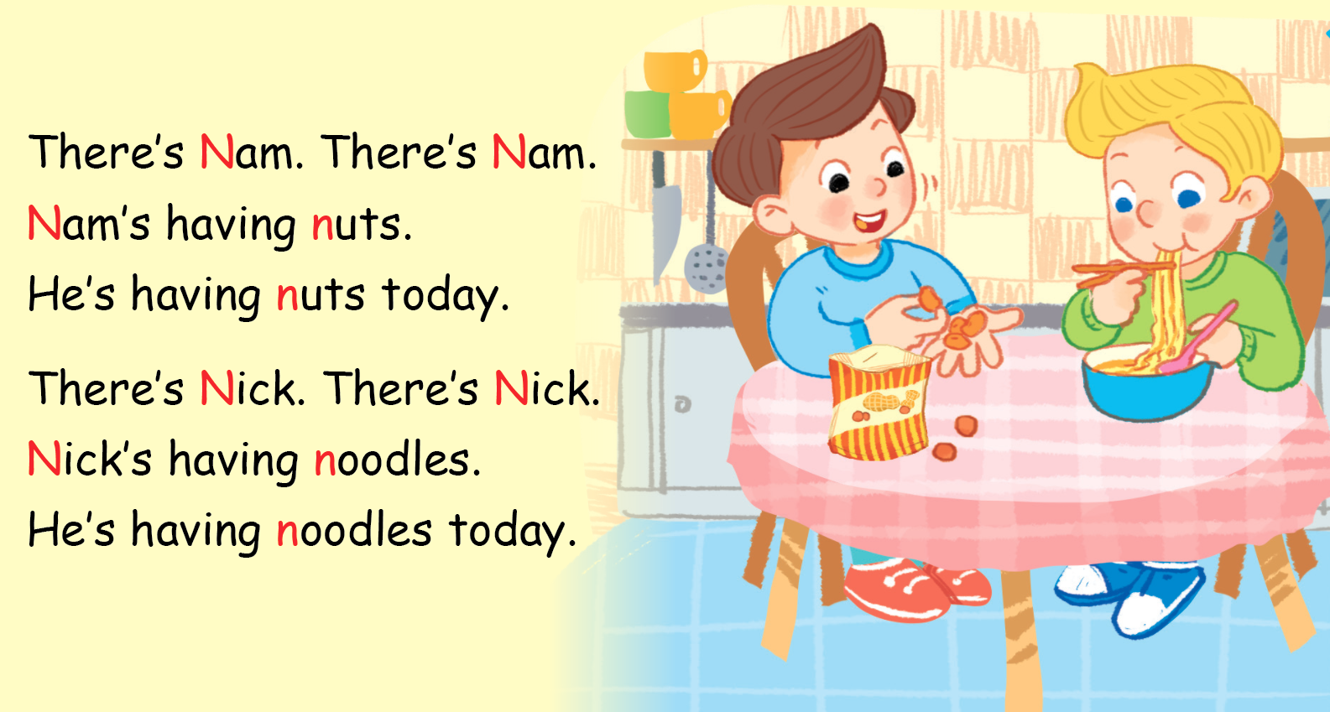

Let’s sing

