Slide 1
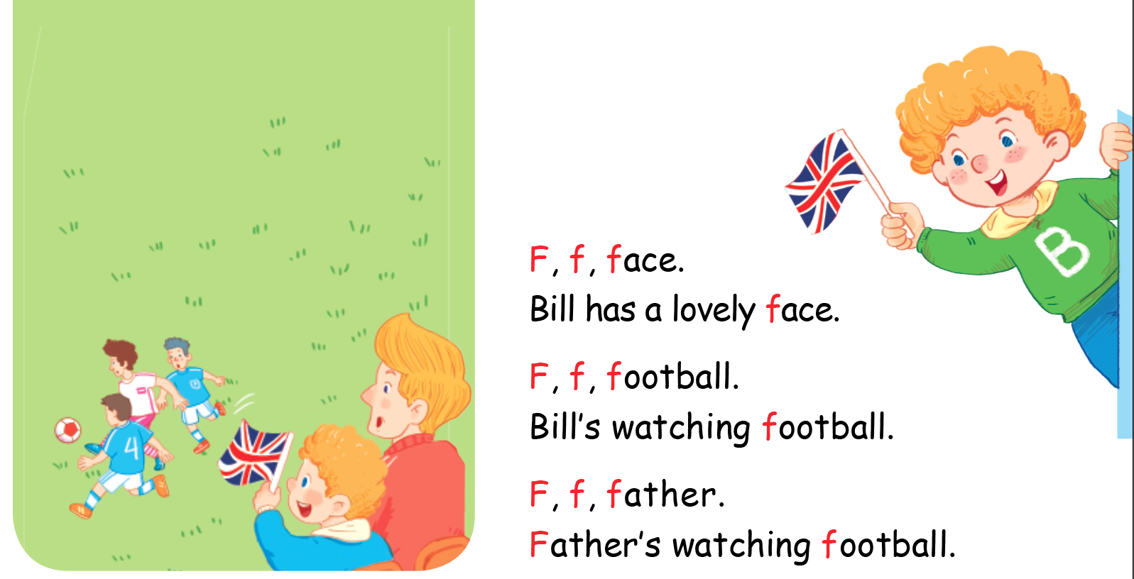

Listen and chant

Slide 2


Listen and tick
Notes:
Listen and tick is divided into 2 steps.
Step 1
Goal: Pupils will be able to listen and choose the correct pictures.
Time: 5 minutes
Say Listen and tick with the TPR actions.
Play the recording and demonstrate the example.
Play the recording and have pupils do the task.
Step 2
Goal: Check
Time: 5 minutes
Play the recording and have pupils say the answer.
Play the recording again and have pupils repeat then give correct answer.

Slide 3
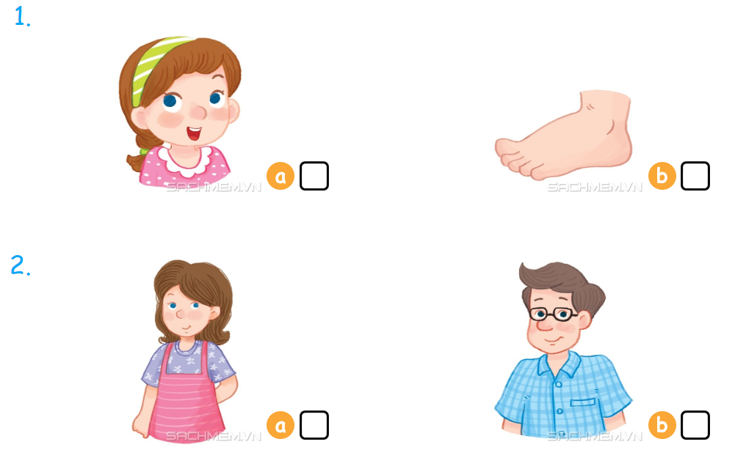

Listen and tick

Slide 4



Look, trace and write
Notes:
Goal: Pupils will be able to trace the letter.
Time: 5 minutes
Have pupils write the word by air tracing and say the word.
Demonstrate how to trace the word and have pupils do the task.

Slide 5
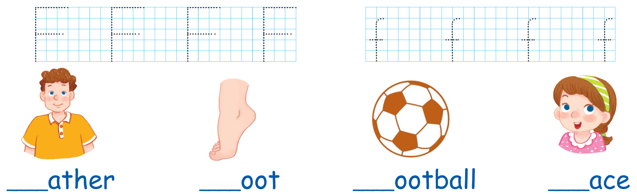

Slide 6

Game
Notes:
Goal: Revise the words learnt
Time: 5 minutes
Game: Score a goal
Have pupils to play the game in groups.
Each group takes turn to choose word to shoot into the net.
Correct shoot will give score to the group.

Slide 7
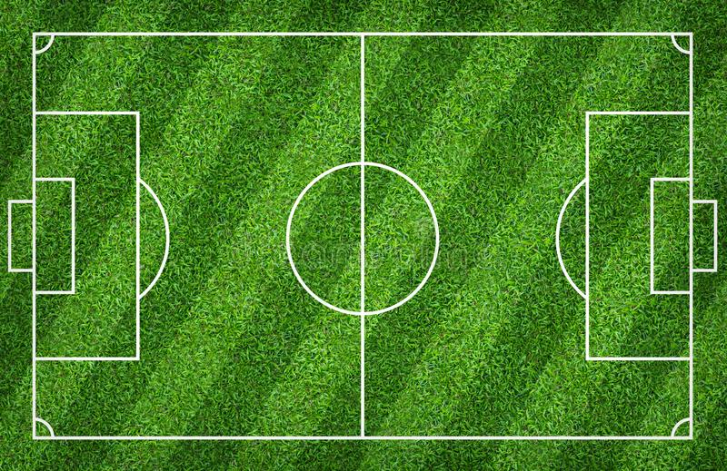

TEAM 1
TEAM 2

Slide 8
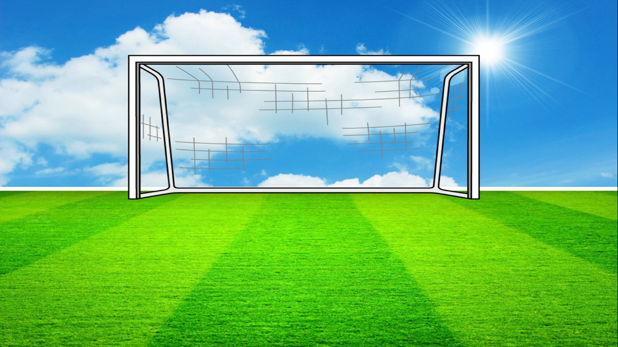
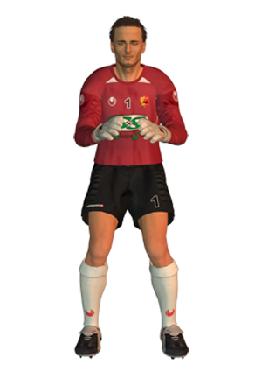




Q1.
frog
GOAL!!
SAVED…
MISSED..

Slide 9



Q2.
Farmer
GOAL!!
SAVED…
MISSED..

Slide 10

Q3.
fish
GOAL!!
SAVED…
MISSED..

Slide 11
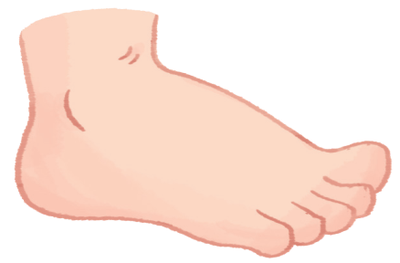
Q4.
face
GOAL!!
SAVED…
MISSED..

Slide 12
Q5.
foot
GOAL!!
SAVED…
MISSED..

Slide 13
Q6.
family
GOAL!!
SAVED…
MISSED..

Slide 14
Q7.
father
GOAL!!
SAVED…
MISSED..

Slide 15
Q8.
fire truck
GOAL!!
SAVED…
MISSED..

Slide 16
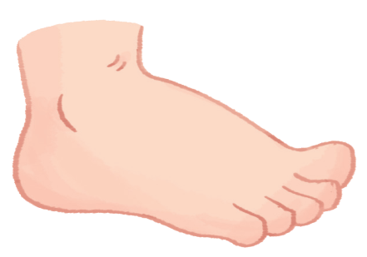
Goodbye
Notes:
Teacher shows the vocabulary of the lesson on slide.
Pupils say goodbye.

Slide 17

Goodbye

Slide 18

Goodbye

Slide 19
Goodbye

