Slide 1



Notes:
Step 3
Listen and repeat
Goal:
- Pupils will be able to listen and repeat the unit keywords cake and cup; listen and repeat the sound c.
- Recognize and say the words with flashcards.
Time: 3-4 minutes.
Introduce the unit keywords cake and cup with flashcards.
Hold up the flashcard for cup and have pupils shout out the word. Stick the flashcard on the board.
Continue with the flashcard for cake.
On the board, there are two flashcards for cup and cake. The flashcard for cup is above the flashcard for cake.
Teacher points to the cup, say the word and have pupils repeat the word. Do the TPR action which saying the word.
Do the same with cake.
Have pupils guess the word and repeat by pointing to cup or cake. Hold your hand up or down to the position of the flashcard.
Turn over the cards, have pupils guess the card and shout out the word.
Swap the cards and have pupils guess.
Play the game with all four 4 flashcards for car, cat, cup, cake.
Ask pupils what is similar at the beginning of each word.
Introduce the sound c, point to the first letter of each word and say. Have pupils listen and repeat.

Slide 2



Notes:
Point and say is divided into 3 main steps.
Step 1
Goal: Pupils will be able to listen and repeat the words.
Time: 3 minutes
Choose a picture on the digital book, click on the picture and have pupils listen and repeat.
Have pupils repeat the word softly, loudly in groups to motivate them.
Step 2.
Goal: Pupils will be able to point and say the pictures.
Time: 5 minutes
Hold up your index finger, demonstrate the action for Point.
Say Point and say with TRP actions.
Point to the car and say car. Have pupil point and say.
Repeat the procedure.
Vary the speed to make the activity fun.
Do the activity in groups.
Ask one or two students to point to the picture and have other pupils say the word.
Step 3
Goal: Pupils will be able to point and say the pictures in pairs.
Time: 5 minutes
Have pupils work in pairs and do the activity.

Slide 3
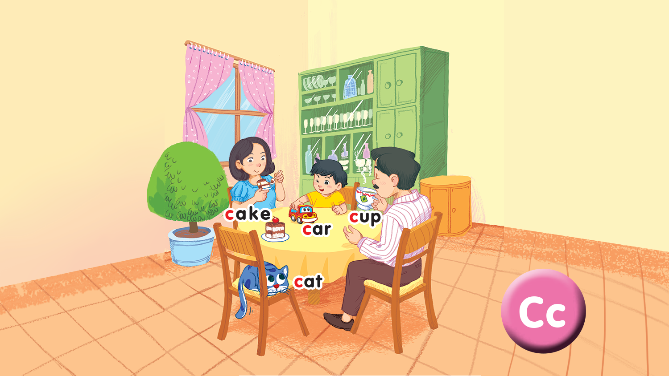
Point and say

Slide 4

Game
Notes:
Miming
Goal: Pupils will be able to recognize the unit keywords through pictures, sounds, and meaning.
Time: 5 minutes
Show the flashcard for car to a pupil.
The pupil does the TPR action for the word. Have other pupils guess the word.
After guessing the word, have the whole class repeat the word in chorus.

Slide 5

Goodbye
Notes:
Goodbye
Time: 2 minutes
Teacher and pupils say goodbye to the words.

Slide 6

Goodbye

Slide 7
Goodbye

Slide 8

Goodbye
cup

Slide 9
Website: hoclieu.vn
Fanpage: facebook.com/www.tienganhglobalsuccess.vn

