Slide 2

Unit 3
Lesson 3
At the street market
Notes:
Goals:
By the end of the lesson, pupils will be able to:
- introduce something using the structure This is my…
- sing along the unit song.

Slide 3

Warm-up
Notes:
Goal: Warm up and revise the unit keywords.
Time: 3 minutes
Find the pair of cards.
Have pupils choose 2 numbers and find the picture hidden under the number. If they are the same, you can open then. If not, close the numbers and have pupils guess again.
After opening all the numbers, have pupils chant the verse relating to the pictures.
Have pupils chant the words.

Slide 4


1
2
3
4

Slide 5


1
2
3
4

Slide 6





Slide 7


Listen and repeat
Notes:
Listen and repeat is divided in to 2 steps.
Step 1
Goal: Pupils will be able to listen to the structure This is my … and understand the meaning.
Time: 7 minutes.
Introduce the structure and have pupils listen and repeat.
Hold up a flashcard for bag and say This is my bag.
Stick the flashcard for bag on the board.
Do the same with other words.
Play the recording, and have pupils listen and repeat.
Step 2
Goal: Pupils will be able to recognize and repeat the structure This is my …
Time: 3 minutes.
Have pupils open the book, listen and repeat.

Slide 8

hat

Slide 9

apple

Slide 10

bag

Slide 11
can
Notes:
Tranh trong sách mềm chưa cập nhật

Slide 12


Slide 13


Slide 14
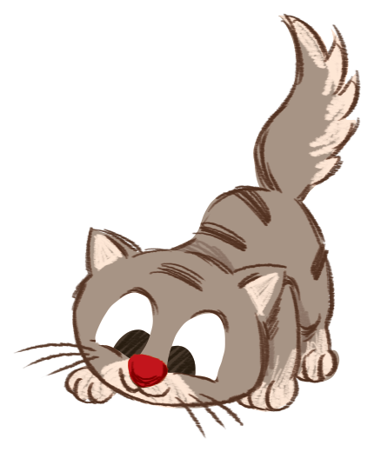

Slide 15


Let’s talk
Notes:
Let’s talk is divided into 2 steps.

Slide 16
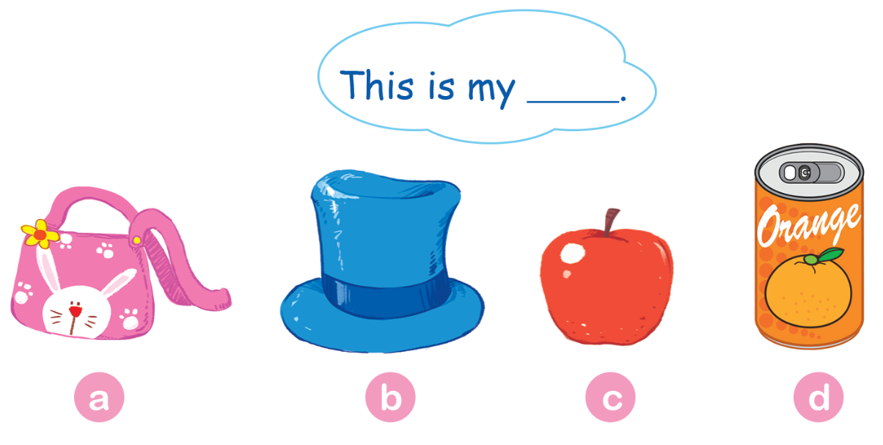
Notes:
Step 1
Goal: Pupils will be able to say a sentence with This is my ….
Time: 3 minutes
Have pupils do the task in the textbook in chorus, pairs then individuals.

Slide 17

Notes:
Step 2.
Goal: Pupils will be able to practice more, using the new structure.
Time: 3 minutes
One pupil hides a flashcard (or real object) behind and say: This is my… for others to guess its true or not.
Pupils repeat the sentence when seeing the real objects.

Slide 18


Let’s sing
Notes:
Let’s sing is divided into 2 steps.
Step 1
Goal: Pupils will be able to read the lyrics of the song.
Time: 3 minutes
Have pupils read the lyrics of the song, sentence by sentence.
Then say with TPR.
Step 2
Goal: Pupils will be able to listen and sing the song
Time: 5 minutes
Have pupils listen to the song and sing with TPR in chorus then in groups.

Slide 19

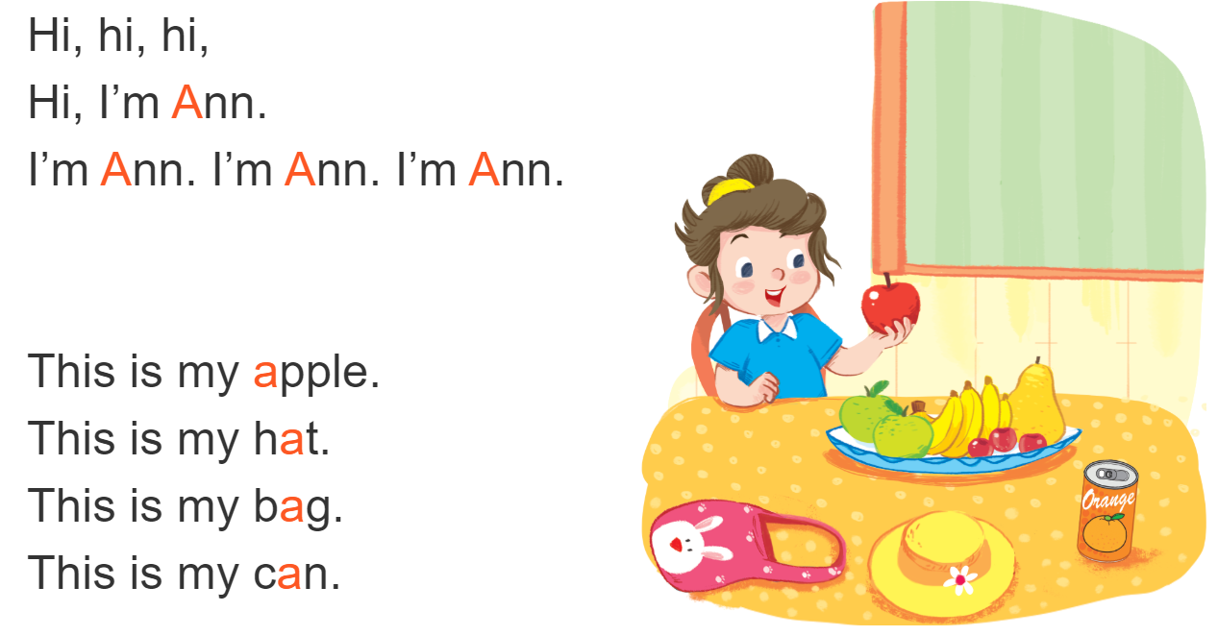
Let’s sing!

Slide 20
Game
Notes:
Goal: Review the unit keywords, the song and the chant.
Time: 5 minutes
Spinning wheel
Revise the words and play the game.

Slide 21






START/STOP
Notes:
Press START/STOP to start or stop the wheel

Slide 22

It’s time to say goodbye
Notes:
Goodbye
Time: 2 minutes
Teacher and pupils say goodbye to the words.

Slide 23

Goodbye
hat

Slide 24
Goodbye
apple

Slide 25
Goodbye
bag

Slide 26

Goodbye
can

Slide 27
Website: hoclieu.vn
Fanpage: facebook.com/www.tienganhglobalsuccess.vn

