Slide 2
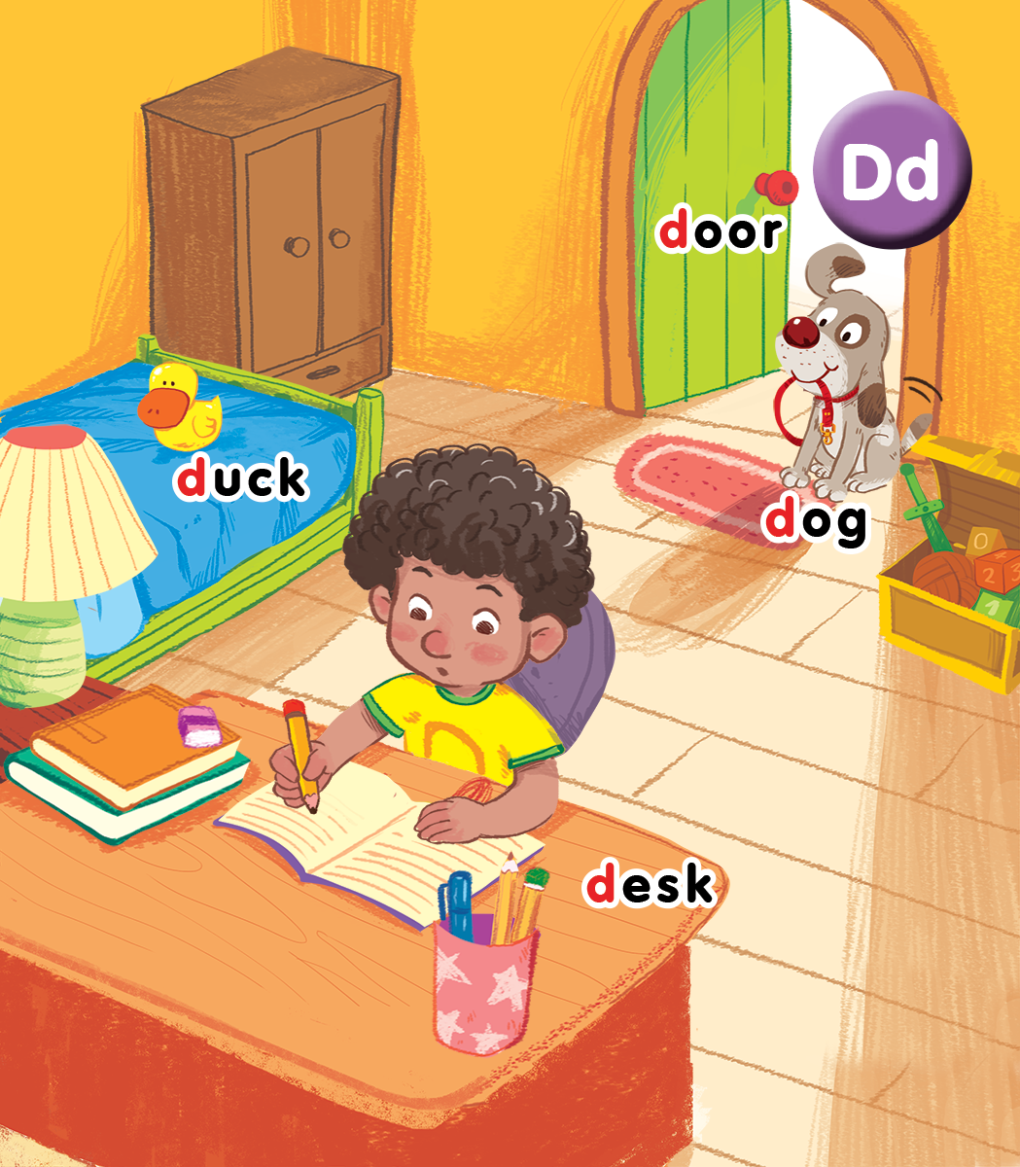
Unit 4
Lesson 2
In the bedroom
Notes:
Goals:
Pupils will be able to say the sound of the letter D/d and the words duck, door, dog and desk in a chant.
Pupils will be able to listen, recognize the words and tick the correct boxes.
Pupils will be able to trace the letter D/d (upper case and lower case).

Slide 3
Sit in groups and try to get as many stars as possible!
Group 1 | Group 2 | Group 3 | Group 4
O | O | O | O
O | O | O | O
O | O | O | O
O | O | O | O
O | O | O | O
O | O | O | O
O | O | O | O
O | O | O | O
Notes:
Classroom management
Pupils sit in groups.
Each group will have a star if they do the task well.
At the end of the lesson, the group with the most stars will be the winners.

Slide 4

Warm-up
Notes:
Goal: Warm up and revise the unit keywords.
Time: 3 minutes
Listen and do
Say the actions and have pupils do the actions with you.
Stand up.
Sit nicely.
Clap your hands.
Stand up. Clap your hands.
Turn around.
Sit nicely.
Stand up.
Open the door.
Hi, dog.
Fist bump
Open the door.
Hi, duck.
Fist bump.
Sit down.
Revise the words in lesson 1.

Slide 5



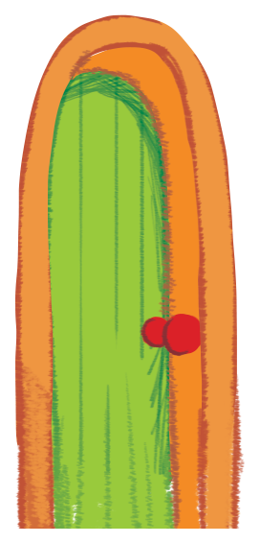

door
duck
desk

Slide 6


Listen and chant
Notes:
Listen and chant is divided into 3 steps.
Step 1
Goal: Pupils will be able to say the sound of the letter D/d and the words in the chant.
Time: 5 minutes.
Have pupils listen and repeat the sound and the words of the chant, sentence by sentence.

Slide 7

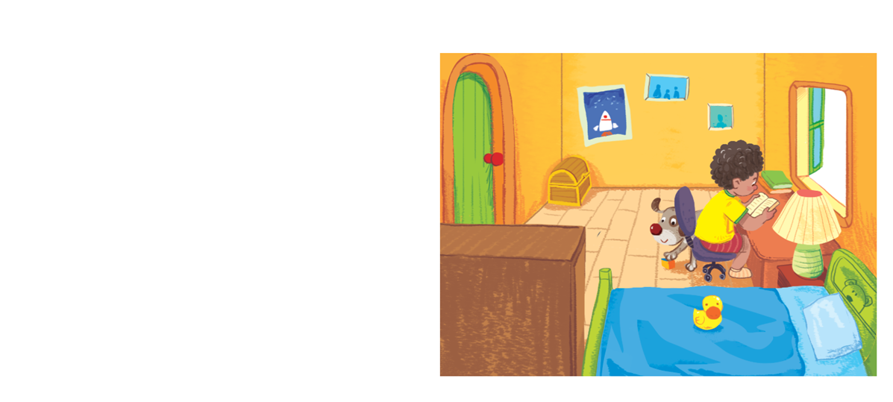
Listen and chant
D, d, duck.
D, d, dog.
A duck and a dog.
D, d, door.
D, d, desk.
A door and a desk.
Notes:
Step 2
Goal: Pupils will be able to chant and clap along.
Time: 3 minutes
Play the recording, have pupils listen and clap along.
Play the recording, have pupils listen, clap and chant along.
+ Round 1. Have pupils listen and clap along.
+ Round 2. Have pupils listen and do TPR actions with teacher.
+ Round 3. Have pupils listen and do the actions and chant along.
Repeat round 3 several times.
Revise the letter D/d by writing in the air.
Step 3
Goal: Pupils will be able to chant and clap along in pairs.
Time:3 minutes
Have pupils chant along in pairs.

Slide 8

Listen and tick
Notes:
Listen and tick is divided into 2 steps.
Step 1
Goal: Pupils will be able to listen and choose the correct pictures.
Time: 5 minutes
Do the TPR action to help the pupils understand the meaning of Listen and tick activity.
Play the recording and have pupils listen and choose the correct picture. Demonstrate an example.
Play the recording and have pupils listen and repeat.
Play the recording and have pupils do the task.
Step 2
Goal: Quick check
Time: 4 minutes
Stick the flashcards on the board.
Have pupils listen again and check the answer.
Ask pupils repeat the answer.

Slide 9
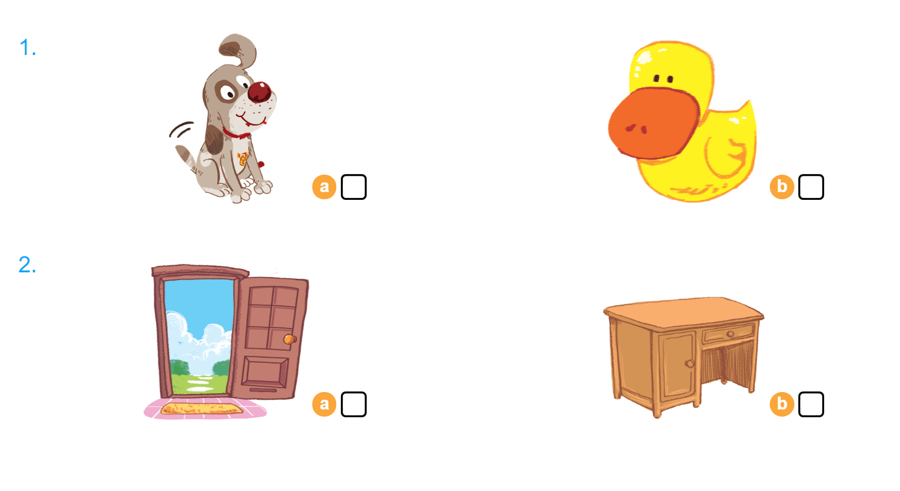

Listen and tick
Notes:
Step 2
Goal: Pupils will be able to listen and choose the pictures.
Time: 5 minutes
Stick the flashcards on the board. Say one word and have pupils choose the correct picture.

Slide 10


Look and trace
Notes:
Goal: Pupils will be able to trace the letter.
Time: 5 minutes
Have pupils say the word.
Demonstrate how to trace the word in the air.
Have pupils write the word by air tracing.
Have pupils do the task in the book with pencil.

Slide 11
Game
Notes:
Goal: Revise the words and chant.
Time: 5 minutes
What’s in the picture?
Play the game in groups.
Say the name of the box to open the box.
Answer the questions or do the action or say the words in the box.

Slide 12
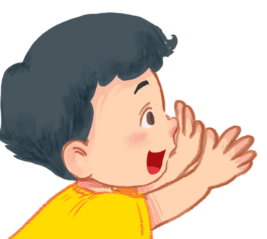












Slide 13
This is _______.
back

Slide 14
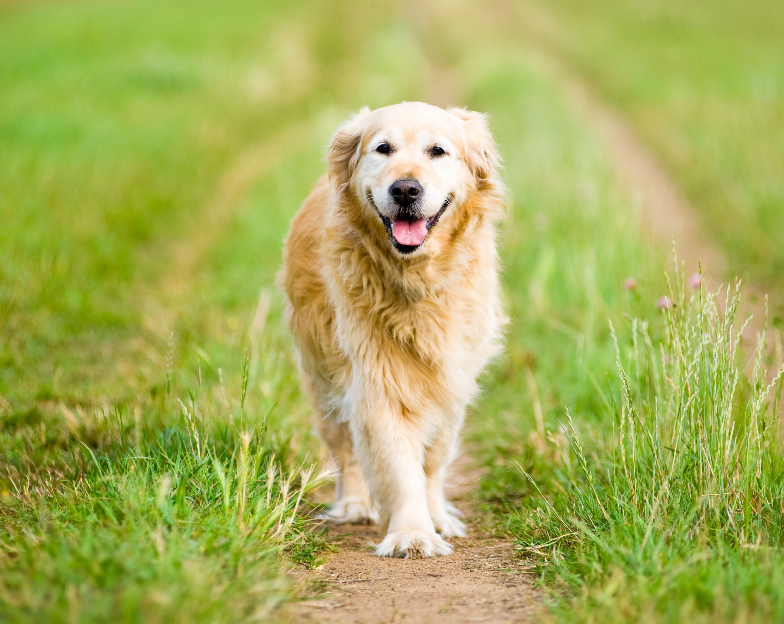
back

Slide 15
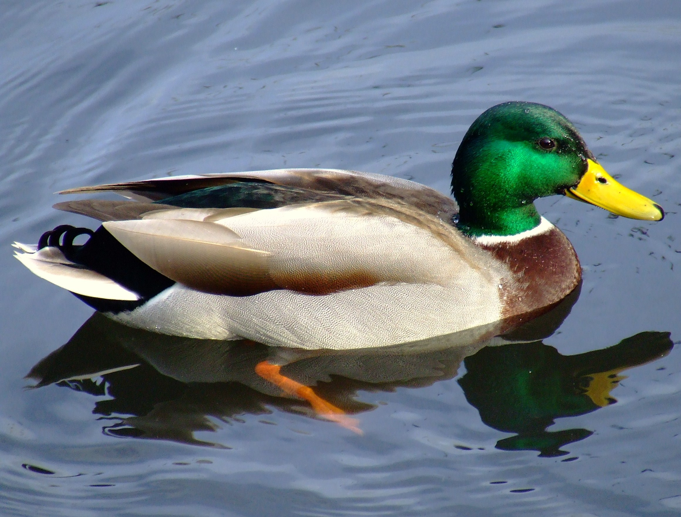
back

Slide 16
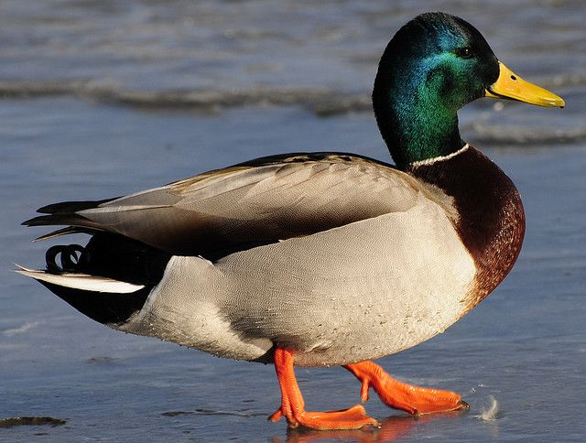
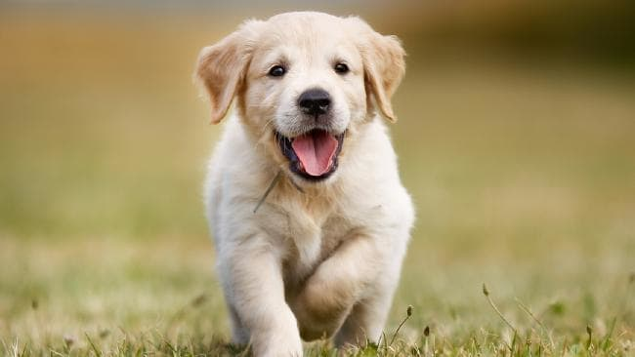
back

Slide 17
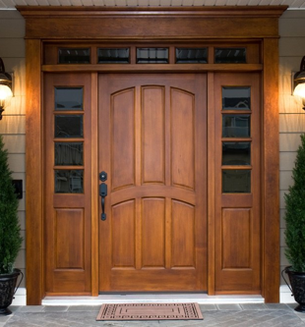
back

Slide 18
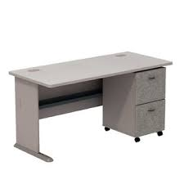

back

Slide 19
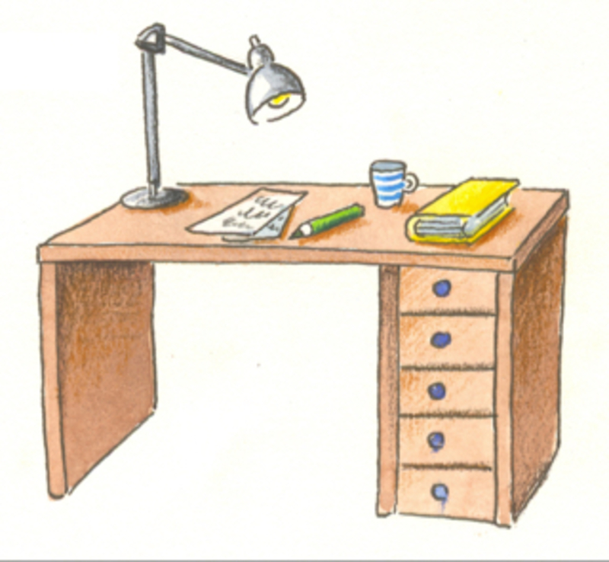
back

Slide 20

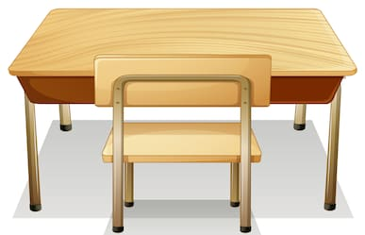
back

Slide 21
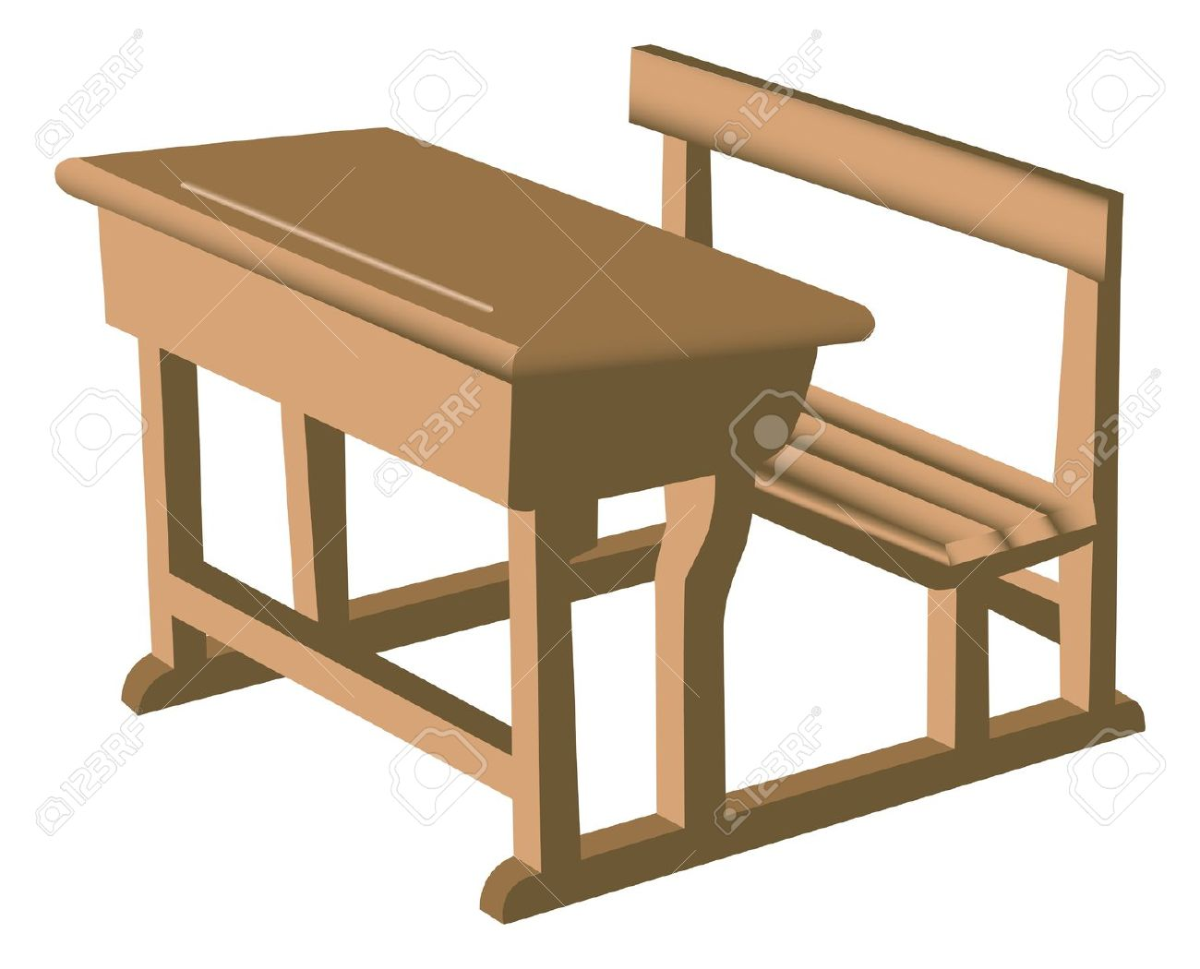
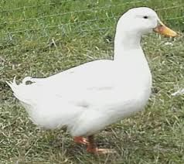
back

Slide 22
back

Slide 23
Chant
D, d duck.
D, d, dog.
A duck and a dog.
back

Slide 24
Chant
D, d door.
D, d, desk.
A door and a desk.
back

Slide 25
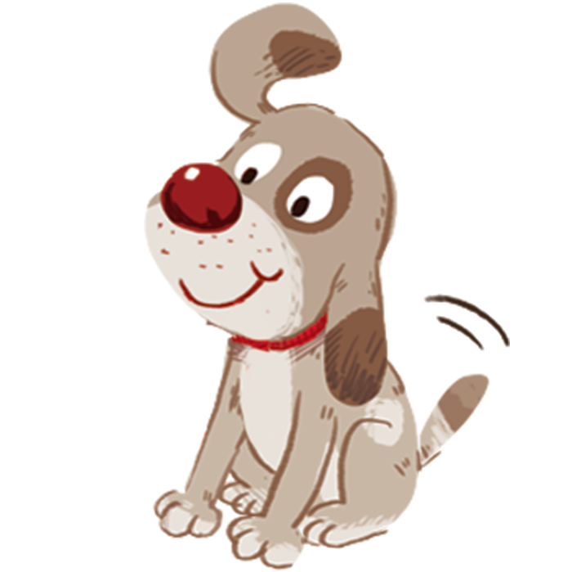
Goodbye
dog
Notes:
Goodbye
Time: 2 minutes
Teacher and pupils say goodbye to the words with TPR actions.

Slide 26
Goodbye
desk

Slide 27
Goodbye
door

Slide 28
Goodbye
duck

Slide 29
Website: hoclieu.vn
Fanpage: facebook.com/www.tienganhglobalsuccess.vn

