Slide 2

Unit 5 - Lesson 3 At the fish and chip shop
Notes:
Goals: By the end of the lesson, pupils will be able to:
listen and repeat the sentence I like milk.
talk about their favourite food/drinks, using I like _____.
sing a song, using the structure I like ________.

Slide 3

Warm-up
Notes:
Goal: Review the chant of Lesson 2.
Time limit: 5 mins.
Teacher and pupils chant and do TPR together.

Slide 4


Listen and repeat
Notes:
Goal:
- Pupils will be able to listen and repeat the sentence I like milk.
Step 1: Getting to know the structure I like _____
Time limit: 5 mins
Teacher shows the structure I like _____. Teacher says I like. Pupils listen and repeat.
Teacher puts thumbs up and says I like. Pupils follow.
Teacher shows picture of “milk” together with the structure. Teacher says I like milk. Pupils repeat.
Teacher does the same with chips, fish, chicken.
Step 2: Pupils listen and repeat.
Time limit: 2 mins
- Pupils open to the Listen and repeat part in their books.
- Teacher plays the audio, pupils listen and repeat.
Step 3: Quick check.
Time limit: 4 mins
- Quick check as teams: Teacher holds up flashcard “fish” and says Team 1. Pupils of team 1 says I like fish. Teacher does the same with the other teams.
- Teacher does the same for individual check.

Slide 5
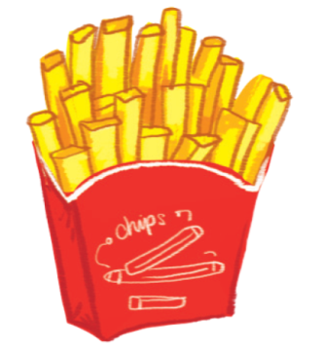

I like
chips

Slide 6
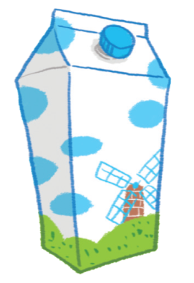

I like
milk

Slide 7
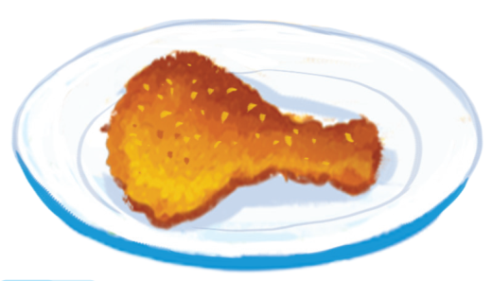

I like
chicken

Slide 8
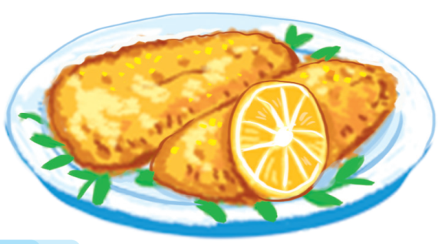

I like
fish

Slide 9

Let’s talk
Notes:
Goal:
Pupils will be able to talk about their favourite food/drinks, using I like _____.
Step 1: Point and say
Time limit: 3 mins
Pupils open to the Let’s talk! part.
Pupils point to the pictures and say, using the structure I like _____.

Slide 10
1
2
3
4
5
6
7
8
9
10
11
12
Notes:
Step 2: Practice
Time limit: 8 mins
Game: Lucky number
Teacher shows the game slides and instructions.
Pupils pick a number and say, using the structure I like ______. If pupils pick the lucky number, their team will have 3 stars.

Slide 11
I like chips.

Slide 12
I like milk.

Slide 13
I like chicken.

Slide 14
I like fish.

Slide 18
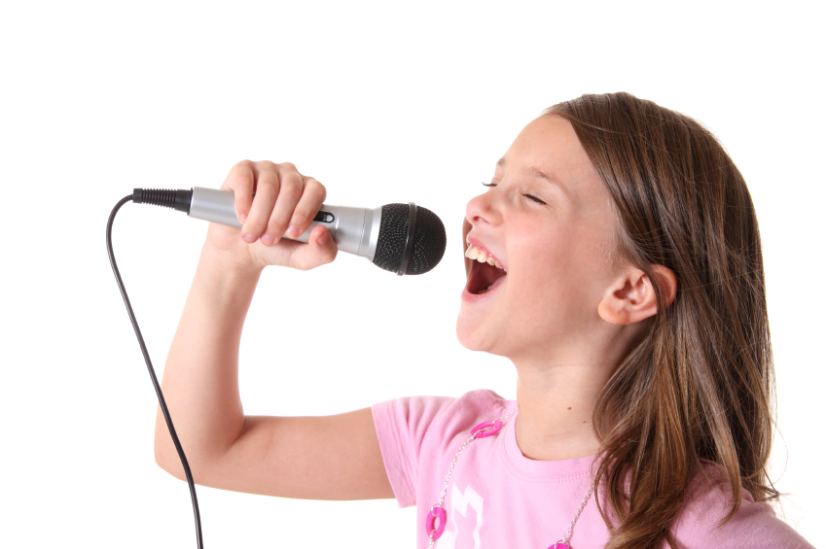


Let’s sing
Notes:
Goal:
- Pupils will be able to sing a song, using the structure “I like ________.”
Step 1: Getting to know the song
Time limit: 4 mins
Teacher and pupils read the song lyrics together.
Teacher plays the audio.
1st time: Pupils only listen
2nd time: Pupils listen and sing.
Step 2: Sing and do
Time limit: 5 mins
Teacher plays the audio, shows pupils some actions to do when singing the song.
Step 3: Quick check
Time limit: 4 mins
Pupils sings and do in teams. Better team gets more stars.

Slide 19
Further activity
Notes:
Goal: Pupils are able to use the structure and vocabulary to write new lyrics for the song.
Teacher divides pupils into small teams (4-5 pupils/ team)
Pupils create new lyrics for the song using words and structure I like_____.
Teacher may have pupils perform the new song.

Slide 20
Goodbye
Notes:
Teacher shows the vocabulary of the lesson on slide.
Pupils say goodbye.

Slide 21
Goodbye

Slide 22
Goodbye

Slide 23
Goodbye

Slide 24
Website: hoclieu.vn
Fanpage: facebook.com/www.tienganhglobalsuccess.vn

