Slide 2

Unit 7 – Lesson 2 In the garden
Notes:
Goals: By the end of the lesson, pupils will be able to:
say the sound of the letter G/g and the words garden, gate, girl, and goat in a chant.
listen, recognize the words and tick the correct boxes.
trace the letter G/g (upper case and lower case).

Slide 3

Warm-up
Notes:
Goals:
- Help pupils feel happy at the beginning of the lesson.
- Review vocabulary of previous lesson
Time limit: 5 mins
- Teacher writes letters “i”, “e”, “g” in big circles on the floor.
- Teacher says a words, pupils jump into the correct circle.

Slide 4


Listen and chant
Notes:
Goal:
- Pupils will be able to say the sound of the letter G/g and the words garden, gate, girl, and goat in a chant.

Slide 5

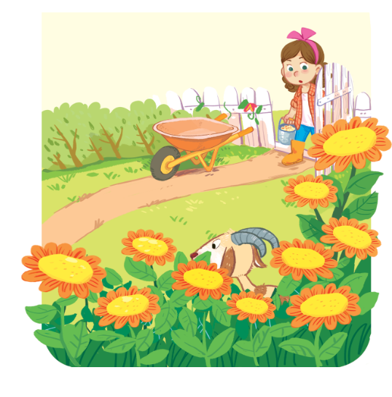
Listen and chant
G, g, goat.
G, g, gate.
A goat and a gate.
G, g, girl.
G, g, garden.
A girl and a garden.
Notes:
Step 1: Read. Listen and repeat the chant.
Time limit: 4 mins
- Teacher shows the chant on slide. Whole class read together.
- Teacher plays the audio. pupils listen through, then listen and repeat.
- Pupils then chant and clap along.
- Pupils chant in teams.
Step 2: Pupils chant and do actions.
Time limit: 4 mins
- Teacher shows pupils how to do actions to describe the vocabulary.
- Pupils do the actions as teams. Then pupils chant and do the actions along.
Example:
g (clap), g(clap), goat (action)
g (clap), g (clap), gate (action)
A goat (action) and a gate (action)
Step 3: Quick check
Time limit: 4 mins
Pupils chant as teams and individually.

Slide 6

Listen and tick
Notes:
Goal:
- Pupils will be able to listen, recognize the words and tick the correct boxes.
Step 1: Listen and tick the correct picture.
Time limit: 5 mins
- Teacher says Listen and tick and writes words on the board.
- Teacher says and does actions: Listen (put hands on one ear) and tick (write a tick in the air). Pupils follow.
- Teacher plays audio. Pupils do the tasks.
- When pupils finish, teacher plays the audio again, pause at each question and checks answer.
Step 2: Quick check
Time limit: 3 mins
- Teacher says a word, pupils go to the board and touch the correct picture.

Slide 7
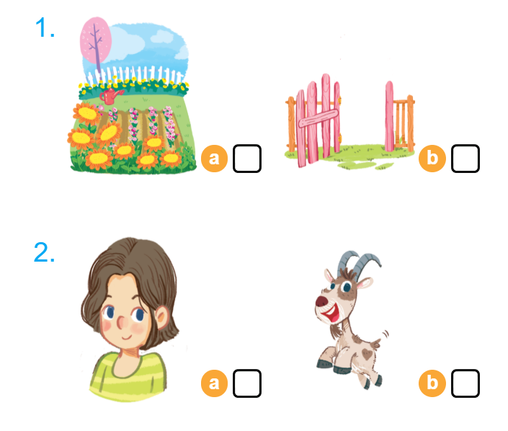

Listen and tick

Slide 8


Look and trace
Notes:
Goal:
- Pupils will be able to trace the letter G/g (upper case and lower case).
Step 1: Ss write letter in the air
Time limit: 3 mins
- Teacher and pupils write letter “i” in the air. (Teacher can make it fast or slowly)
Step 2: Look and trace
Time limit: 4 mins
- Teacher writes letter on the board.
- Pupils look and trace in their books.

Slide 9
GAME
Notes:
Goals:
- Pupils are able to write letter “g”.
- Pupils are able to identify words that have the sound /g/.
Time limit: 6 mins
- Teacher says a word. If it has the sound /g/, pupils write letter “g” on the board. If not, pupils don’t write.
- Teacher may have some pupils says the word.

Slide 10
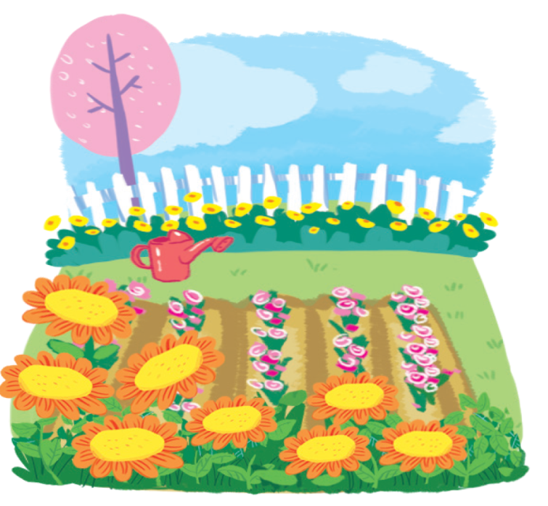
Goodbye
Notes:
- Teacher shows the vocabulary of the lesson on slide.
- Pupils say goodbye.

Slide 11
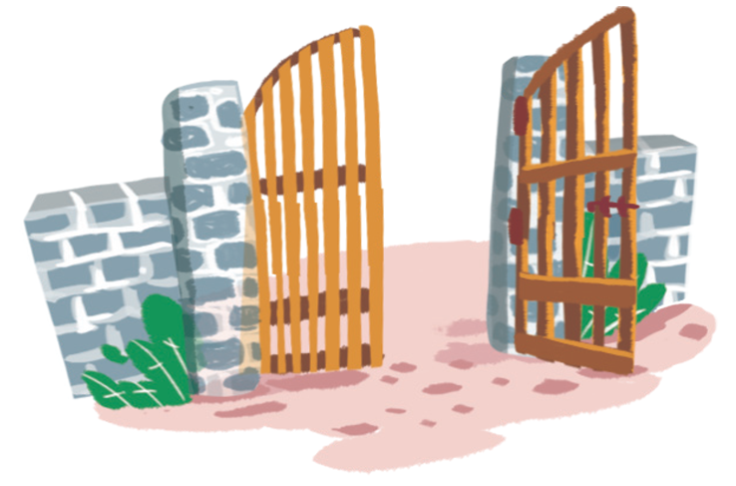
Goodbye

Slide 12
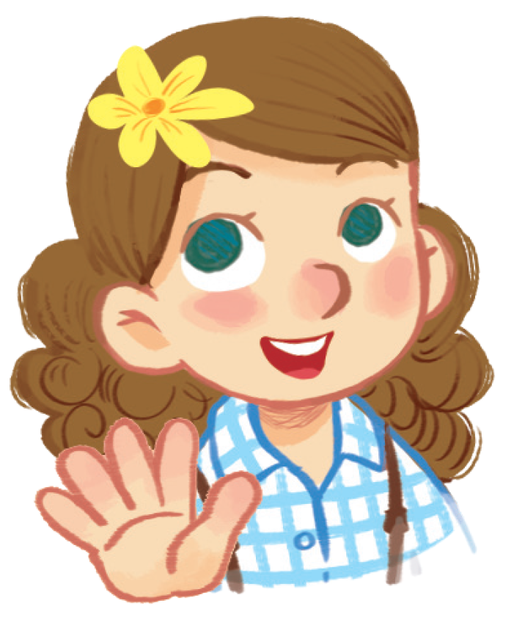
Goodbye

Slide 13
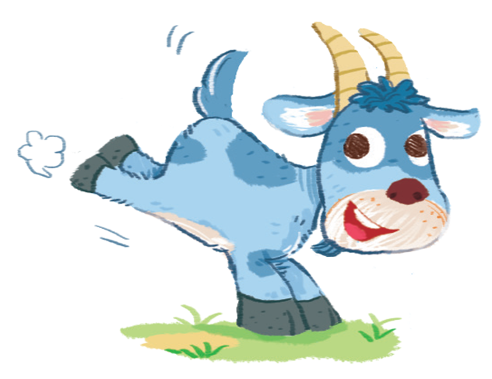
Goodbye

Slide 14
Website: hoclieu.vn
Fanpage: facebook.com/www.tienganhglobalsuccess.vn

