Slide 2
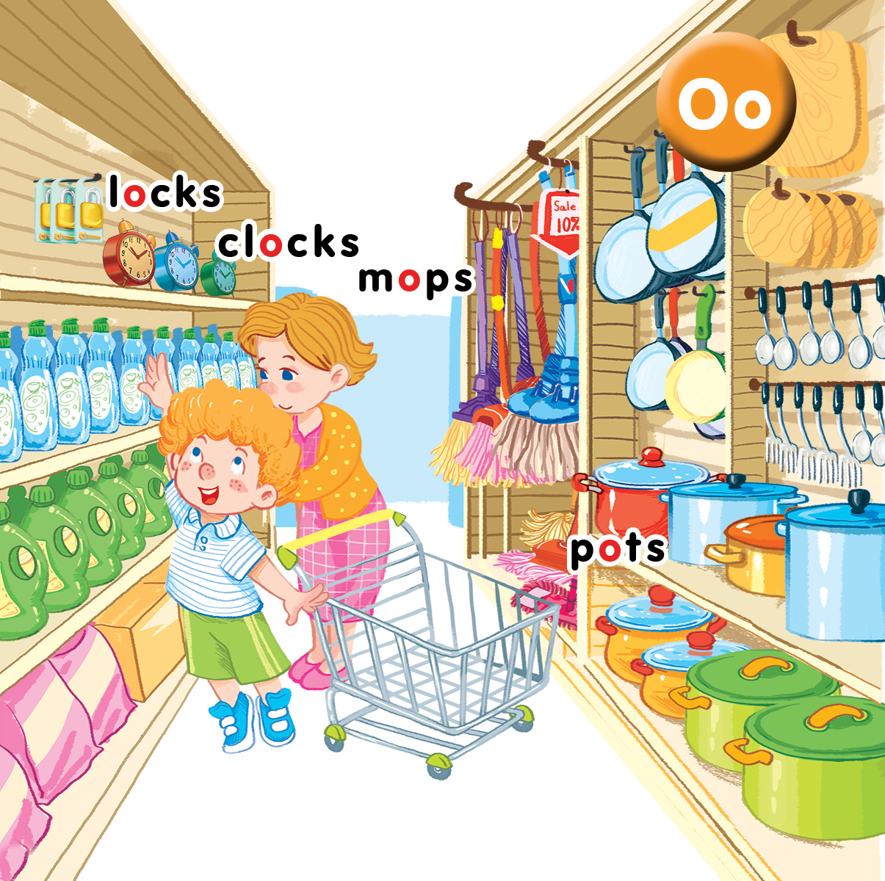
Unit 9
In the shop
Lesson 1
Notes:
Goals:
By the end of the unit, pupils will be able to:
pronounce the sound of the letter O/o in isolation and in the words clocks, locks, mops and pots correctly.
say the sound of the letter O/o and the words clocks, mops, pots, locks in a chant.
recognize the words in different situations when listening.
Use the exchange “How many_____?” – “_____” to ask and answer questions about the quantity of things (from two to five).
trace the letter O/o and complete the words m_ps, p_ts, l_cks, cl_cks.
sing a song focusing on structure “There are_____.”
Lesson 1
By the end of the lesson, pupils will be able to:
pronounce the sound of the letter O/o in isolation and in the words clocks, locks, pots, mops.
listen and recognize the words clocks, locks, pots, mops.
recognize and say the words

Slide 3

Warm-up
Notes:
Goal: Warm up the class and have pupils revise the language in the previous lesson.
Time: 3 minutes
Have pupils look at the picture parts and guess the words.
Ask What is it? Students answer the words.

Slide 4


Slide 6
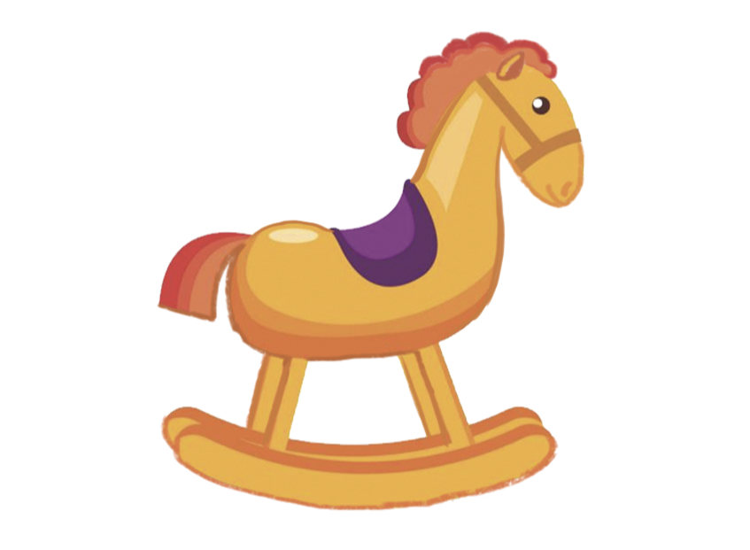

Slide 8


Slide 10


Slide 12



Notes:
Listen and Repeat is divided into 4 steps.
Step 1
Goal: Listen and repeat the sound of letter o and introduce the context.
Time: 3 minutes
Say Open your book! with a TPR action. Have pupils open the book, Unit 9, In the shop. Teacher opens the digital book.
Teacher sticks the card with letter “o” and say the sound.
Play the recording and have pupils listen and repeat.
Says: Today we are going to learn 4 words that have the sound /o/.
Introduce the context of the picture having 4 words.

Slide 13

o

Slide 14
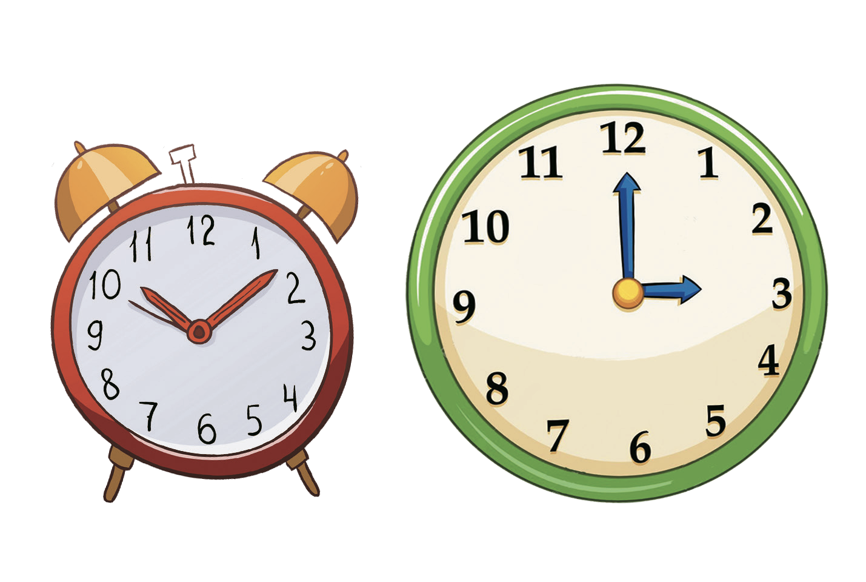

clocks
locks
Notes:
Step 2
Goal:
- Pupils will be able to listen and repeat the unit key words locks and clocks.
- Recognize and say the words with flashcards.
Time: 3 minutes
Introduce the unit keywords clocks and locks with flashcards.
On the board, the flashcard for clocks is above the flashcard for locks.
Teacher points to the clocks, says the word and has pupils repeat the word. Do the TPR action.
Do the same with locks .
Have pupils guess the word and repeat by pointing to clocks and locks. Hold your hand up or down to the position of the flashcard.
Turn over the cards, have pupils guess the card and say the word out loud.
Swap the cards and have pupils guess.

Slide 15

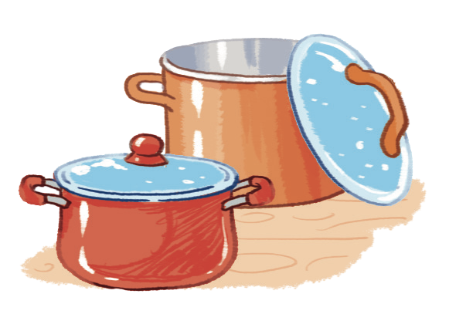
mops
pots
Notes:
Step 3
Goal:
- Pupils will be able to listen and repeat the Unit keywords mops and pots.
- Recognize and say the words with flashcards.
Time 3 minutes.
Do the same procedures with step 2

Slide 16
clocks
mops
locks
pots
Notes:
Step 4
Goals: Pupils will practice more the new words and revise the sound o.
Time: 5 minutes
Play the game Slap the board with all four 4 flashcards for clocks, locks, mops and pots.
Revise the sound o, point to the letter of each word and say. Have pupils listen and repeat.

Slide 17



Notes:
Point and say is divided into 3 main steps.
Step 1
Goal: Pupils will be able to listen and repeat the words.
Time: 3 minutes
Have pupils listen, point and repeat / say the words.
Choose a picture on the digital book, click on the picture and have pupils listen and repeat.
Have pupils repeat the word softly, loudly in groups to motivate them.
Step 2.
Goal: Pupils will be able to listen and point to the pictures.
Time: 4 minutes
Have pupils listen and point to the pictures in the book.
Hold up your index finger, demonstrate the action for Point.
Say Listen and point with the TRP actions.
Say clocks then point to the clocks for demonstration.
Say other words and have pupils point to them.
Vary the speed to make the activity fun.
Step 3
Goal: Pupils will be able to point and say.
Time: 4 minutes
Say locks, have pupils point to the locks and say locks.
Do the same with different groups
Have pupils work in pairs, 1 points and 1 says the word and does the TPR.

Slide 18

Game
Notes:
Goal: Pupils will be able to produce the unit words.
Time: 5 minutes
Who is faster game
Divide class into 4 teams.
Show the slides.
Have pupils take turn to say the word from the 1st to the last pupil.
Have pupils in the team say the word in chorus when all members have finished.
The quicker the winner.

Slide 23
Goodbye
locks
Notes:
Goodbye
Time: 2 minutes
Teacher and pupils say goodbye to the words.

Slide 24

Goodbye
clocks

Slide 25
Goodbye
mops

Slide 26
Goodbye
pots

Slide 27
Website: hoclieu.vn
Fanpage: facebook.com/www.tienganhglobalsuccess.vn

