Slide 2
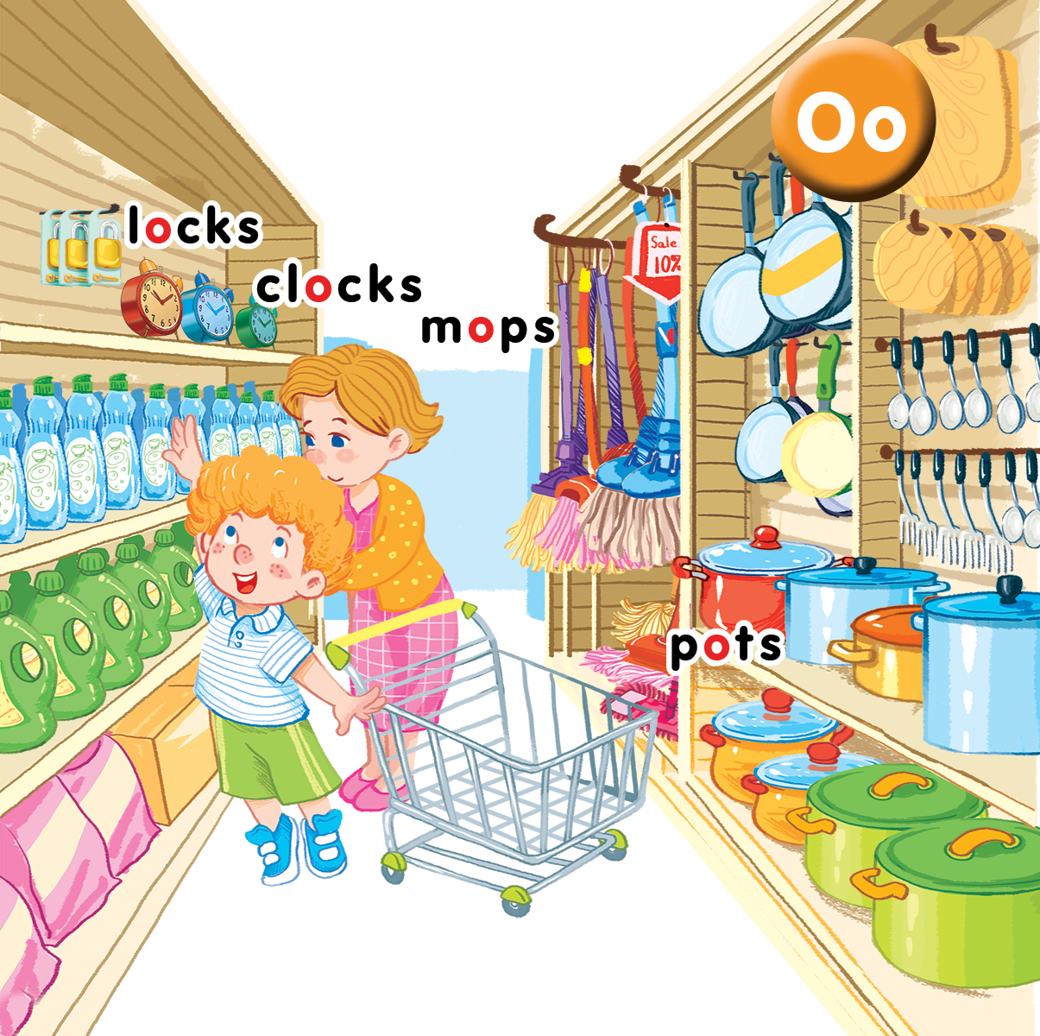
Unit 9
In the shop
Lesson 2
Notes:
Lesson 2
By the end of the lesson, pupils will be able to:
- say the sound of the letter O/o, the words clocks, locks, mops, pots and the structure There are____ in a chant.
- listen, recognize the words and tick the correct boxes.
- trace the letter O/o and complete the words m_ps, cl_cks, l_cks, p_ts.

Slide 3

Warm-up
Notes:
Miming
Goal: Warm up and revise the Unit keywords.
Time: 5 minutes
Show the flashcard for clocks to a pupil.
The pupil does the TPR action for the word. Have other pupils guess the word.
After guessing the word, have the whole class repeat the word in chorus.
Do the same with other words.

Slide 4


Listen and chant
Notes:
Listen and chant is divided into 3 steps.

Slide 5

Listen and chant
O, o, locks and clocks.
There are two locks.
There are three clocks.
O, o, mops and pots.
There are four mops.
There are five pots.
Notes:
Step 1
Goal: Pupils will be able to read the chant lyrics.
Time: 3 minutes.
Have pupils read the chant lyrics in chorus, then in group.
Step 2
Goal: Pupils will be able to listen, chant and clap along.
Time: 3 minutes
Play the recording, have pupils listen and clap along.
Play the recording, have pupils listen, clap and chant along
+ Round 1. Have pupils listen and clap along.
+ Round 2. Have pupils listen and do the TPR actions with teacher.
+ Round 3. Have pupils listen and do the actions and chant along.
+ Repeat round 3 several times.
Step 3
Goal: Pupils will be able to chant and clap along in pairs.
Time: 3 minutes
Have pupils chant along in pairs.

Slide 6

Listen and tick
Notes:
Listen and tick is divided into 2 steps.

Slide 7
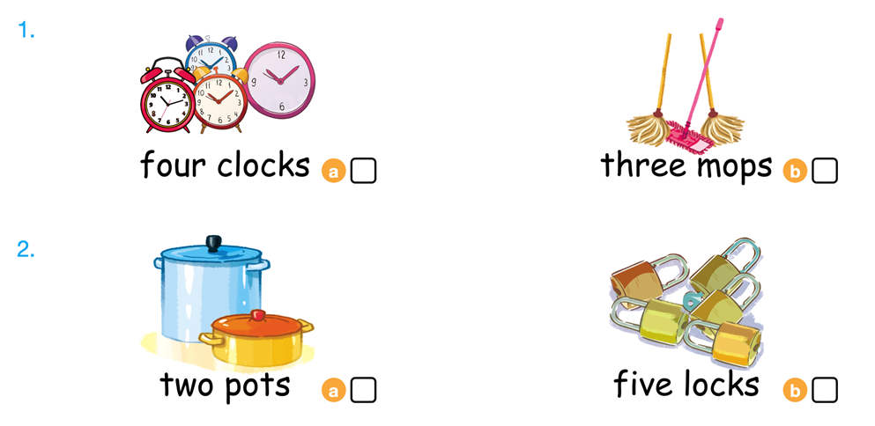

Listen and tick
Notes:
Step 1
Goal: Pupils will be able to listen and choose the correct pictures.
Time: 5 minutes
Say Listen and tick with the TPR actions.
Play the recording and demonstrate the example.
Play the recording and have pupils do the task.
Step 2
Goal: Check
Time: 3 minutes
Play the recording and have pupils say the answer.
Play the recording again and have pupils repeat then give correct answer.

Slide 8



Look, trace and write
Notes:
Goal: Pupils will be able to trace the letter.
Time: 5 minutes
Have pupils write the word by air tracing and say the word.
Demonstrate how to trace the word and have pupils do the task.

Slide 9
Game
Notes:
Goal: Revise the words and chant.
Time: 5 minutes
Charades
Have pupils play the game Charades in groups.
Pupils choose a flashcard and do action. The others will guess the word and chant.
For example:
Pupil 1: Choose the flashcard of pot then do TPR action
Other pupils say: Pot. O, o, pot

Slide 10

Goodbye
locks
Notes:
Goodbye
Time: 2 minutes
Teacher and pupils say goodbye to the words.

Slide 11
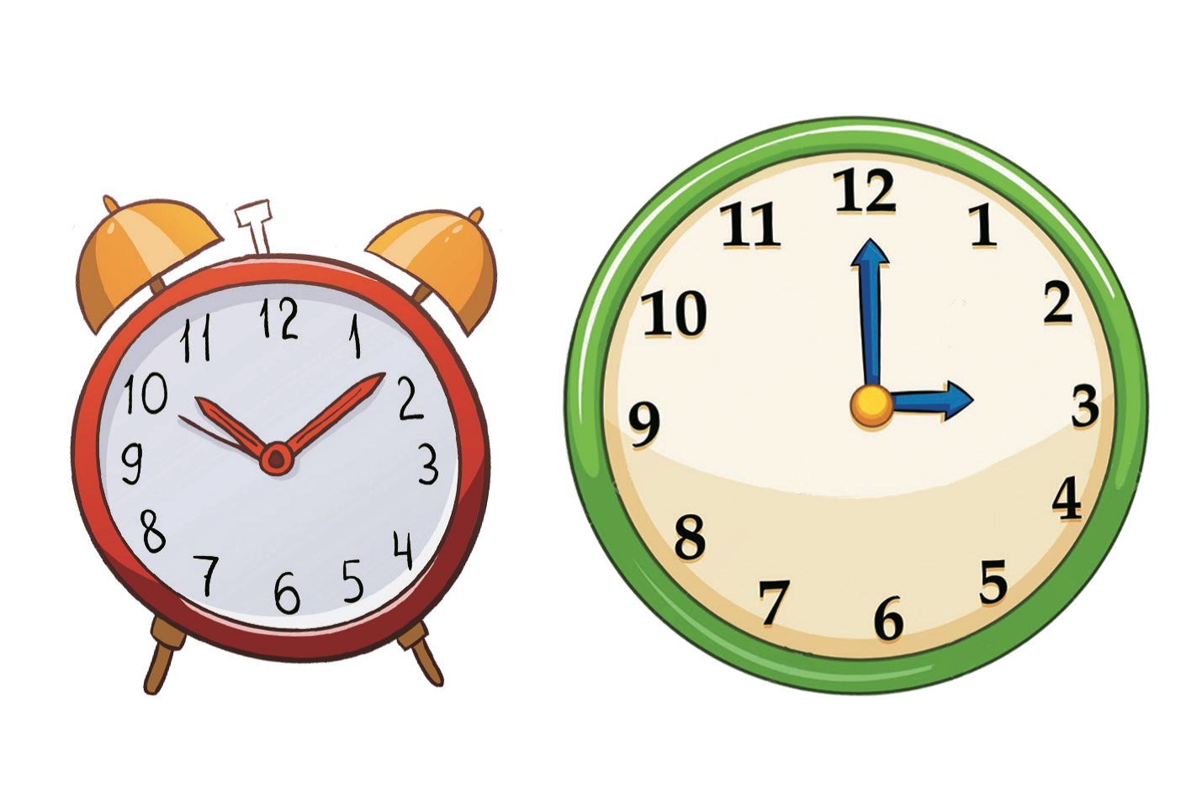
Goodbye
clocks

Slide 12

Goodbye
mops

Slide 13

Goodbye
pots

Slide 14
Website: hoclieu.vn
Fanpage: facebook.com/www.tienganhglobalsuccess.vn

