Slide 1









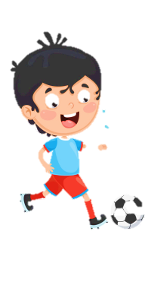

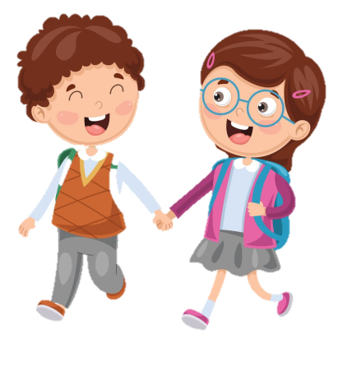



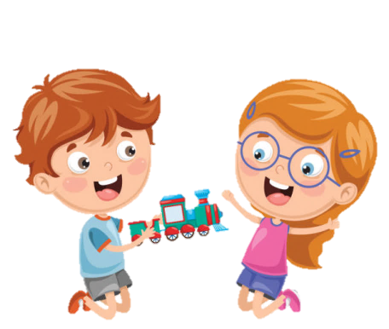






Slide 2






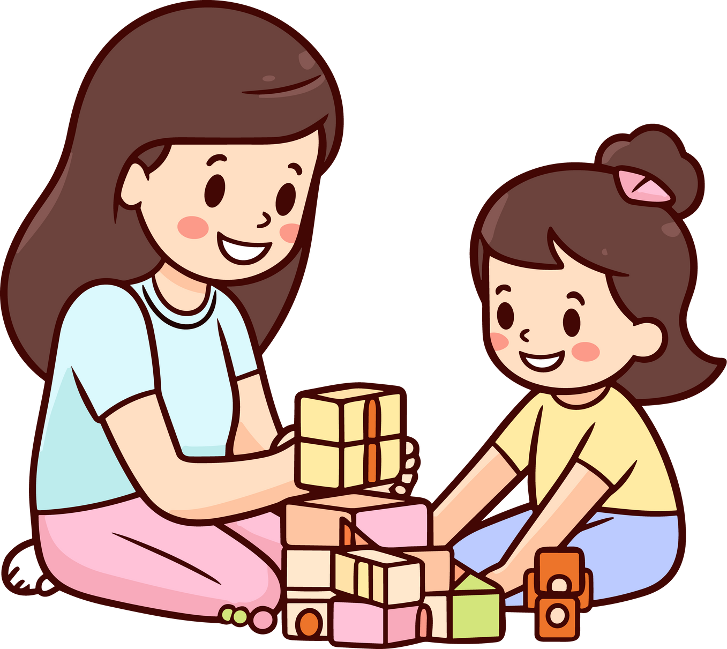

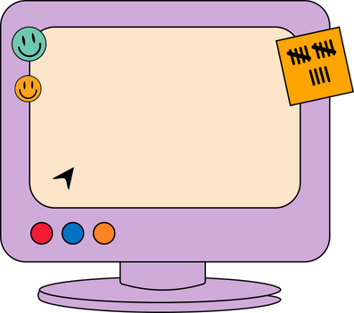
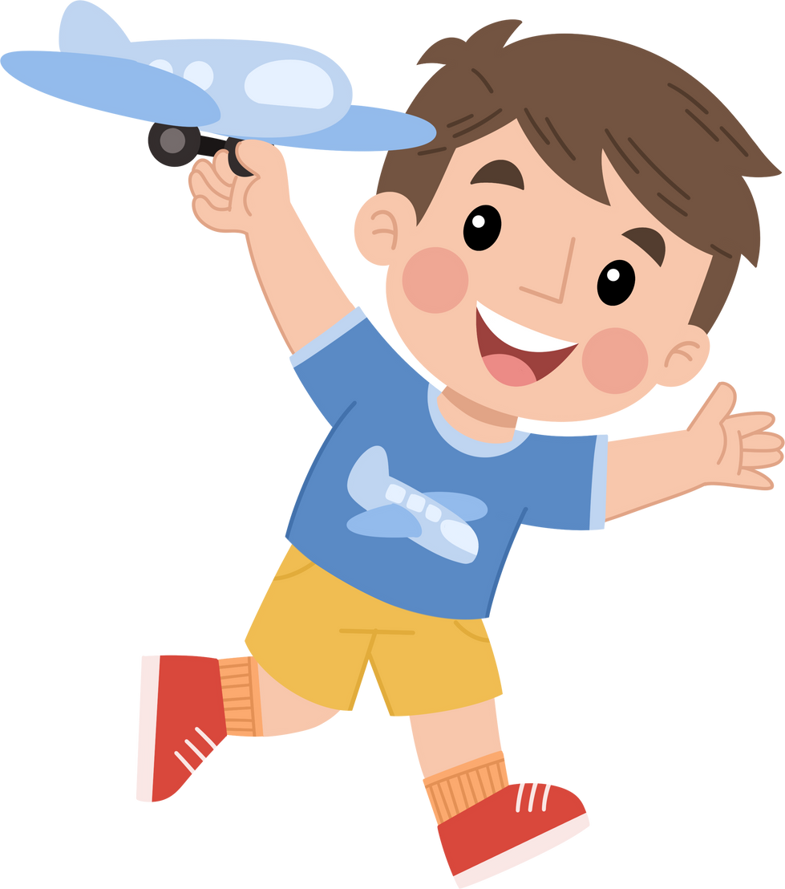

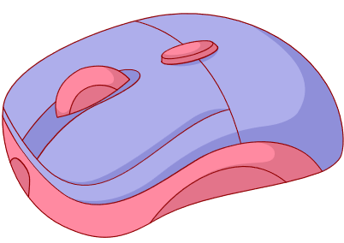
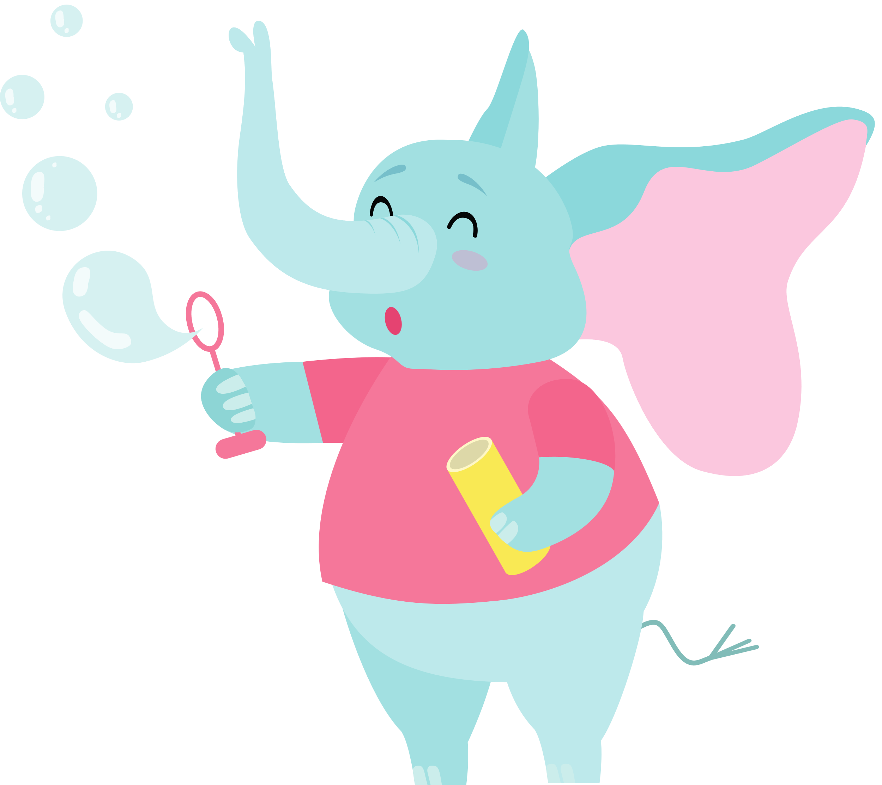



Unit 2
My Favourite things
Lesson 1 Part 1 2 3

Slide 3



Warm-up
1
What’s in the box ?

Slide 4
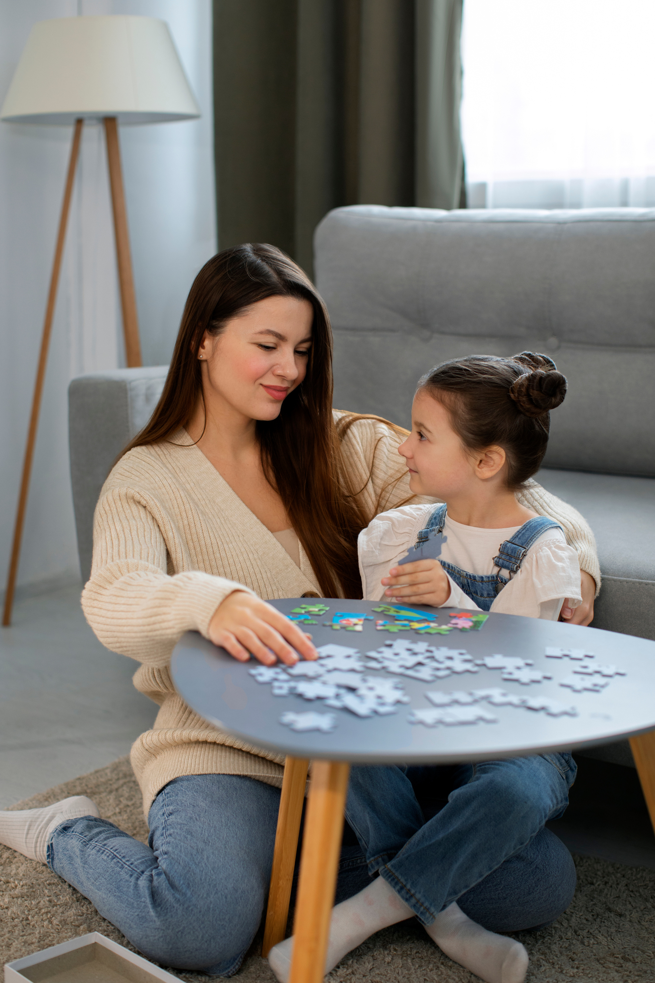






LOOK AT THE PICTURE.
WHAT DO YOU SEE? TICK.
puzzle
sofa
boy
kite
girl
blue
A child is doing a puzzle with her mother.

Slide 5









WHAT IS YOUR FAVOURITE TOY?
TELL YOUR FRIEND.

Slide 6
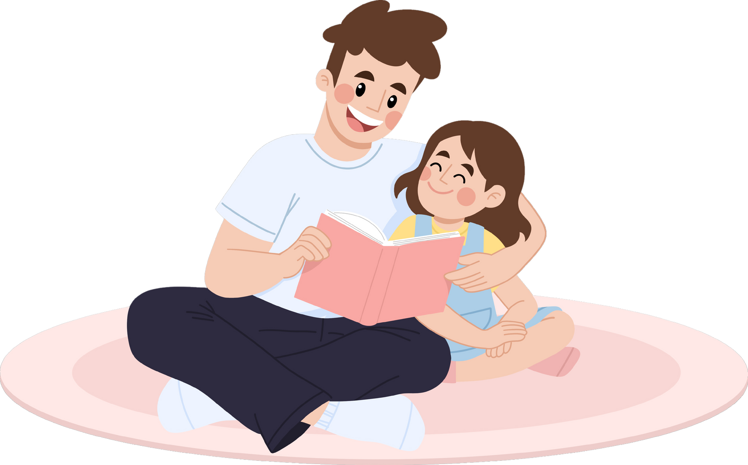


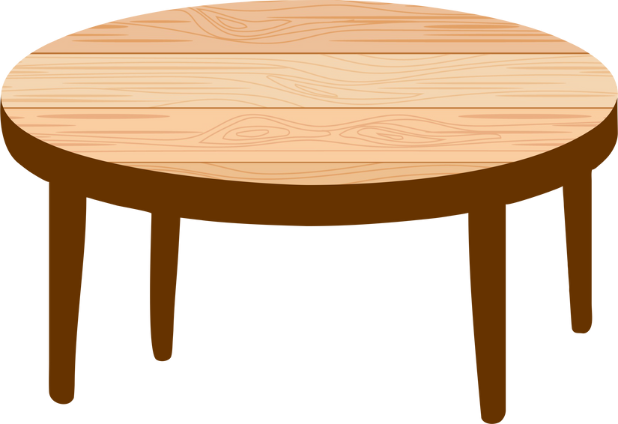

2
Presentation

Slide 7


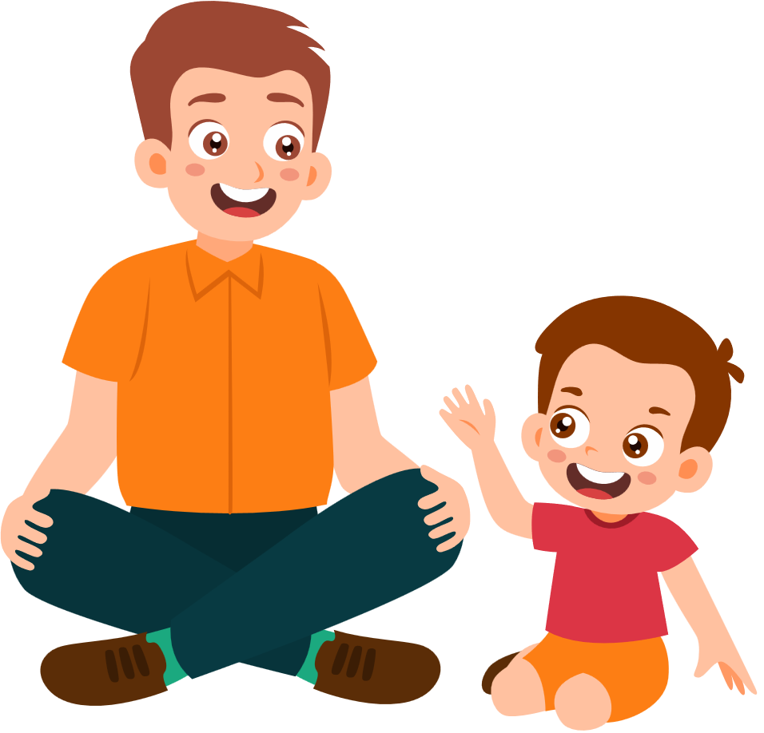


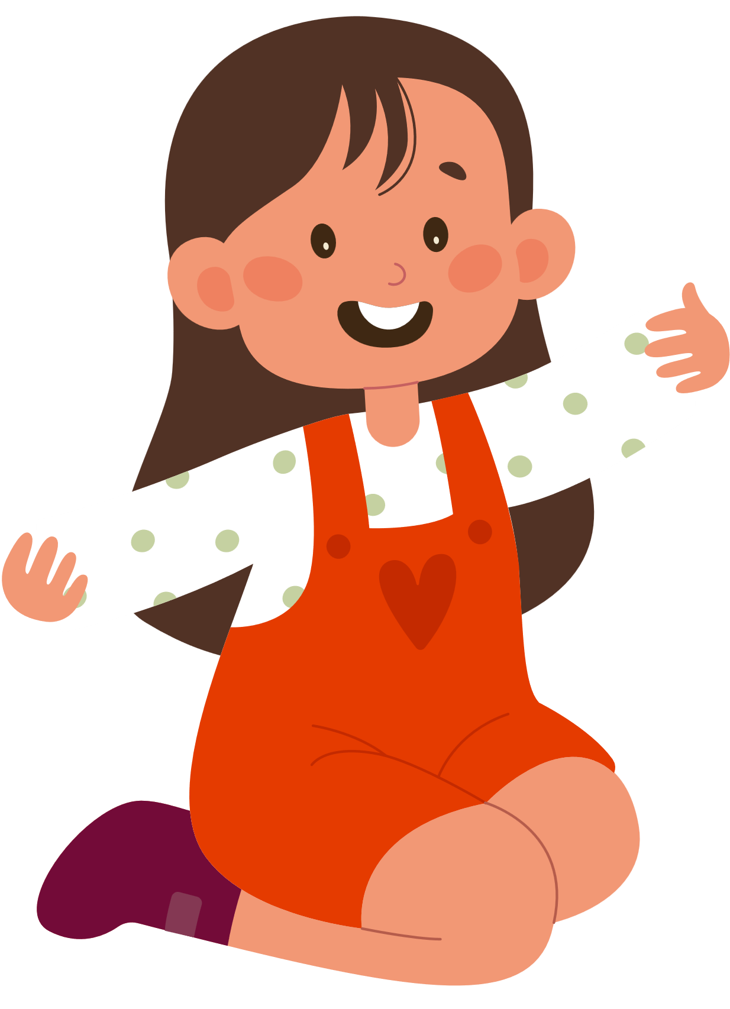




What’s Dad got in his box?
his b
A typewriter
A puzzle
some books

Slide 8





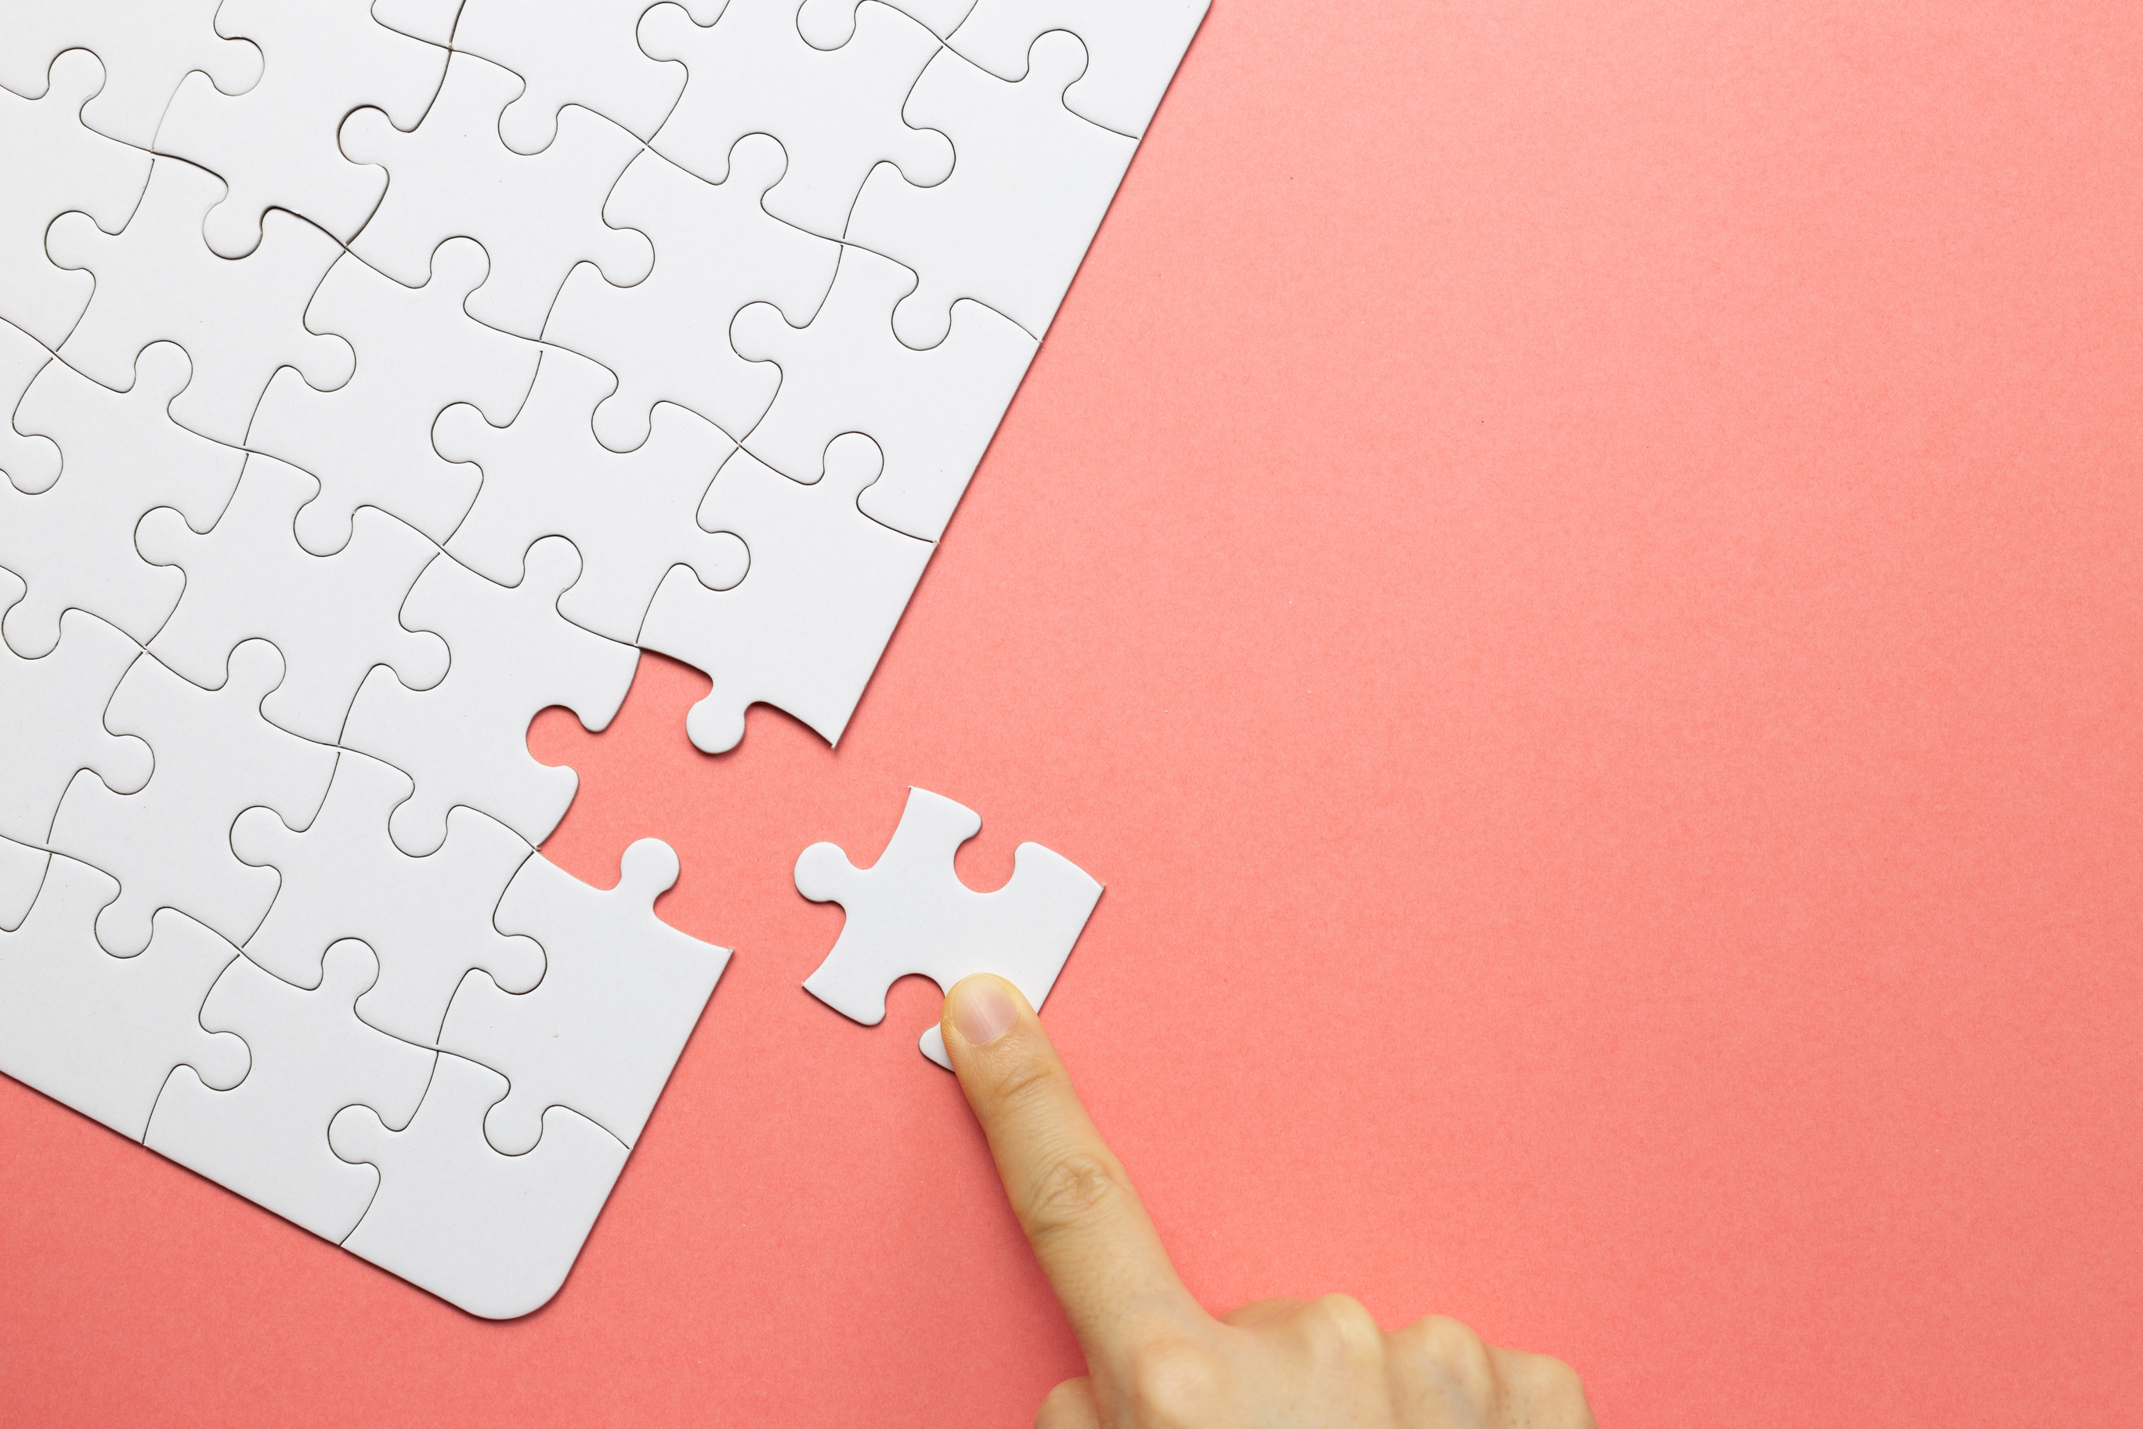

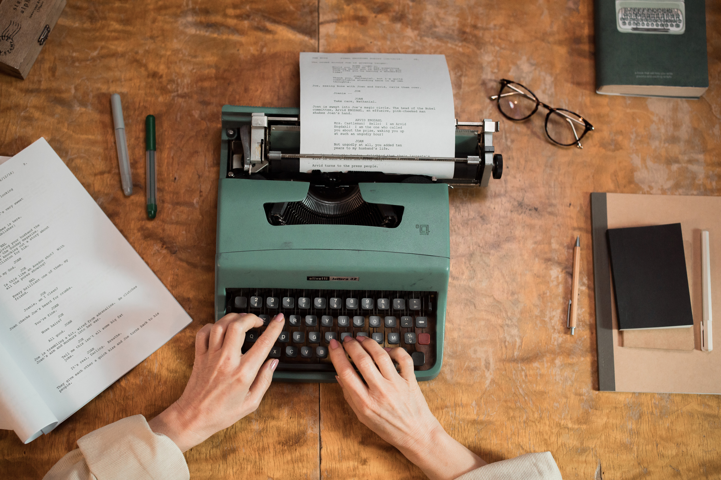
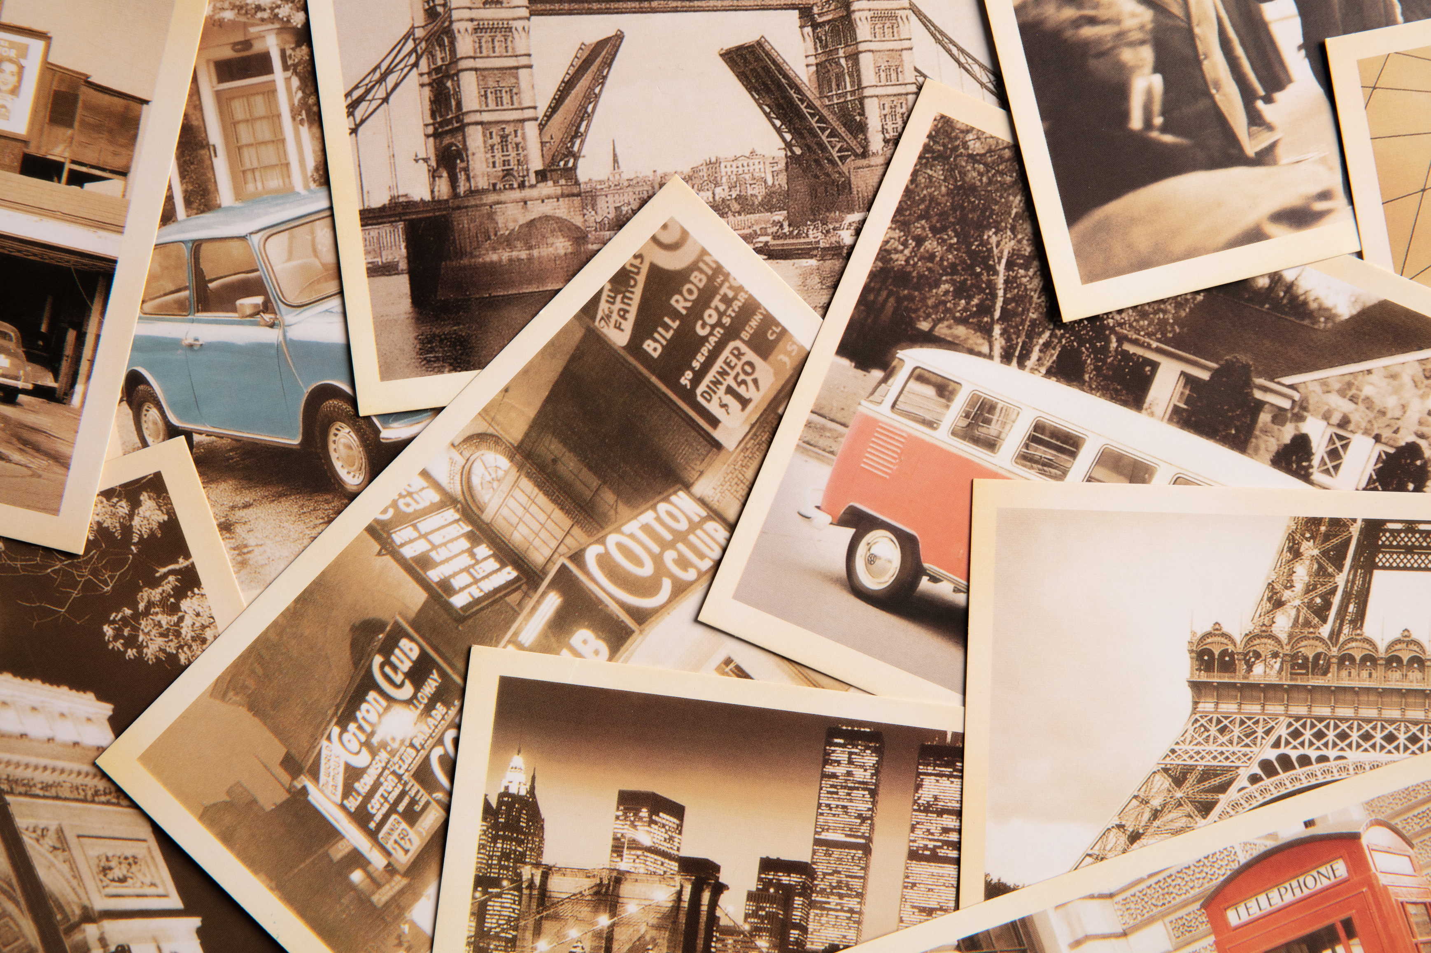
VOCABULARY
2 Listen, point and repeat
computer
piece
puzzle
typewriter
photo

Slide 9
3
Practice

Slide 10


When I was eight years old, my favourite thing was a puzzle.

Slide 11
4
Production

Slide 12
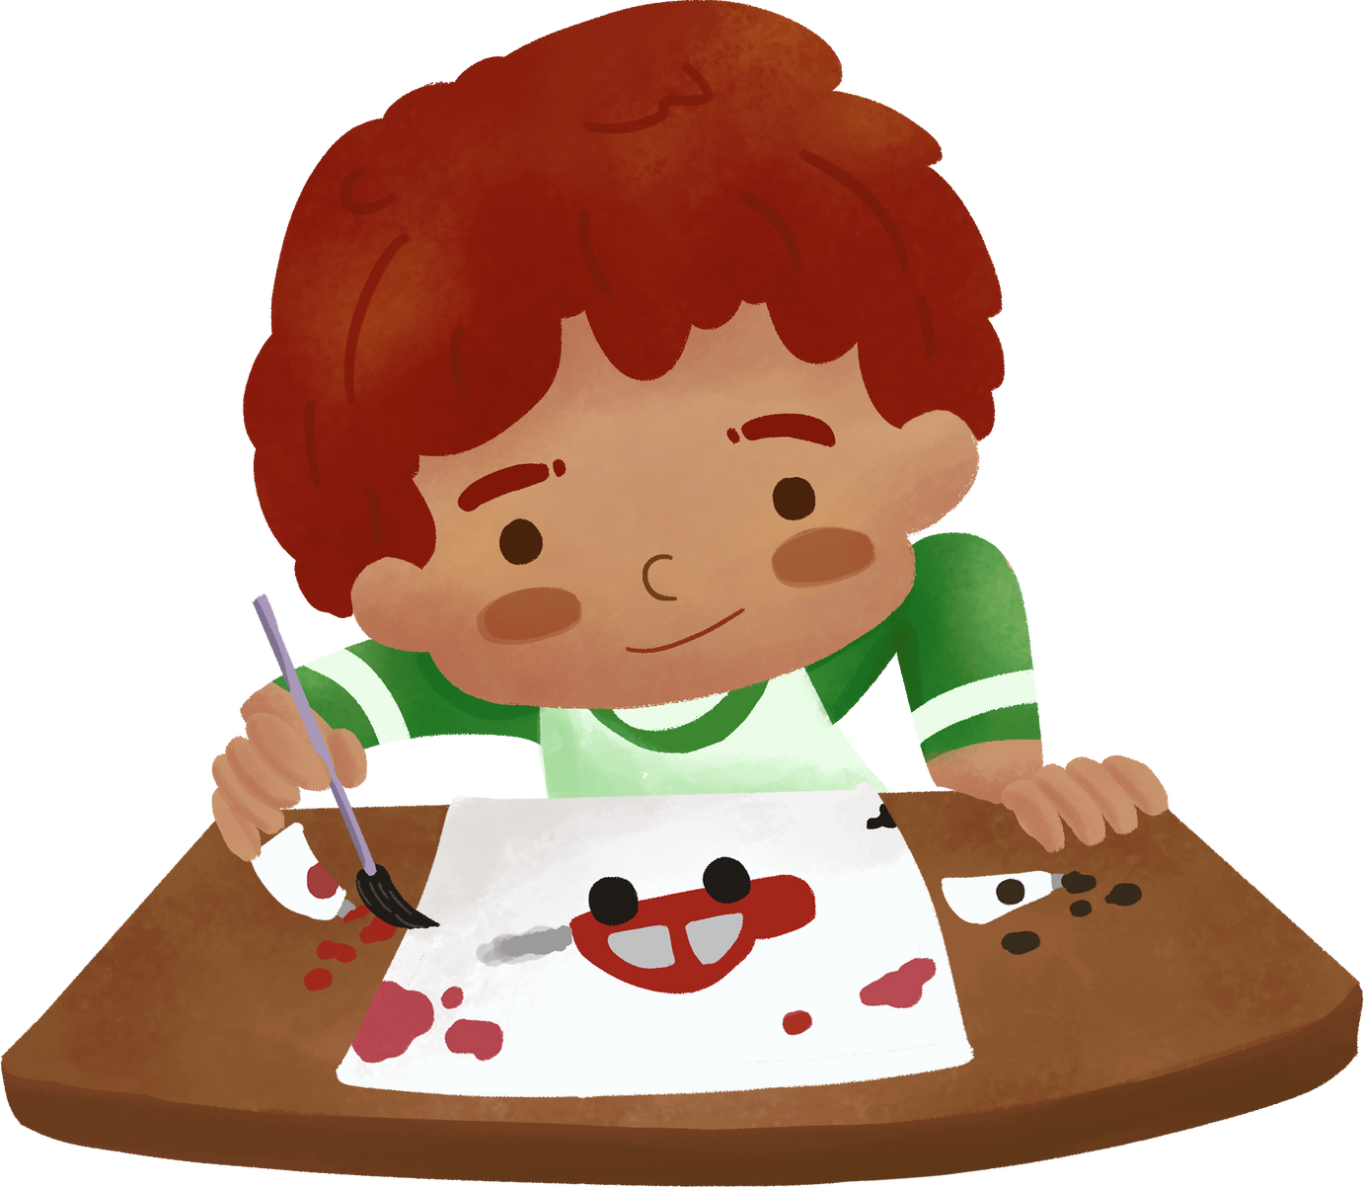
Draw your favourite thing when you were small . Then say.
When I was eight years old, my favourite thing was a ________.
car

Slide 13
5
Wrap-up & Assessment

Slide 14




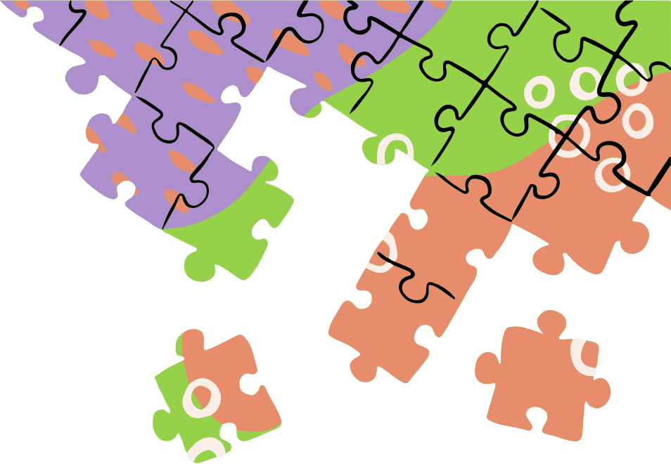



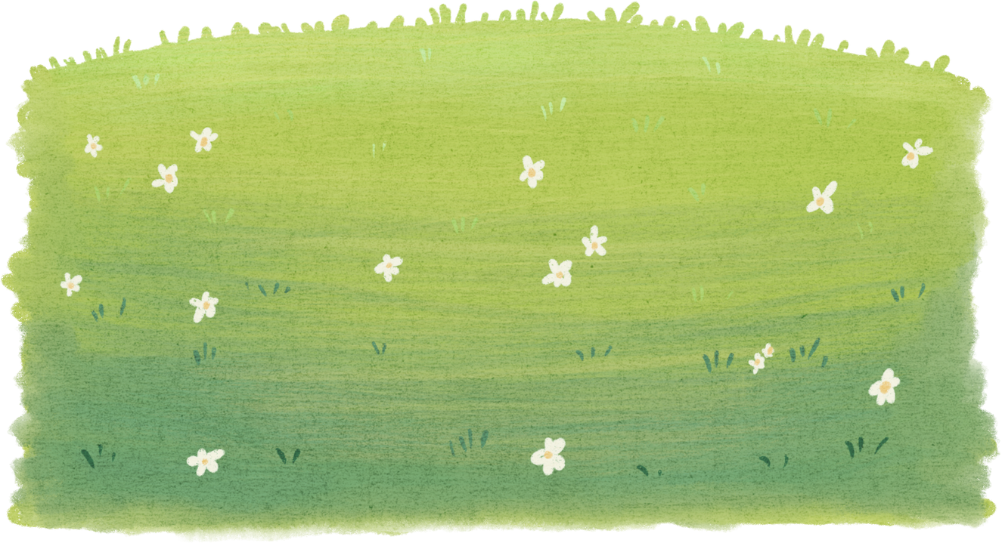
ASSESSMENT
Fill the missing letters
ph_to
w
o
type_riter
p
e
com_uter
pi_ce
pu__le
zz

Slide 15

Wrap-up
Vocabulary
puzzle, computer,
typewriter, photo, piece
Unit 2 : My Favourite Things
Lesson 1 – Part 1,2,3
What have we learnt today?
Structure
When I was ___ years old,
my favourite thing was___.

Slide 16

Thank you
for your attention

