Slide 1









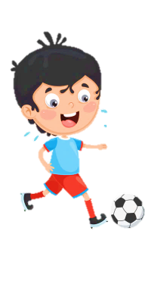













Slide 2
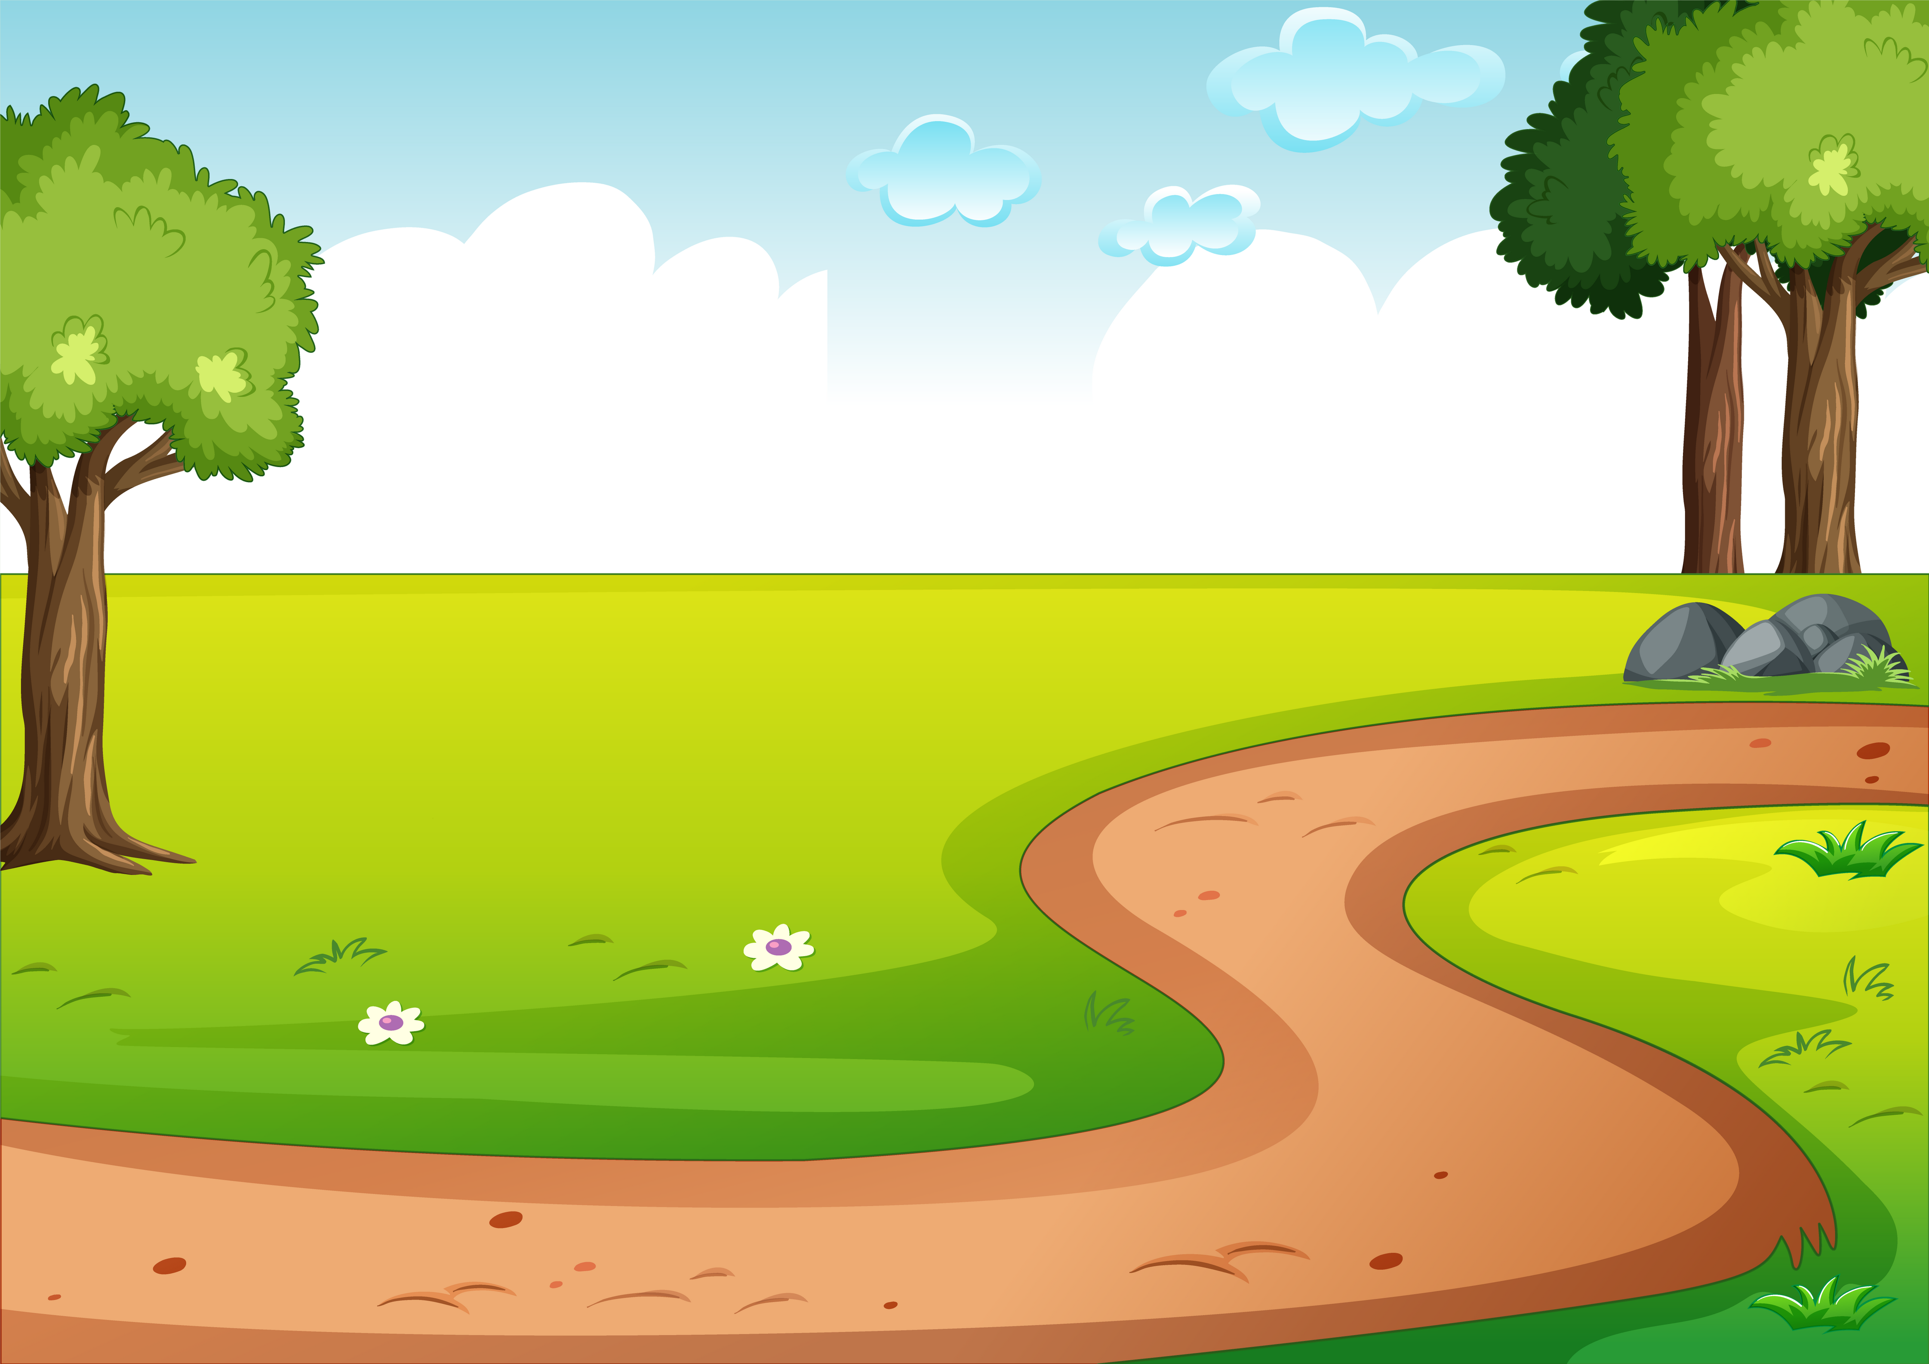

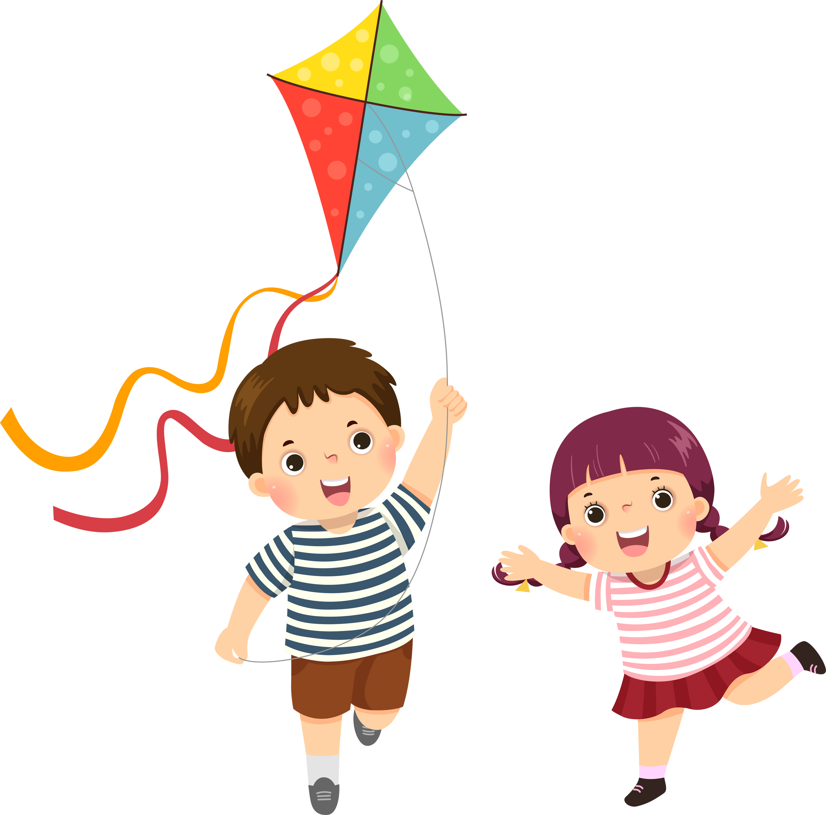

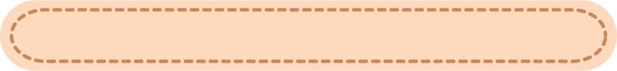
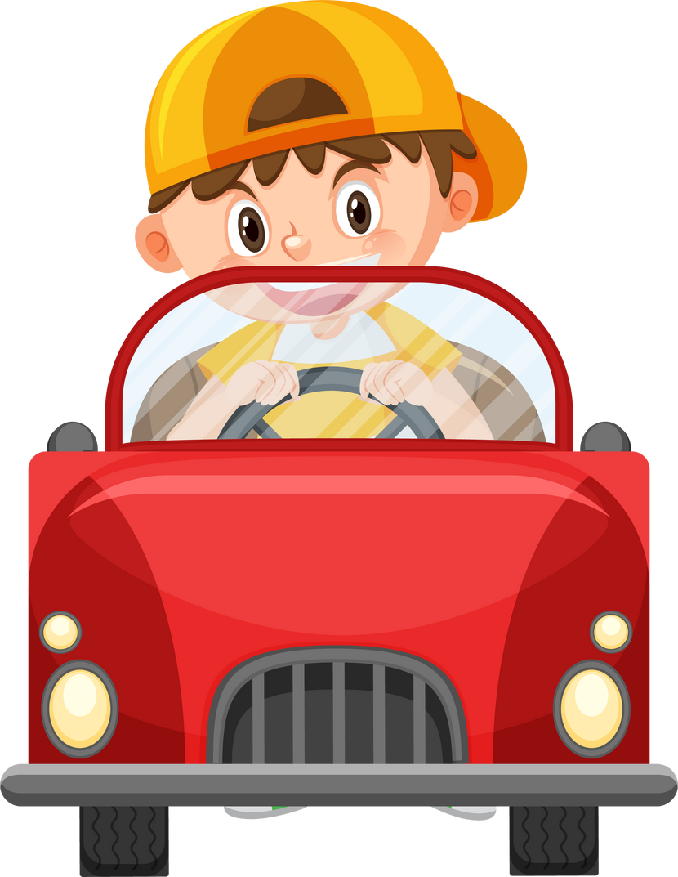

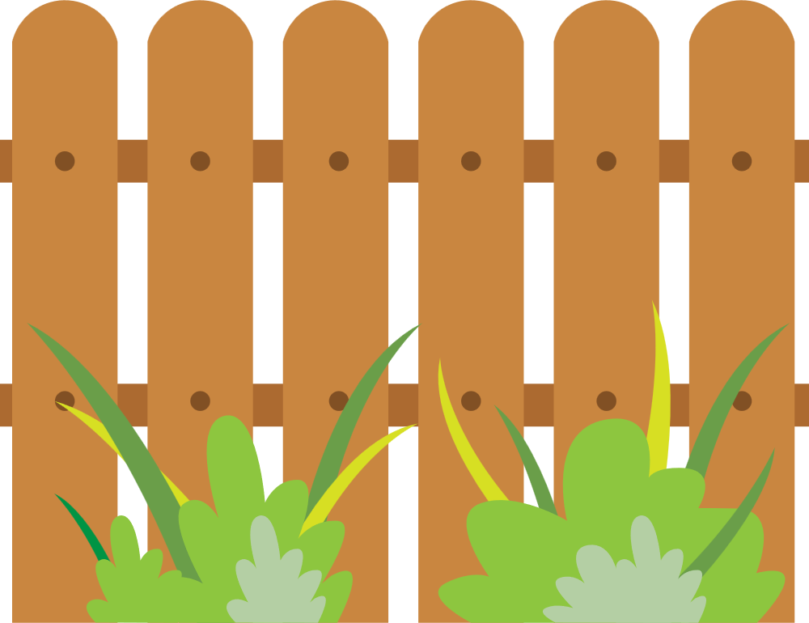


Unit 2
My Favourite Things
LESSON 1. TASK 4 5 6

Slide 3



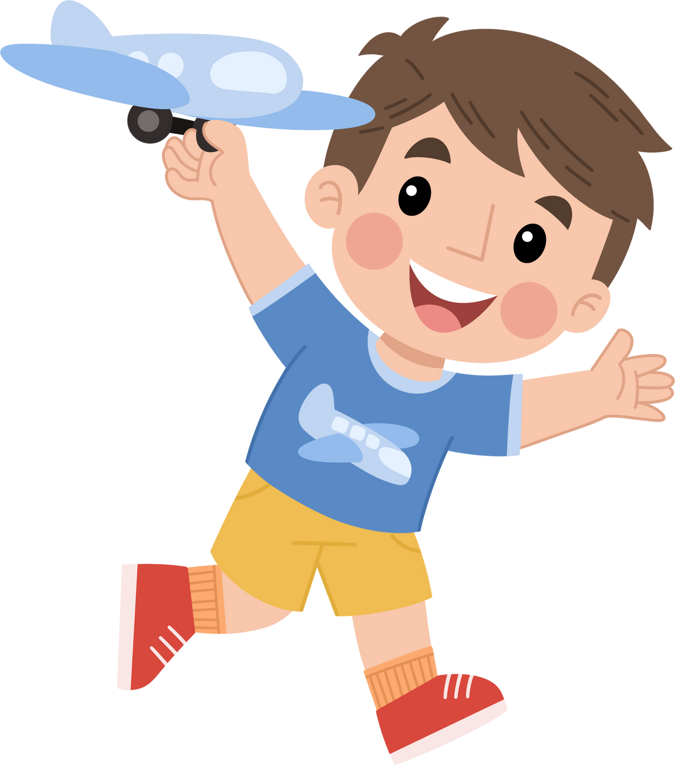
Table of contents
01
01
Warm Up
Warm Up
02
02
Presentation
Presentation
03
03
Practice
Practice
04
04
Production
05
Wrap-up & Assessment

Slide 4



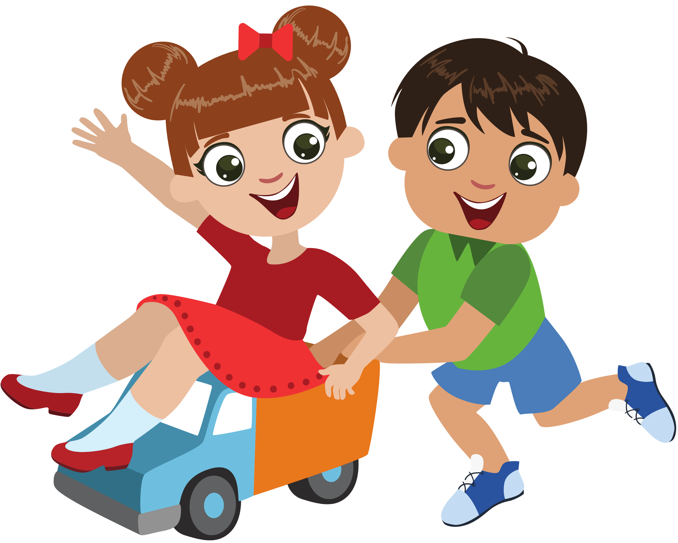
1
Warm Up

Slide 5

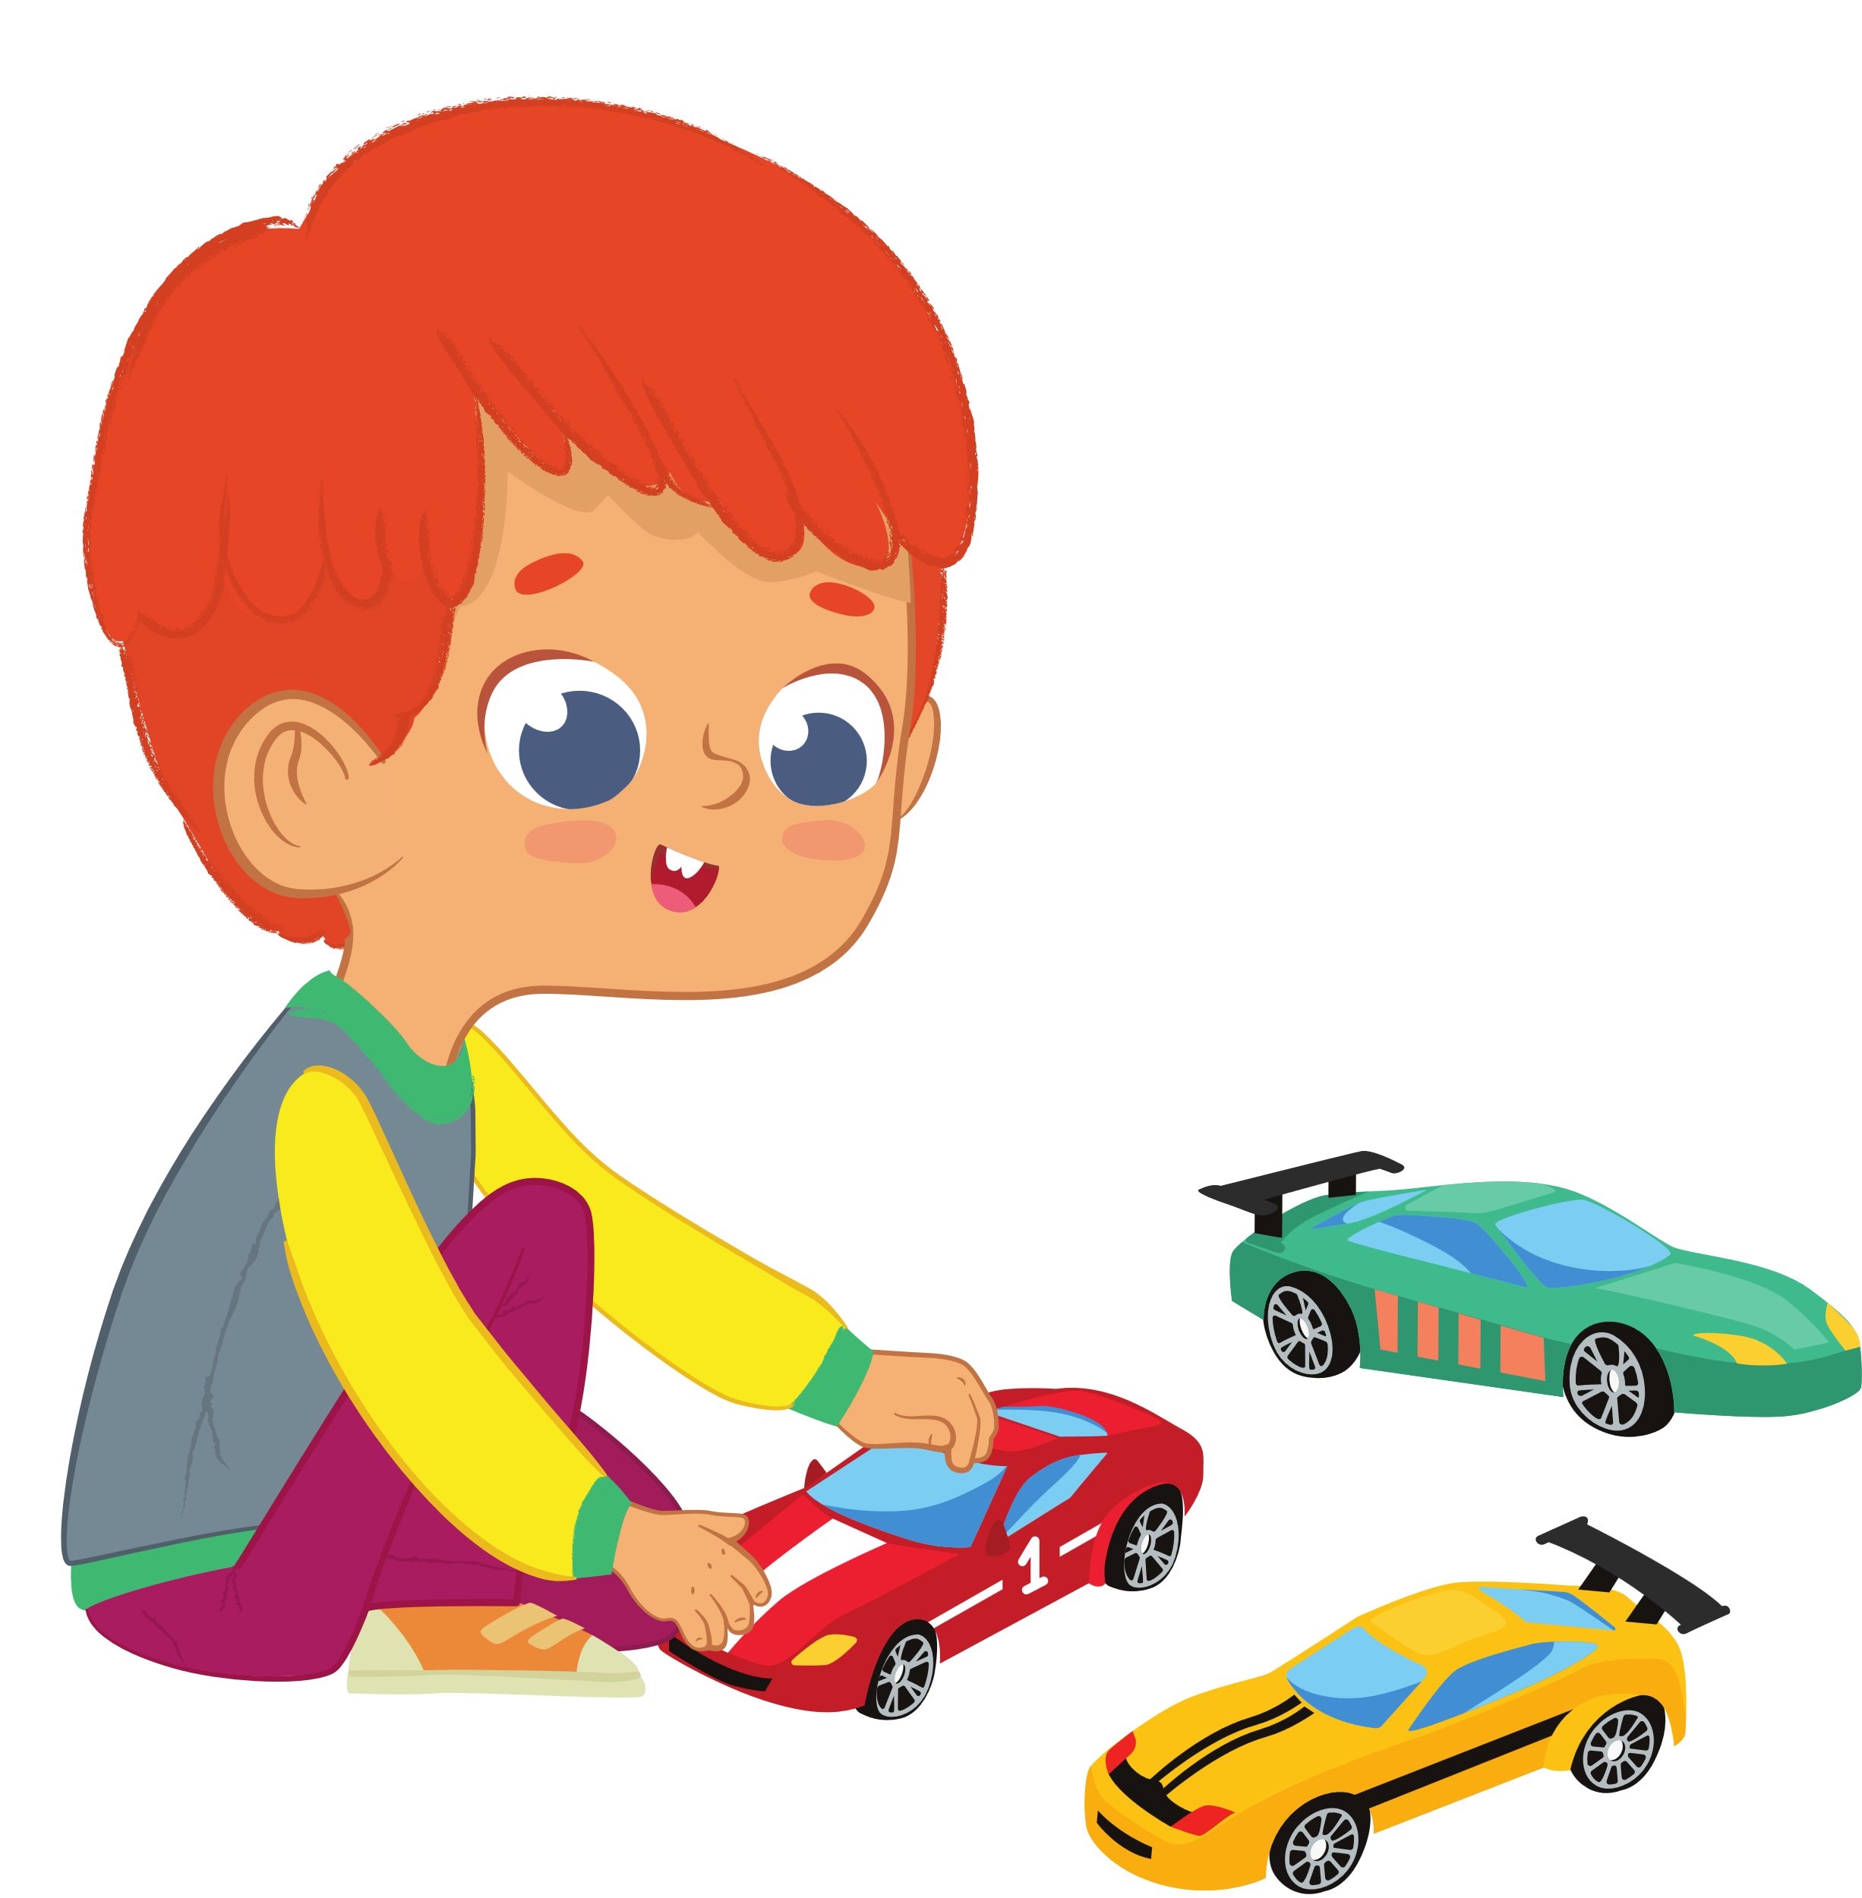
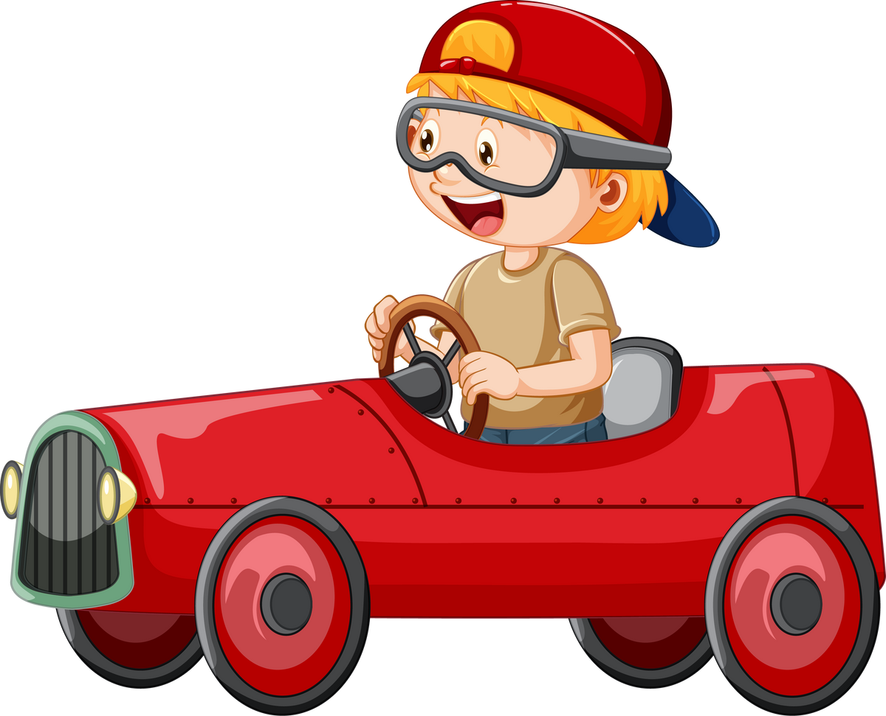
2
Presentation

Slide 6




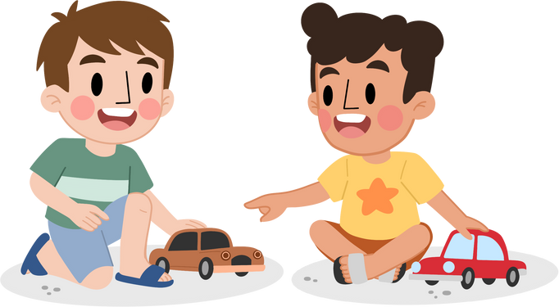

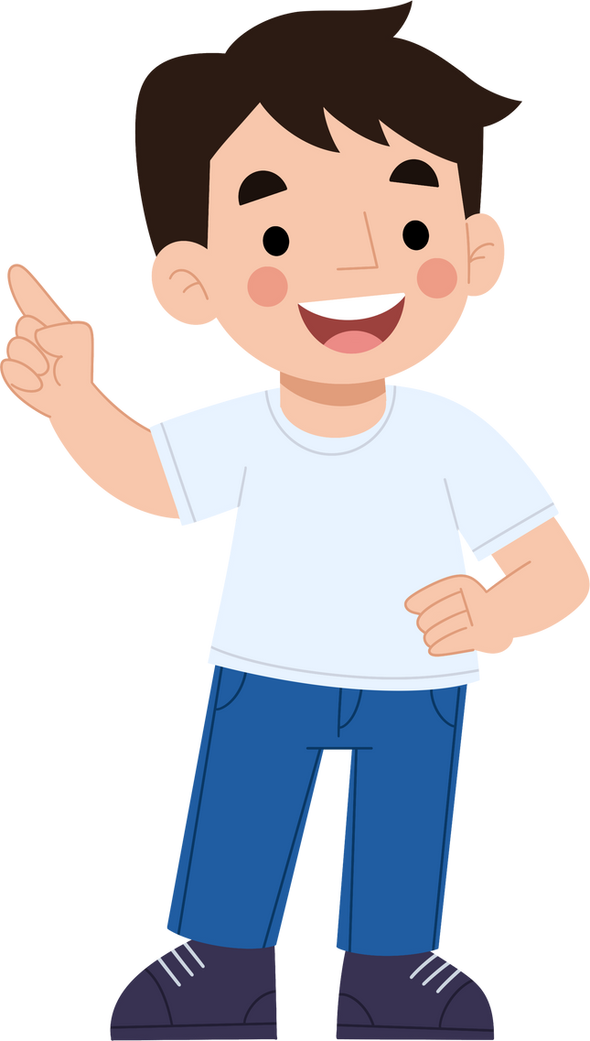


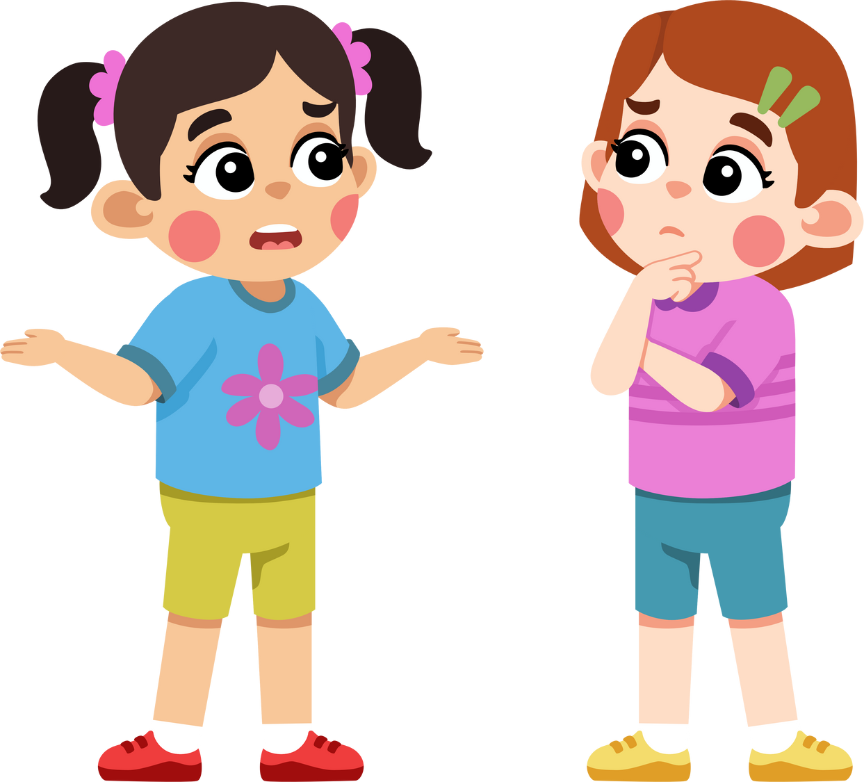
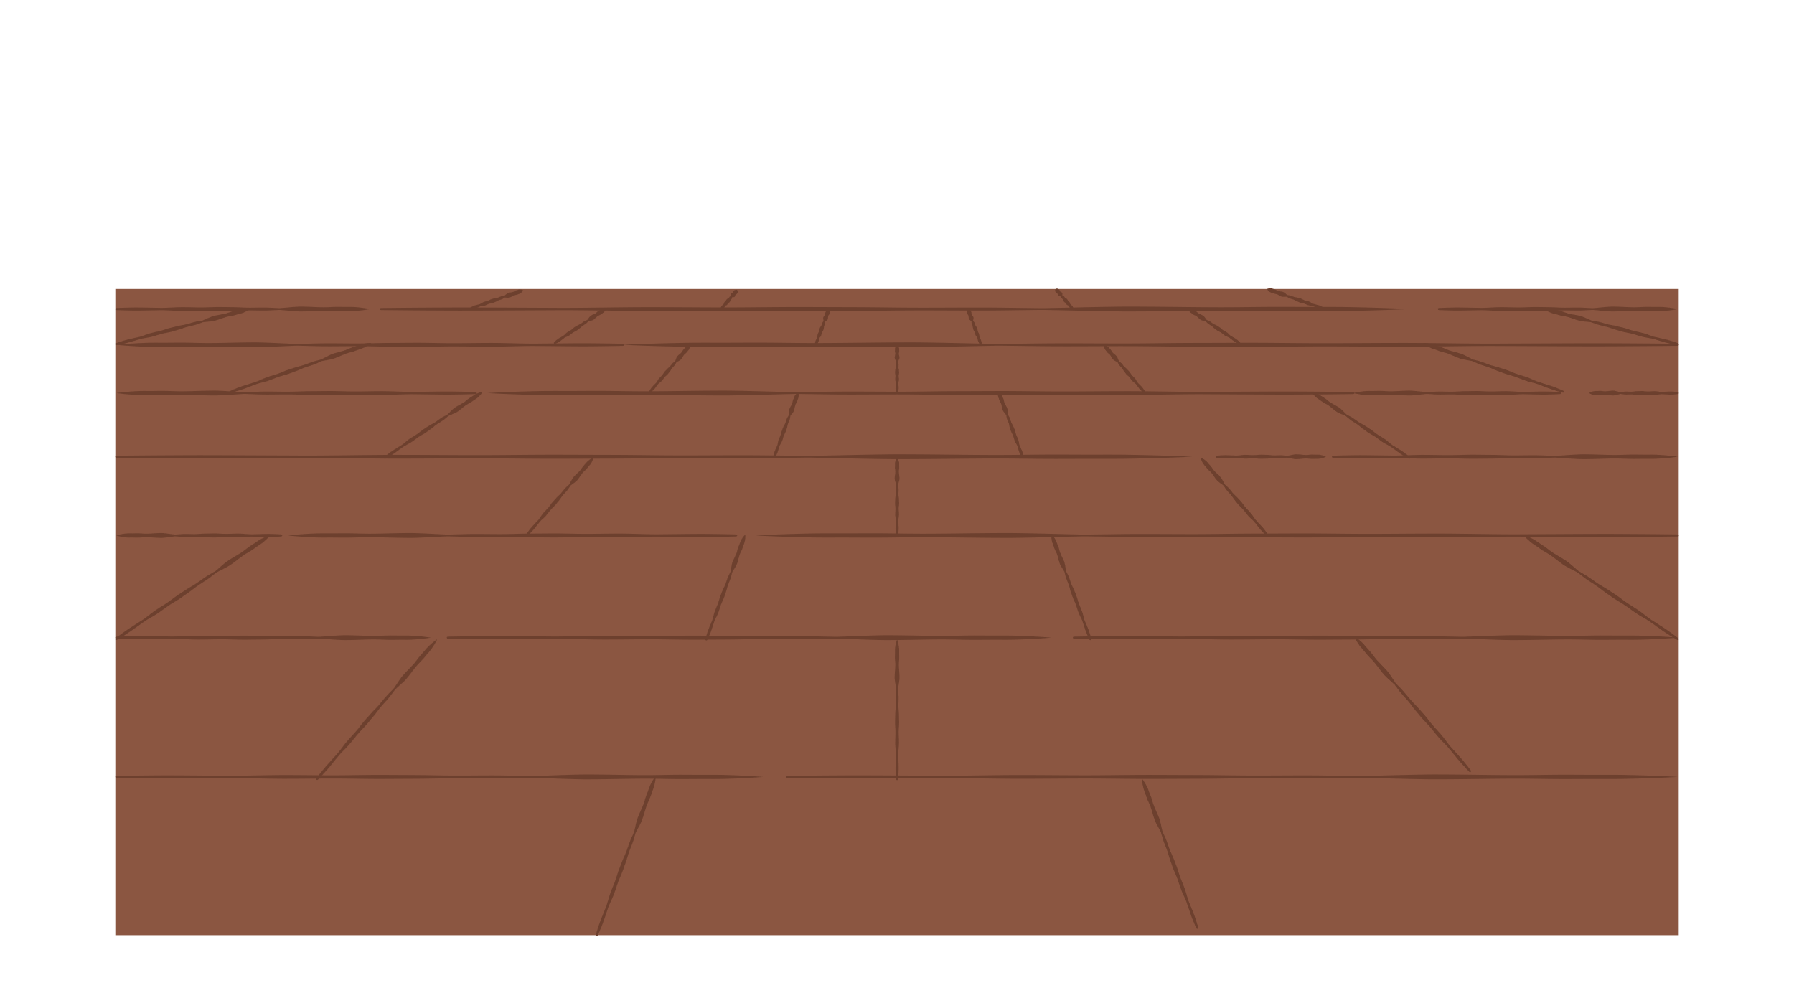
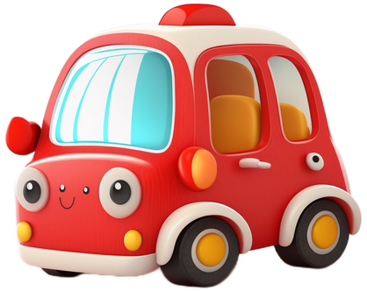
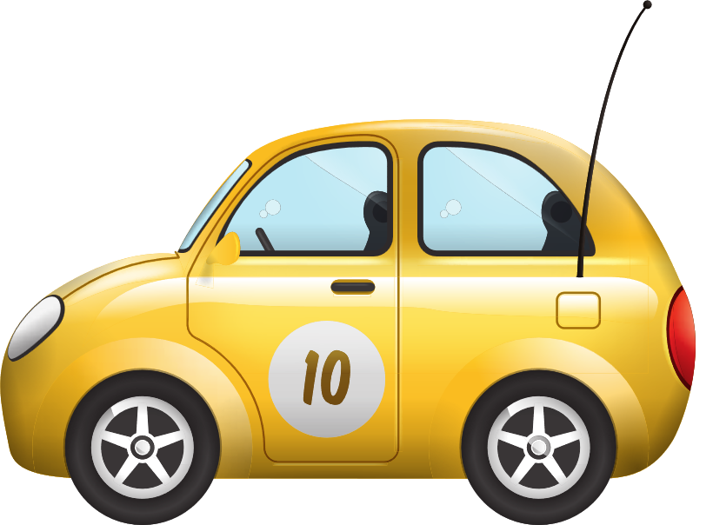
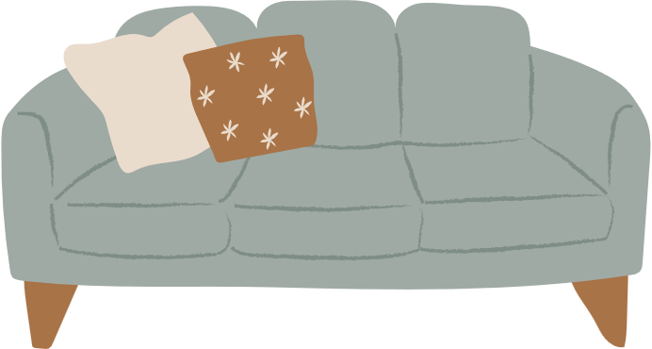

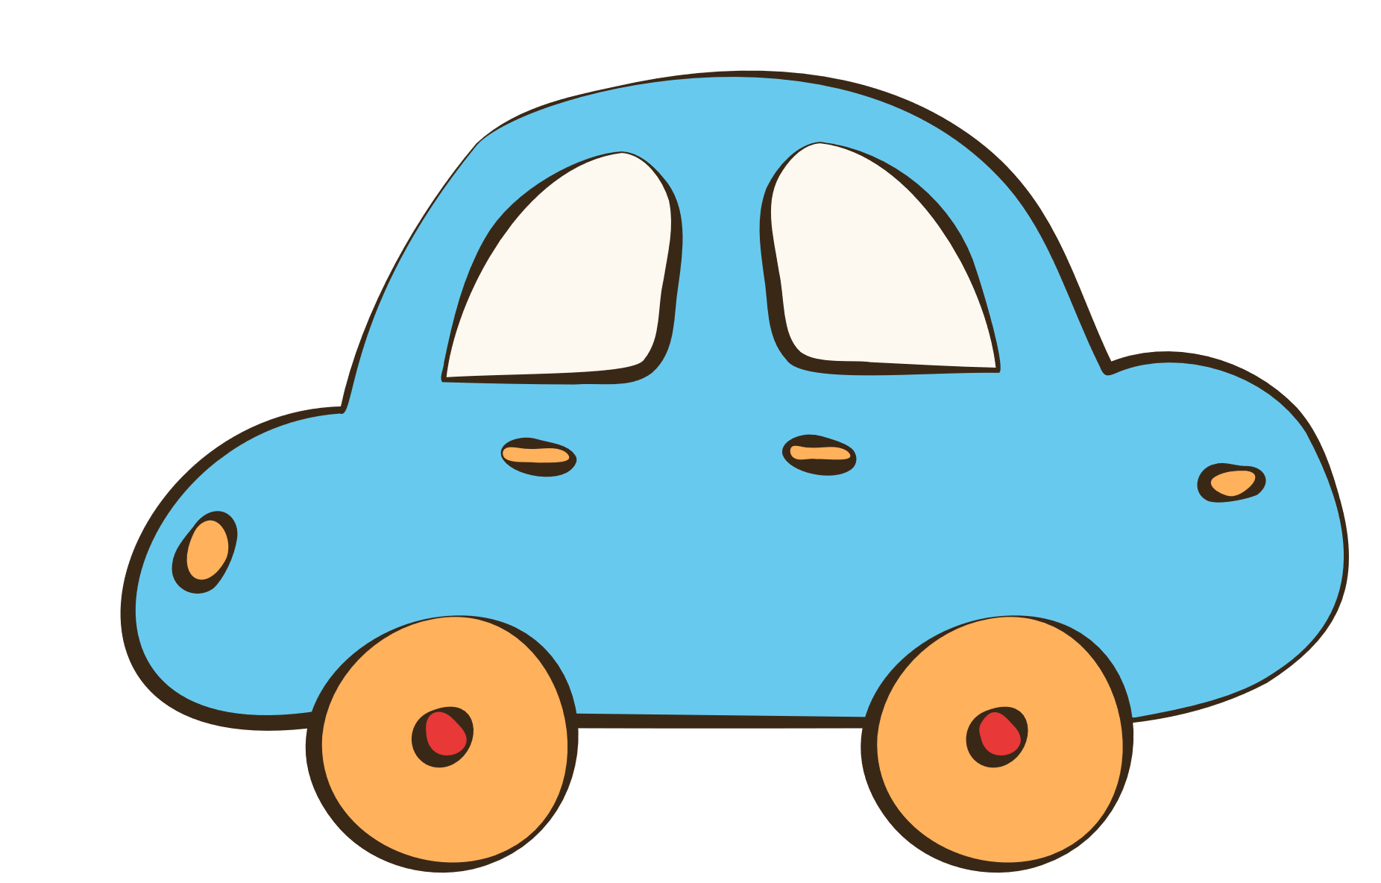

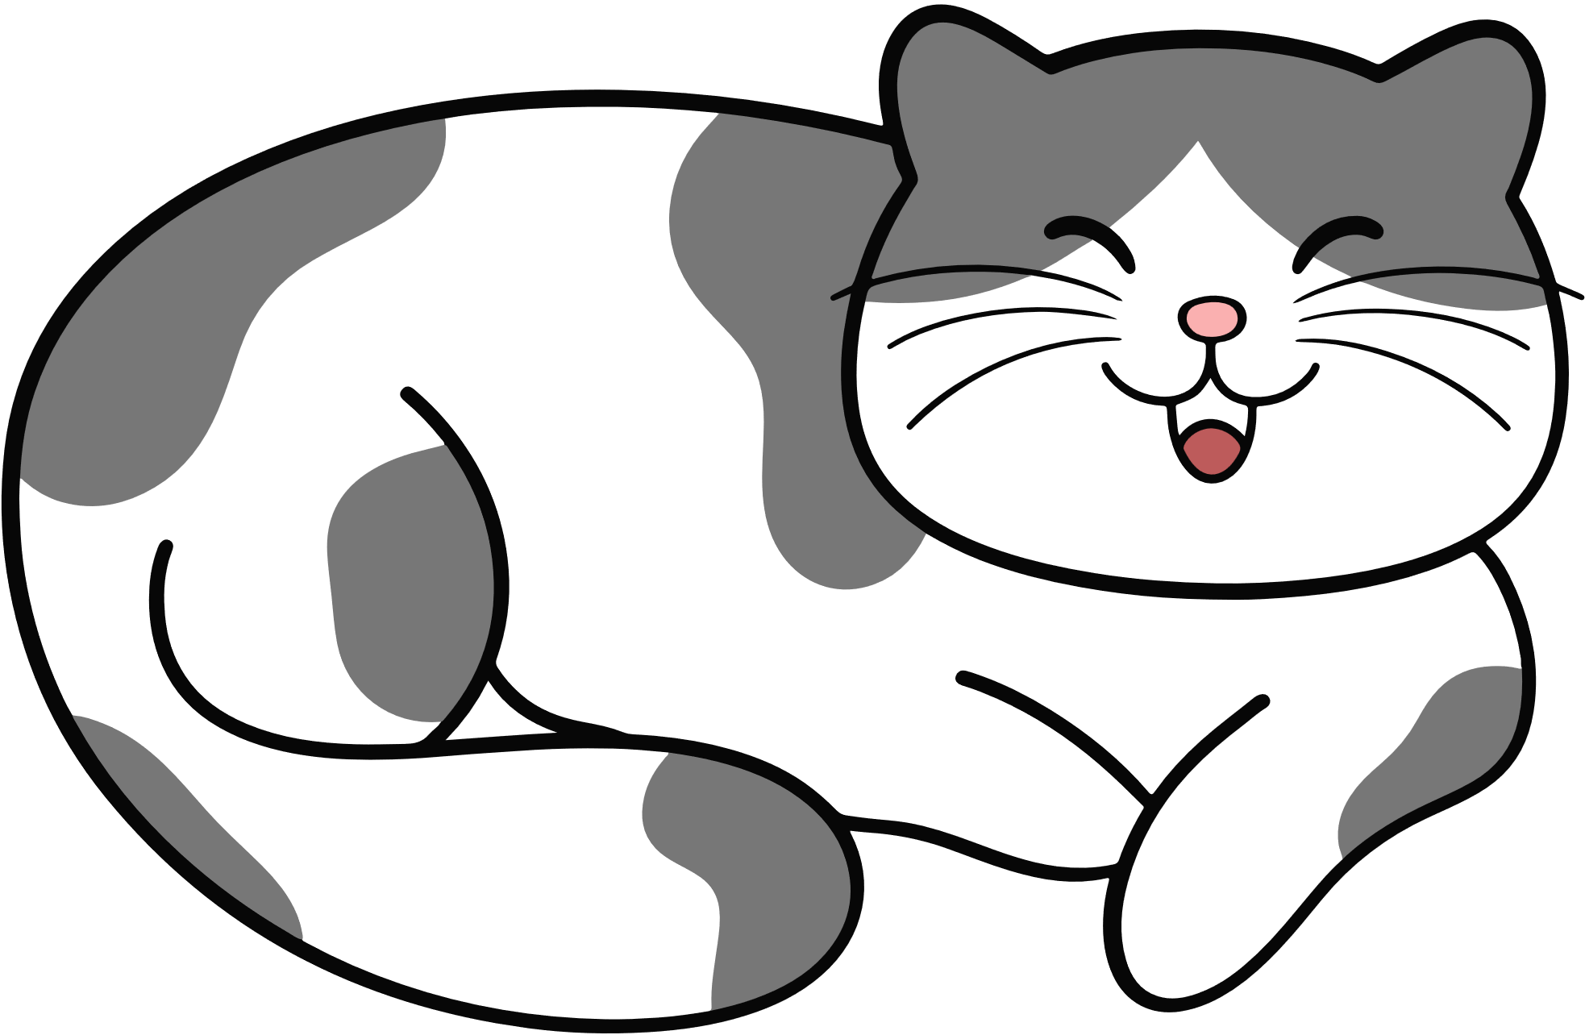
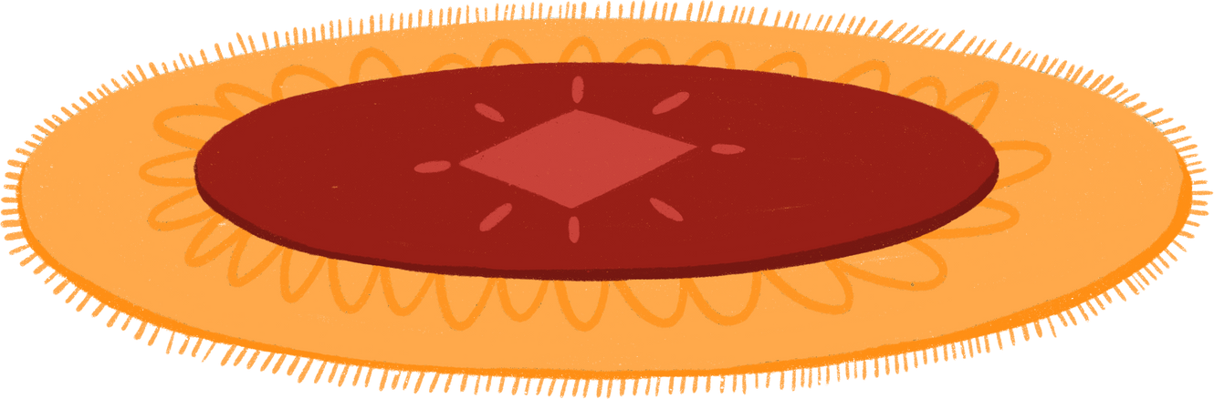
4 Listen and read.
They were my toy cars.
When you were nine years old, what were your favourite things?
They were new and big.
What were they like?

Slide 7
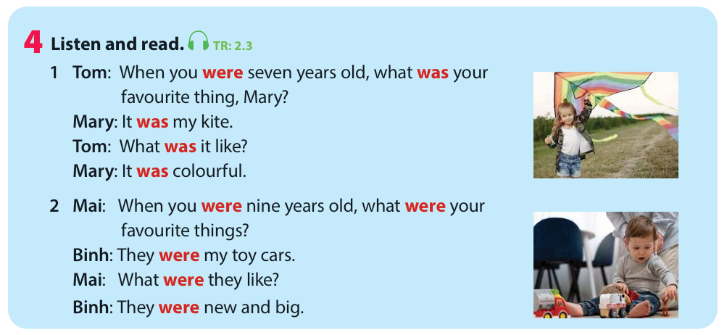

Slide 8
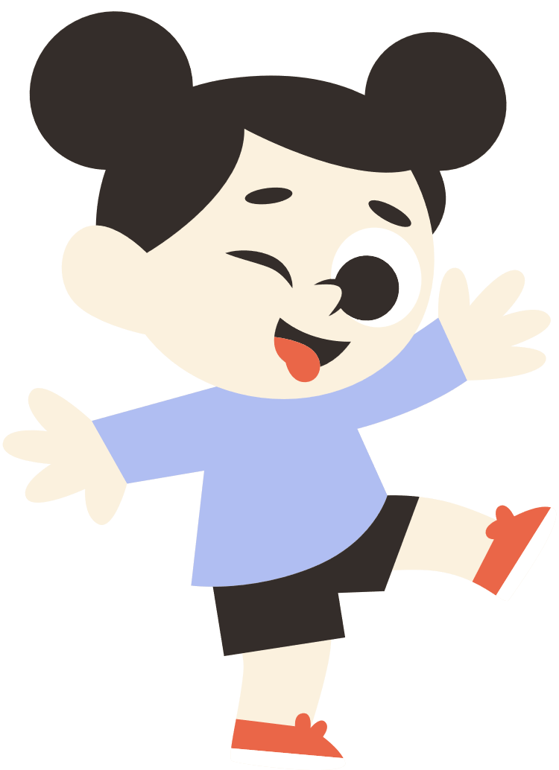
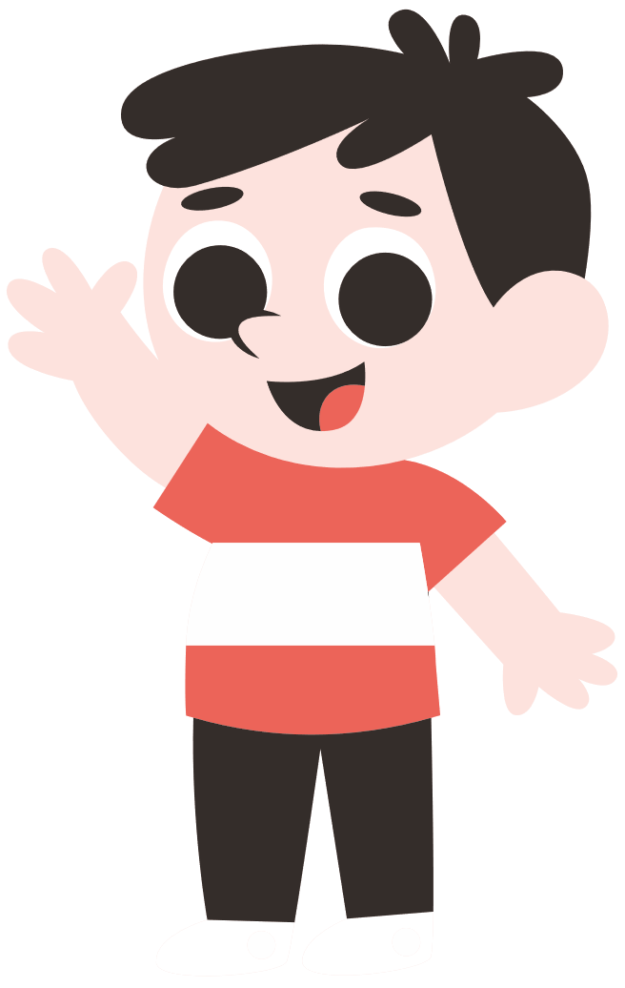

PAST SIMPLE
Review Grammar:
Past simple with To Be

Slide 9

was and were
I
He
She
It
You
We
They
was
were

Slide 10


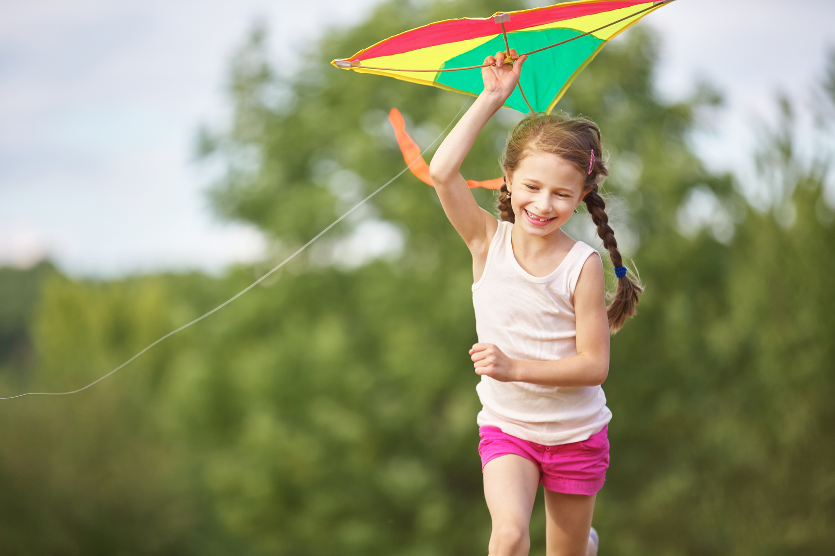
Choose was or were . Then say aloud.

Slide 11

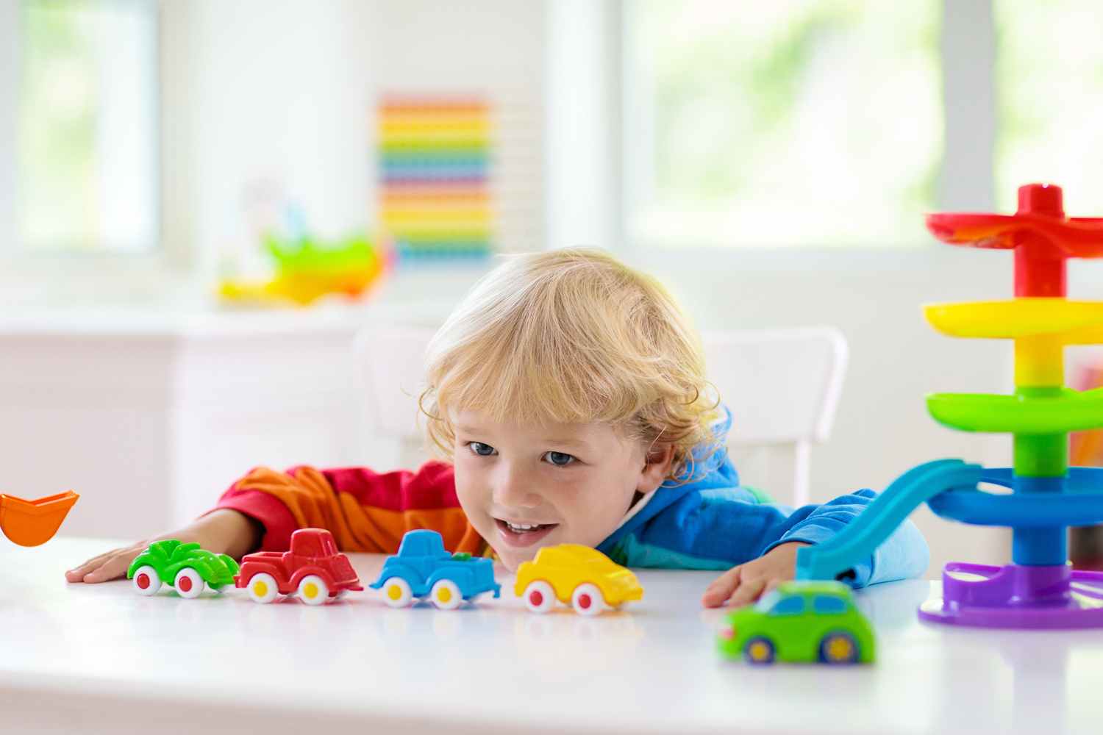
Choose was or were . Then say aloud.

Slide 12


3
Practice

Slide 13




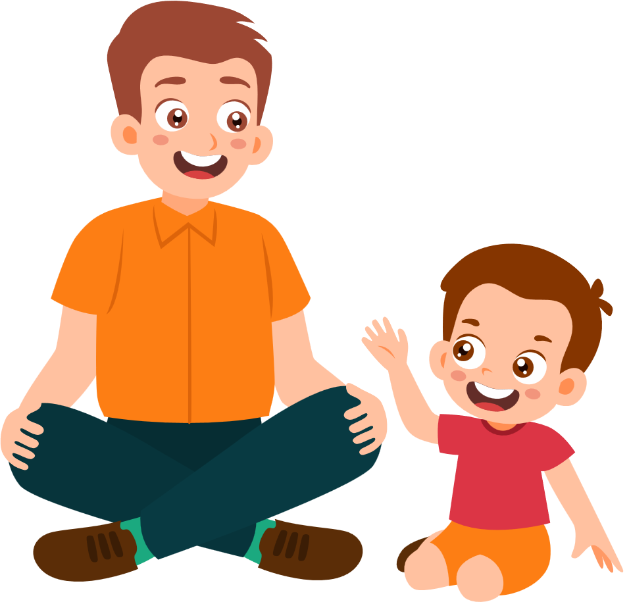






my
Surprised
present

Slide 14





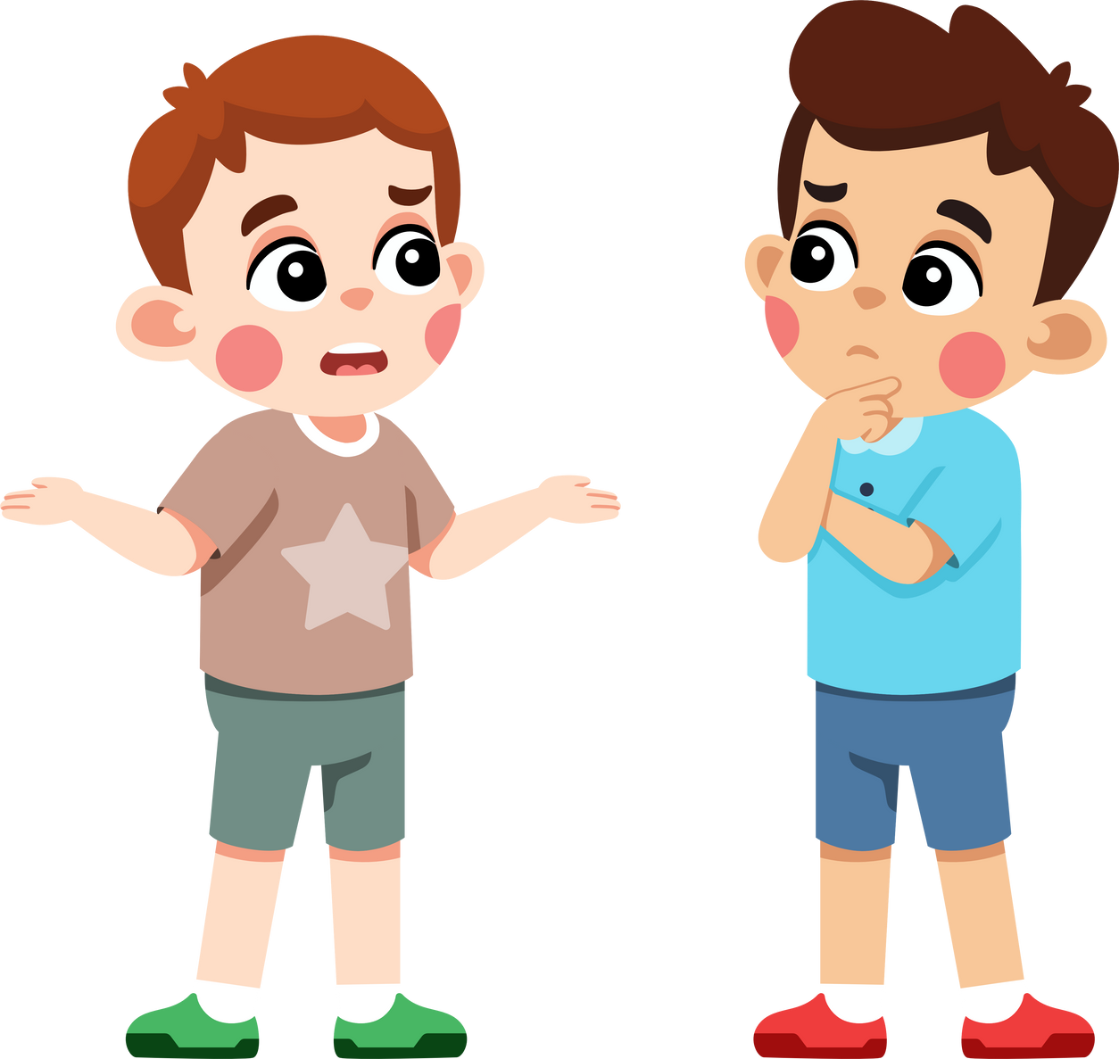



5
Look. Ask and answer.
Mike’s brothers / six years old
/ puzzles / interesting
Mike’s brothers were six years old
When _________________________
what were their favourite things ?
his puzzles
They were ________.
They were ___________.
interesting
What were they like?

Slide 15



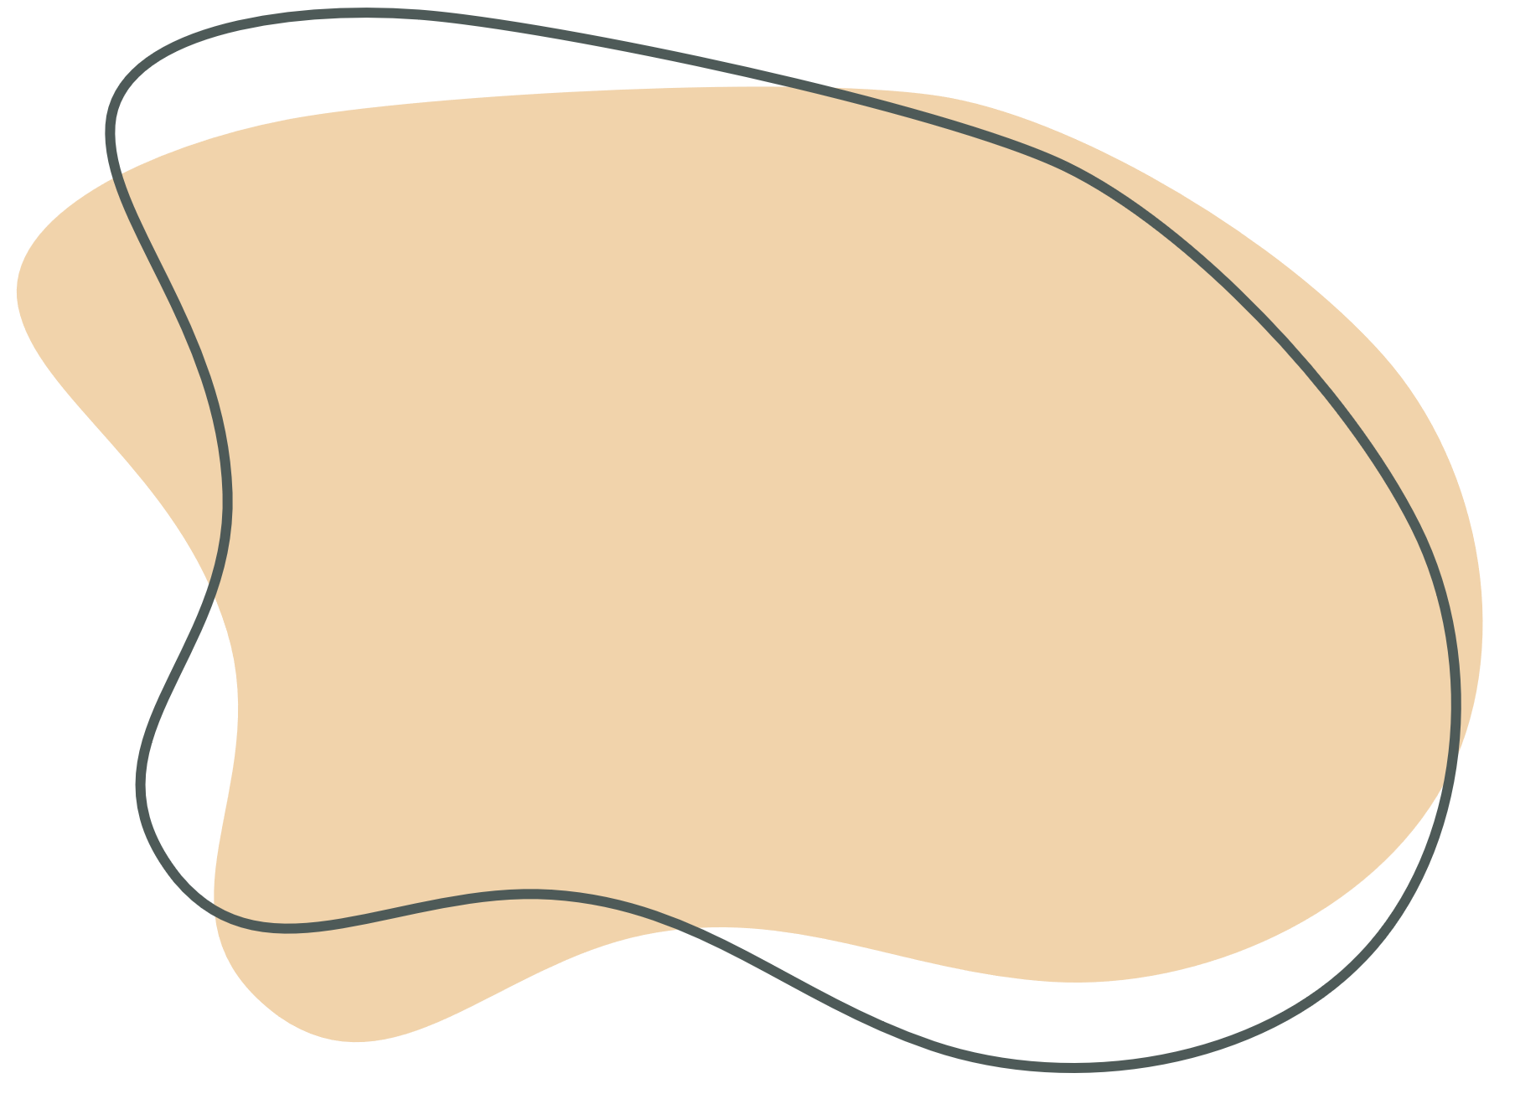

5
Look. Ask and answer.
his toy cars
They were_________.
Peter was five years old
When____________________
what were his favourite things?
fun
They were___.
What were they like?
Peter / five years old
/ toy cars / fun

Slide 16
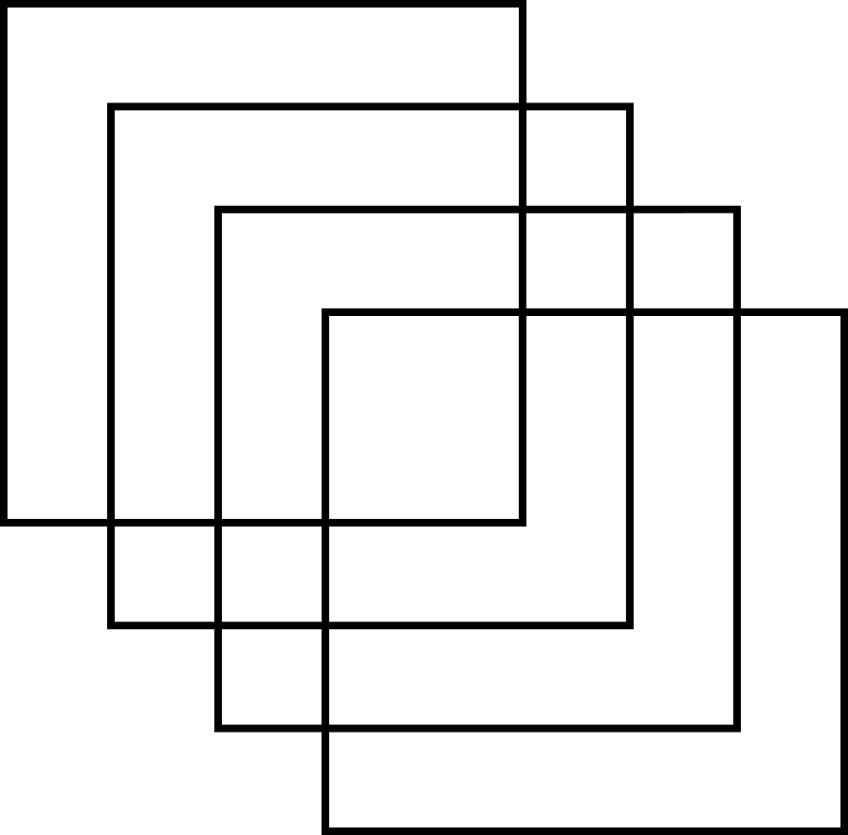



5
Look. Ask and answer.
When you were five years old,
what was your favourite toy?
It was _________ .
my kite

Slide 17




4
Production

Slide 18

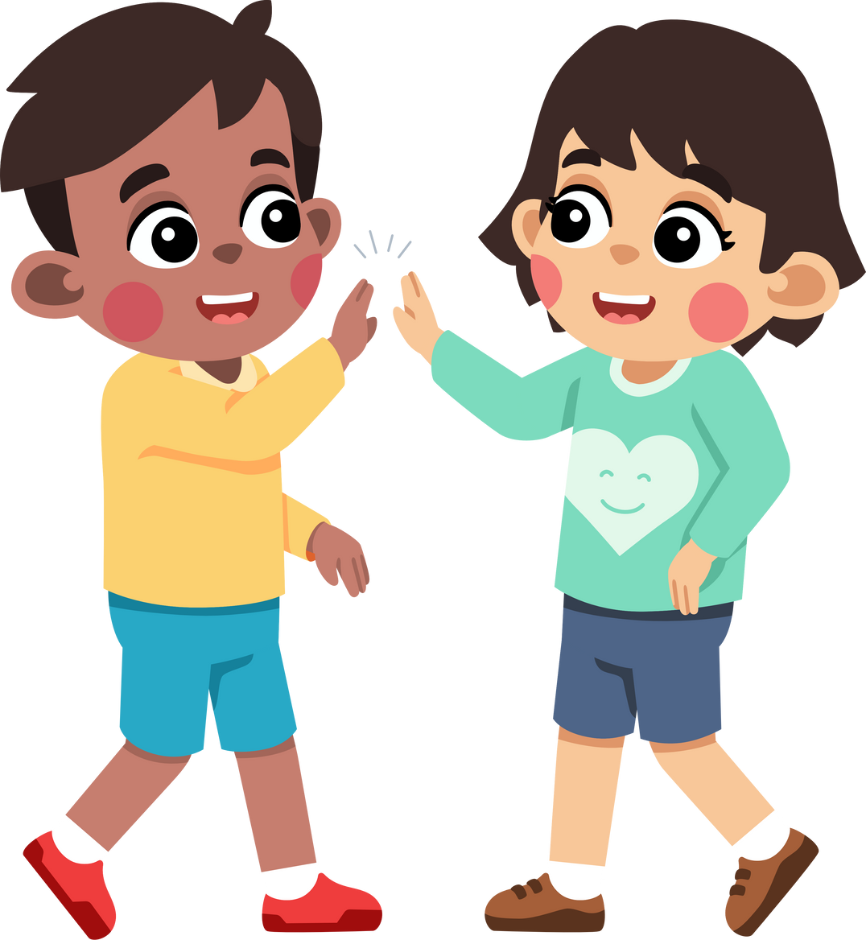
6
Let’s talk.
In pairs, ask and answer these questions:
• five years old / toy
• seven years old / storybook
• nine years old / game
It was
_______.
When you were five years old,
what was your favourite toy?
What was it like?
It was _______.

Slide 19


5
Wrap Up &
Assessment

Slide 20







WRAP UP
What have we learnt today ?
Review Vocabulary:
computer, puzzle, photo, typewriter, piece
Review Grammar: Past simple with To Be
● When you were seven years old, what was
your favourite thing?

Slide 21




Complete the text with the correct word.
When I _______ a boy, my favourite toy was a ___________.
My father gave it to me for the New Year Eve. It was ____in colour . It had four___________. It moved very ____________. I played with my truck everyday.
was
truck
red
wheels
fast

Slide 22










Thanh You
for your attention

