Slide 1









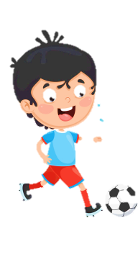












Slide 2






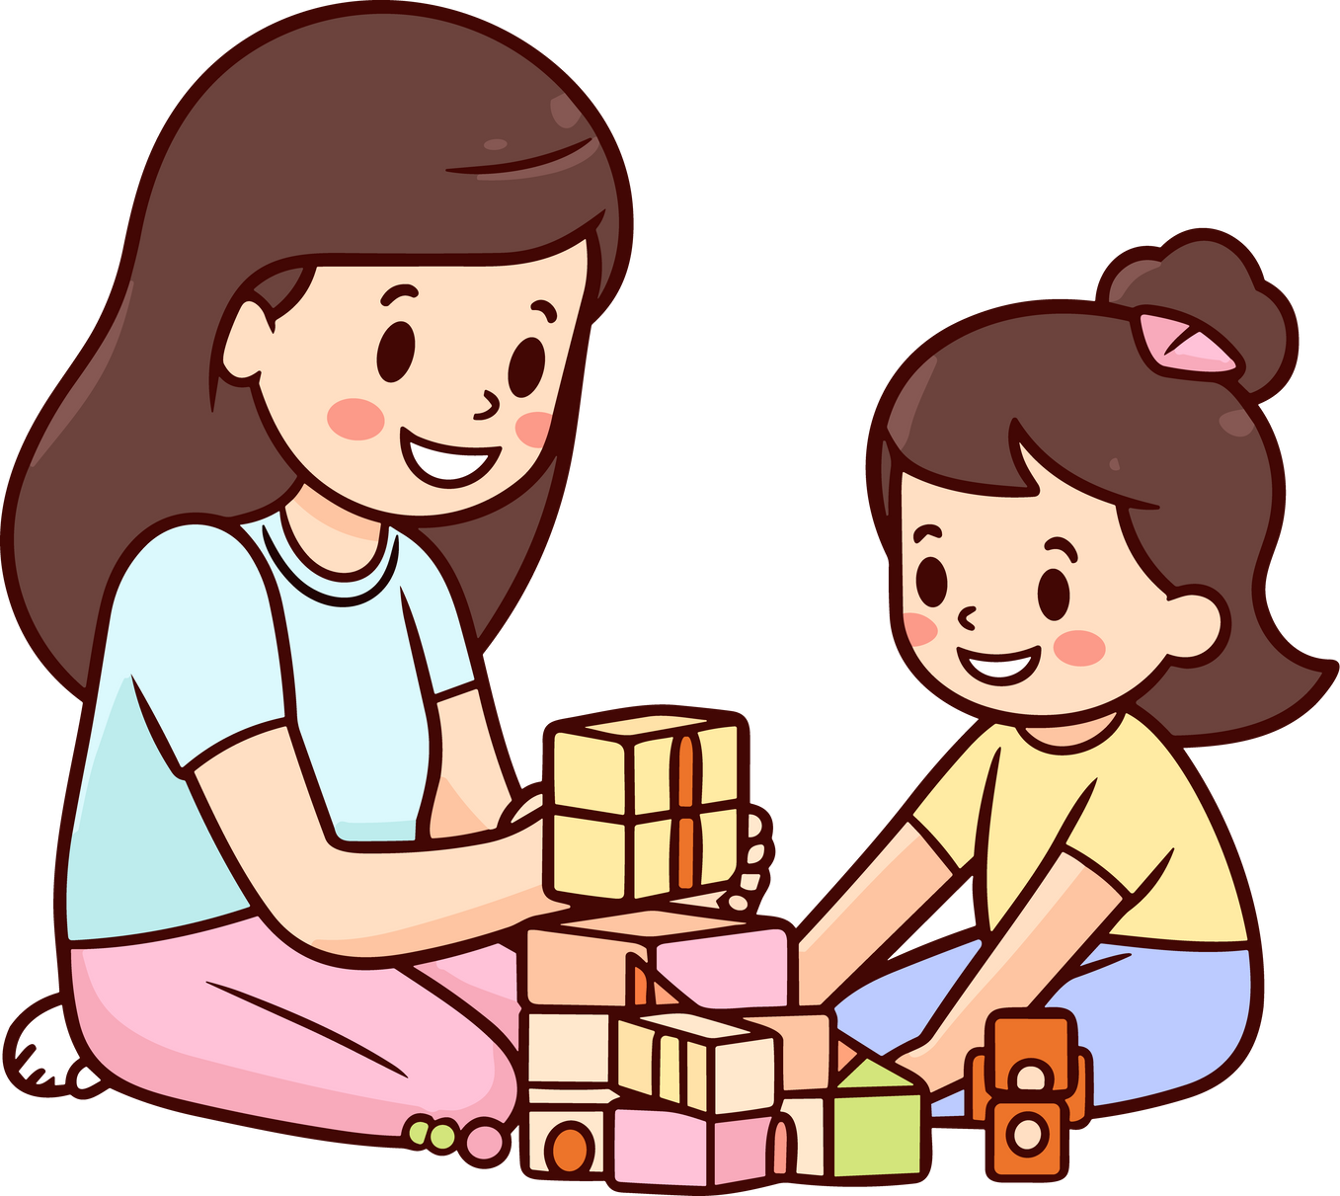

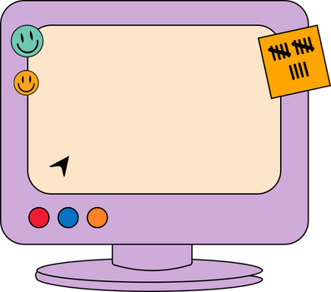


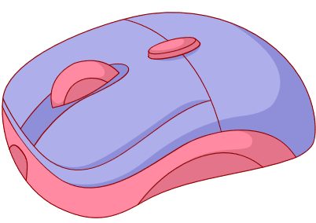




Unit 2
My Favourite Things
Lesson 2 Part 4-5-6

Slide 3



Warm Up
1
Pass the bomb!

Slide 4



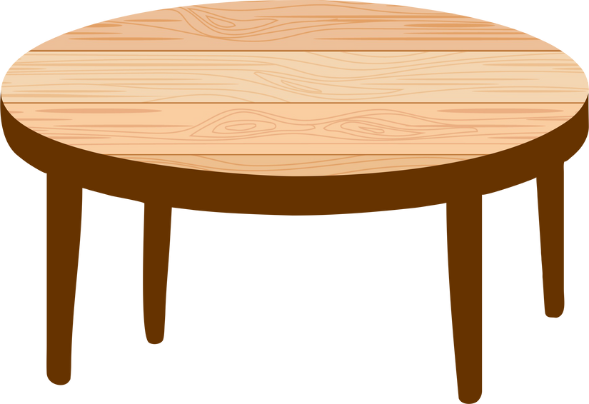

2
Presentation

Slide 5
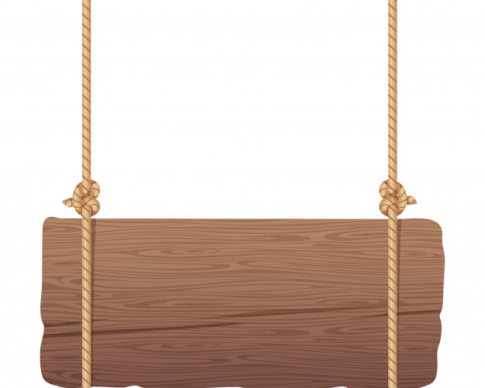
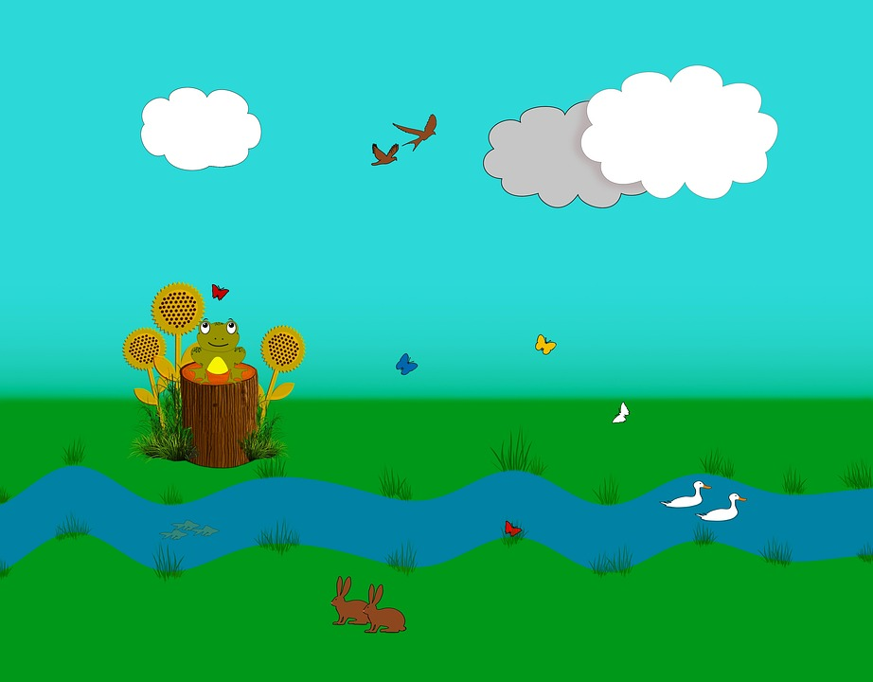
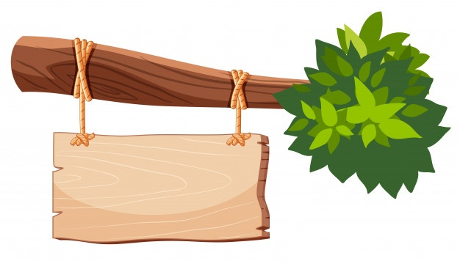
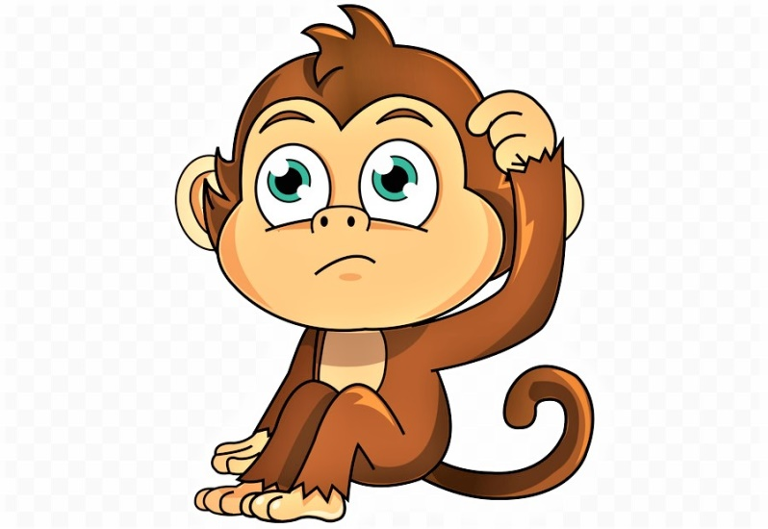
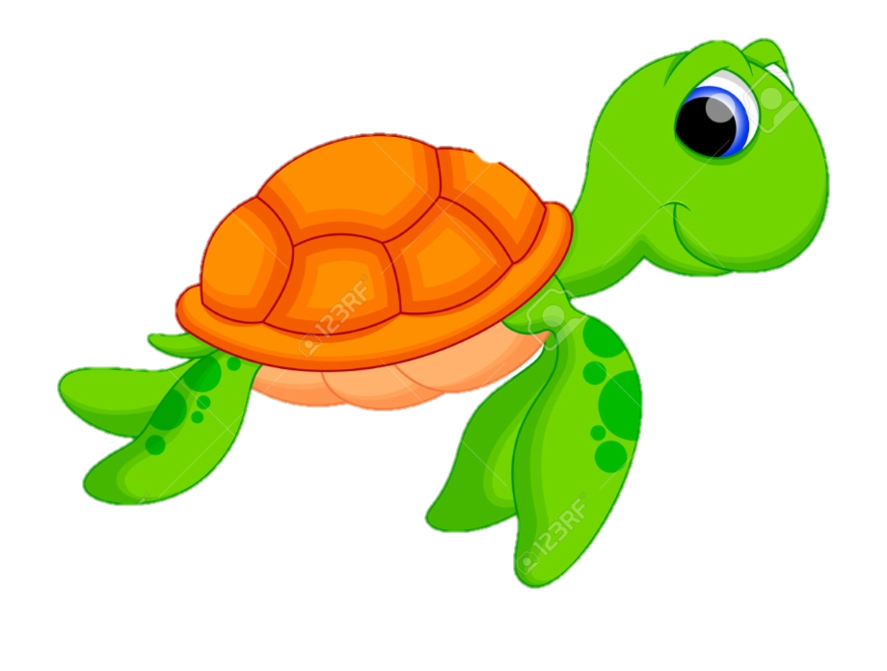
help the monkey

Slide 6
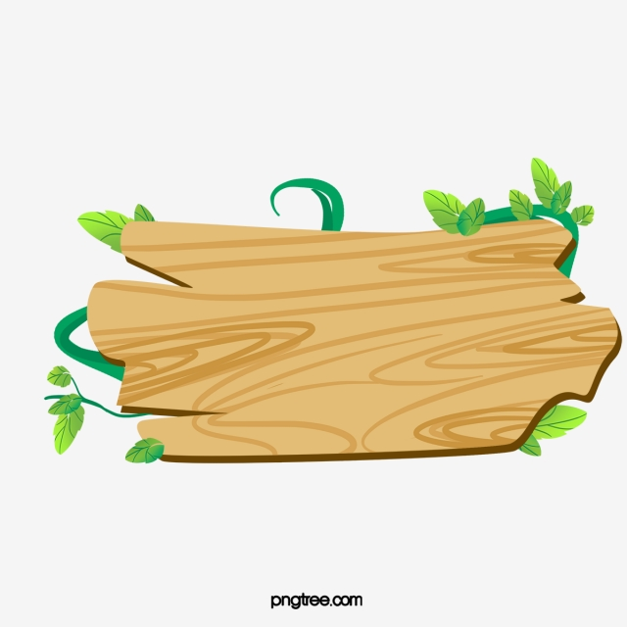
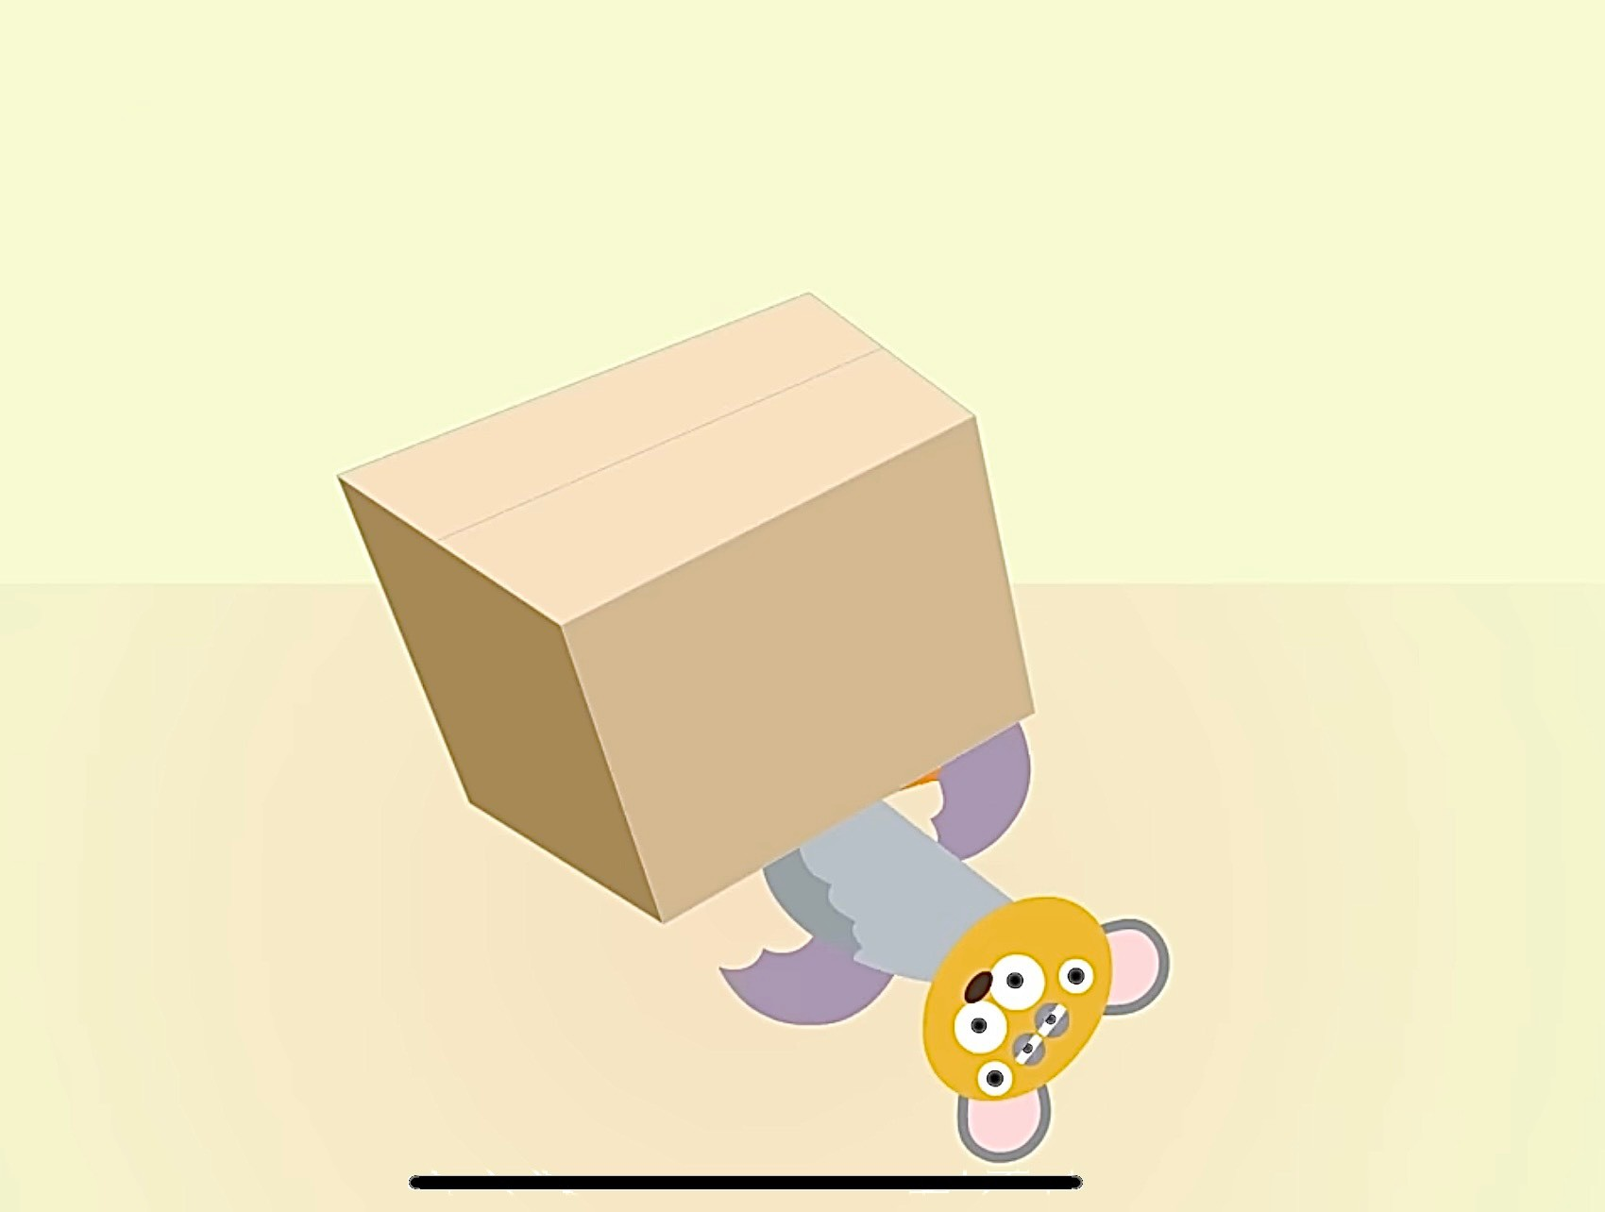
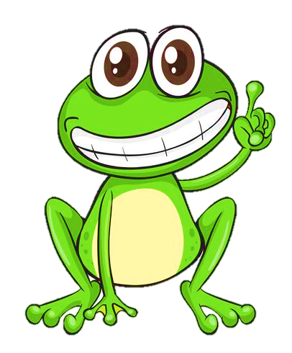

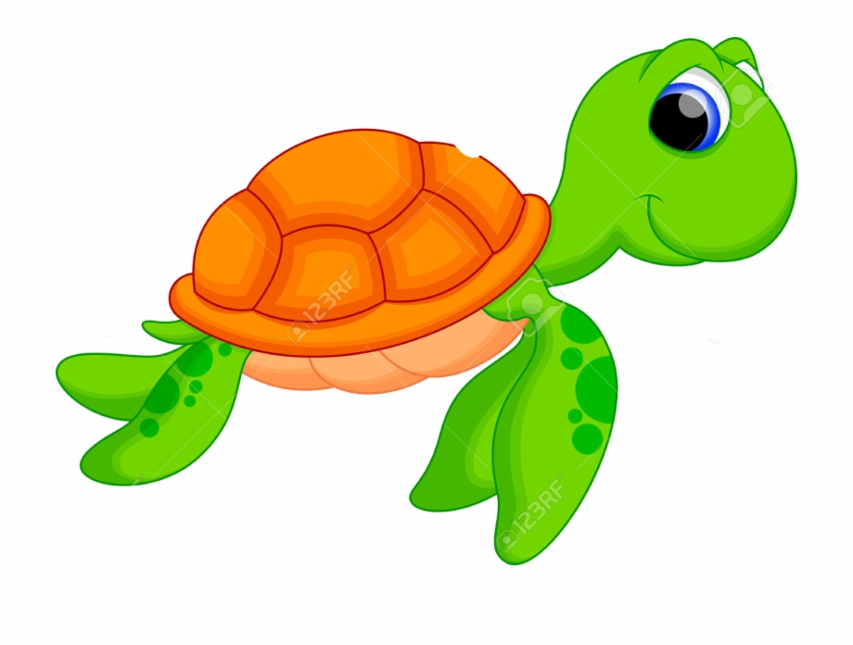
Question 1
The bat is ____ the box.
4 stars
Next to
above
below
Notes:
Ấn vào con ếch/ chim cánh cụt có đáp án đúng để xem điểm

Slide 7
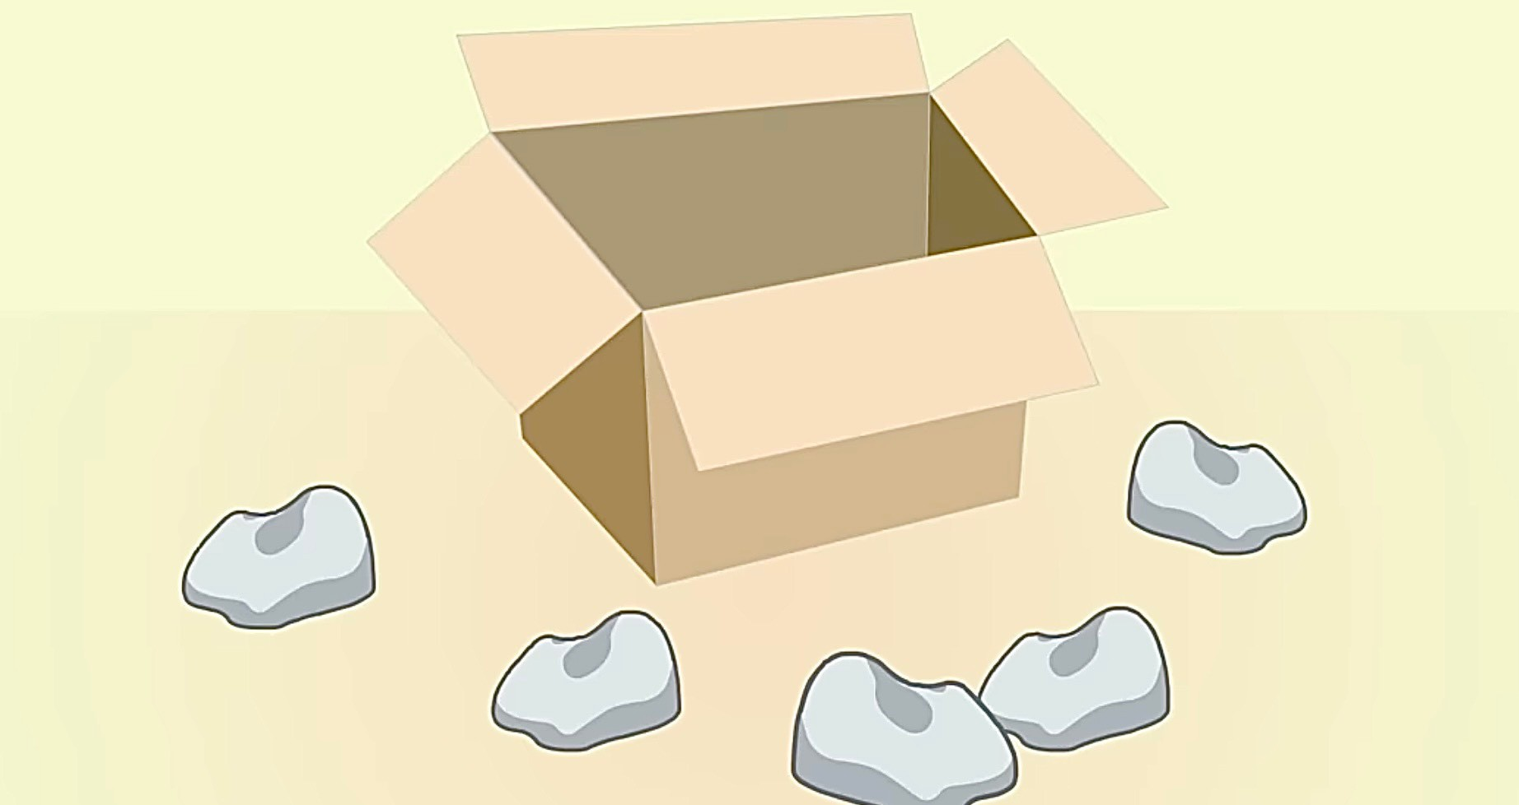


Question 2
The rocks are ____
the boxes.
outside
inside
7 stars

Slide 8
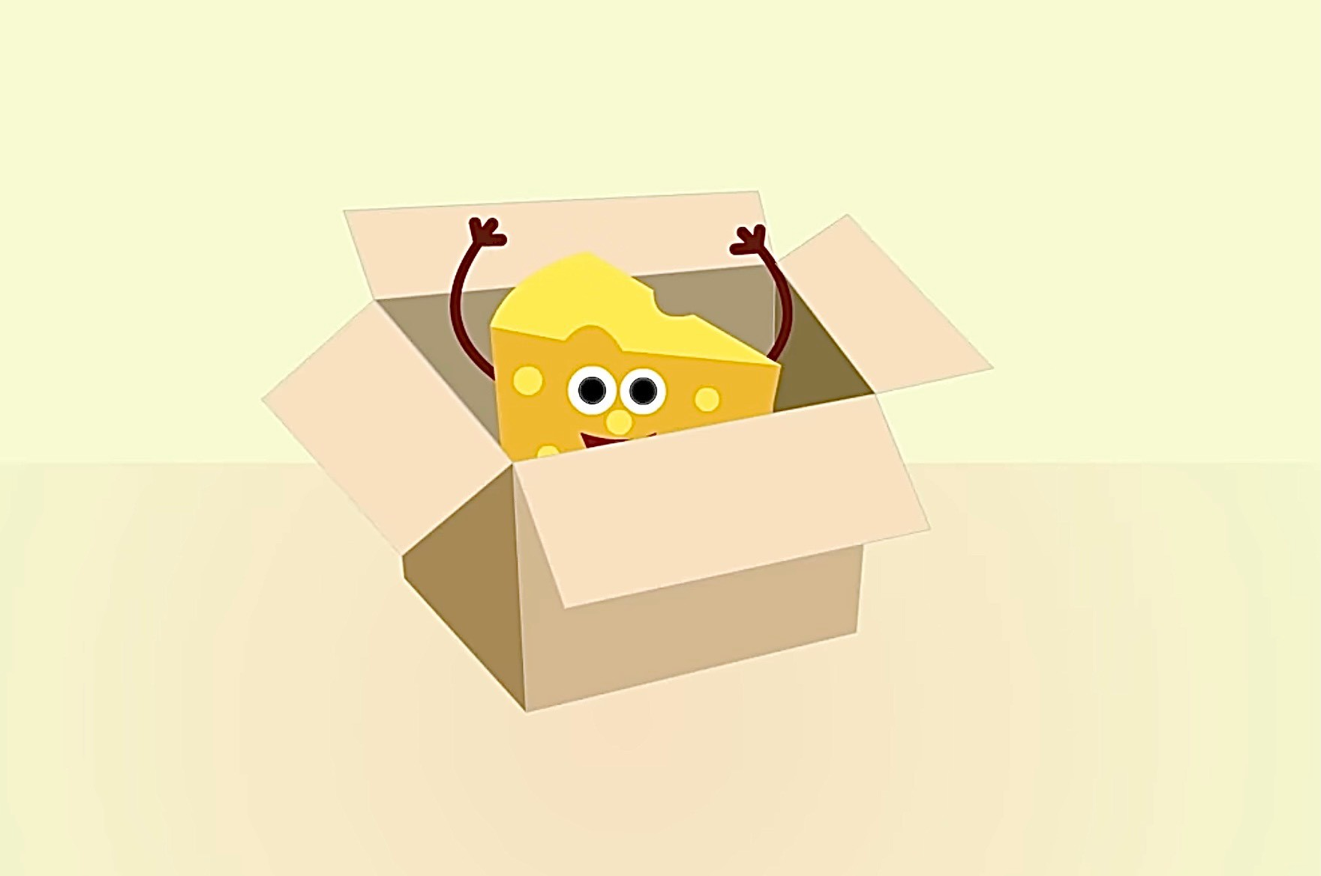
Question 3
The cheese is _____ the box.
6 stars
Next to
outside
inside

Slide 9
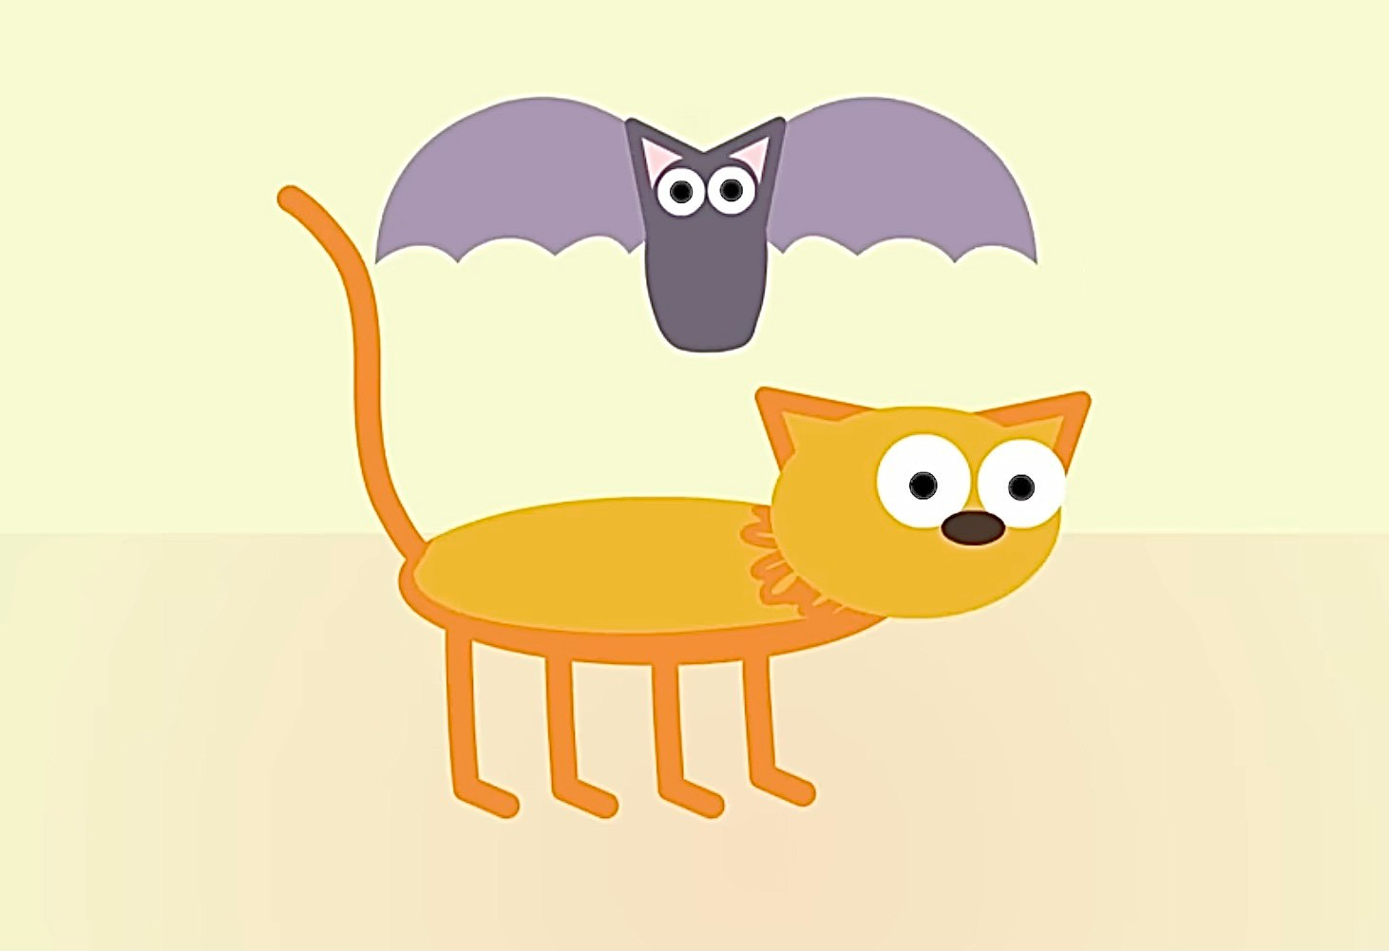
Question 4
The bat is ____ the cat.
under
above
5 stars

Slide 10



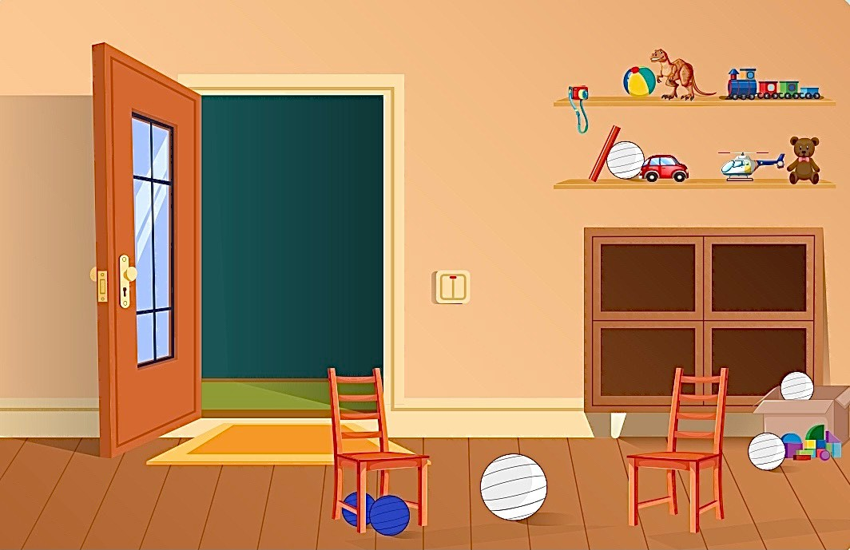
4
Listen and read.
1 Two blue balls are below the chair.
2 A green ball is above the cupboard.
3 A yellow ball is inside the box.
4 There is a pink ball outside the box.
5 There is a big red ball
in the middle of the room.

Slide 11
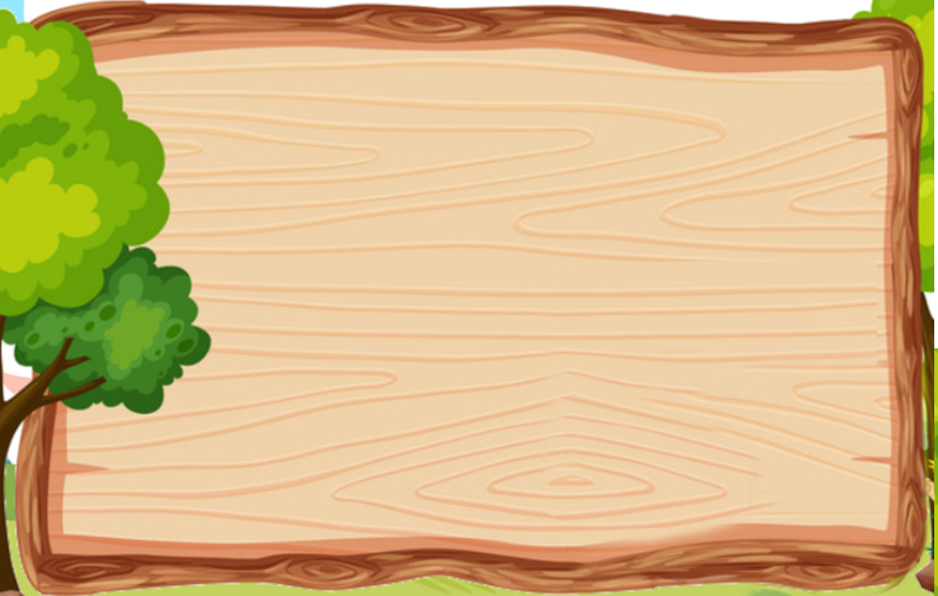


4 Listen and read. Then find and colour the ball.
1 Two blue balls are below the chair.
2 A green ball is above the cupboard.
3 A yellow ball is inside the box.
4 There is a pink ball outside the box.
5 There is a big red ball in the middle of the room.

Slide 12

Practice
3

Slide 13

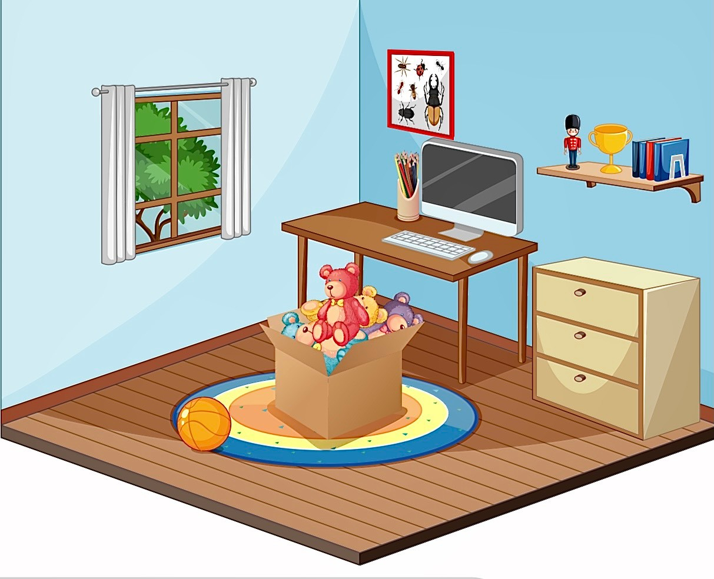
5 Look and write.
What can you see in the picture?

Slide 14
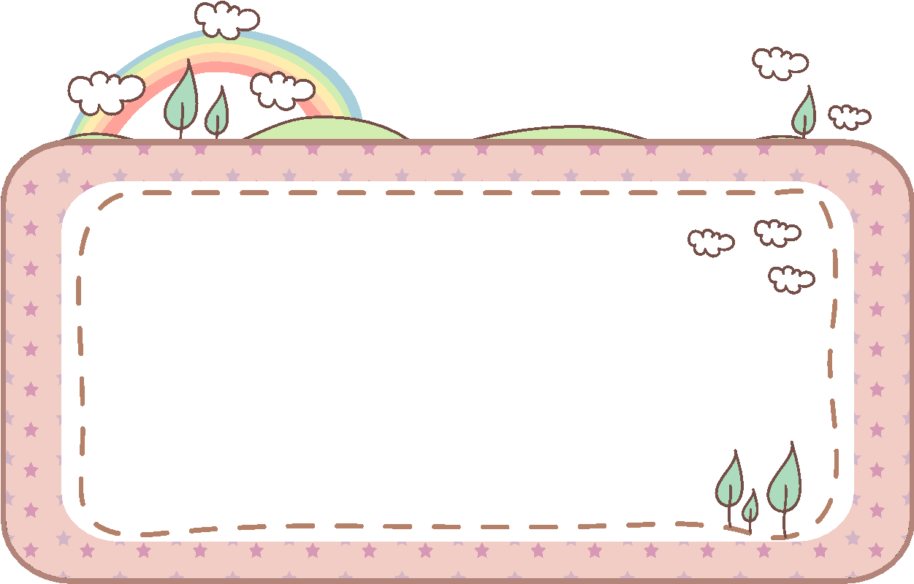
5 Look and write.
inside outside in the middle of above below
below
a. The pencils are _____ the picture.
outside
b. The ball is _____ the toy box.
above
c. The picture is _____ the table.
in the middle of
d. The toy box is _______________ the room.
inside
e. The teddy bears are ______ the toy box.

Slide 15
4
Production

Slide 16
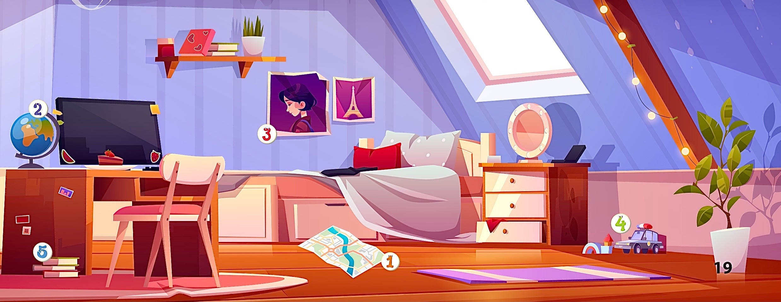

6 Let’s talk.
Where is
the map?

Slide 17


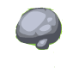






1
4
HELP THE POOH
2
5
3
Notes:
Ấn Help the pooh để hiện số 1. Ấn số và trả lời câu hỏi. Ấn bình honey để nhảy sang slide Assessment

Slide 18
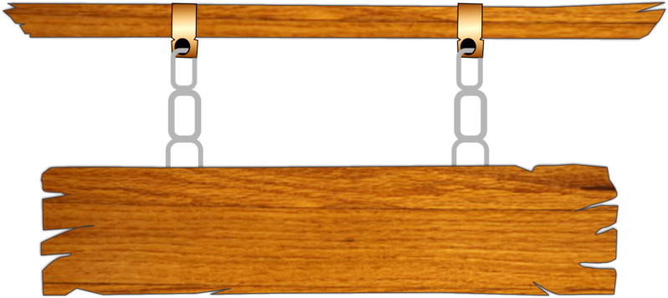




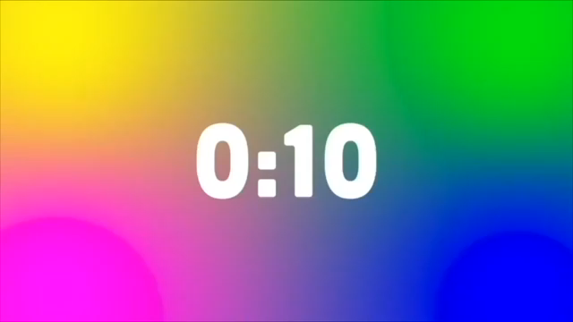



The map is ___ the floor.
on
A
in
B
under
C
behind
D
BACK

Slide 19
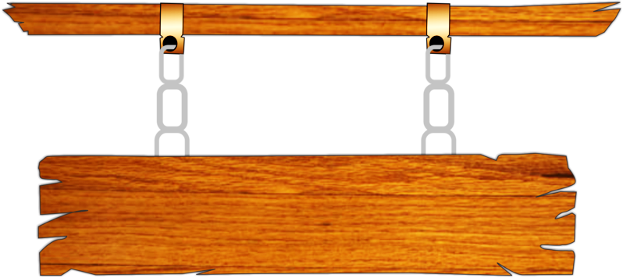

2. Where is the globe?
-It’s _______ the computer.
A
in
B
next to
C
outside
D
inside
BACK

Slide 20
3. Where are the pictures?
- They’re ____ the bed.
A
ouside
B
inside
C
below
D
above
BACK

Slide 21
4. Where is the car?
-It’s on the ______.
floor
A
chair
B
table
C
floro
D
BACK

Slide 22
5. Where are the books?
They’re ____ the globe.
A
above
B
below
C
under
D
inside
BACK

Slide 23
Wrap-up &
Assessment
5

Slide 24
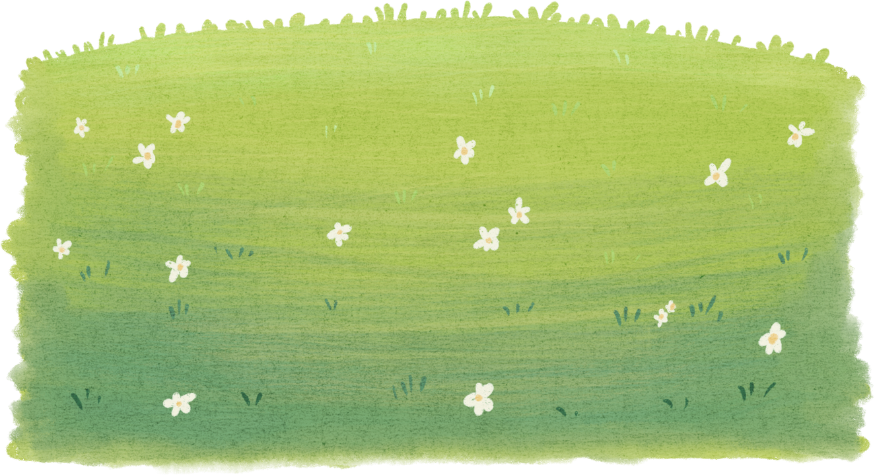
ASSESSMENT
Matching Game
1.The map is
a.on the desk.
2.These books
b.middle of the room.
3.Red ball is in the
c.the teddy bear?
4.Where is
d.are outside the box.
1
A
2
D
3
B
4
C

Slide 25



Wrap-Up
Vocabulary
inside, outside, below,
above, in the middle of
Unit 2: My favorite things
Lesson 2- Part 4,5,6
What have we learnt today?
Structure
Where is the ball?
-It’s below the chair.

Slide 26

Thank you
for your attention

