Slide 1






















Slide 2






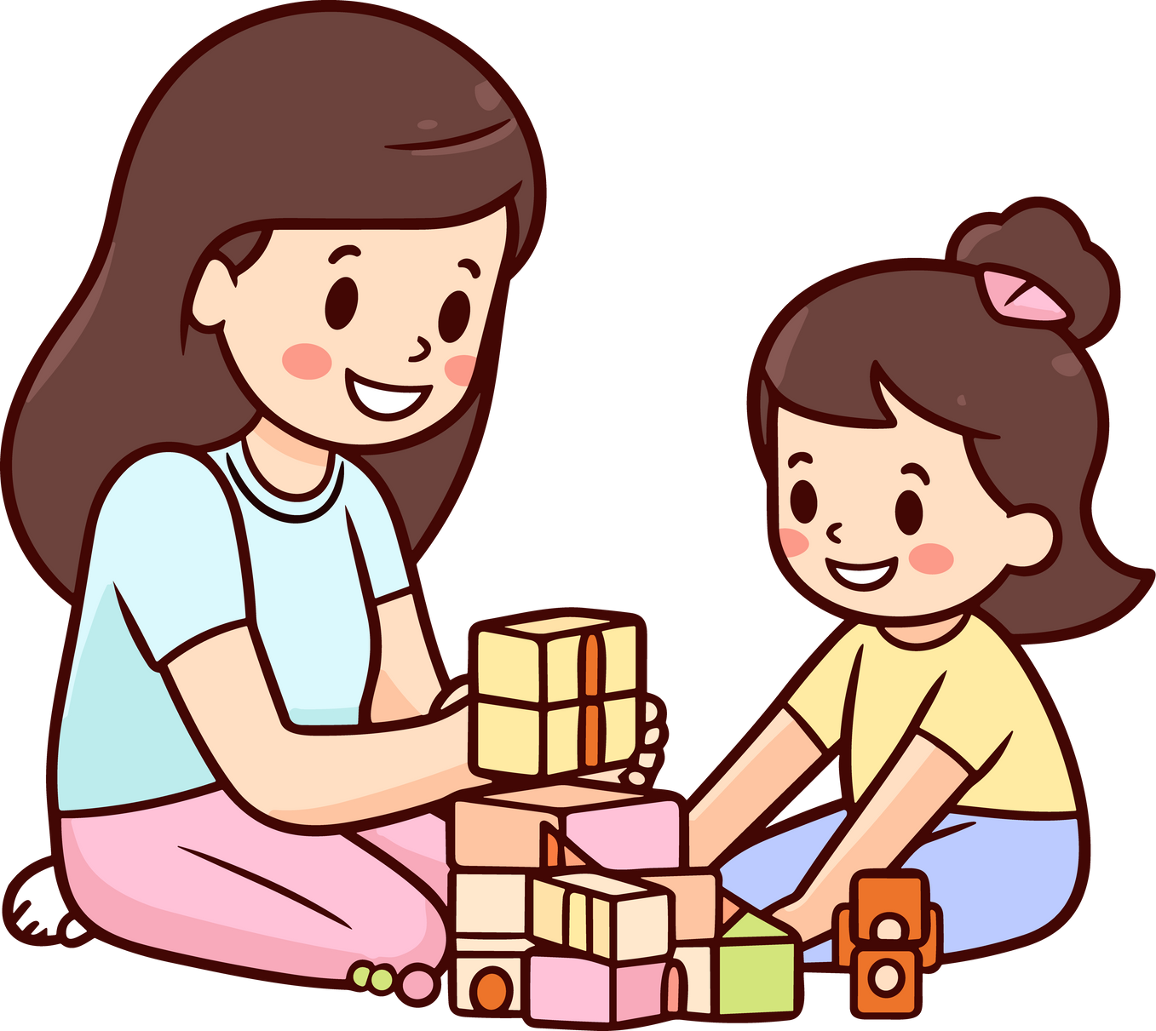




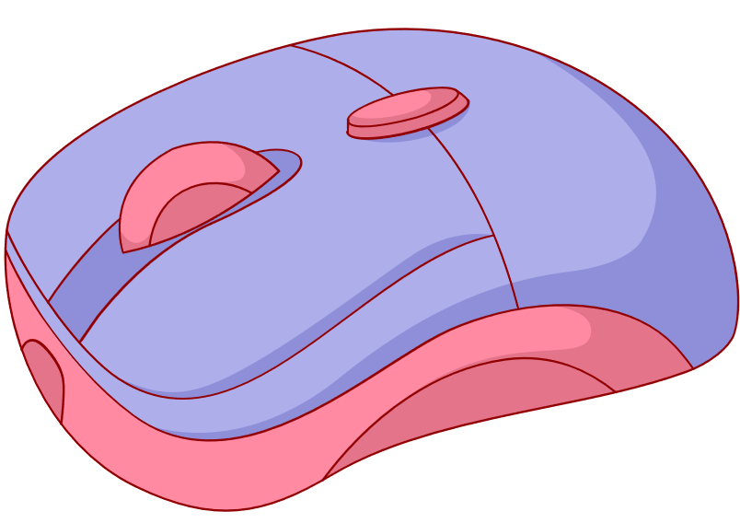




Unit 2
My Favourite Things
Lesson 3: Activity 4-5-6

Slide 3













1
Warm Up
2
Presentation
3
Practice
Tables
of content
4
Production
5
Wrap-up & Assessment

Slide 4

Warm Up
1

Slide 5
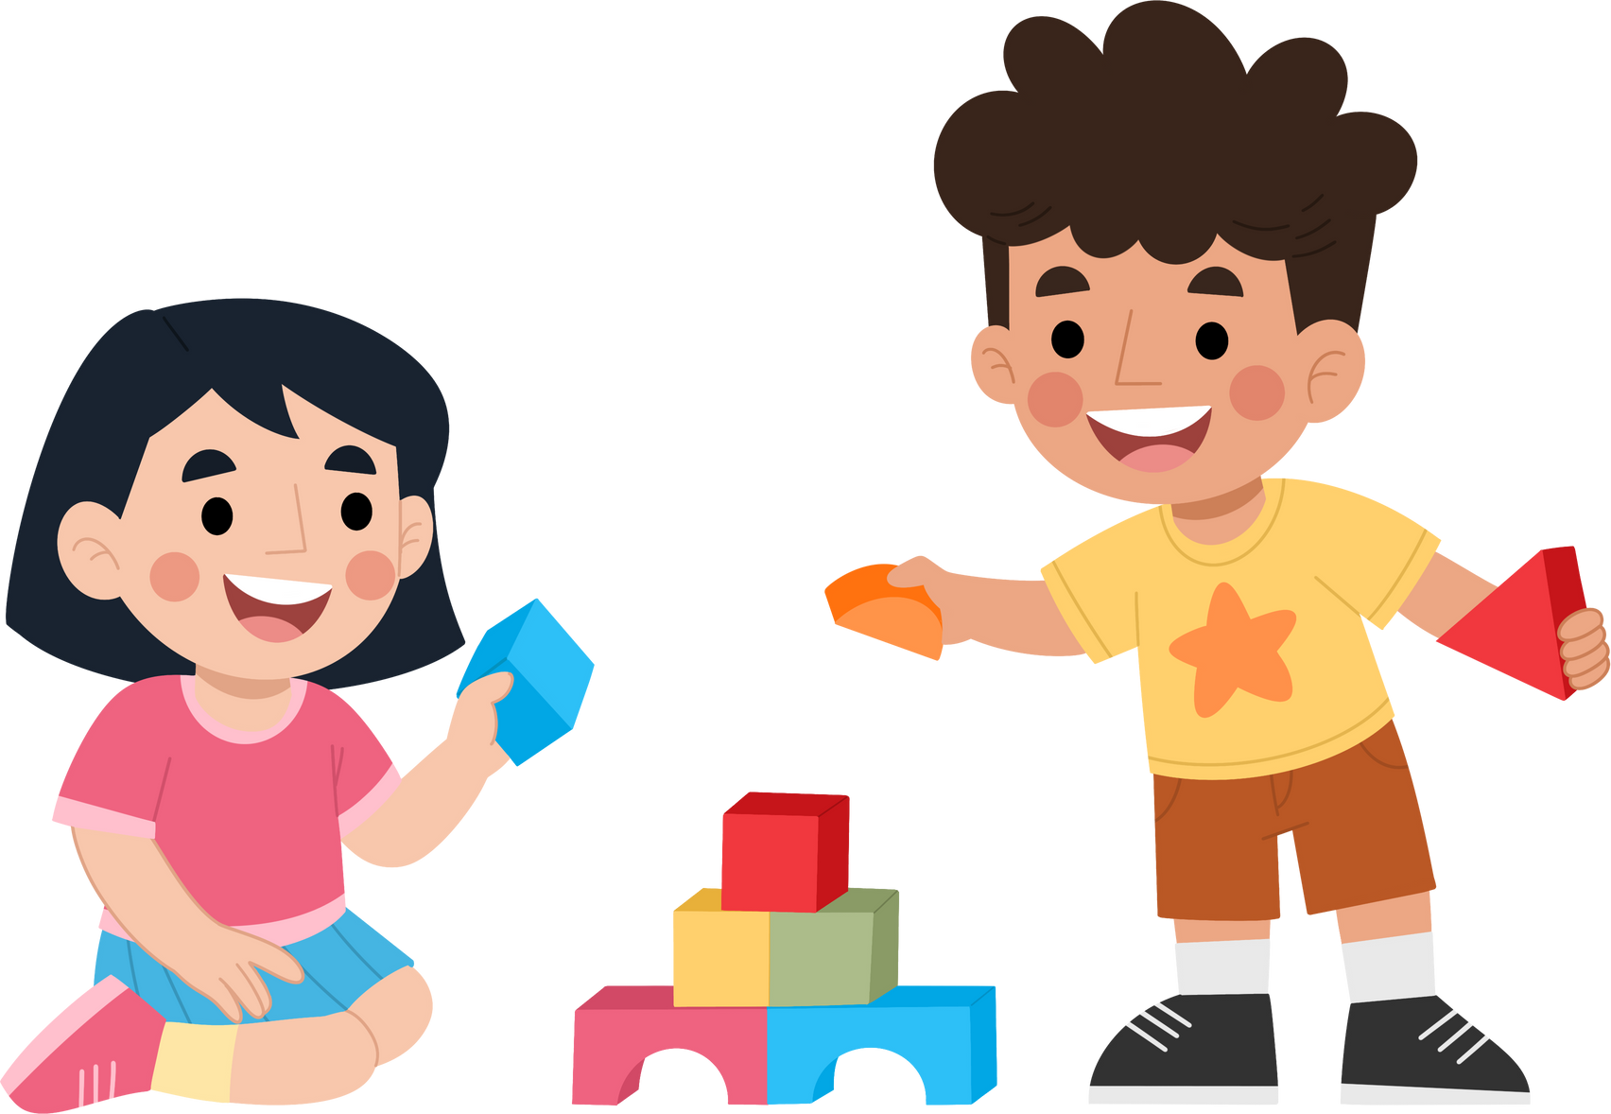





Vocabulary checking game
Notes:
Look the letters on the blocks to make the correct words

Slide 6







Slide 7




Slide 8




Notes:
Click on the question block to reveal the letter.

Slide 9
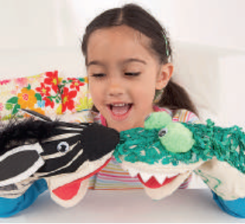




Notes:
Click on the question block to reveal the letter.

Slide 10





2
Presentation

Slide 11



and
but
/ænd/
/bʌt/
Ann and Jim
expensive but it isn’t good

Slide 12

Let’s check!
Notes:
Look the letters on the blocks to make the correct words

Slide 13
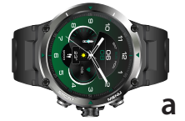


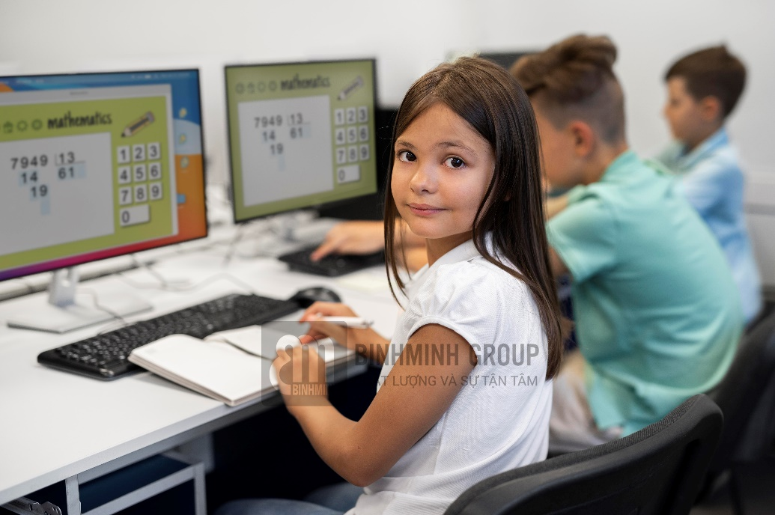
4. Match, listen and check.
Computers are exciting and fun.
My watch is green and black.
The magazine is new, but it’s boring.
This book is interesting, but it’s expensive.
d
a
c
b
C
d

Slide 14
Practice
3

Slide 15
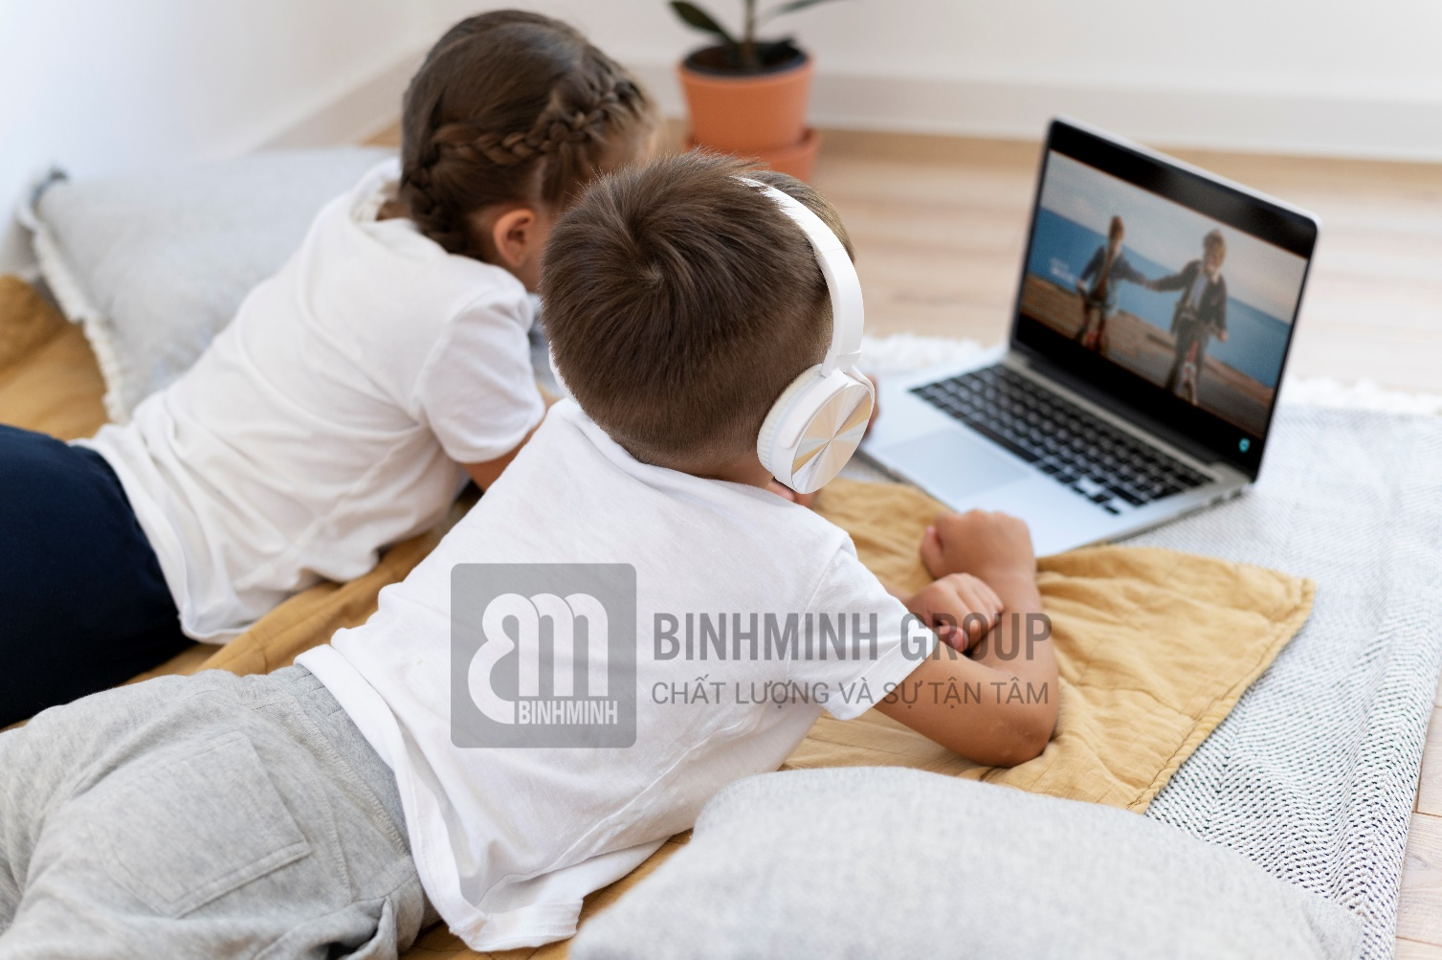



5. Complete the sentence with “and” or “but”.
1. The film is strange, ___ it’s cool.
2. Ben ___ Sam have got ice skates.
and
but

Slide 16

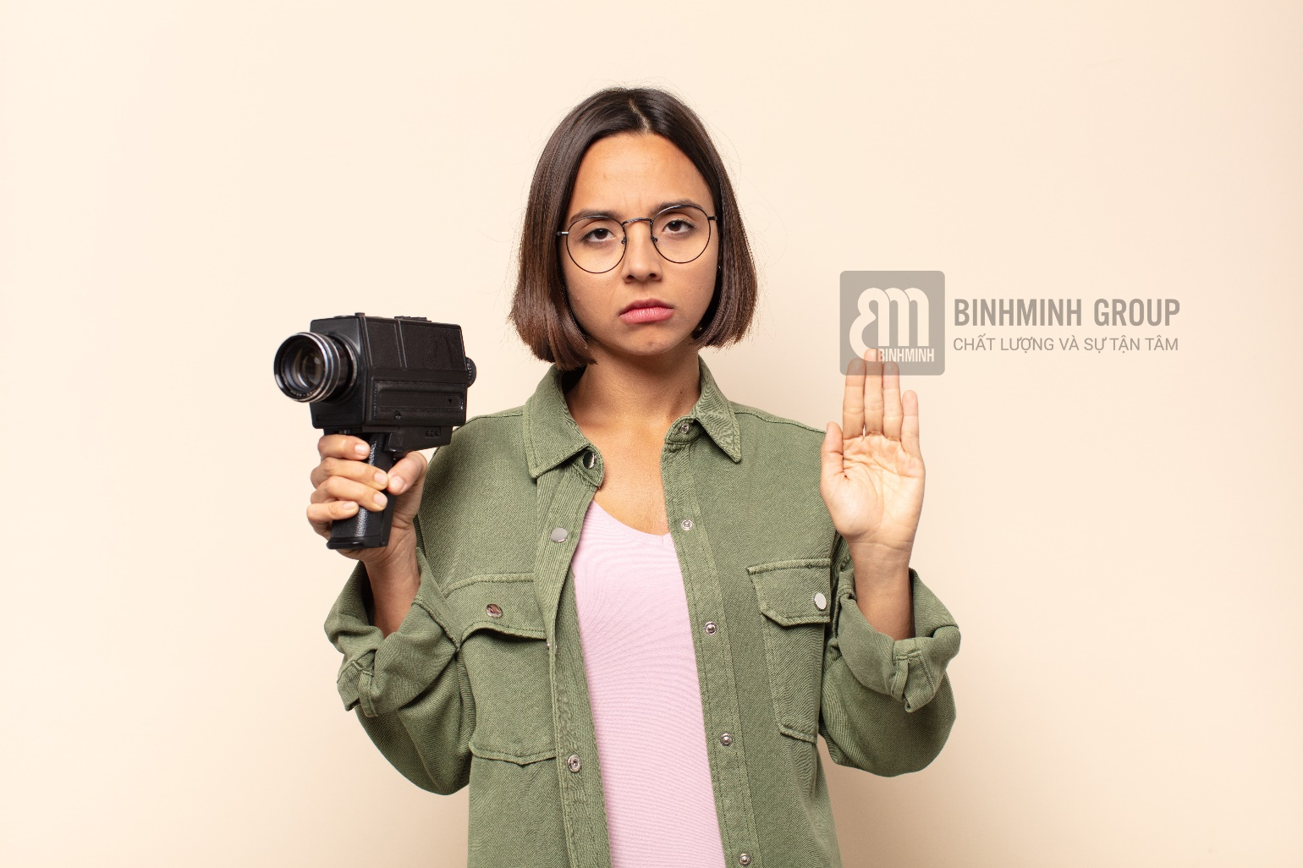
5. Complete the sentence with “and” or “but”.
3. I’ve got a map ____ a globe.
4. The camera is new, ___ it isn’t very good.
and
but

Slide 17

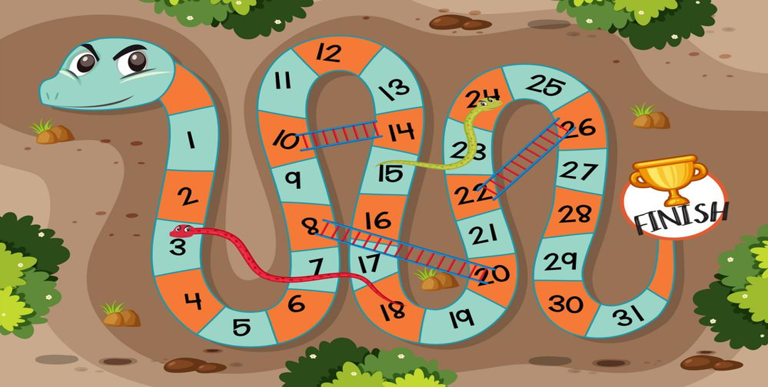










1
2
3
4
5
6
7
8
Notes:
T divides the class into 2 teams. Each team will choose a figure (girl or boy).
Each team chooses a number from 1 to 8 and answer the question. If the answer is correct, the team will get the chance to roll the dice. If not, the chance is given to the other team.
Click on the dice icon to roll. The steps each team can move are corresponding to the number on the dice. If they move to the head of snake or one side of the ladder, they can move to the tail of snake or the other side of the ladder.
The first team coming to finish will win the game.

Slide 18
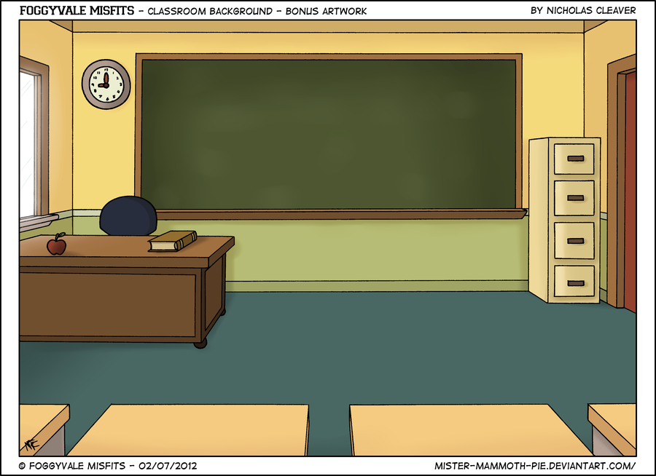


Listen and repeat:
Computers are exciting and fun.

Slide 19

Congratulations!
Let’s roll the dice.

Slide 20
Fill in the blank:
My favourite toys are black ___ yellow.
and

Slide 21

Make a sentence.
The camera / new / isn’t very good.
The camera is new, but it isn’t very good.

Slide 22
Make a sentence:
My favourite toys / comic books / puppets
My favourite toys are comic books and puppets.

Slide 23
Listen and repeat:
This book is interesting, but it’s expensive.

Slide 24
Listen and answer: How is the magazine?
The magazine is new, but it’s boring.

Slide 25
Congratulations!
Let’s roll the dice.

Slide 26
4
Production

Slide 27

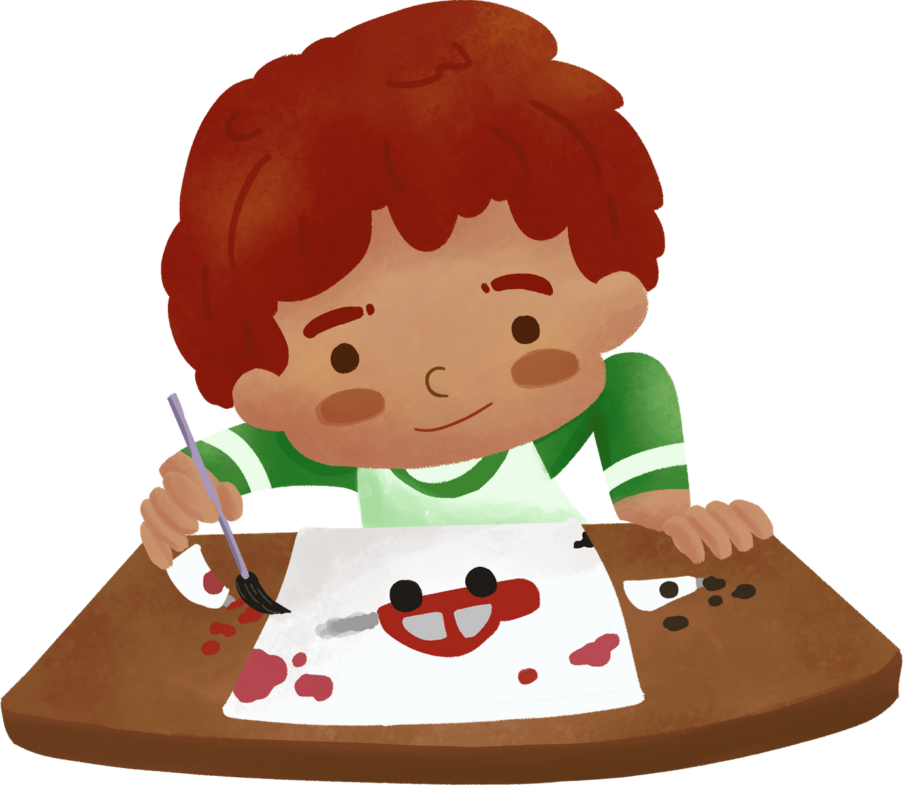
Draw and write about your favourite things using “and” and “but”.
My favourite things are my toy cars. They are black and yellow. My cars are nice but they are expensive …

Slide 28
Wrap-up &
Assessment
5

Slide 29




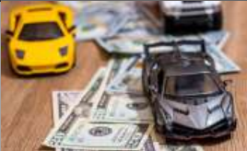


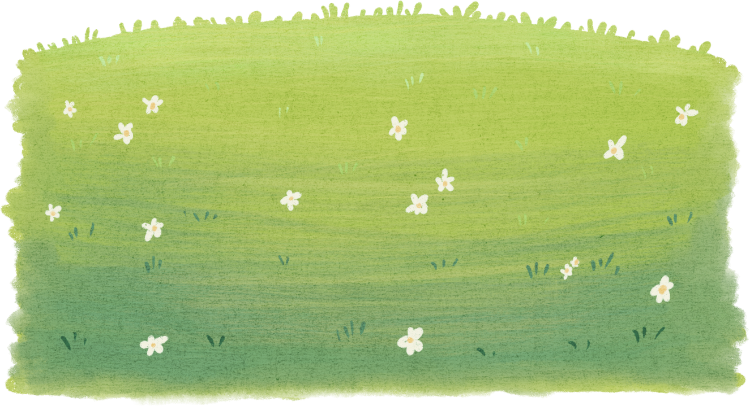
Fill in the blanks:
ASSESSMENT
and
but
expensive ___ boring.
black ___ yellow.
Dan ___ his friends
new ____ it isn’t good.
and
but

Slide 30

Wrap-Up
Vocabulary
and, but
Unit 2: My favourite things
Lesson 3 – Part 4,5,6
What have we learn today?
(and, but)
Structure
… yellow and black
… new but it isn’t very good.

Slide 31

Thank you
for your attention

