Slide 1


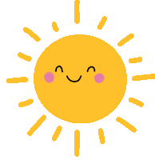


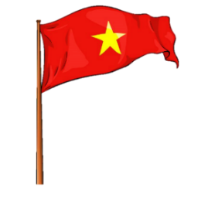





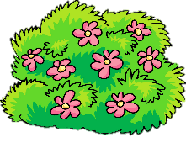
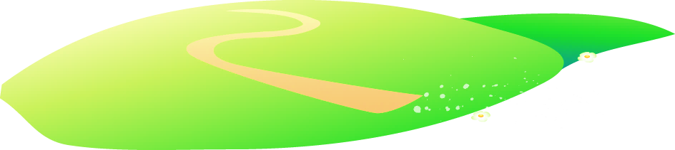


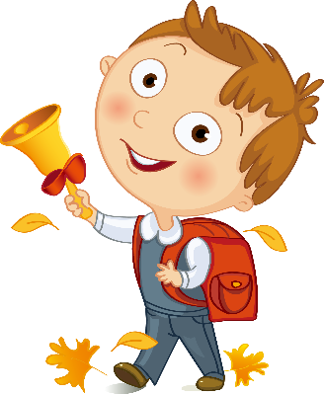
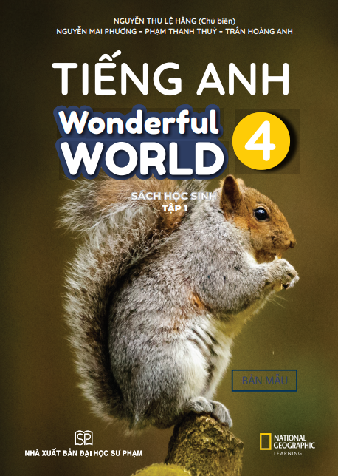


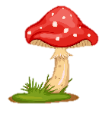
Notes:
Để nguyên trang bìa như này, chỉ thay đổi tên bài trong quá trình làm. Logo của sách Wonderful World

Slide 2
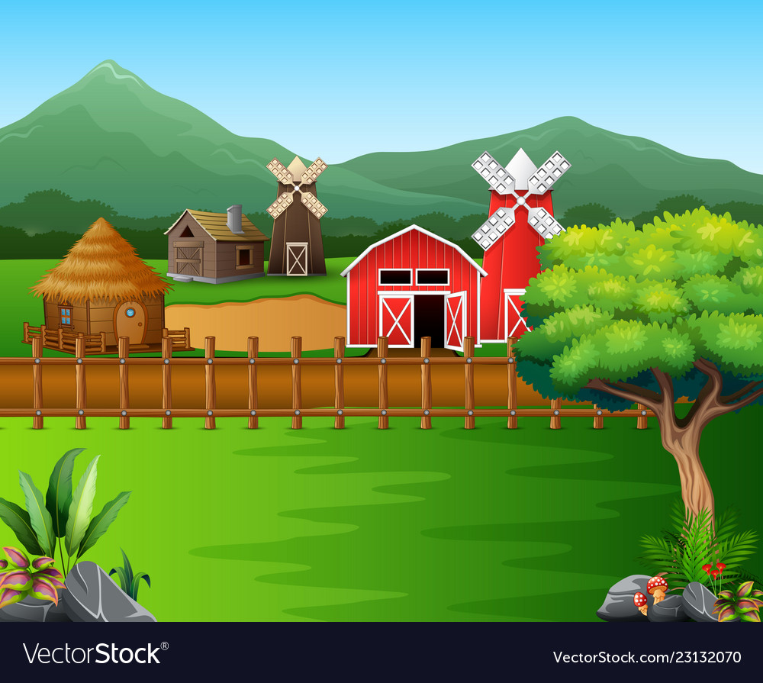


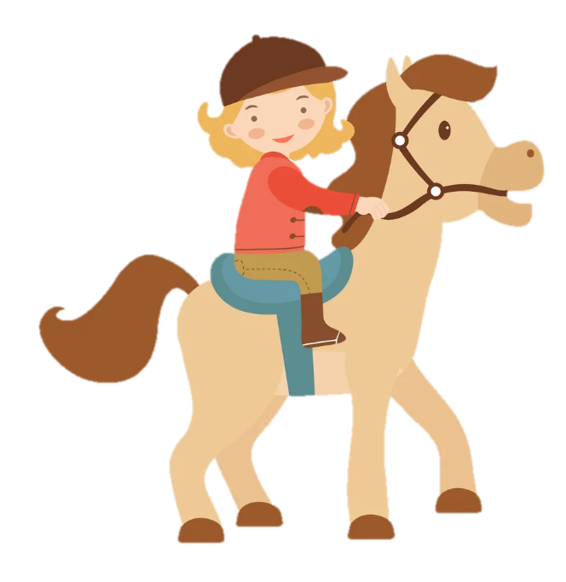
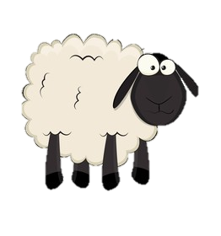
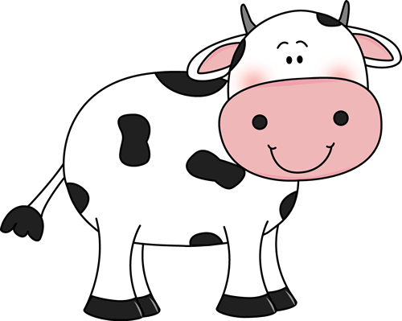
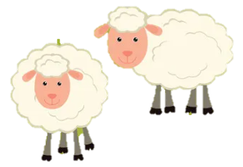
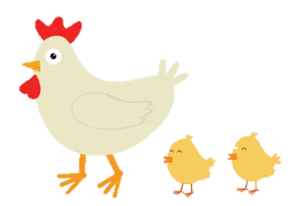
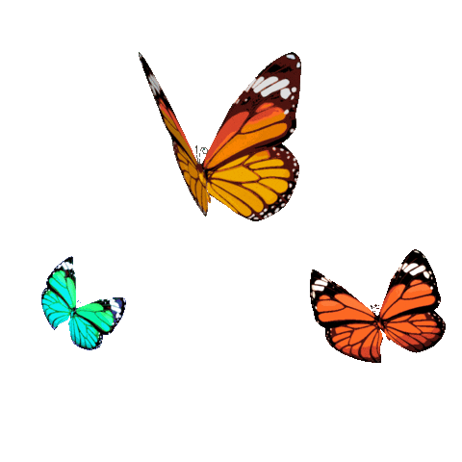
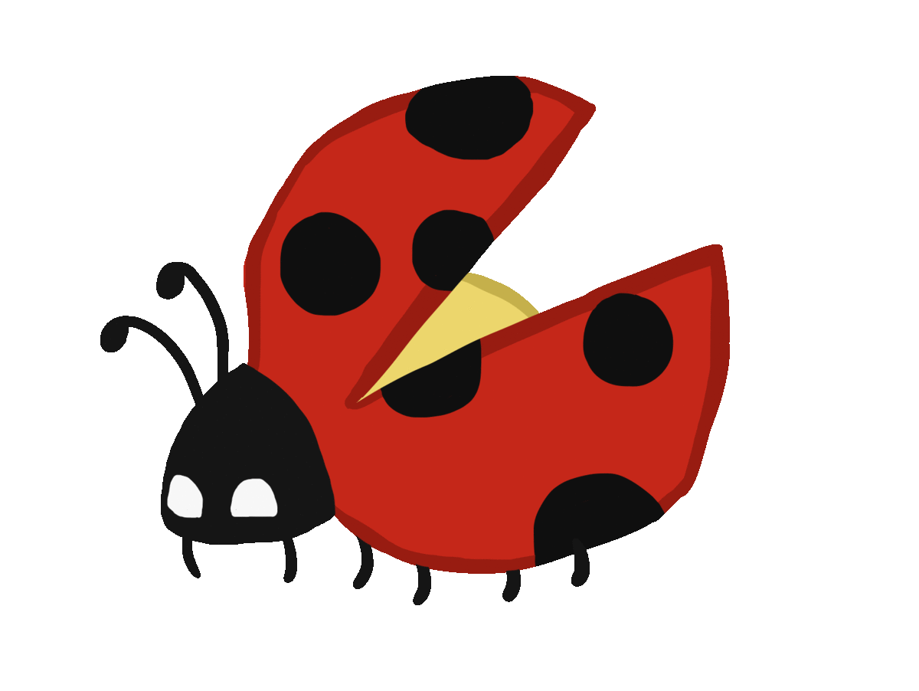
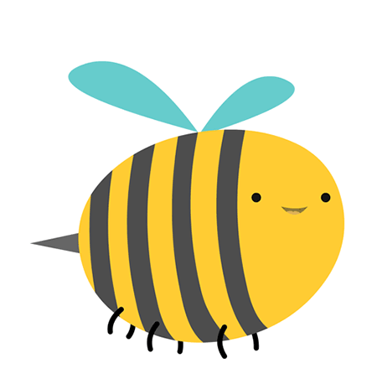
Unit 3: On the farm
Lesson 2. Task 7 8 9

Slide 3
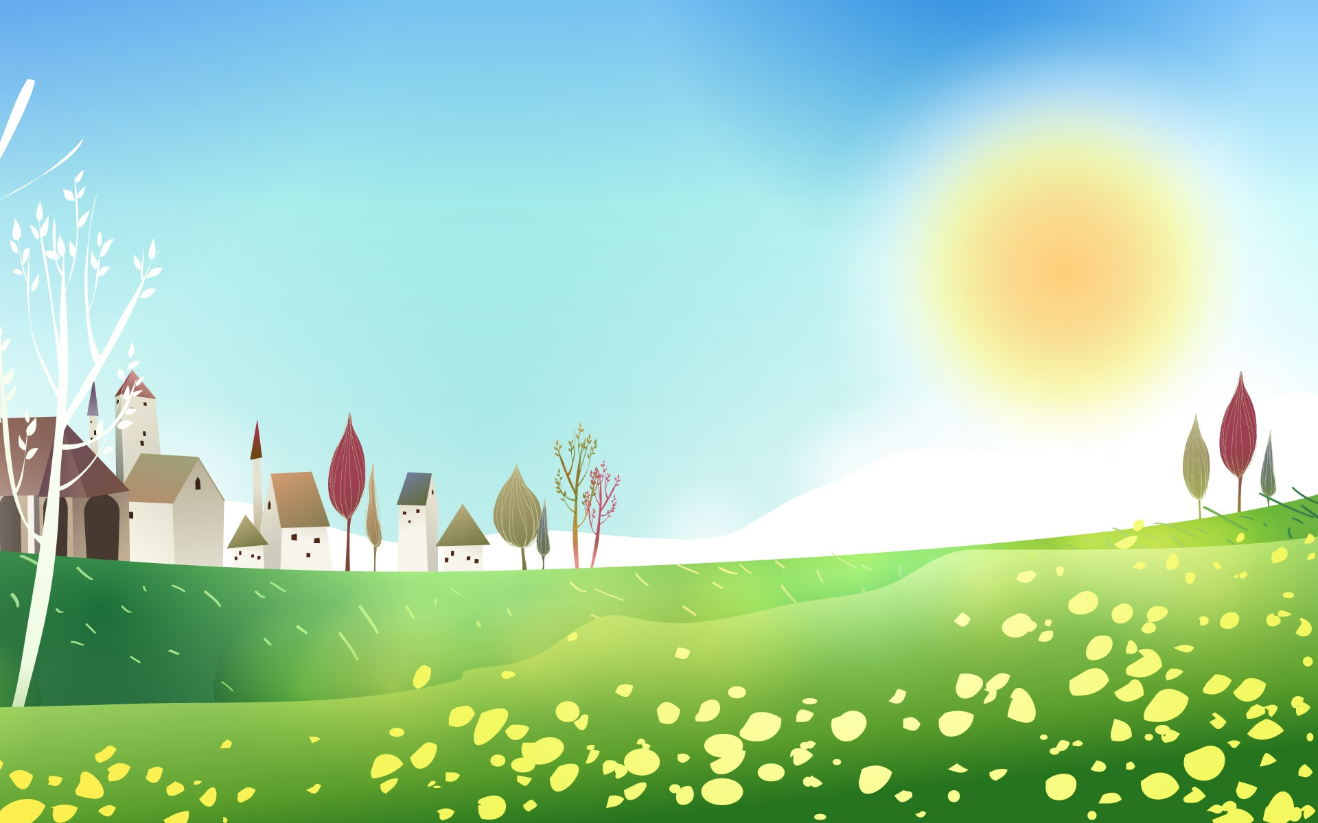


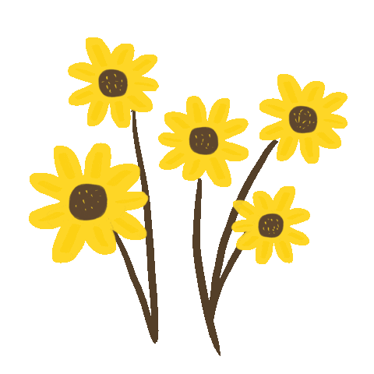

1
Warm Up

Slide 4
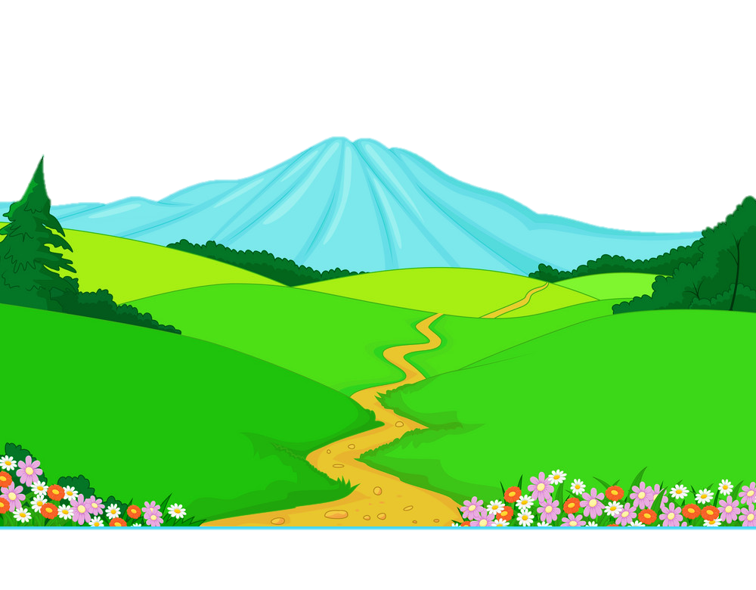
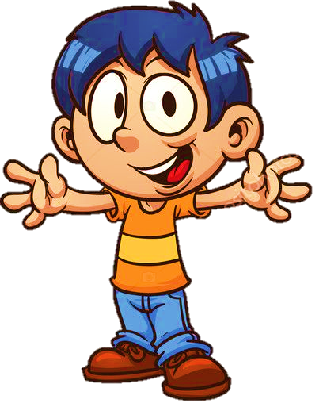
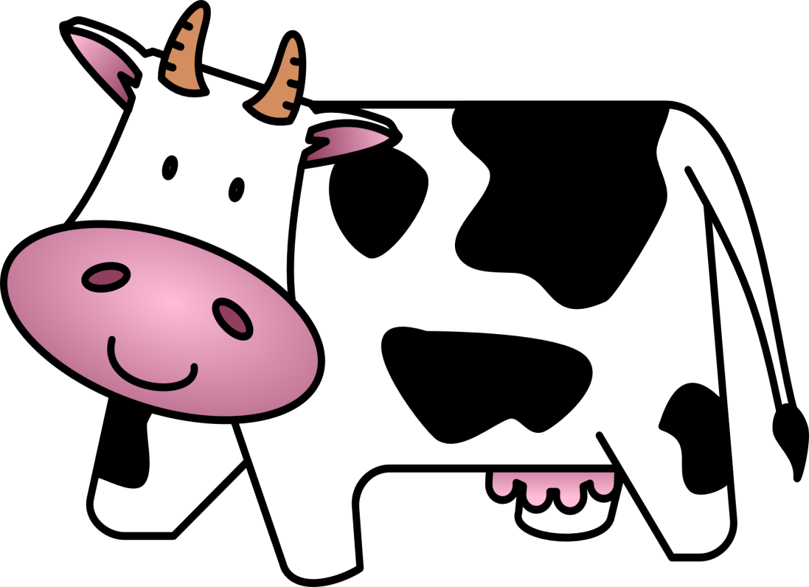
a cow
I have got……………….

Slide 5
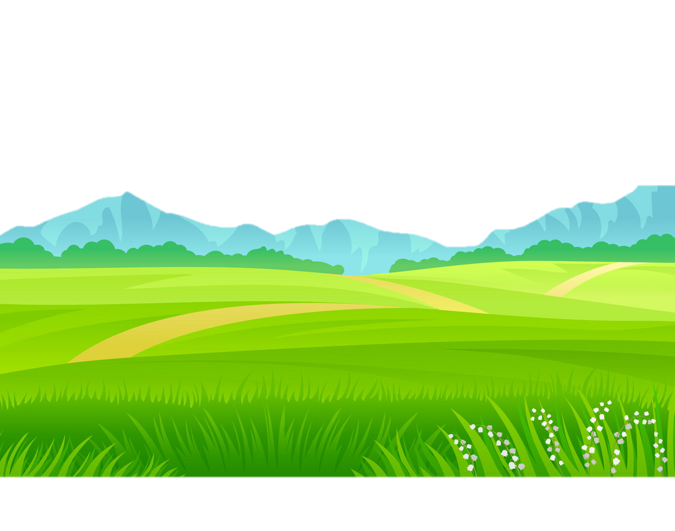
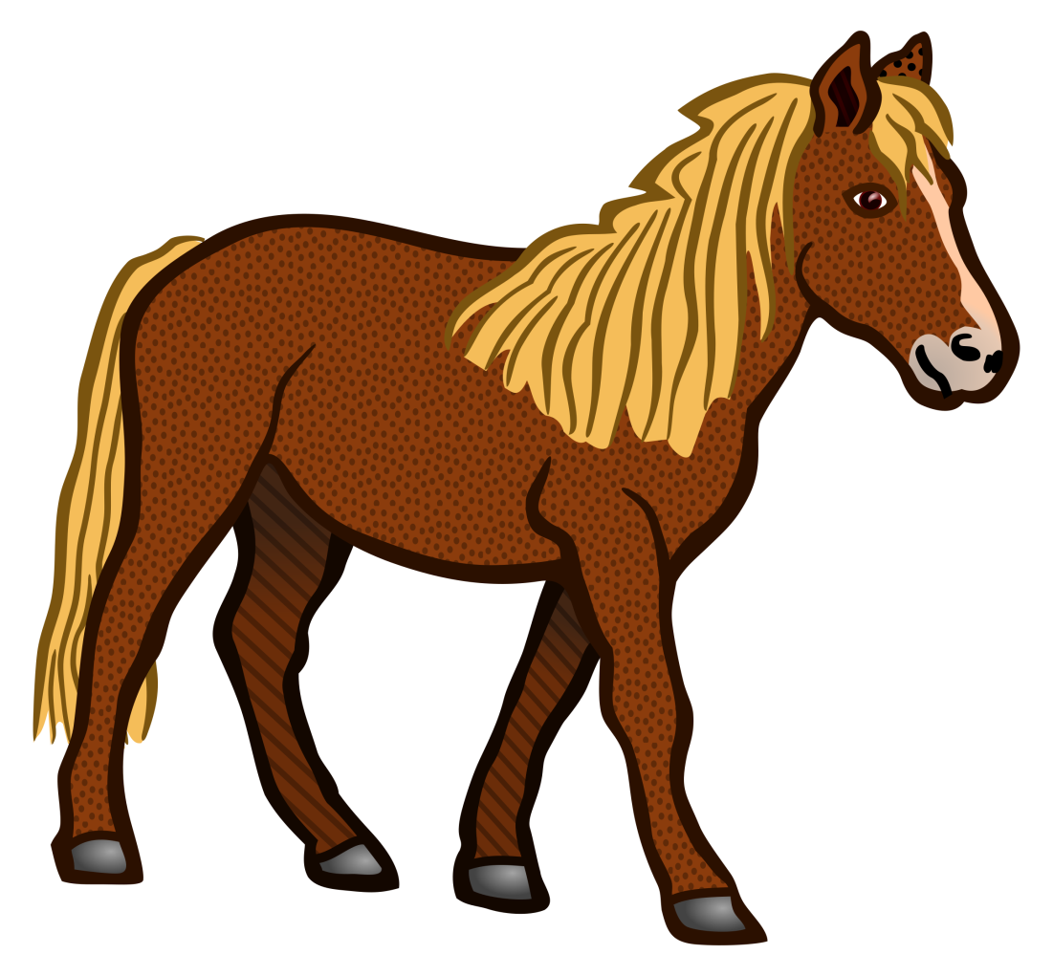
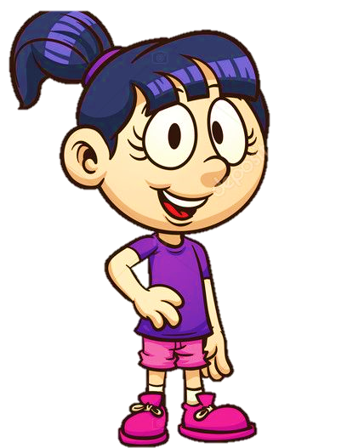
a horse
I have got………...

Slide 6
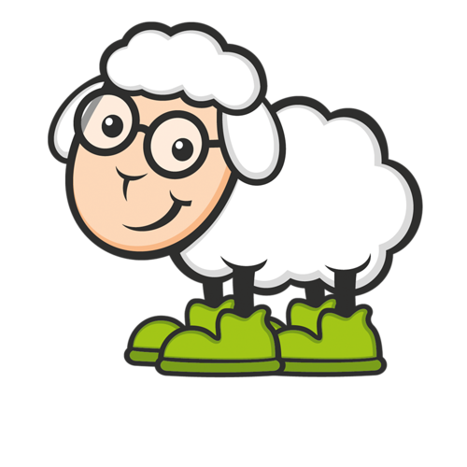
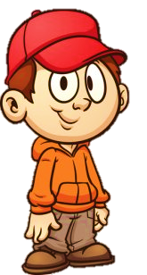
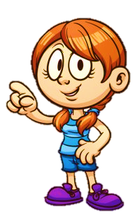
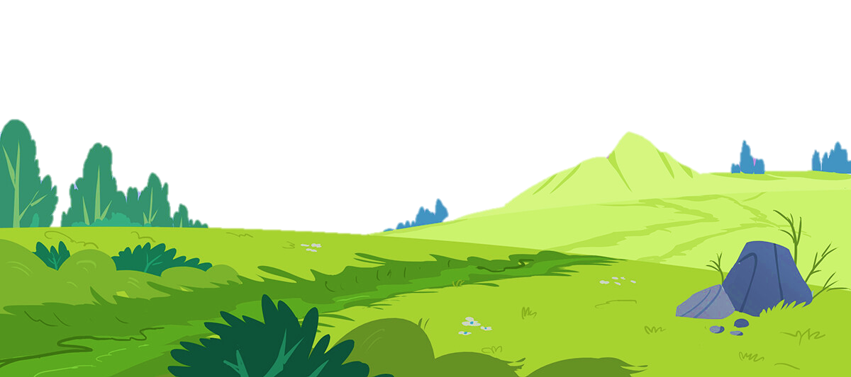
a sheep
We have got ………….

Slide 7
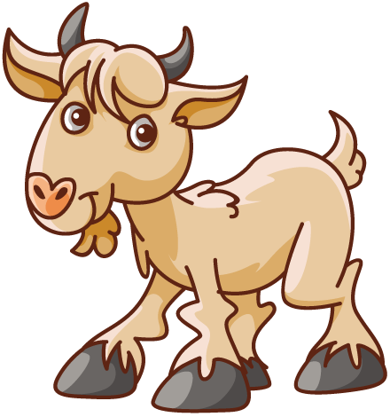
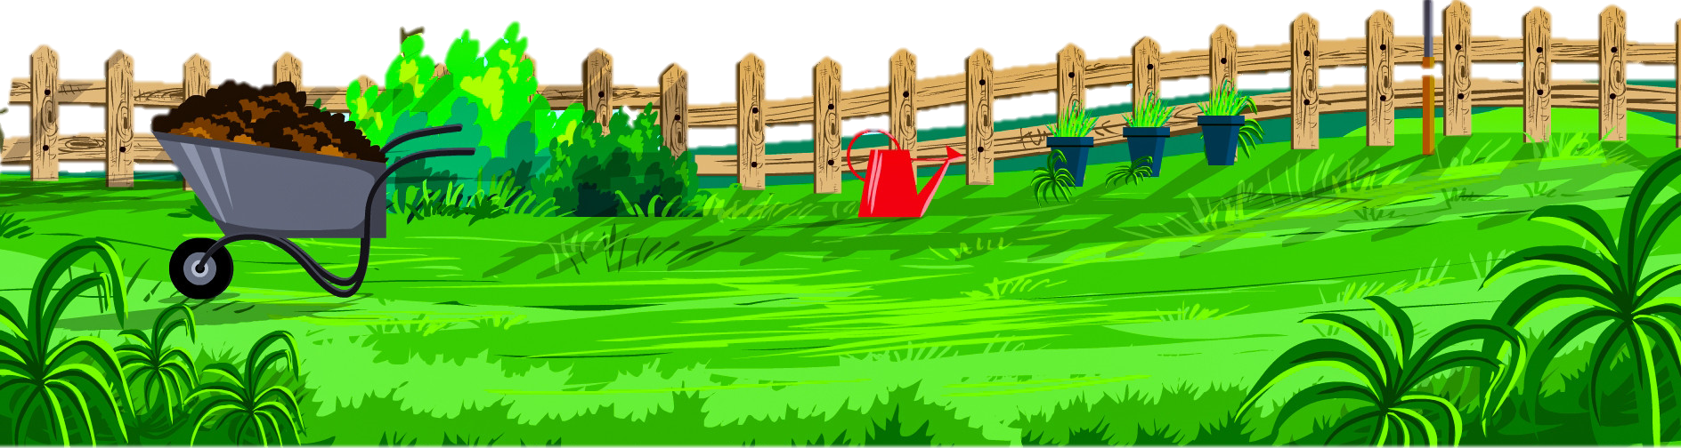
a goat
I have got…………..

Slide 8
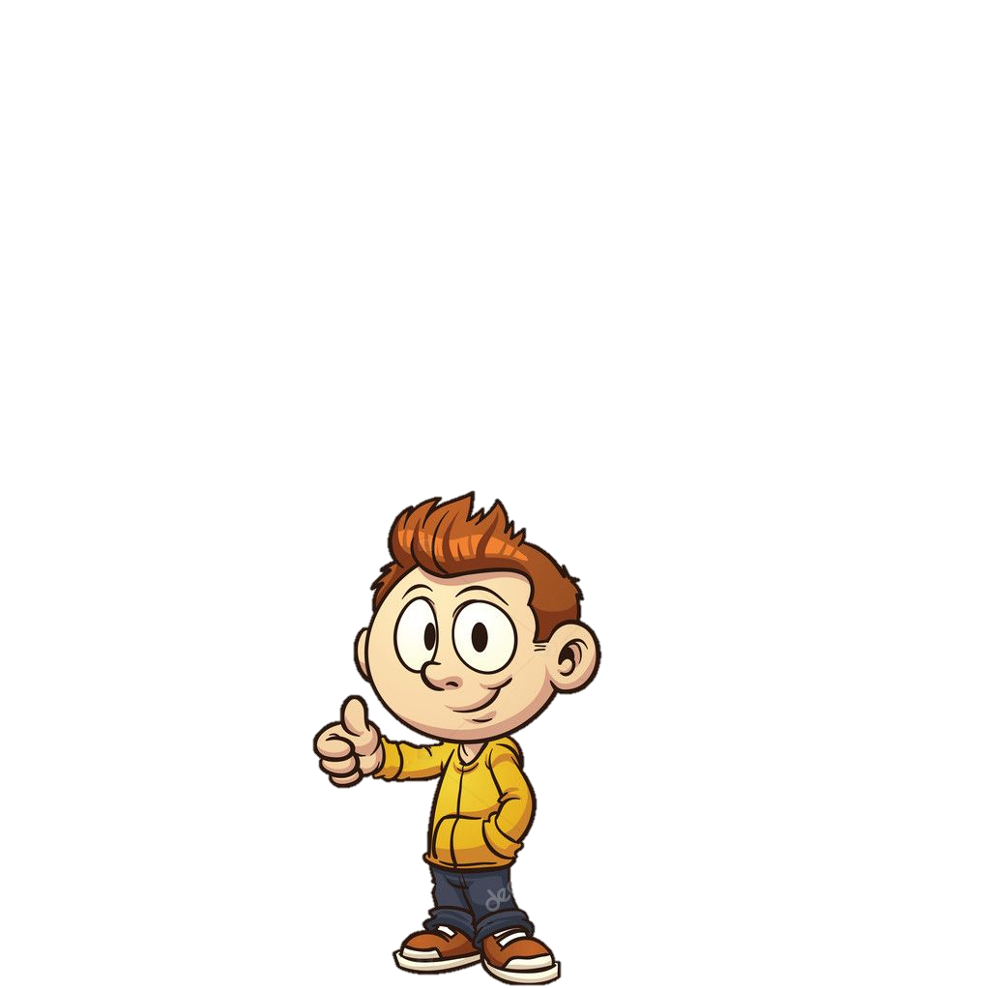
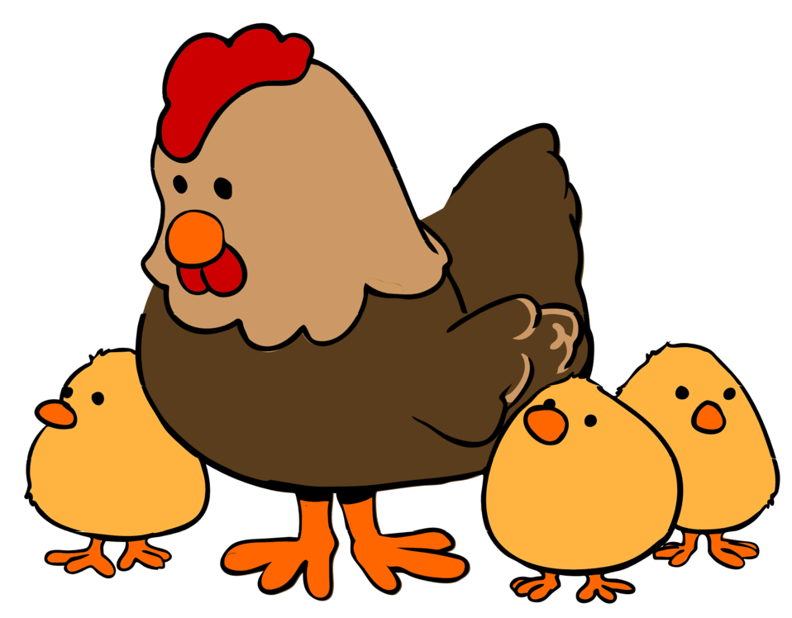
a hen
They have got……………

Slide 9
2
Presentation

Slide 10

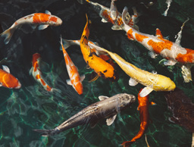
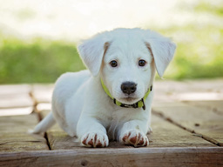

7. Listen and tick.
✓
1. My cousin has got……………… …………………………..

Slide 11
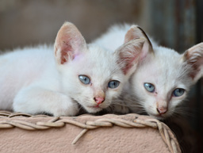
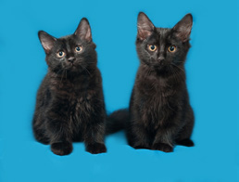
7. Listen and tick.
✓
2. I haven’t got……………… …………………………..

Slide 12
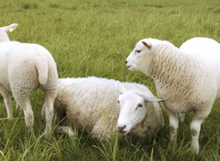
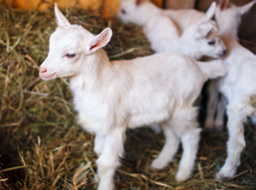
7. Listen and tick.
✓
3. My parents have got……………… …………………………..

Slide 13
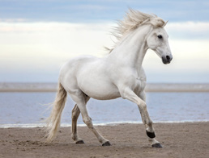
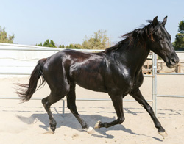
7. Listen and tick.
✓
4. I have got……………… …………………………..

Slide 14
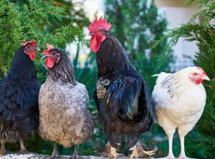
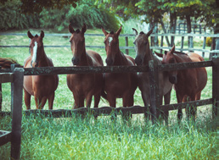
7. Listen and tick.
✓
5. We haven’t got……………… …………………………..

Slide 15
3
Practice

Slide 16
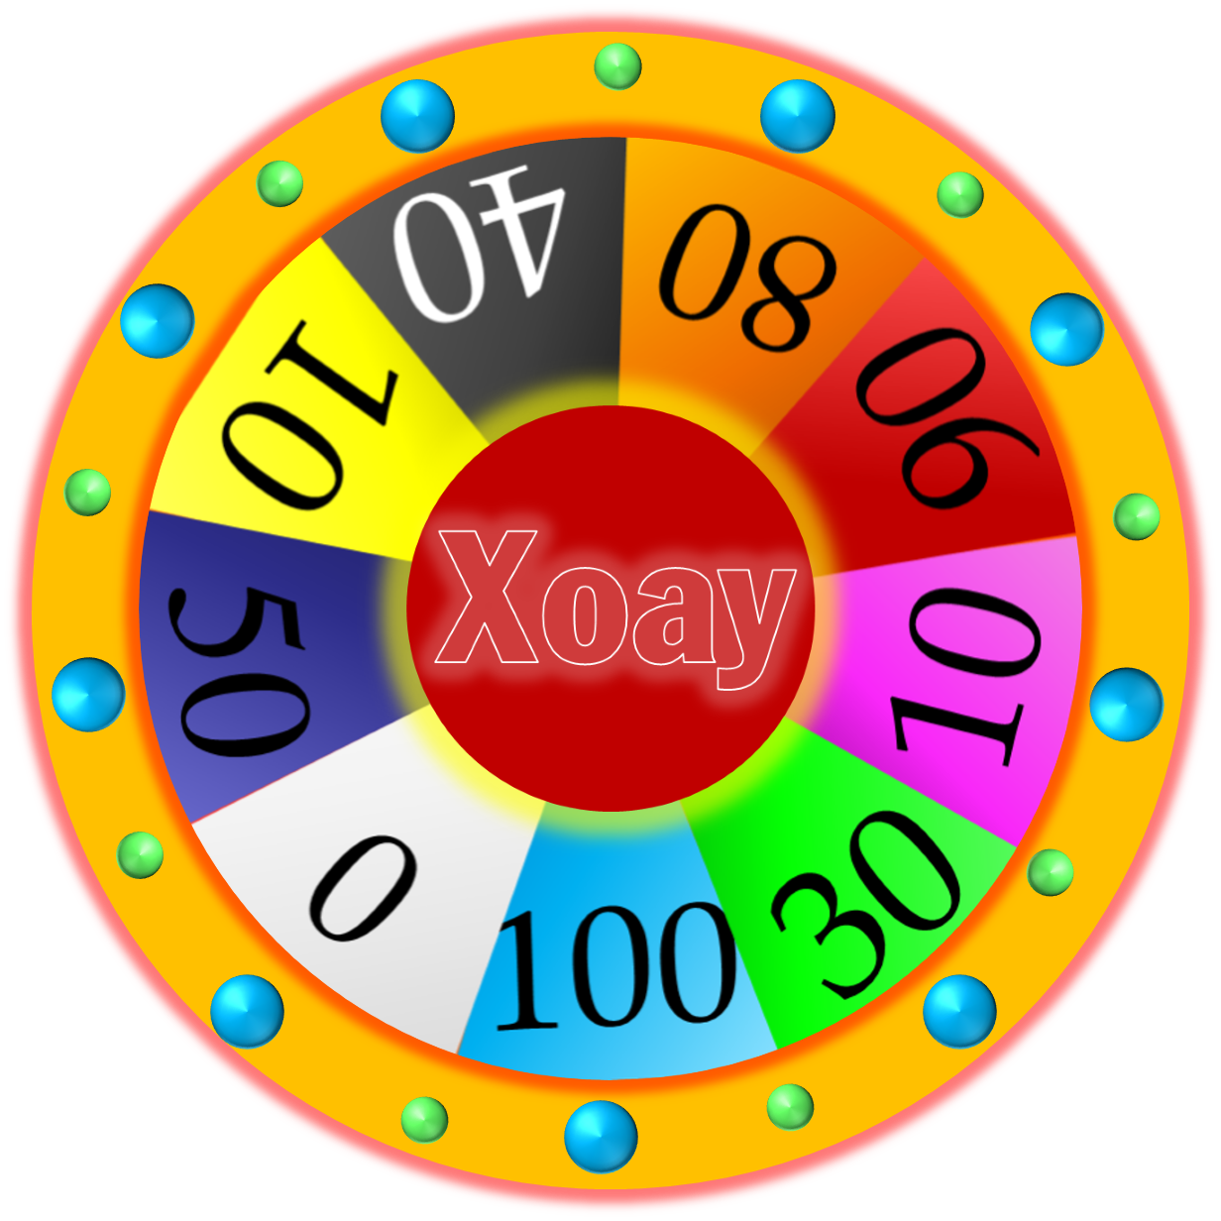
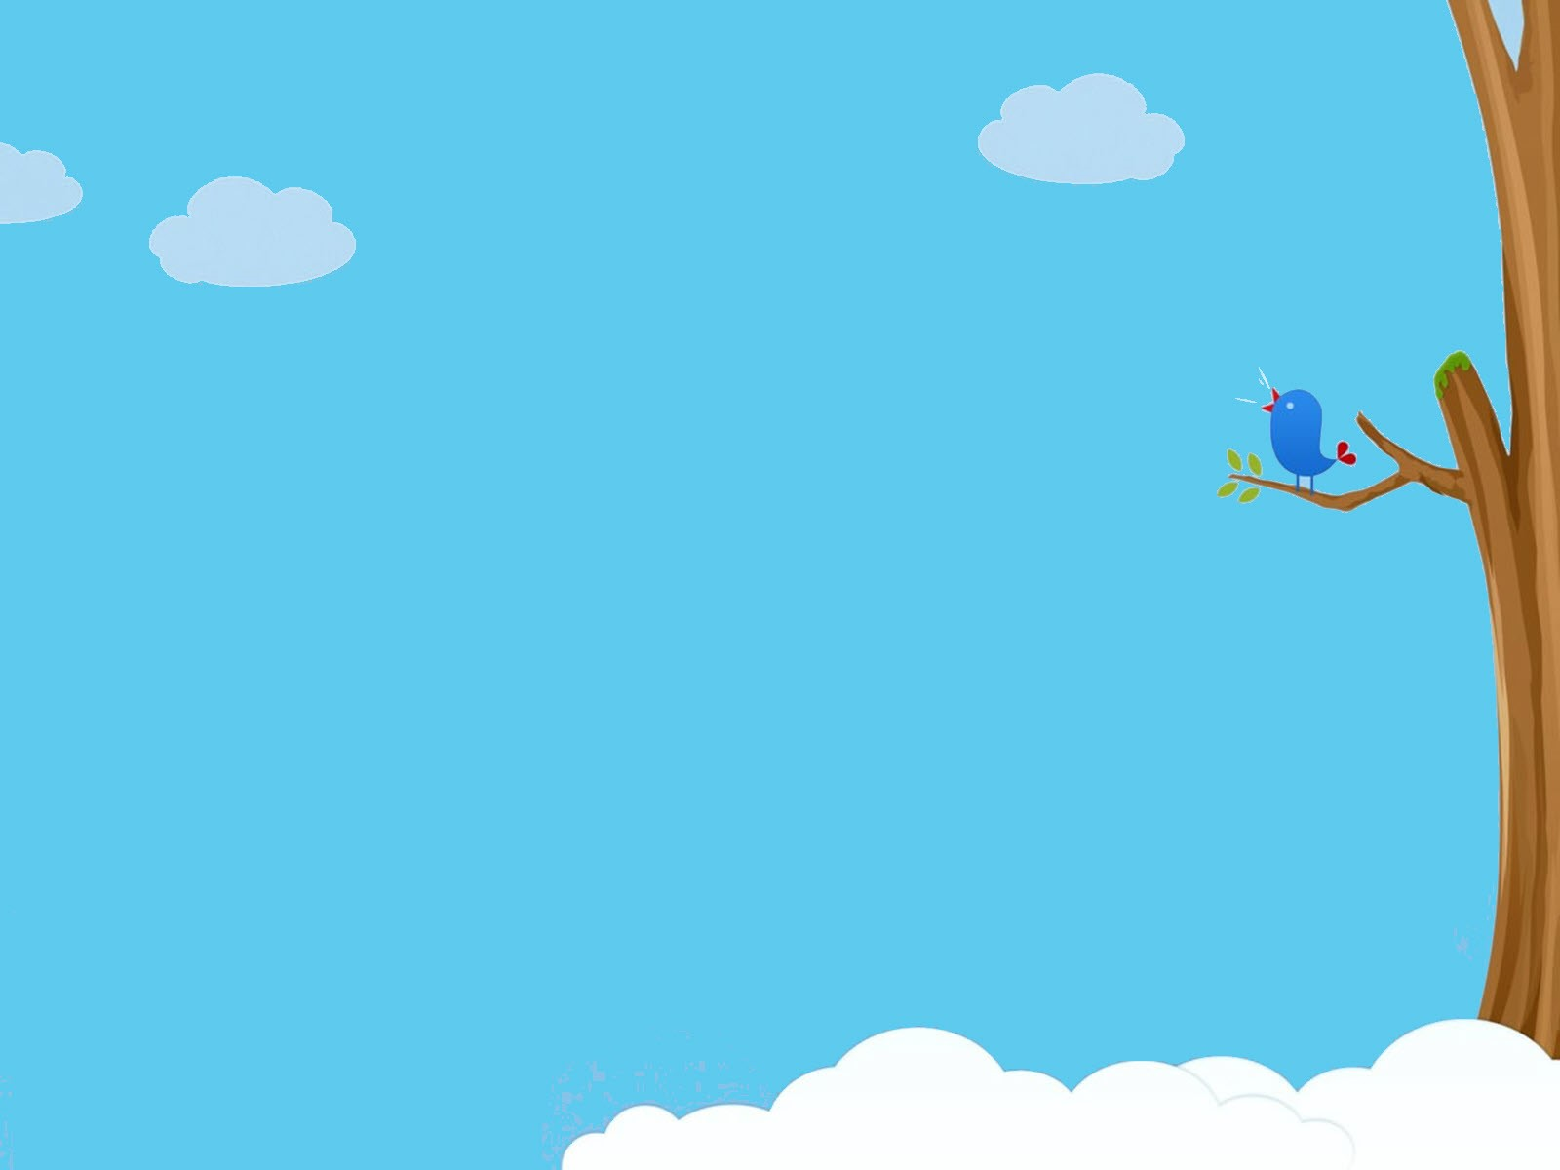




WHEEL OF FORTUNE
30
20
40
10
1
2
3
50
80
60
70
4
5
Next
START
Notes:
CLICK Start để quay => click vào vòng quay để dừng.

Slide 17

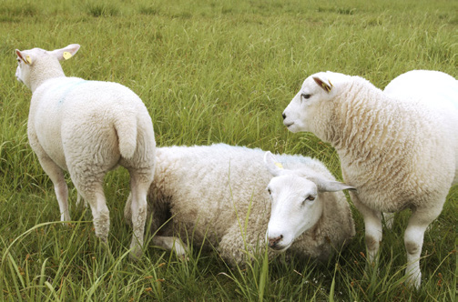
8. Look and Say. .
BACK
white fur (✓)/ long tαils (✘)
The sheep hαve got white fur. They hαven’t got long tαils.

Slide 18
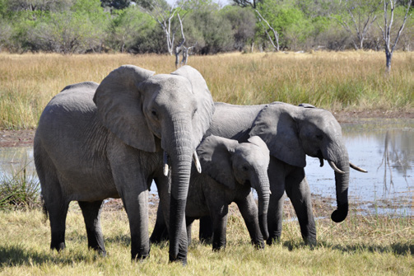
8. Look and Say.
BACK
big feet (✓)/ long fur (✘)
The elephants have got big feet. They haven’t got long fur.

Slide 19
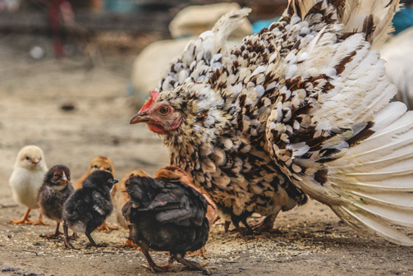
8. Look and Say.
BACK
wings (✓) / long tαils (✘ )
The chickens have got wings. They haven’t got long tails.

Slide 20
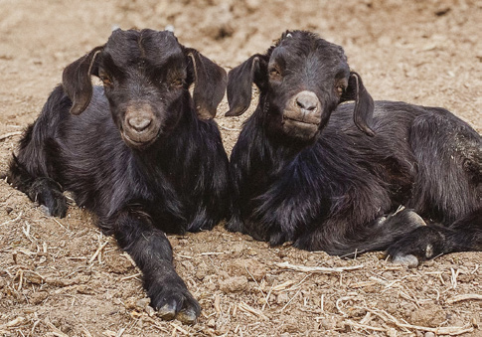
8. Look and Say.
BACK
tαils (✓) / wings (✘ )
The goats have got tails. They haven’t got wings.

Slide 21
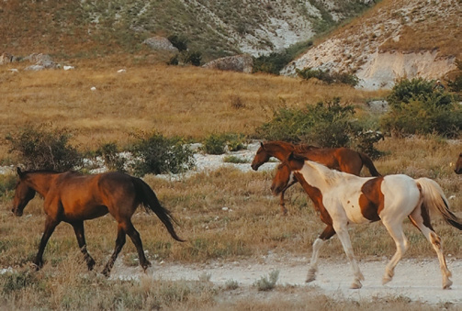
8. Look and Say.
BACK
long legs (✓) / hαnds (✘ )
The horses have got long legs. They haven’t got hands.

Slide 22
4
Production

Slide 23

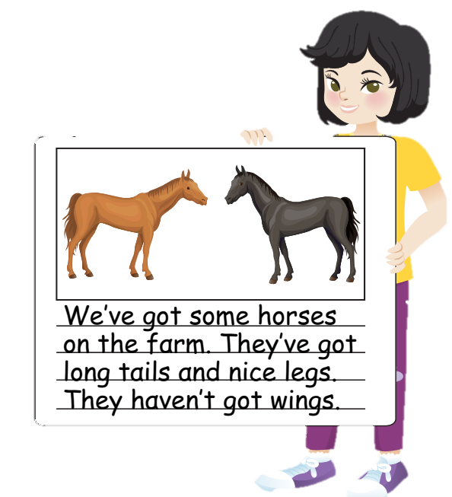
9. Draw and write. Say.
We’ve got some horses on the fαrm...

Slide 24
5
Assessment

Slide 25
Circle
1. We hαven’t / hαsn’t got α goαt.
2. Horses hαven’t got wings / legs.
3. I hαven’t / hαsn’t got α sheep.
4. Cows hαven’t got tαils / hαnds.
5. Fish hαven’t got feet / eyes.

Slide 26


Review
haven’t = have not
The sheep hαve got white fur.
They hαven’t got long tαils.

Slide 27


Thank you
& goodbye!

