Slide 1



















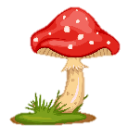
Notes:
Để nguyên trang bìa như này, chỉ thay đổi tên bài trong quá trình làm. Logo của sách Wonderful World

Slide 2
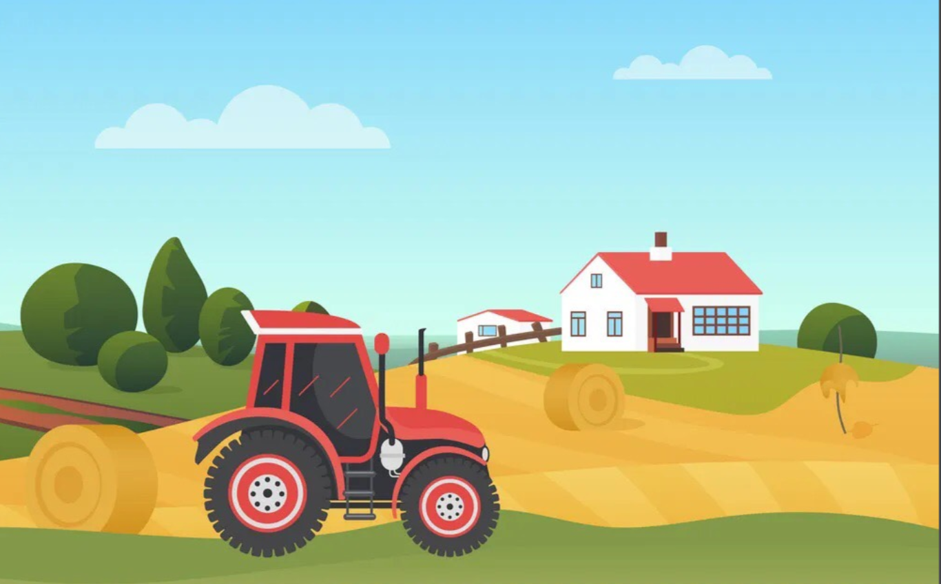


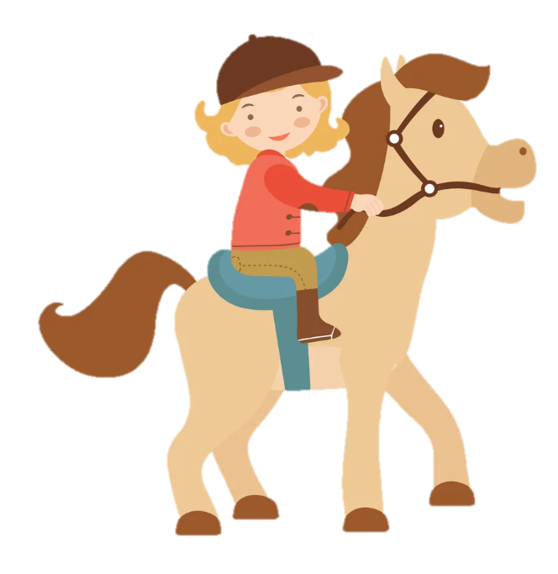
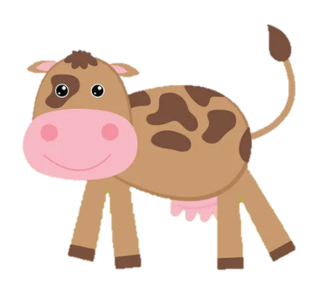
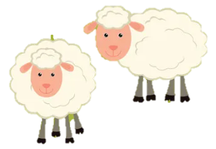
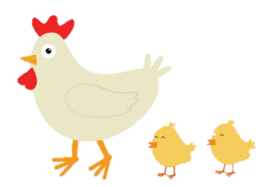
Unit 3: On the farm
Funtime and Project

Slide 3
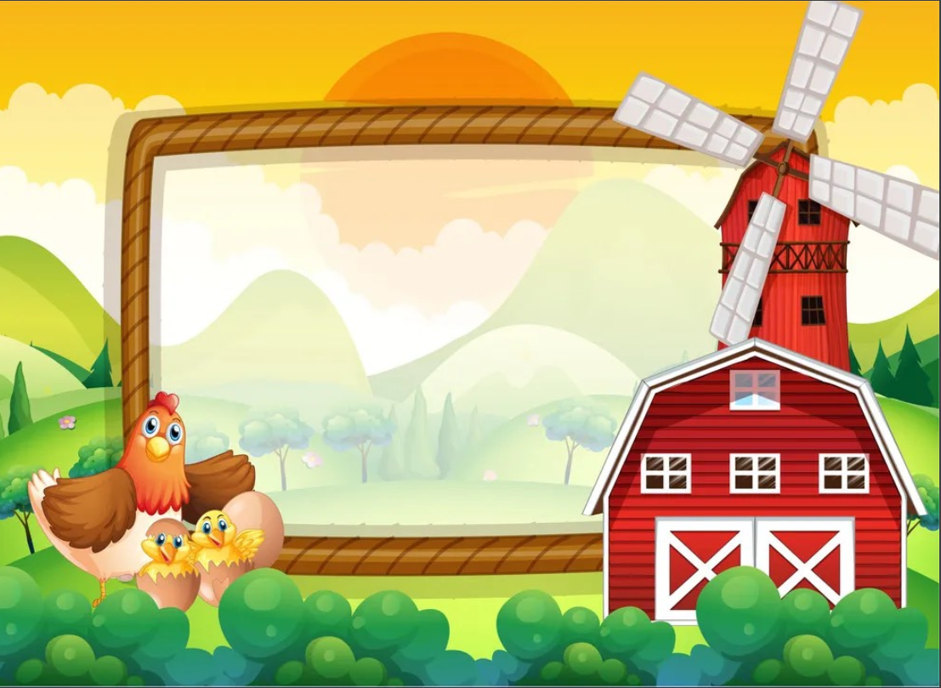
1
Warm Up

Slide 4
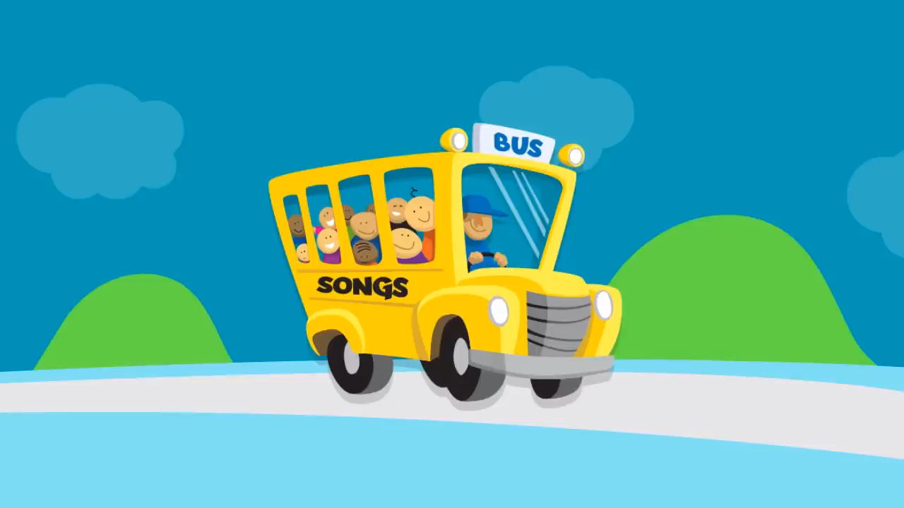
Listen and sing!

Slide 5
2
Fun time

Slide 6
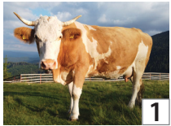
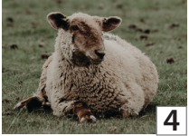
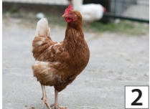
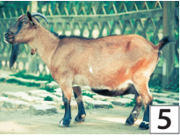
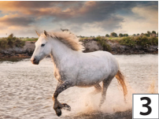
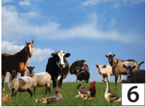
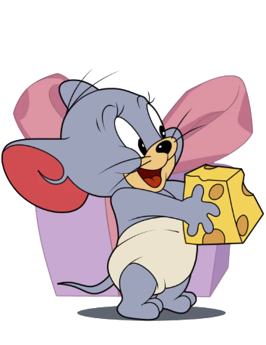
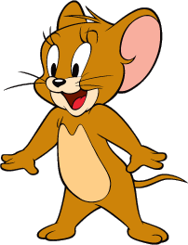
1. Find and Circle!
A | N | I | M | A | L | S | G | N | O
U | H | A | V | G | O | A | T | R | T
C | O | W | R | G | A | R | B | T | M
K | R | A | V | A | O | W | N | R | Q
A | S | H | E | E | P | U | N | O | F
U | E | V | C | H | I | C | K | E | N
I | B | E | W | O | Y | X | Y | E | M
1
2
3
4
5
6
1
2
3
4
5
6

Slide 7
3
Project

Slide 8
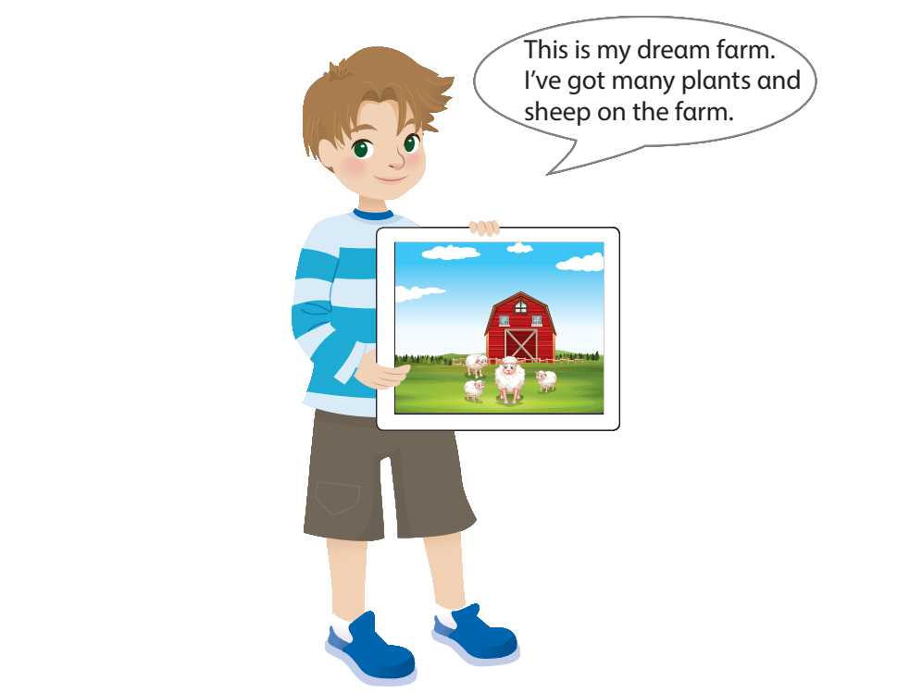
My dream farm

Slide 9
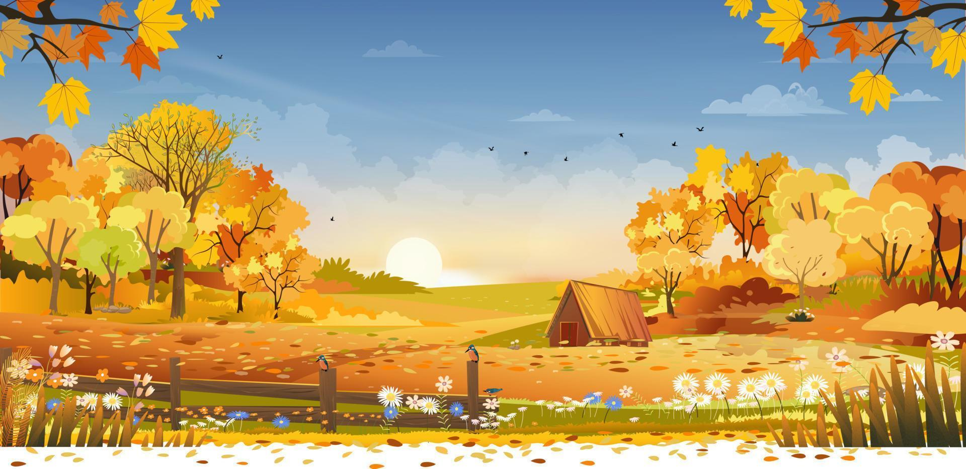
Let’s draw your dream farm!

Slide 10
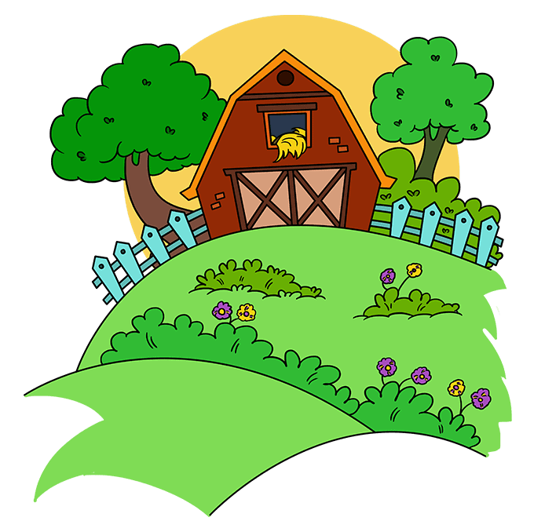
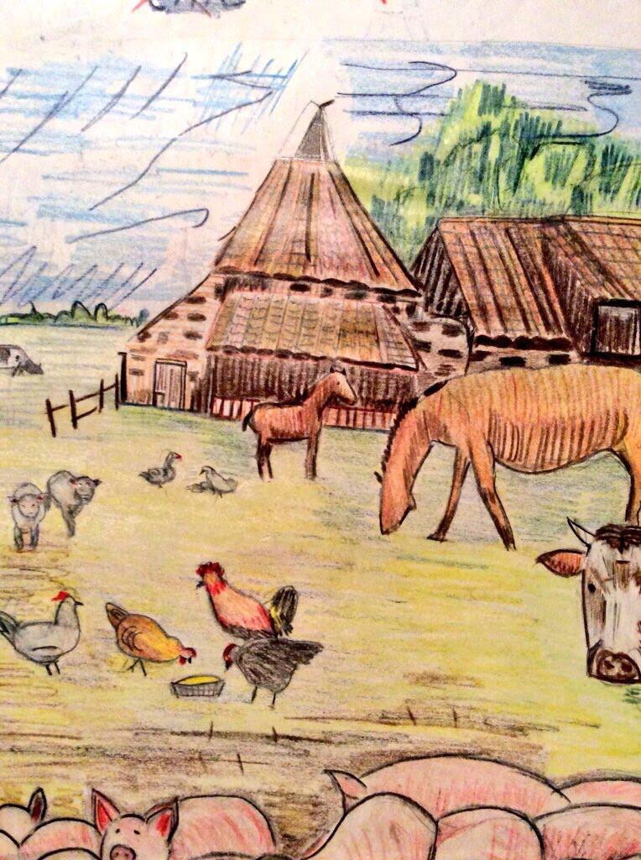
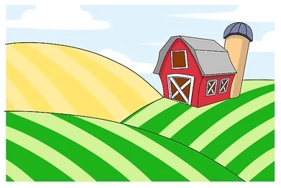
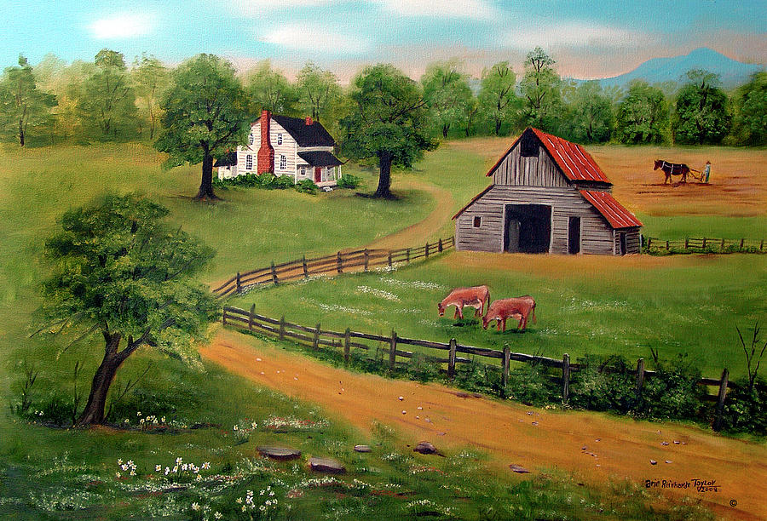
Imagine. What will your dream farm be like?

Slide 11
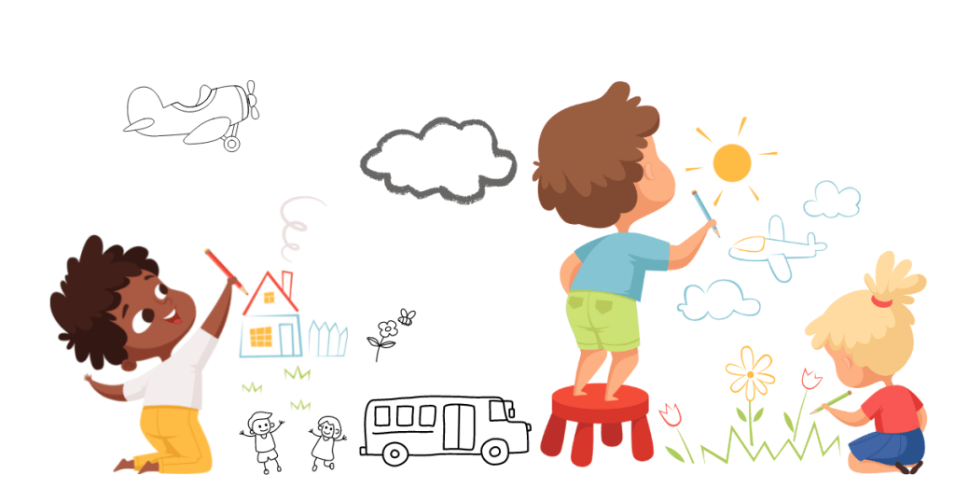
It’s time to draw!

Slide 12
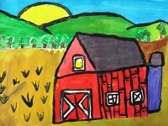
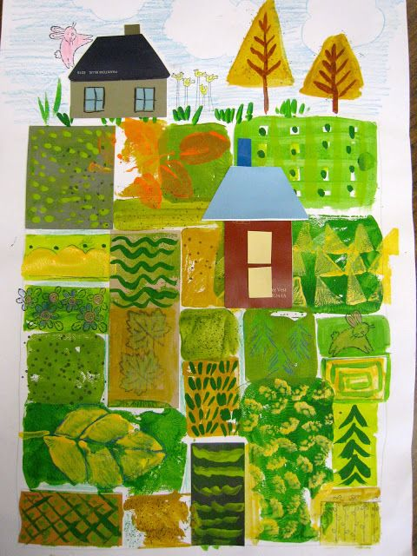
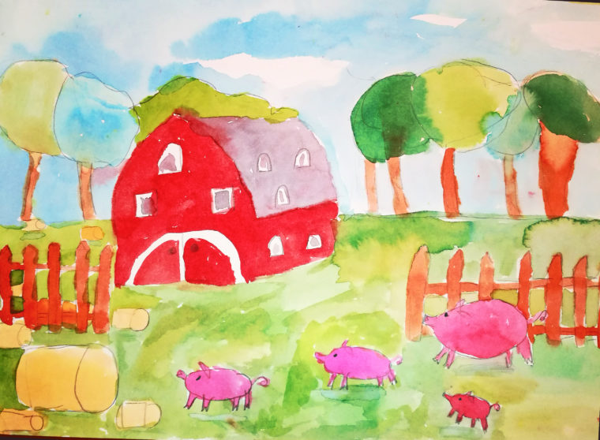
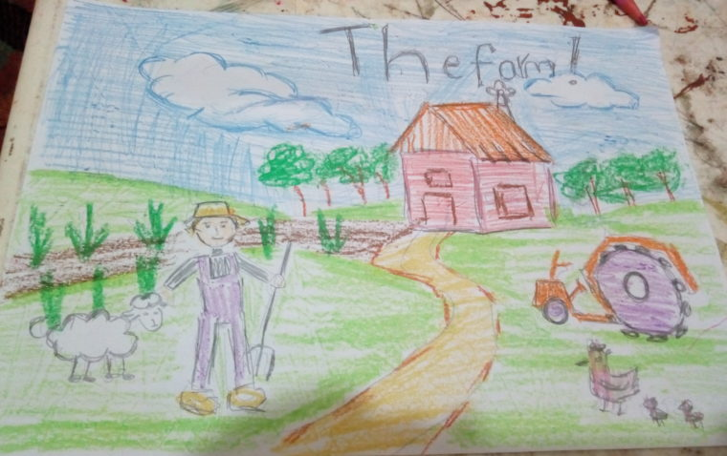
Show off your drawings!

Slide 13
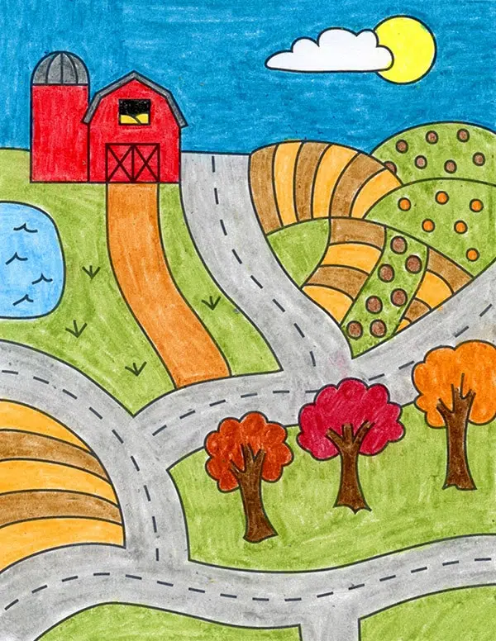
Describe your farm!
This is my farm. I’ve got many plants on my farm.
This is my farm. I’ve got cows on my farm.

Slide 14
Ask and answer.
Have you got plants on the farm?
Have you got chickens on the farm?
Yes, we have.
No, we haven’t.
Have you got horses on the farm?
Yes, we have.

Slide 15
3
Wrap up
&Assessment

Slide 16

2
REMEMBER !
Have you got animals on the farm?
Yes, we have. / No, we haven’t.

Slide 17
REMEMBER !
I’ve got plants on my farm.
A horse hasn’t got hands.

Slide 18

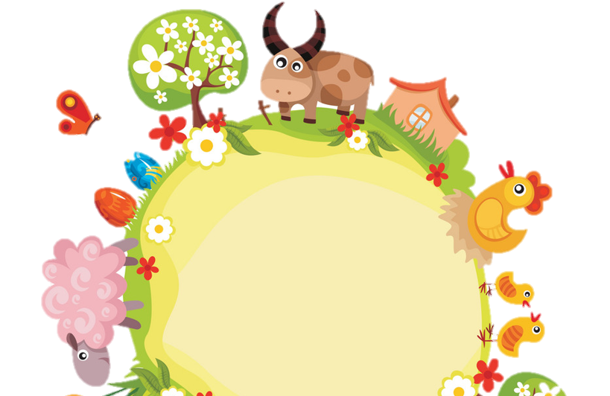
Thank you
& goodbye!

