Slide 1








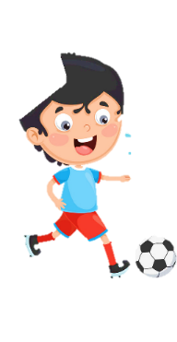












Unit 3
Animals
Lesson 1 – Task 4,5,6
Notes:
Để nguyên trang bìa như này, chỉ thay đổi tên bài trong quá trình làm. Logo của sách Wonderful World

Slide 2

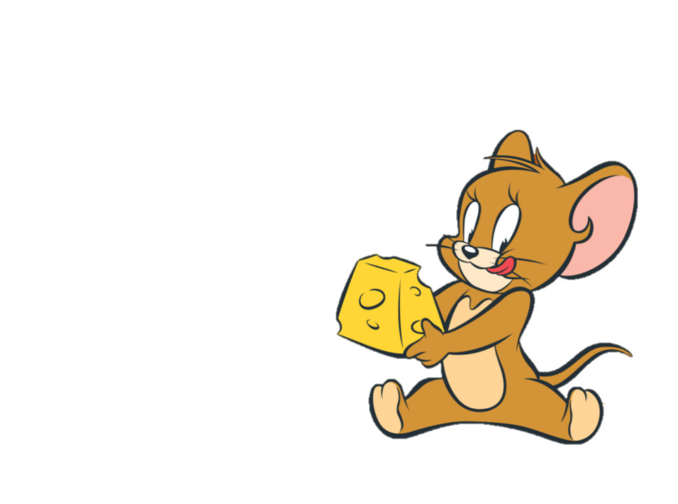
Warm Up
01.
GAME : JERRY’S GUESS

Slide 3
2 Presentation
Notes:
Stop here

Slide 4

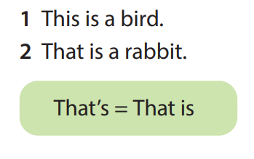
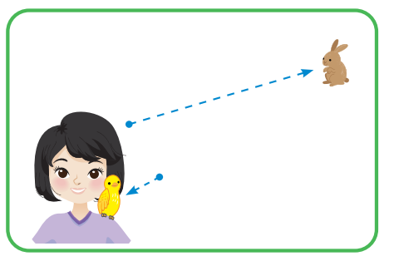
4 Listen and repeat
That’s
This is

Slide 5
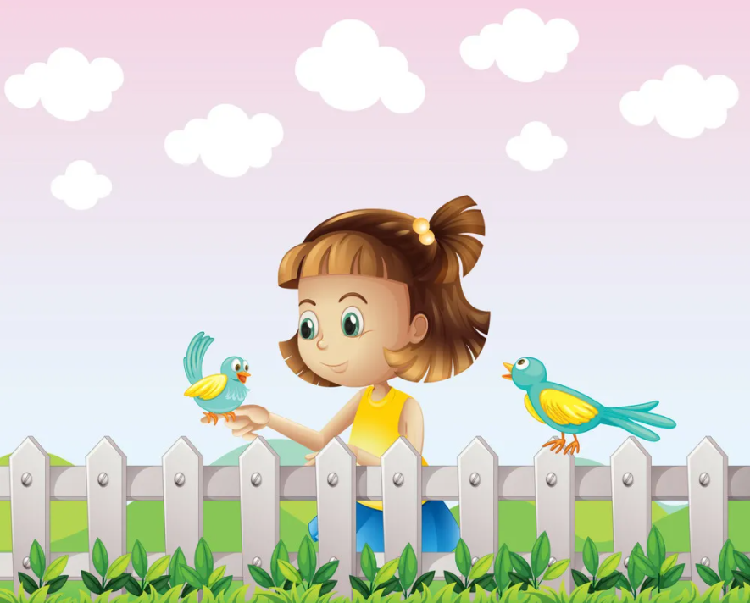

This is a bird .

Slide 6
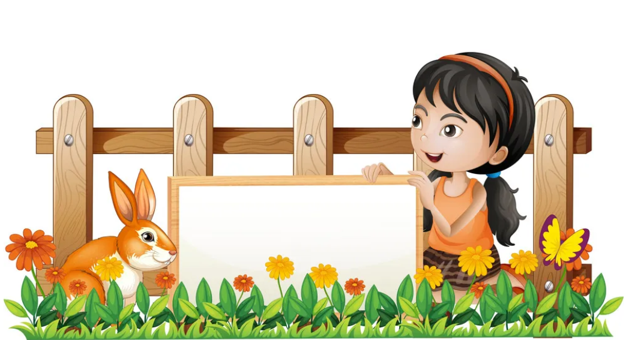
That is a rabbit.

Slide 7
LISTEN AND TICK

Slide 8
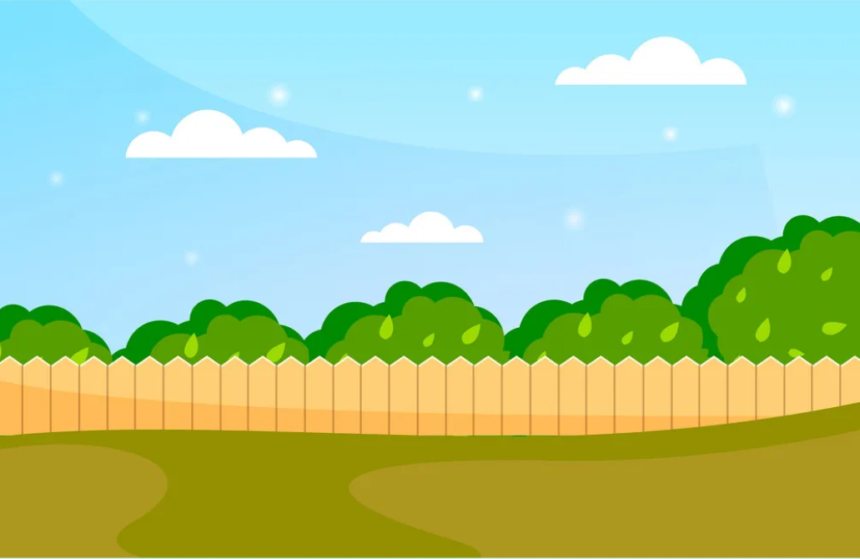
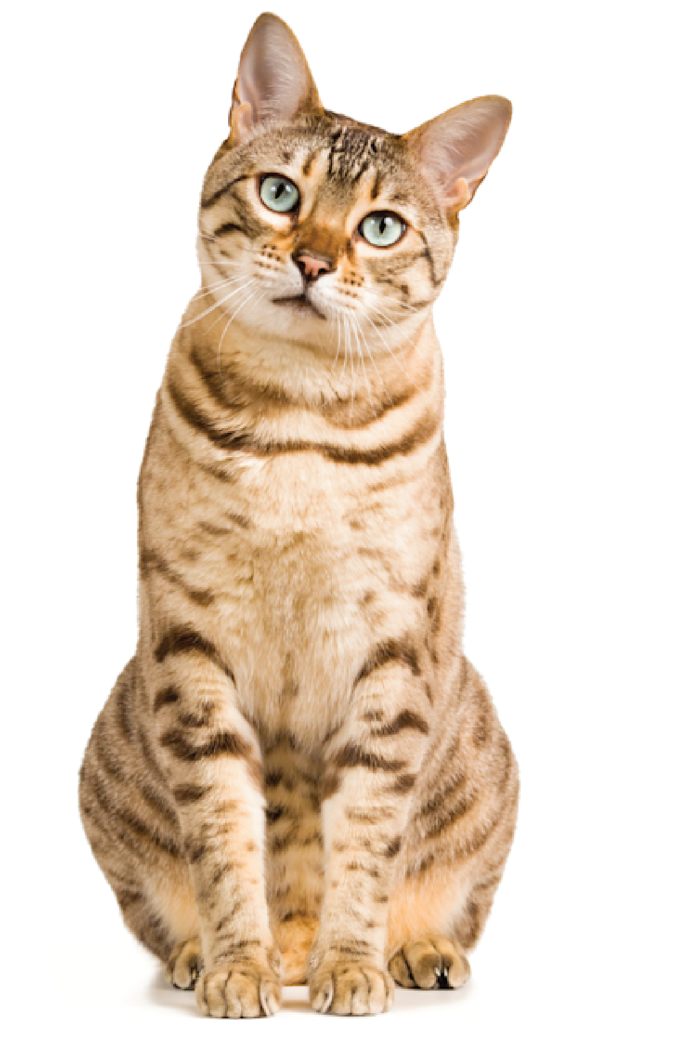
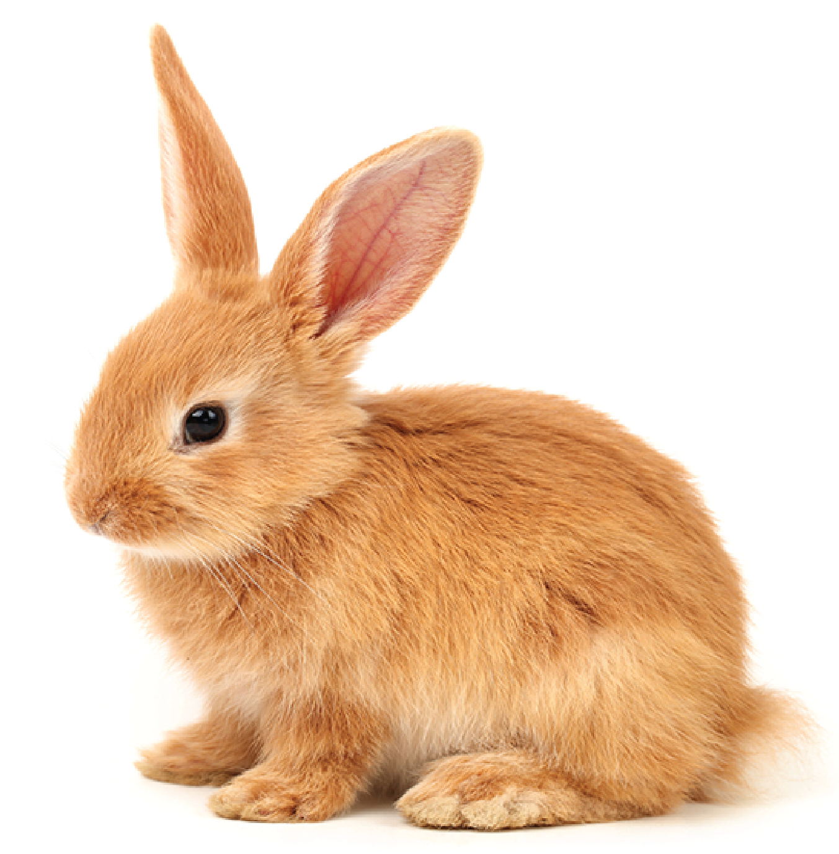
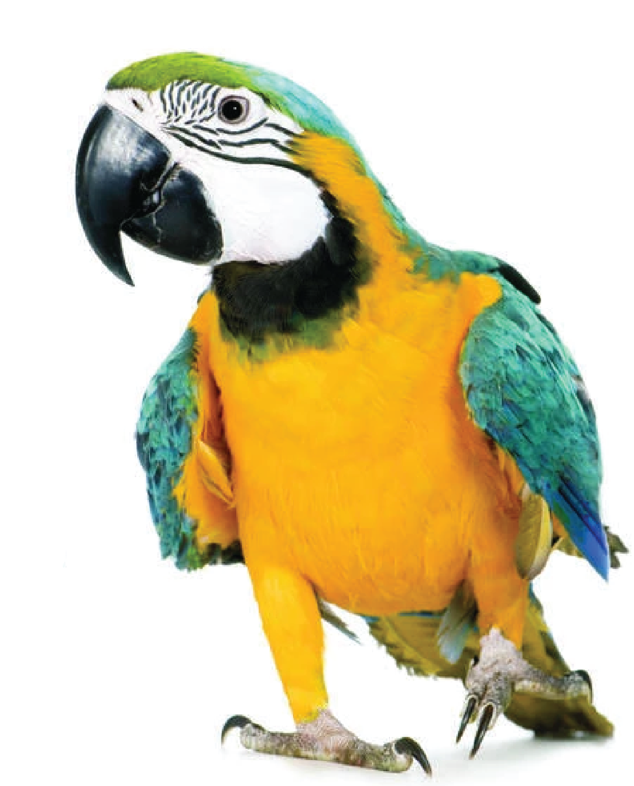
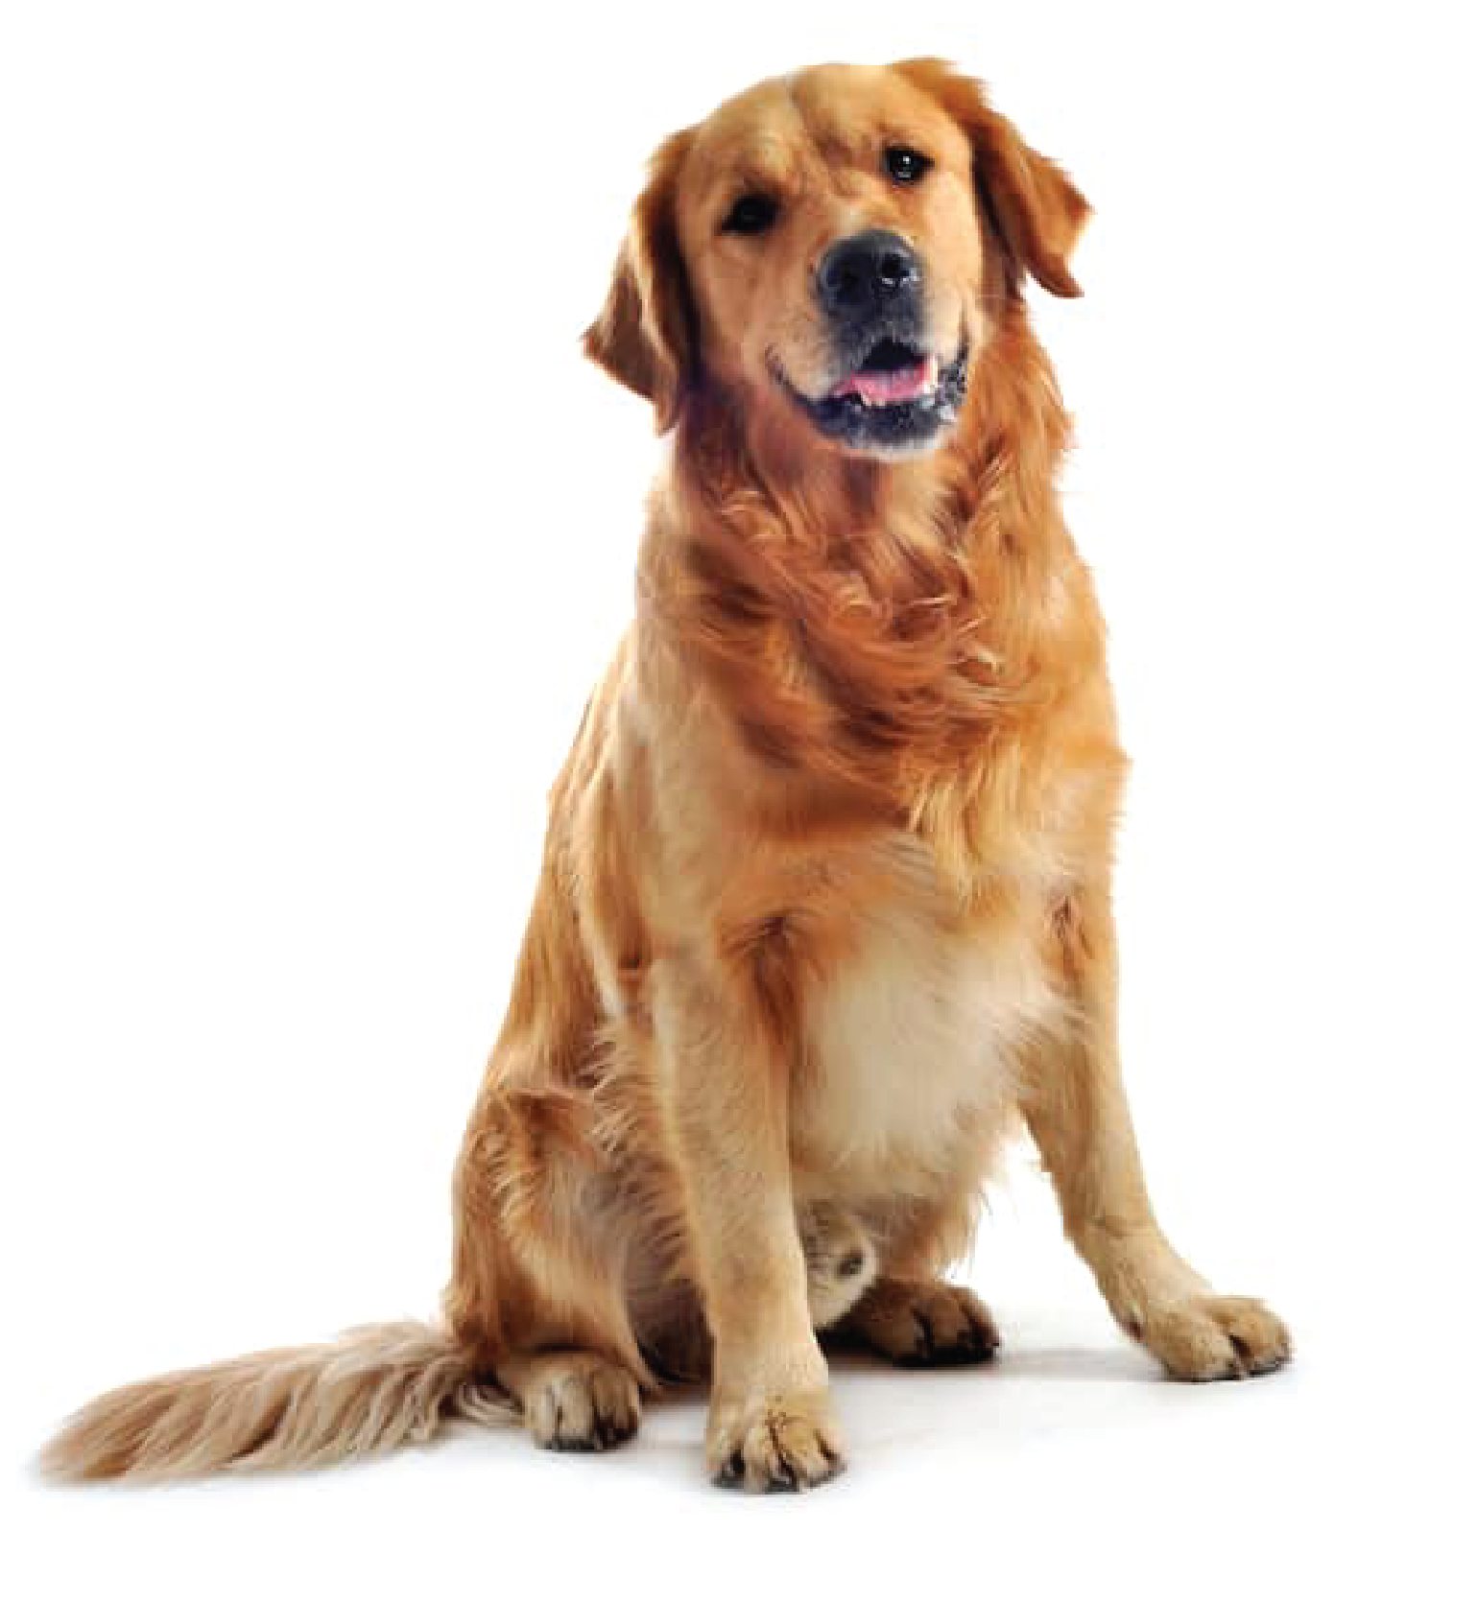
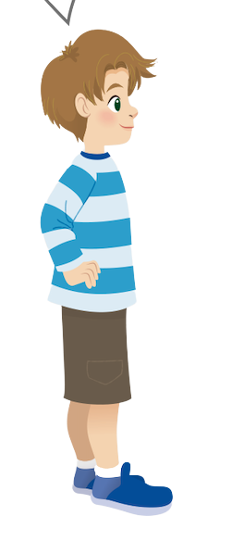
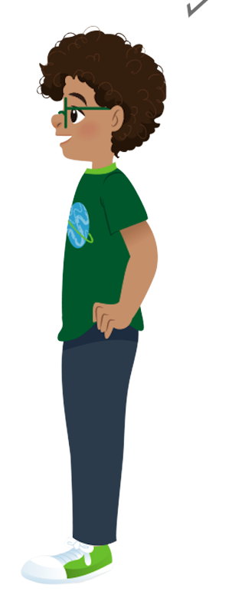
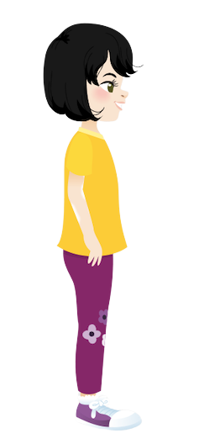
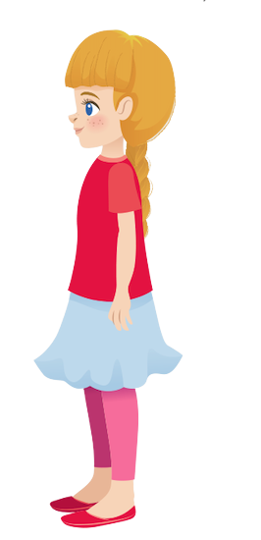
Listen and tick
✓
2. That is a
✓
1.This is a
That’s
Sophie
This is
Ana
Alex
Tomas

Slide 9
03.
Practice

Slide 10



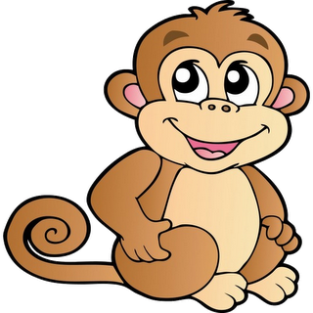
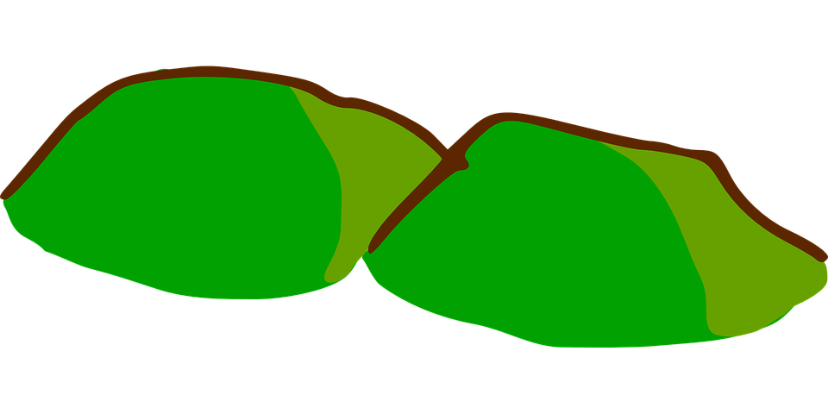
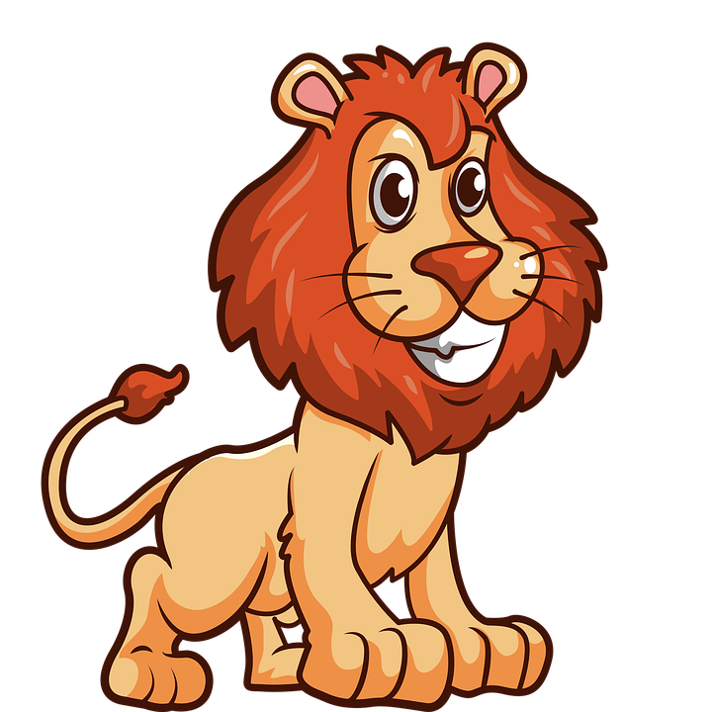
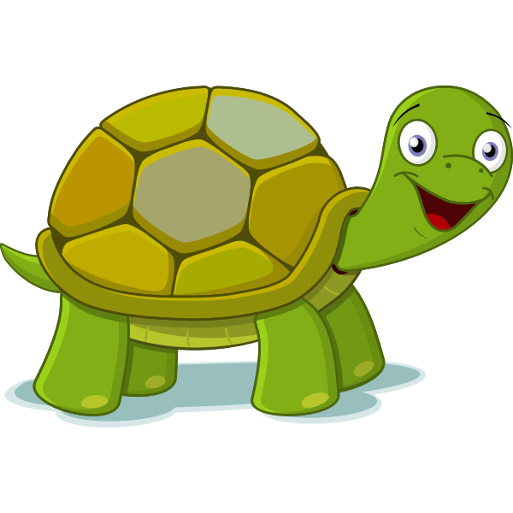
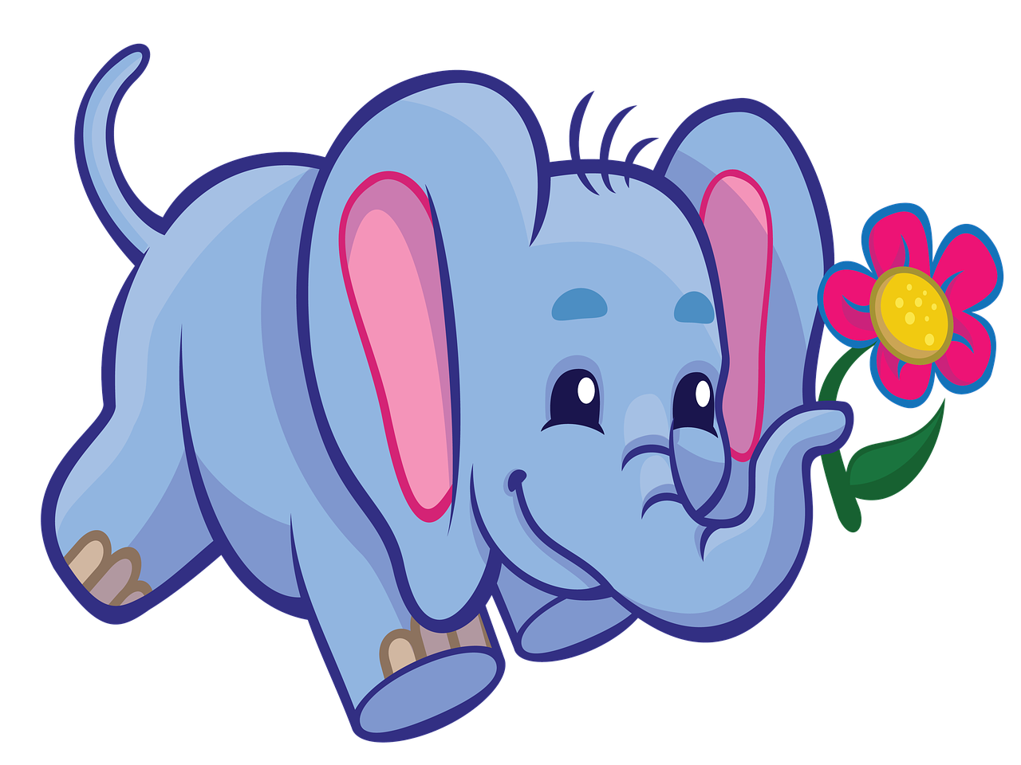

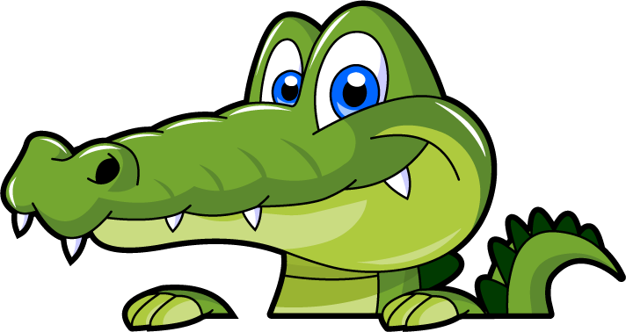
Build Bridge Game
1
2
3
4
5
Next
Notes:
Bấm các viên gạch để xuất hiện câu hỏi
Bấm Next để qua phần kế tiếp

Slide 11
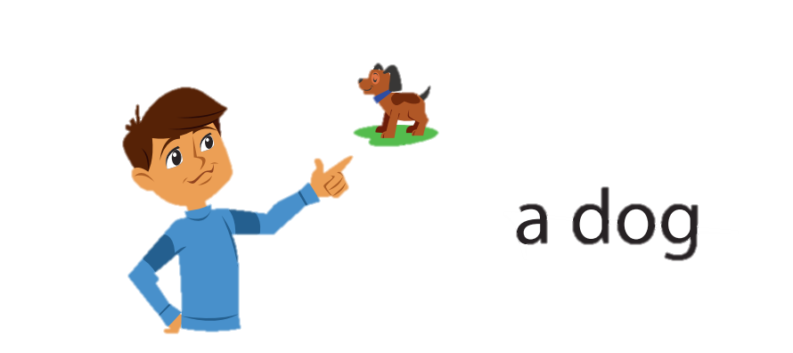
That’s a dog.
back

Slide 12
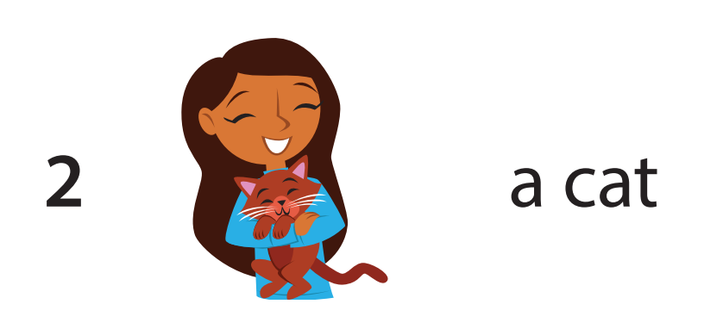
This is a cat.
back

Slide 13

That’s a bird.
back

Slide 14
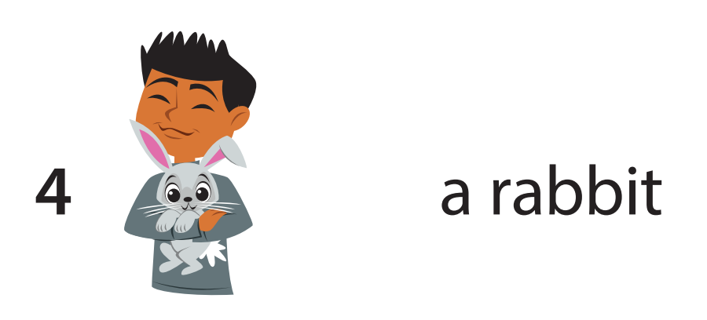
This is a rabbit.
back

Slide 15
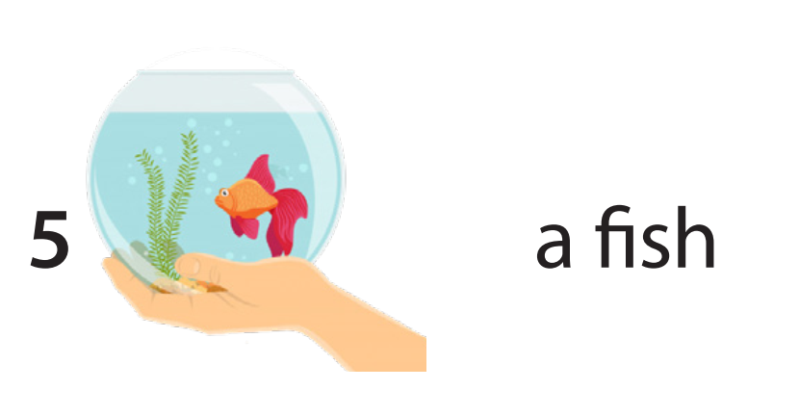
This is a fish.
back

Slide 16
04.
Production

Slide 17

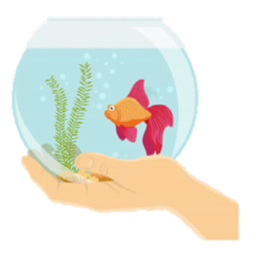
Draw your pets. Talk
My pets
That’s …
This is …

Slide 18
05.
Assessment

Slide 19

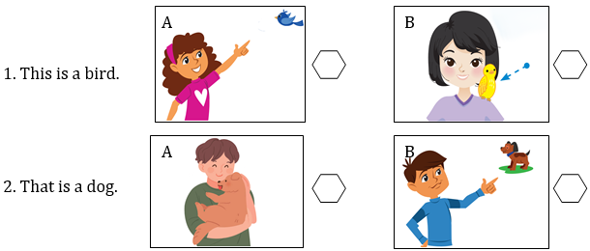
Tick the correct picture

Slide 20
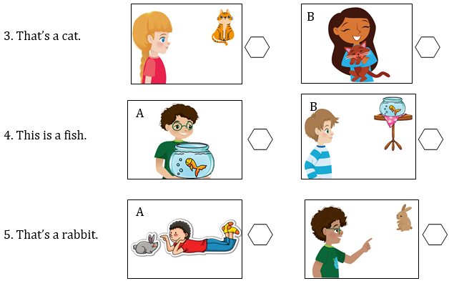
Notes:
THIẾT KẾ HOẠT ĐỘNG TƯƠNG TÁC 2 SLIDE 27 VÀ 28

Slide 21
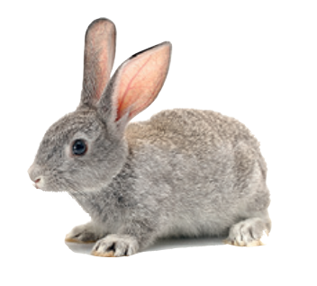
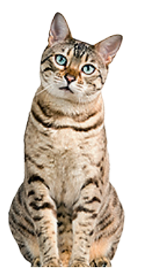

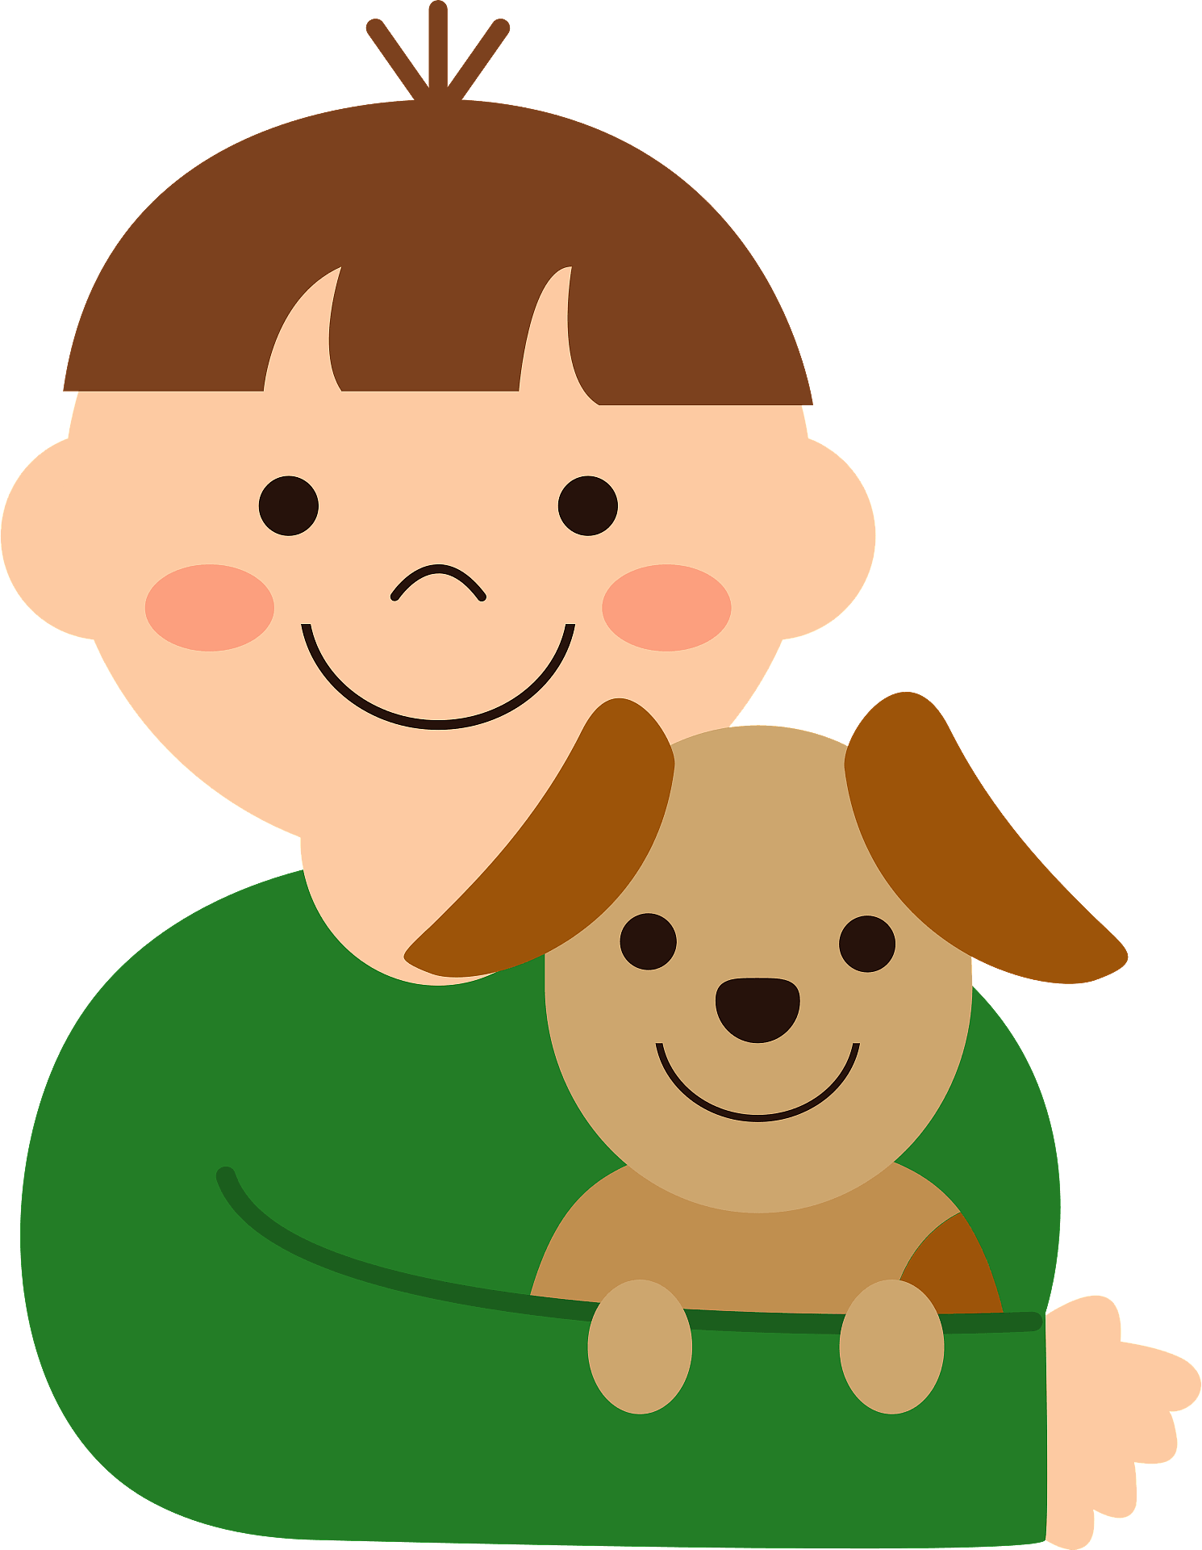
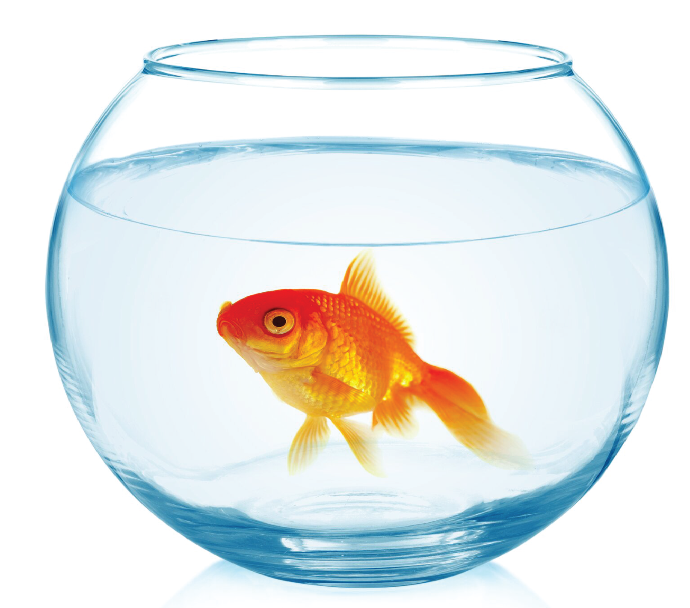

Look, read and write
1. This is a ………………..
2. That’s a ………………..
3. …………….. is a bird.
4. …………….. is a dog.
5. That’s a …………………
rabbit
cat
That
This
fish

Slide 22



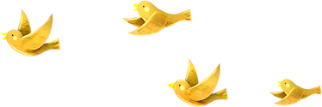
Good bye.
See you again!

