Slide 1








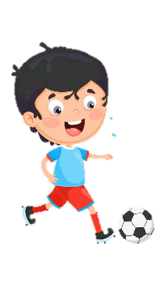












Unit 3
Animals
Lesson 3 – Task 4,5,6
Notes:
Để nguyên trang bìa như này, chỉ thay đổi tên bài trong quá trình làm. Logo của sách Wonderful World

Slide 2



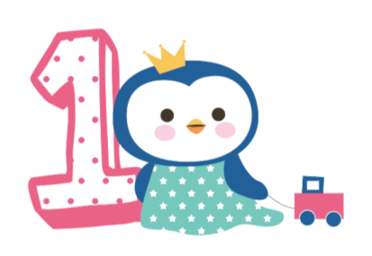



Warm up
Game : Save the spaceship

Slide 3



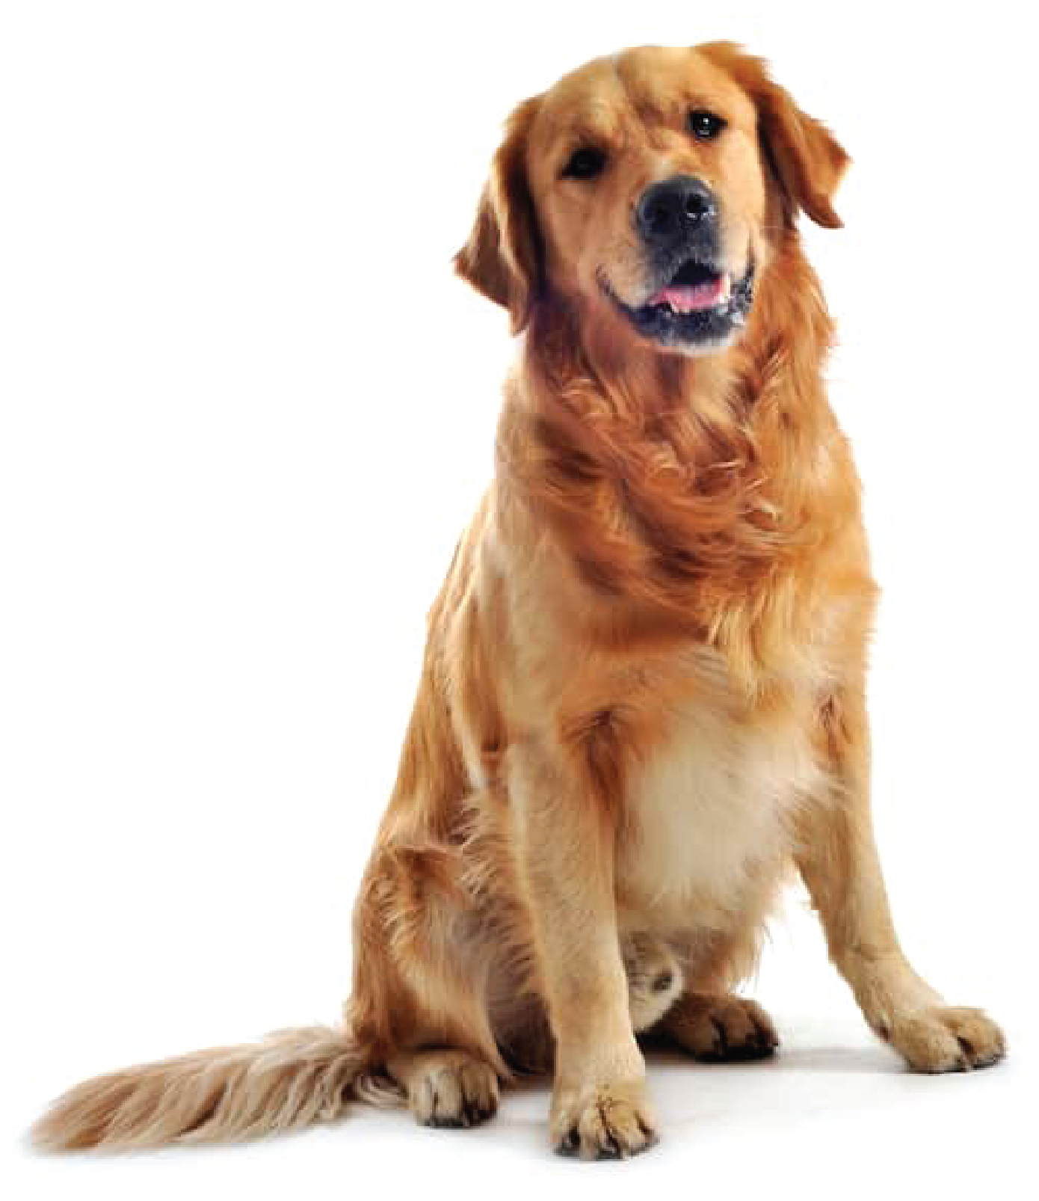




Save the spaceship!
What is this?
It’s a ………
dog

Slide 4
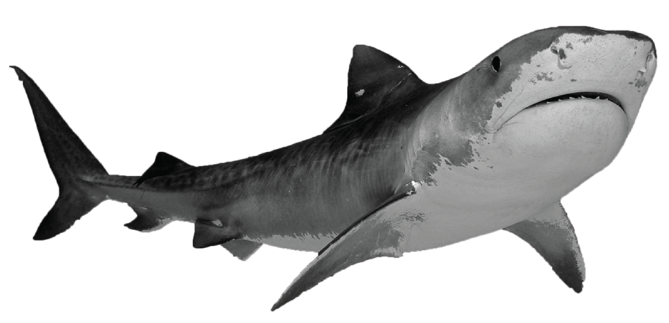
Save the spaceship!
What’s that?
It’s a ……..…
shark

Slide 5
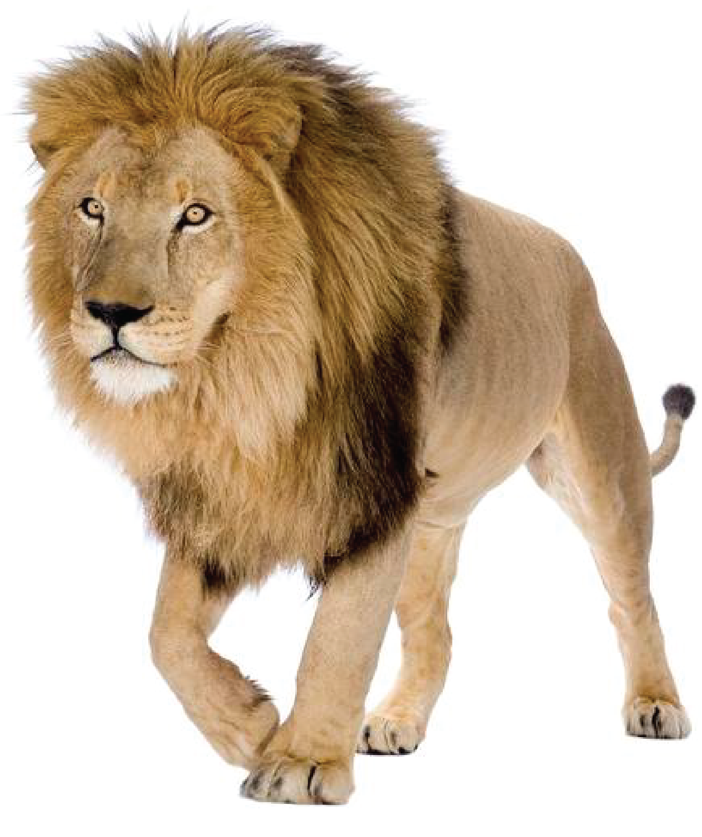
Save the spaceship!
What’s this?
It’s a ………
lion

Slide 6
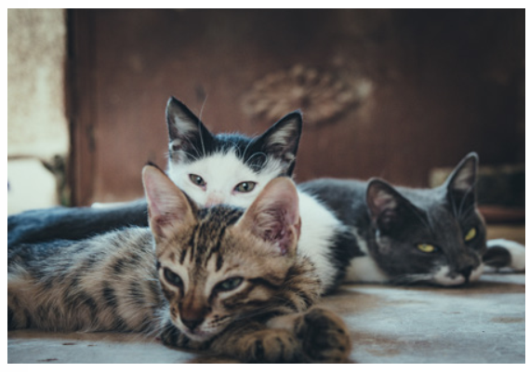
Save the spaceship!
What are these?
These are ………
cats

Slide 7
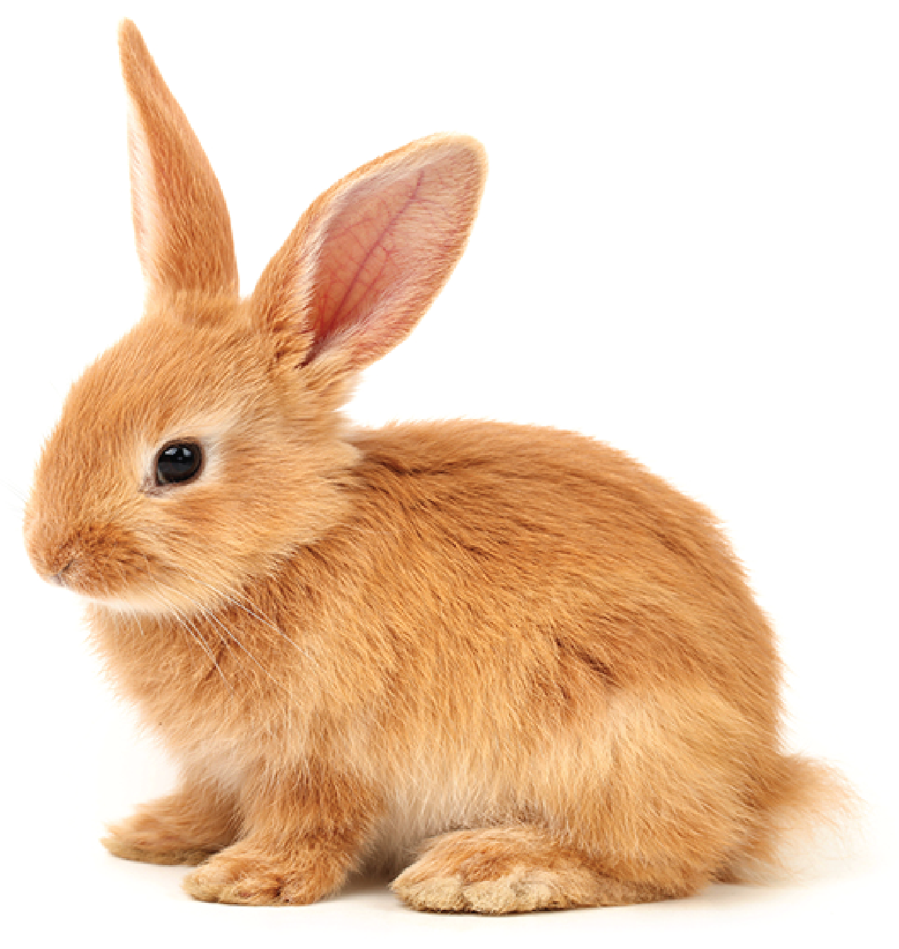
Save the spaceship!
What’s that?
It’s a …….……
rabbit

Slide 8
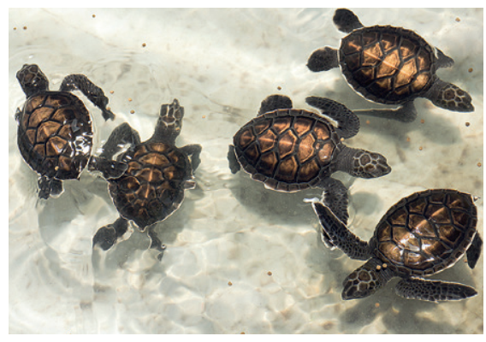
Save the spaceship!
What are those?
Those are ……...……
turtles

Slide 9
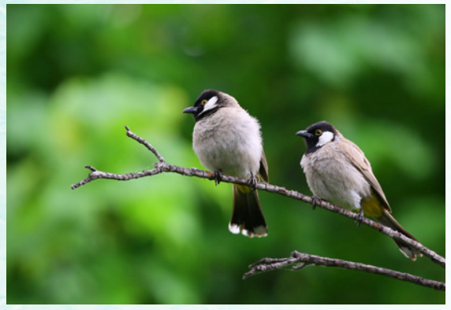
Save the spaceship!
What are those?
Those are ….……
birds

Slide 10
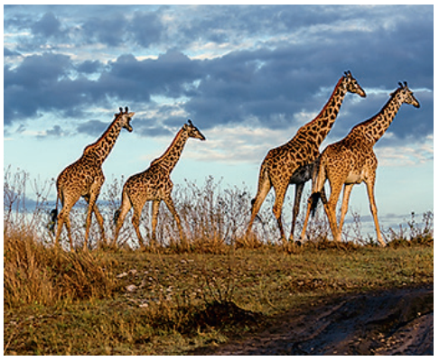
Save the spaceship!
What are those?
Those are ……….……
giraffes

Slide 11

Presentation
Task 4: Listen and repeat.

Slide 12

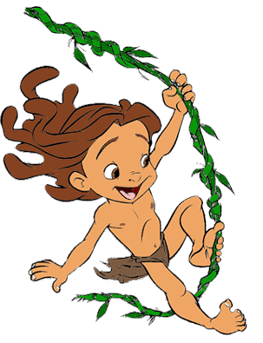
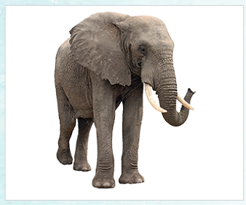
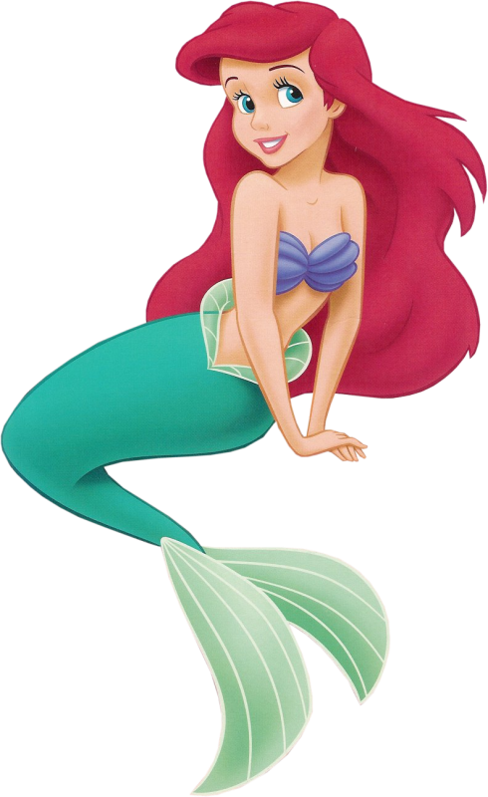
It’s an elephant.
What’s this?

Slide 13
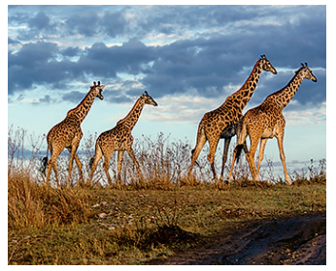
They’re giraffes.
What are those?

Slide 14

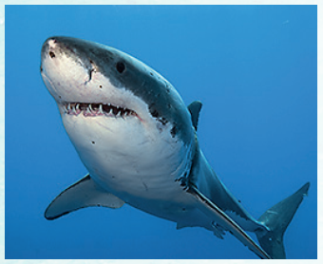
What’s that?
It’s a shark.

Slide 15
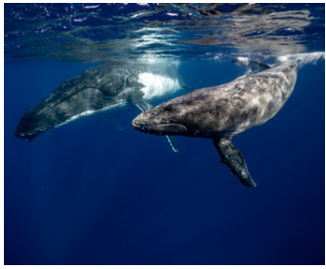
What are these?
They’re whales.

Slide 16
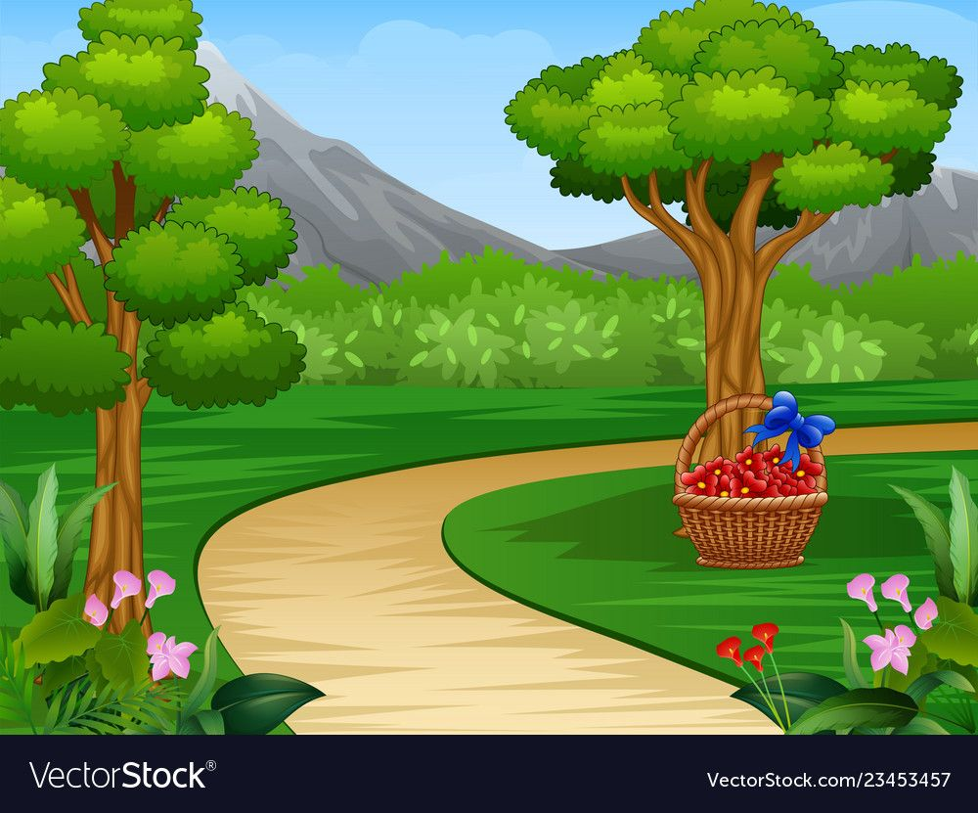


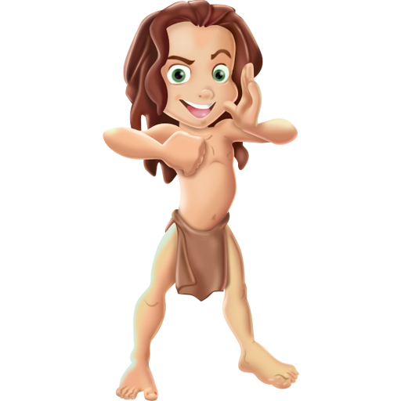
Picking apples
1
3
4
2
Notes:
Bấm vào số để xuất hiện câu hỏi
Bấm vào viền quả táo để biến mất
Bấm vào Tarzan hoặc Mermaid để hái táo
Bấm vào biểu tượng chuyển slide ở trên cùng để chuyển qua phần kế tiếp

Slide 17
Picking apples

Slide 18
Picking apples

Slide 19
Picking apples

Slide 20
Picking apples

Slide 21
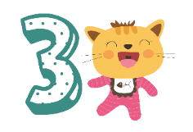
Practice
Task 5: Ask and answer

Slide 22
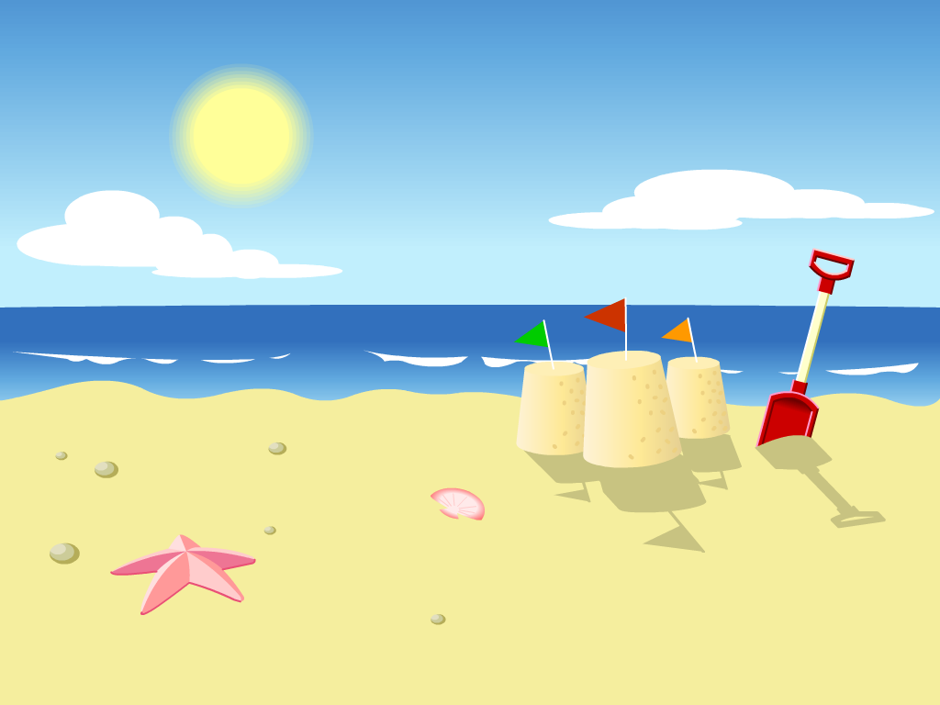


1
3
5
4
2
Flying Kites Game

Slide 23
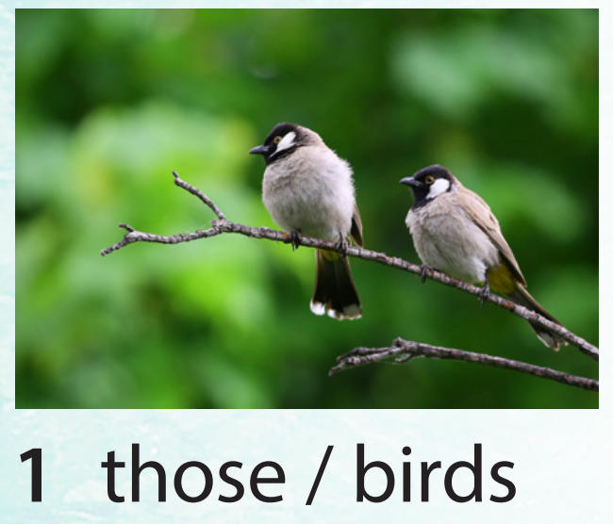
What are those?
They’re birds.

Slide 24
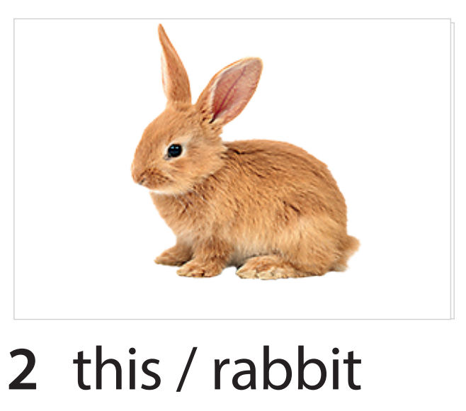
What is this?
It’s a rabbit.

Slide 25
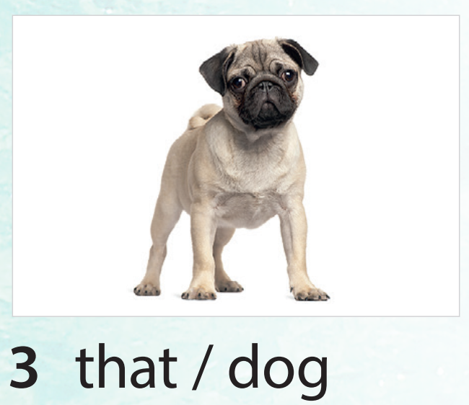
What’s that?
It’s a dog.

Slide 26
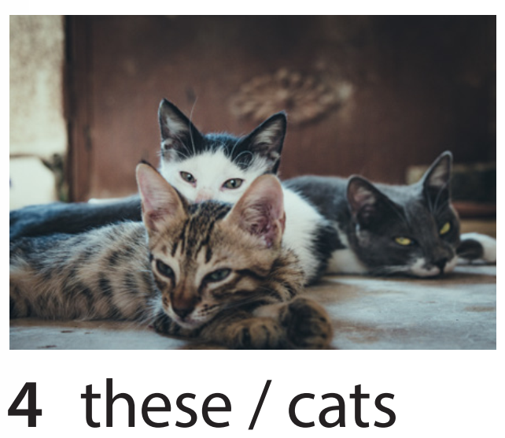
What are these?
They’re cats.

Slide 27
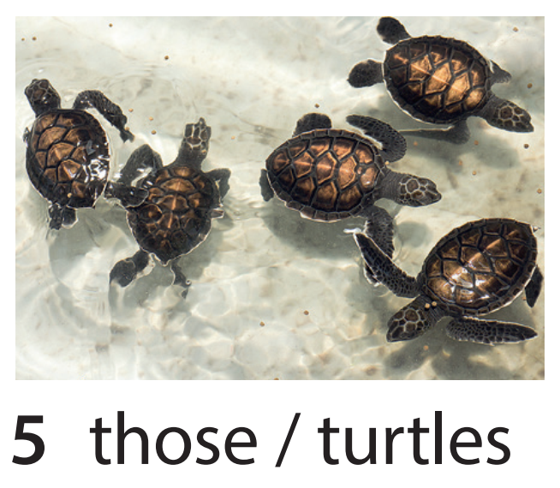
What are those?
They’re turtles.

Slide 28
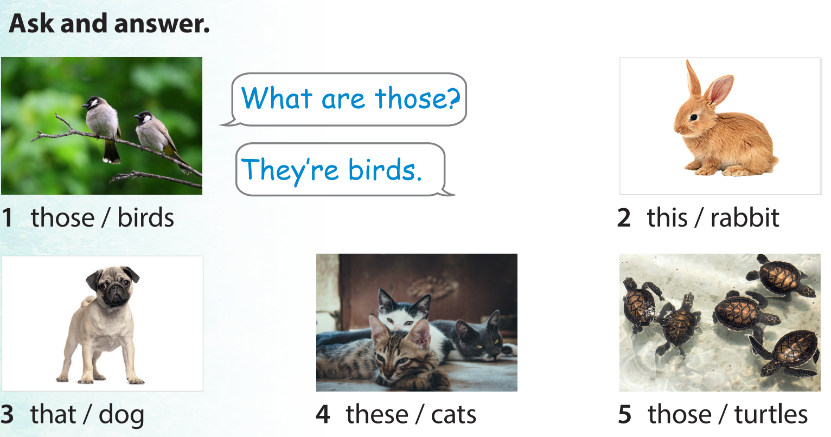

Slide 29
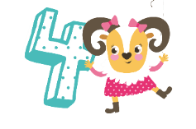
Production
Draw and write.Say

Slide 30
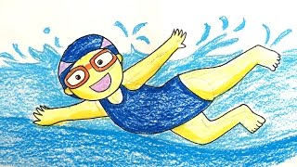
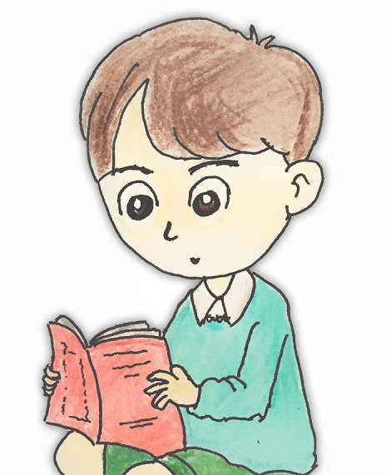
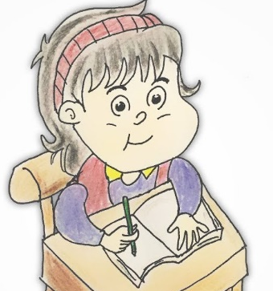
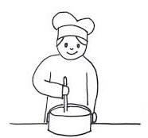

PRODUCTION
What we can do?

Slide 31


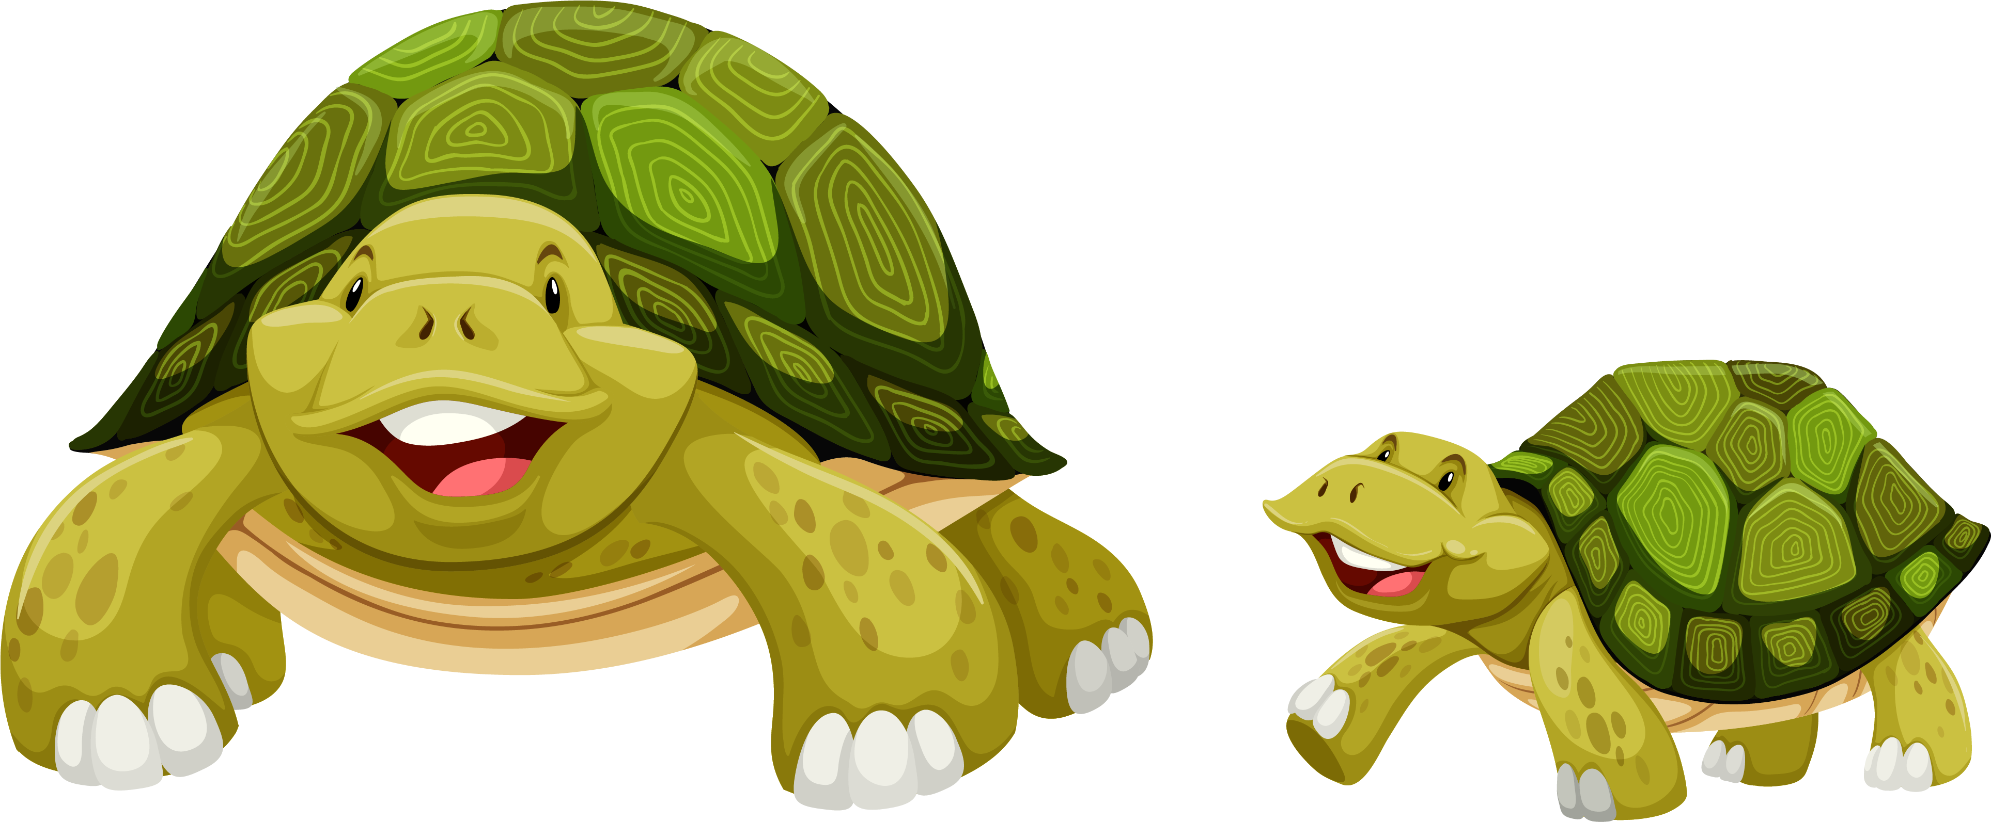
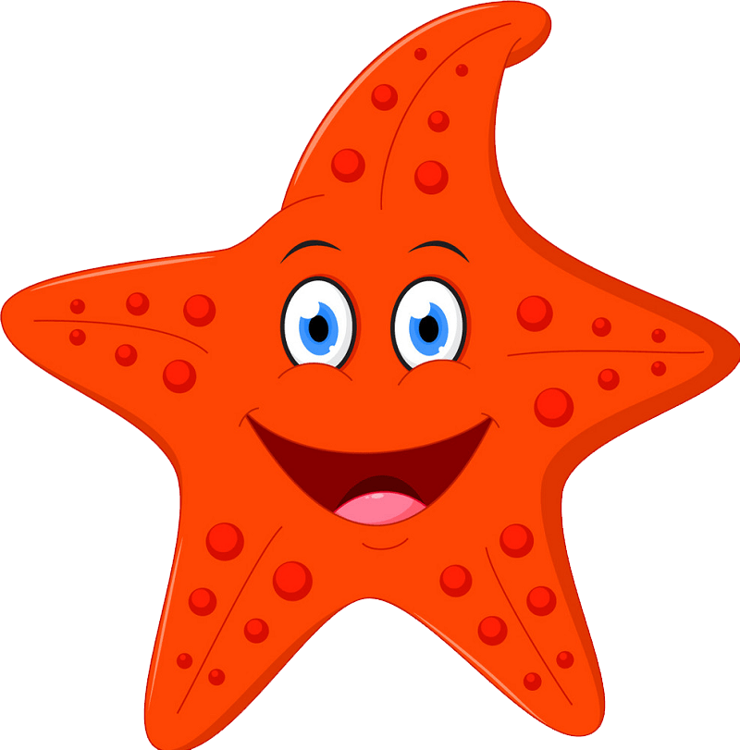
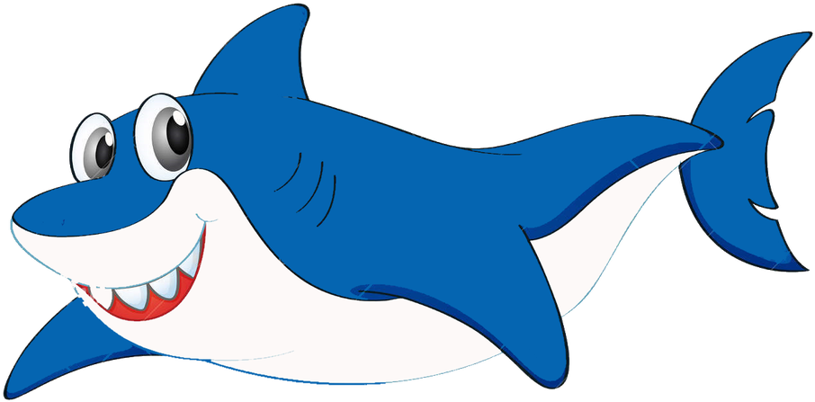
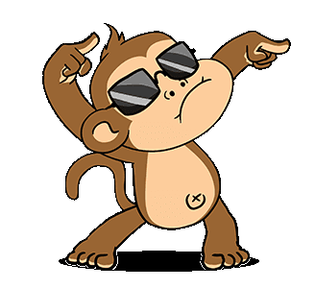
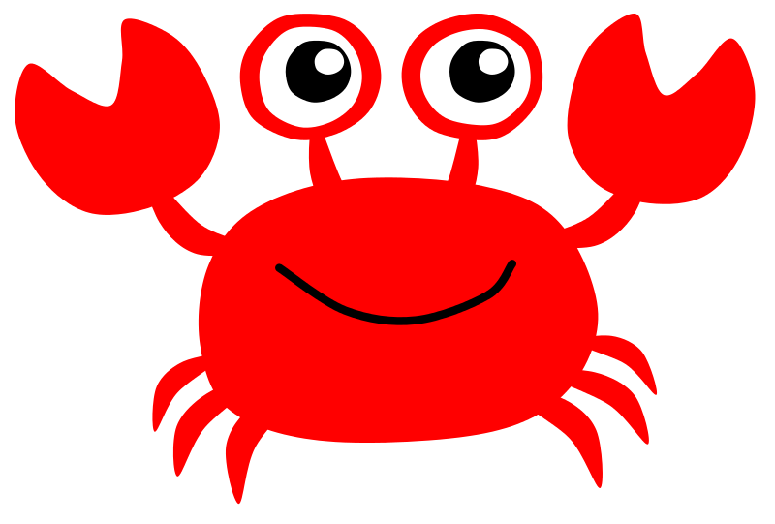
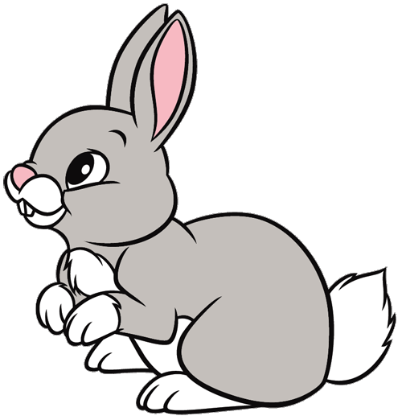
Art festival

Slide 32



5 ASSESSMENT

Slide 33
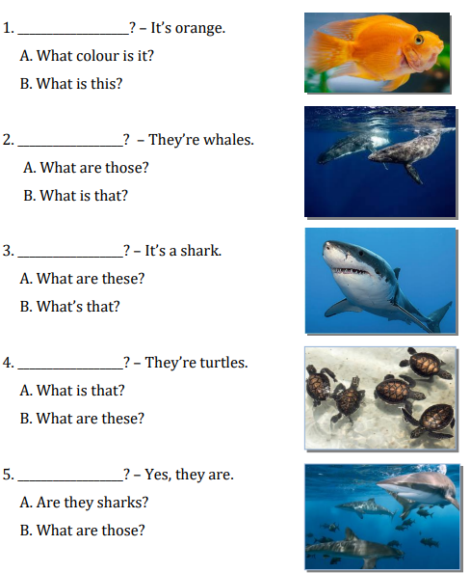
Look and choose the correct question for the answer
Notes:
THIẾT KẾ HOẠT ĐỘNG TƯƠNG TÁC CHO 5 CÂU HỎI NÀY

Slide 34


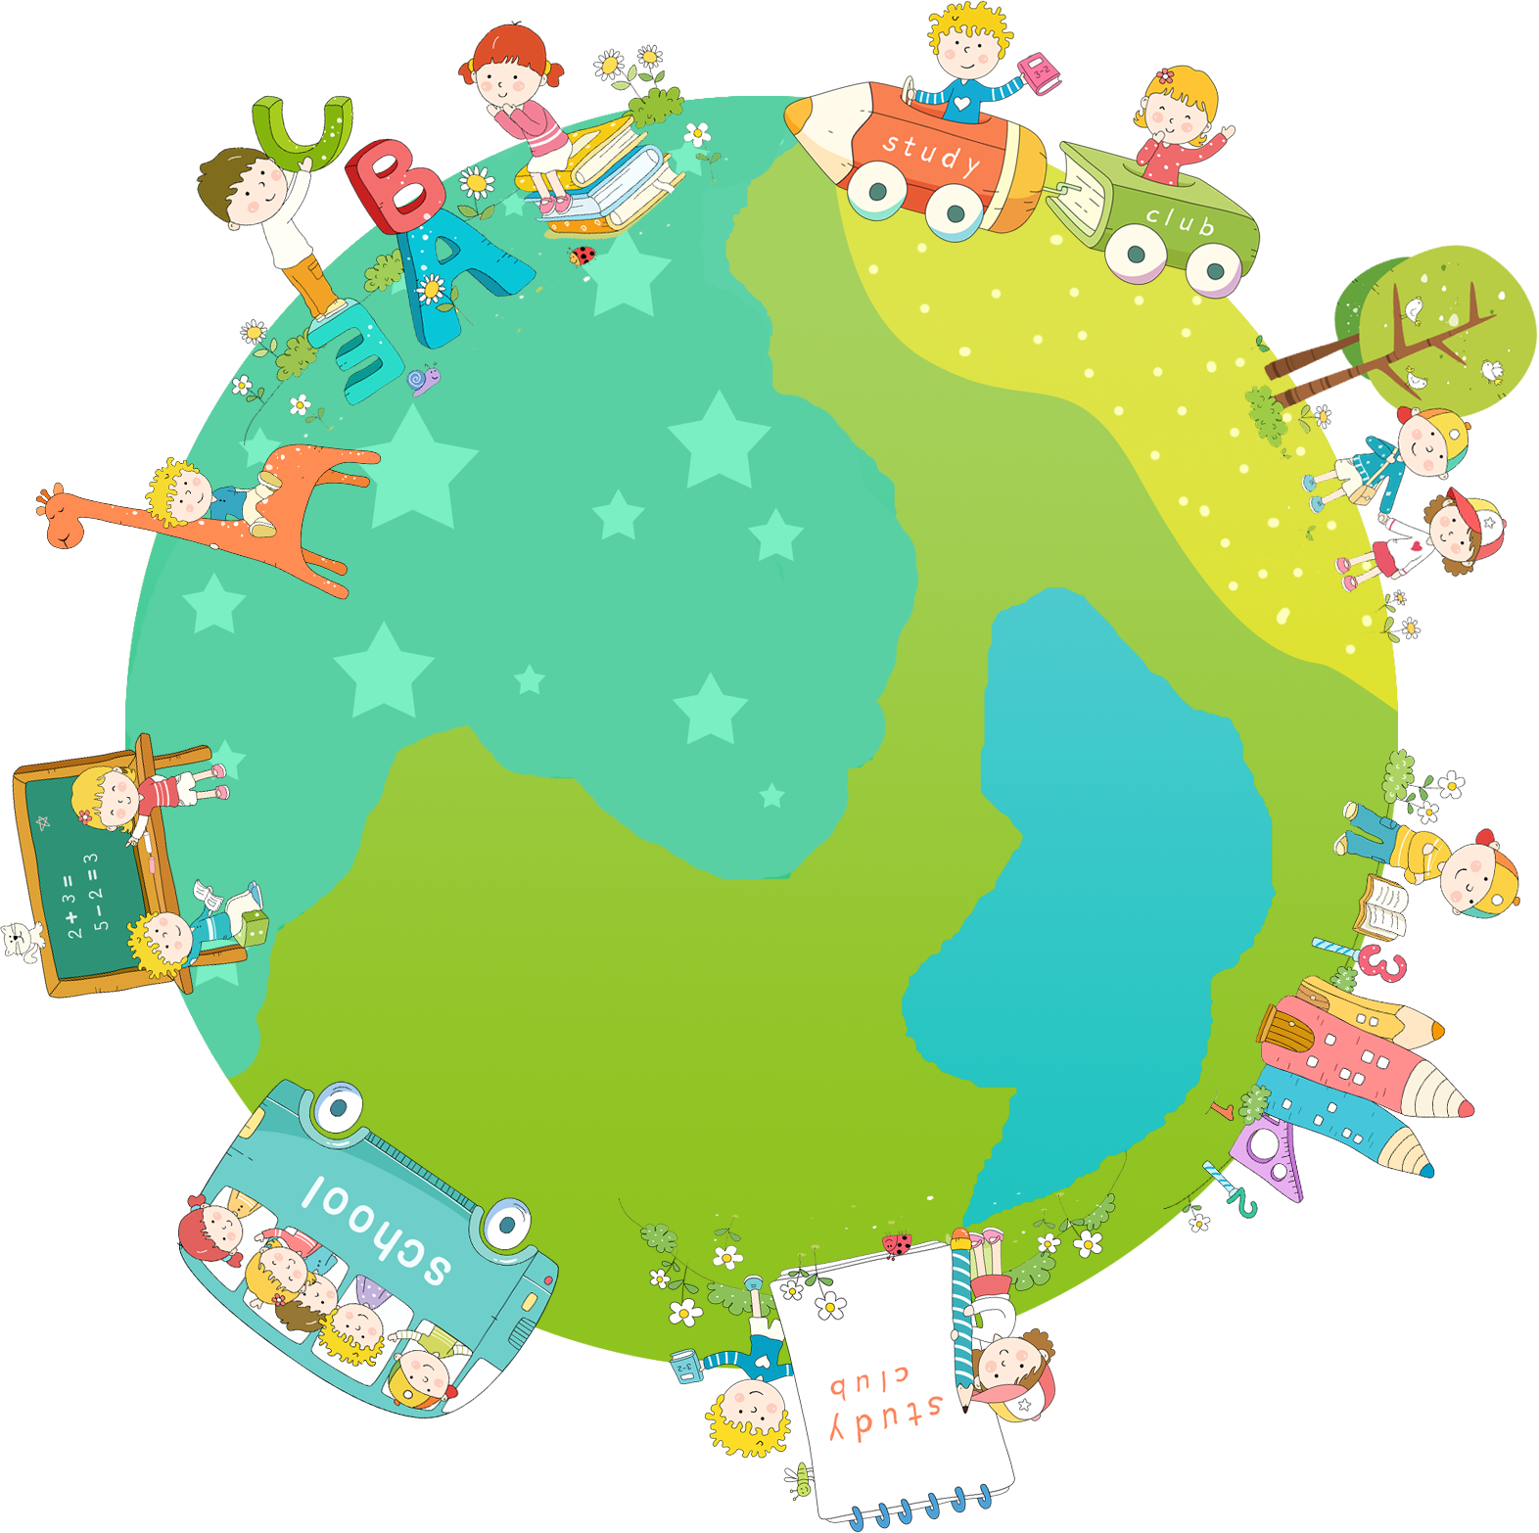

Good bye.
See you again!

