Slide 1




















Notes:
Để nguyên trang bìa như này, chỉ thay đổi tên bài trong quá trình làm. Logo của sách Wonderful World

Slide 2



Unit 7:
My Favorite sport
Lesson 1-Task 1,2,3

Slide 3


Warm up!
GUESSING TOPICS
Notes:
Sts look at the pictures and guess the topic .
THIẾT KẾ HOẠT ĐỘNG TƯƠNG TÁC Ở SLIDE 4,5,6,7. Ở MỖI SLIDE CÓ KÈM HÌNH ẢNH MINH HOẠ. HS SẼ NHÌN TRANH VÀ TRẢ LỜI TỰ LUẬN.

Slide 4
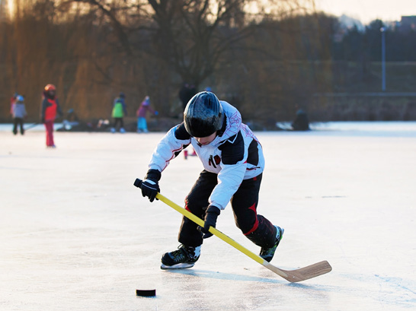
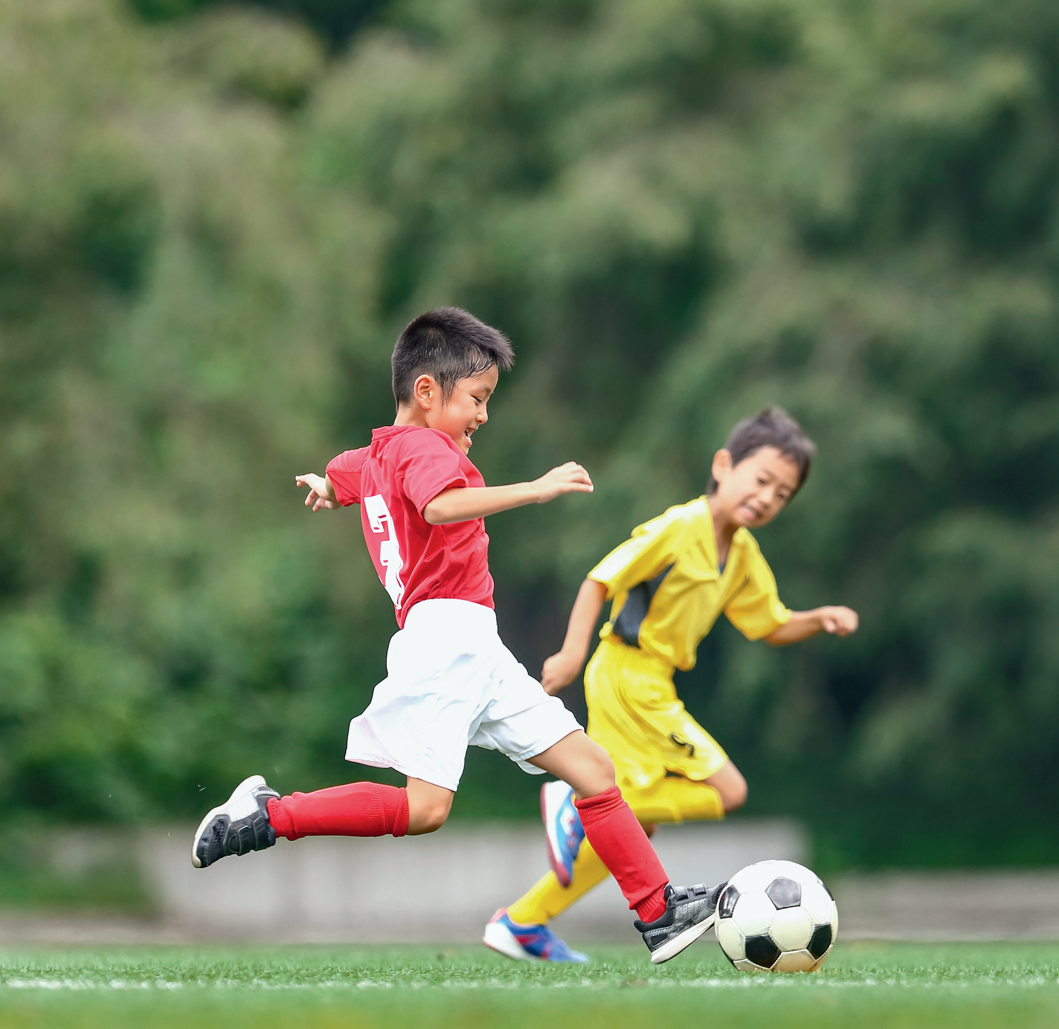
SPORTS

Slide 5

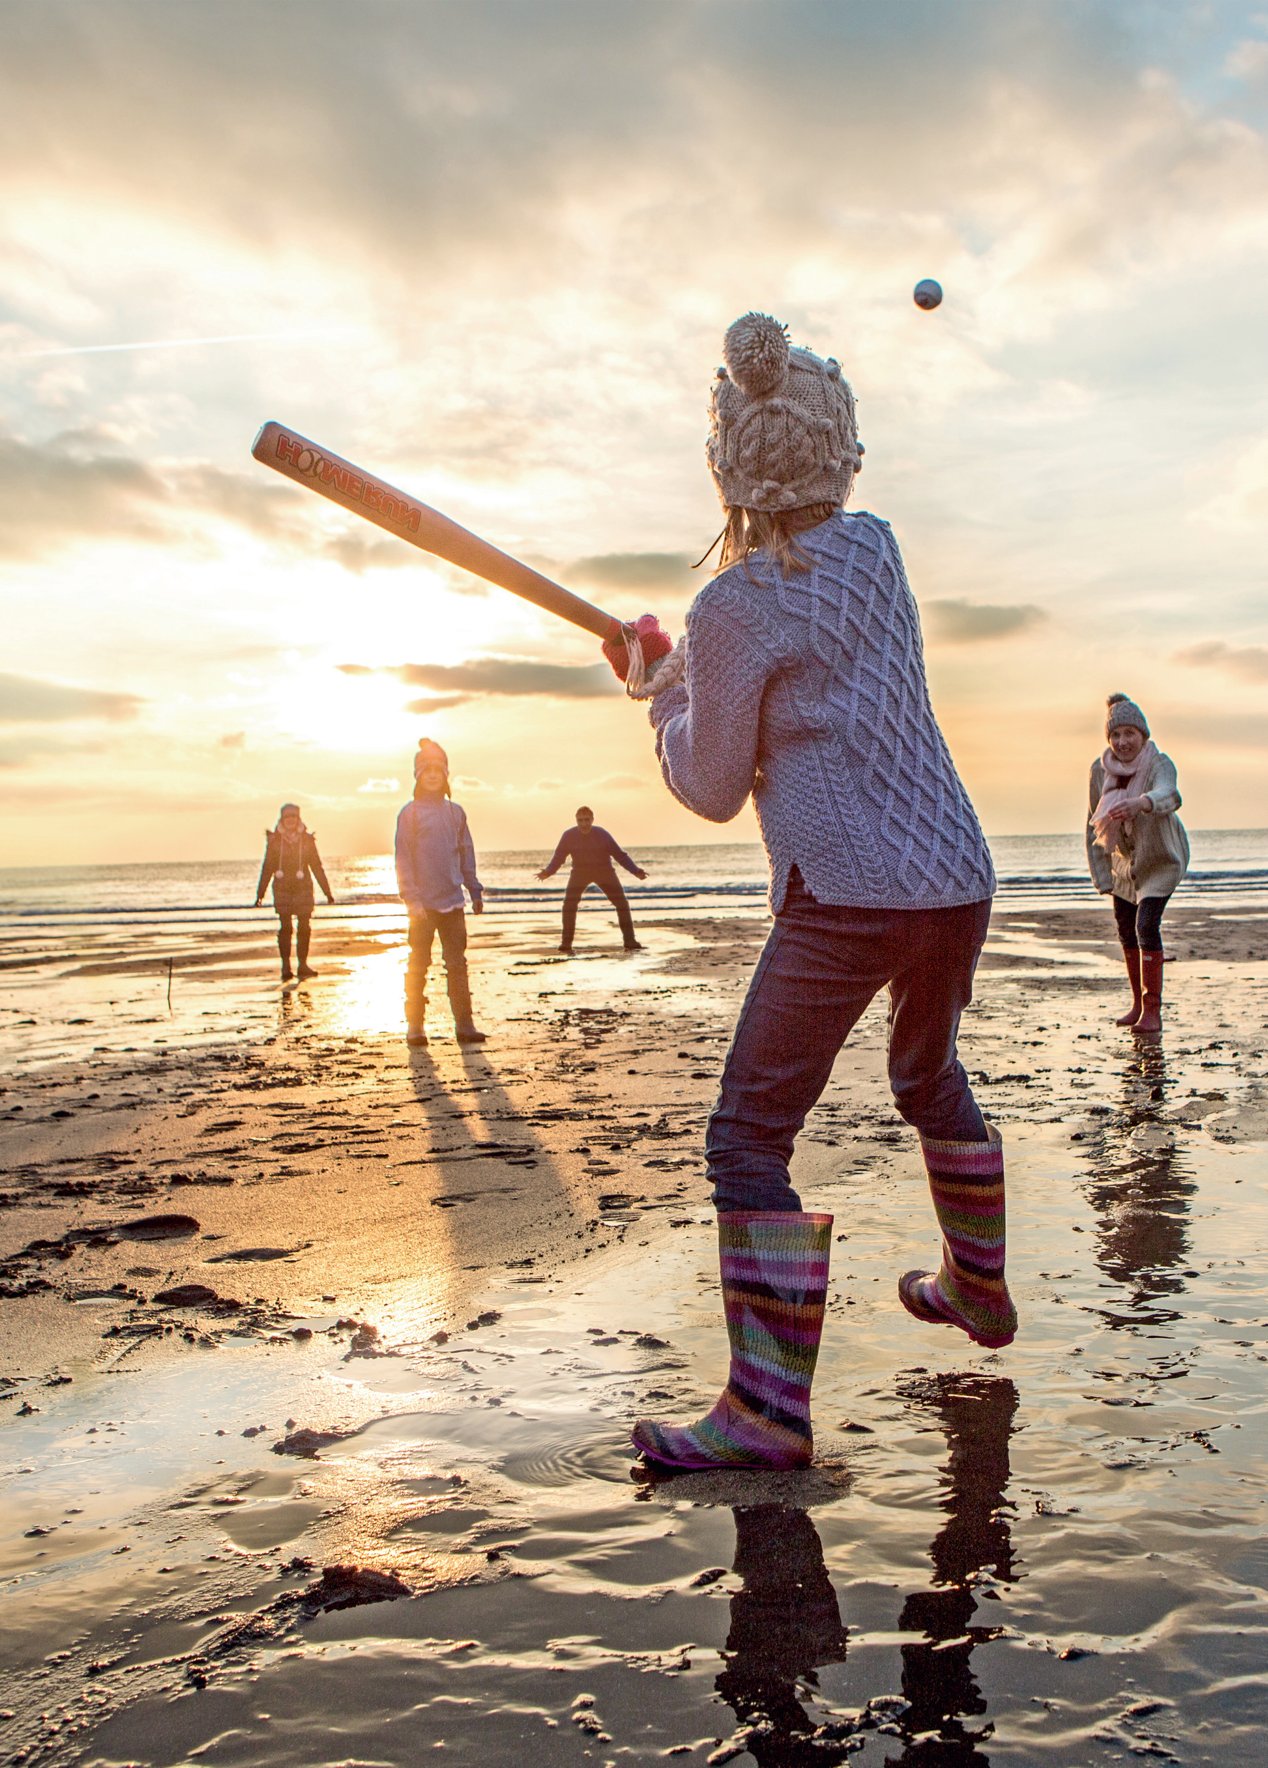
Look and tick what you see
✓
boots
dress
✓
✓
hat
coat
Family on the beach

Slide 6
Presentation

Slide 7

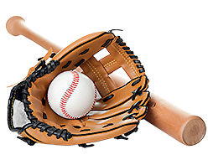
baseball

Slide 8

basketball

Slide 9

football

Slide 10

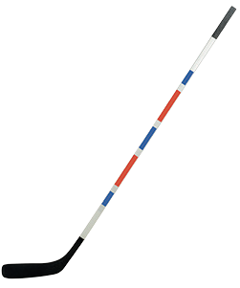
hockey

Slide 11
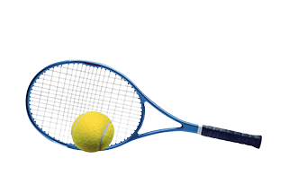
tennis

Slide 12


baseball
basketball
football
hockey
tennis
Notes:
Click at the words to listen the sounds.

Slide 13

VOCABULARY CHECKING
Mini game
Notes:
Ask 5 students to hold the flashcards . T stand behind and point to one st
Ask class to say the word aloud, the st holding the picture with that word will raise the picture.

Slide 14




Slide 15




1. Listen and point. Repeat

Slide 16


Slide 17
Practice

Slide 18

2. Listen and tick

Slide 19
3. Ask and answer.
Use the words in 1.

Slide 20

Can you play baseball?
No, I can’t .

Slide 21
Production

Slide 22


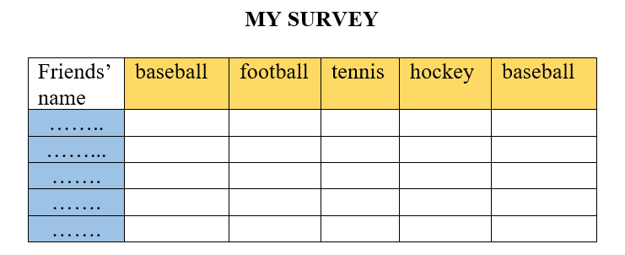
Notes:
Give sts a handout
Let Sts do the survey with their group
In 5 minutes, Sts have to find 2 Sts can play football and play tennis.
Ask volunteers to say the names of Sts can play football and play tennis .

Slide 23
Assessment

Slide 24
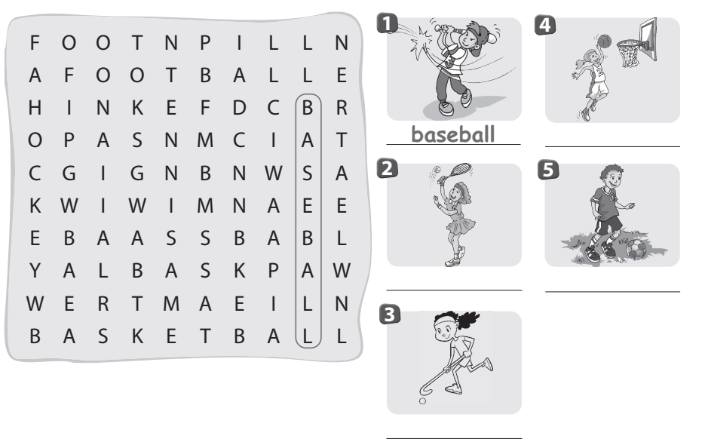
2. Find and circle. Write. (Workbook)
basketball
tennis
football
hockey

Slide 25




Thank you & goodbye!

