Slide 1




















Slide 2


Unit 8 - Lesson 1 – Period 1

Slide 3

Tick the correct answer.
1 WARM UP
Notes:
Warm up
Guessing game cho 1 dòng

Slide 4
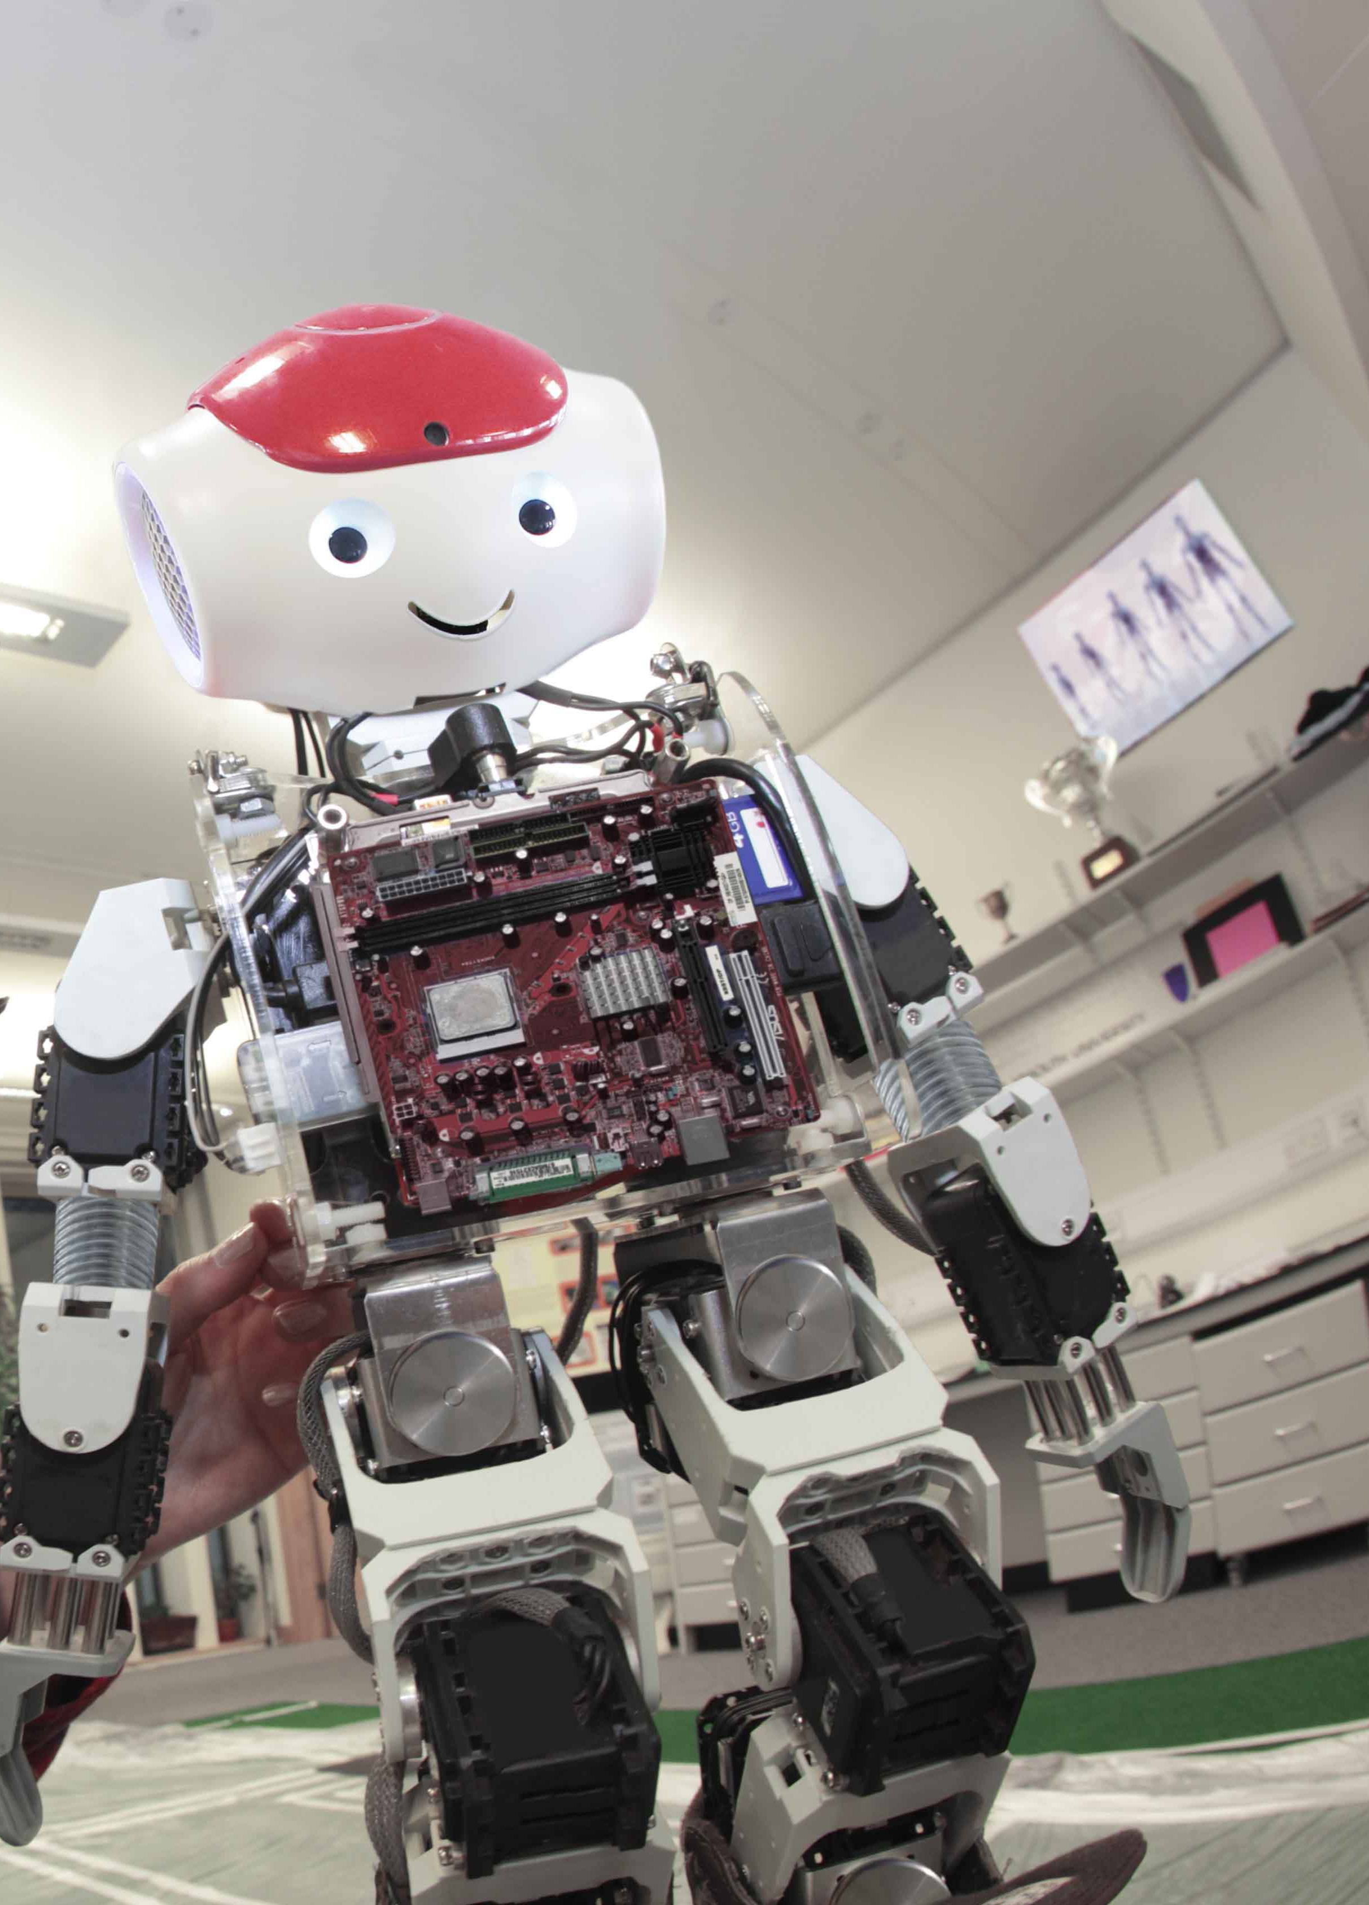
Look at the photo. Tick the body part that the robot hasn’t got.
legs
eyes
✔
✔
wings
hands

Slide 5
2 Presentation
Task 1 Listen and point.
Notes:
Dấu câu

Slide 6
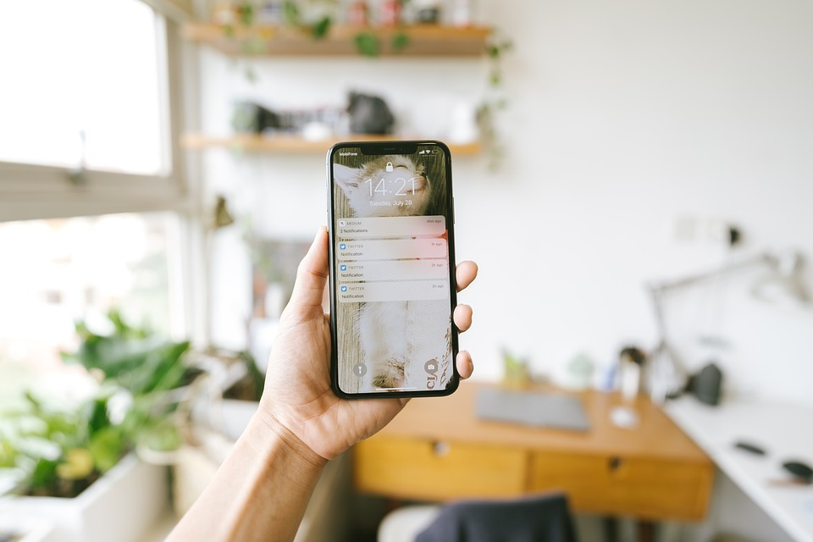
smartphone
What is it?

Slide 7
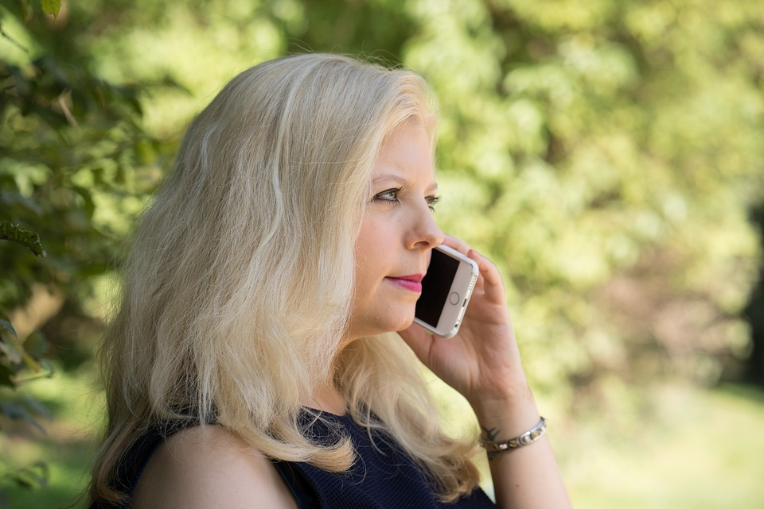
Make phone calls
What can you do?

Slide 8
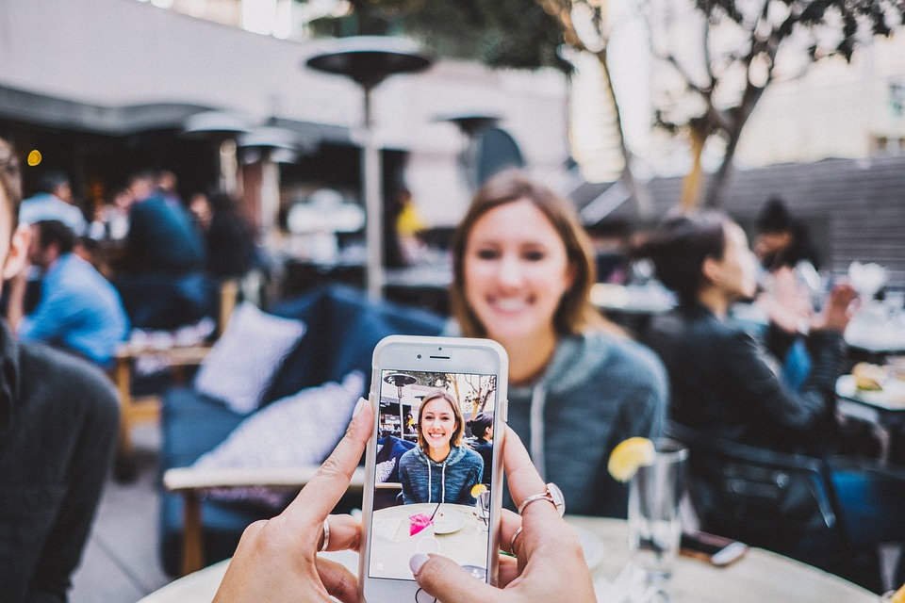
Make videos
What can you do?

Slide 9
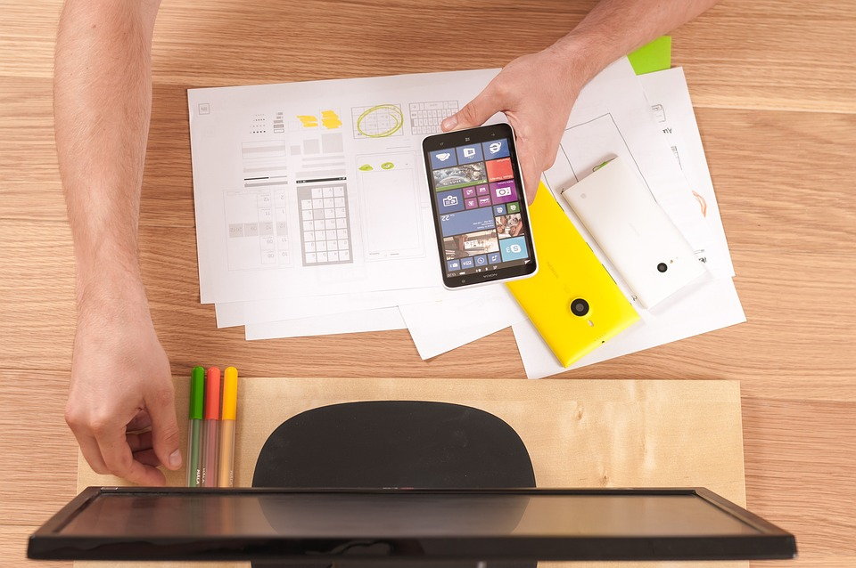
Write emails
What can you do?

Slide 10




1 Listen and point. Repeat.
Make phone calls
Write emails
Smartphone
Make videos

Slide 11


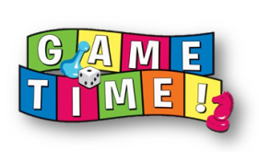



HONEY BEE GAME

Slide 12

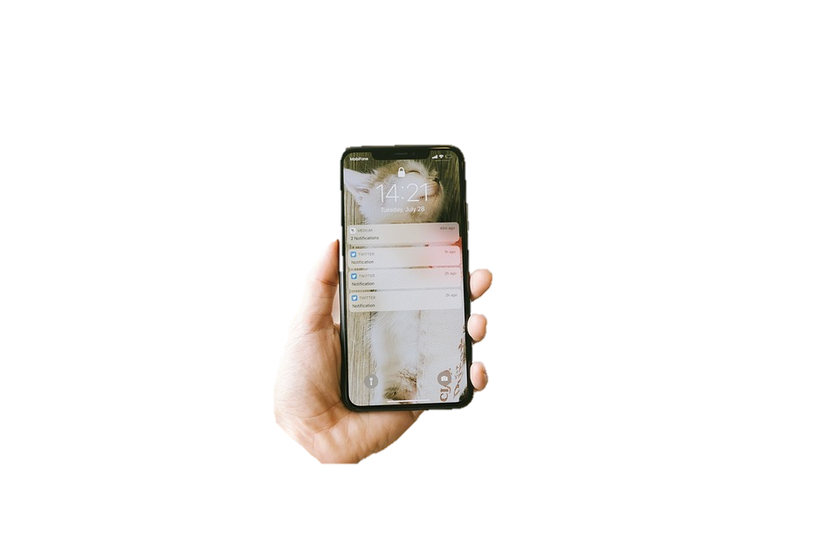


smartphone
There is a ______.
10
table
spoon
smartphone

Slide 13

make phone calls
I can ____________.
10
eat
make phone calls
run

Slide 14


make videos
She can_________.
10
make videos
watch TV
play game

Slide 15

write emails
They _________ to their friends.
10
write emails
run
eat

Slide 16
Practice
Task 2 Listen and read.Write.
Notes:
Dấu câu

Slide 17




2
Listen and read. Write.
It’s my new smartphone.
Whose phone is it? It’s nice!
Linh
Luna
Wow! What can you do on your smartphone?

Slide 18
2
Listen and write.
I can take photos and make videos on my phone.
Cool! Can we write emails on a smartphone?
Linh
Luna
Yes, we can. I sometimes write emails on my phone.

Slide 19
2
Listen and write
Linh
Luna
What can Luna do on her smartphone?
- She can take _____, make _____and write _______.
photos
videos
emails

Slide 20
3 Practice
Task 3 Look.
Ask and answer
Notes:
Dấu câu

Slide 21



3
Look. Ask and answer
What can we
do on a
smartphone/ computer?

Slide 22

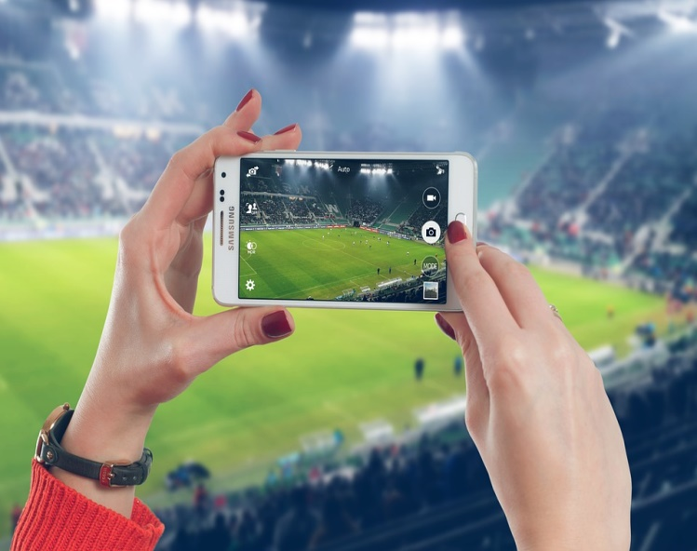



We can … .
1. take photos
3. make phone calls
2. learn English
4. make videos
Notes:
Ấn vào bức tranh để xem cuộc hội thoại. Ấn vào tên lửa sang mục tiếp theo

Slide 23



3
Look. Ask and answer.
We can
take photos.
What can we do on a smartphone?
BACK

Slide 24
3
Look. Ask and answer.
We can
learn English.
What can we do on a computer?
BACK

Slide 25
3
Look. Ask and answer.
We can make
phone calls.
What can we do on a smartphone?
BACK

Slide 26

3
Look. Ask and answer.
We can make
videos.
What can we do on a computer?
BACK

Slide 27
4 Production
Notes:
Xem video và thực hành gấp giấy tạo hình điện thoại

Slide 28
5 Assessment
Notes:
Đây k phải là extra, đây là hđ 3 của bài

Slide 29




Matching Game
Take photos
Learn English
1
4
Smart phone
2
Write emails
Make phone calls
3
5

Slide 30
6 Wrap up
Notes:
Đây k phải là extra, đây là hđ 3 của bài

Slide 31
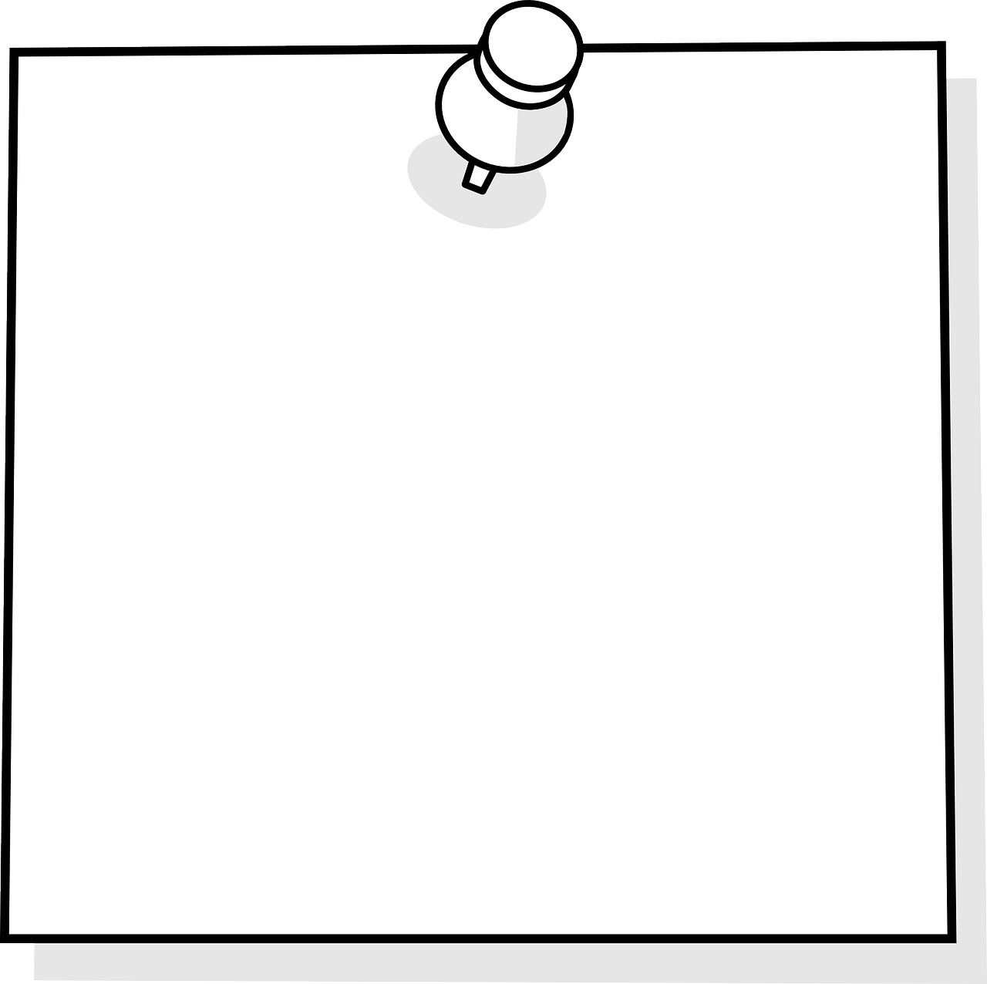
Vocabulary
Smartphone: Điện thoại thông minh
Make phone calls: Gọi điện
Make videos: Quay video
Take photos: Chụp ảnh
Learn English: học tiếng Anh
Write emails: Viết mail
Structure
I/we/they + can + V: có thể làm gì.

Slide 32




Thank you & goodbye!

