Slide 1









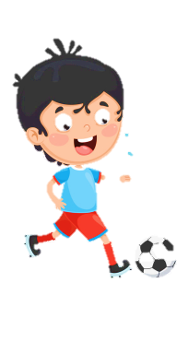












Notes:
Để nguyên trang bìa như này, chỉ thay đổi tên bài trong quá trình làm. Logo của sách Wonderful World

Slide 2



Unit 7: Jobs
Lesson 2
Task 1, 2, 3

Slide 3
1. WARM UP
Catch the word

Slide 4
2. PRESENTATION

Slide 5
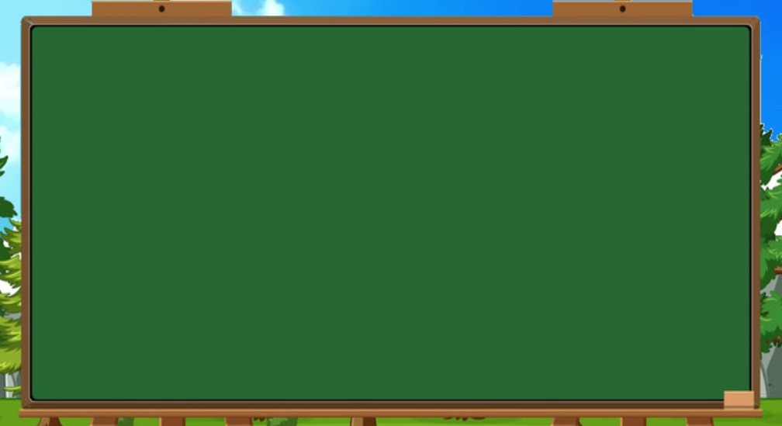
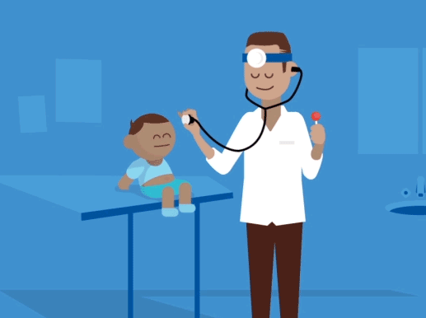

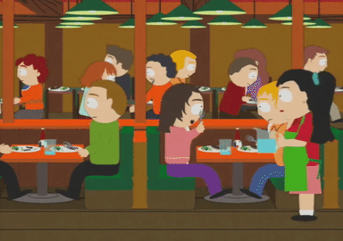


in a restaurant
in a hospital
in a studio
in a clinic

Slide 6
3. PRACTICE

Slide 7
1. Listen and point. Repeat.
in a clinic
in a restaurant
in a hospital
in a studio

Slide 8
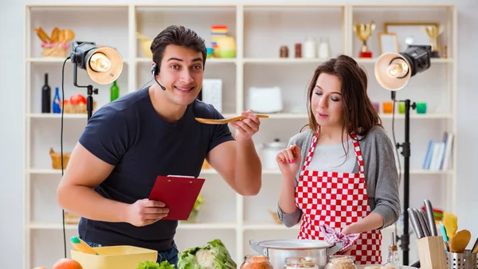
2. Listen and read.
Anna: This is my cousin, Andy on TV. He’s cooking in a studio.
Alex: Wow! What does he do?
Anna: He’s a chef. He can cook great food.
Alex: Cool! Where does he work?
Anna: He works in a restaurant in Hanoi. He can cook Vietnamese food too.

Slide 9
2. Write.
Andy is a ________. He works in a _____________ in Hanoi.
He can cook ____________ food.
chef
restaurant
Vietnamese

Slide 10
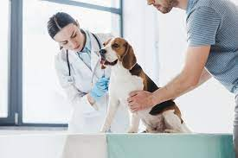
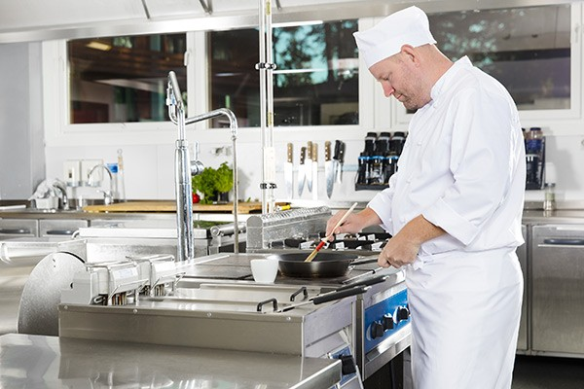
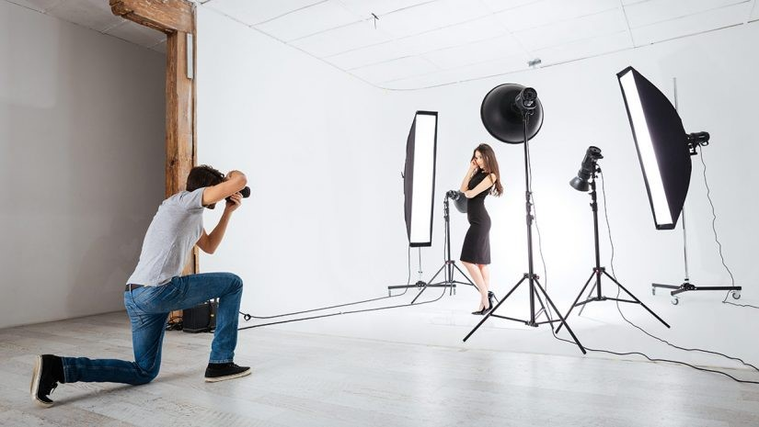
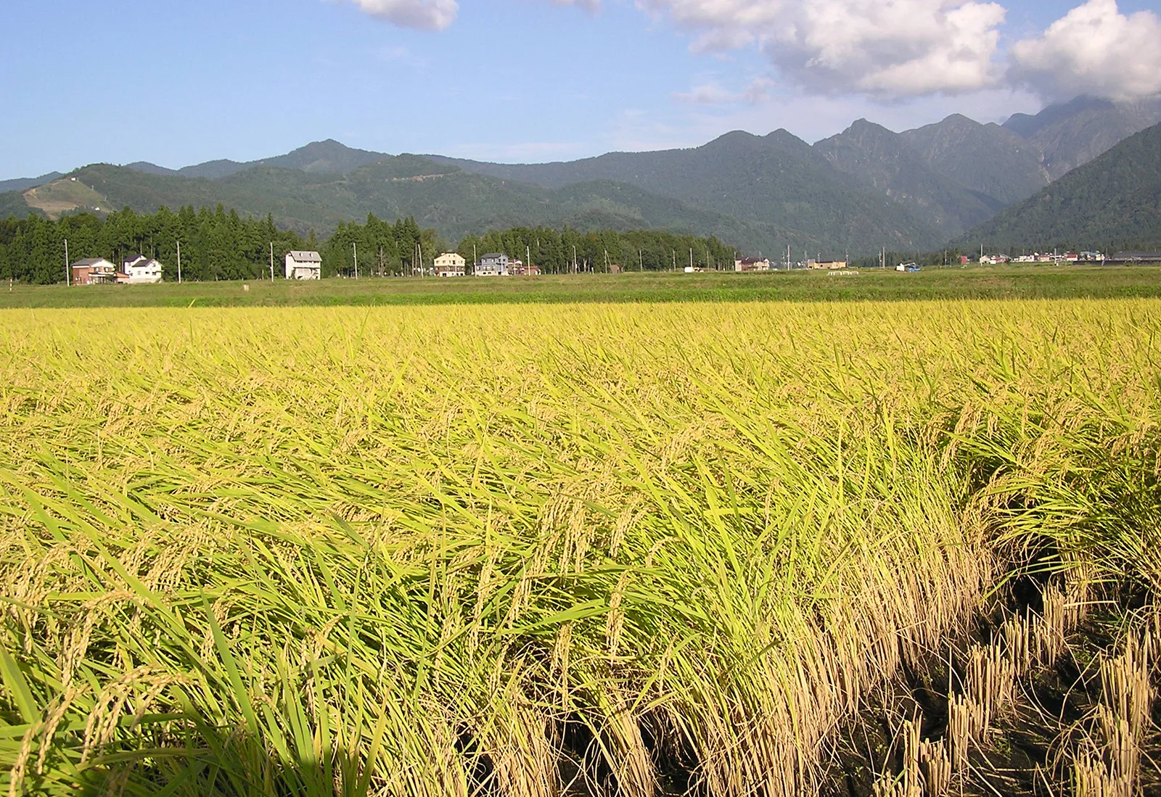
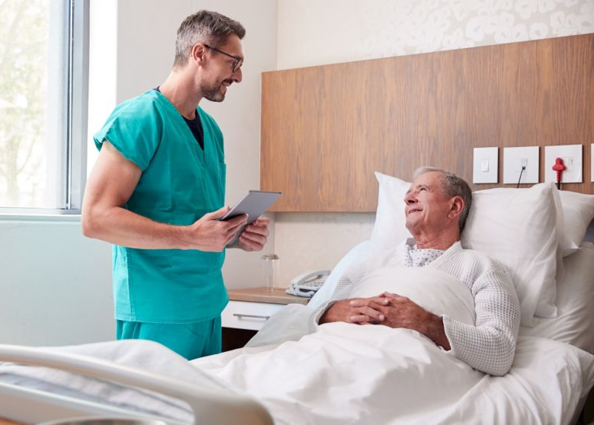
3. Match and say.
He’s a vet. He works in a clinic.
in a restaurant
in a hospital
in a clinic
in a studio
in a field

Slide 11
4. PRODUCTION

Slide 12
5. ASSESSMENT

Slide 13
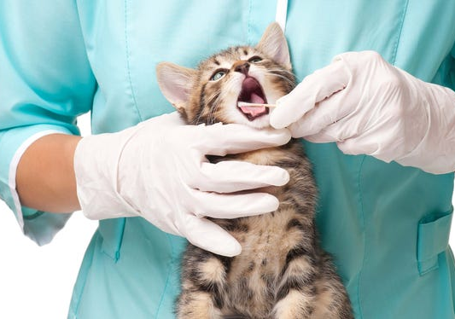
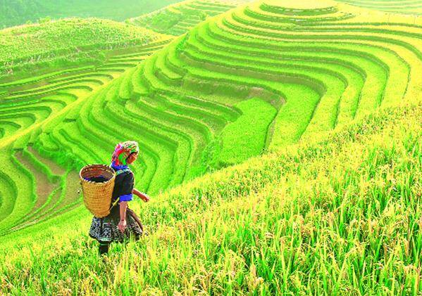
Unscramble and match
haopitsl
rastaurnte
cinlic
sdituo
fedli
studio
clinic
___________________
___________________
hospital
restaurant
field
___________________
___________________
___________________

Slide 14

UNIT 7: JOBS
LESSON 2: PERIOD 1
What we learnt today:
Vocabulary:
1. in a clinic
2. in a hospital
3. in a restaurant
4. in a studio

Slide 15




Thank you & goodbye!

