Slide 1









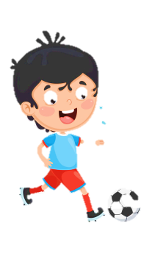
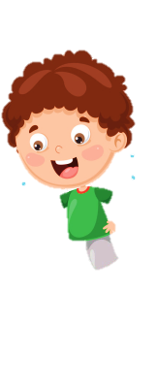
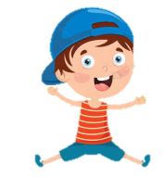










Notes:
Để nguyên trang bìa như này, chỉ thay đổi tên bài trong quá trình làm. Logo của sách Wonderful World

Slide 2


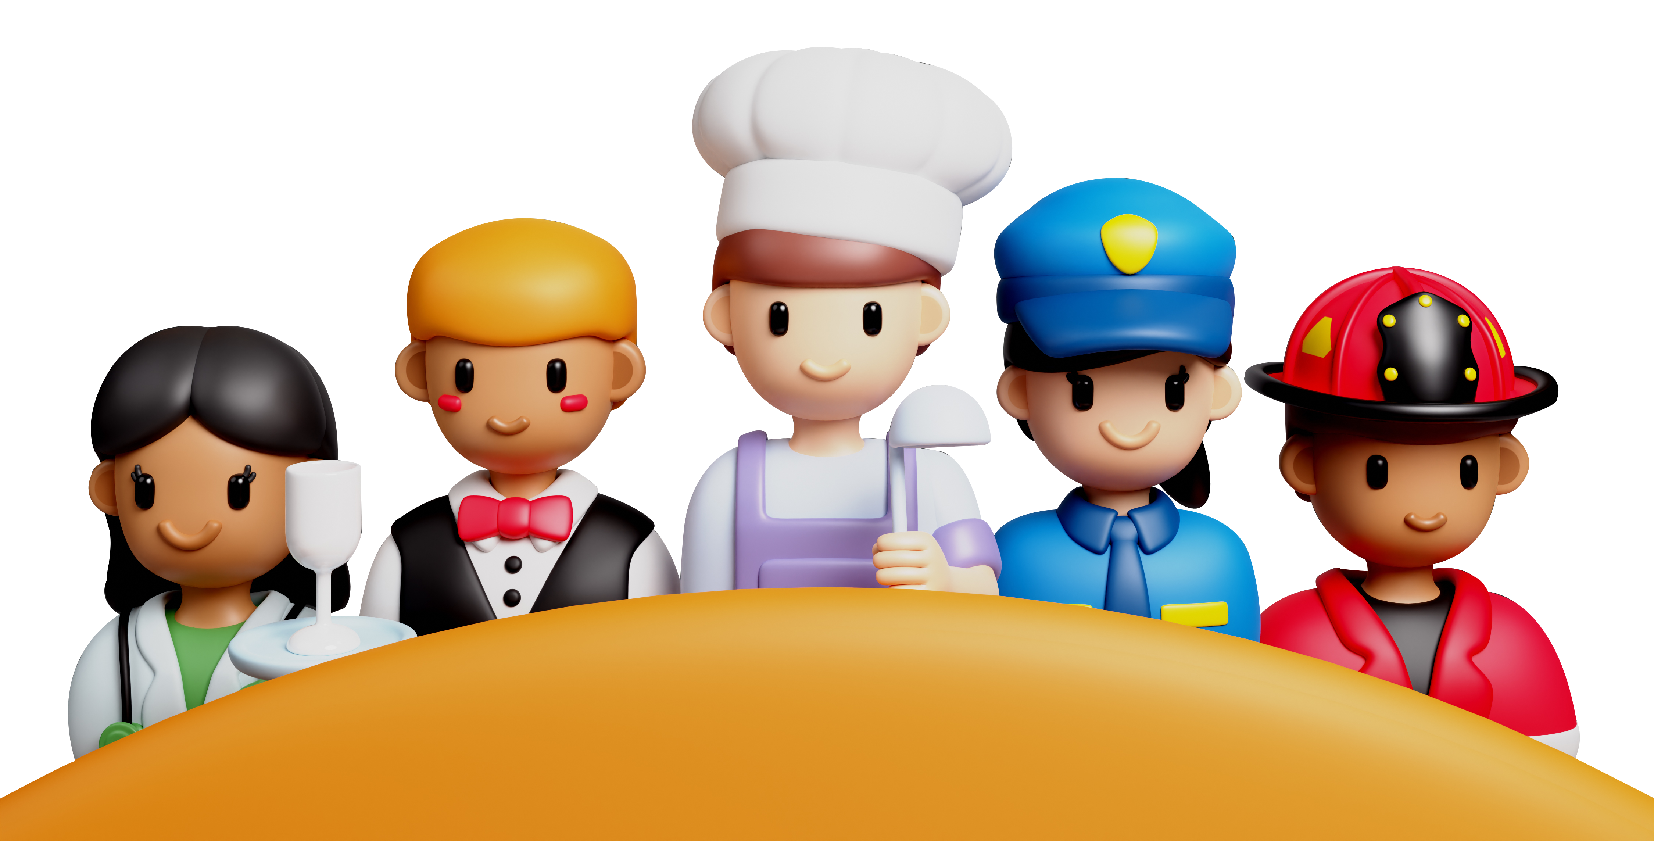
Unit 7: Jobs
Lesson 2
Task 7, 8, 9

Slide 3


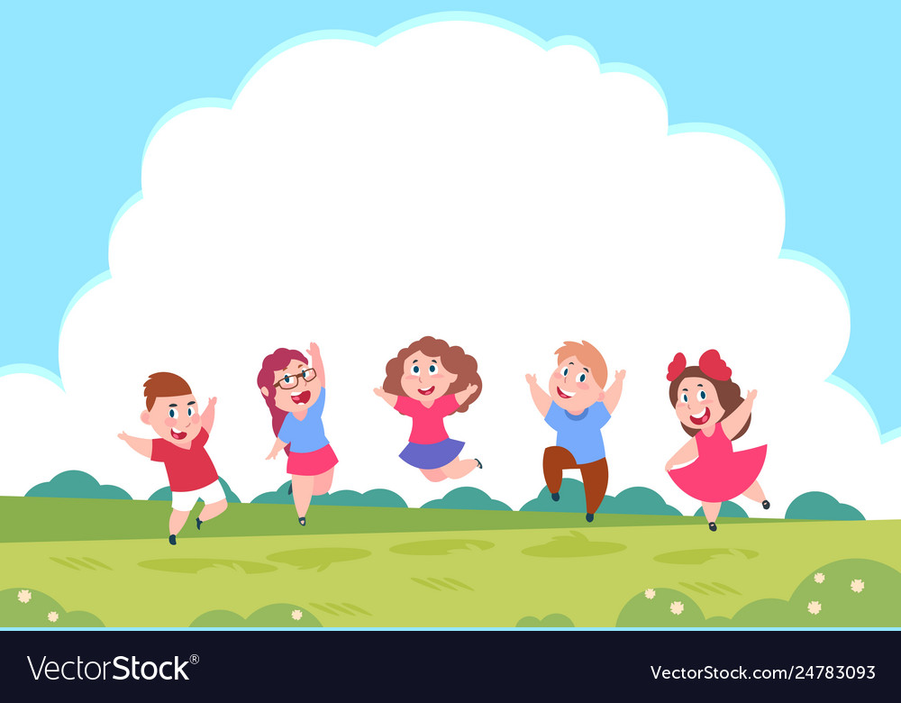
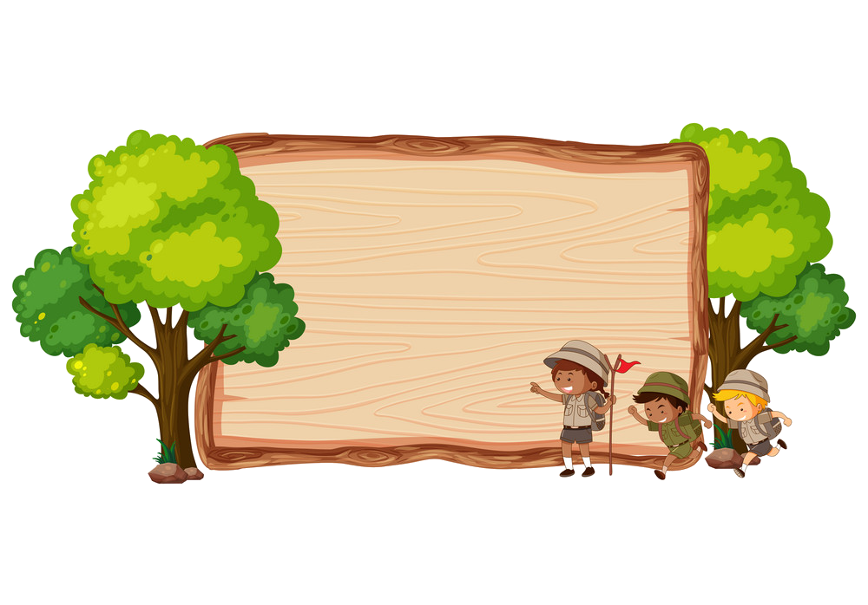


1. WARM UP
Pass the bomb
Notes:
- Ss standing in a circle.
- One S will be given a ball.
- T plays a song and counts 1,2,3 to start the game.
- The S with the ball will say the name of a job and pass the bomb to the one in their left.
- T will stop the song randomly. When the song is stopped, the one with the ball will lose and they will take the fine (dancing along or singing, etc

Slide 4



Pass the bomb
Notes:
Pass the bomb
- One S will be given a ball.
- T plays a song and counts 1,2,3 to start the game.
- The S with the ball will say a word relating to before our time topic and pass the bomb to the one in their left.
- T will stop the song randomly. When the song is stopped, the one with the ball will lose and they will take the fine (dancing along or singing, etc.)

Slide 5
2. REVIEW

Slide 6
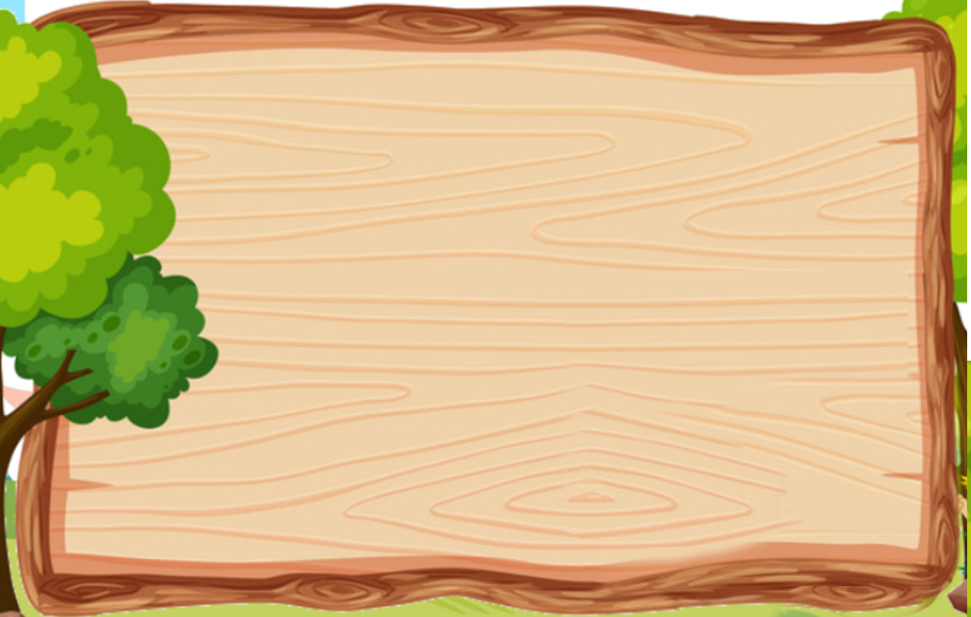
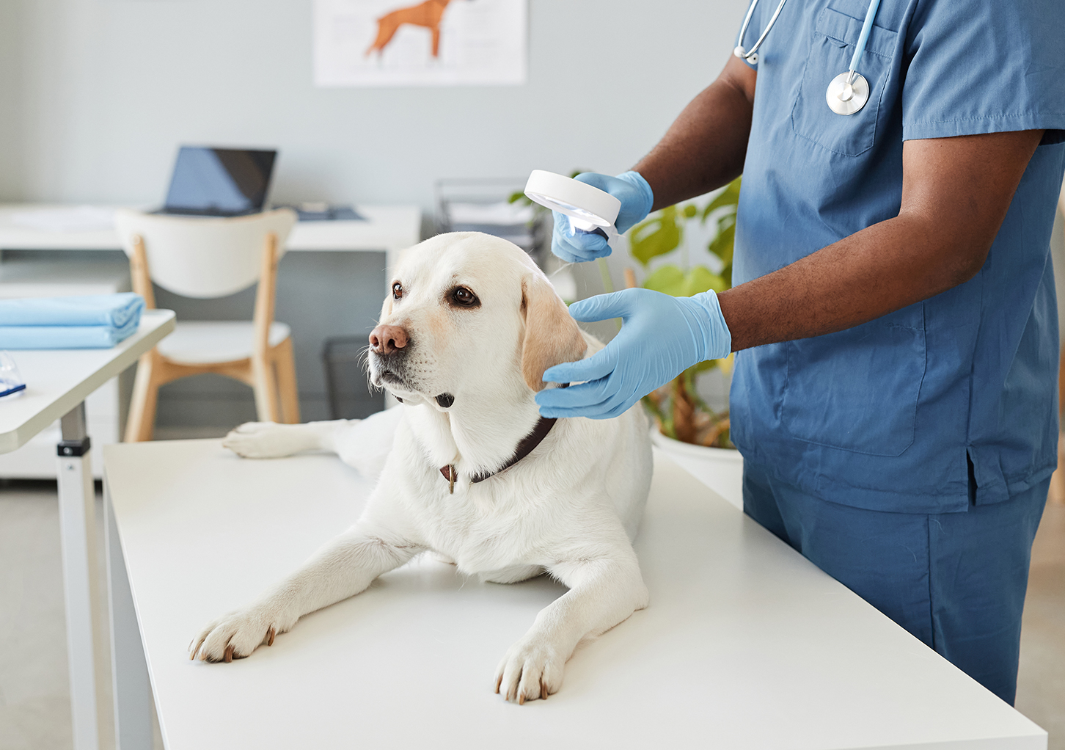
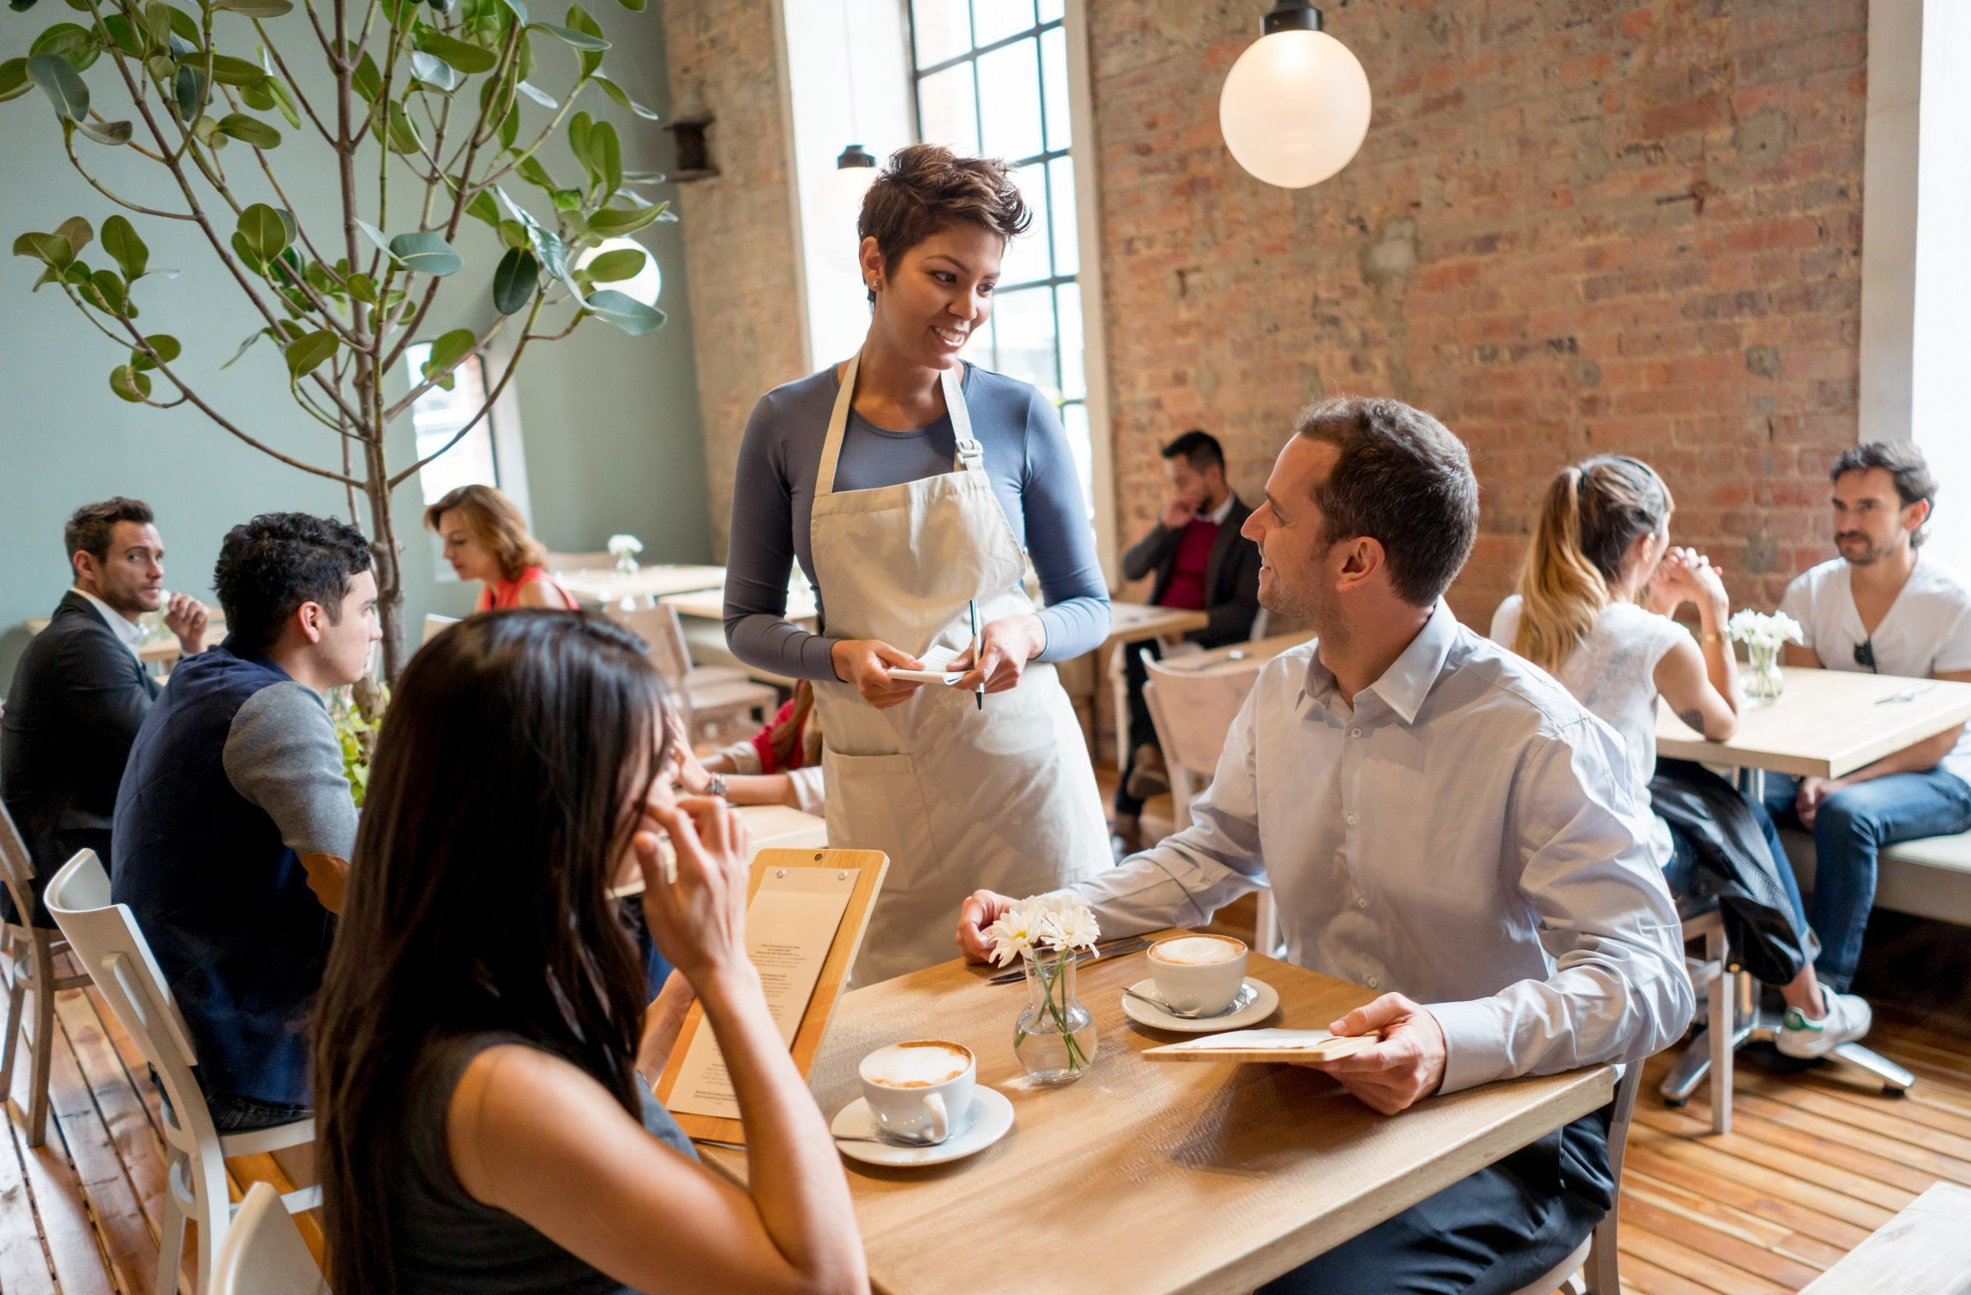

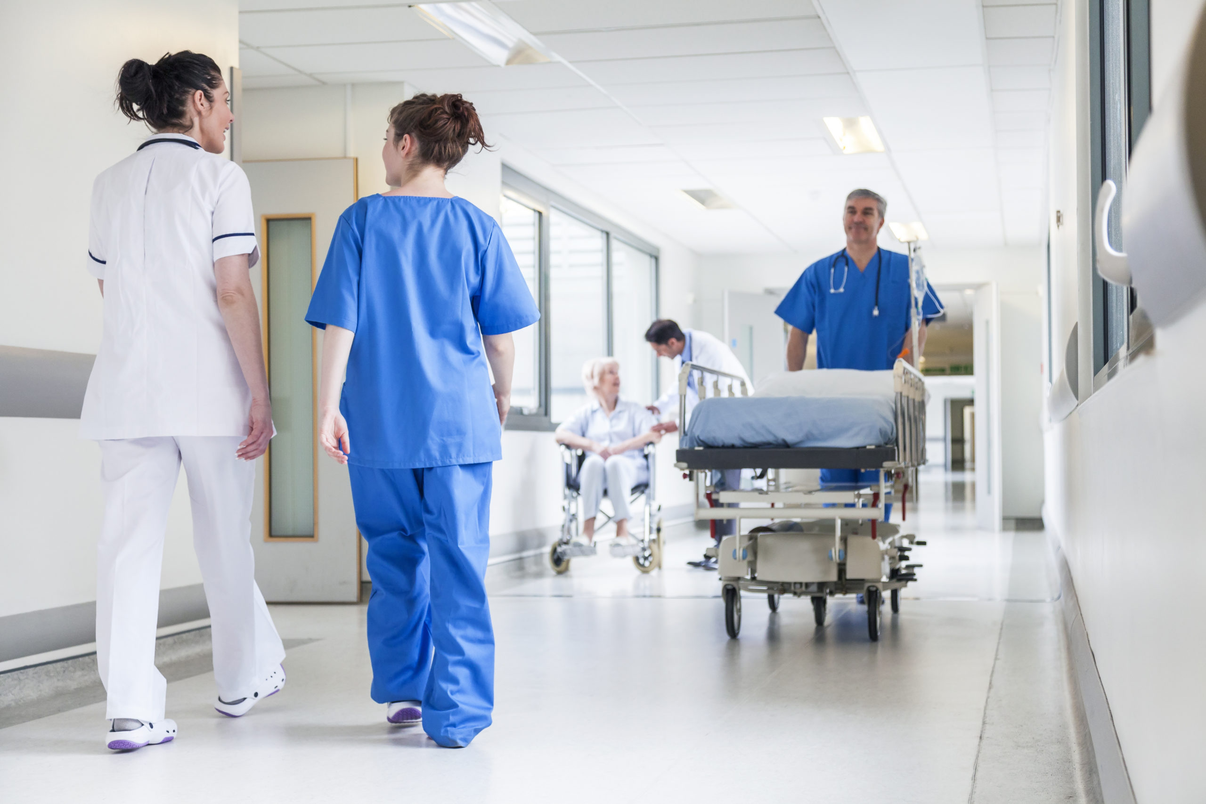
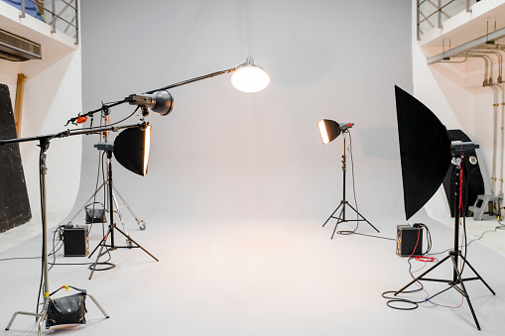
Listen and repeat.
in a clinic
in a restaurant
in a hospital
in a studio

Slide 7
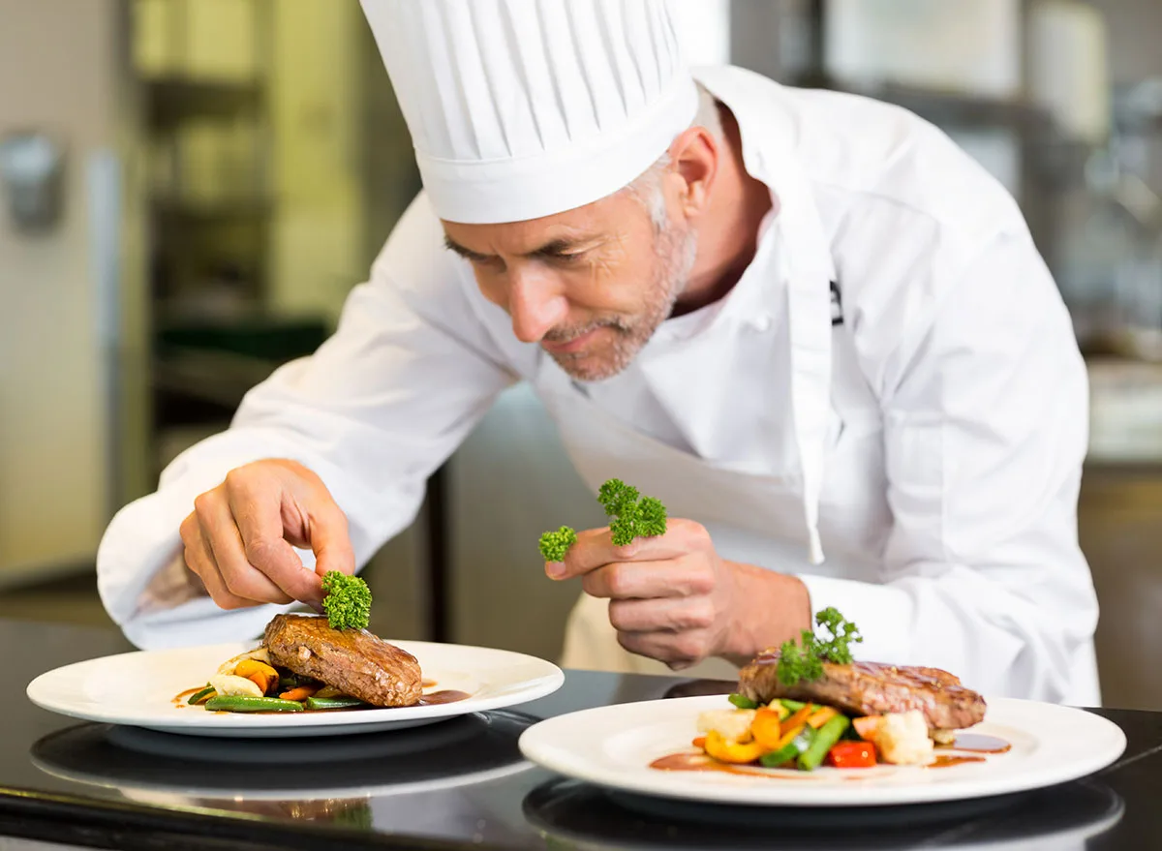
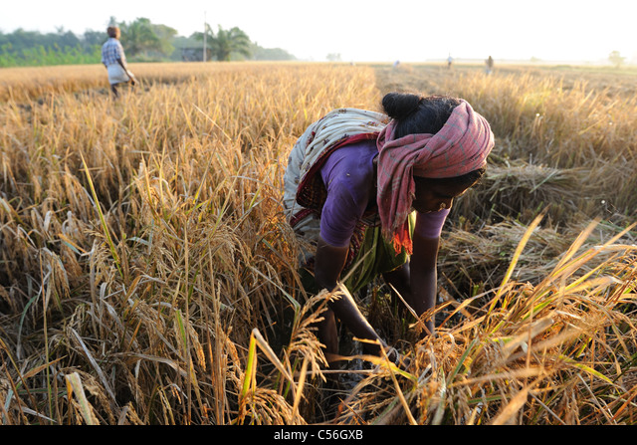
Listen and repeat.
Where does he work?
- He works in a restaurant.
2. Where does she work?
- She works in a field.

Slide 8
3. PRACTICE

Slide 9
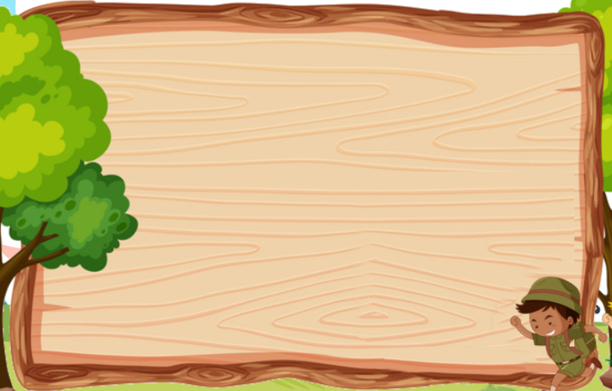
7. Listen and circle
Joe is a ___________.
doctor b. chef c. vet
2. Joe loves ___________.
animals b. plants c. babies
3. Joe works ___________.
on a farm b. in a hospital c. at a zoo
4. Joe ___________ elephants, monkeys, tigers and lions.
a. takes care of b. plays with c. takes photos of

Slide 10

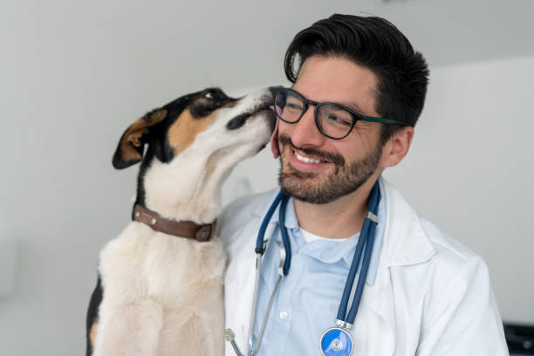


8. Look, ask and answer.
mother/ doctor/ in a hospital
2. father/ vet/ in a clinic
What does your mother do?
She’s a doctor.
Where does she work?
She works in a hospital.

Slide 11
4. PRODUCTION

Slide 12
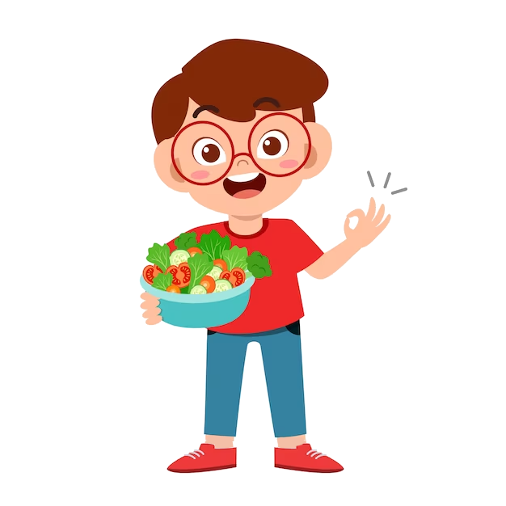

9. Let’s talk.
My father works in a hospital. He’s a doctor.
Where does your father work?

Slide 13
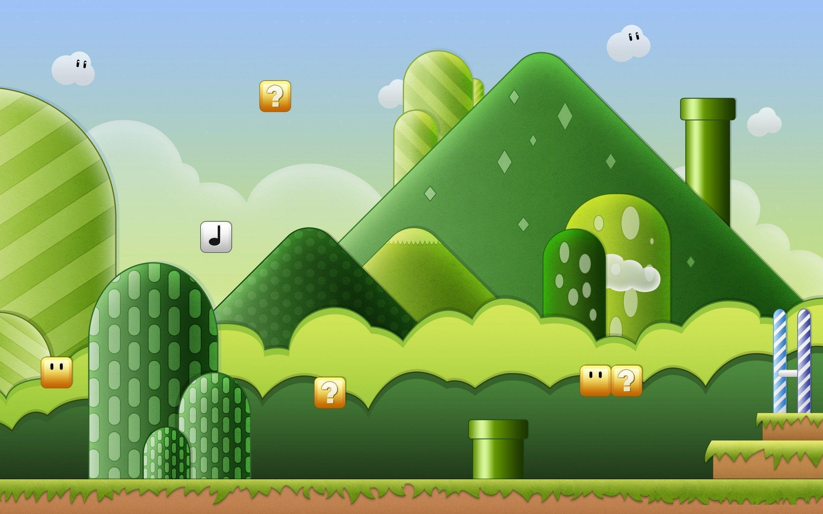

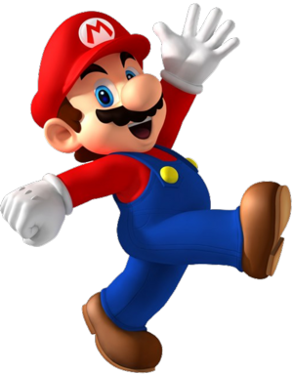

Slide 14



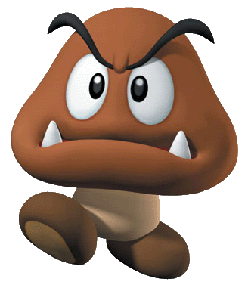
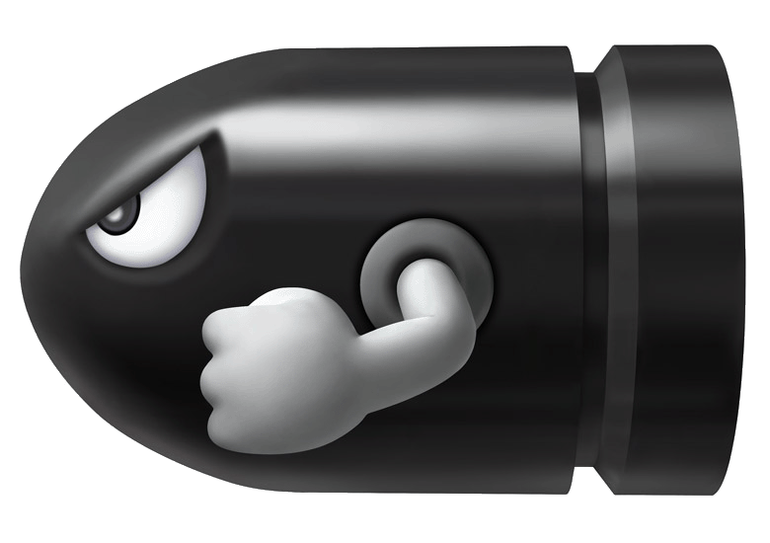




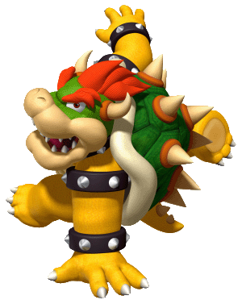





Blast 1 point from a team!
Enemies!!! Lose 3 points!
1 Point!
2 Points!
Blast 2 points from a team!
3 Points!
Blast 3 points from a team!
4 Points!
5 Points!!
10 points!

Slide 15


3
B
5
7
D
E
9
1
K
Notes:
Click on the face to choose a question

Slide 16



Slide 25
5. ASSESSMENT

Slide 26
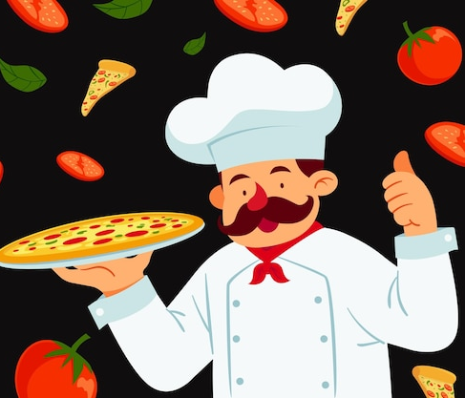

Look and write.
vet restaurant chef works
1. Joe is a _______. He works in an Italian _________ in Hanoi. He can make great pizzas and spaghetti.
2. Mariana is my cousin. She’s young and nice. She is a ________. She takes good care of animals. She _______ in a clinic in Singapore.
chef
restaurant
vet
works

Slide 27
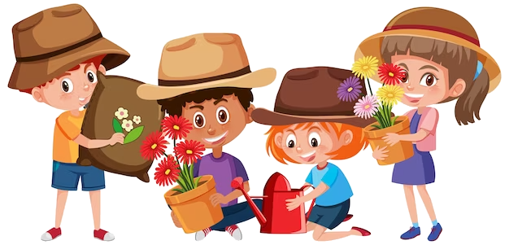
UNIT 7: JOBS
LESSON 2: PERIOD 3
What we learnt today:
Review vocabulary:
- in a hospital, in a restaurant, in a studio, in a clinic
Review structure:
- Where does he work?
- He works in a restaurant.

Slide 28




Thank you & goodbye!

