Slide 1






















Notes:
Để nguyên trang bìa như này, chỉ thay đổi tên bài trong quá trình làm. Logo của sách Wonderful World

Slide 2
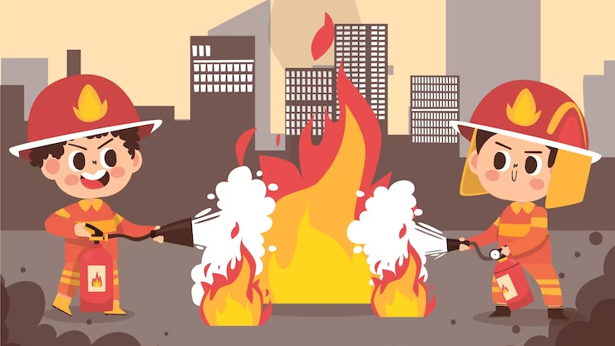

Unit 7: Jobs
Lesson 3
Task 1, 2, 3

Slide 3
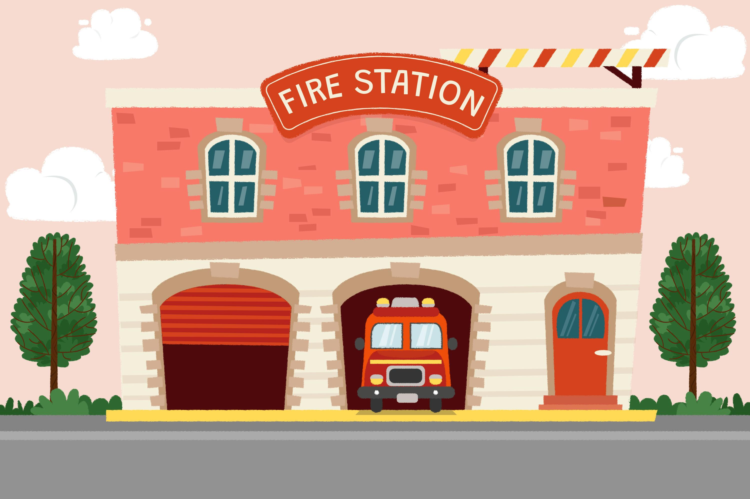
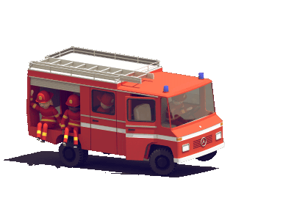
1. Warm up
Watch the video

Slide 4
2. PRESENTATION

Slide 5
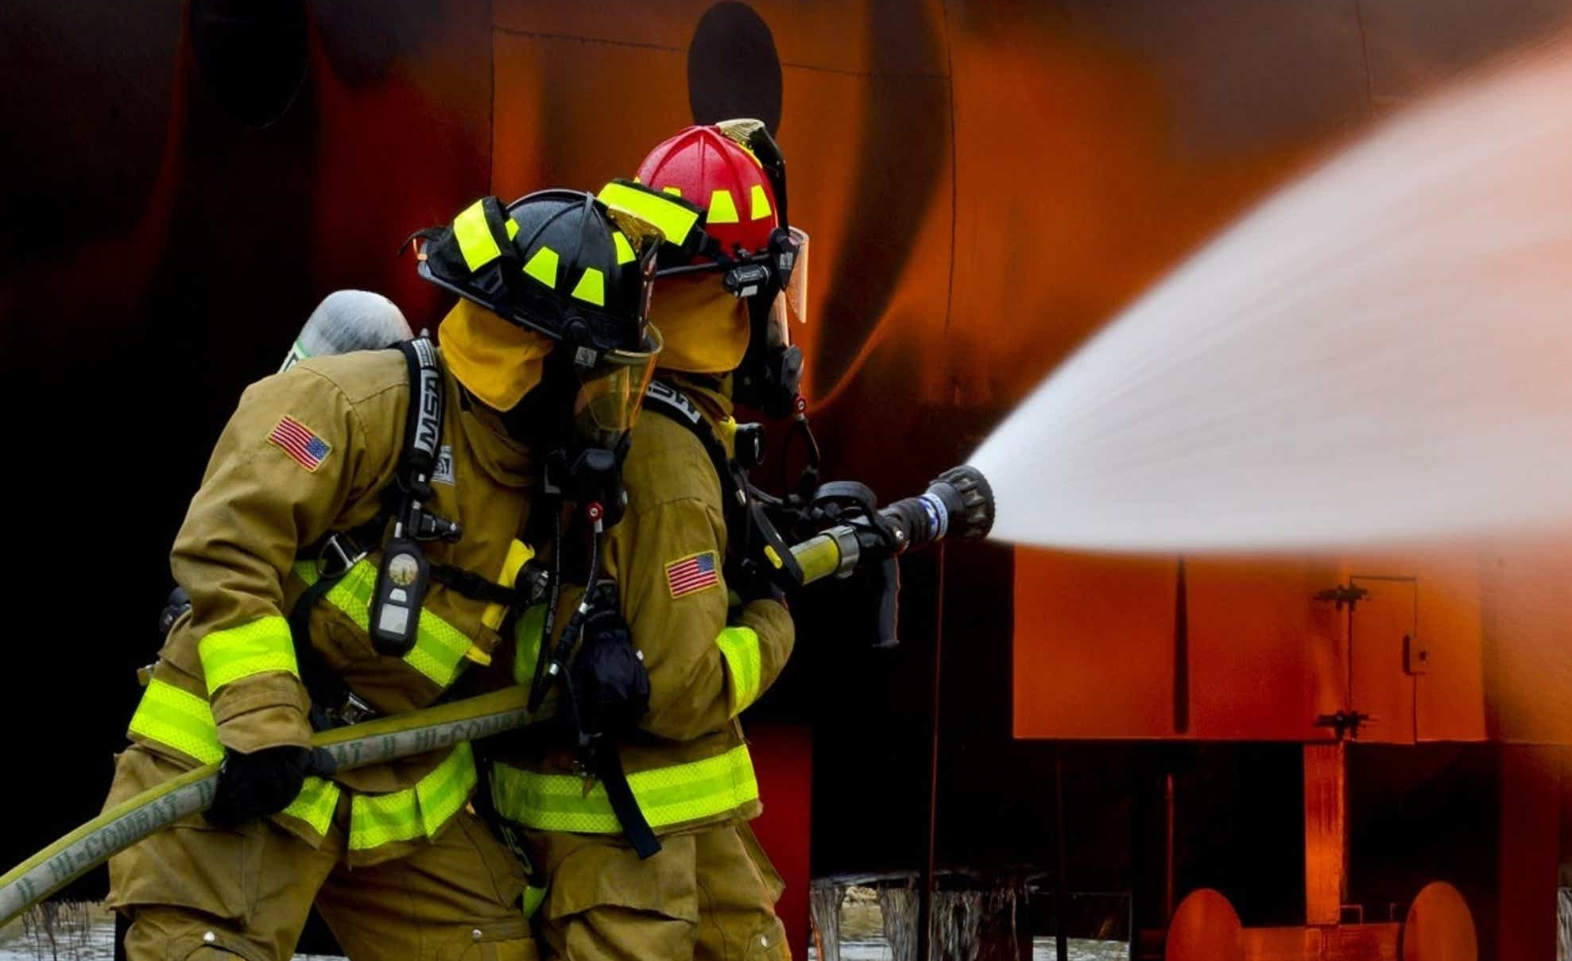
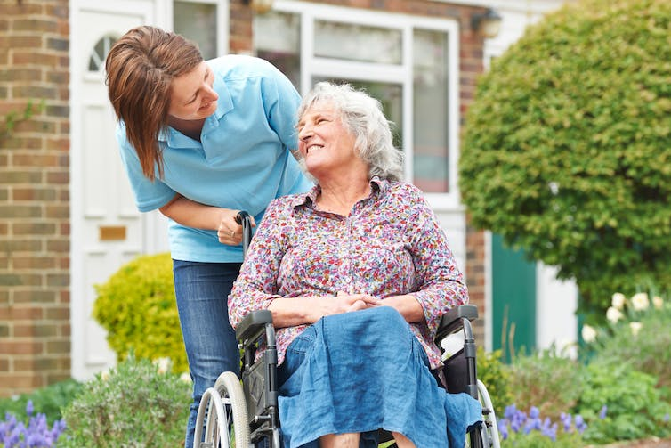
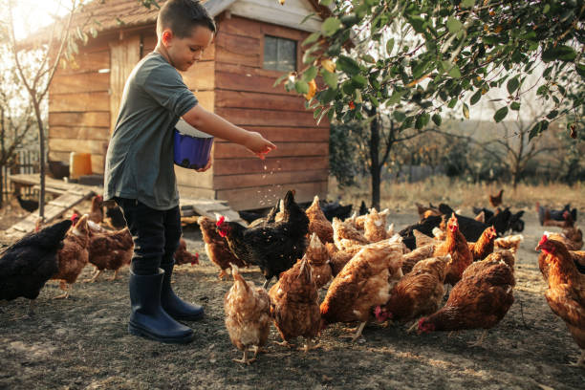
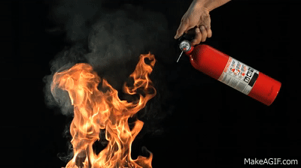

firefighter
feed animals
put out fires
take care of people

Slide 6
3. PRACTICE

Slide 7
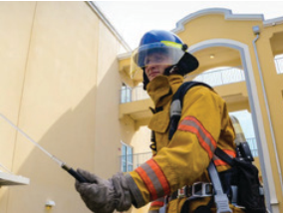
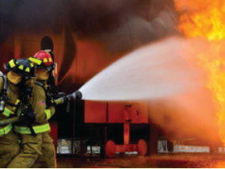
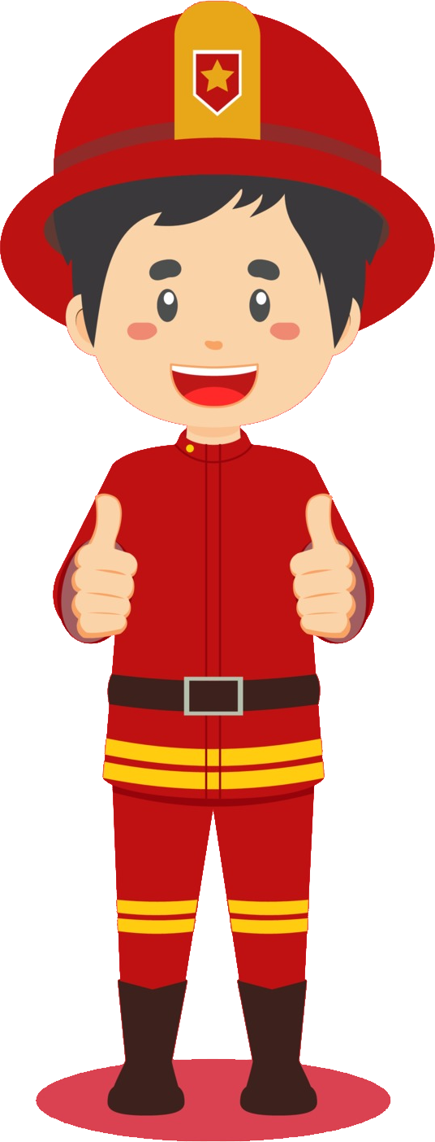
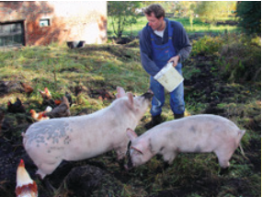
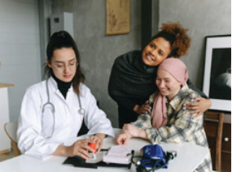
1. Listen and point. Repeat.
firefighter
put out fires
feed animals
take care of people

Slide 8


2. Listen and tick.
1. Jack wants to be a vet because he loves ____ □animals. □people.
2. Milly wants to be a ___ □firefighter. □photographer.
3. A firefighter ___ □takes care of people. □puts out fire.

Slide 9
4. PRODUCTION

Slide 10
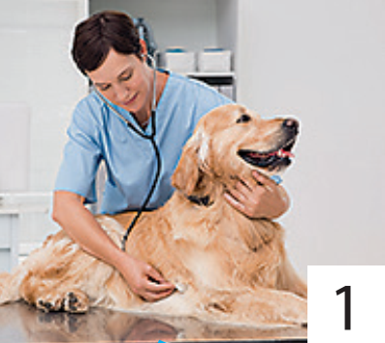
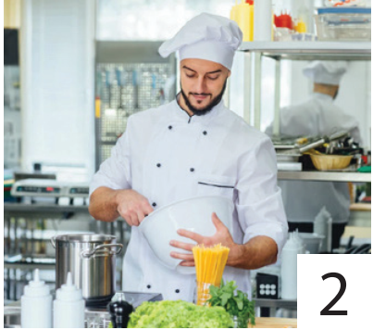
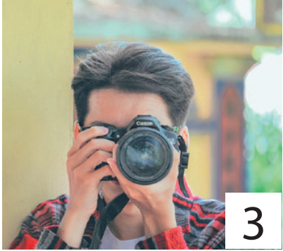
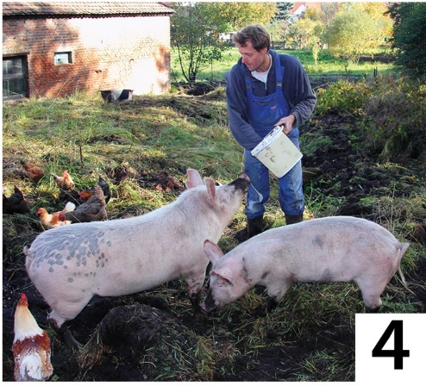
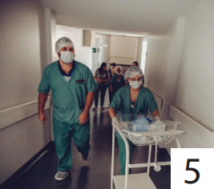
3. Look and say.
A vet takes care of animals.
takes care of people
cooks good food
feeds animals
takes care of animals
takes photos

Slide 11
5. ASSESSMENT

Slide 12
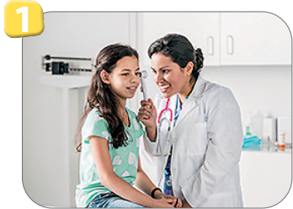
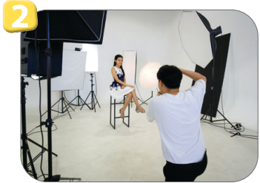
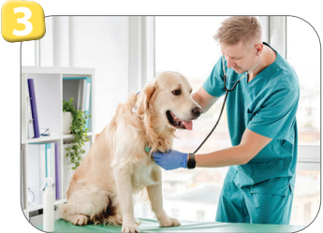
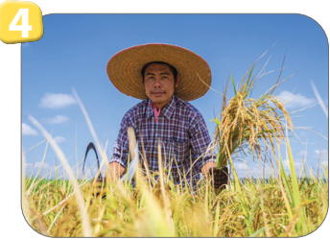

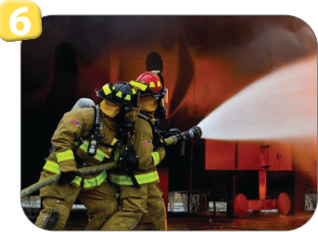
Look and write.
She takes care of people: _____
He works in a studio: ___________
He takes care of animals: ____
doctor
photographer
vet
He feeds animals: _____
She helps students: ______
He puts out fires: _________
farmer
teacher
firefighter

Slide 13
UNIT 7: JOBS
LESSON 3: PERIOD 1
What we learnt today:
Vocabulary:
1. firefighter
2. feed animals
3. put out fires
4. take care of people

Slide 14




Thank you & goodbye!

