Slide 1









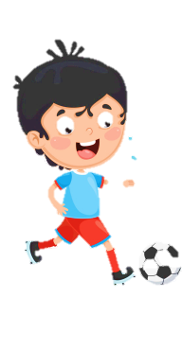
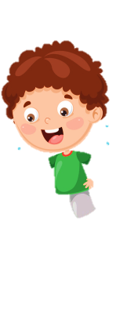

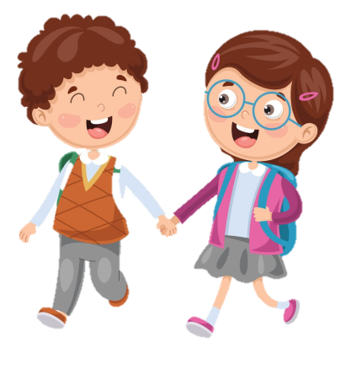




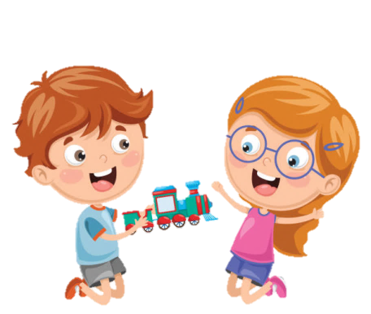





Slide 2
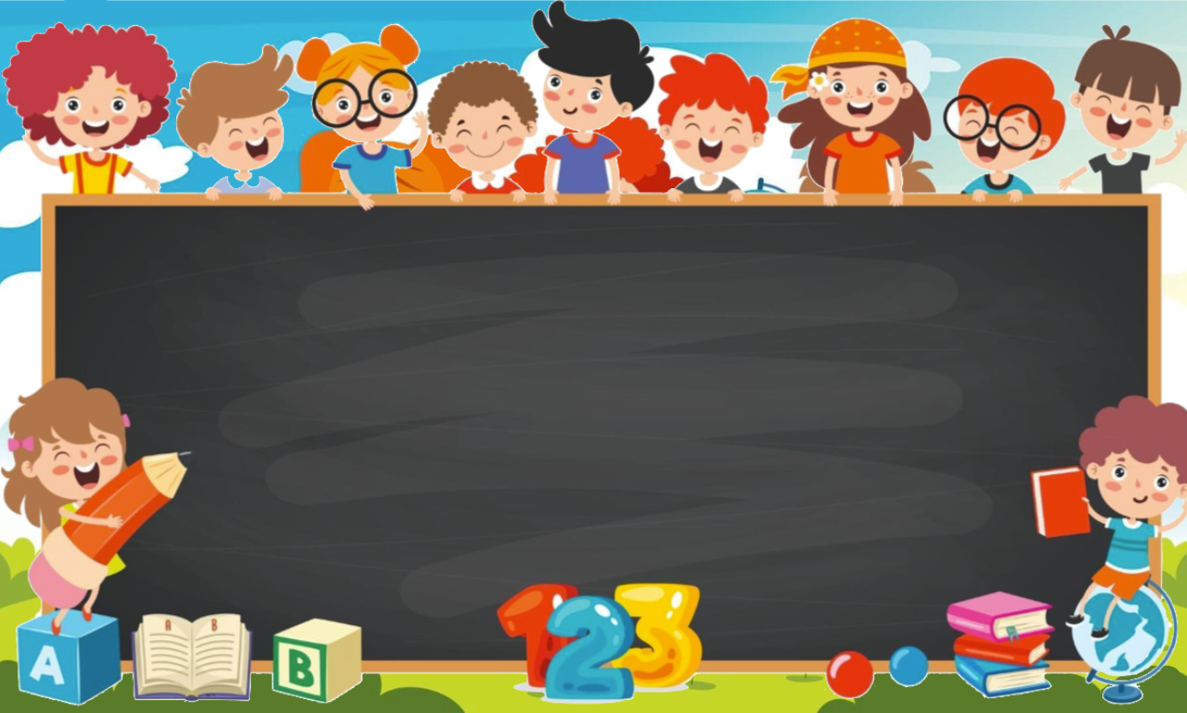
Unit 7: Jobs
Lesson 3
Task 4, 5, 6

Slide 3

1. WARM UP
Who am I?

Slide 4

Guess the job
Notes:
T divides the class into 4 teams. Each team will be given a bell.
- Each slide shows 4 pictures relating to a job. Each picture will be shown in 3 seconds. (The more pictures are shown, the less points are given).
- The team coming up with the answer will ring the bell to get the chance to answer.
- The game will last for 6 rounds

Slide 5

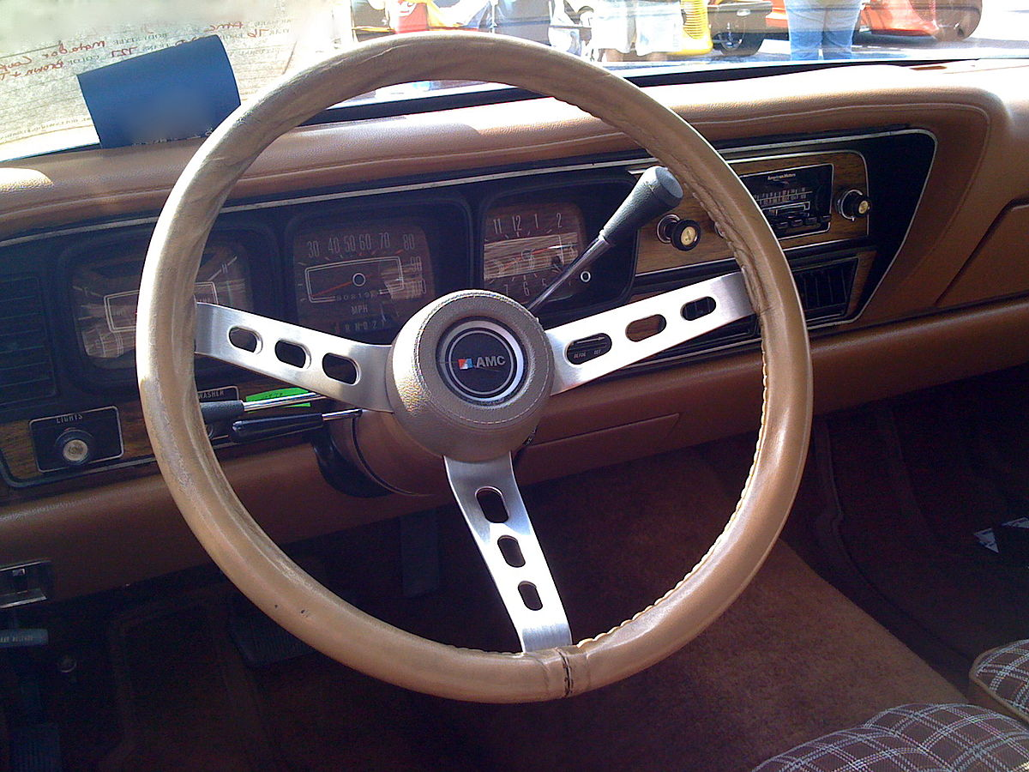
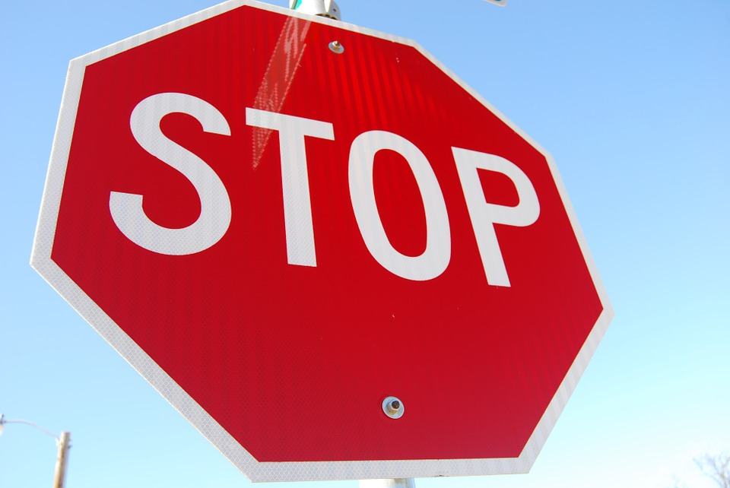
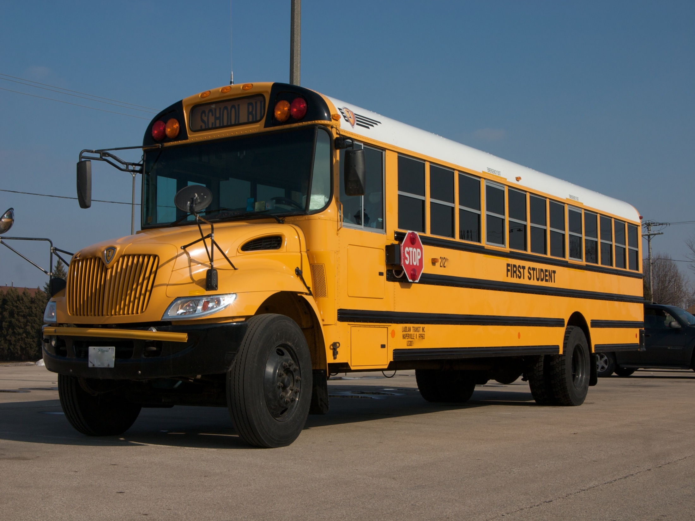
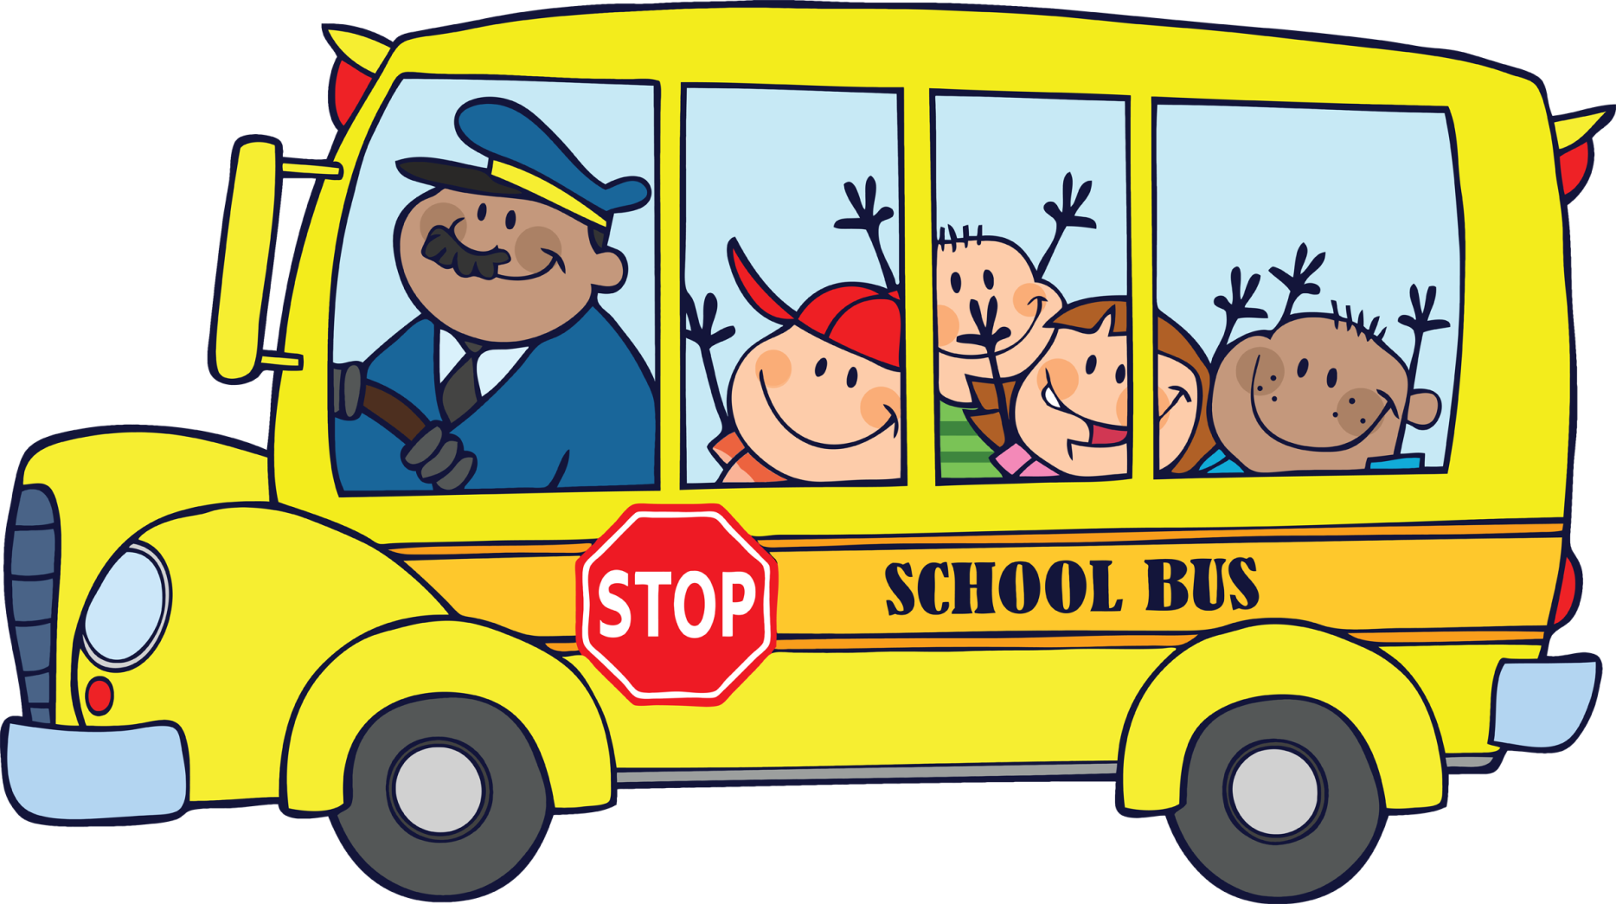

Slide 6


Slide 7
BUS DRIVER

Slide 8
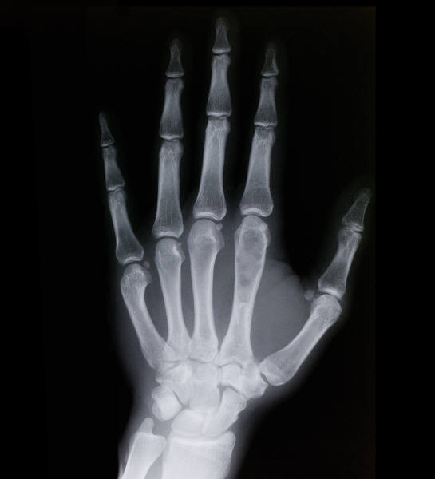
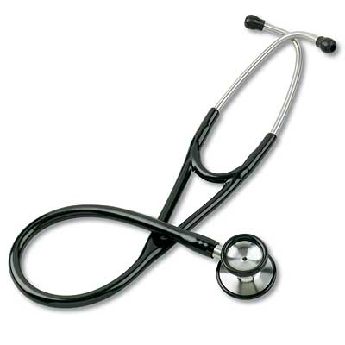
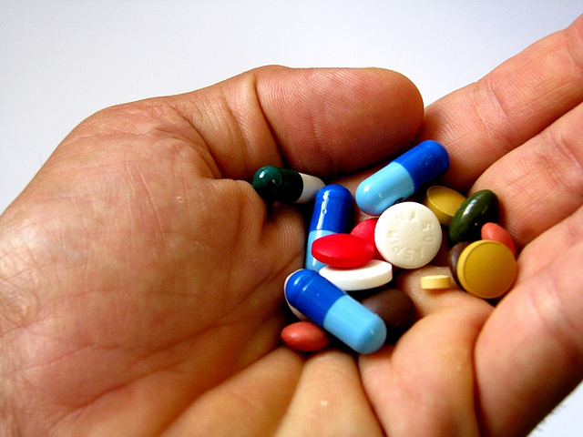
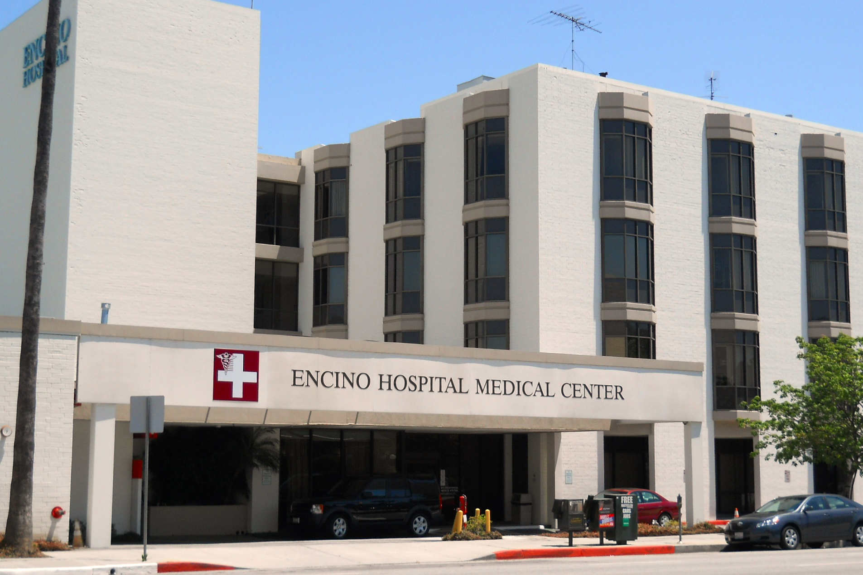
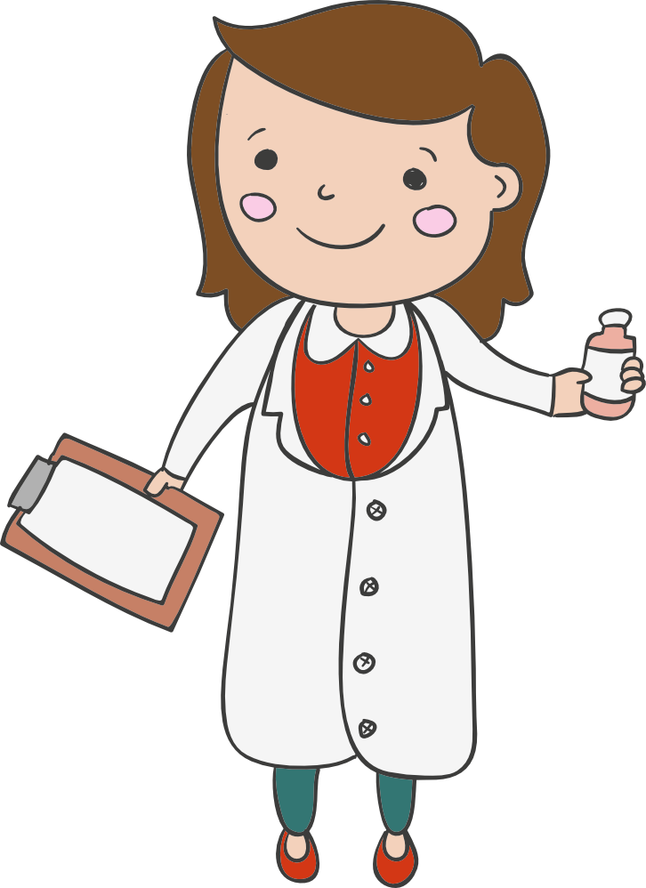

Slide 10
DOCTOR

Slide 11
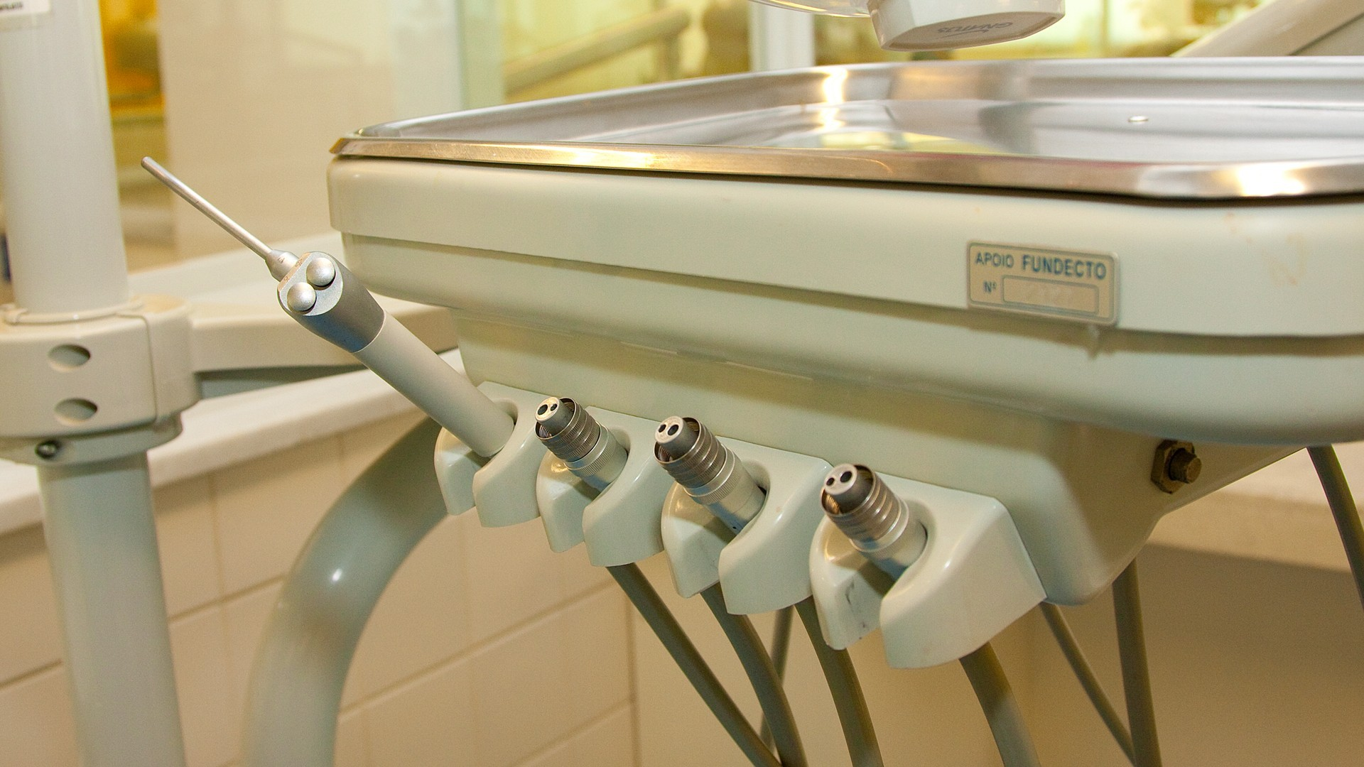
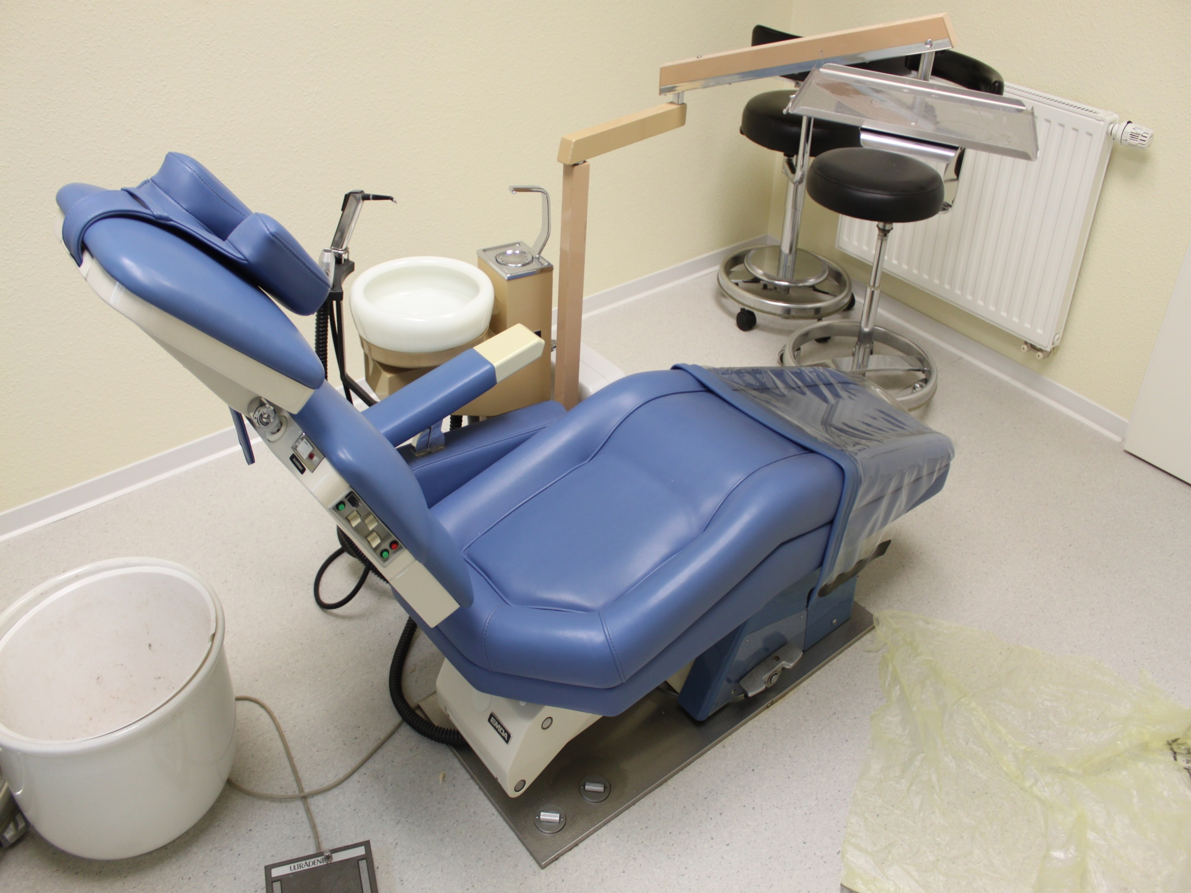
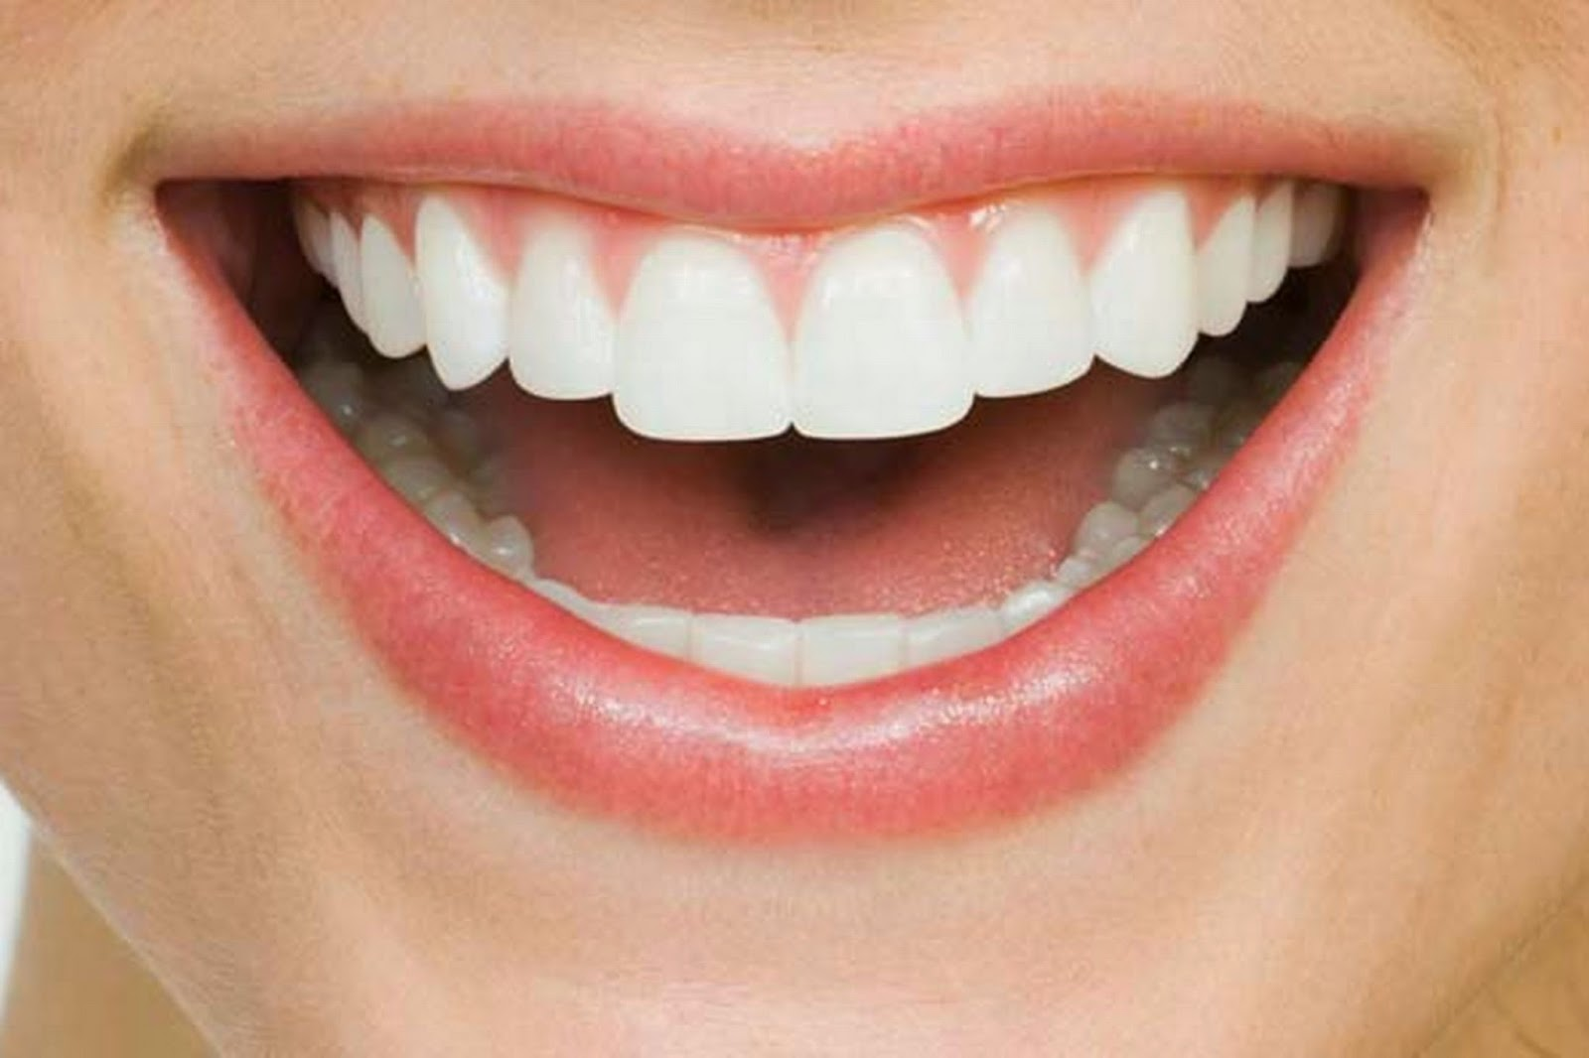
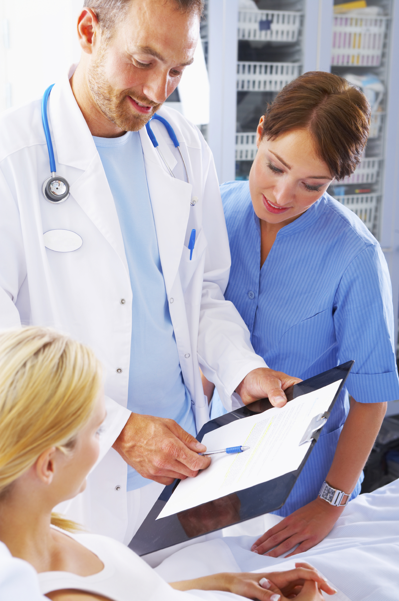

Slide 13
DENTIST

Slide 14

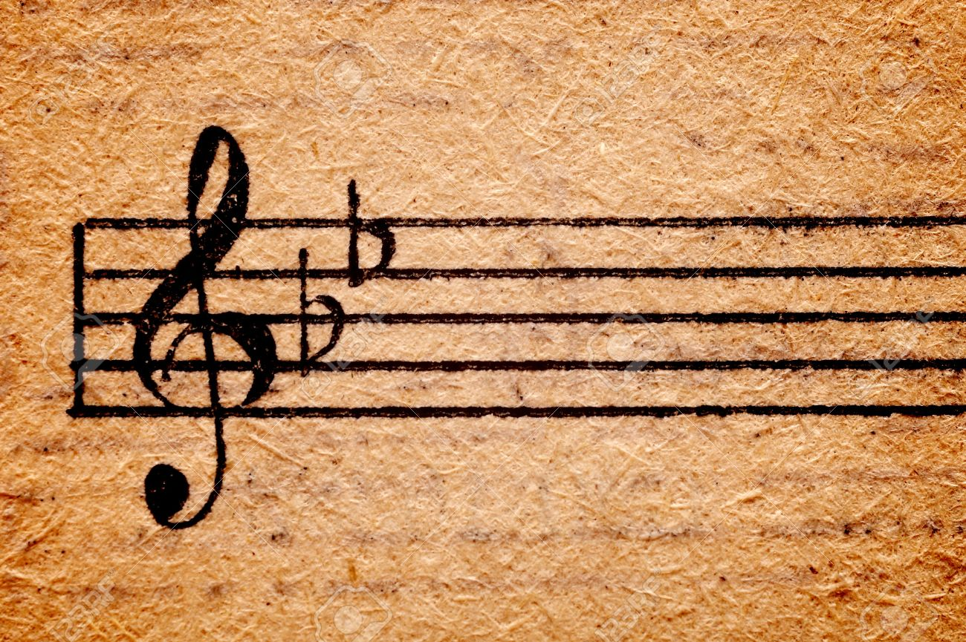

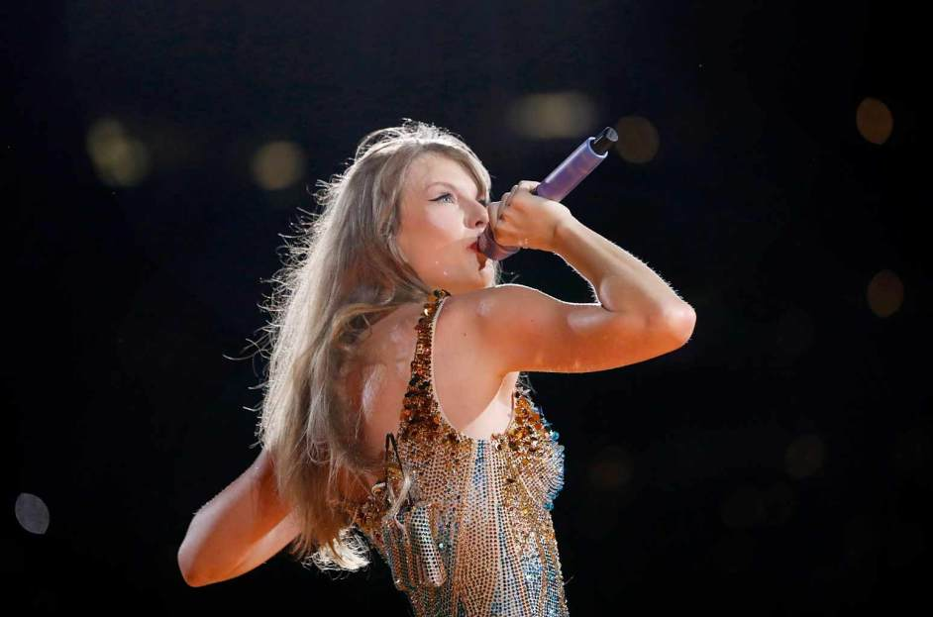

Slide 16
SINGER

Slide 17
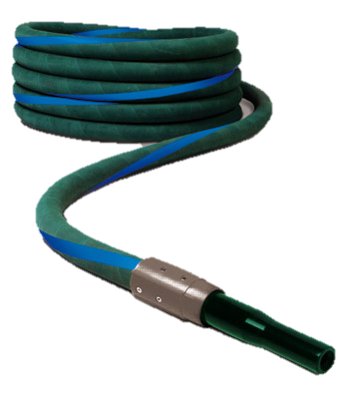
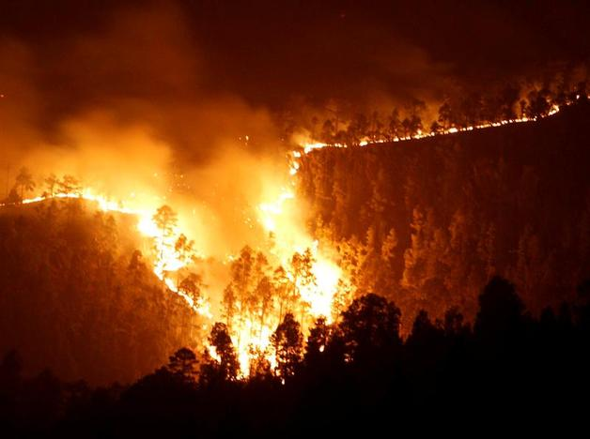
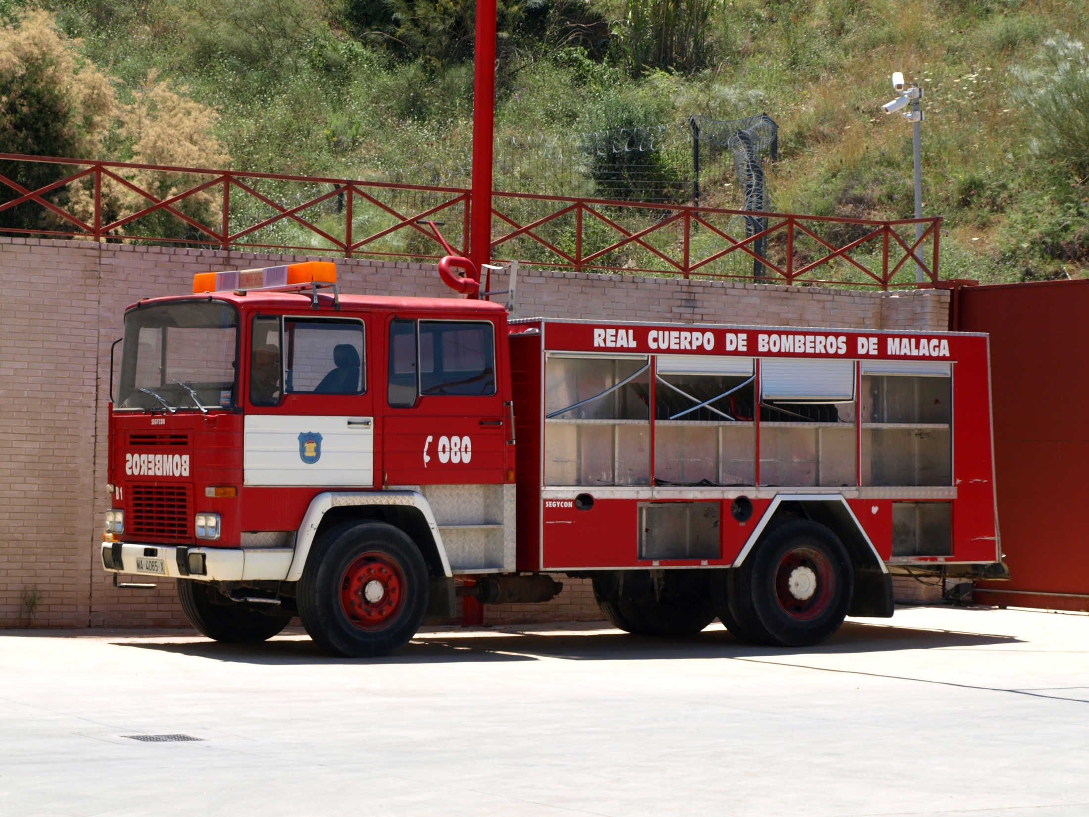
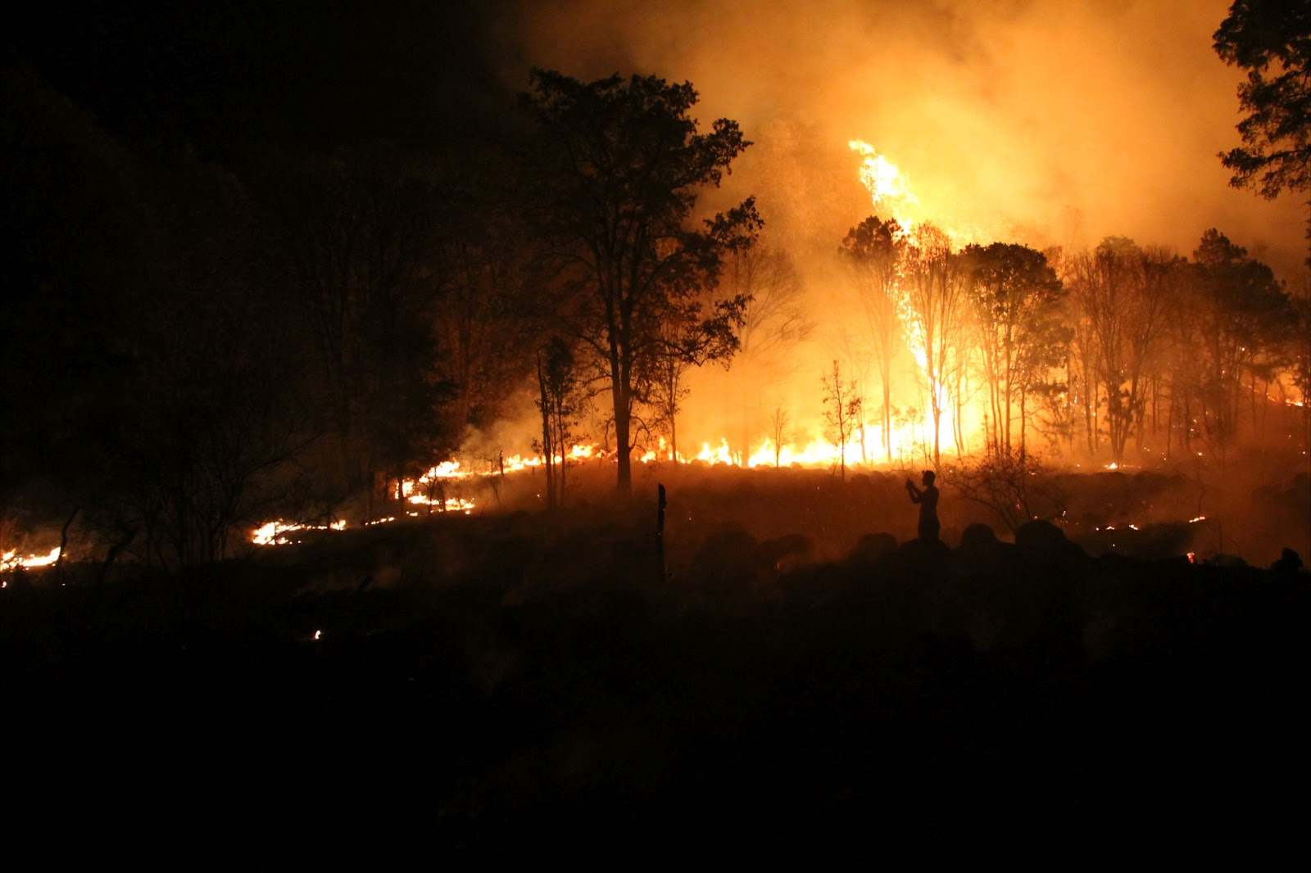
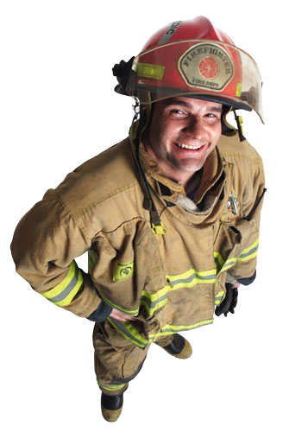

Slide 19
FIRE FIGHTER

Slide 20
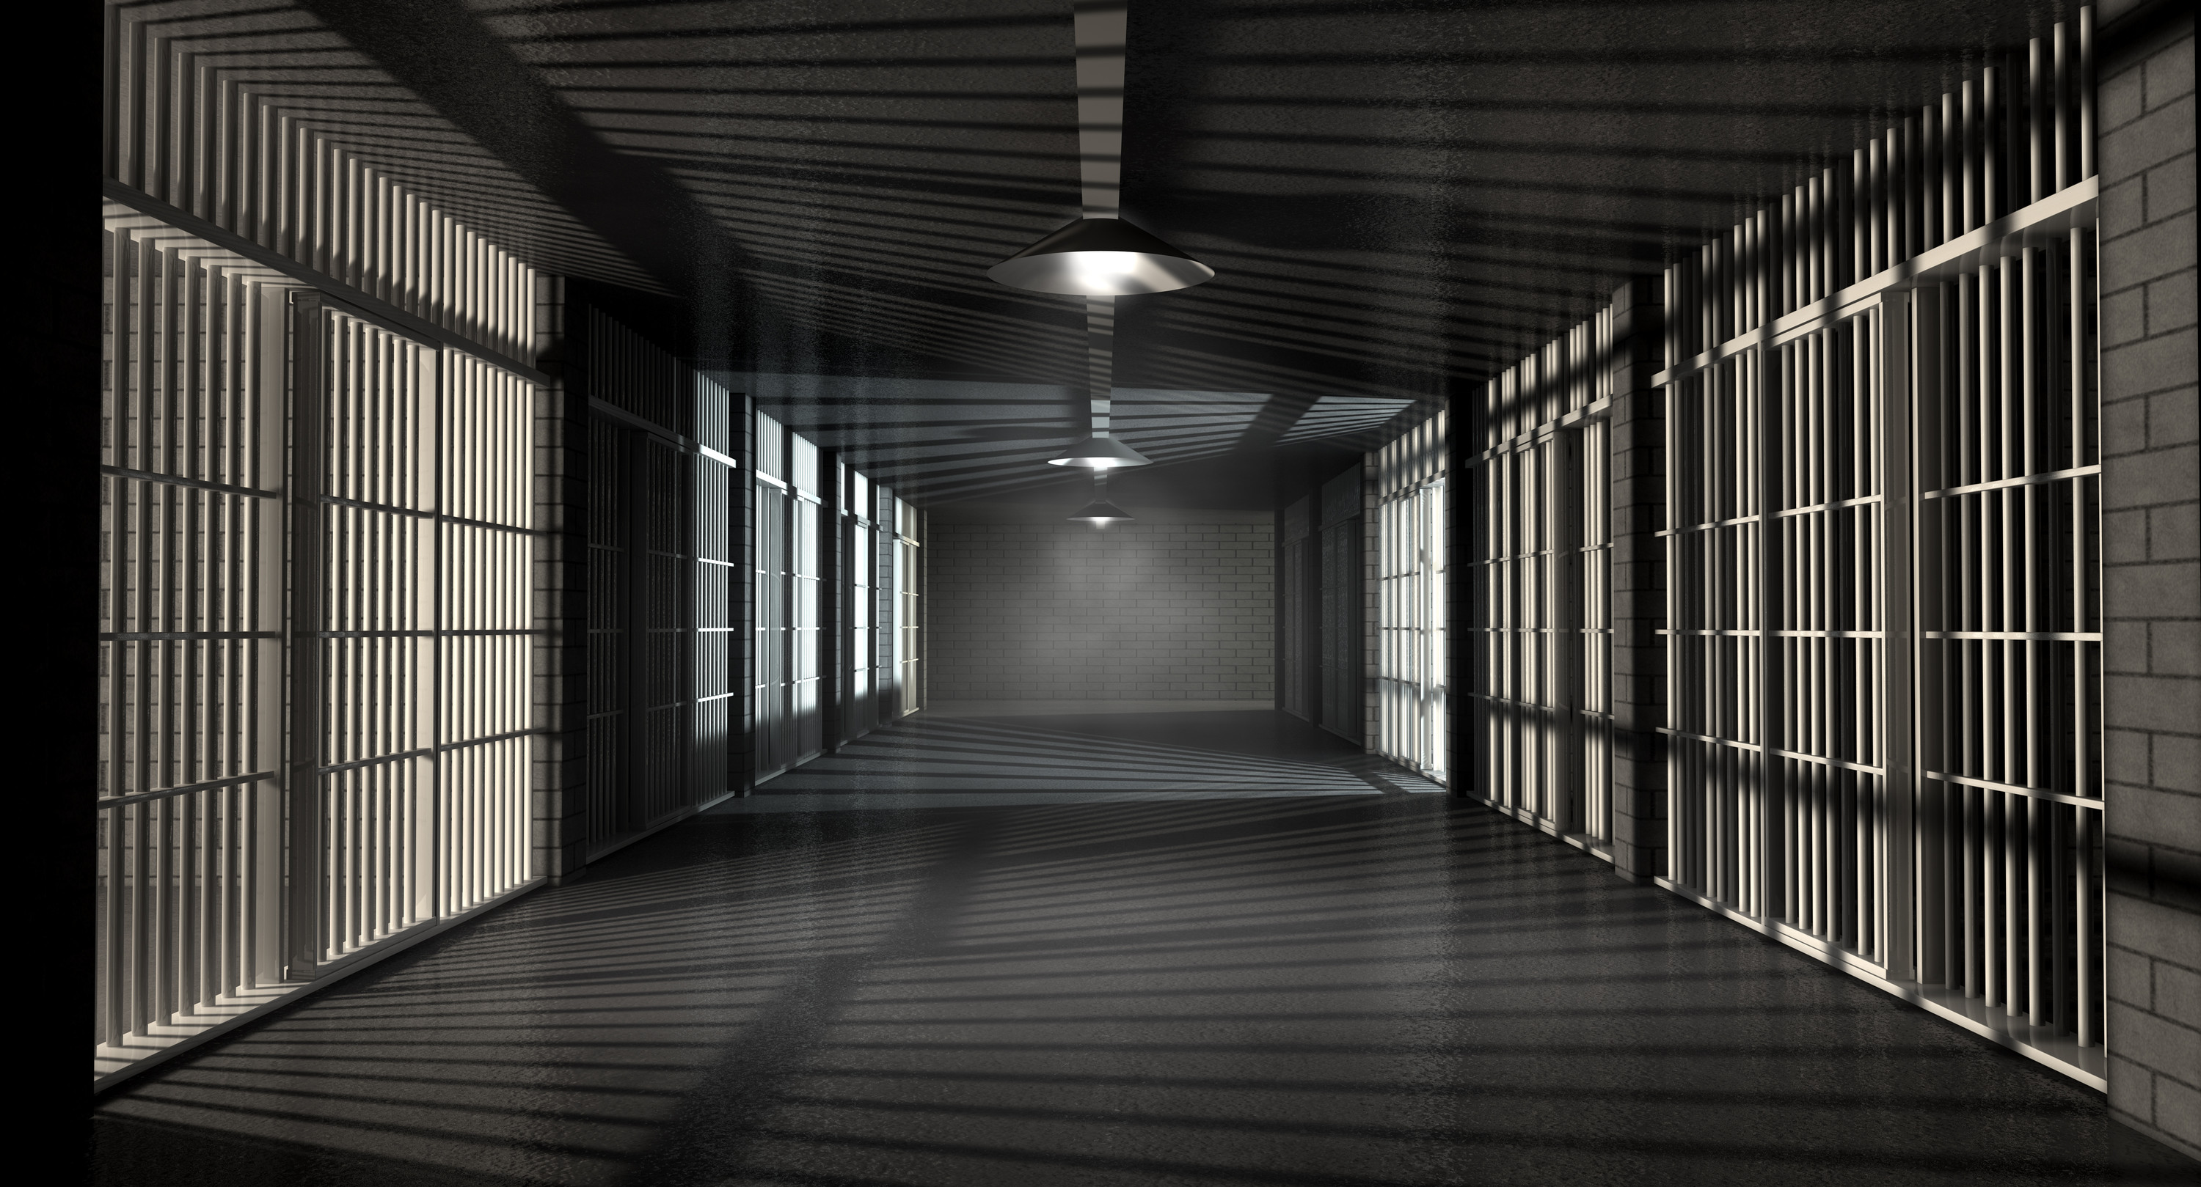
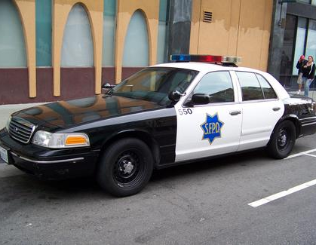
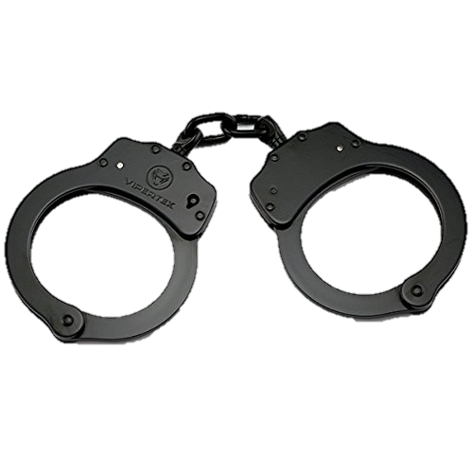
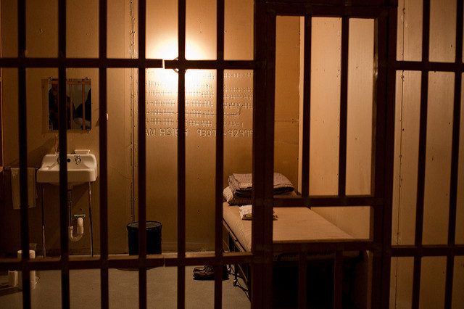
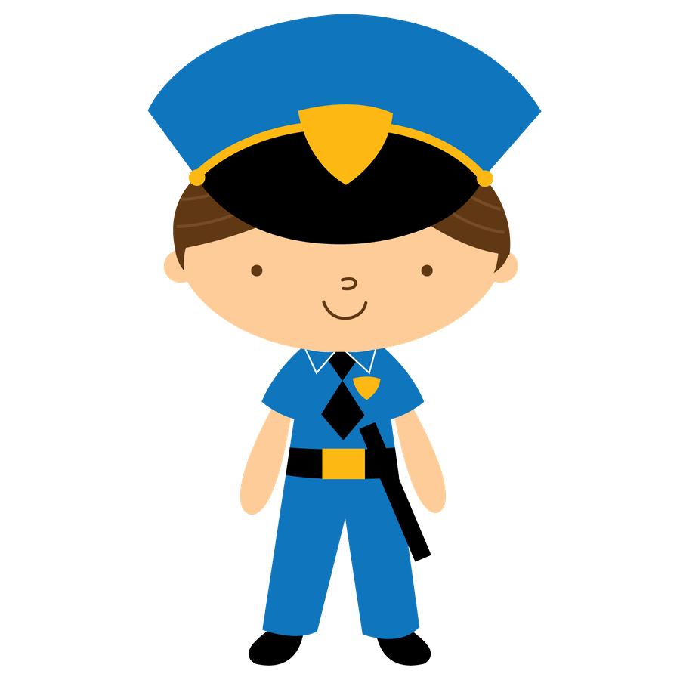

Slide 22
POLICE OFFICER

Slide 23
2. REVIEW

Slide 24
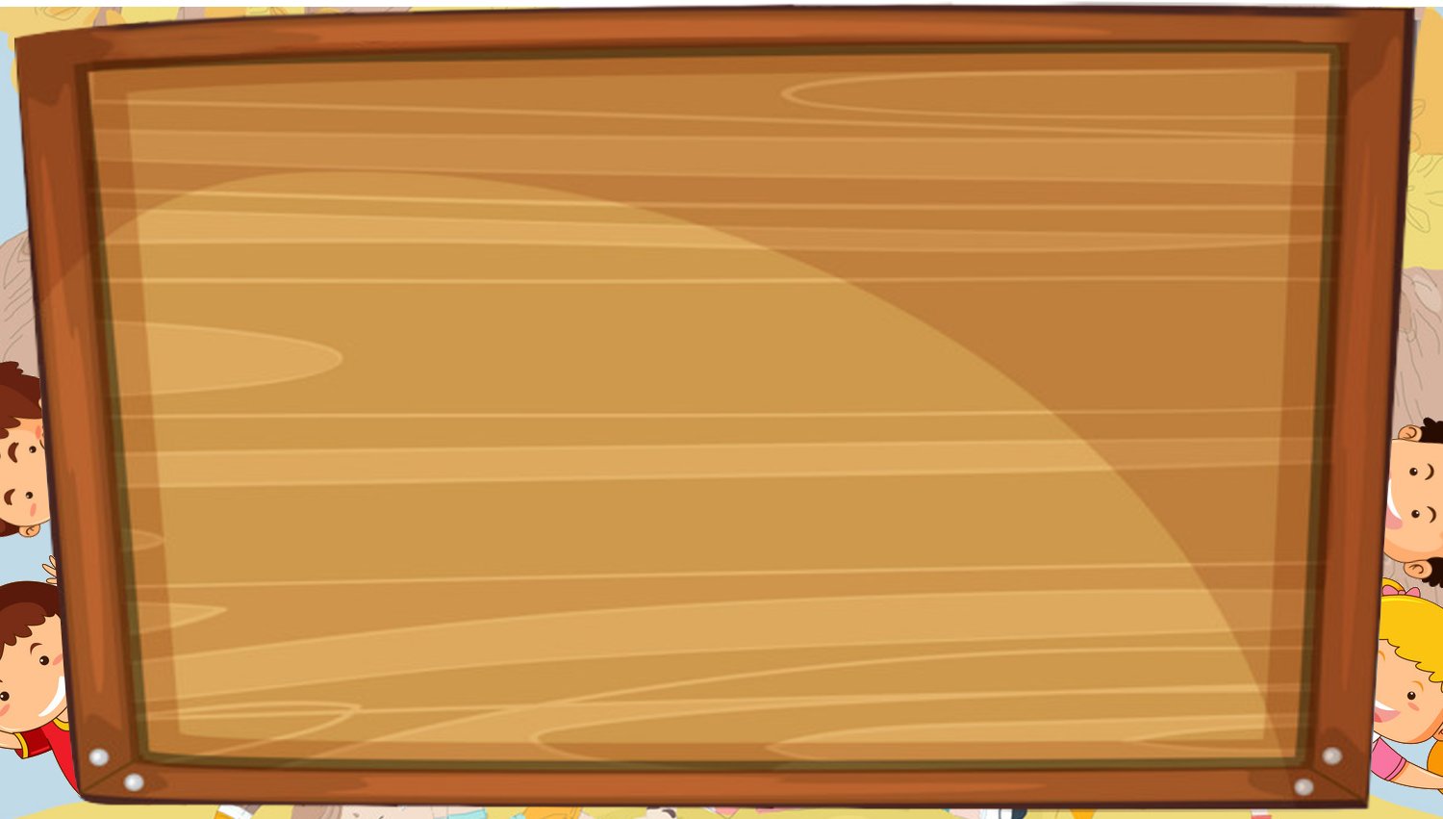
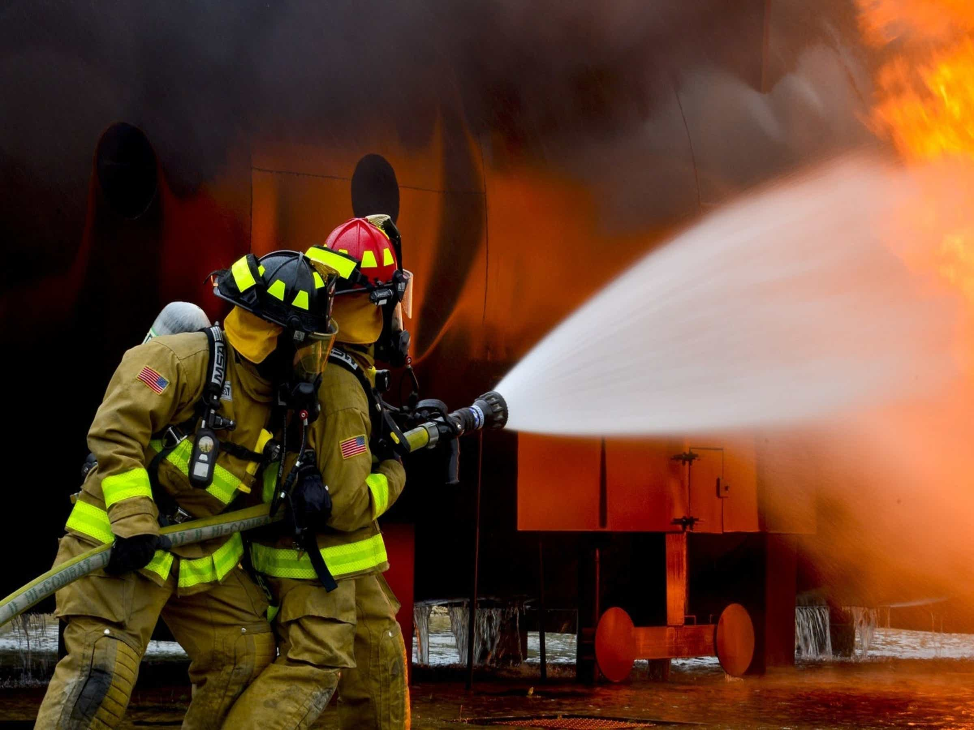
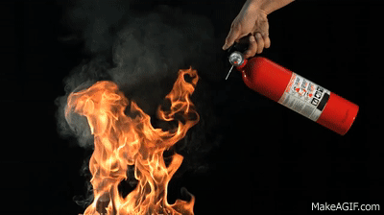
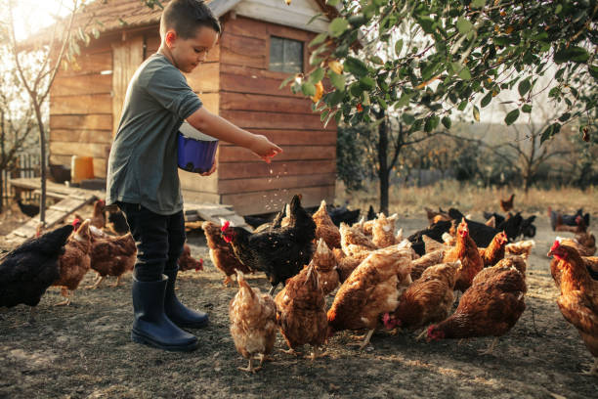
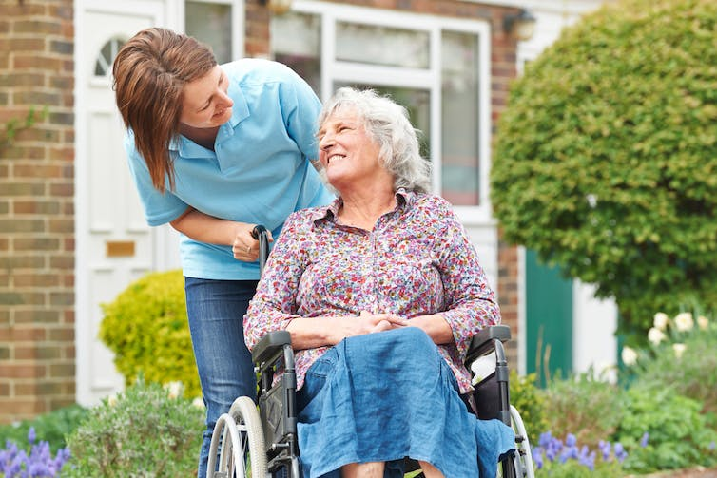
Listen and point. Repeat.
firefighter
put out fires
feed animals
take care of people

Slide 25
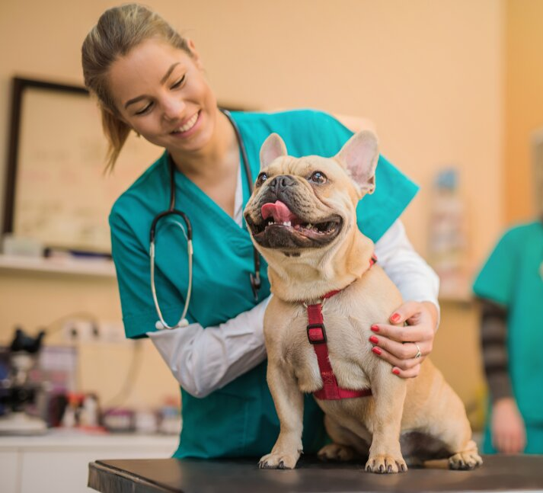
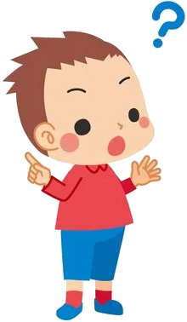
4. Listen and repeat.
What does a vet do?
A vet takes care of animals.

Slide 26
3. PRACTICE

Slide 27
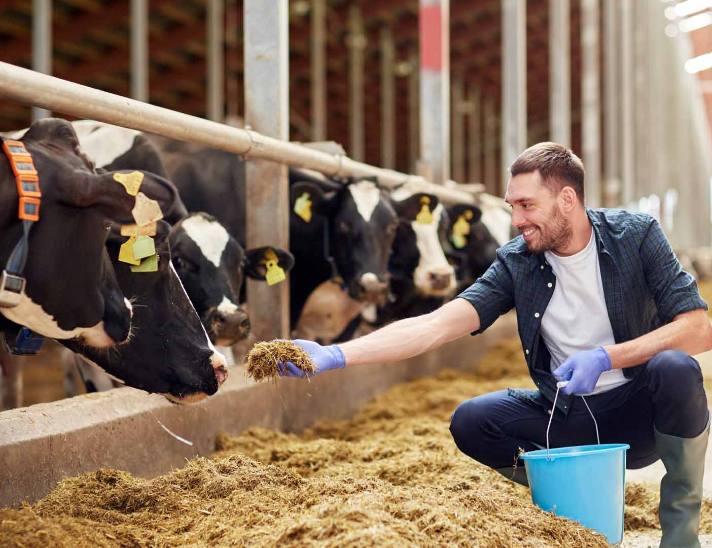
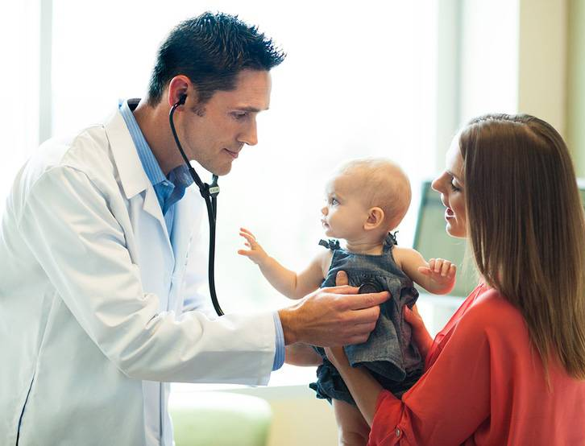
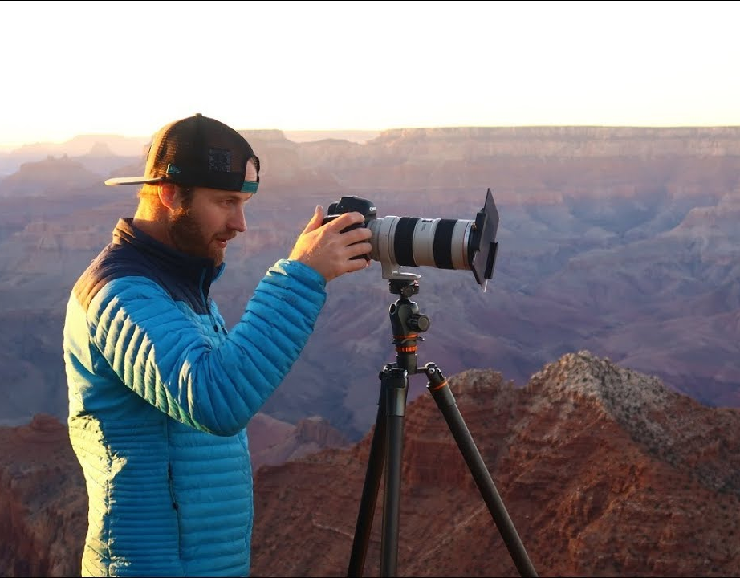
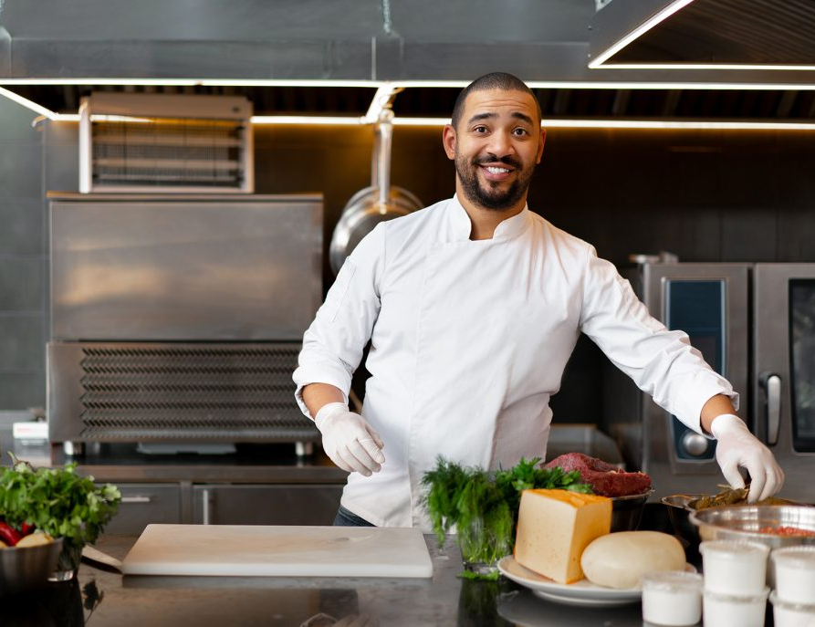
5. Look. Ask and answer.
What does a farmer do?
A farmer feeds animals.

Slide 28
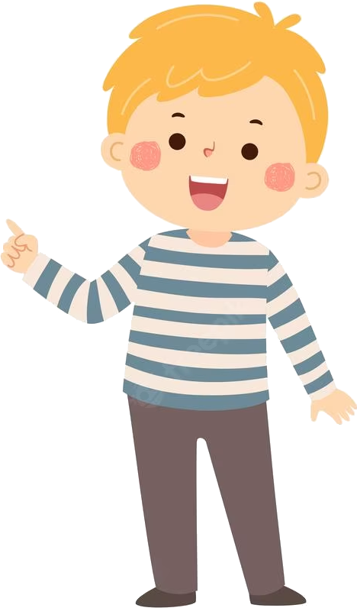
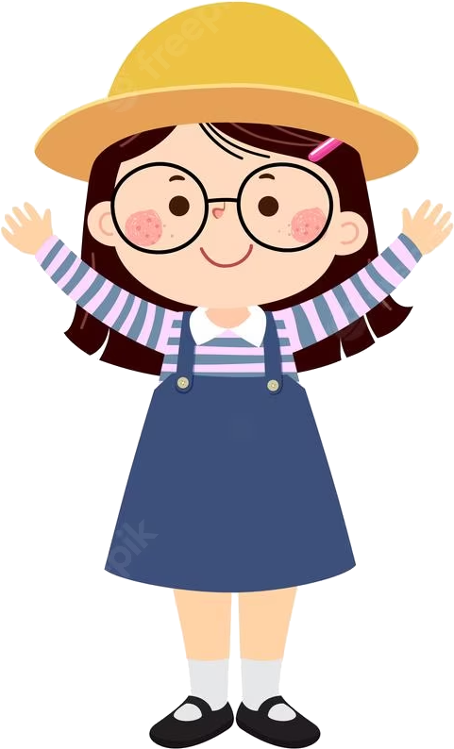
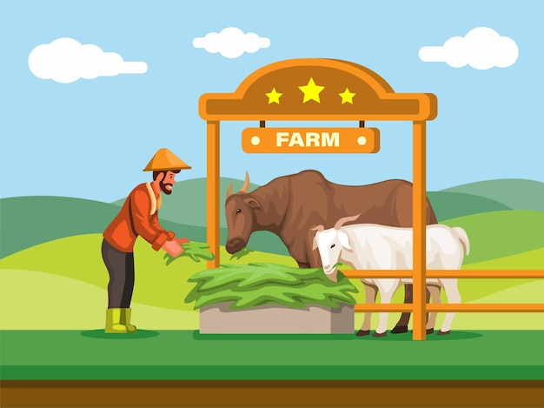
6. Role-play
What does he do?
He’s a farmer.
He works on a farm.
Where does he work?
What does he do everyday?
He feeds animals on the farm.

Slide 29
4. PRODUCTION
Secret garden

Slide 30
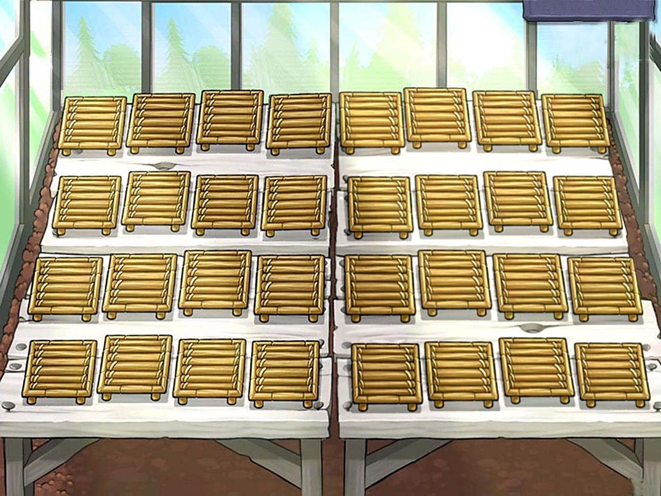

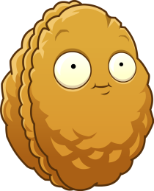








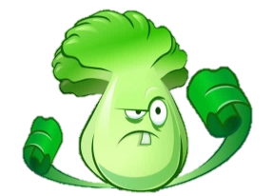
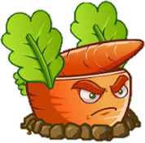



- 2
-1
+2
+3
Notes:
T divides the class into 2 groups. Each group will choose a name and play rock, scissors, paper to decide which group goes first.
The two groups will take turns to choose a plant and answer the corresponding questions.
If the answer is correct, T will click on the ball to make it move. If not, the chance is given to the other team.
Which team get higher score will win.)
When the game is finished, click on the next button on the right bottom edge to move to next slide.

Slide 31
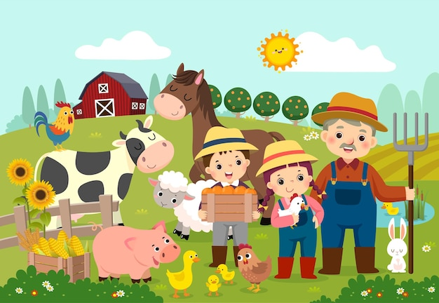

Fill in the blank:
A farmer _______ on a farm.
works

Slide 32
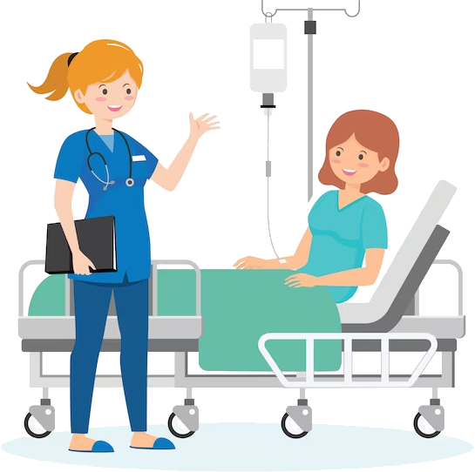
What does a doctor do?
A doctor takes care of people.

Slide 33

What does a chef do?
A chef cooks great food.

Slide 34
Listen and fill in the blank:
feeds
A farmer ______ animals.

Slide 35

What does a teacher do?
A teacher teaches children.

Slide 36

What does a photographer do?
A photographer takes photos.

Slide 37

What does a firefighter do?
A firefighter puts out fires.

Slide 38
5. ASSESSMENT

Slide 39

Read and circle.
1. What does a vet do?
A vet takes care of animals/ people
2. What does a student do?
A student learns/ works at school.
3. What does a chef do?
A chef cooks great food/ helps animals.
4. What does a farmer do?
A farmer helps people/ feeds the animals.
5. What does a photographer do?
- A photographer takes nice photos/ takes cares of people.

Slide 40


UNIT 7: JOBS
LESSON 3: PERIOD 2
What we learnt today:
1. Review vocabulary:
- firefighter, feed animals, put out fires, take care of
2. Structure:
What does a vet do?
A vet takes care of animals.

Slide 41




Thank you & goodbye!

