Slide 1





















Unit 7
Fun time
and project

Slide 2



1
Fun time
Let’s sing a song!

Slide 3

1
Fun time

Slide 4


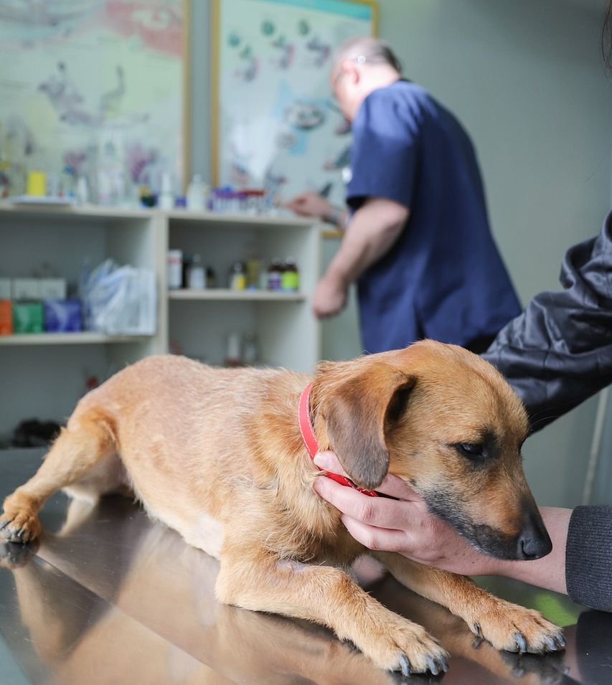
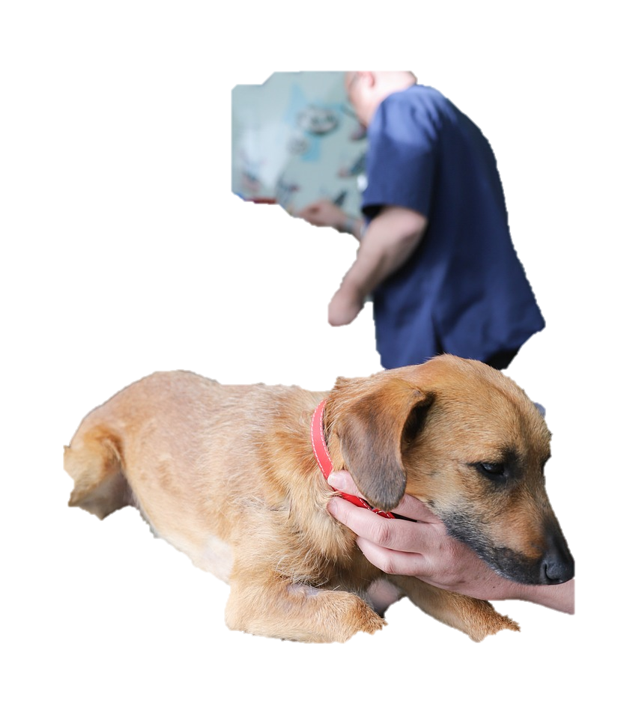
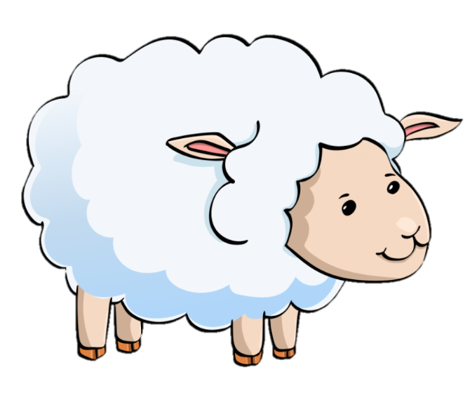
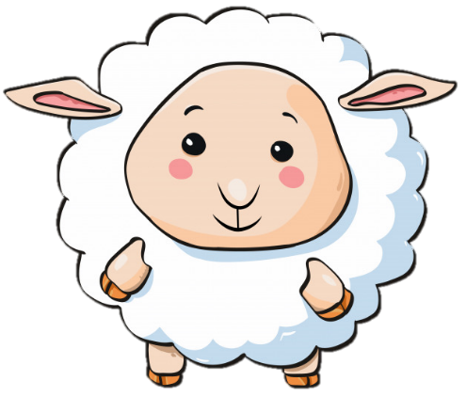
5 stars
Where does he work?
He works in a clinic.

Slide 5
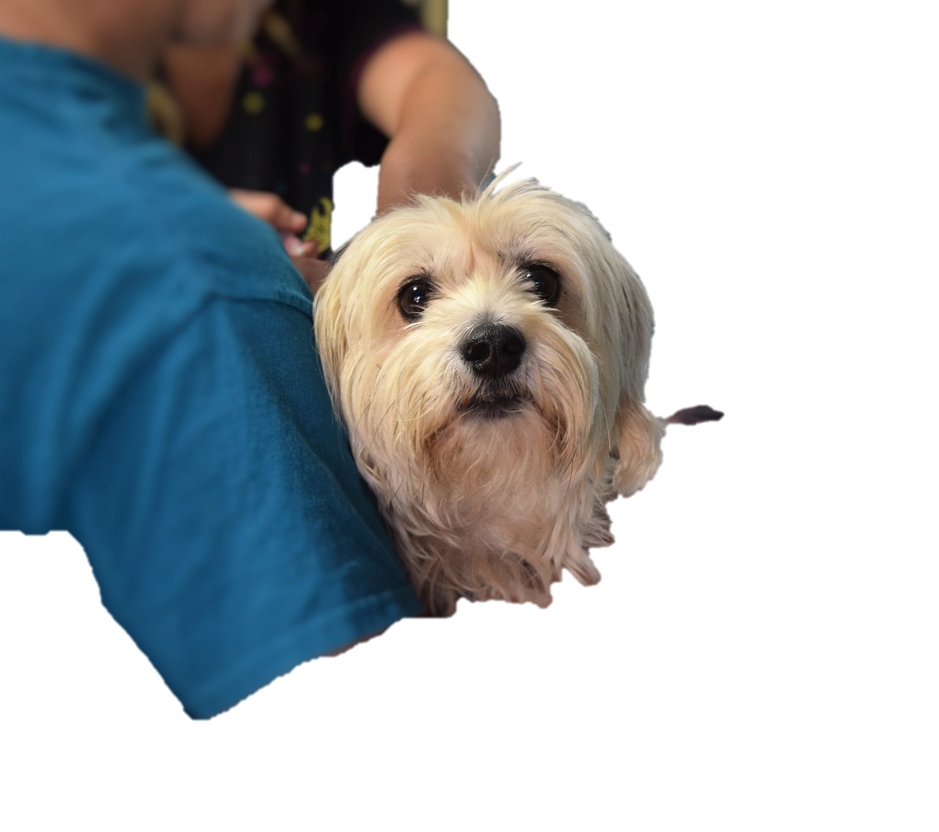
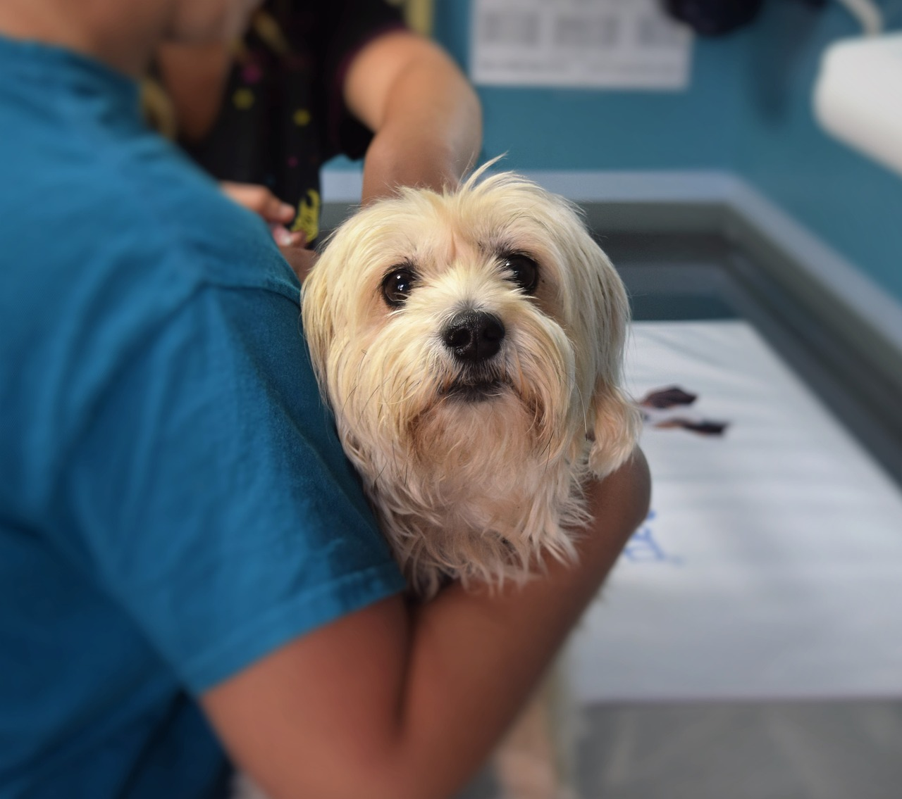
3 stars
What does he do?
He takes care of animals.
Notes:
Dấu chấm câu

Slide 6

4 stars
Is he a vet?
Yes, he is.

Slide 7
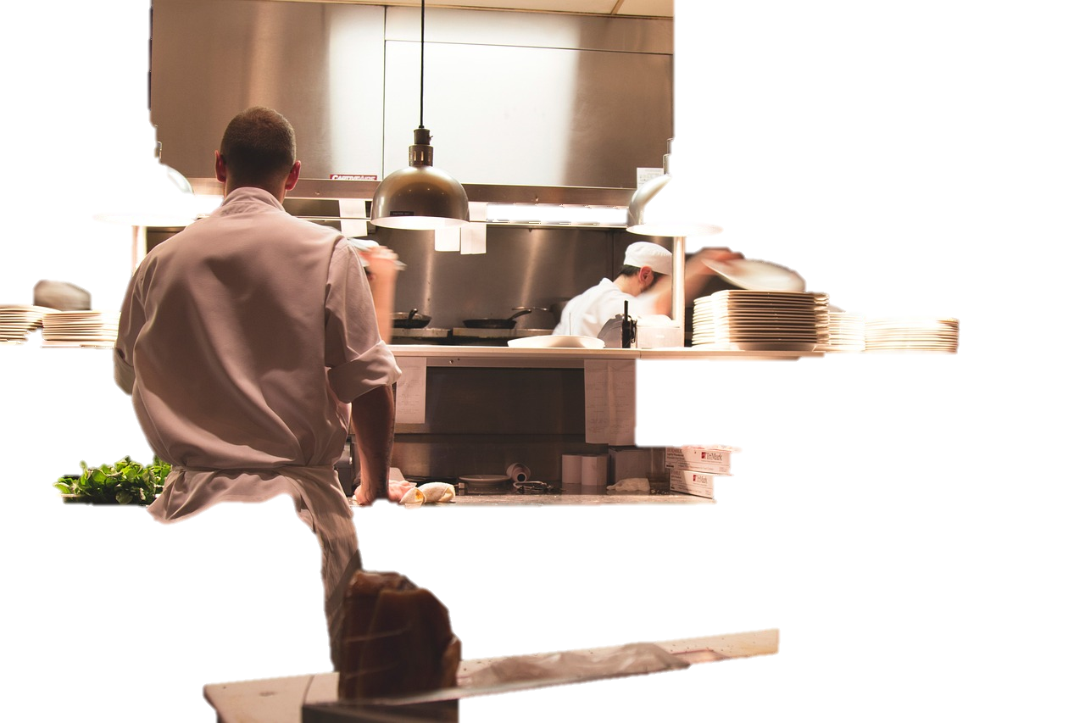
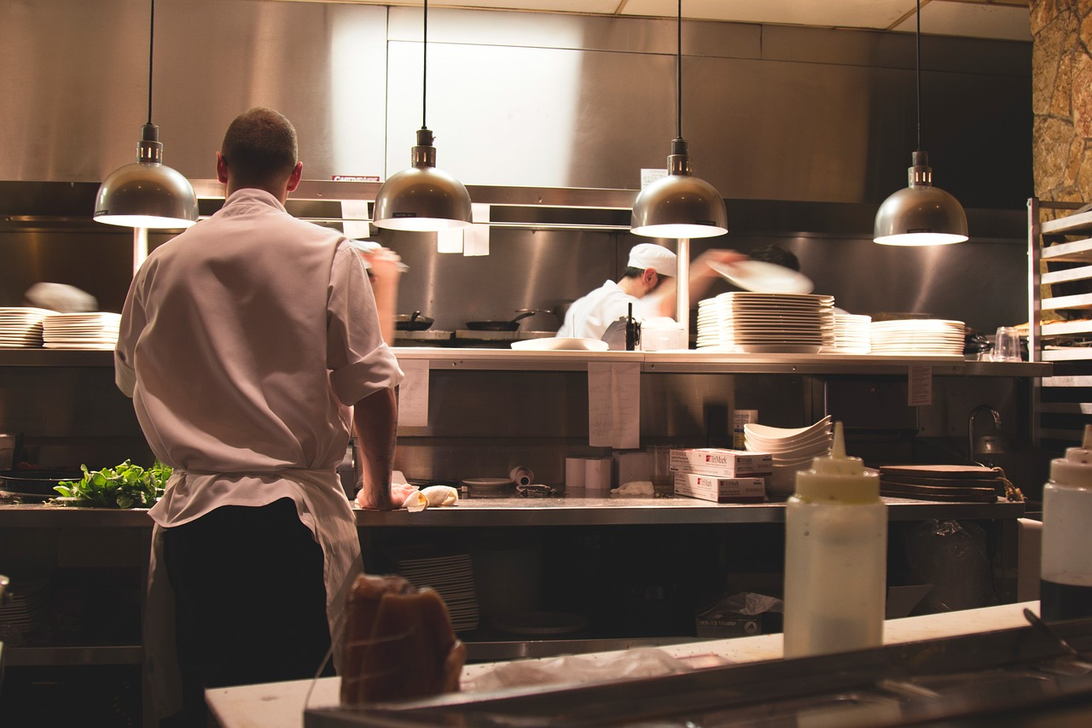
5 stars
Where does he work?
He works in a restaurant.

Slide 8
What does he do in his free time?
4 stars
He cooks good food.

Slide 9

2
Project
Jobs quiz

Slide 10


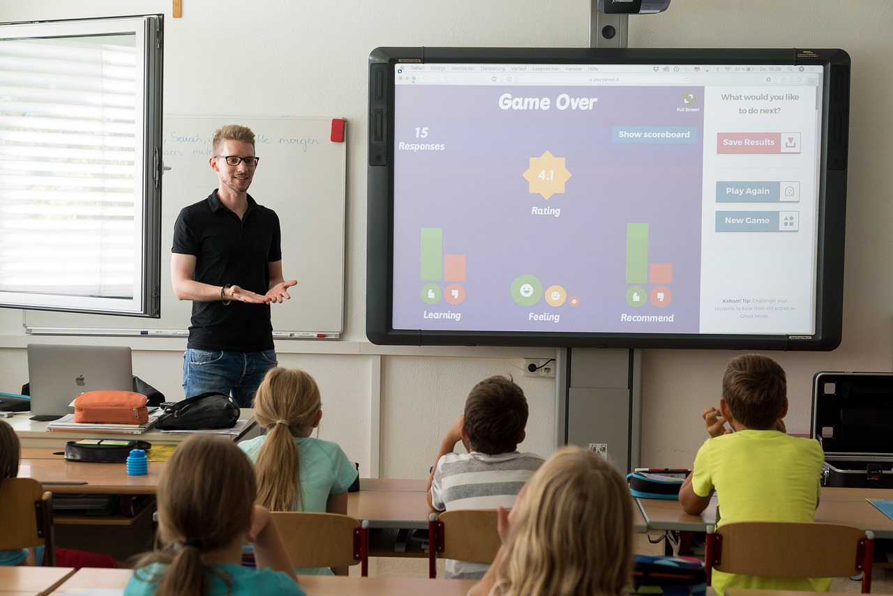

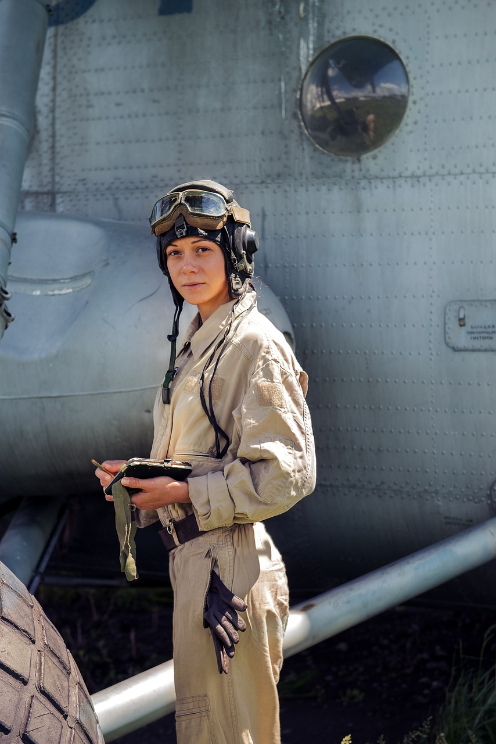
Look and tick
✔
teacher
doctor
engineer
vet
✔
pilot
nurse
✔

Slide 11
2
Project
Jobs

Slide 12

REMEMBER !
I want to be ….
I can ….
I want to work in...

Slide 13



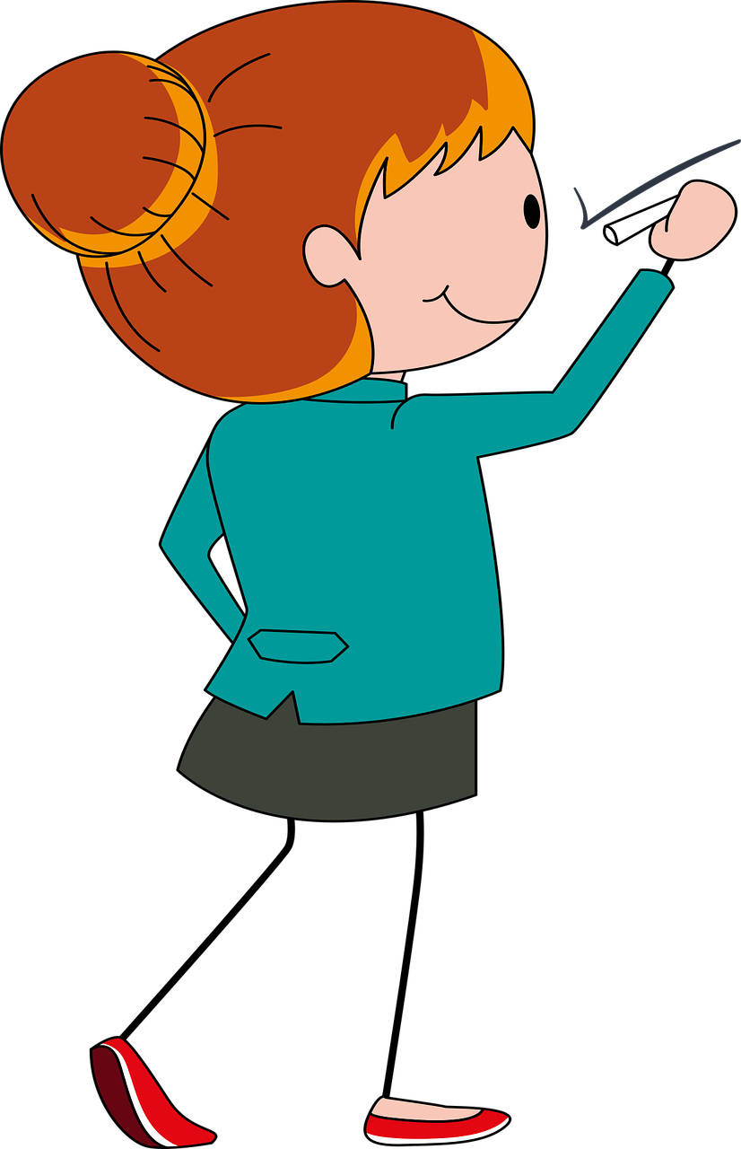
I want to be ….

Slide 14



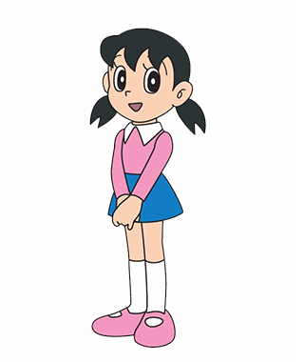
What do you want to be?
I want to be a chef.

Slide 15
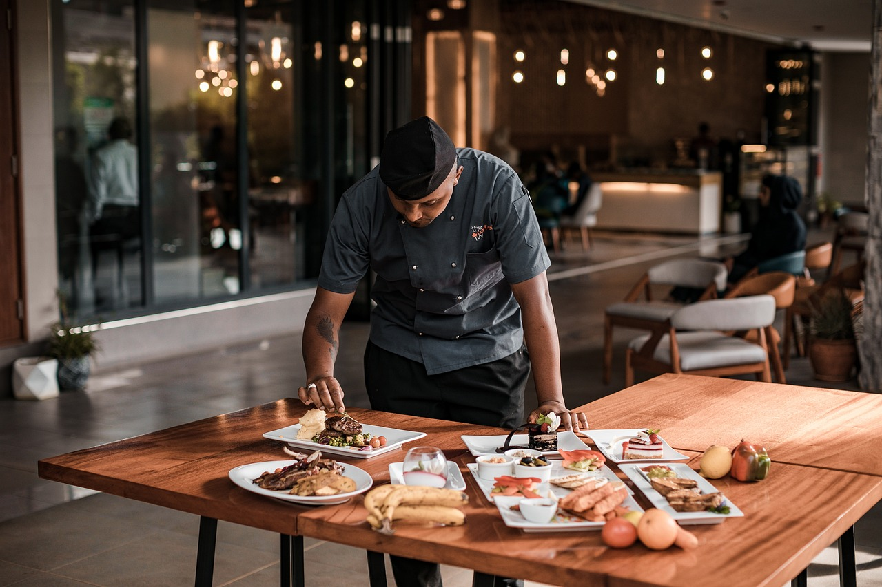
Where do you work?
I want to work in a restaurant.

Slide 16
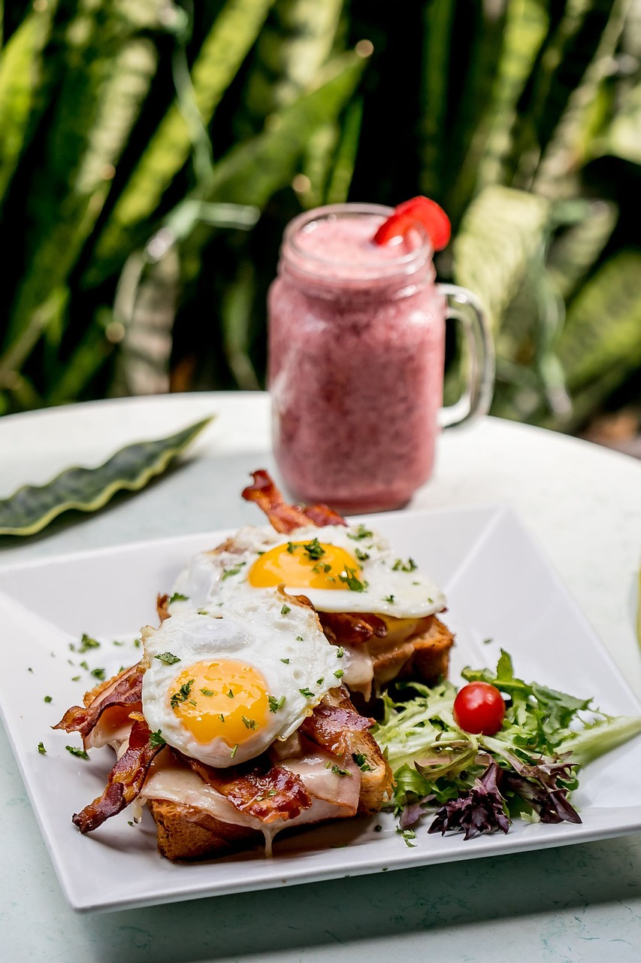
What can you do?
I can cook good food.

Slide 17

Are you a nurse?
No, I am not. I’m a chef.

Slide 18
2
Project
Your Jobs

Slide 19

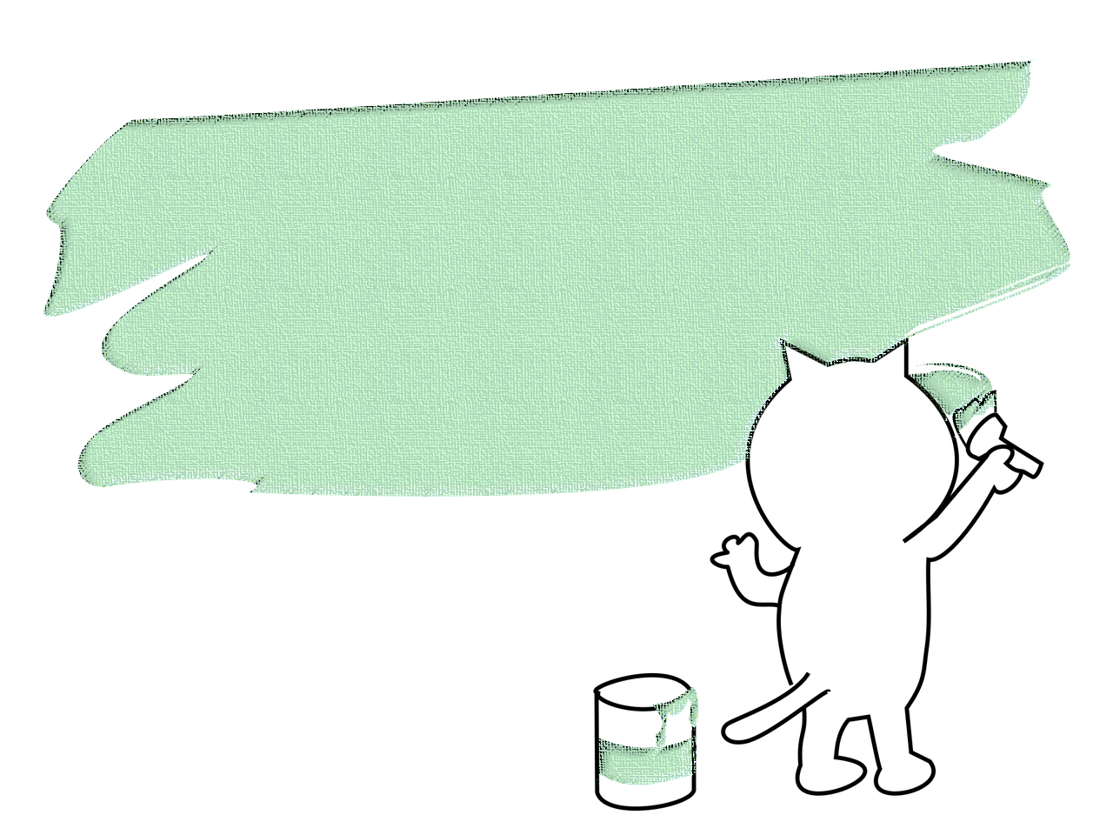
Drawing and Presenting

Slide 20




Thank you & goodbye!

