Slide 1




















Slide 2




Unit 8 - Lesson 3 – Period 1

Slide 3
Racing game.
1 WARM UP
Notes:
Warm up
Guessing game cho 1 dòng

Slide 4
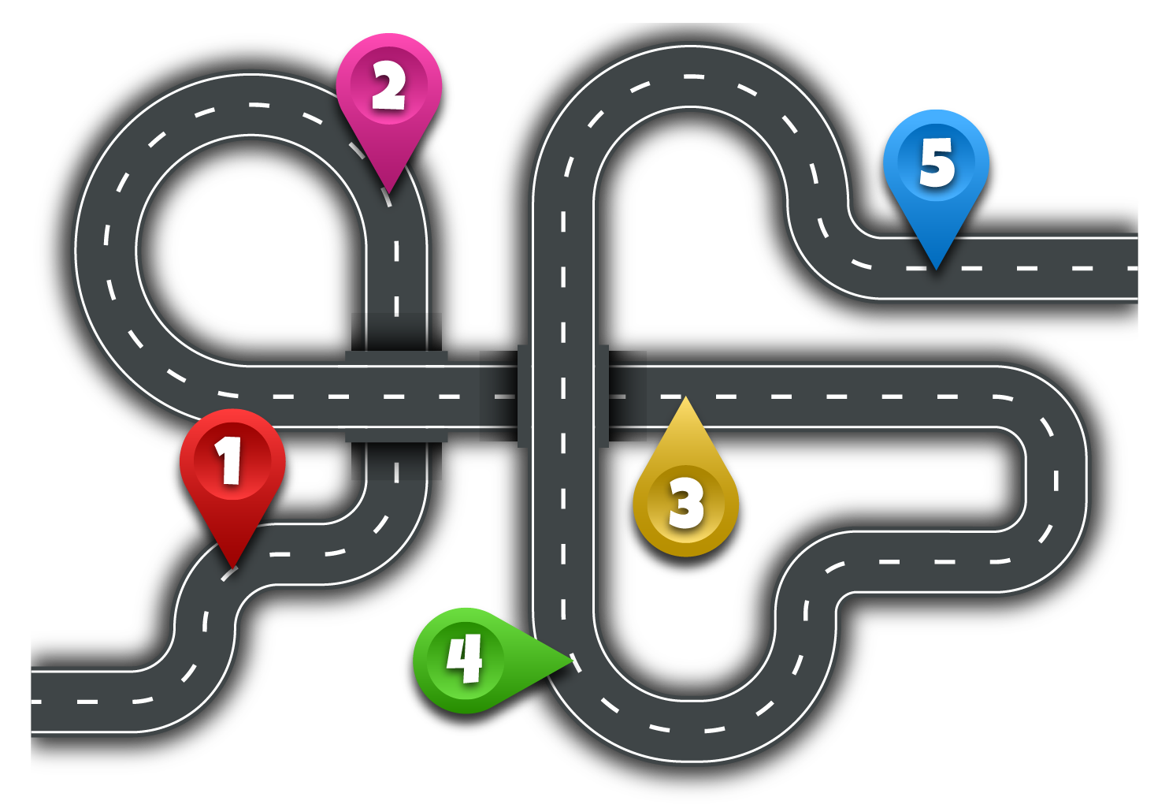








2
5
1
3
4
Next
Notes:
Ấn vào người đua xe sẽ di chuyển đến số 1, click số 1 ra câu hỏi, tương tự với các số còn lại
Ấn next sang slide Presentation

Slide 5

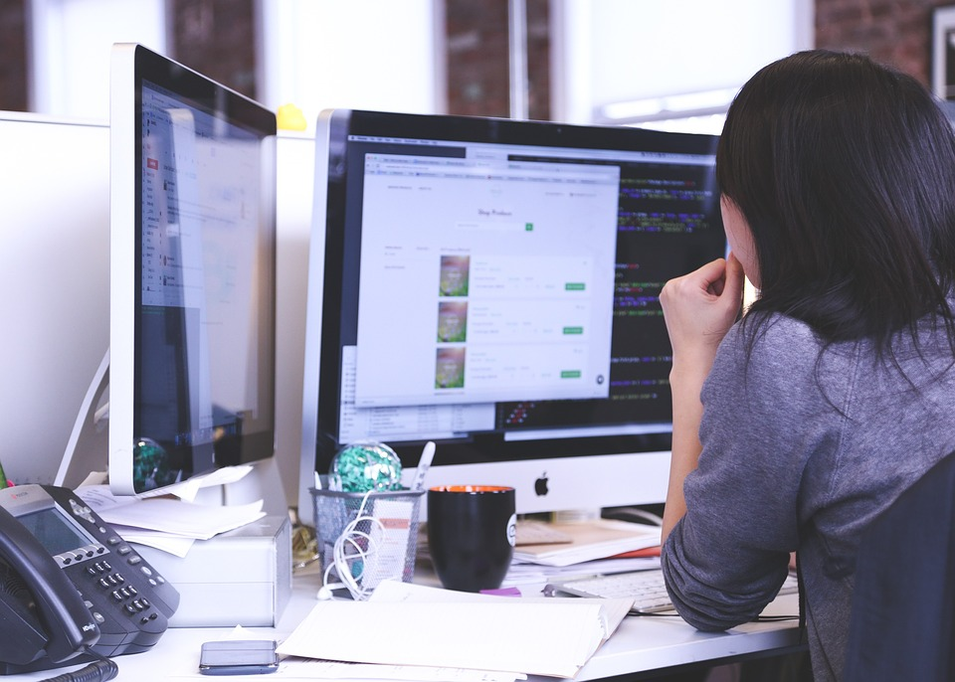
Q1: We can _______.
We can surf the Internet.
Check
Go

Slide 6

Can we work in groups?
Q2
✔
Yes, we can.
Check
Go

Slide 7
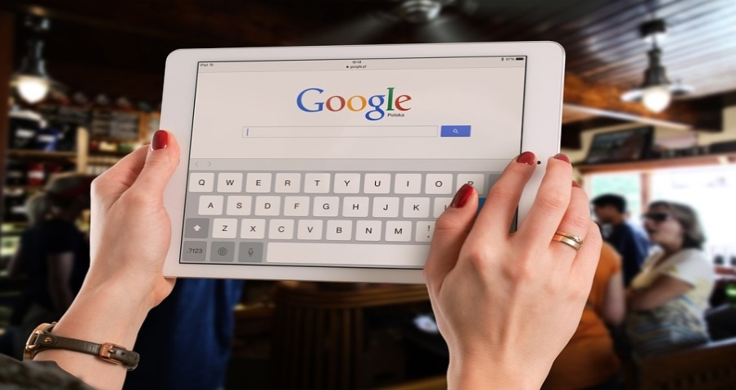
Q3: He can use the _____ in class.
tablet
Check
Go

Slide 8

Q4: Anna ____writes emails on phone.
always
Check
Go

Slide 9
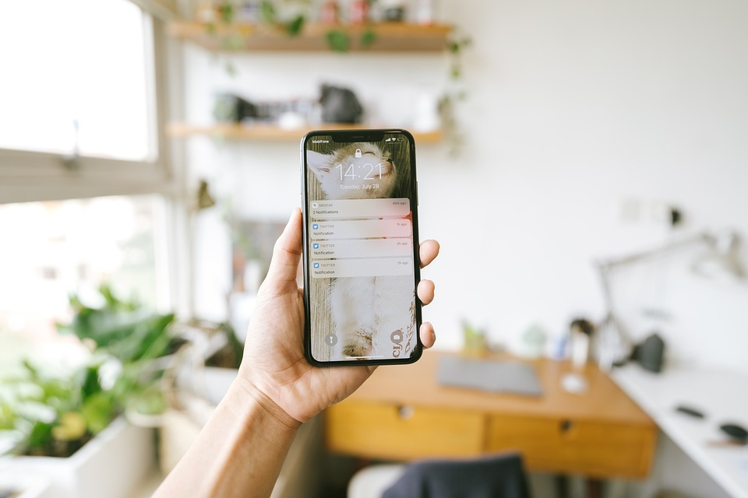
Q5: You have a new _________.
smartphone
Check
Go

Slide 10
2 Presentation
Task 1 Listen and point.
Notes:
Dấu câu

Slide 11

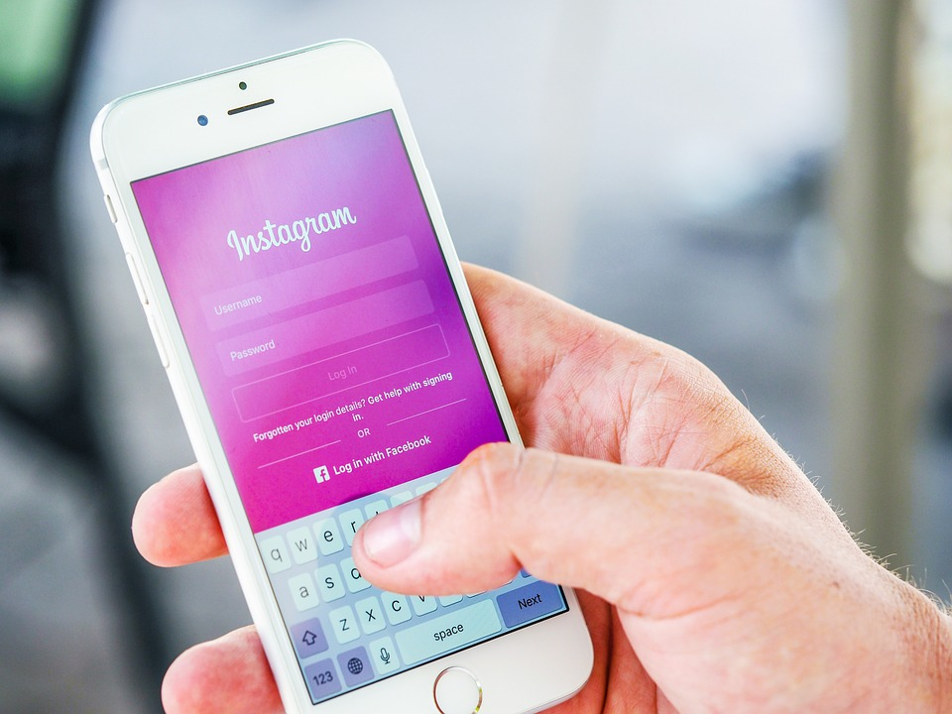
1.Listen and point.
Change the password

Slide 12
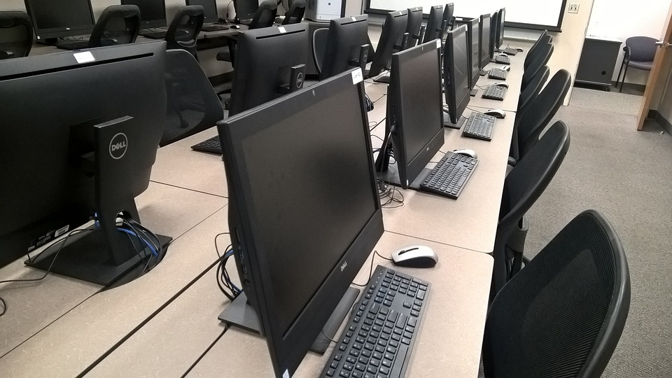
Use the computer lab
What is it?

Slide 13

Use the projector
What is it?

Slide 14
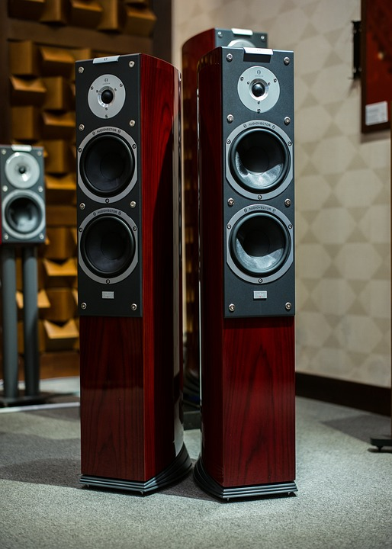
Use the speaker

Slide 15


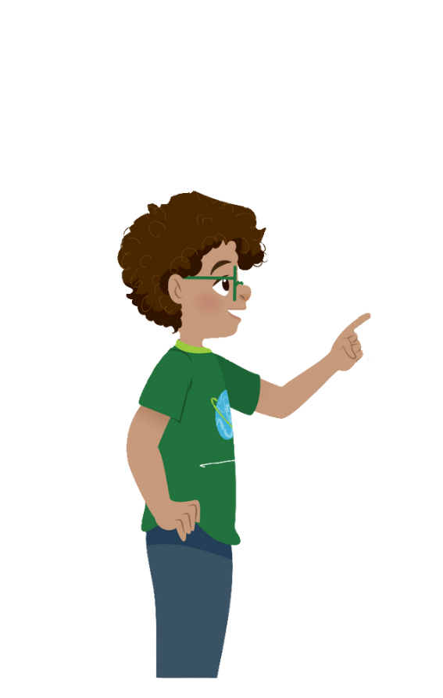
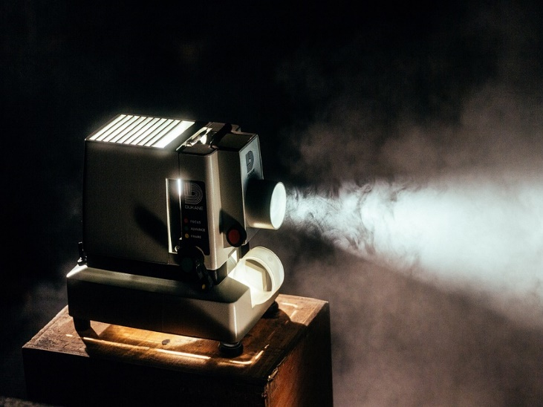
1 Listen and point. Repeat.
Change the password
Use the computer lab
Use the projector
Use the speaker

Slide 16














PROTECT
JUNGLE

Slide 17
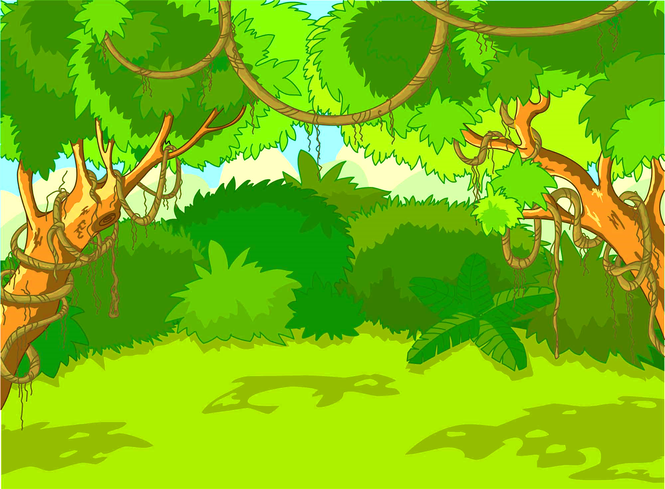


















1
2
3
4
Notes:
Ấn số để sang slide câu hỏi, ấn vào con khỉ tương ứng với số đã chọn sau khi trả lời đúng
Ấn mũi tên để sang slide practice sau khi chơi xonggame

Slide 18
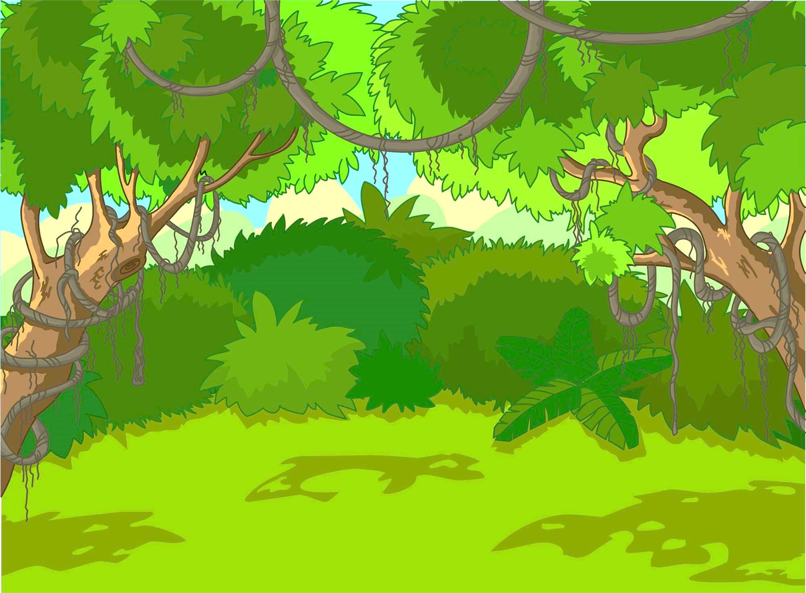

What is it?
Projector
Notes:
Ấn mũi tên để back lại slide gốc

Slide 19

We can
________.
change the password

Slide 20
Teacher can use the _____.
speaker

Slide 21
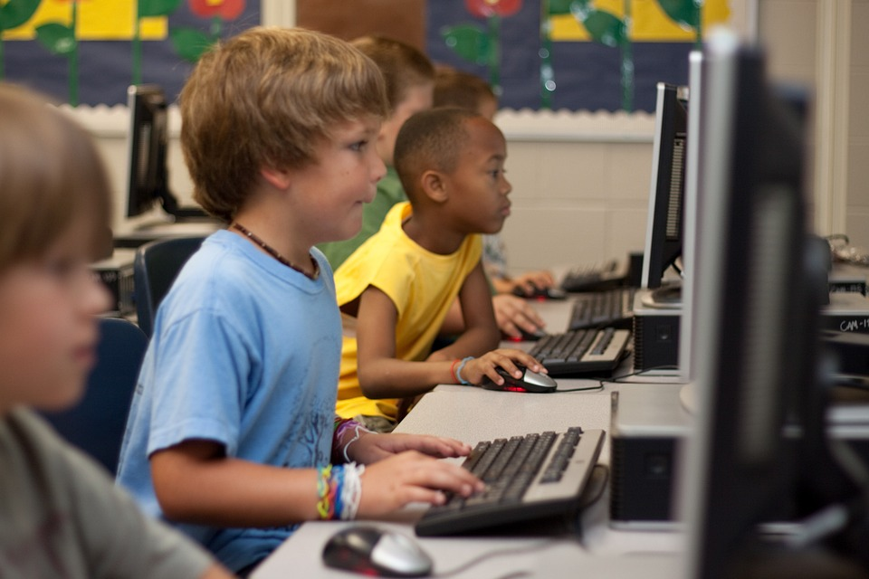
Students __ use the computer.
A.can
A.can
B. can’t

Slide 22
3 Practice
Task 2 Listen and write.
Notes:
Dấu câu

Slide 23


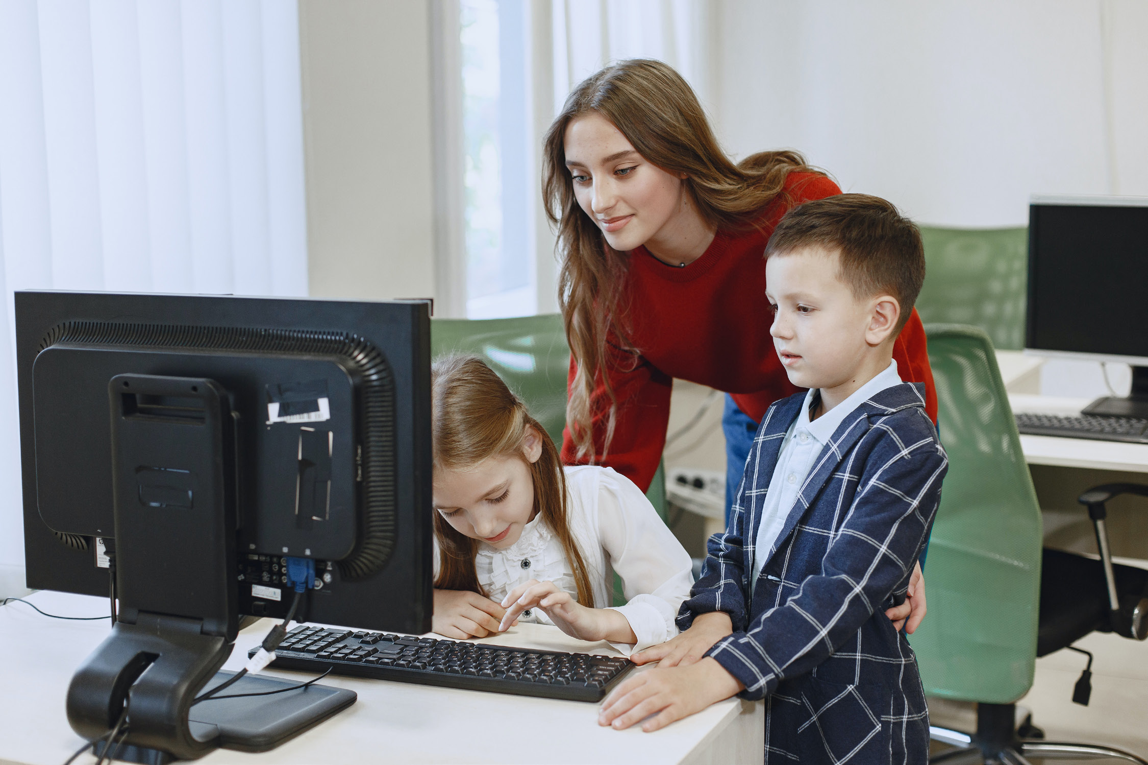
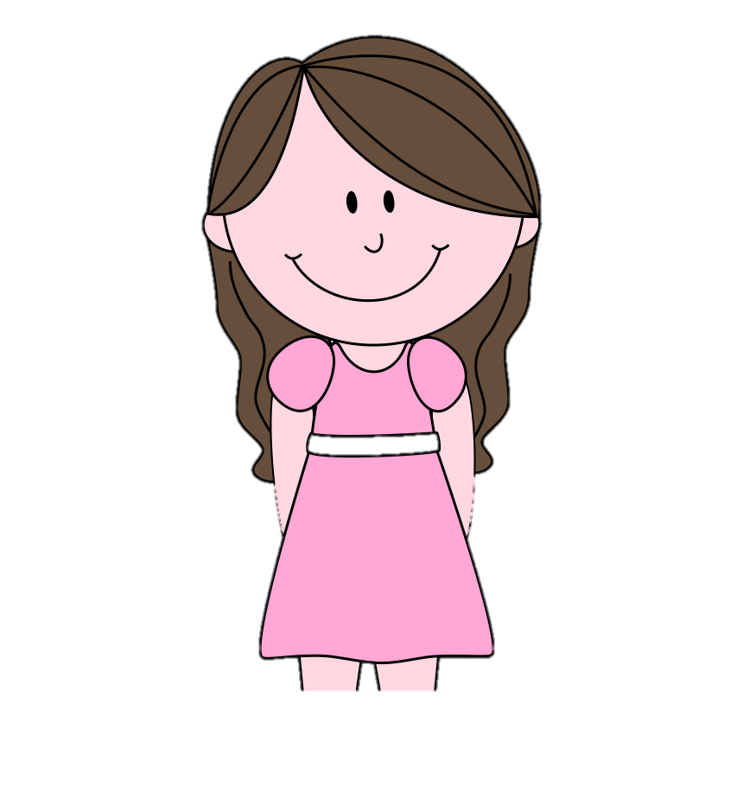
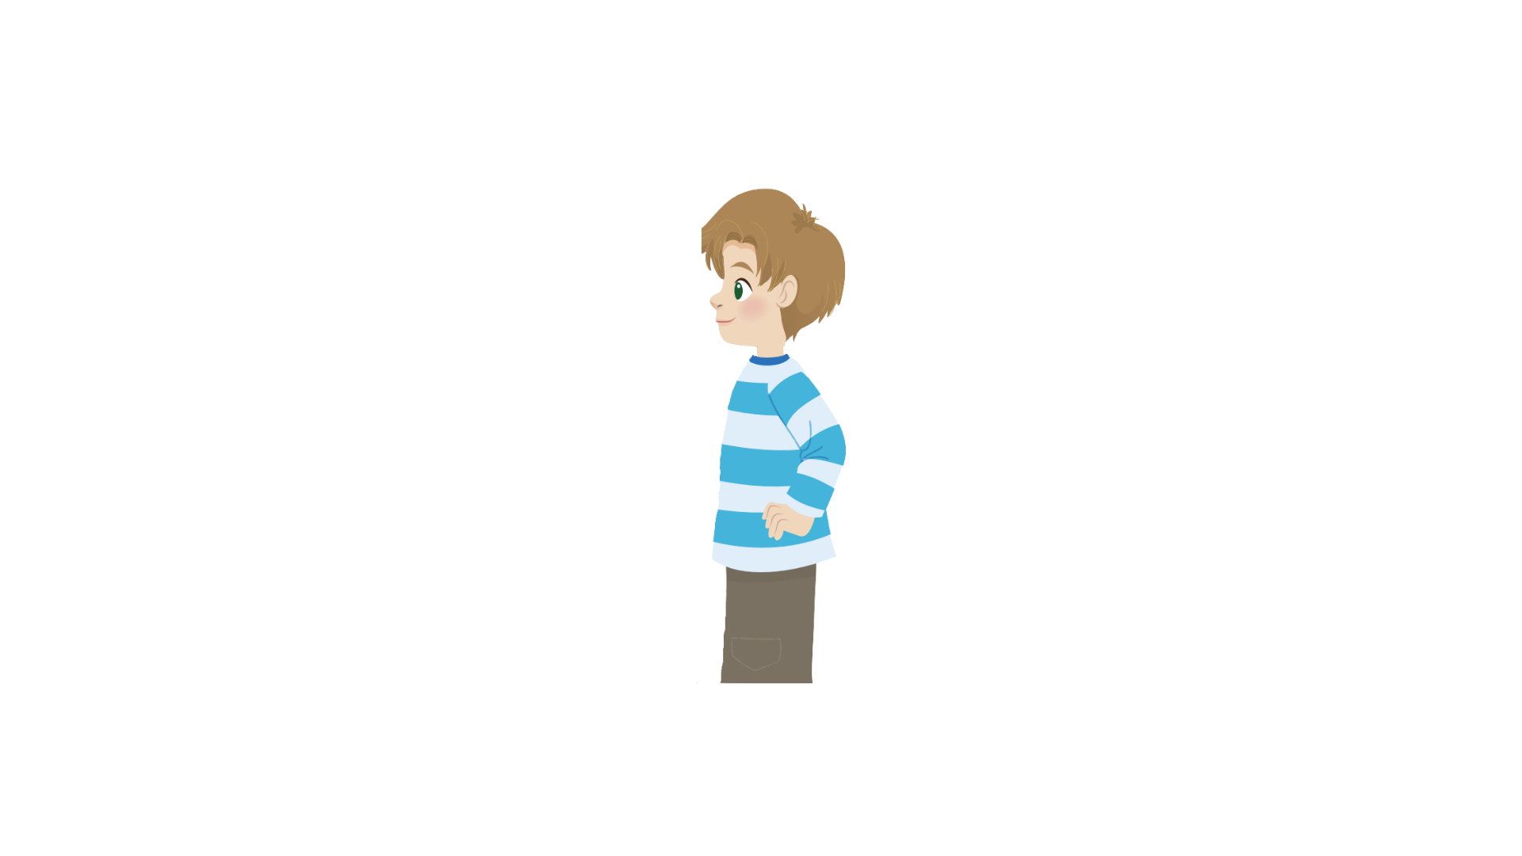
2
Listen and write.
All teachers and students can.
Teacher Sam, who can use the computer lab?
Can we use the projector there?
Yes, you can. And you can use the speaker, too.
That’s great!
Thank you.
Sam
Andy

Slide 24

2
Listen and write.
1. Teachers and ______ can use the computer lab.
Sam
students
Andy

Slide 25
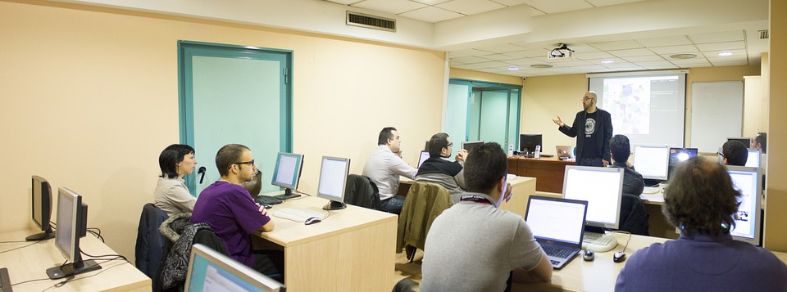
2
Listen and write.
2. They can use the ________and speaker in the computer lab.
projector

Slide 26
3 Practice
Task 3 Look and say.
Notes:
Dấu câu

Slide 27




3
✔
Look and say.
Students/ use the computer lab
Yes, they can.
Can students
use the computer lab?

Slide 28

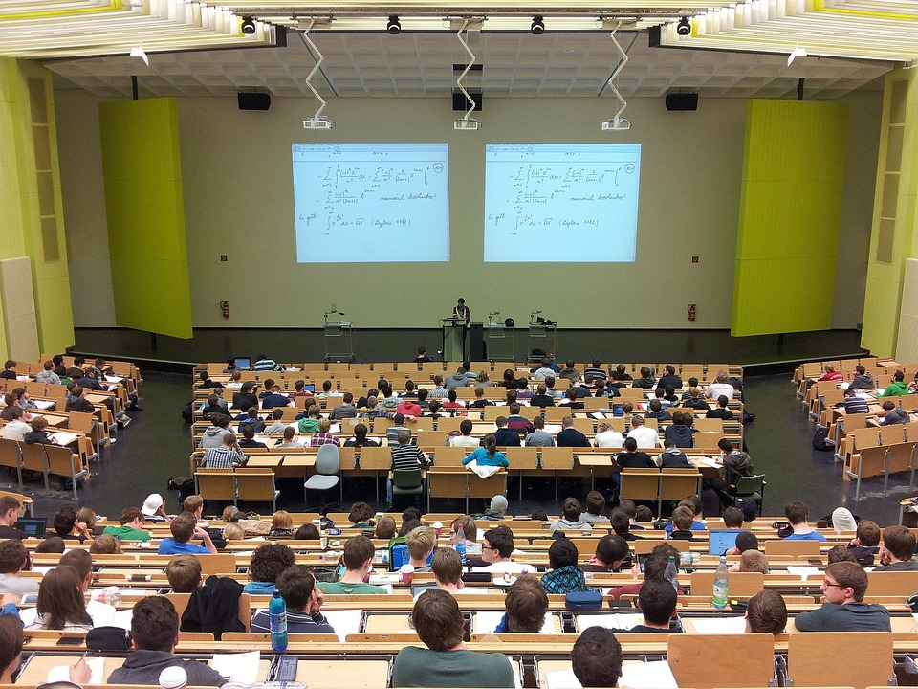
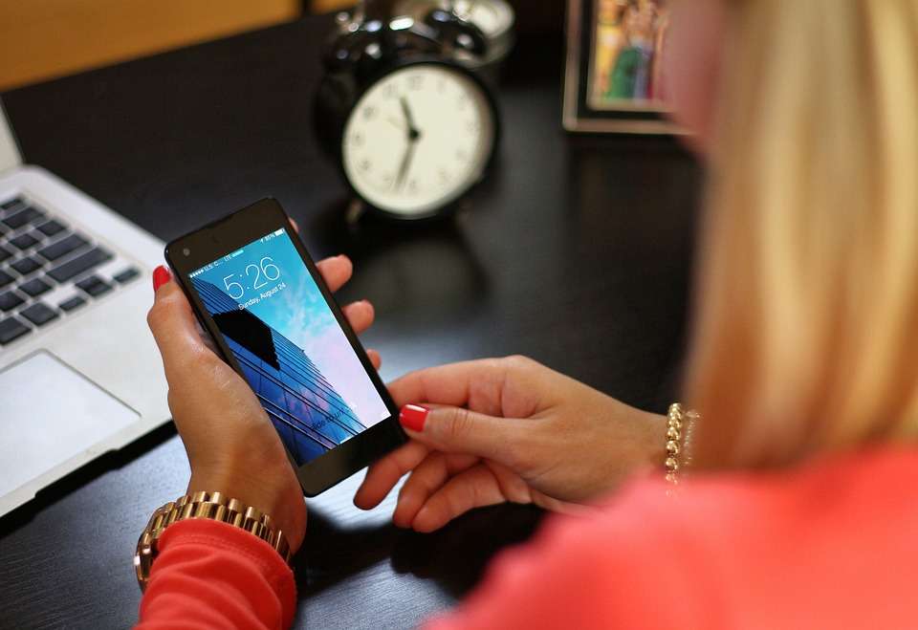
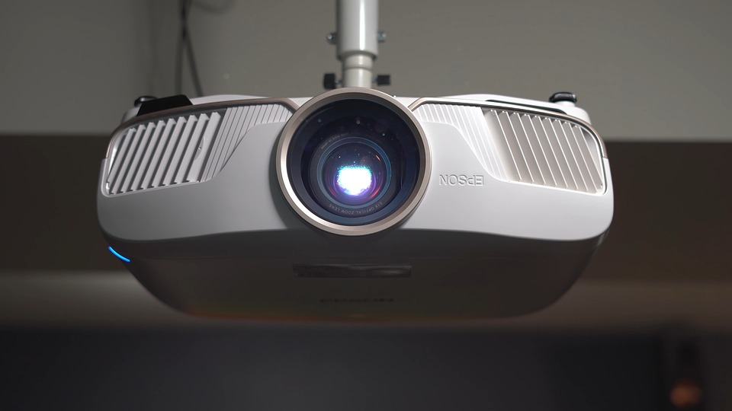

Click to the picture to get the dialogue
1
2
3
4

Slide 29

X
1. Students/use the speaker
HOME
Can students use the speaker?
No, they can’t.
Notes:
Trình bày lại chữ

Slide 30
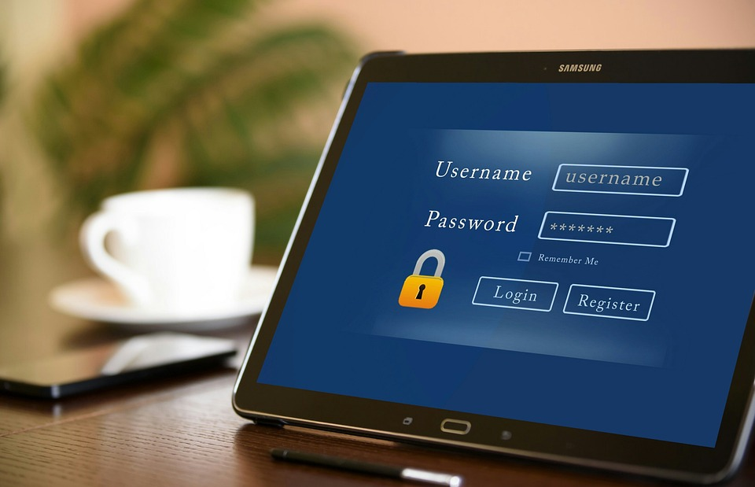
2.Teacher/change the password
✔
HOME
Can teacher change the password?
Yes, she can.
Notes:
Trình bày lại chữ

Slide 31
x
3. Students/use phones in class
HOME
Can students use phones in class?
No, they can’t.
Notes:
Trình bày lại chữ

Slide 32
4. Teachers/ use the projector
✔
HOME
Can teachers use the projector?
Yes, they can.
Notes:
Trình bày lại chữ

Slide 33
4 Production
Notes:
Đây k phải là extra, đây là hđ 3 của bài

Slide 34
5 Assessment
Notes:
Đây k phải là extra, đây là hđ 3 của bài

Slide 35




Look and read. Put tick (✓) or cross (✗) in the box.
True
False
1. I can surf the Internet.
✓
Students can’t use
the computer lab .
✓
3. Teacher can use the projector.
✓

Slide 36
6 Wrap up
Notes:
Đây k phải là extra, đây là hđ 3 của bài

Slide 37

REMEMBER
STRUCTURE:
Teacher, who can use the _____?
Can students/ teachers use ____?
-Yes, they can.
-No, they can’t.
VOCABULARY:
Change the password
Use the computer lab
Use the speaker
Use the projector
37

Slide 38




Thank you & goodbye!

