Slide 1




















Slide 2




Unit 8 - Lesson 3 – Period 2

Slide 3










1 Warm-up
Unscramble the word

Slide 4



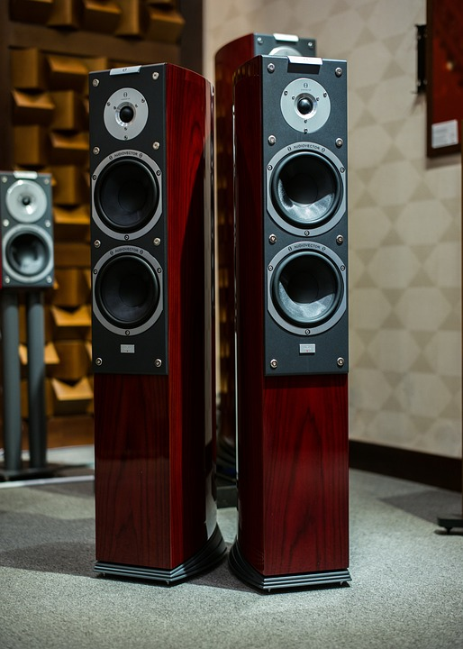

Question 1
SPEAKER
Reorder the letters to make the correct word.
SKEPAER
Answer
Next

Slide 5

Question 2
Reorder the letters to make the correct word.
PROJECTOR
PORJETCOR
Answer
Next

Slide 6

Question 3
COMPUTER
Reorder the letters to make the correct word.
COPUMTRE
Answer
Next

Slide 7
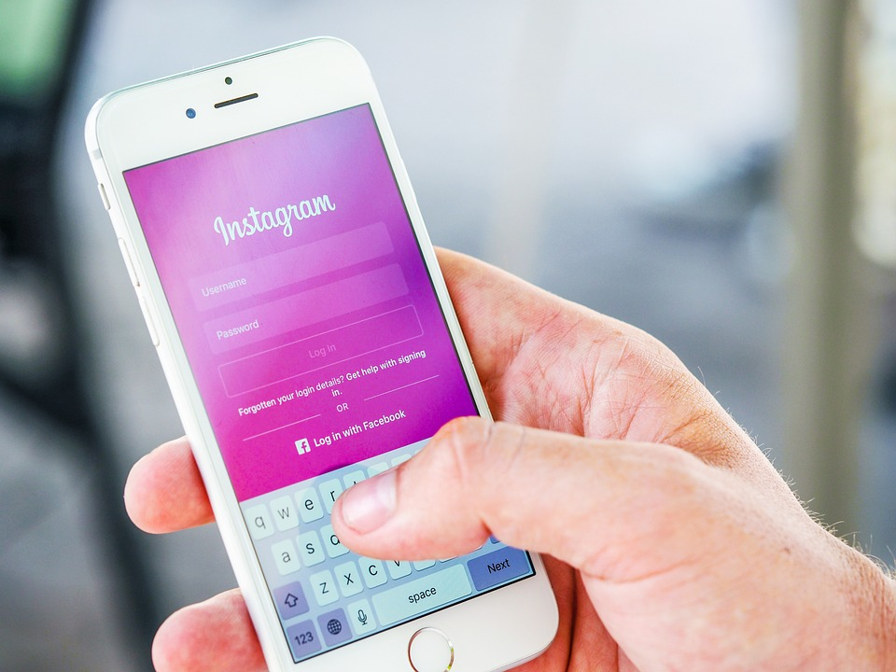
Question 4
PASSWORD
Reorder the letters to make the correct word.
PSSAOWRD
Answer
Next

Slide 8
2 Presentation
Task 4 Listen and repeat.

Slide 9

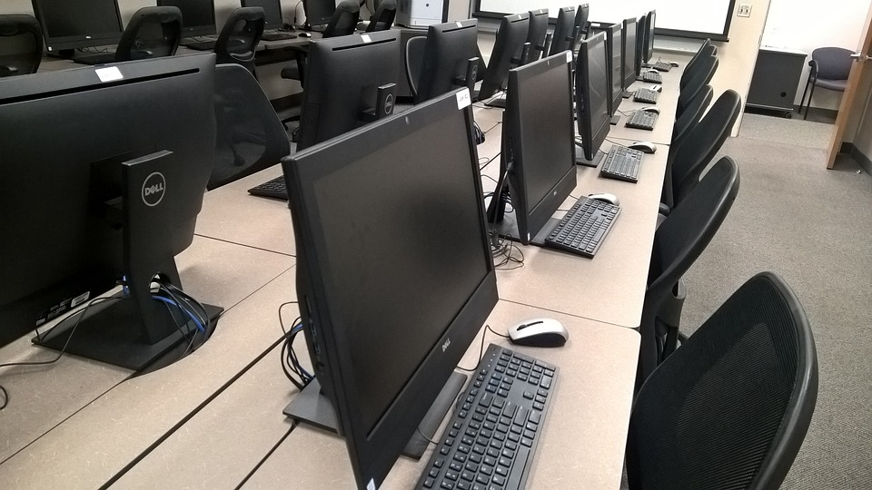

Circle and say.
dchangethepasswordrt
usetheprojectorabcdetw
1
2
3
4
Change the password
Use the computer lab
Use the speaker
Use the projector
ftusethespeakerify
abgkusethecomputerlabjckfb

Slide 10


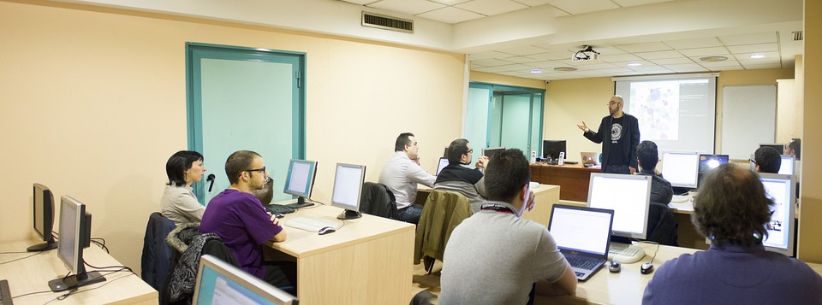



4
Listen and repeat.
1. Who can use the computer lab?
-Teachers and students can.

Slide 11
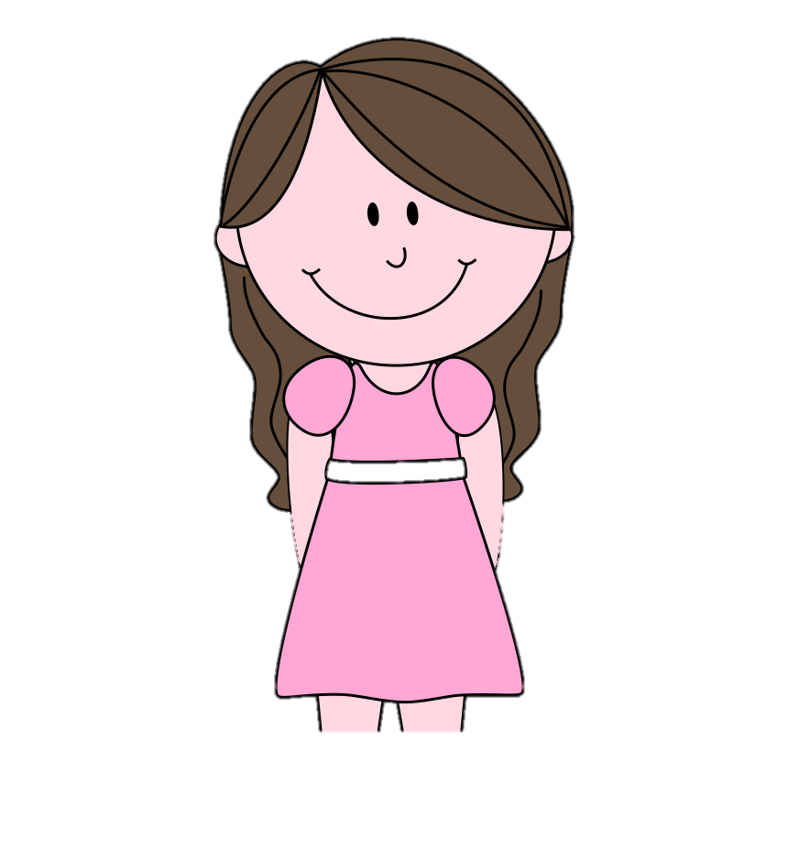
2. Who can change the password?
Teachers can.

Slide 12
3 Practice
Task 5 Match.
Ask and answer

Slide 13

Matching time

Slide 14

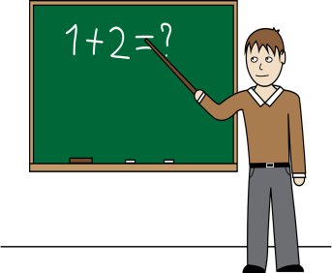


Teachers
Students
Use the speaker
Use the projector
Change the password
Use the speaker
Use the projector
Use the computer lab
Make phone calls
Surf the Internet
Use the computer lab

Slide 15

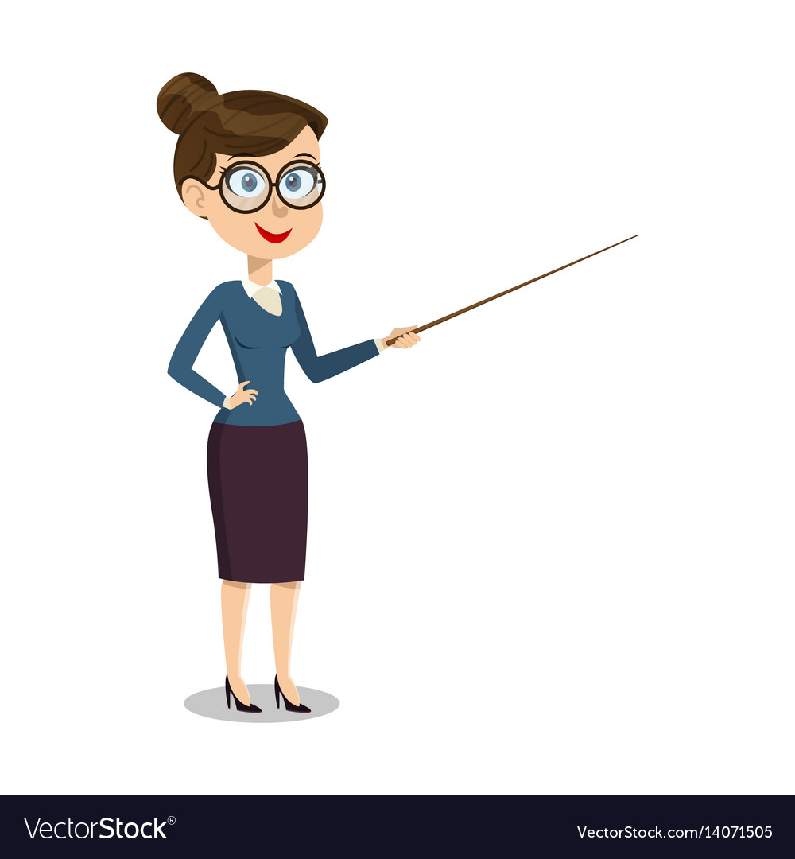

5
Match. Ask and answer.
1. Use the computer lab
Who can use the computer lab?
Teachers and students can.

Slide 16
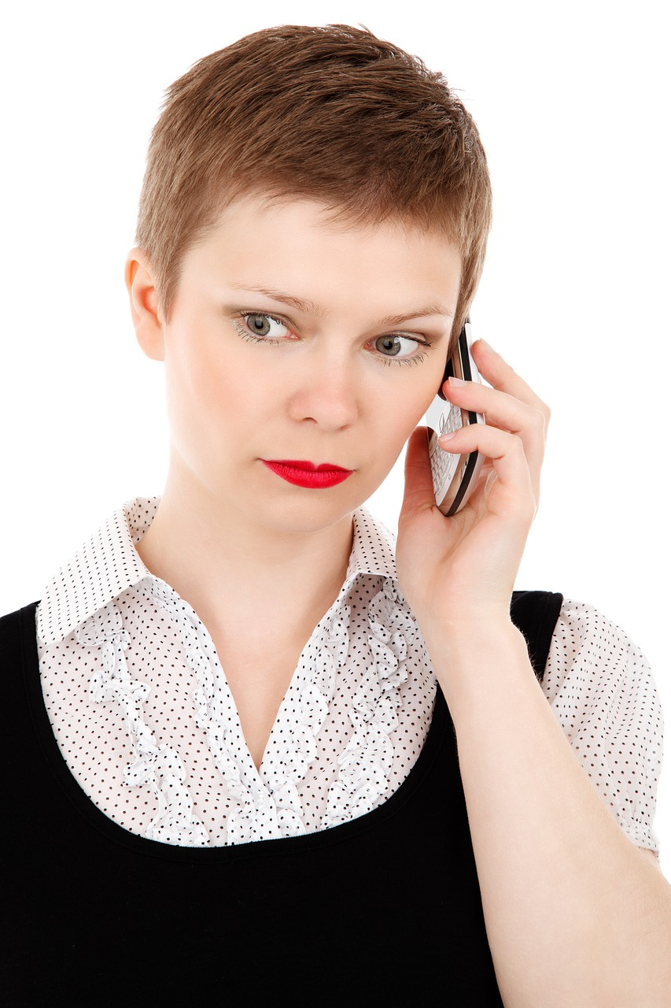
2. Make phone calls
Teachers can.
Who can make phone calls?

Slide 17
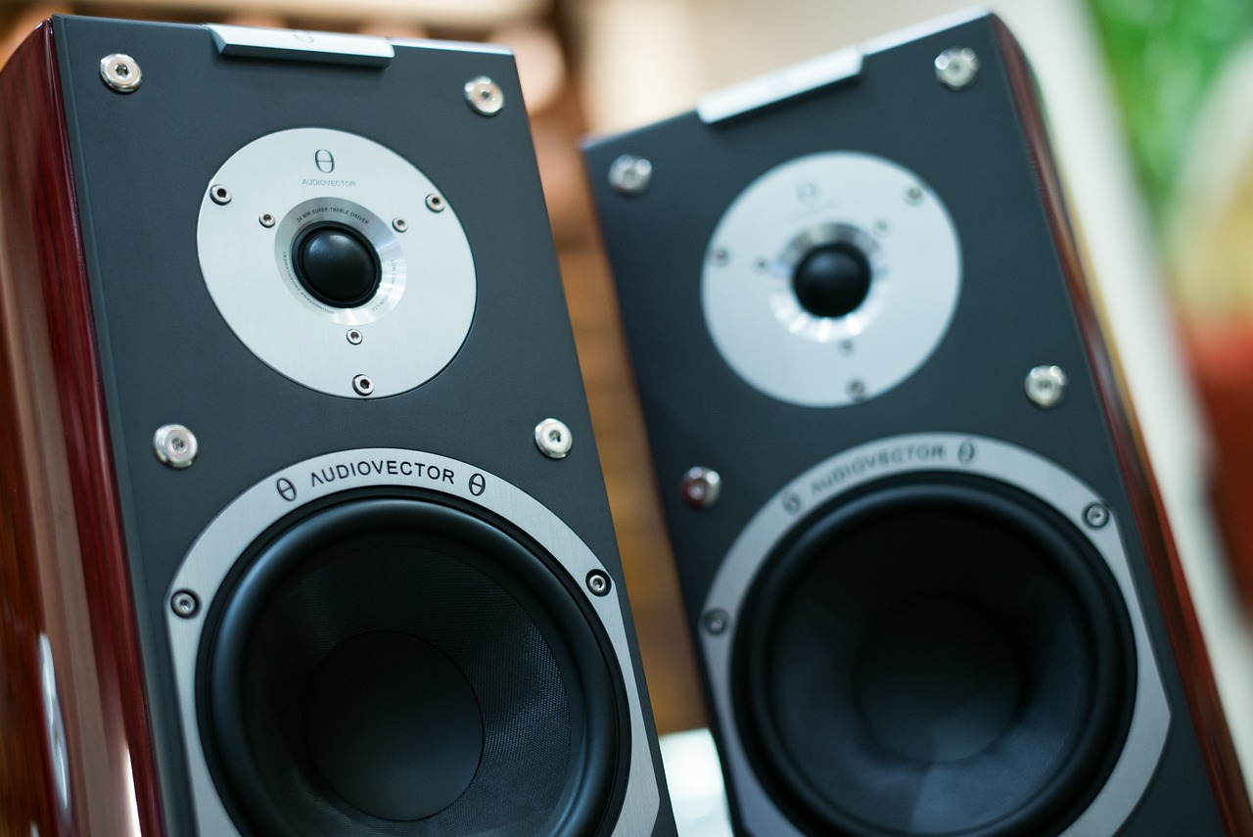
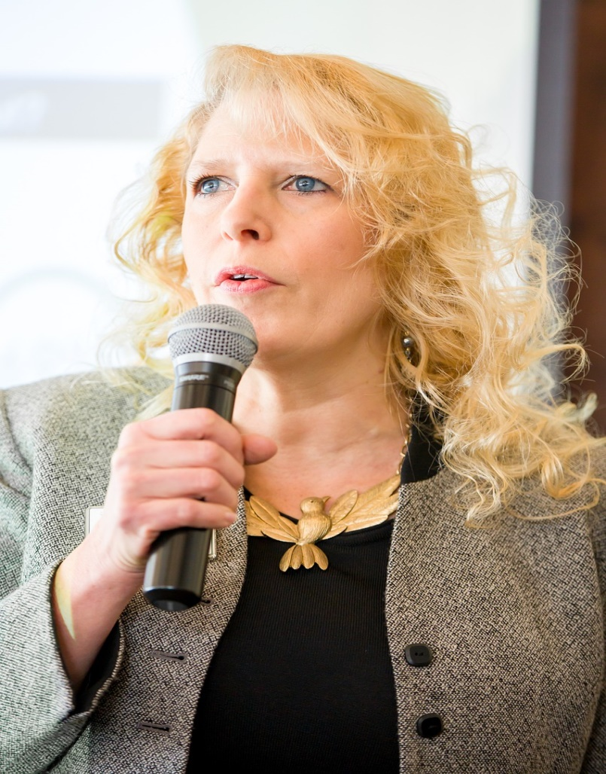


3. Use the speaker
Who can use the speaker?
Teachers and students can.

Slide 18
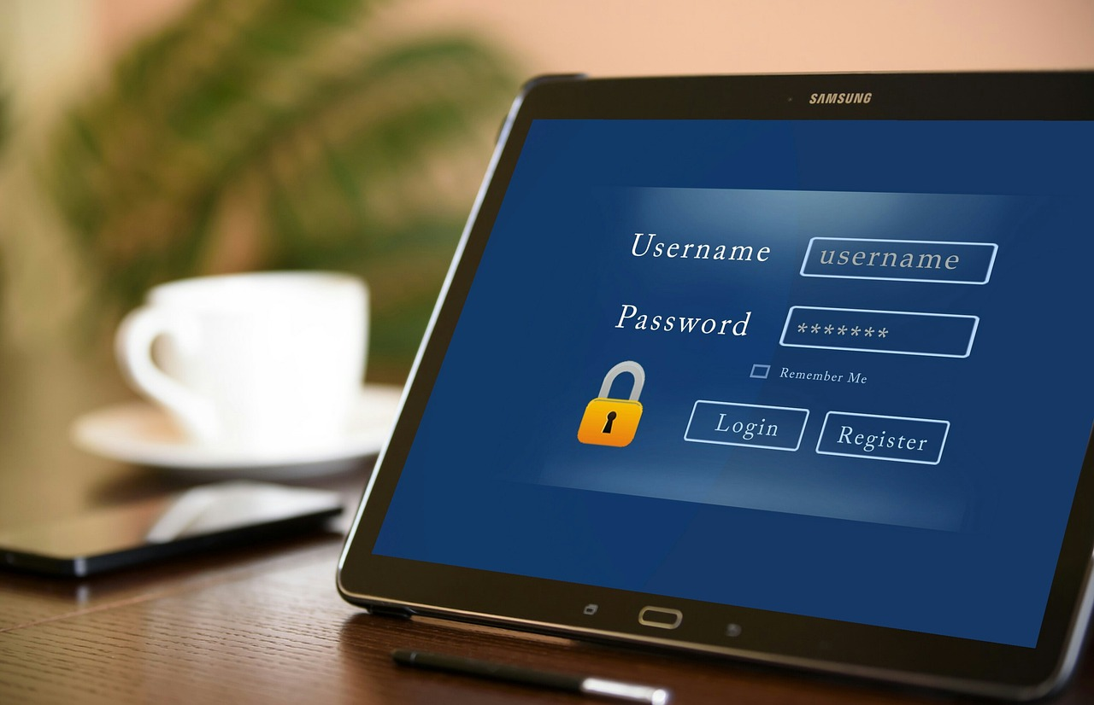
4 Change the password
Teachers can.
Who can change the password?

Slide 19

5. Use the projector
Who can use the projector?
Teachers and students can.

Slide 20

5. Surf the Internet
Who can surf the Internet?
Teachers can.

Slide 21
4 Production
Task 6 Let’s talk!

Slide 22


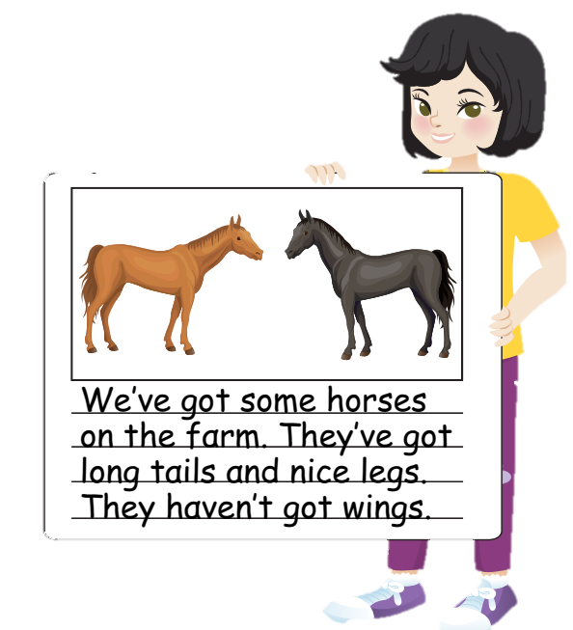


Let’s talk
We can …
We can’t …
✔
❌
We can use the speaker in the class.
We can’t use smartphone in class.

Slide 23
5 Assessment

Slide 24

CANDY CATCHER

Slide 25







Teachers can use the ____.
A. speaker
01
B. phone

Slide 26


Listen and choose.
A. Teachers and students.
02
B. Students.

Slide 27
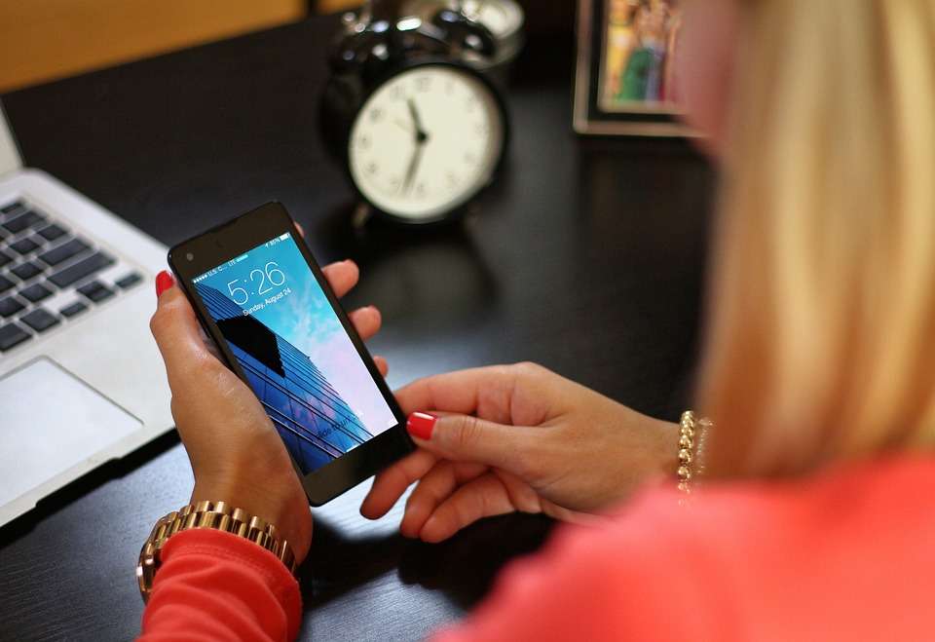
Choose the correct answer.
A. We can use the tablet.
03
B. We can use the smartphone.

Slide 28
Fill in the blank.
I can ___ emails on phone.
A. written
B. wrote
04
C. write

Slide 29
6 Wrap up

Slide 30

REMEMBER
VOCABULARY:
Use the computer lab
Use the speaker
Use the projector
Change the password
STRUCTURE:
We can …
We can’t …

Slide 31




Thank you & goodbye!

