Slide 1





















Notes:
Để nguyên trang bìa như này, chỉ thay đổi tên bài trong quá trình làm. Logo của sách Wonderful World

Slide 2


Unit 9. Places in town
Lesson 2. Task 1, 2, 3

Slide 3


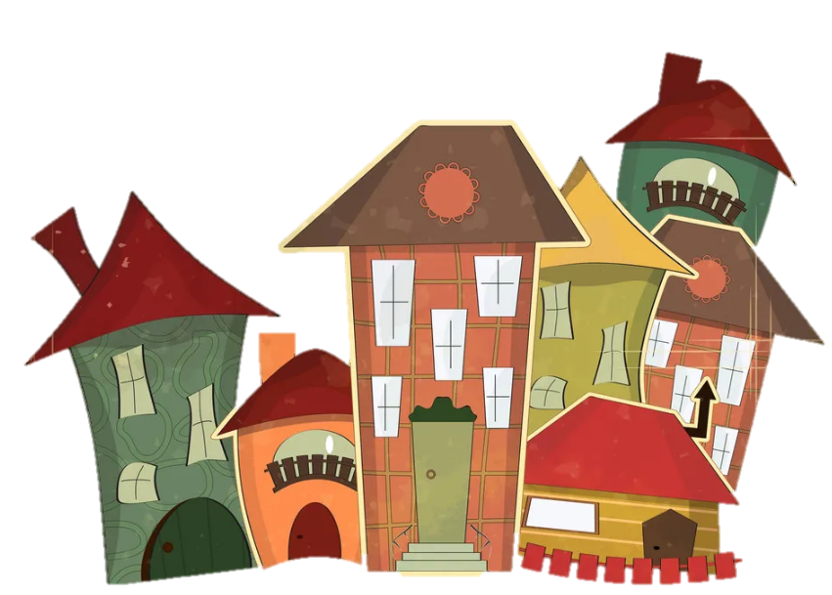


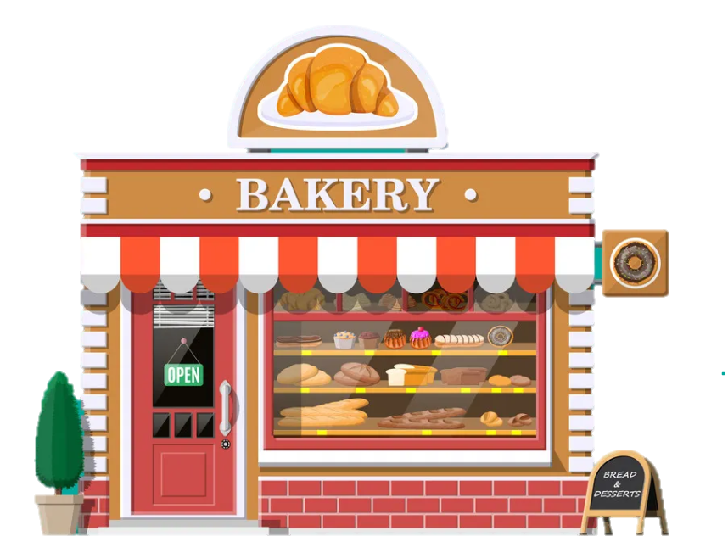


1
Warm Up

Slide 4

2
Presentation

Slide 5

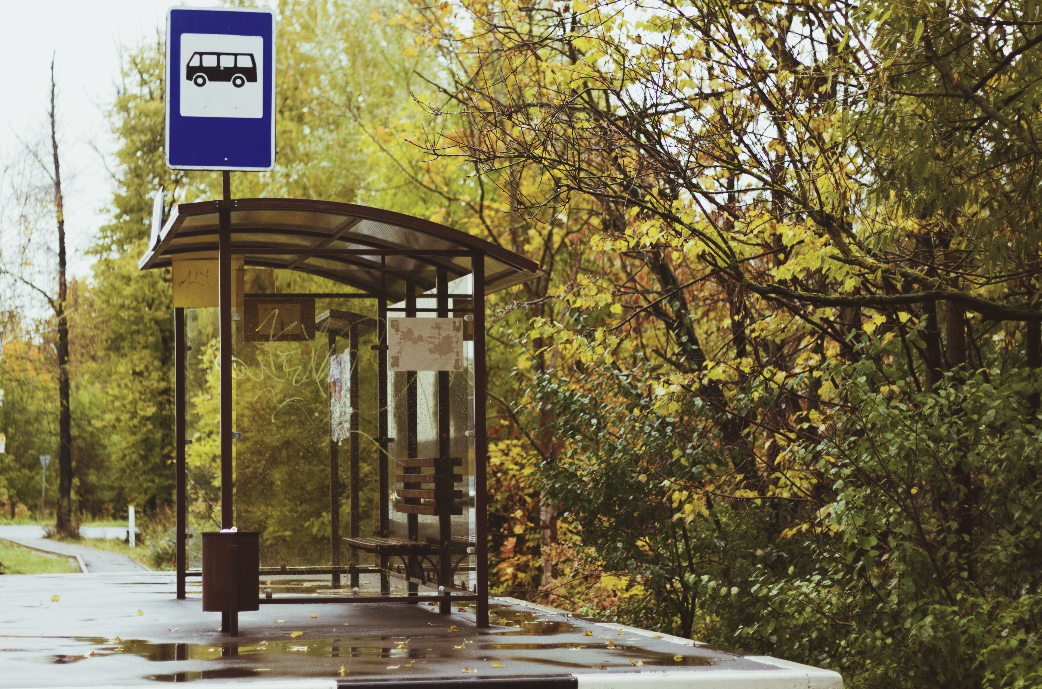
Bus stop

Slide 6
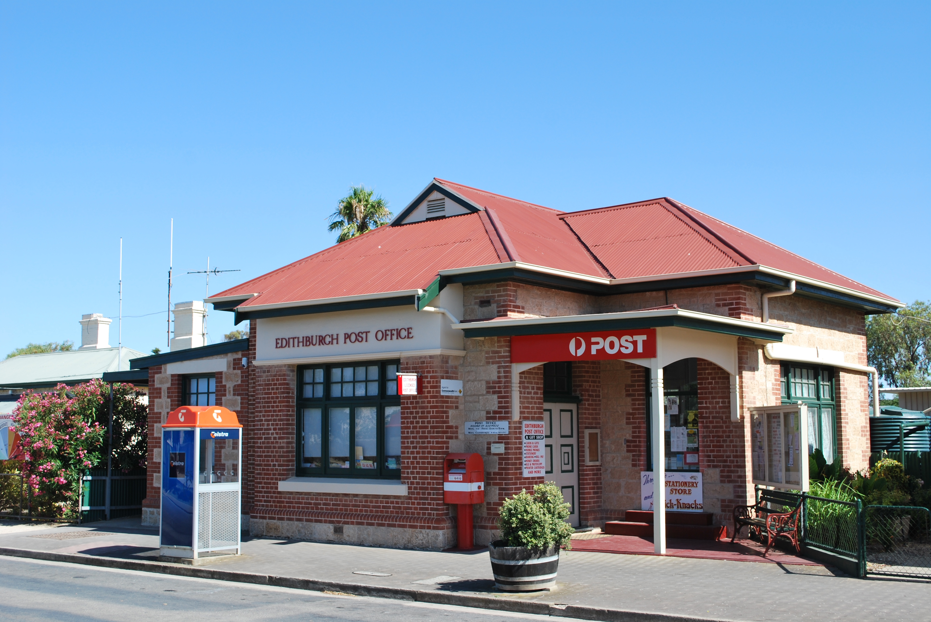
Post Office

Slide 7
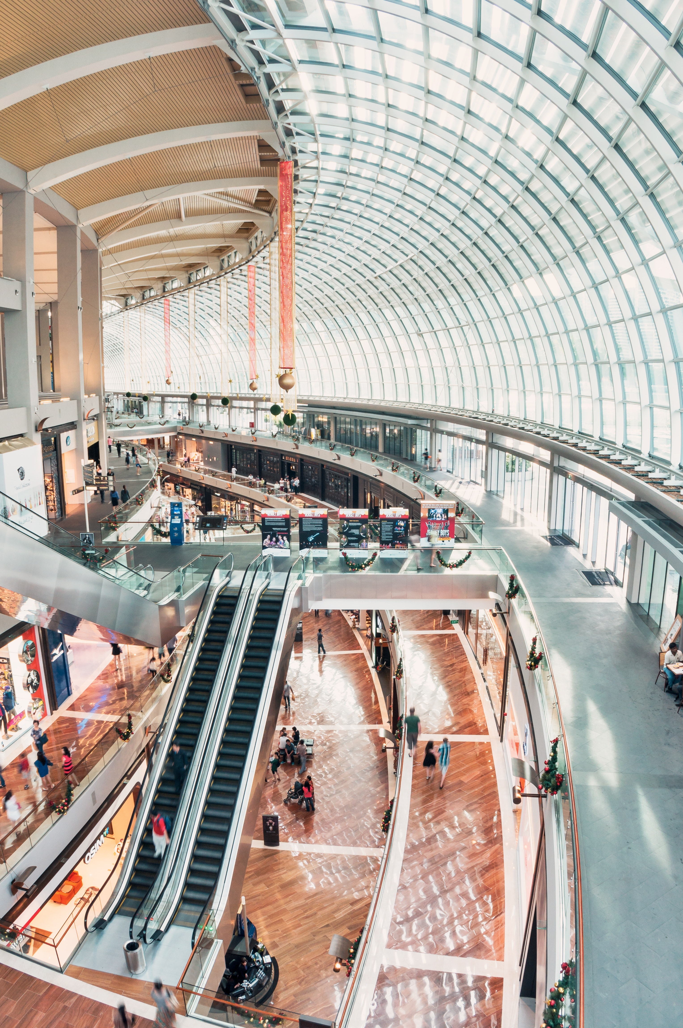
Shopping centre

Slide 8
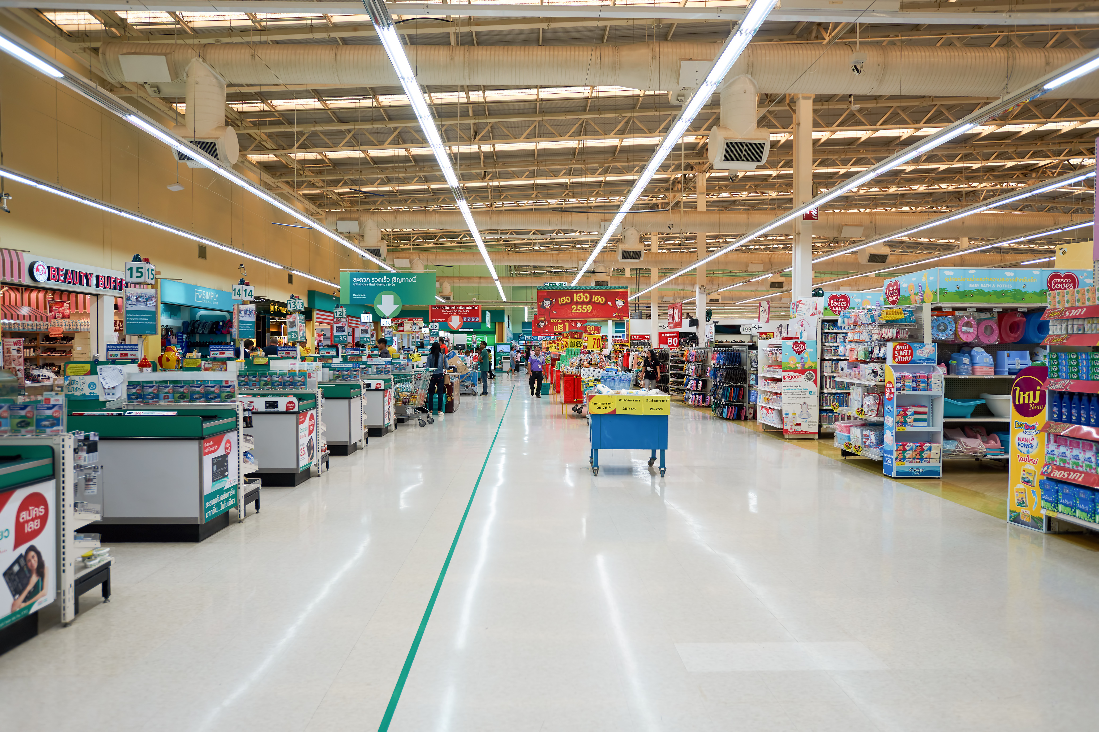
Supermarket

Slide 9



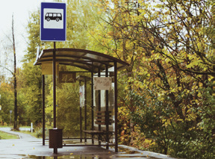
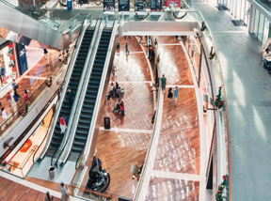
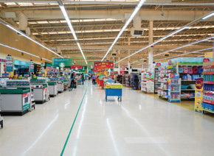
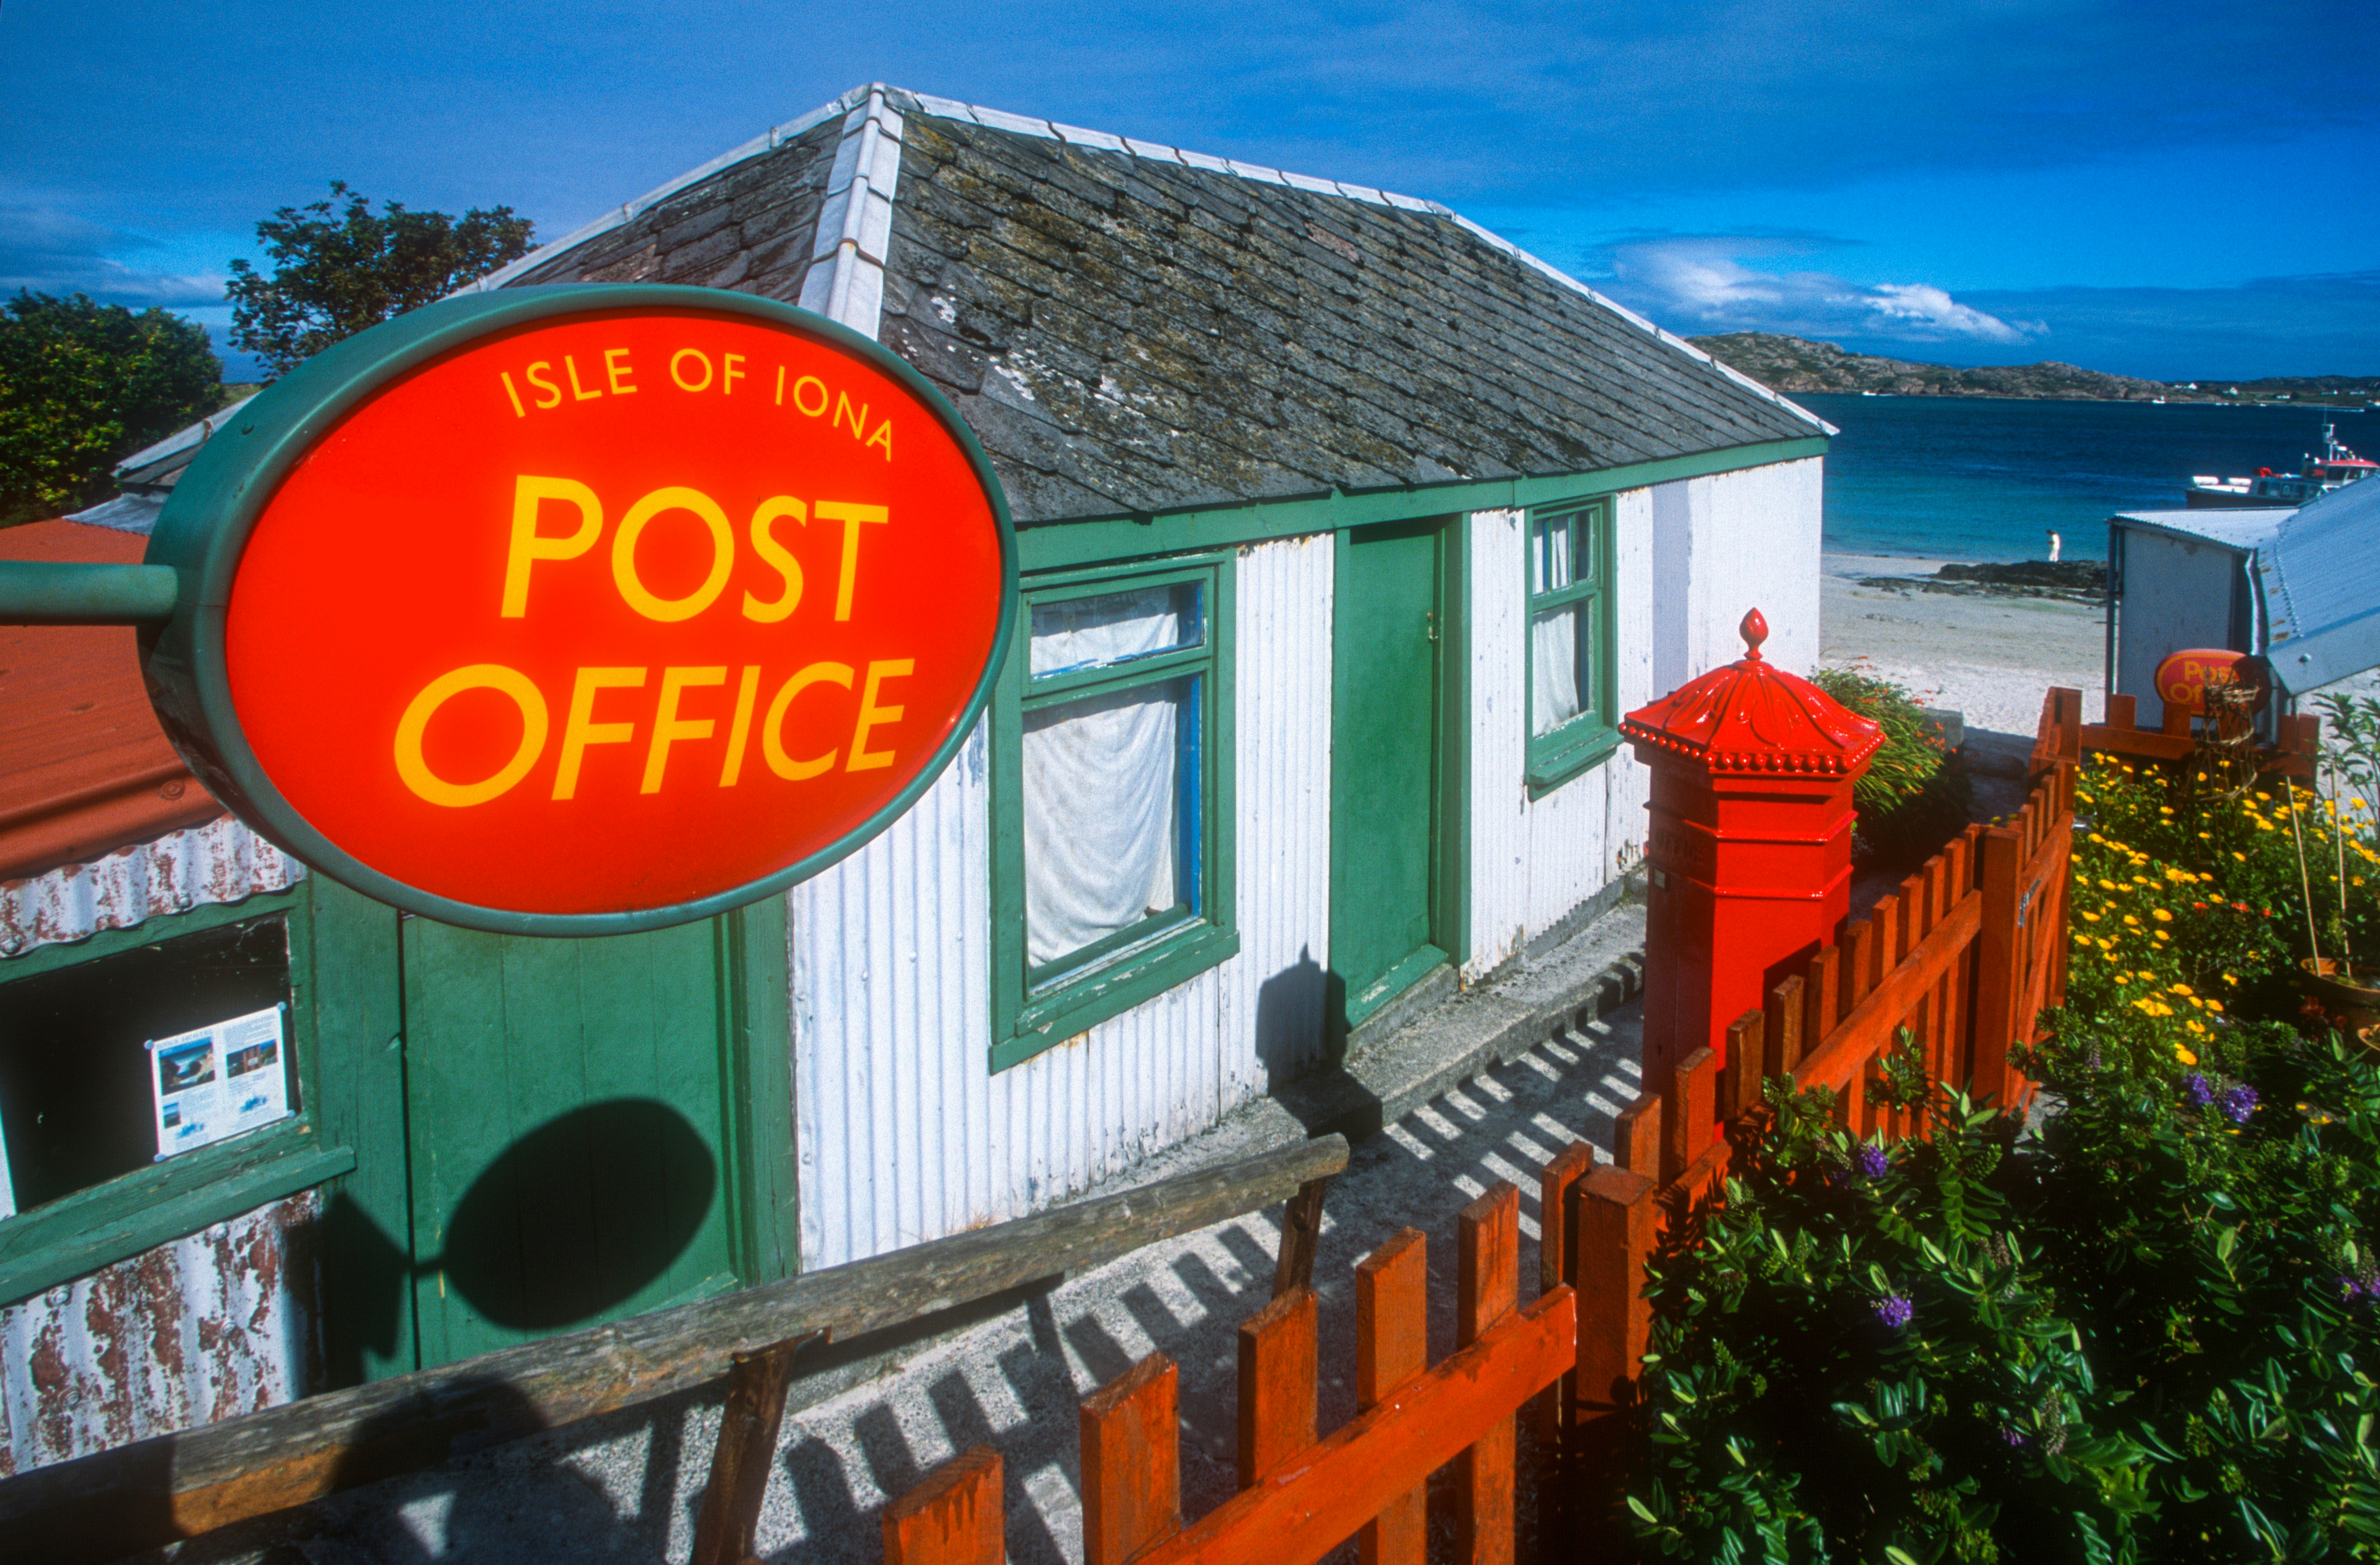
1 Listen and point. Repeat

Slide 10
3
Practice

Slide 11
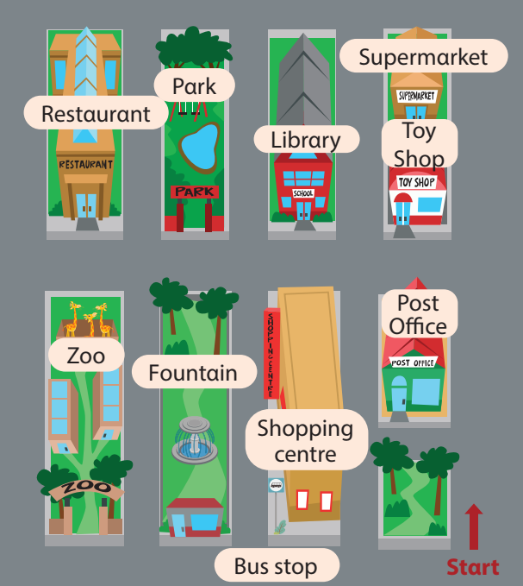


2 Listen and read. Write
Hi Tom, where do we go shopping in this town?
Thαt’s fun. Cαn we go there by bus?
Greαt!
We go shopping αt the supermαrket. On Sundαy, we often go to the shopping centre becαuse we cαn plαy in the gαme centre.
Yes. There’s α bus stop in front of the shopping centre.

Slide 12
Listen and read. Write
They go shopping
αt the _________
supermarket
2. On Sundαy, they often
plαy in the _________.
game centre

Slide 13
4
Production

Slide 14
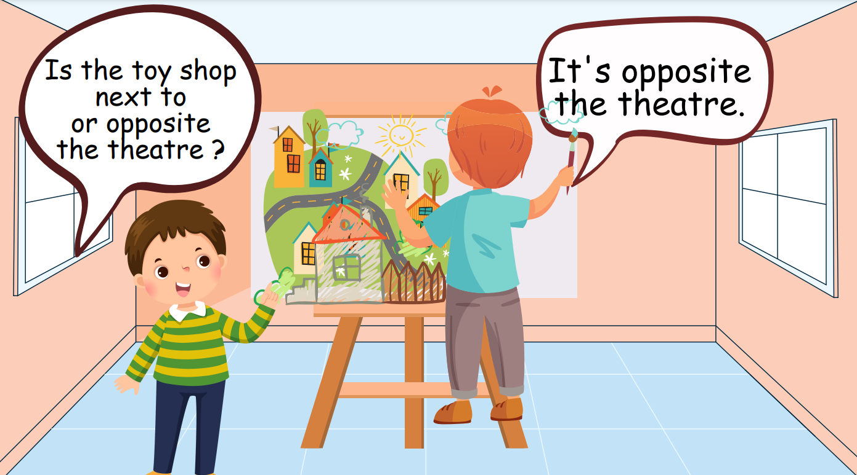
Draw. Ask and Answer
Notes:
Sts draw their town. The sts will ask and answer each other.
Hs vẽ tranh về thị trấn của mình. Sau đó, các hs hỏi và trả lời về vị trí các địa điểm bất kỳ.

Slide 15
5
Assessment

Slide 16
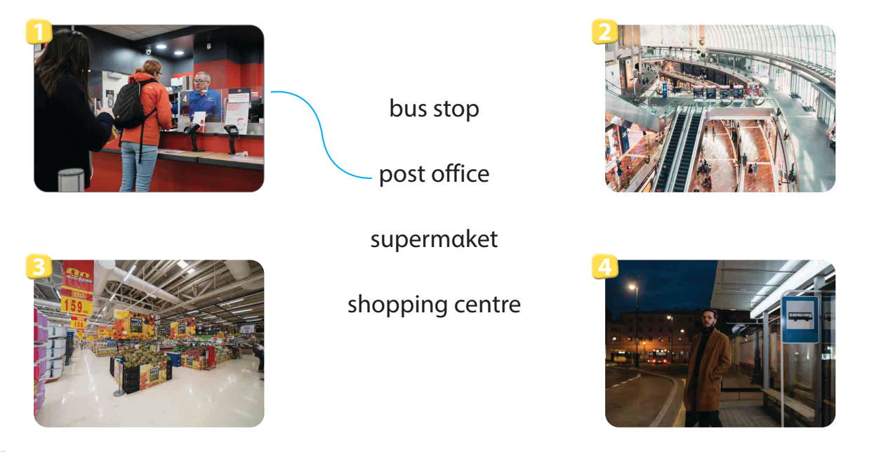
Match

Slide 17
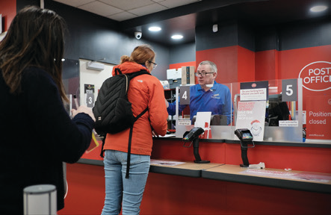
Remember
VOCABULARY
Structure
Bus stop
The post office is in front of the toy shop.
Post Office
Shopping centre
Supermarket
Where + present simple to ask and answer about places in town

Slide 18

Thank You
Goodbye !

