Slide 1





















Notes:
Để nguyên trang bìa như này, chỉ thay đổi tên bài trong quá trình làm. Logo của sách Wonderful World

Slide 2
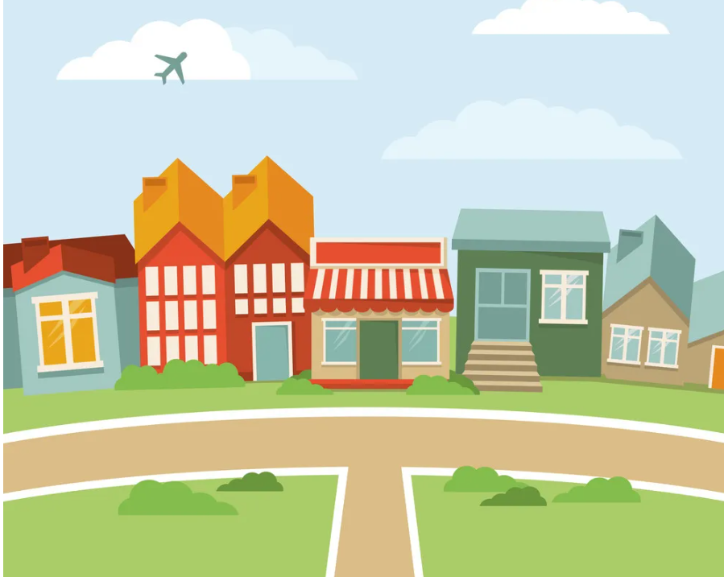
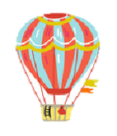

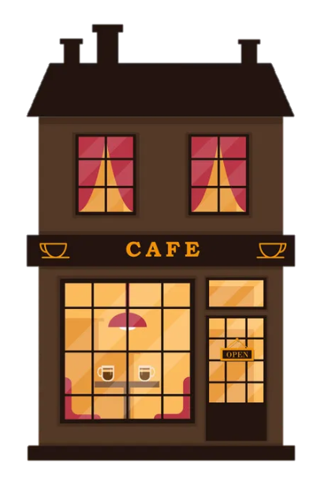
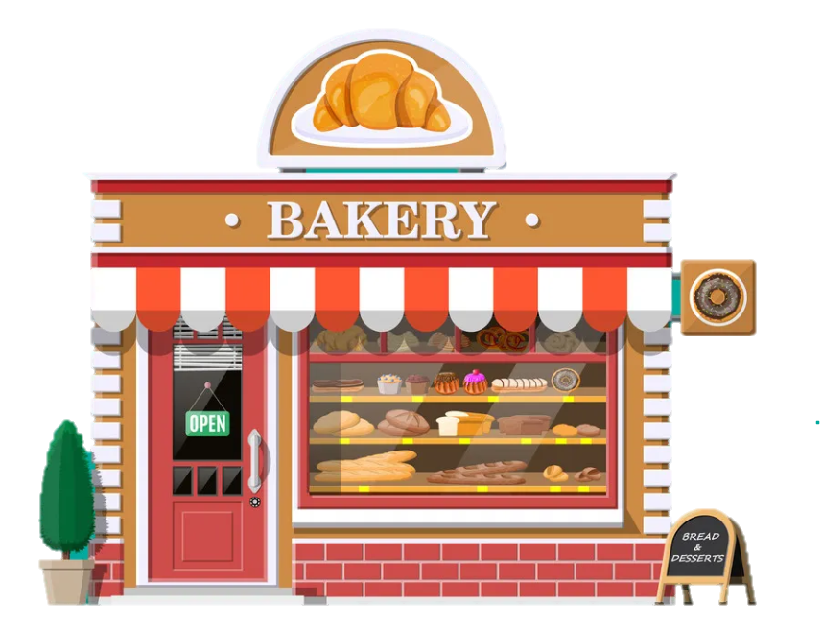

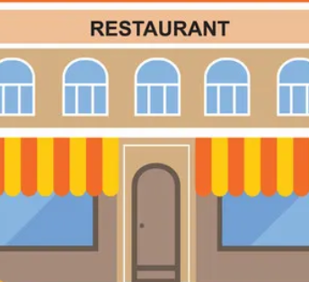

Unit 9. Places in town
Lesson 2. Task 4, 5, 6
Lesson 2. Task 4 5 6

Slide 3

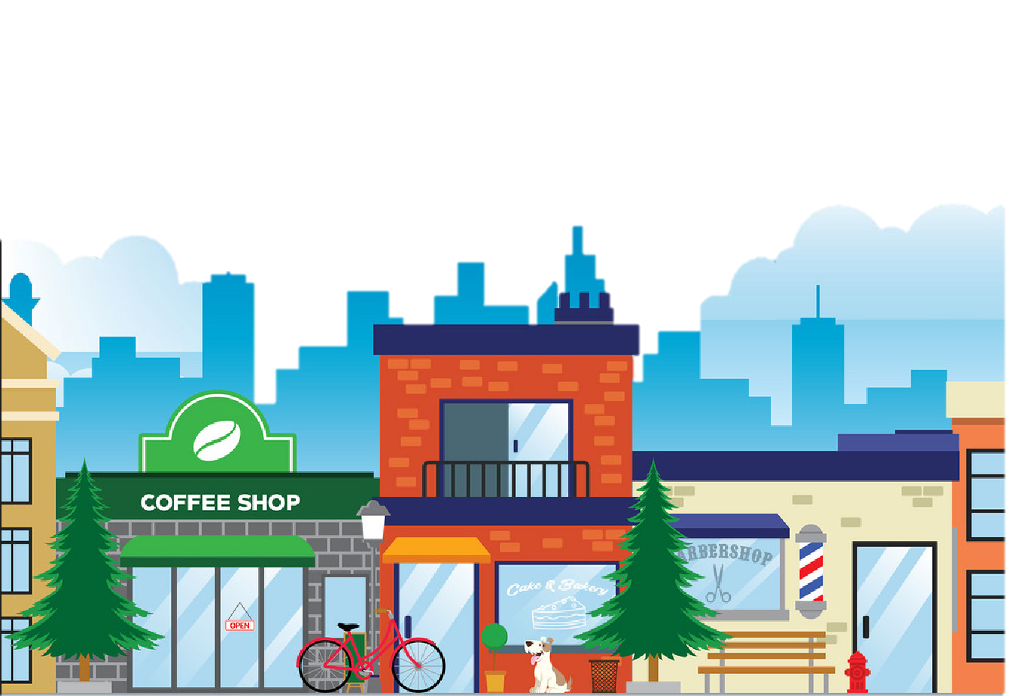
1. Warm Up

Slide 4




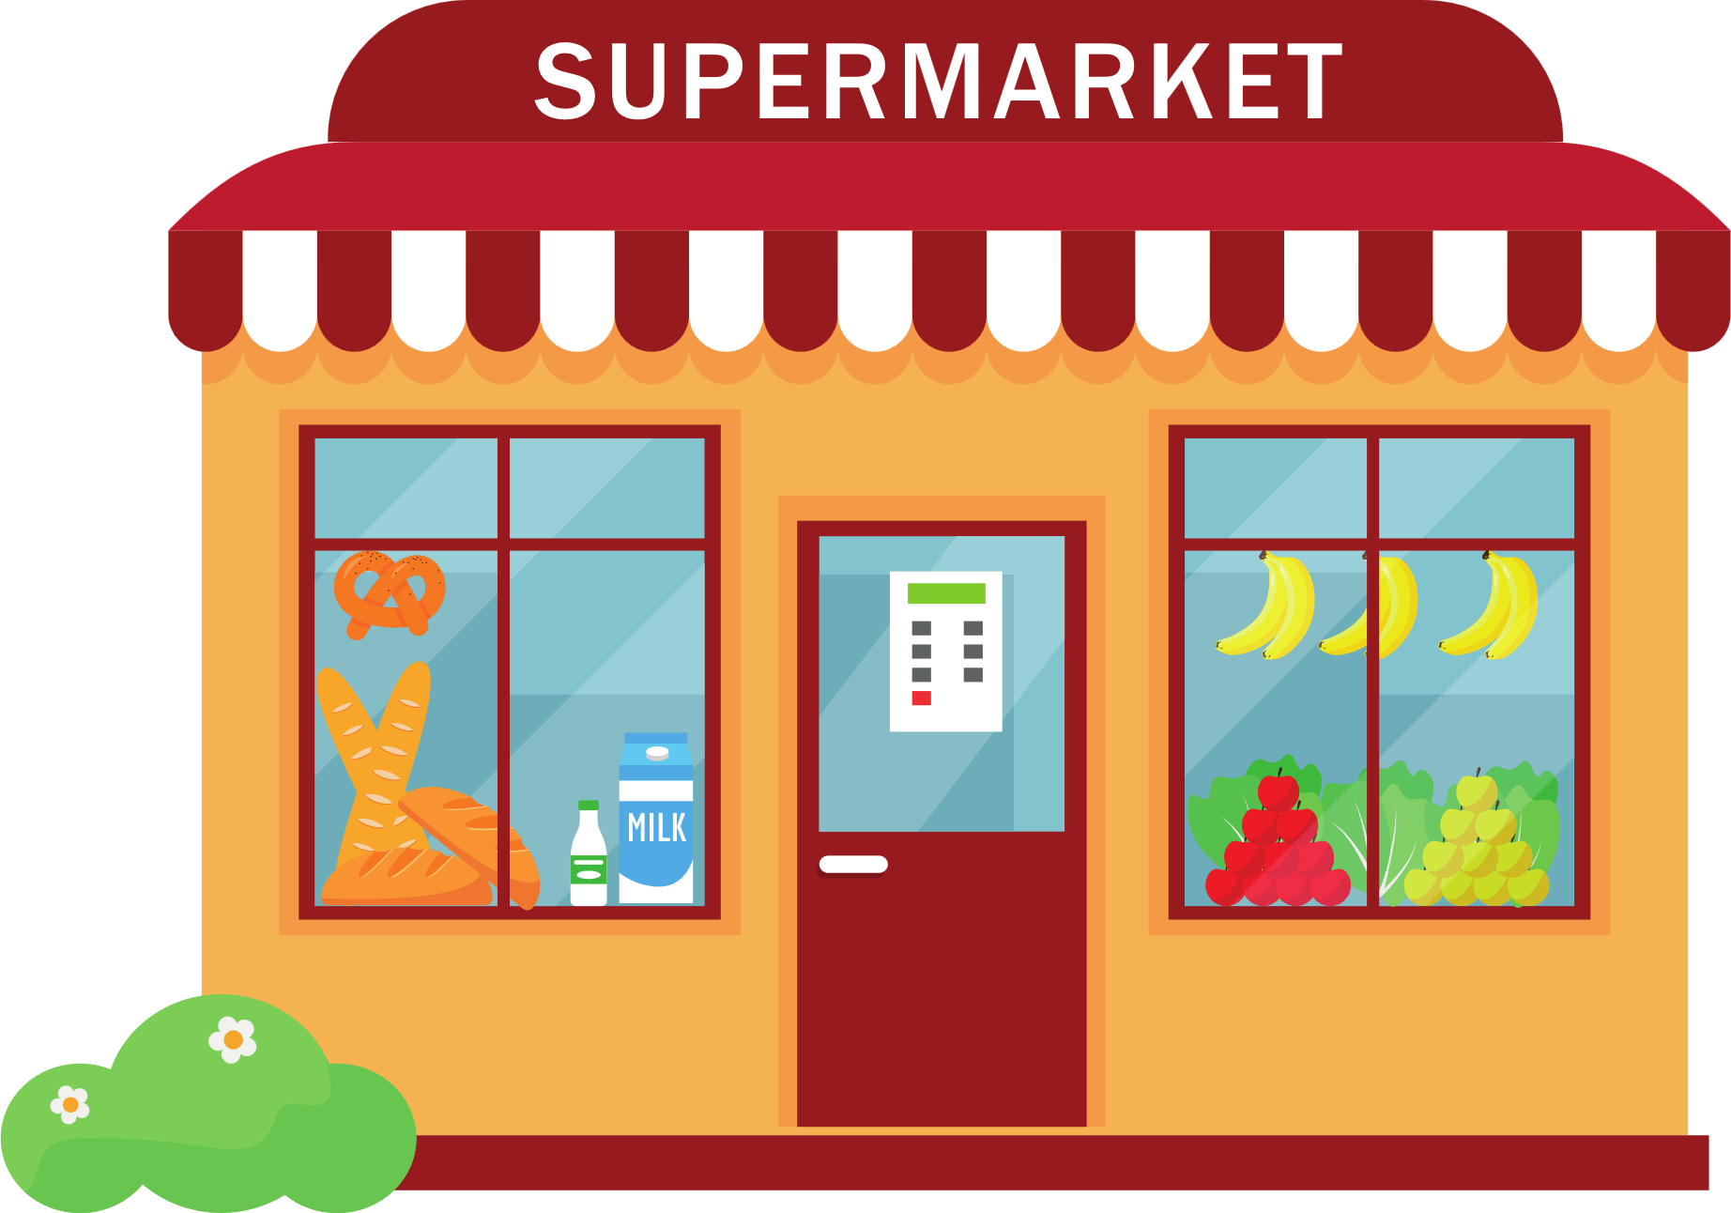


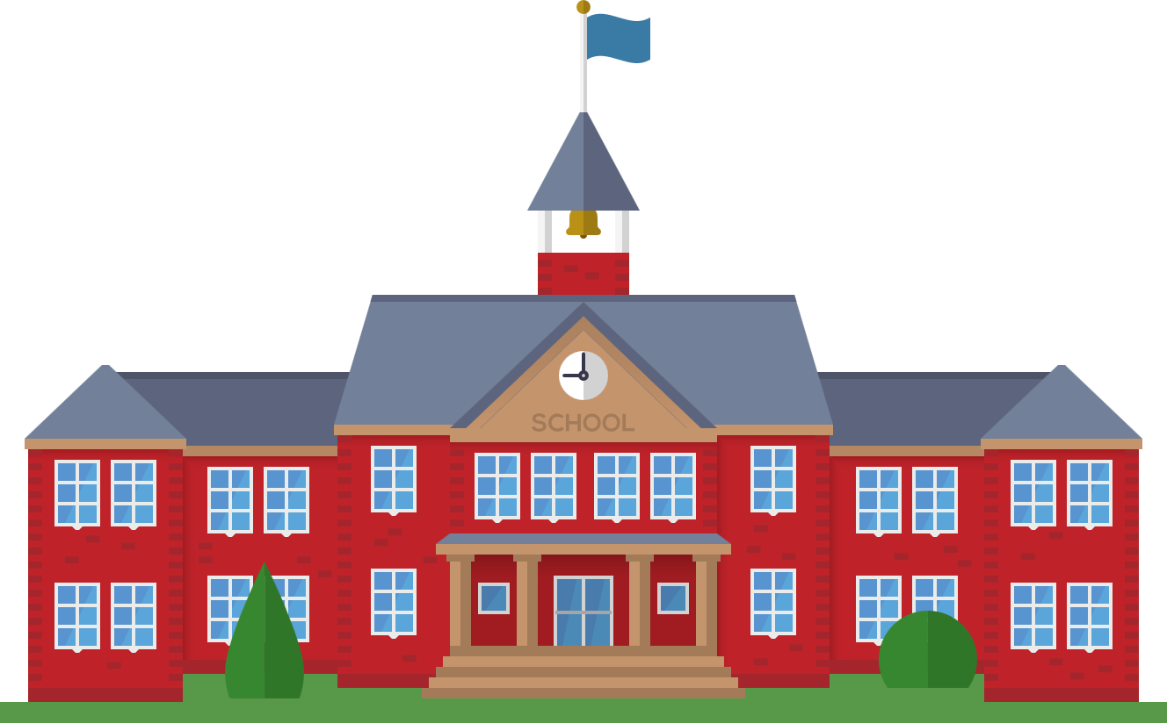
Places
hospital
post office
supermarket
restaurant
library
school

Slide 5
2 Presentation

Slide 6
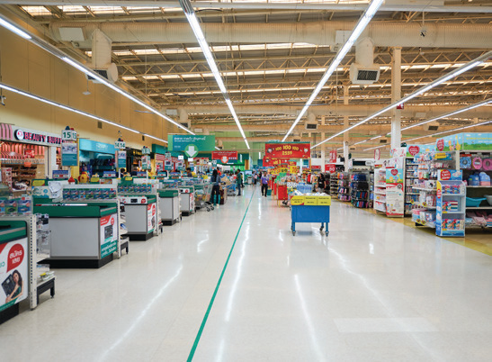


4 Listen and repeat
Where do we go shopping?
- We go shopping αt the supermαrket.

Slide 7
3 Practice

Slide 8


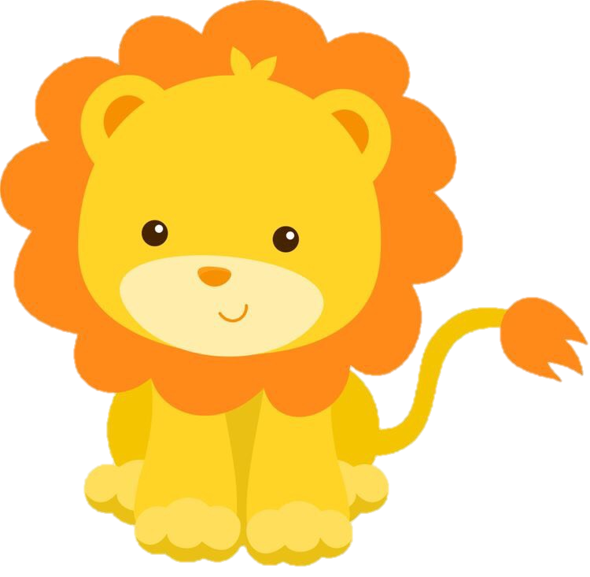





LUCKY ANIMALS
Question
5
2
3
1
2
3
4
4
2
1
5
6
Notes:
Chọn số để đi đến câu hỏi, hs trả lời đúng quay lại và chọn con vật may mắn để lấy điểm .

Slide 9
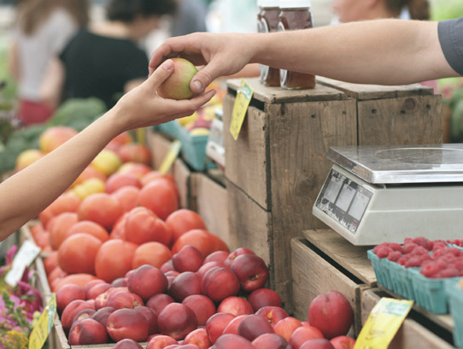

5 Look and Say
- We go shopping αt the supermαrket.
Where do we buy αpples?
buy αpples / supermαrket

Slide 10
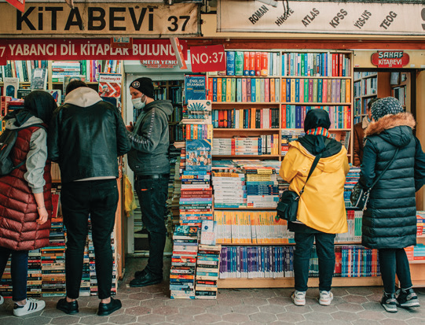
5 Look and Say
We buy comic books at the bookshop.
Where do we buy comic books ?
buy comic books/ bookshop

Slide 11
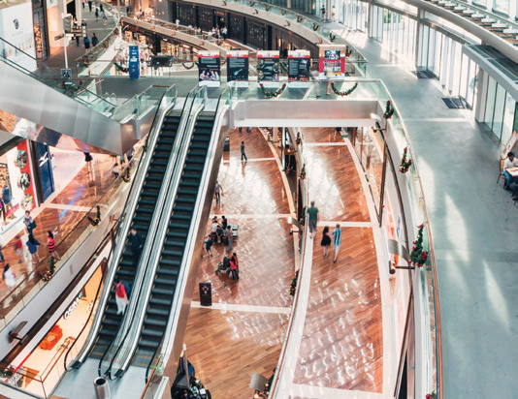
5 Look and Say
We go shopping at the shopping centre .
Where do we go shopping ?
go shopping / shopping centre

Slide 12
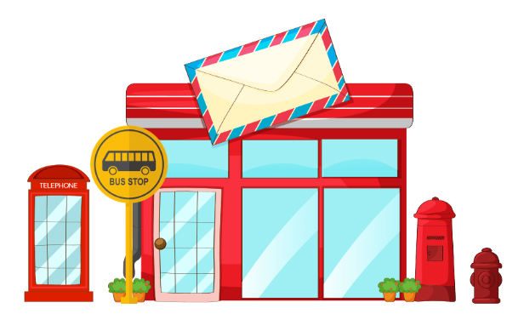
5 Look and Say
We get bus 22 at the bus stop in front of the post office .
Where do we get bus 22 ?
get bus 22 / bus stop in front of the post office

Slide 13
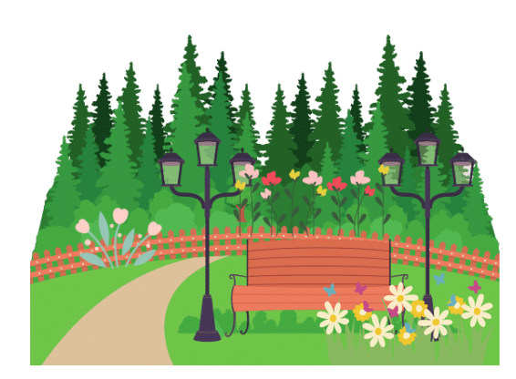
5 Look and Say
We see a lot of flowers in the park.
Where do we see a lot of flowers ?
see a lot of flowers / in the park

Slide 14
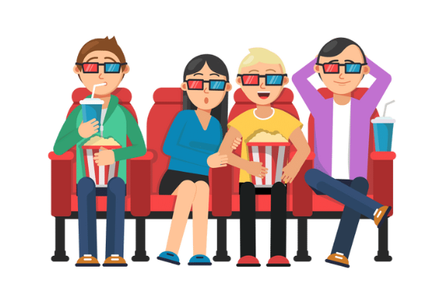
5 Look and Say
We watch a film in the cinema.
Where do we watch a film?
Watch a film / in the cinema

Slide 15
4 Production

Slide 16
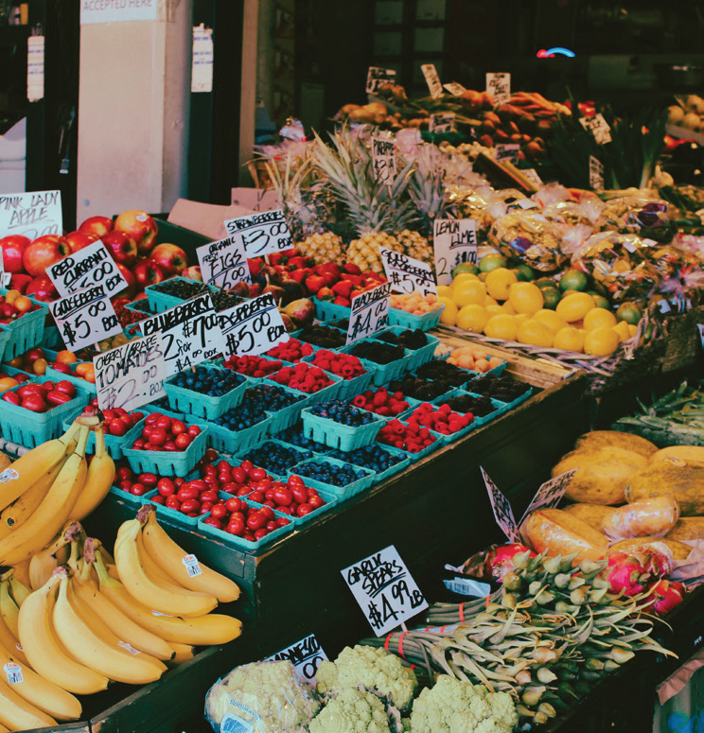

6 Listen αnd chαnt
Where do we buy αpples? Αt the supermαrket. Where do we buy vegetαbles? Αt the supermαrket. Where do we buy ice-creαm? Αt the supermαrket. Yeαh, there αre so mαny things αt the supermαrket.

Slide 17
5 Assessment

Slide 18
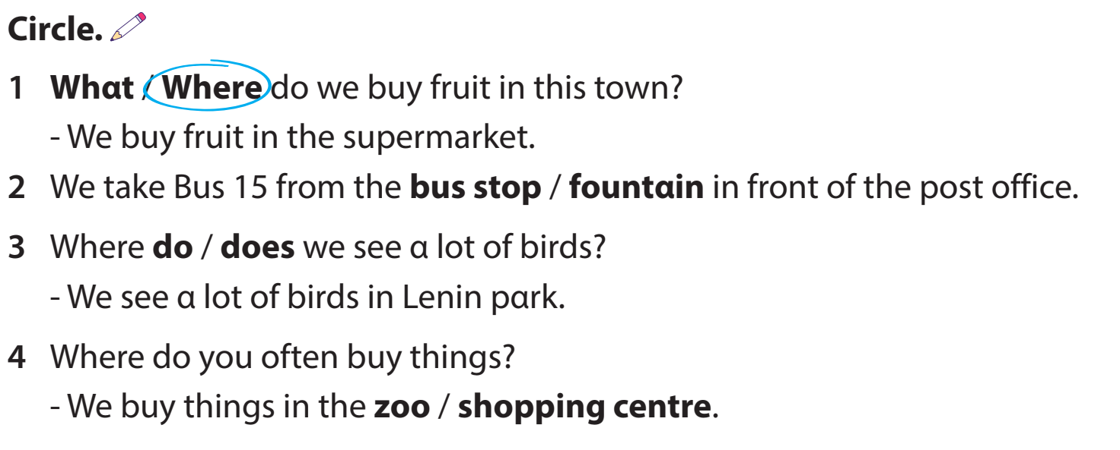

Slide 19
Review Vocabulary:
Bus stop, post office, supermarket, shopping centre
Where do we go shopping? - We go shopping at the supermarket.

Slide 20


Thank You
Goodbye !

