Slide 1









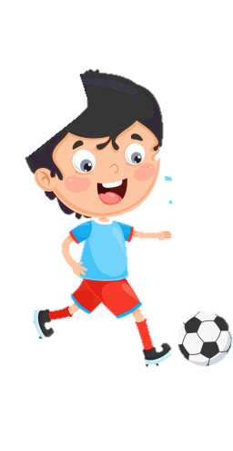













Slide 2

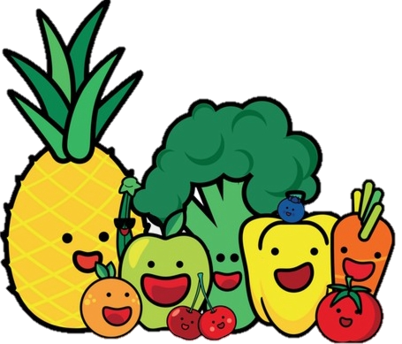
Unit 9: My Favourite Food
Lesson 3 – Task 1, 2, 3

Slide 3
1 WARM UP
Guess the food

Slide 4







Guess the food
Notes:
Teacher shows 5 flowers. Ss have to choose one of them to guess what food it is.

Slide 5
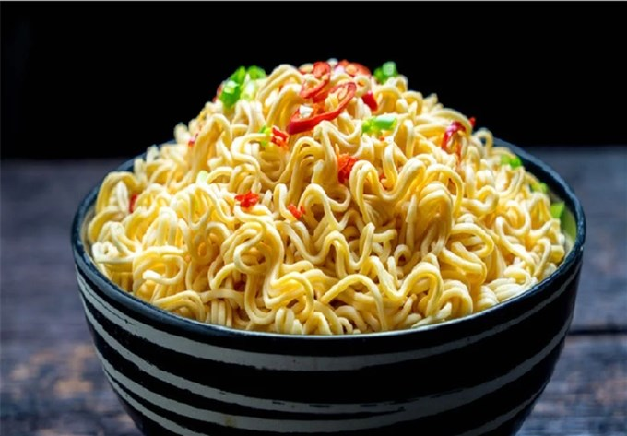
noodles
Back

Slide 6
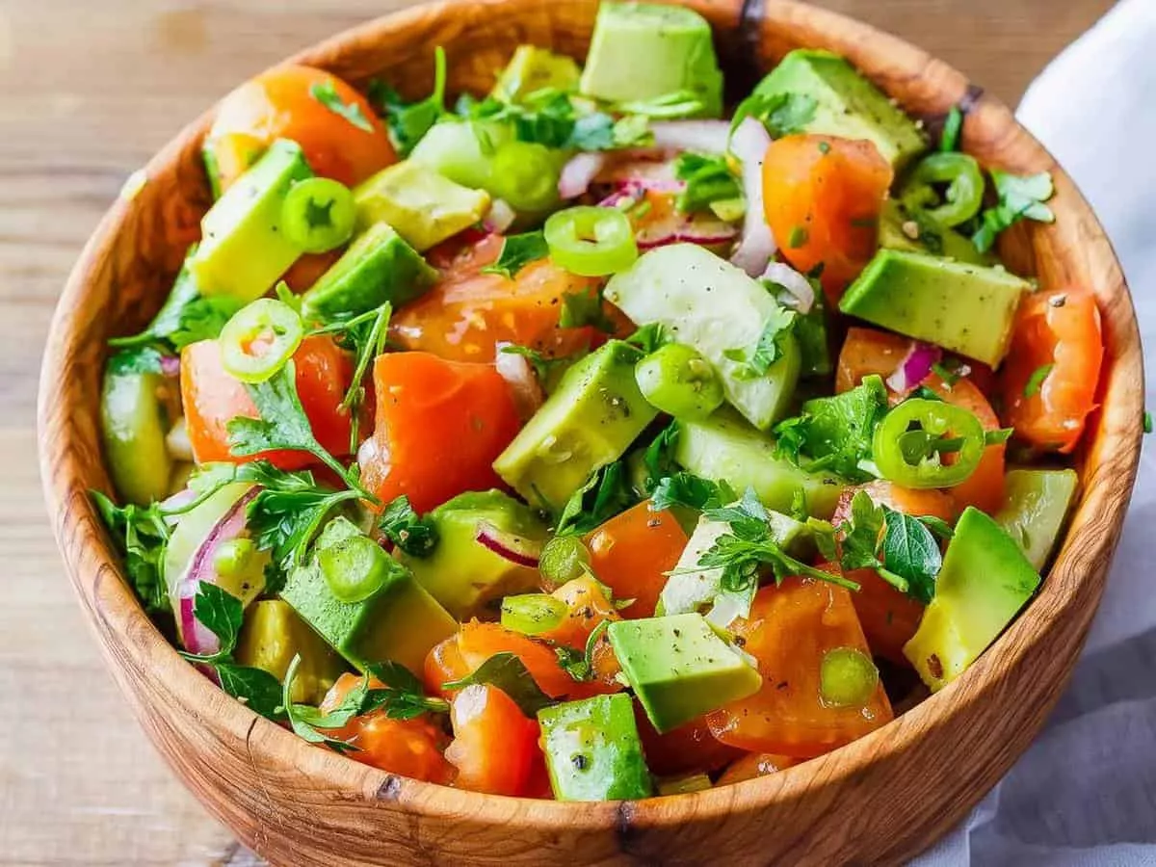
salad
Back

Slide 7
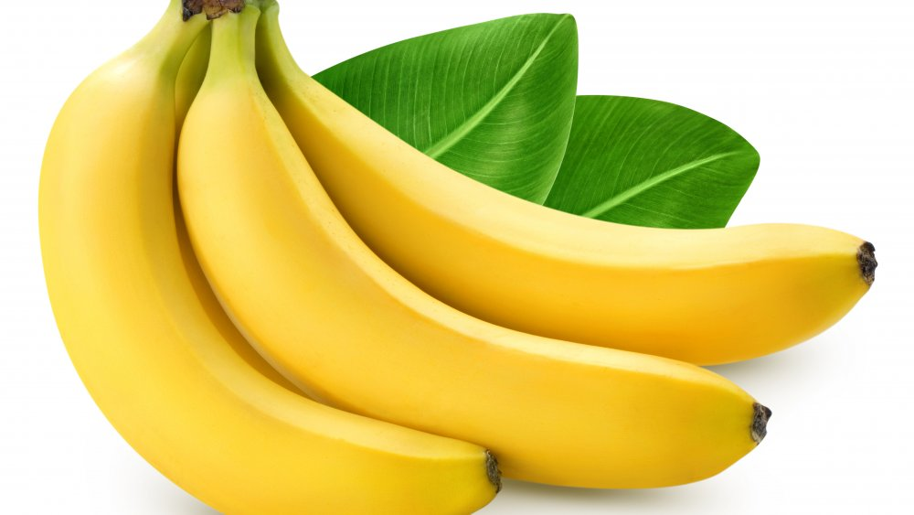
bananas
Back

Slide 8
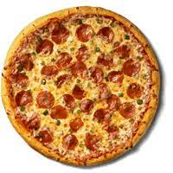
pizza
Back

Slide 9
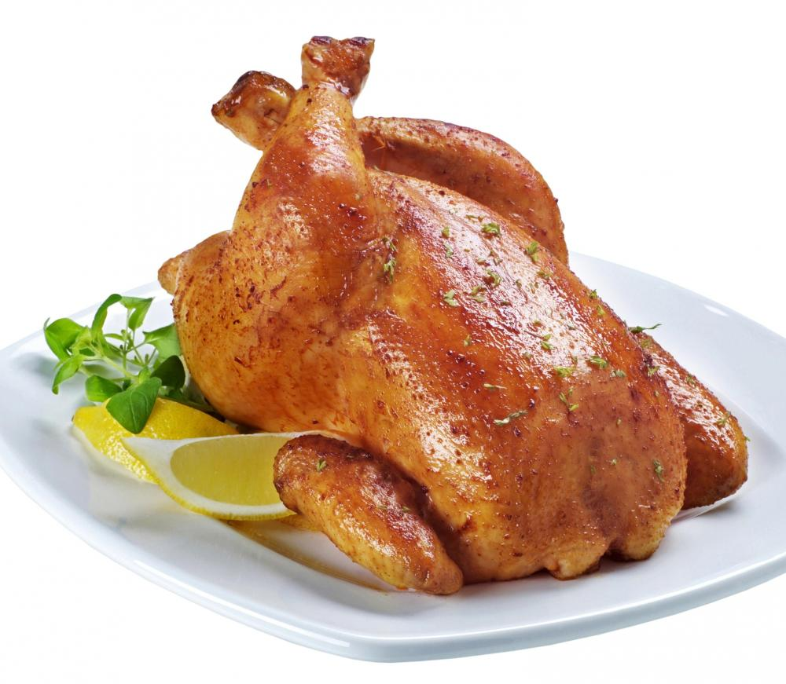
chicken
Back

Slide 10
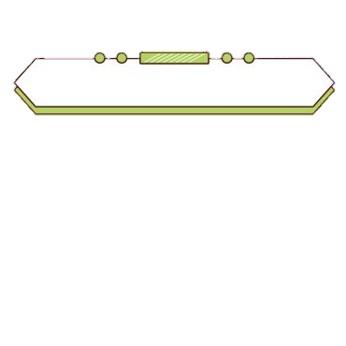

2 PRESENTATION
Task 1 Listen and point. Repeat.

Slide 11

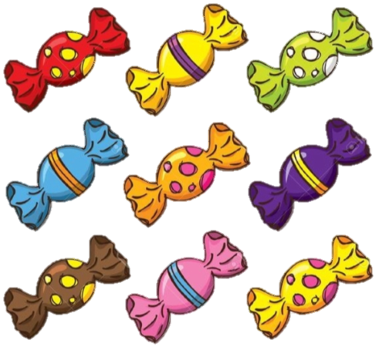
New words
sweets

Slide 12
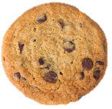
New words
biscuit

Slide 13

New words
ice cream

Slide 14
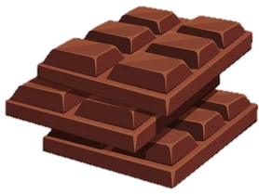
New words
chocolate

Slide 15


Listen and point. Repeat.
biscuit
ice cream
sweets
chocolate
Notes:
- Play the words one by one
- Play the track 9.8, ask students to listen and repeat in chorus, groups.
- Say a word for students to repeat then point.

Slide 16

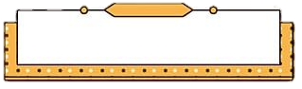

Let’s check vocabulary!
Get the goal
Notes:
Students have to answer the questions to help the boy and the girl get the goal.

Slide 17






Slide 18





Question 1: What is it?
A. sweets
B. ice cream
C. chocolate
D. ice

Slide 19



Question 2: What is it?
A. pizza
B. chocolate
C. ice cream
D. biscuit

Slide 20


Question 3: What is it?
A. biscuit
B. ice cream
C. sweets
D. chocolate

Slide 21


Question 4: What is it?
A. biscuit
B. noodle
C. ice cream
D. sweets

Slide 22

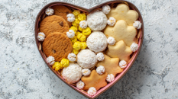

Question 5: What are they?
A. bread
B. chicken
C. biscuits
D. chocolates

Slide 23
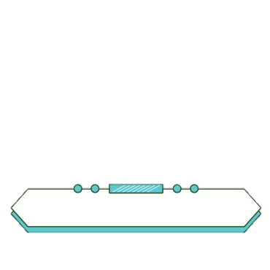

3 PRACTICE
Task 2 Listen and tick.

Slide 24
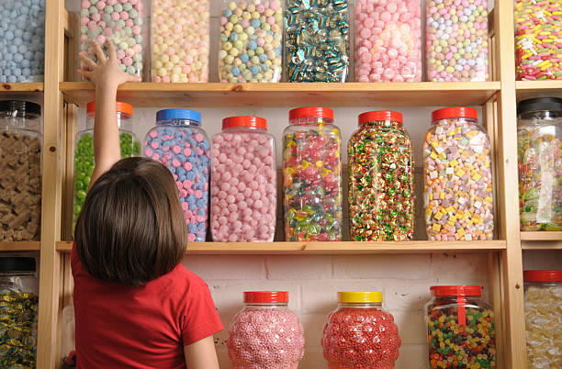
Grandpa: Come on, Leo. Let’s go to the sweet shop!
Leo: Look, Grandpa. There are a lot of apple sweets, and there is a lot of chocolate, too.
Grandpa: Let’s get some sweets.
Leo: Are there biscuits?
Grandpa: Yes, they’re in the box. Let’s get some!
✓
1 There are a lot of ______ apple sweets banana sweets in the shop.
✓
2 There are __________ biscuits sweets in the box.

Slide 25


3 PRACTICE
Task 3 Look and say.

Slide 26
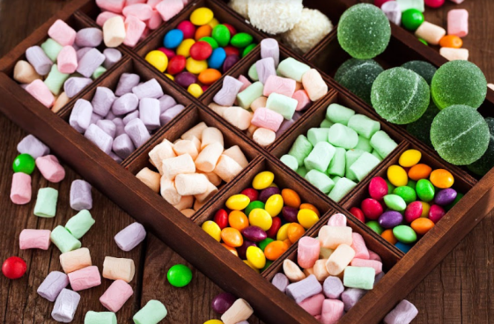
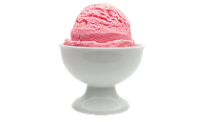
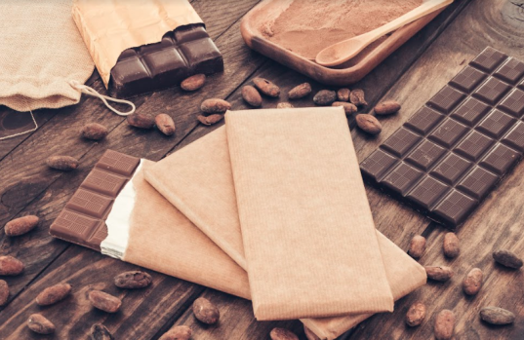

1 There are ....
2 There are ....
3 There is ....
4 There is ....
There is a lot of chocolate.
Let’s get some!
There are a lot of biscuits in the box.
Let’s get some!
There are a lot of sweets in the box.
Let’s get some!
There is a cup of ice cream.
Let’s get some!
Notes:
Ask Ss to look at 4 pictures and identify names of them.
- Introduce the structures “ There is/ there are...” again. Then ask Ss to look at the example and say.
- Work in pairs and talk about 4 pictures.
- Call some pairs to prensent in front of the class.
- Give them feedback.

Slide 27
4 PRODUCTION
Game “What is it?”
Notes:
(Teacher calls pairs of SS from the differen groups. One of them chooses a piece of paper and uses their language to describe the word. The other has to guess the word in 20 seconds.)

Slide 28

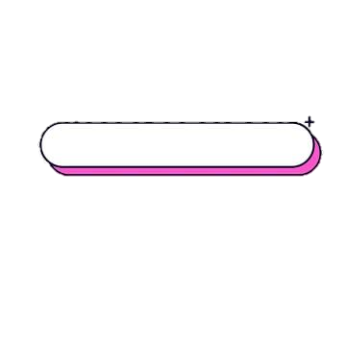
Example
What is it?
It’s round. It’s small and brown. What is it?
It’s a biscuit.
biscuit

Slide 29
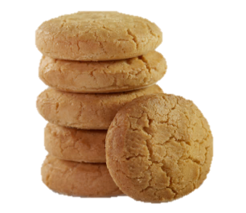



5 ASSESSMENT
Look, match and fill in the blanks.
1
sw_ _ ts
ee
2
_iscuit_
b s
3
ice cr_ _ m
ea
4
ch_ col_ te
o a

Slide 30




Thank you & goodbye!

