Slide 1






















Notes:
Để nguyên trang bìa như này, chỉ thay đổi tên bài trong quá trình làm. Logo của sách Wonderful World

Slide 2

Unit 9. Places in town
Lesson 3 Task 4 5 6

Slide 3

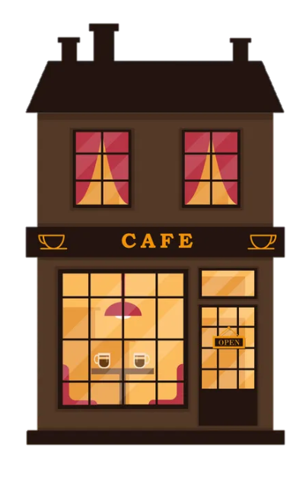

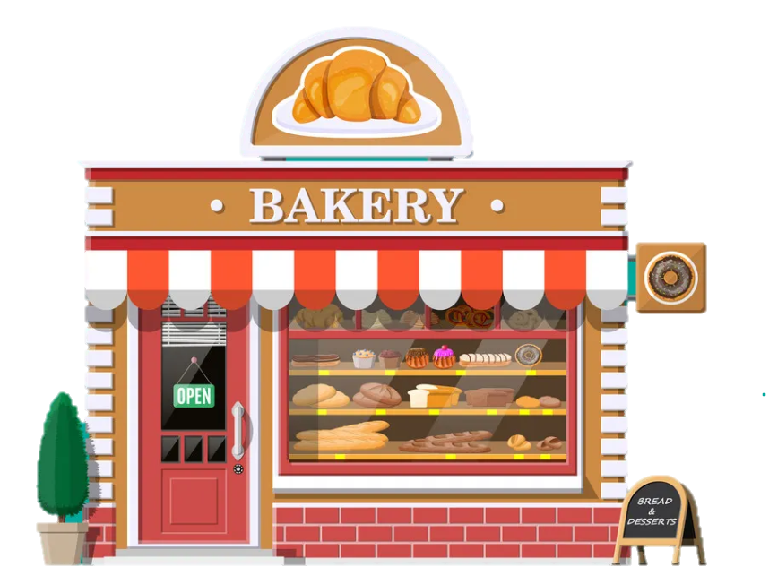
1
Warm Up

Slide 4
2
Presentation

Slide 5
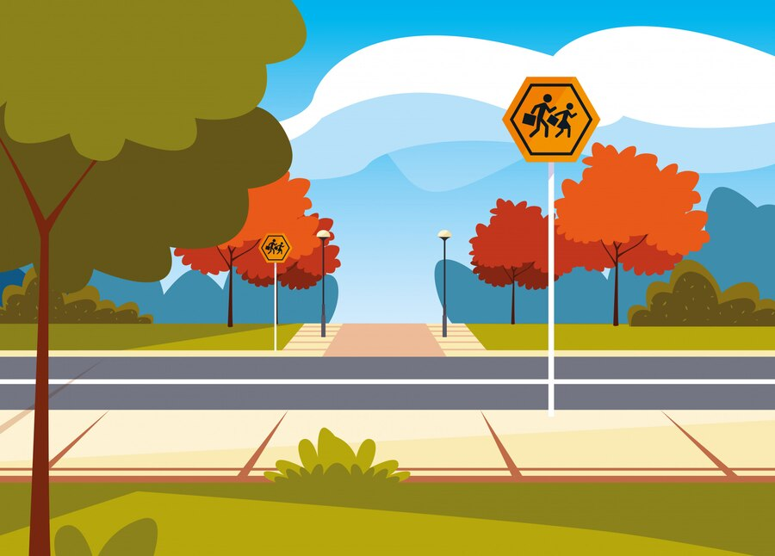

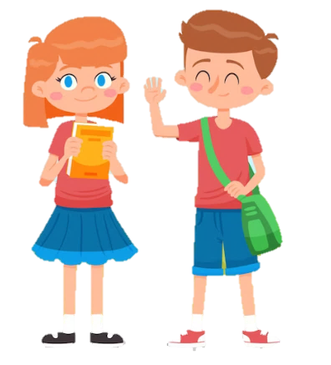
4 Listen and Repeat.
Go strαight on High street αnd then turn right. The cinemα is opposite the school.
How do we go to the cinema ?

Slide 6
3
Practice

Slide 7
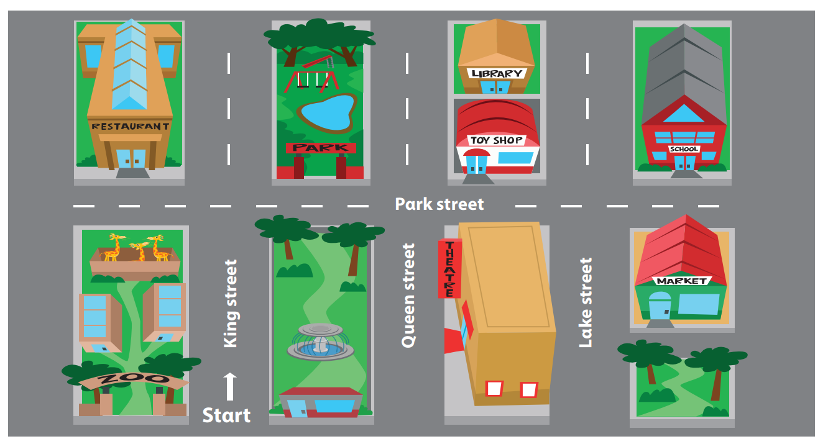

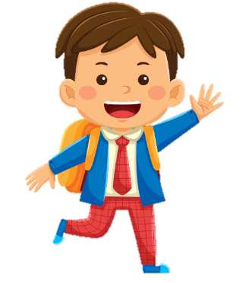

5 Look αnd sαy.
How do we get to
the toy shop?
We go strαight on King street, αnd
then turn right. The toy shop is opposite the theαtre.

Slide 8


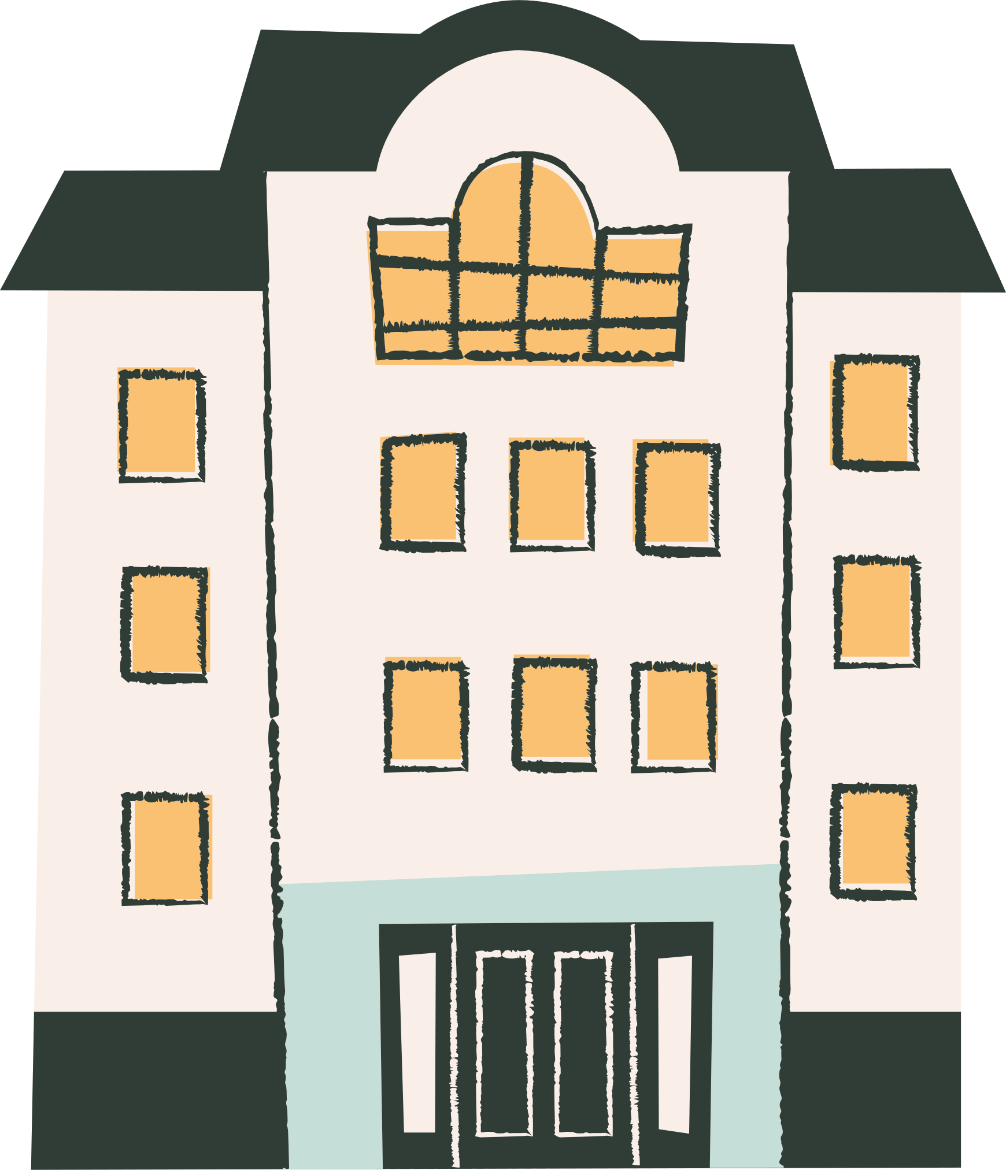
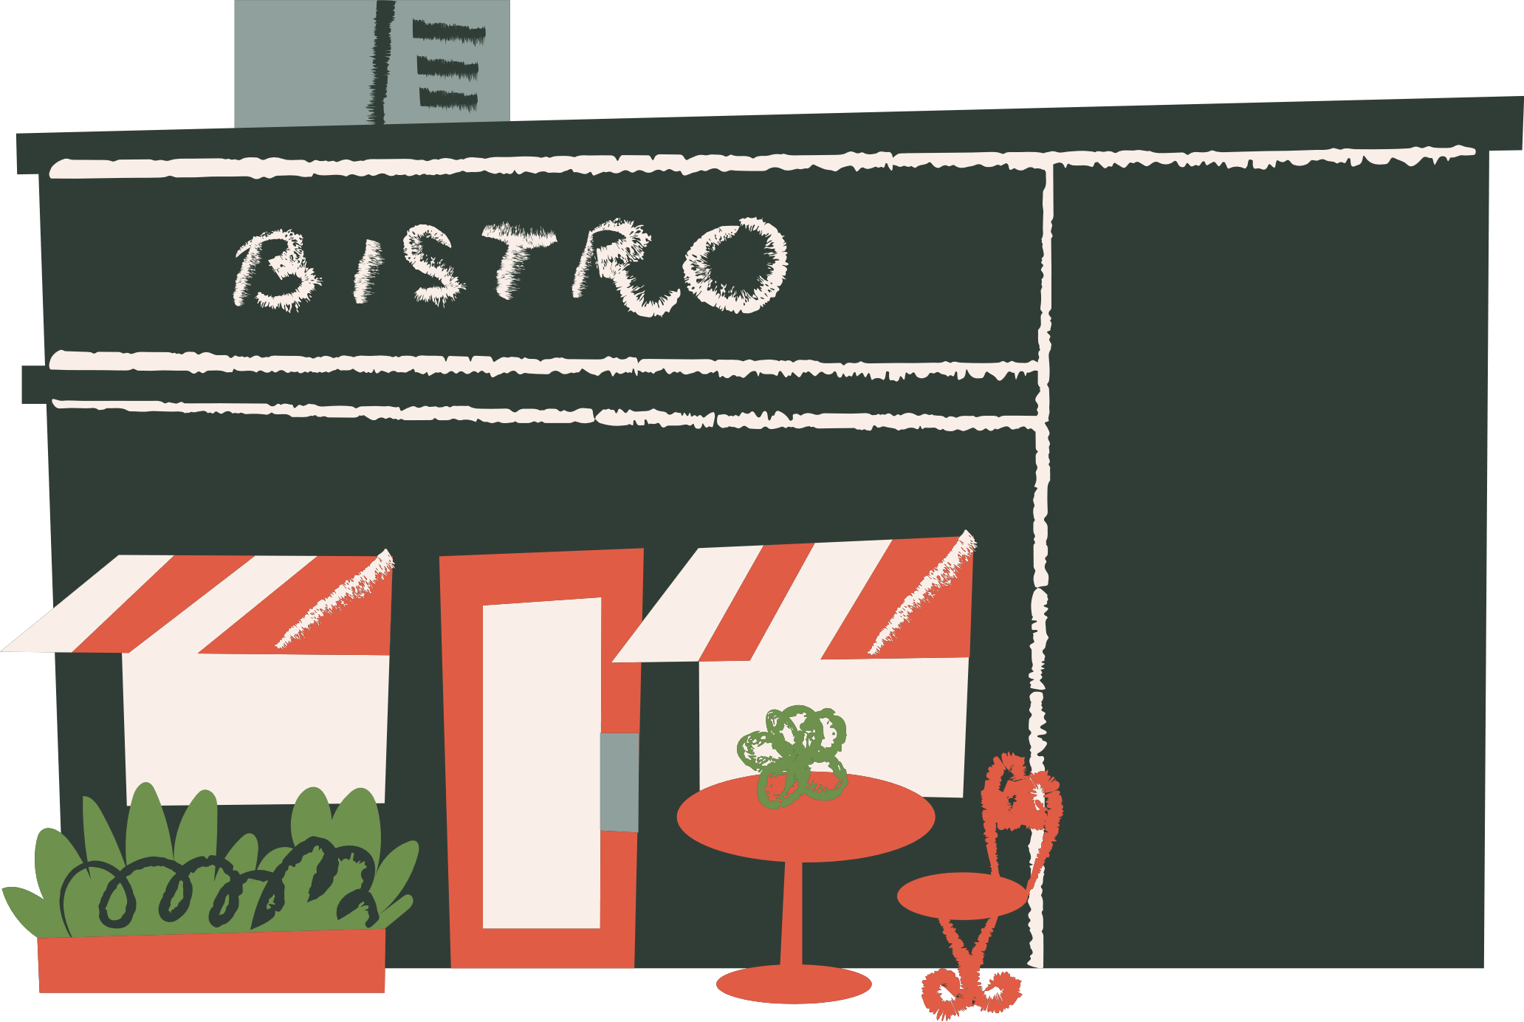

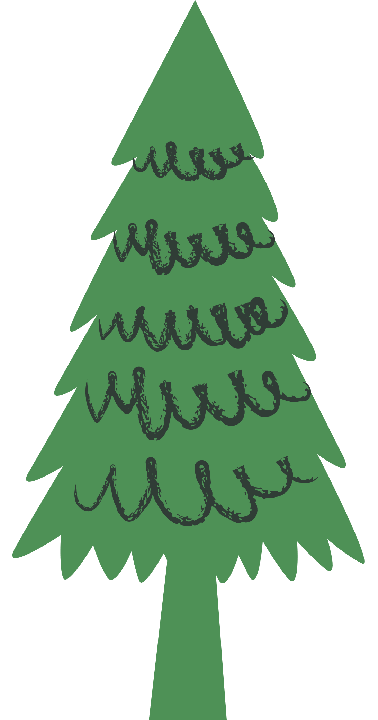
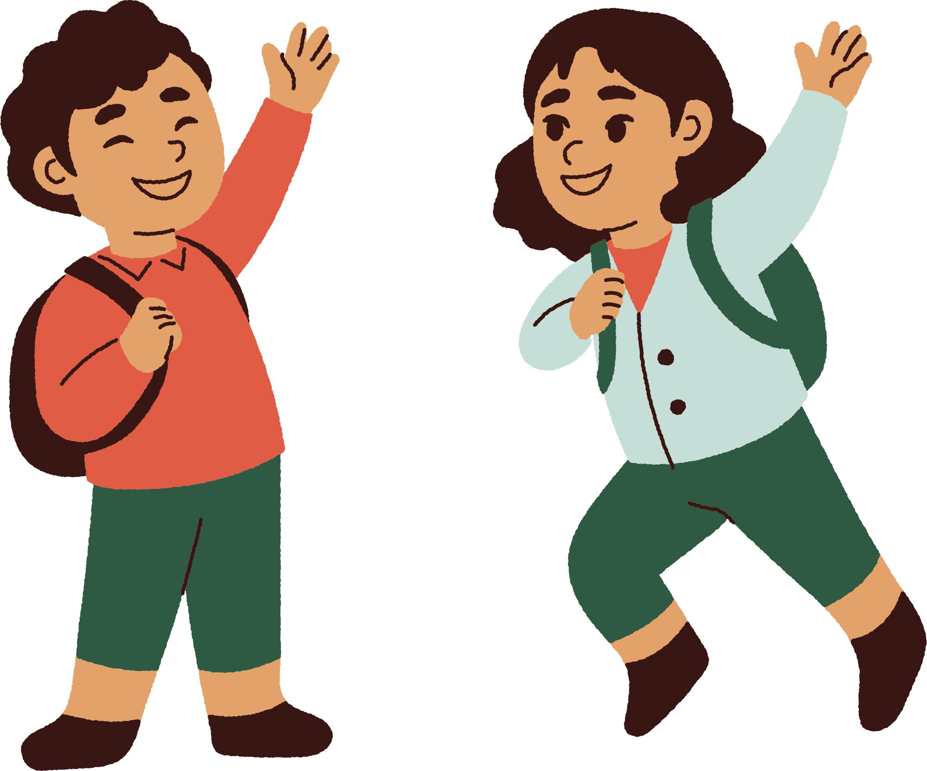

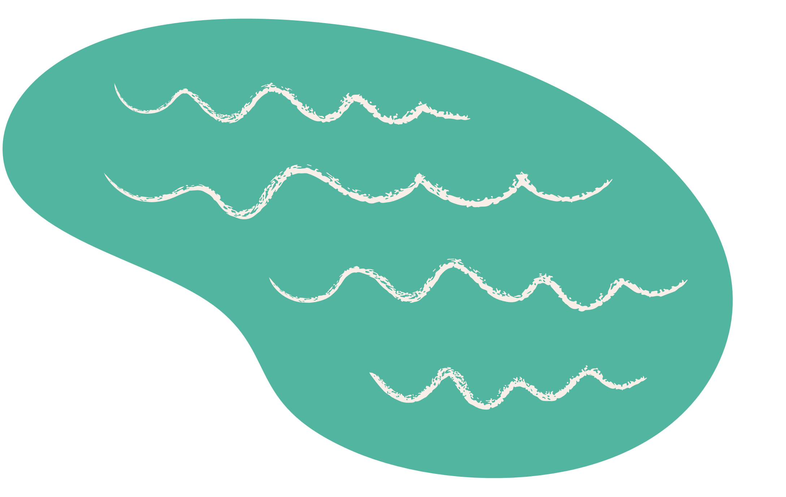
Tell Us Where

Slide 9
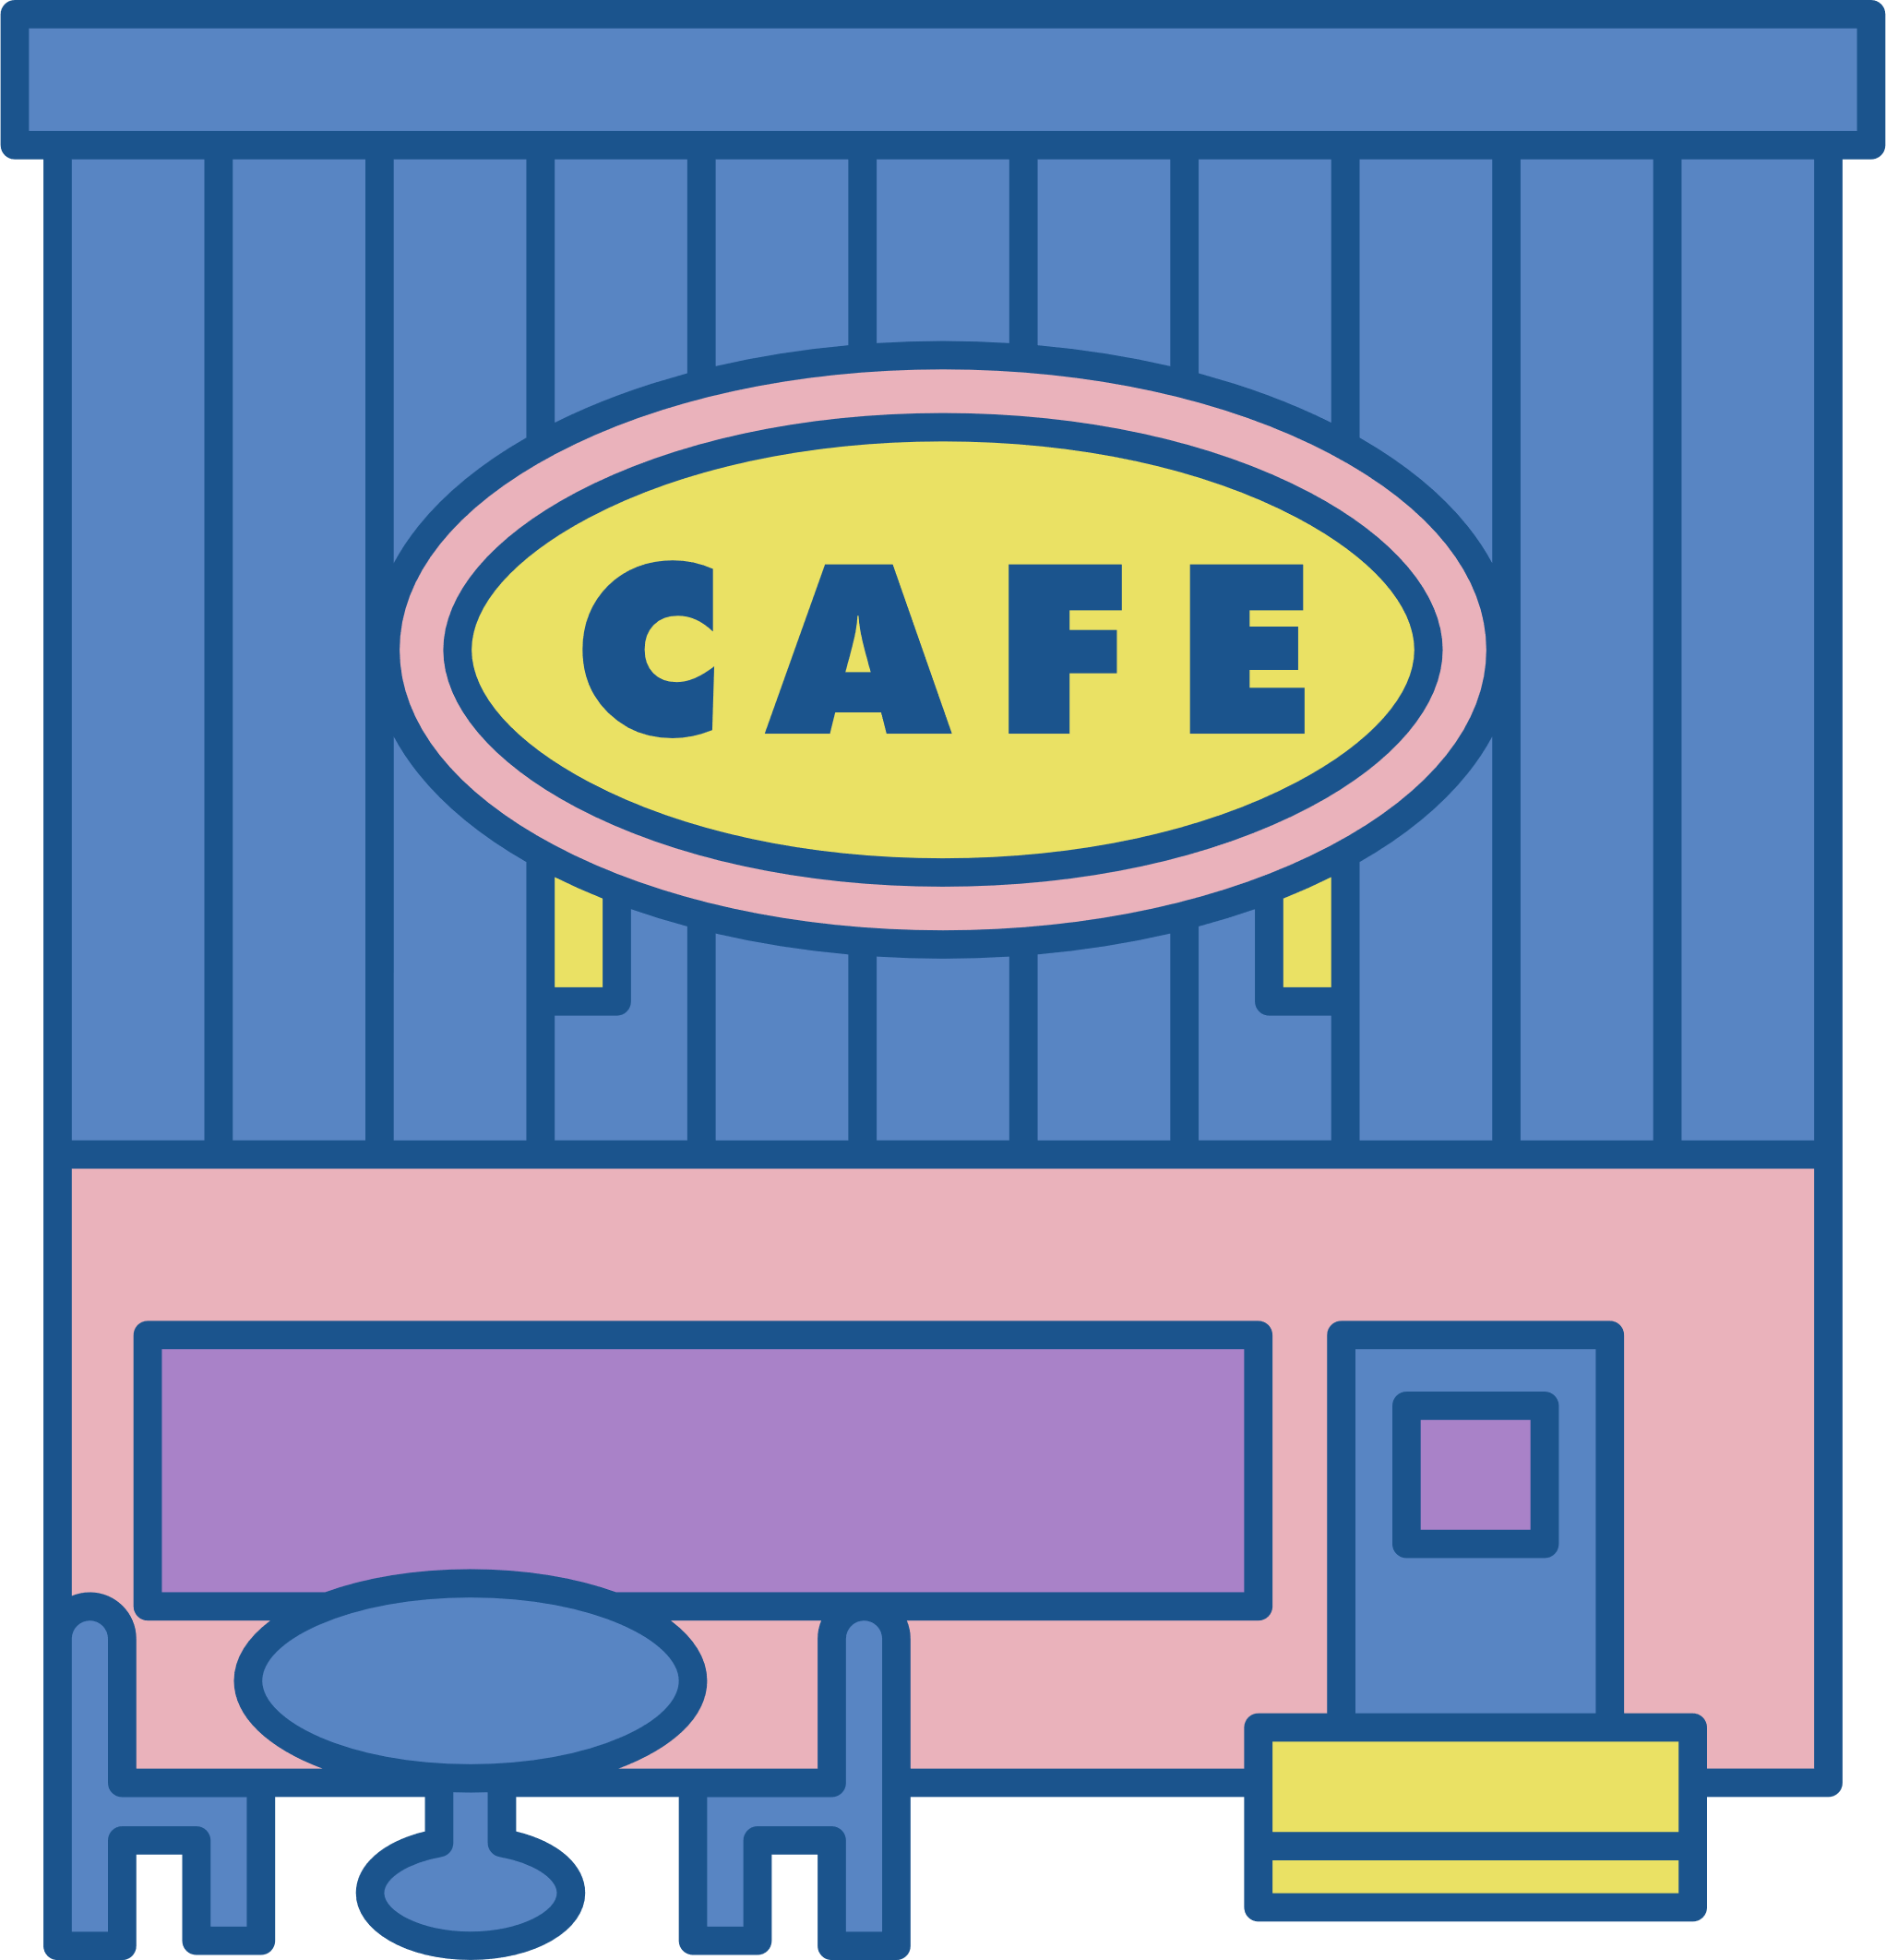
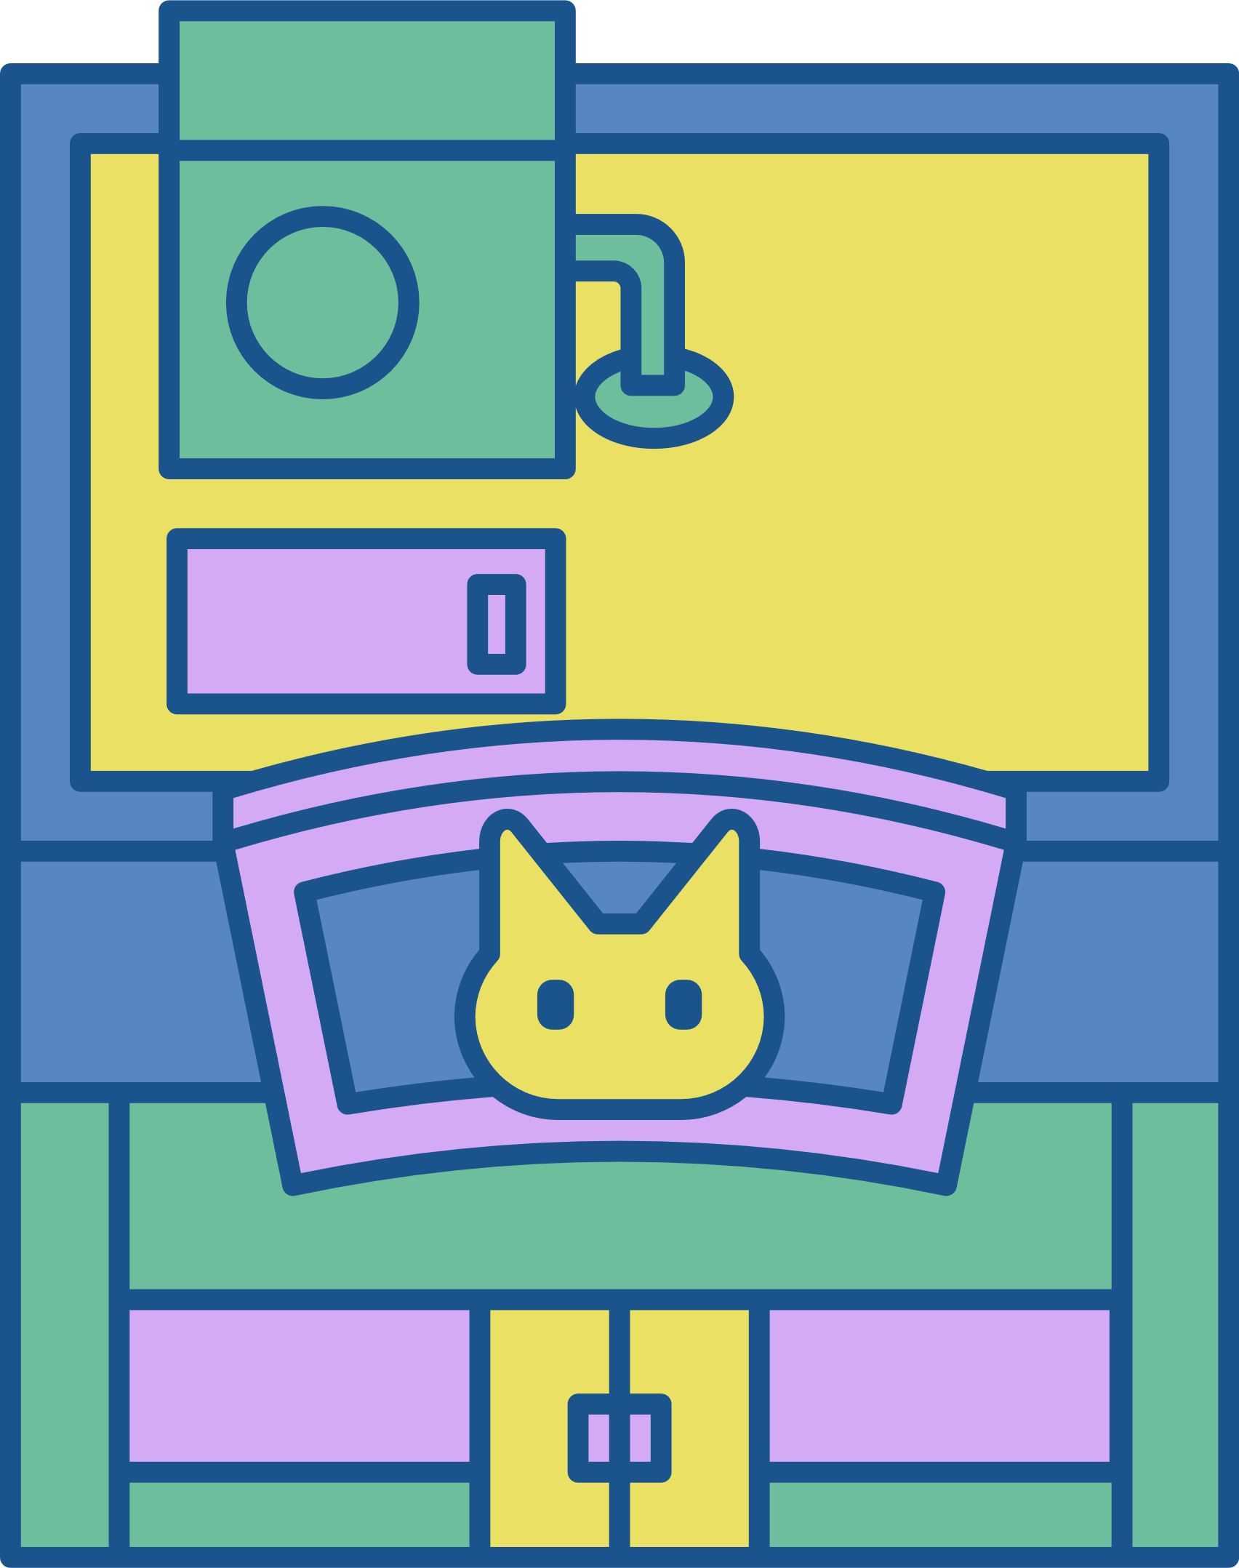
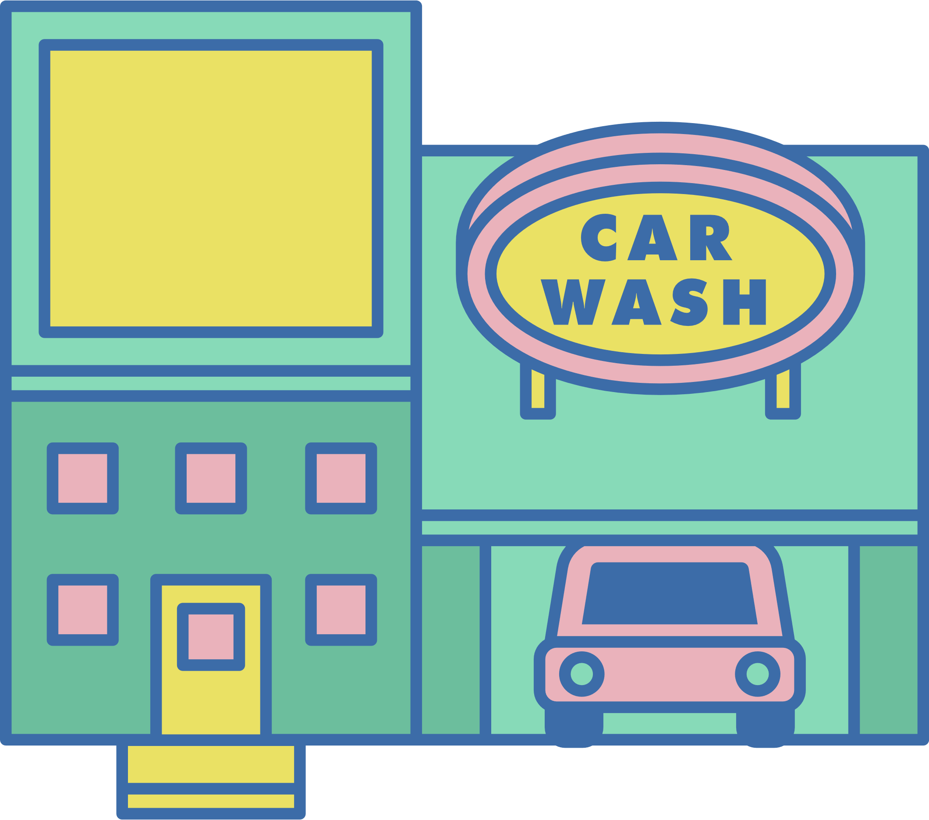
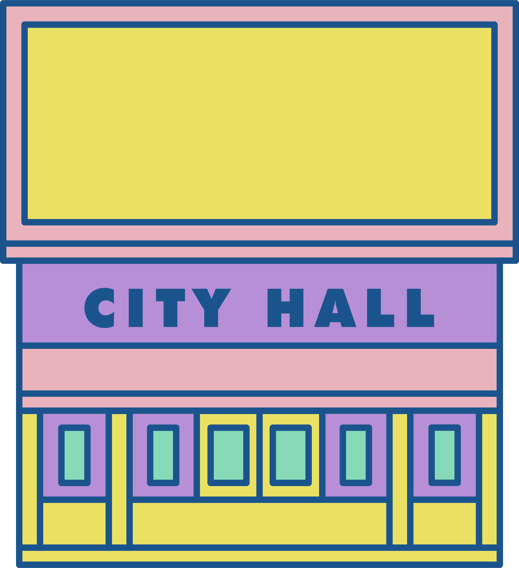




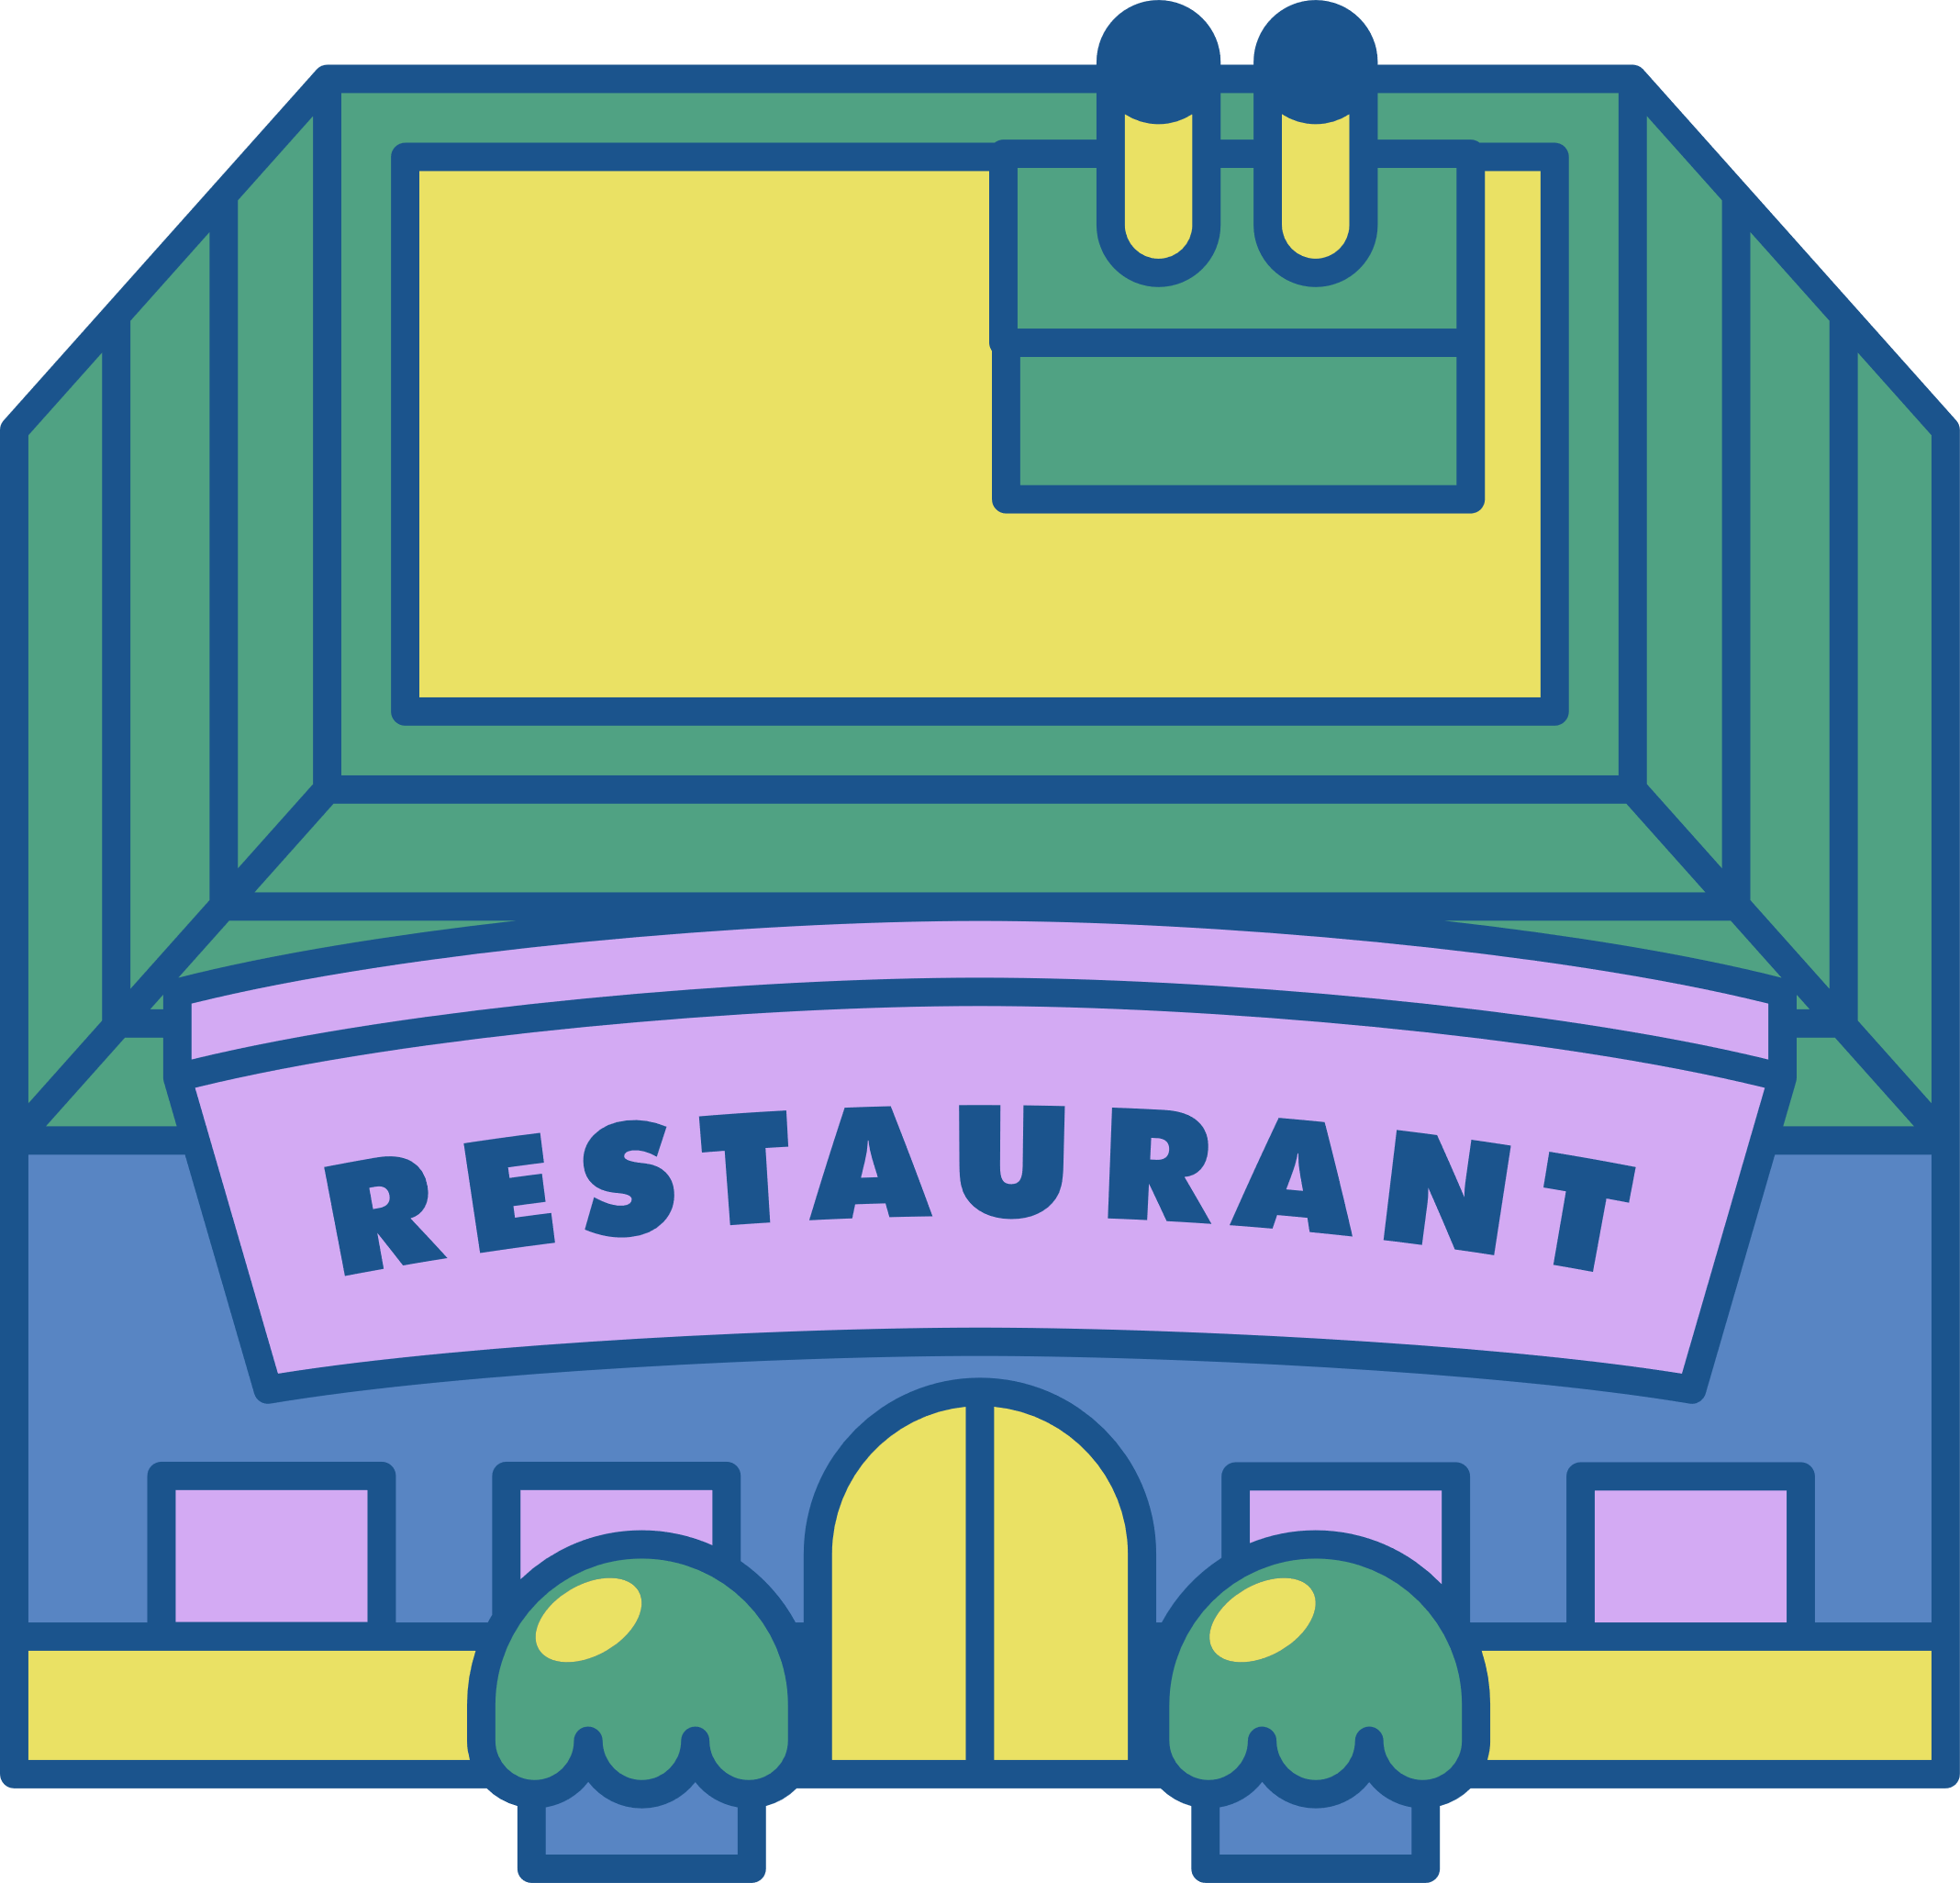
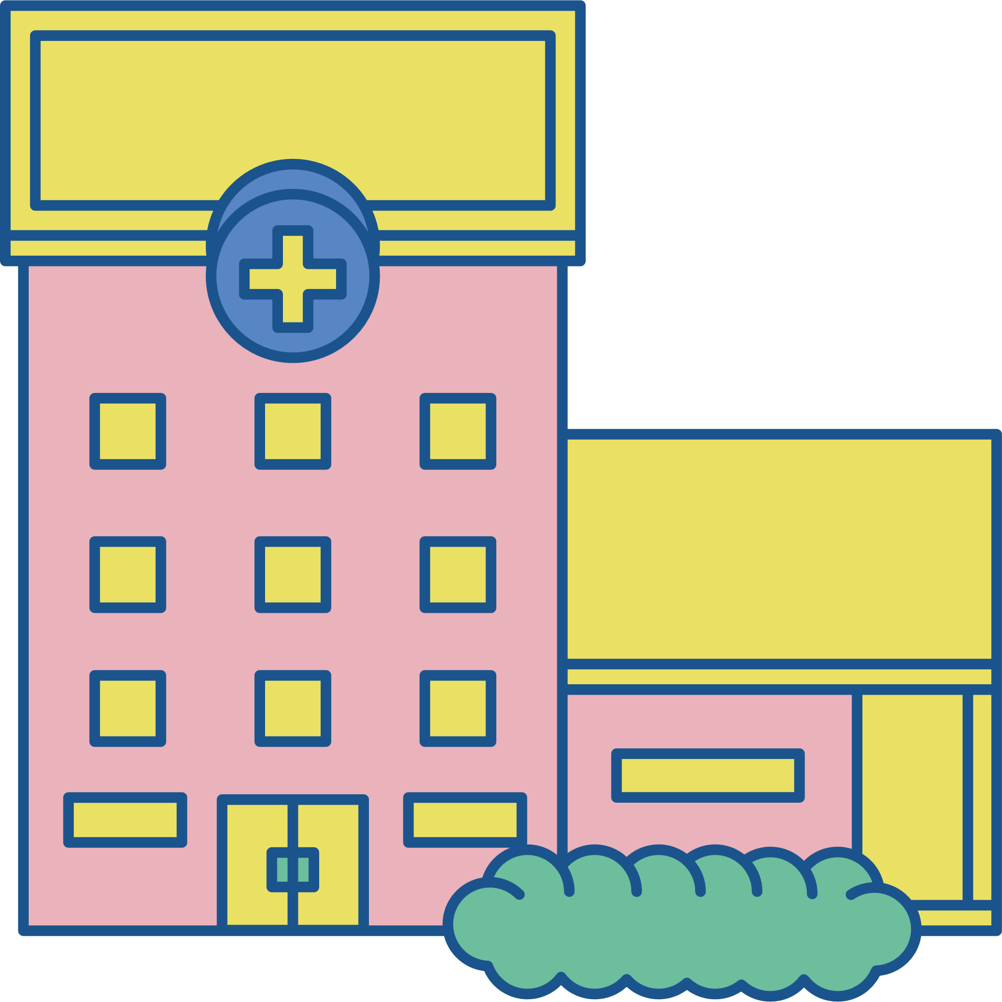
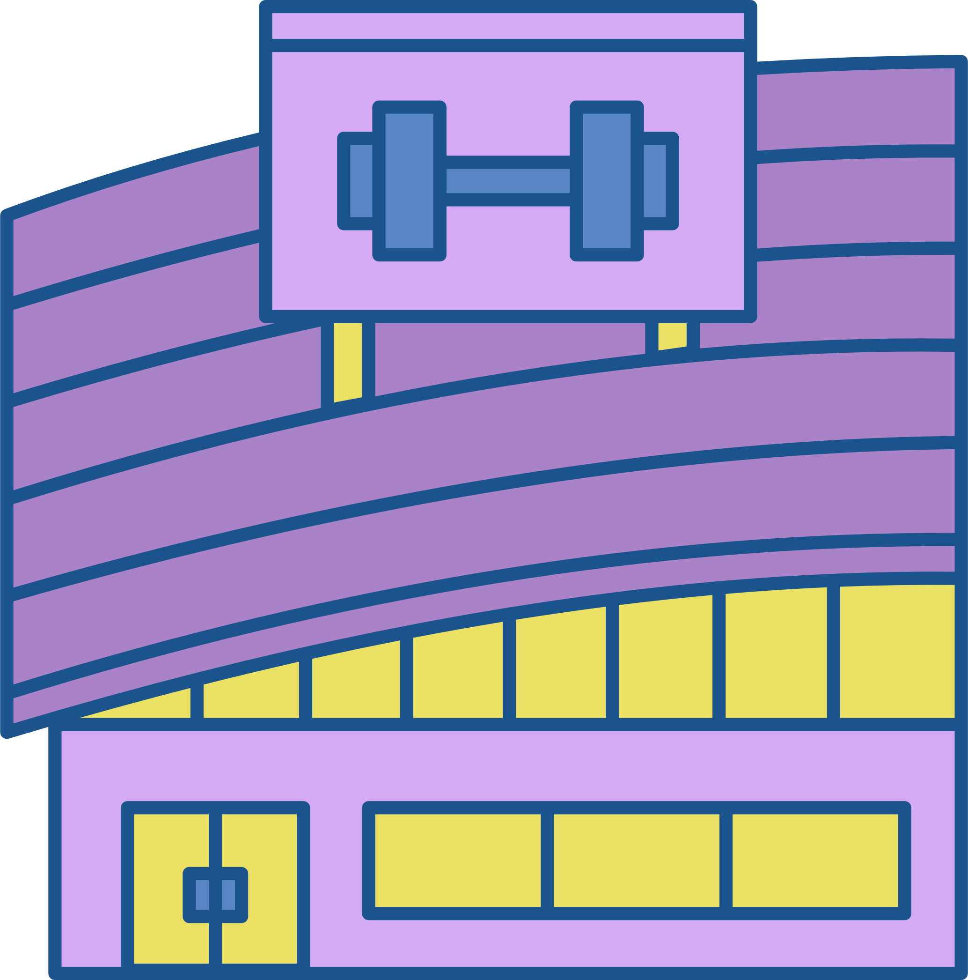

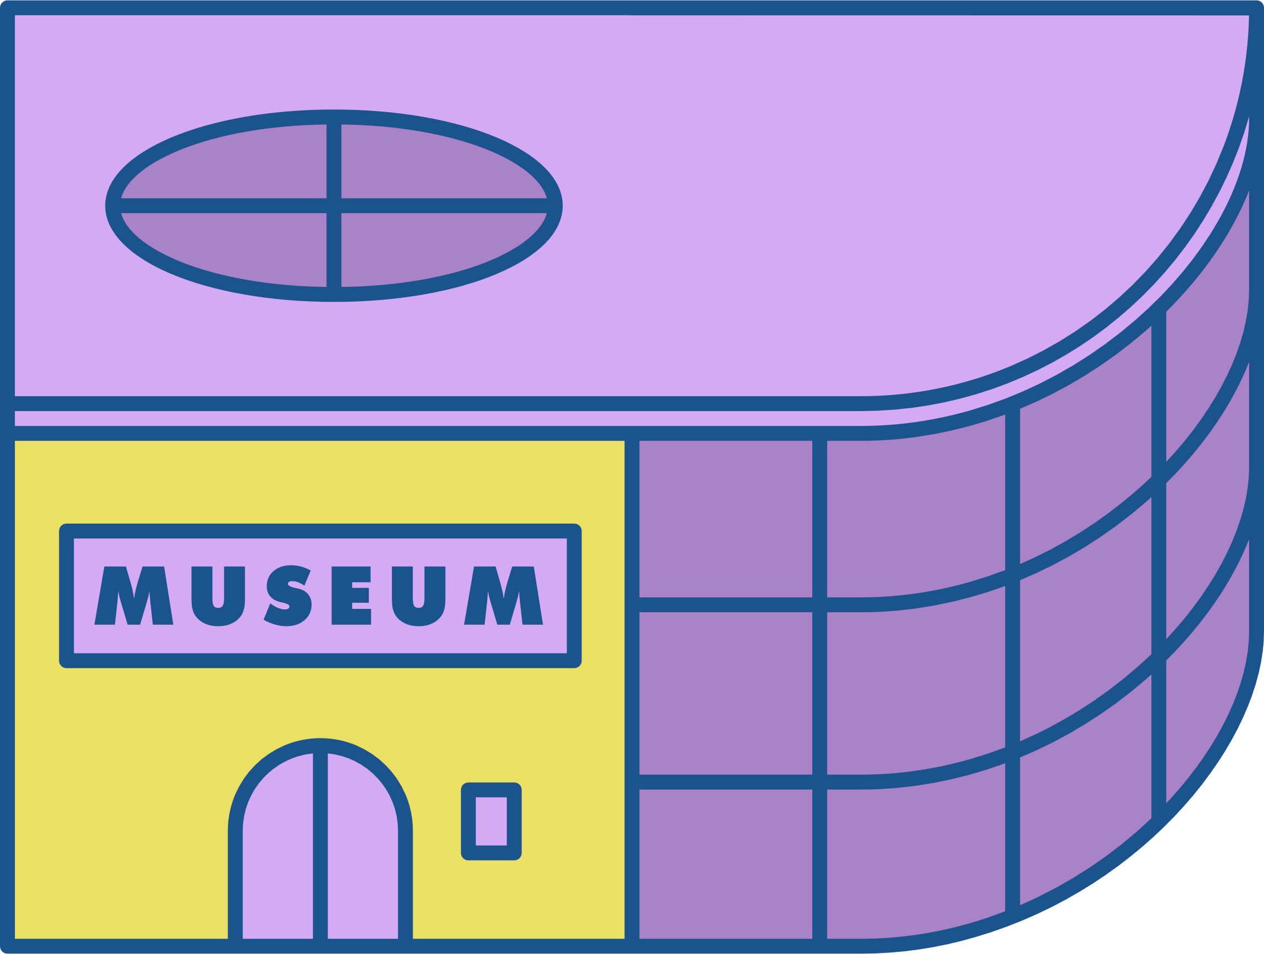


PART 1
How much have you learnt about prepositions of place?
First, look at the city map. What can you see?

Slide 10


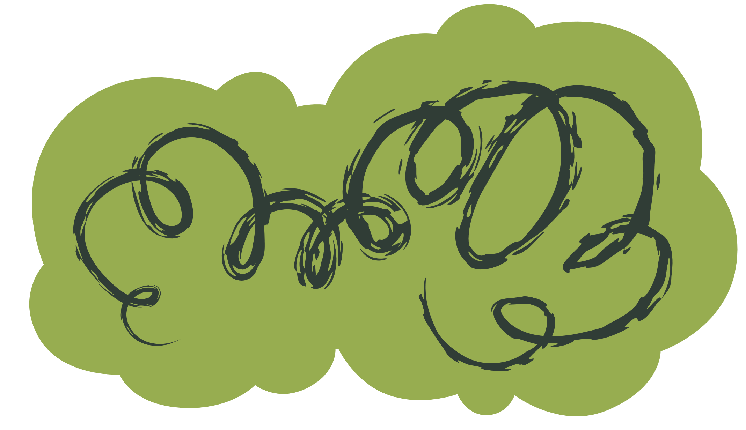
MULTIPLE CHOICE
Read the sentences and choose the correct option

Slide 11
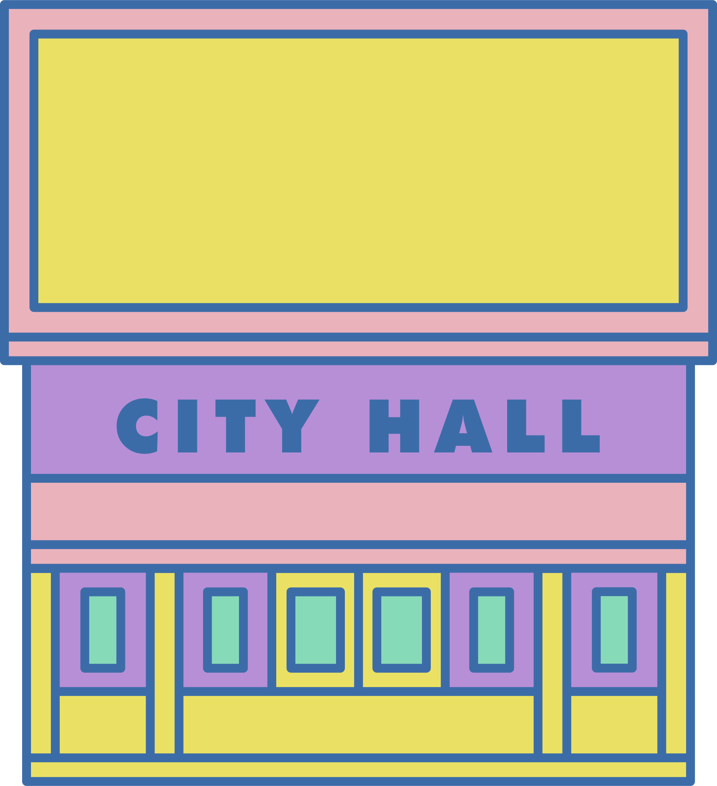



The car wash is ...................... the city hall
NEXT TO
OPPOSITE
BETWEEN

Slide 12

There is a tree ............................ the gym
IN FRONT OF
OPPOSITE
BETWEEN

Slide 13
There is a hospital ........................
the restaurant and the school
BETWEEN
OPPOSITE
NEXT TO

Slide 14
PART 2
TRUE OR FALSE
Read the sentences and decide whether they are true or false

Slide 15
The school is opposite the gym
TRUE
FALSE

Slide 16

The school is opposite the gym
TRUE
FALSE

Slide 17
The cafe is between the pet shop and the car wash
TRUE
FALSE

Slide 18

The
pet shop
is between the
cafe
and the
car wash
TRUE
FALSE

Slide 19



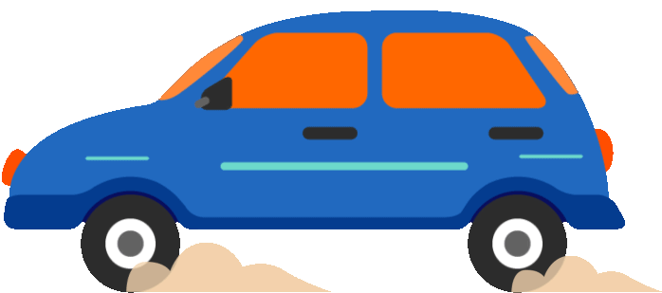


PART 3
Asking and giving directions

Slide 20





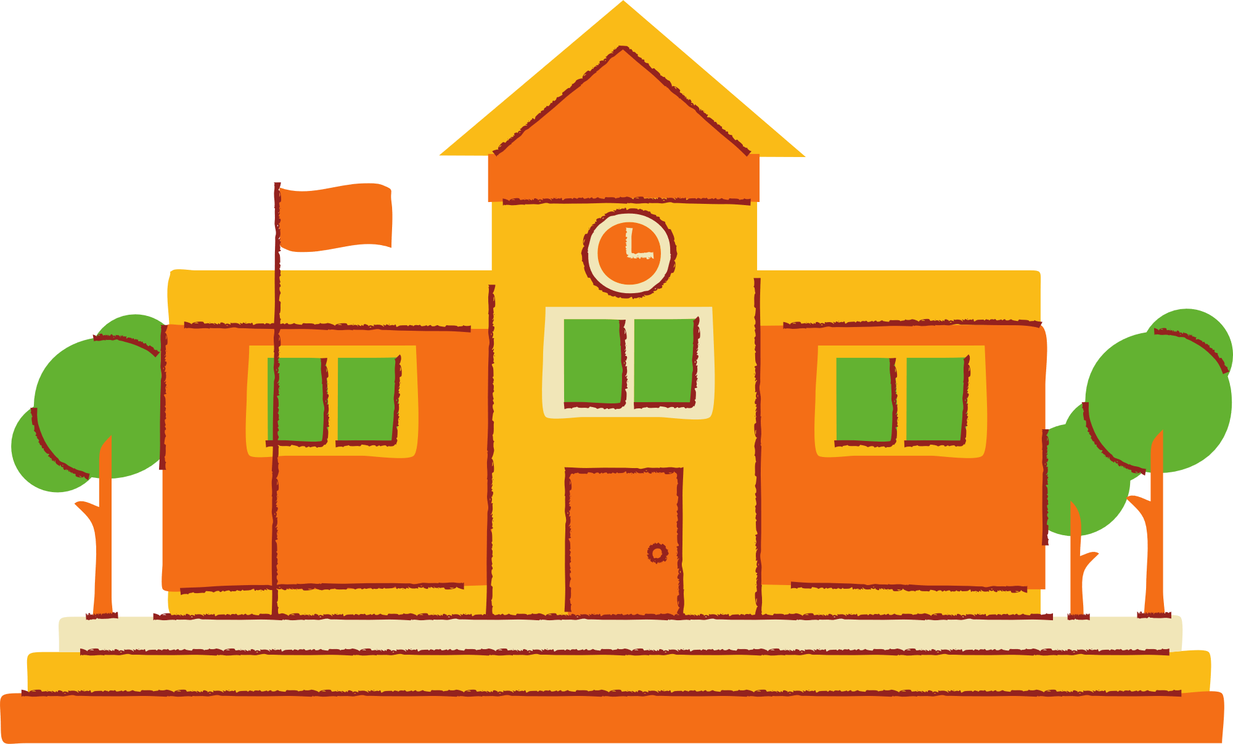

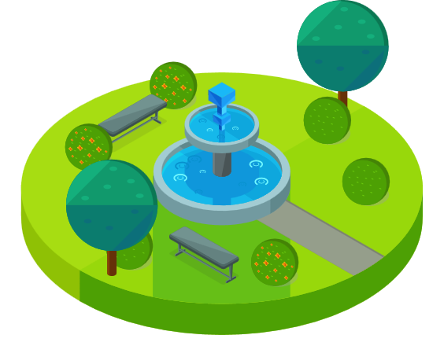



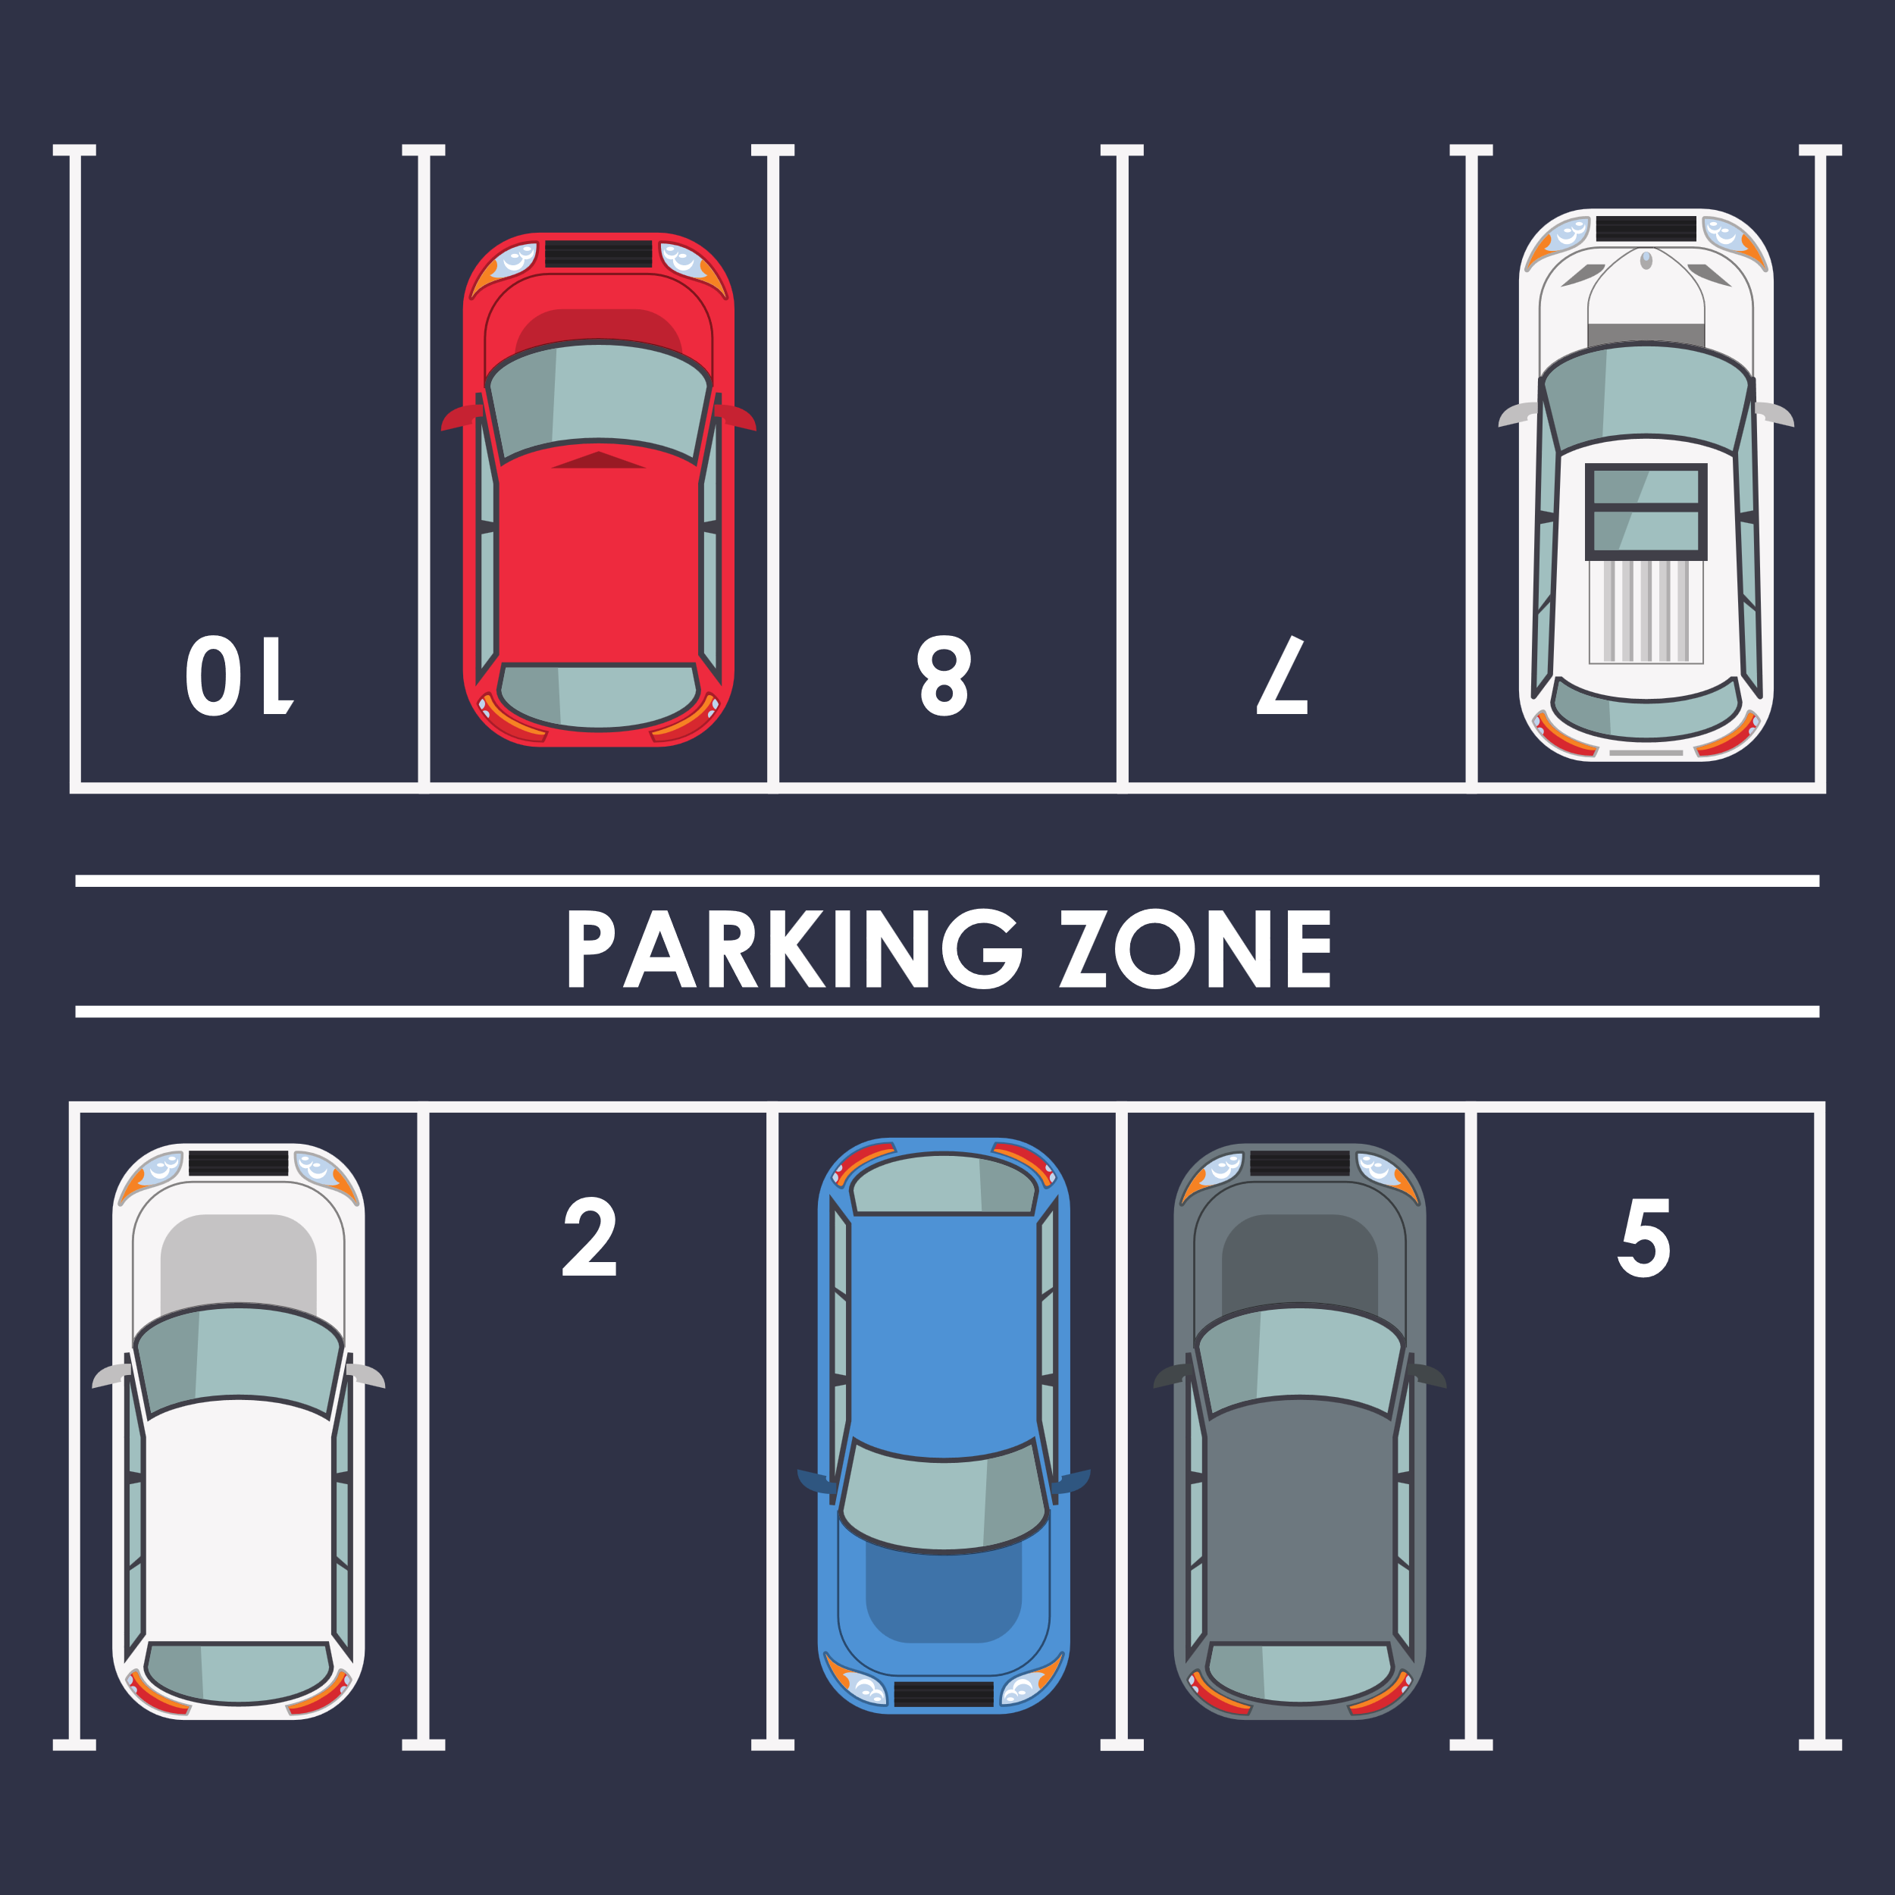
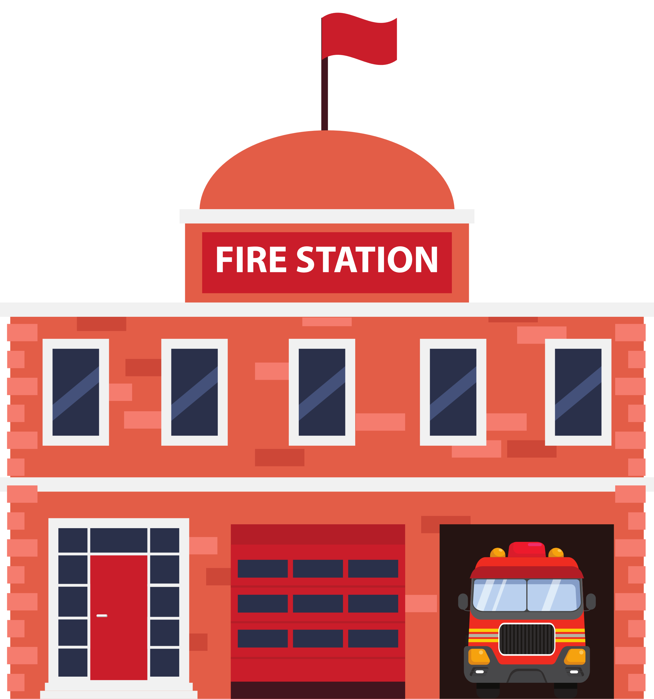
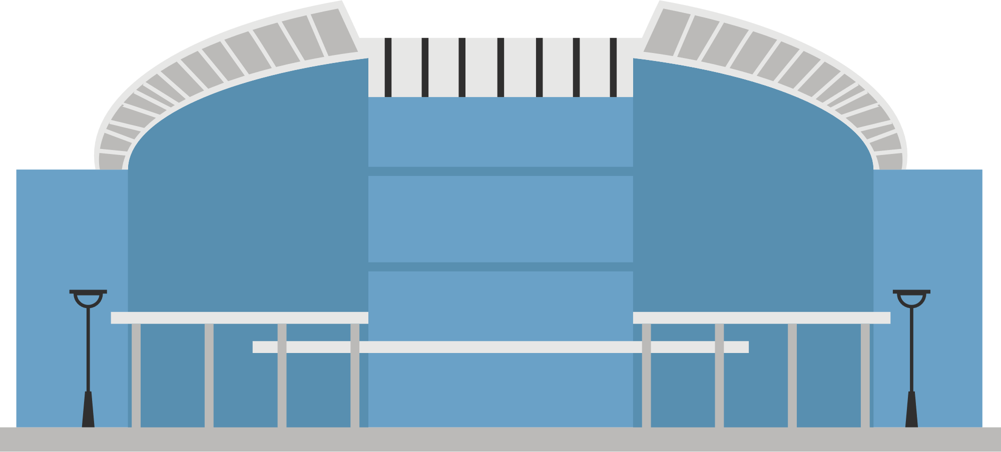
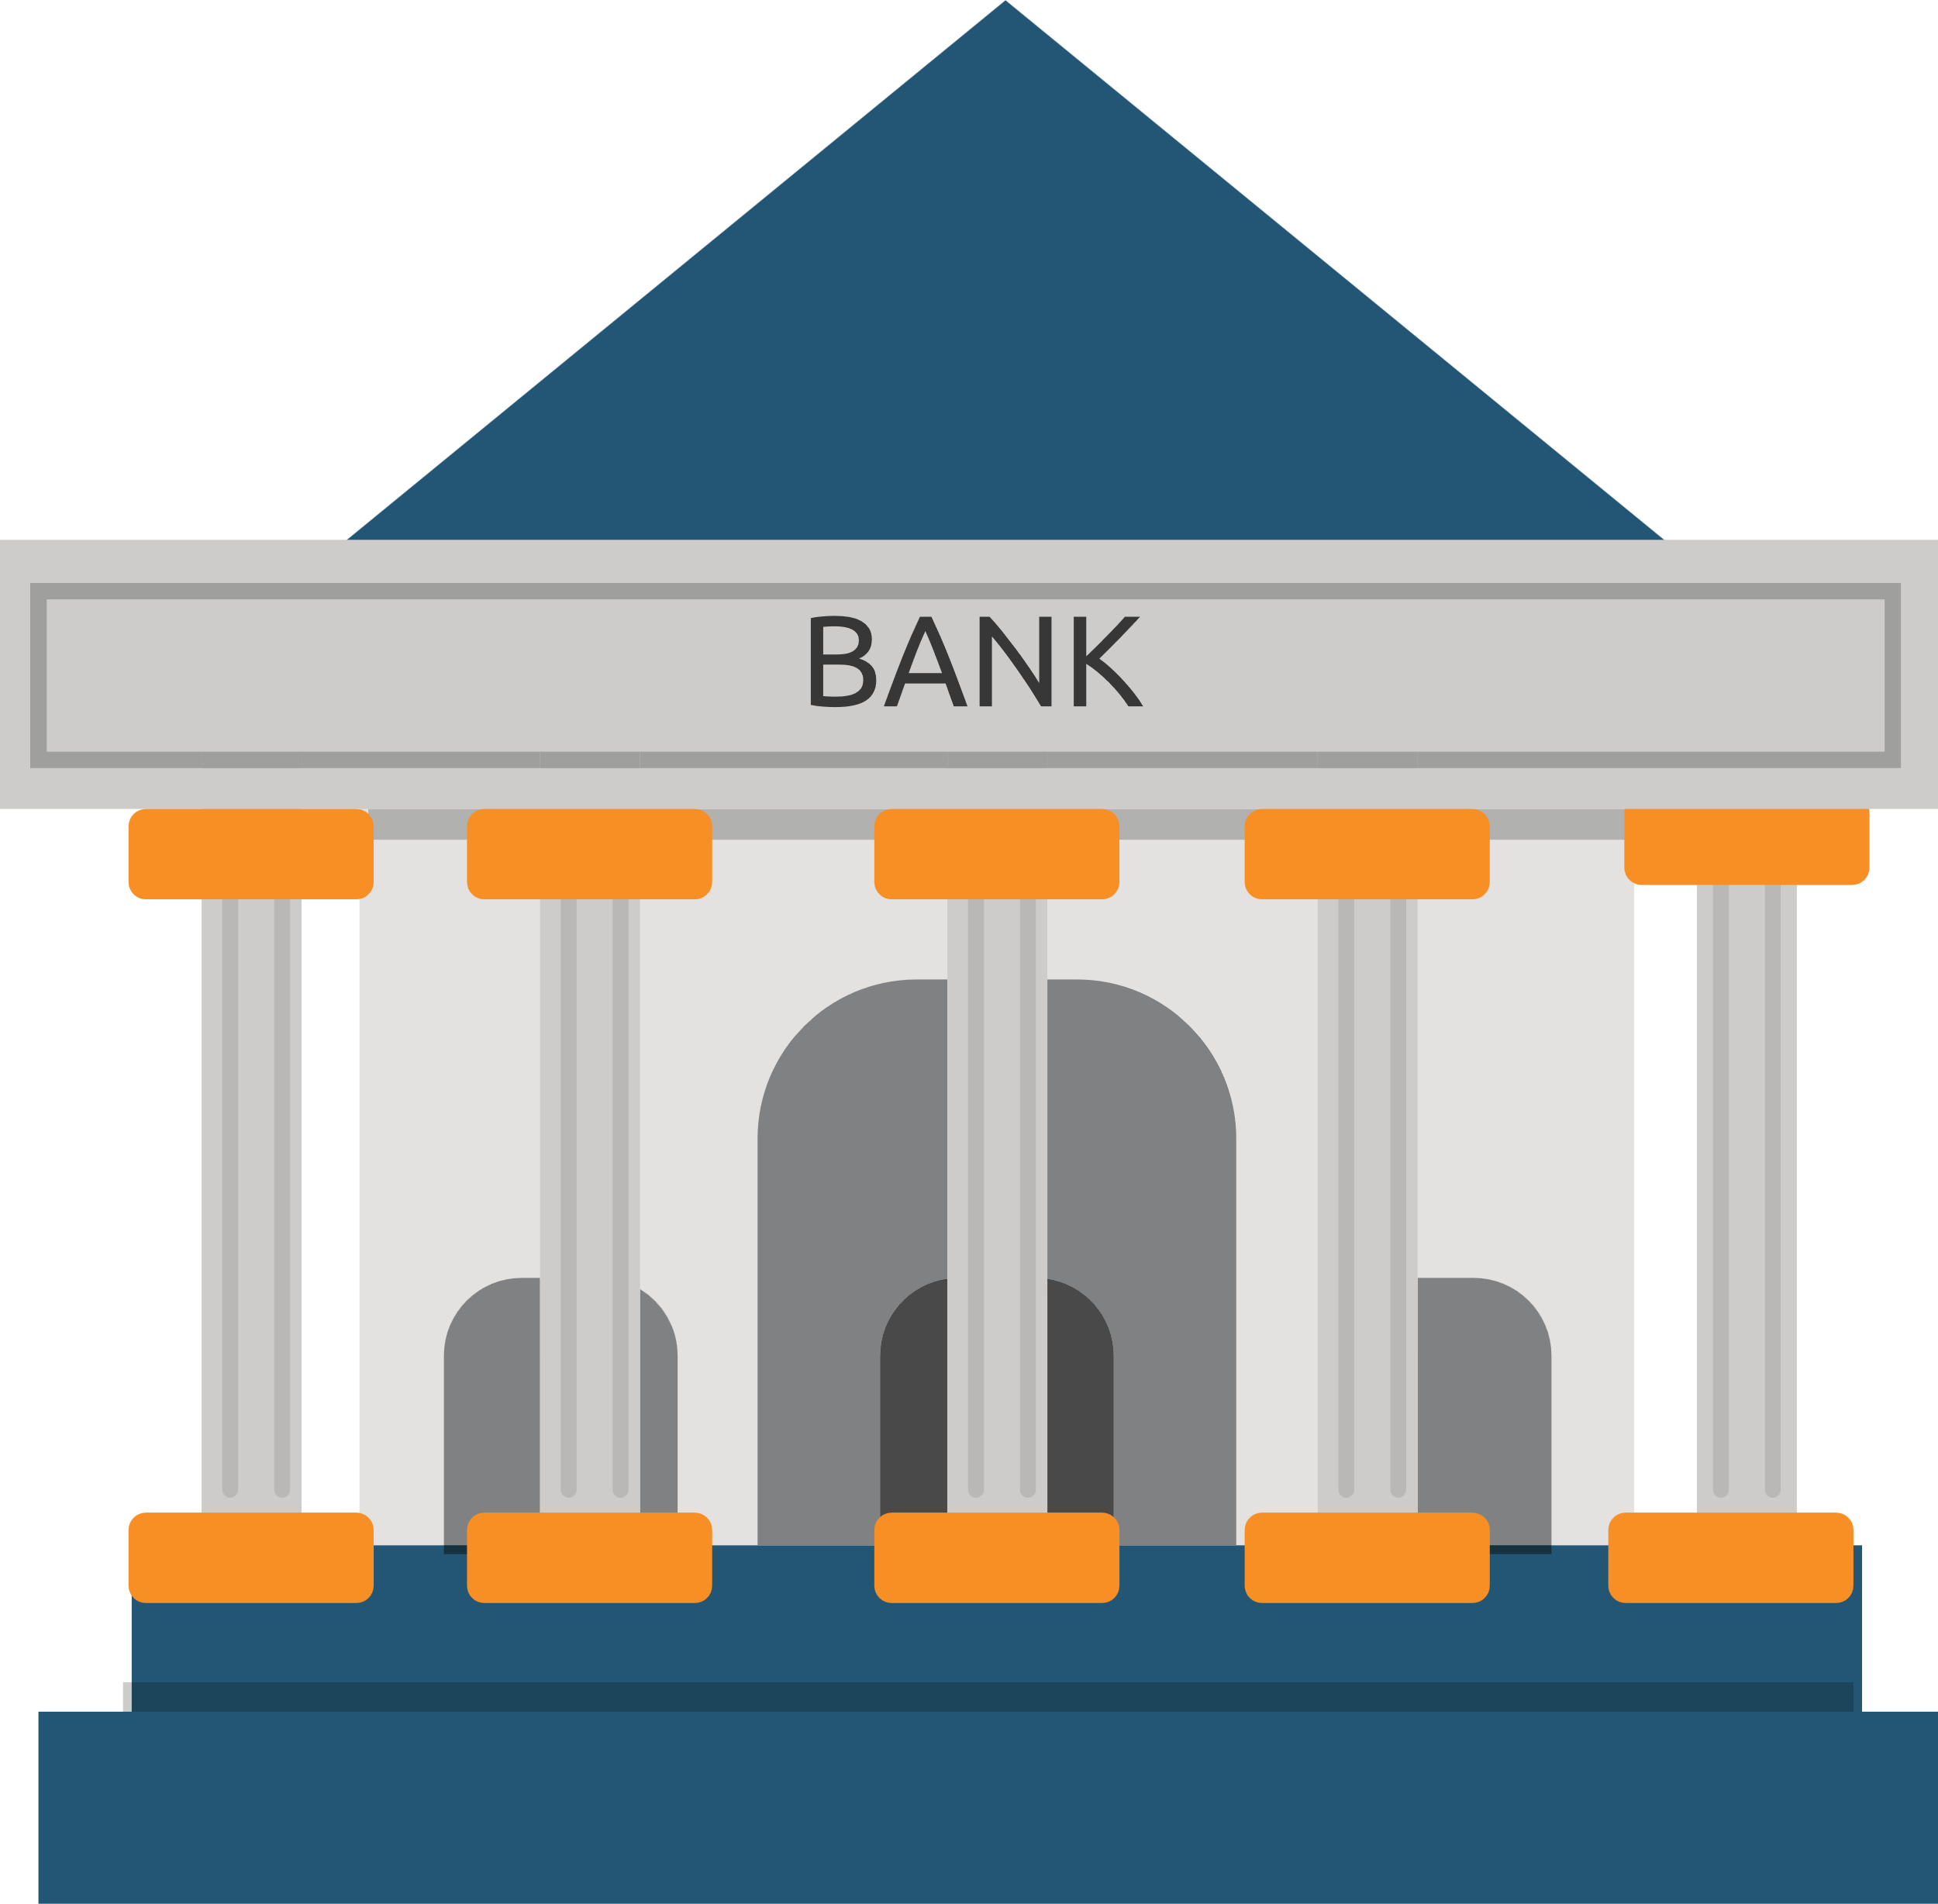
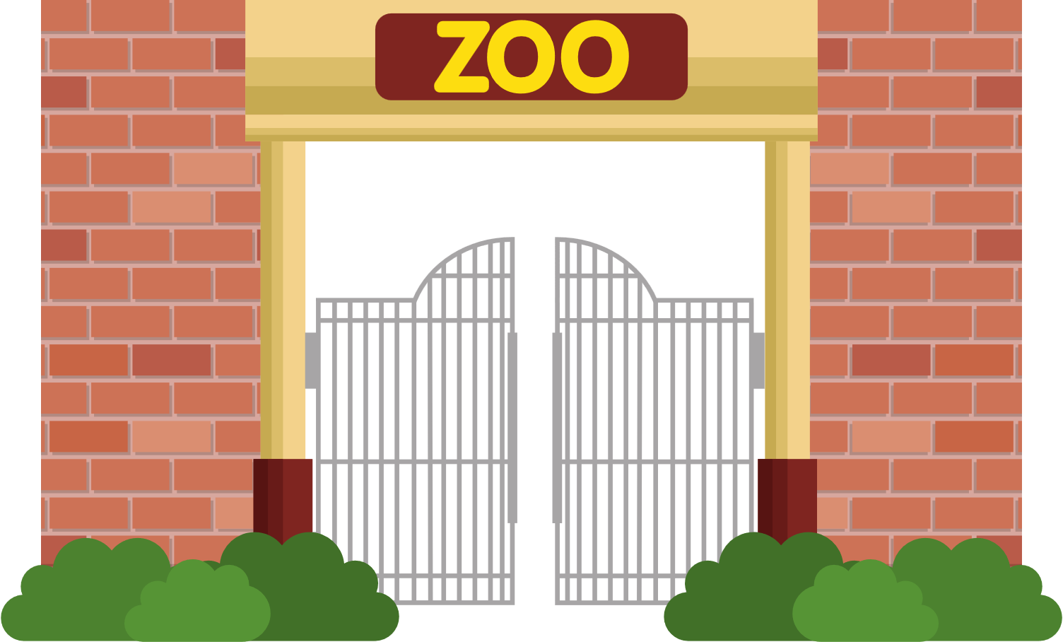
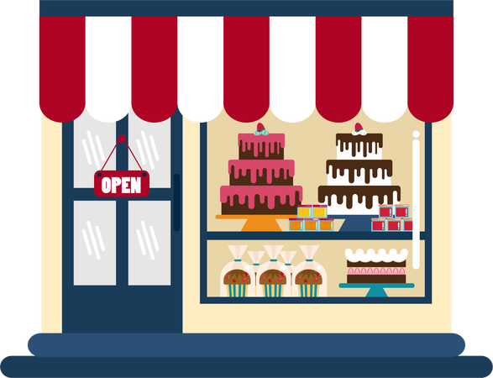
Where is museum?
Go straight and then
turn right . It’s behind the fountain.

Slide 21


Where is the bank ?
Go straight and then
turn left . It’s next to the library.

Slide 22
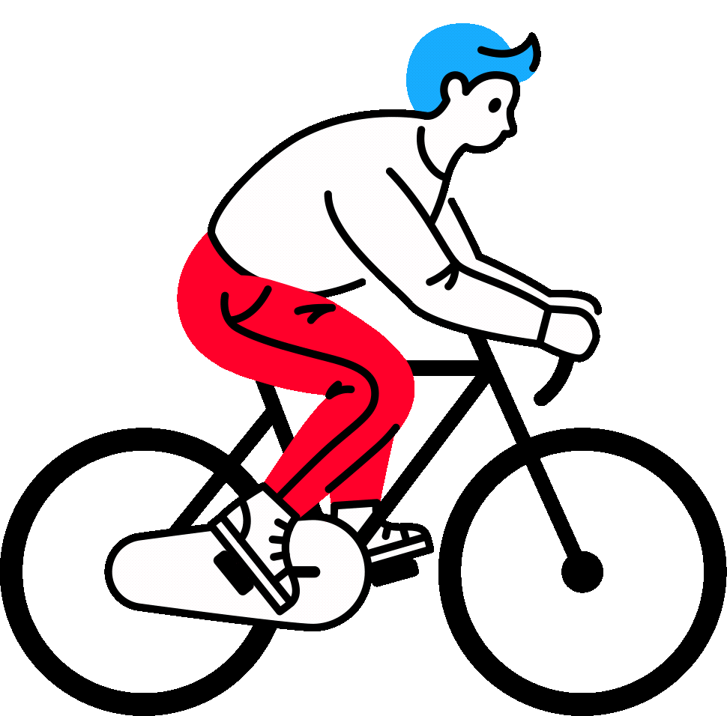
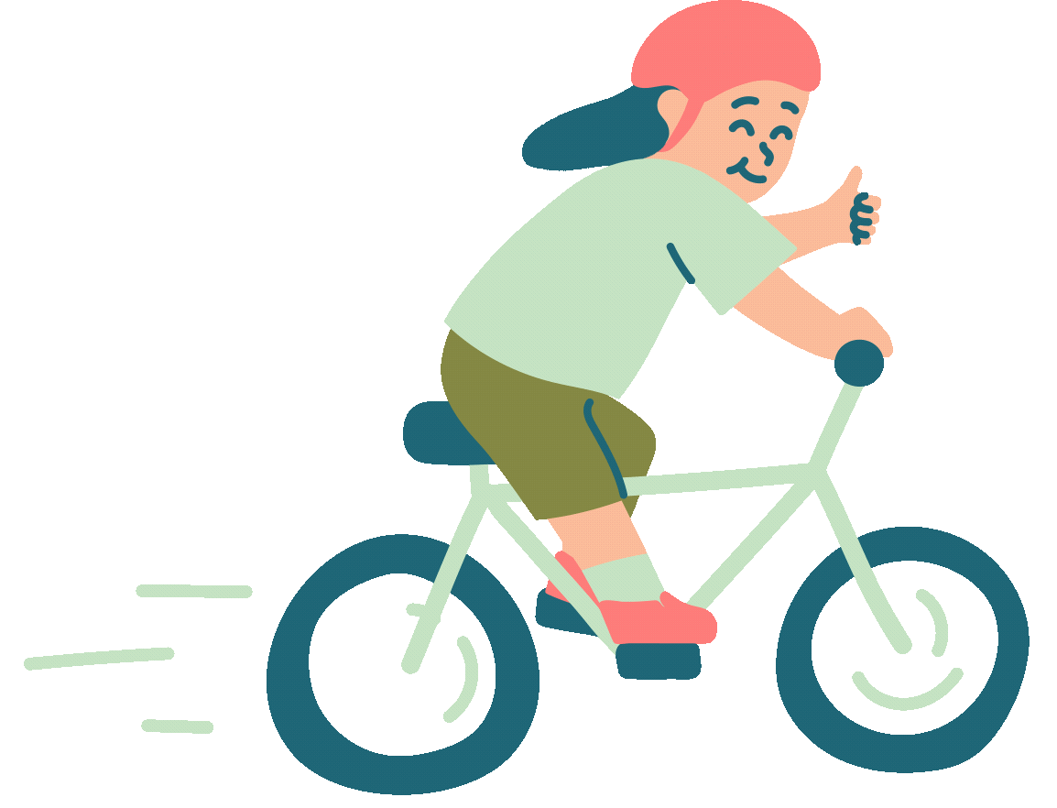
Where is the zoo ?
Go straight and then
turn right . It’s behind the Parking Zone.

Slide 23
Where is the library ?
Go straight and then
turn right . It’s behind the toy shop.

Slide 24





Giving directions
Go straight
Next to
Turn left
Between
Turn right
In front of

Slide 25
4
Production

Slide 26
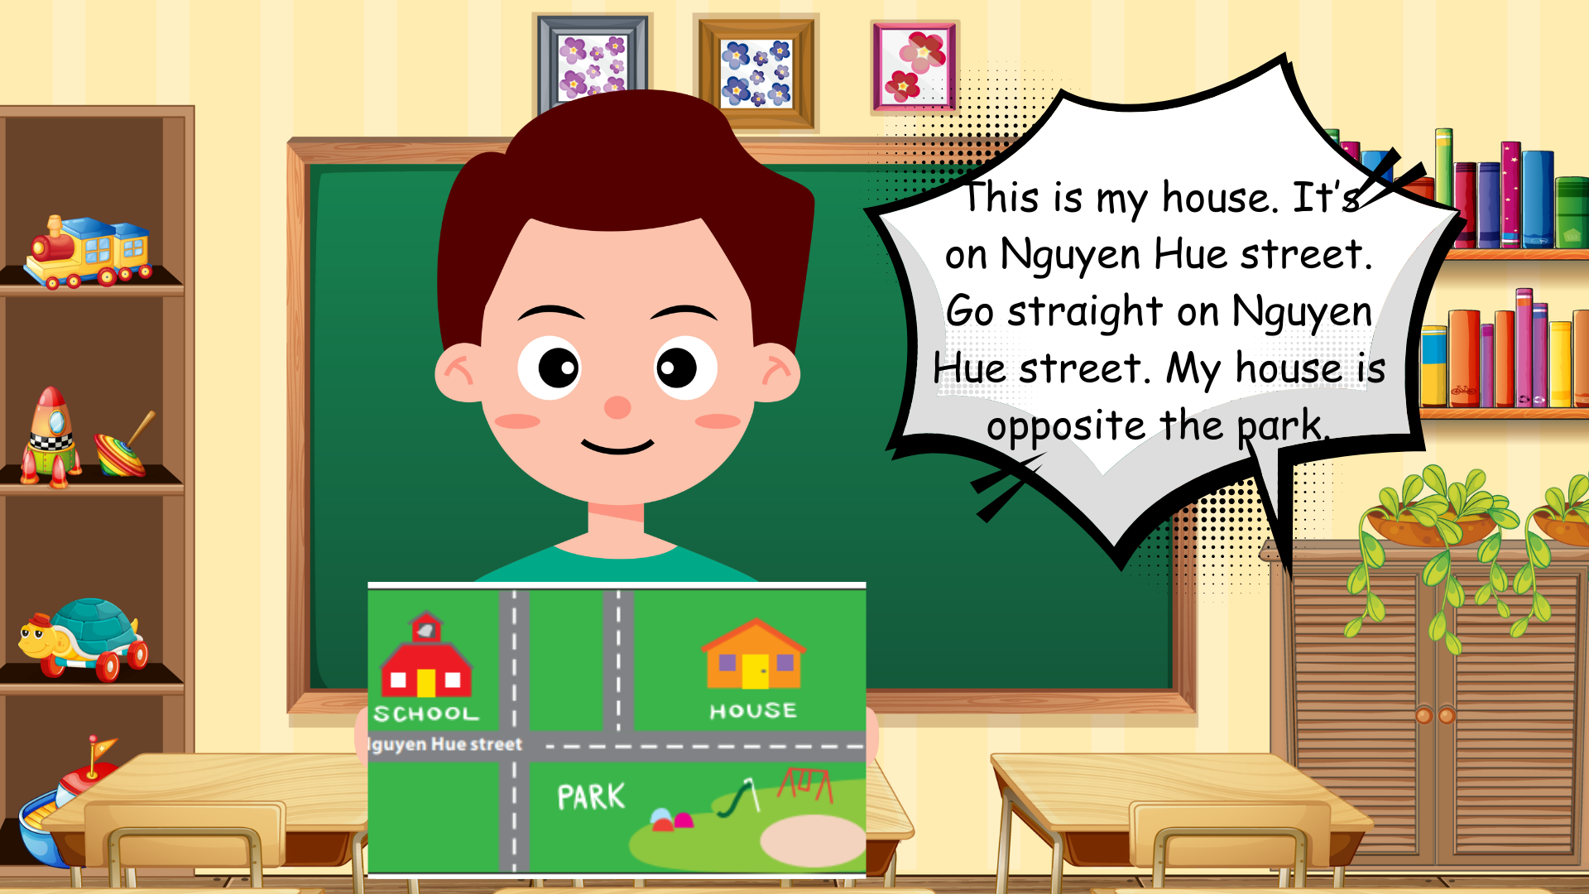
Draw and write. Say

Slide 27
5
Assessment

Slide 28
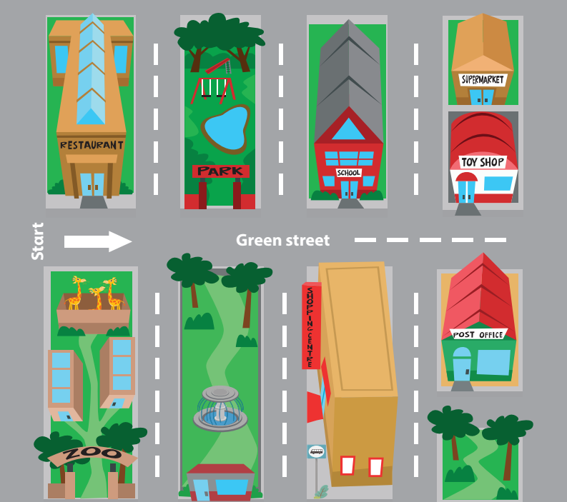
Fill the words
1. Go straight on Green Street, pass the school. Turn left . The supermarket is ……………. the toy shop .
behind
2. Go straight on Green Street. Pass the fountain. Turn ………………….. The bus stop is behind the shopping centre.
right

Slide 29
Review Vocabulary Cross the road, go straight, Turn left, turn right
Wrap Up
How do we go to the cinema?
- Go straight on High Street and then turn right. The cinema is opposite the pool.

Slide 30
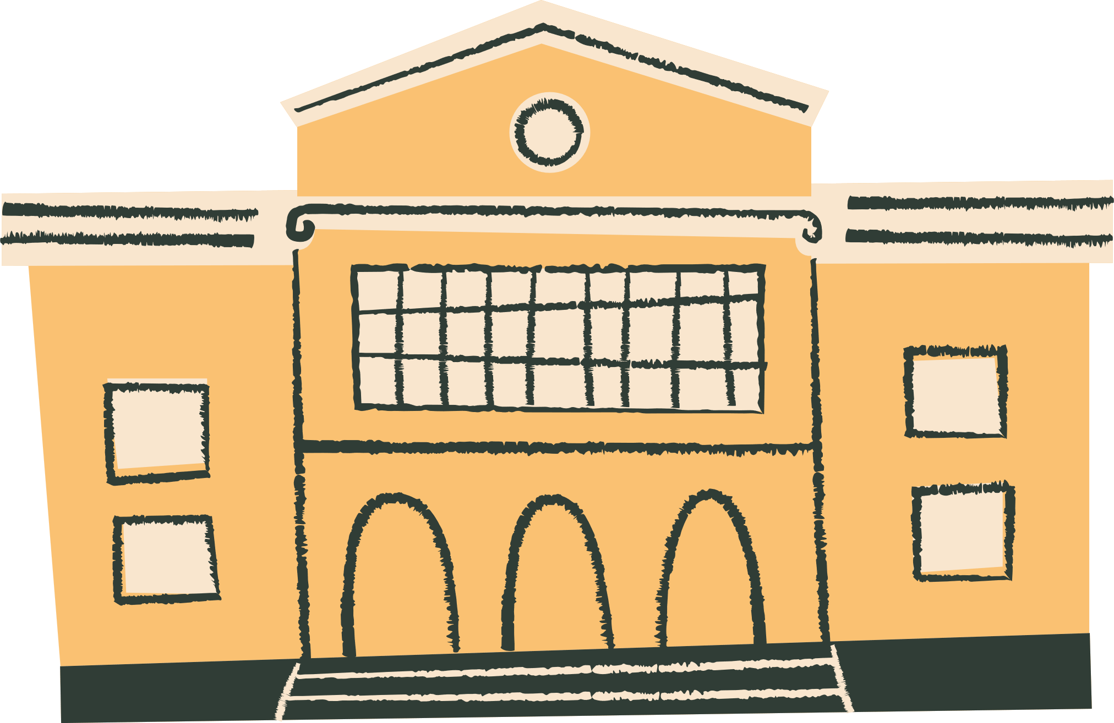



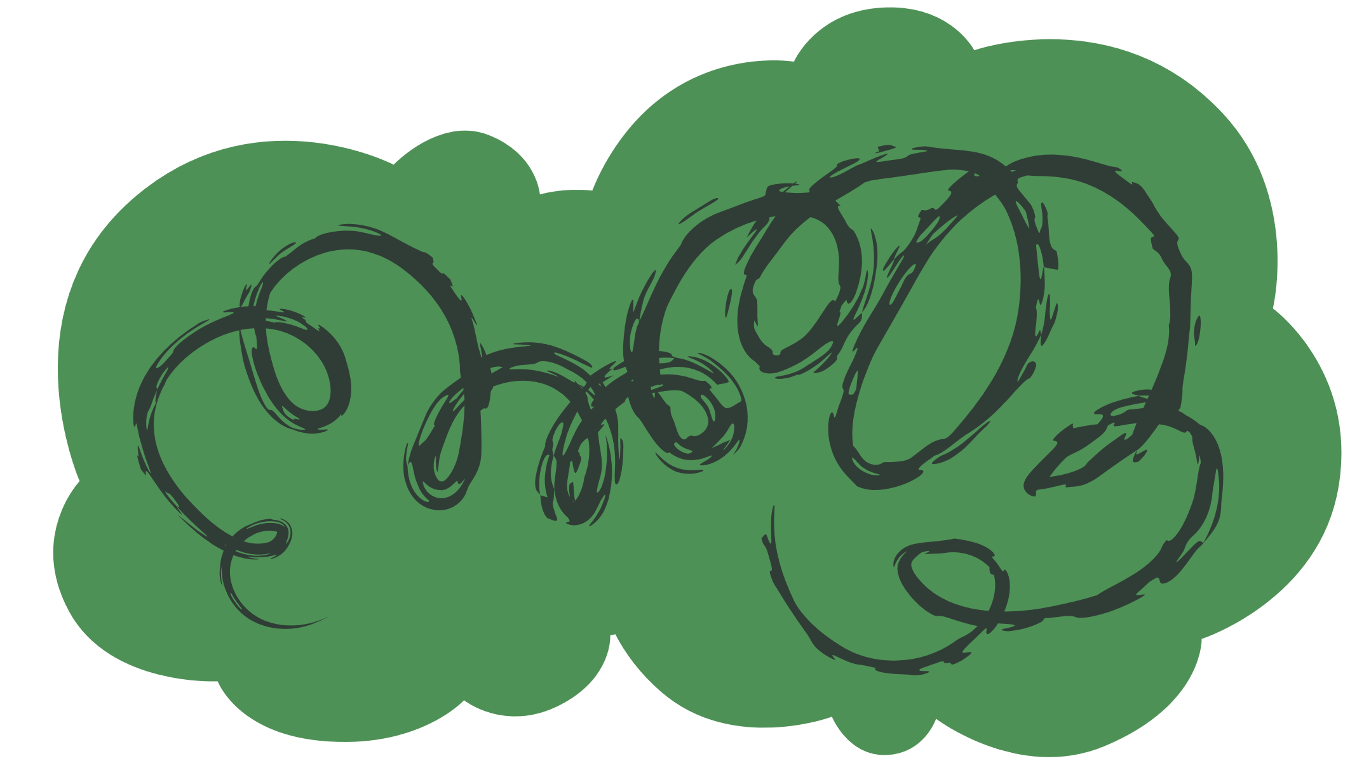
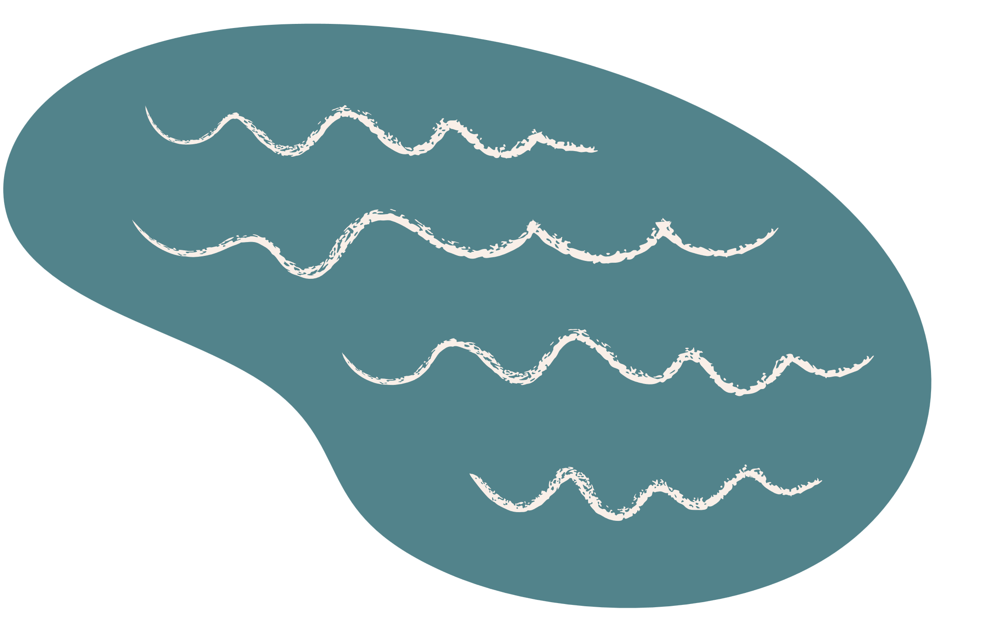

Thank You!

