Slide 1






















Notes:
Để nguyên trang bìa như này, chỉ thay đổi tên bài trong quá trình làm. Logo của sách Wonderful World

Slide 2






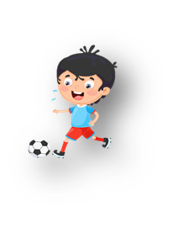




Unit 10: On holiday
Lesson 1: Task 1, 2, 3

Slide 3

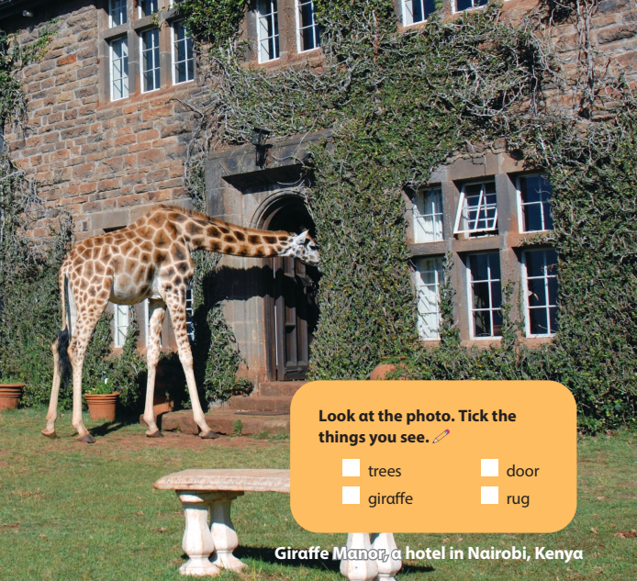
✓
✓
✓

Slide 4


2. Presentation

Slide 5

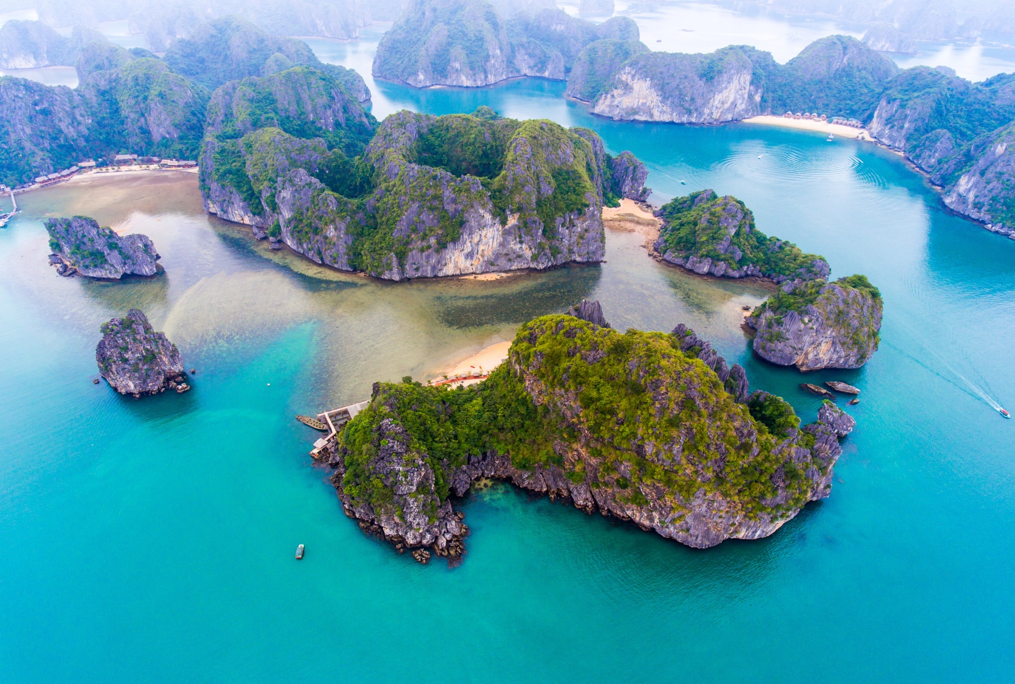
bay

Slide 6
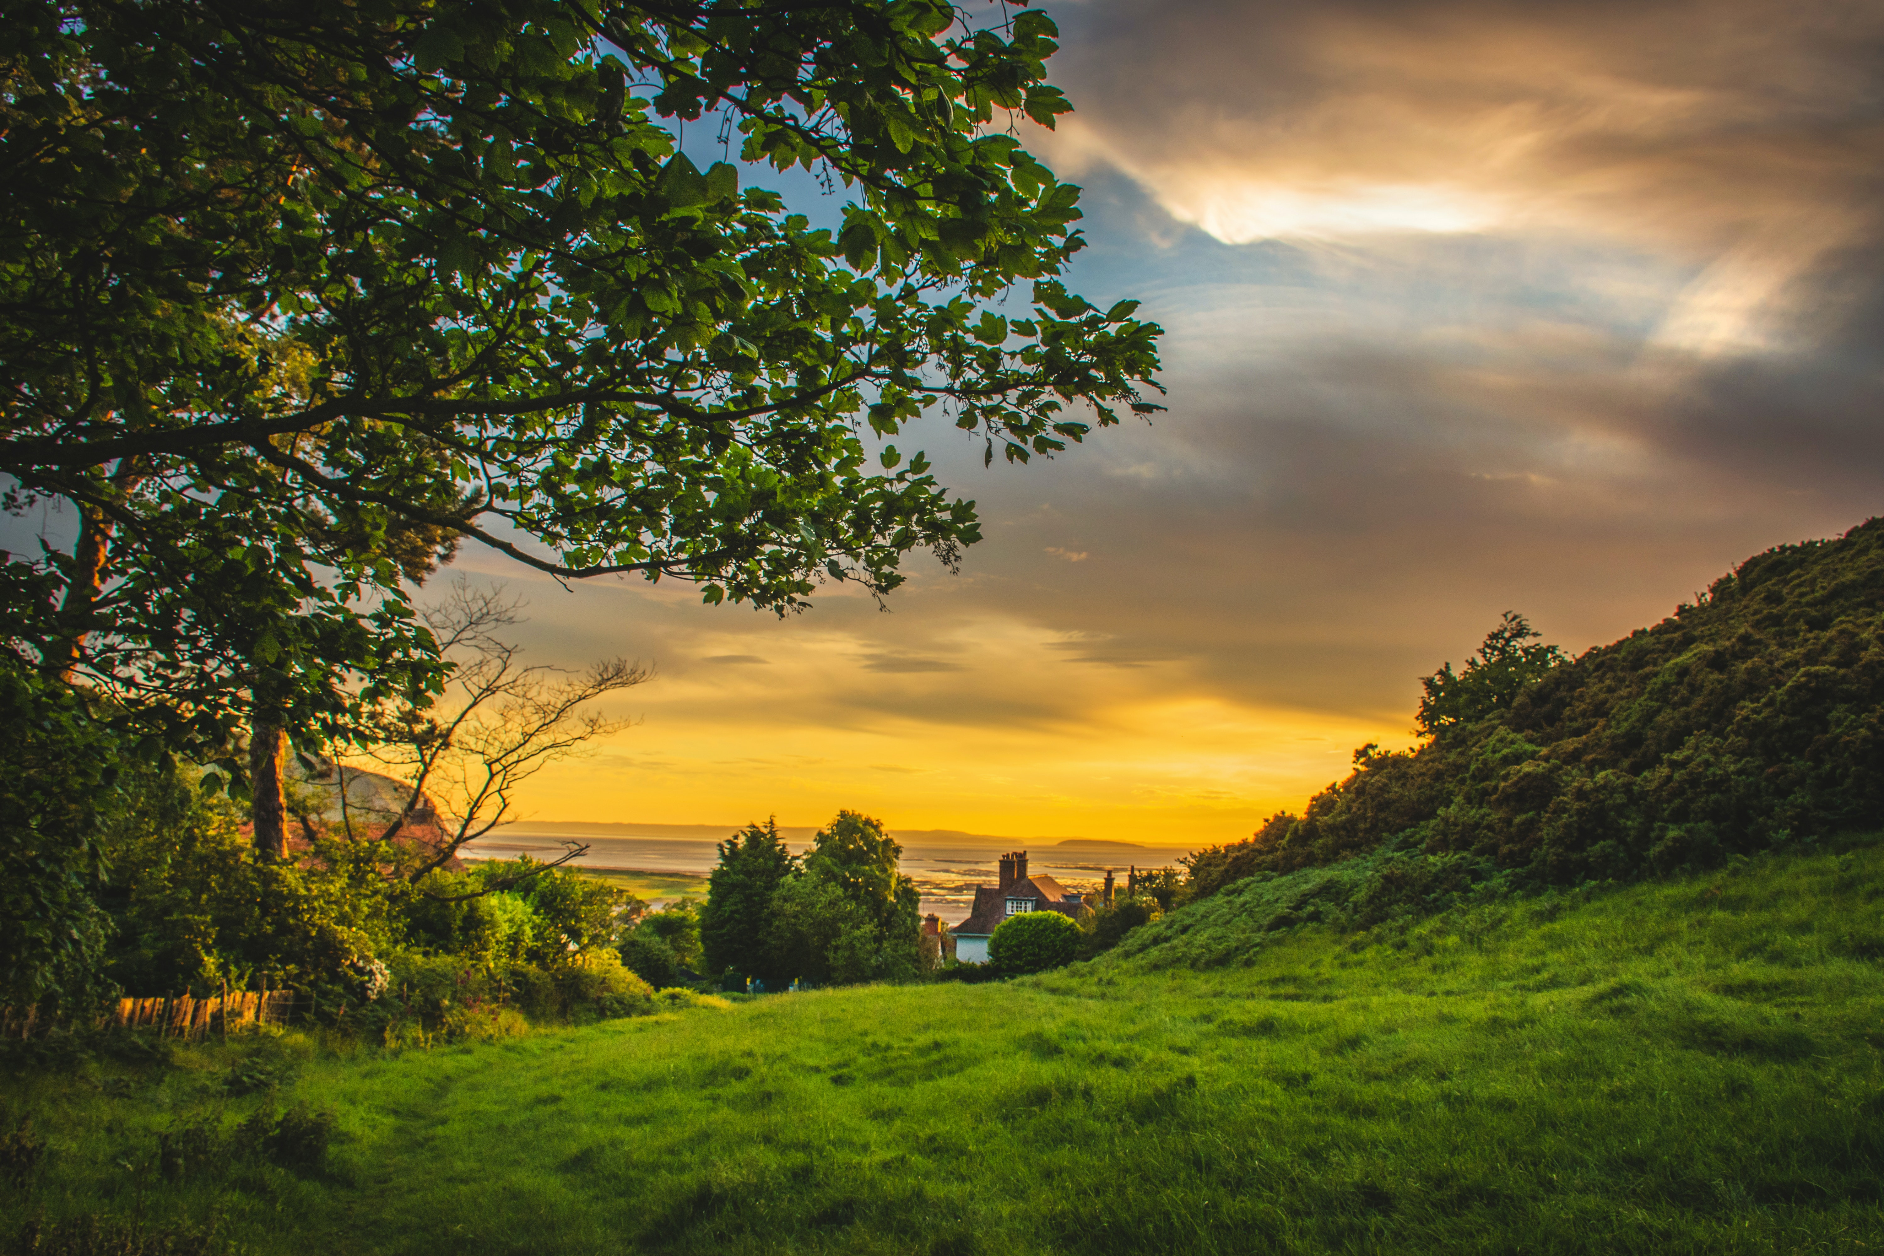
hill

Slide 7
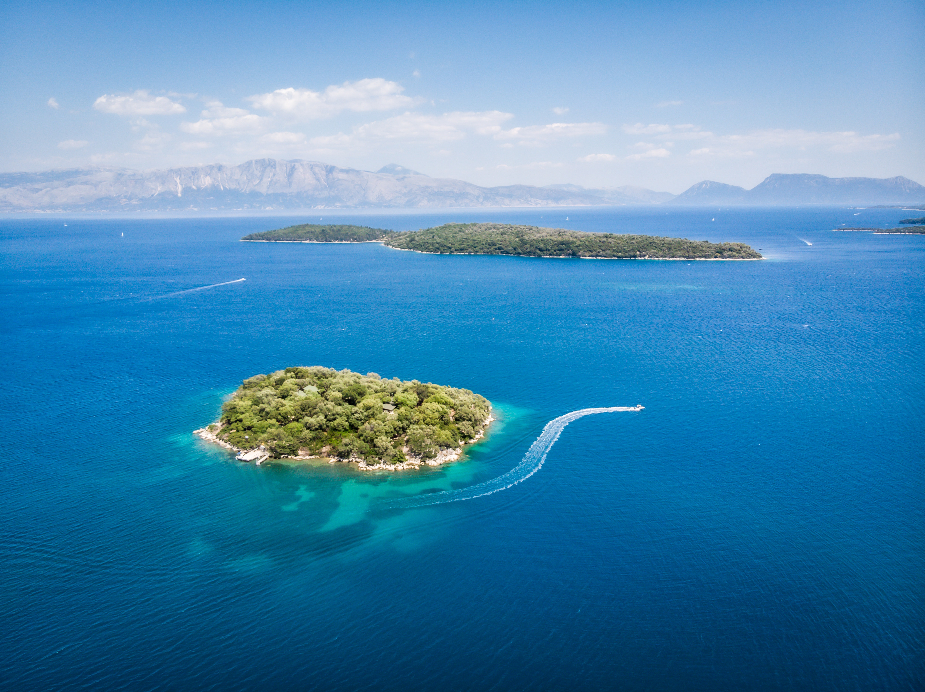

island

Slide 8
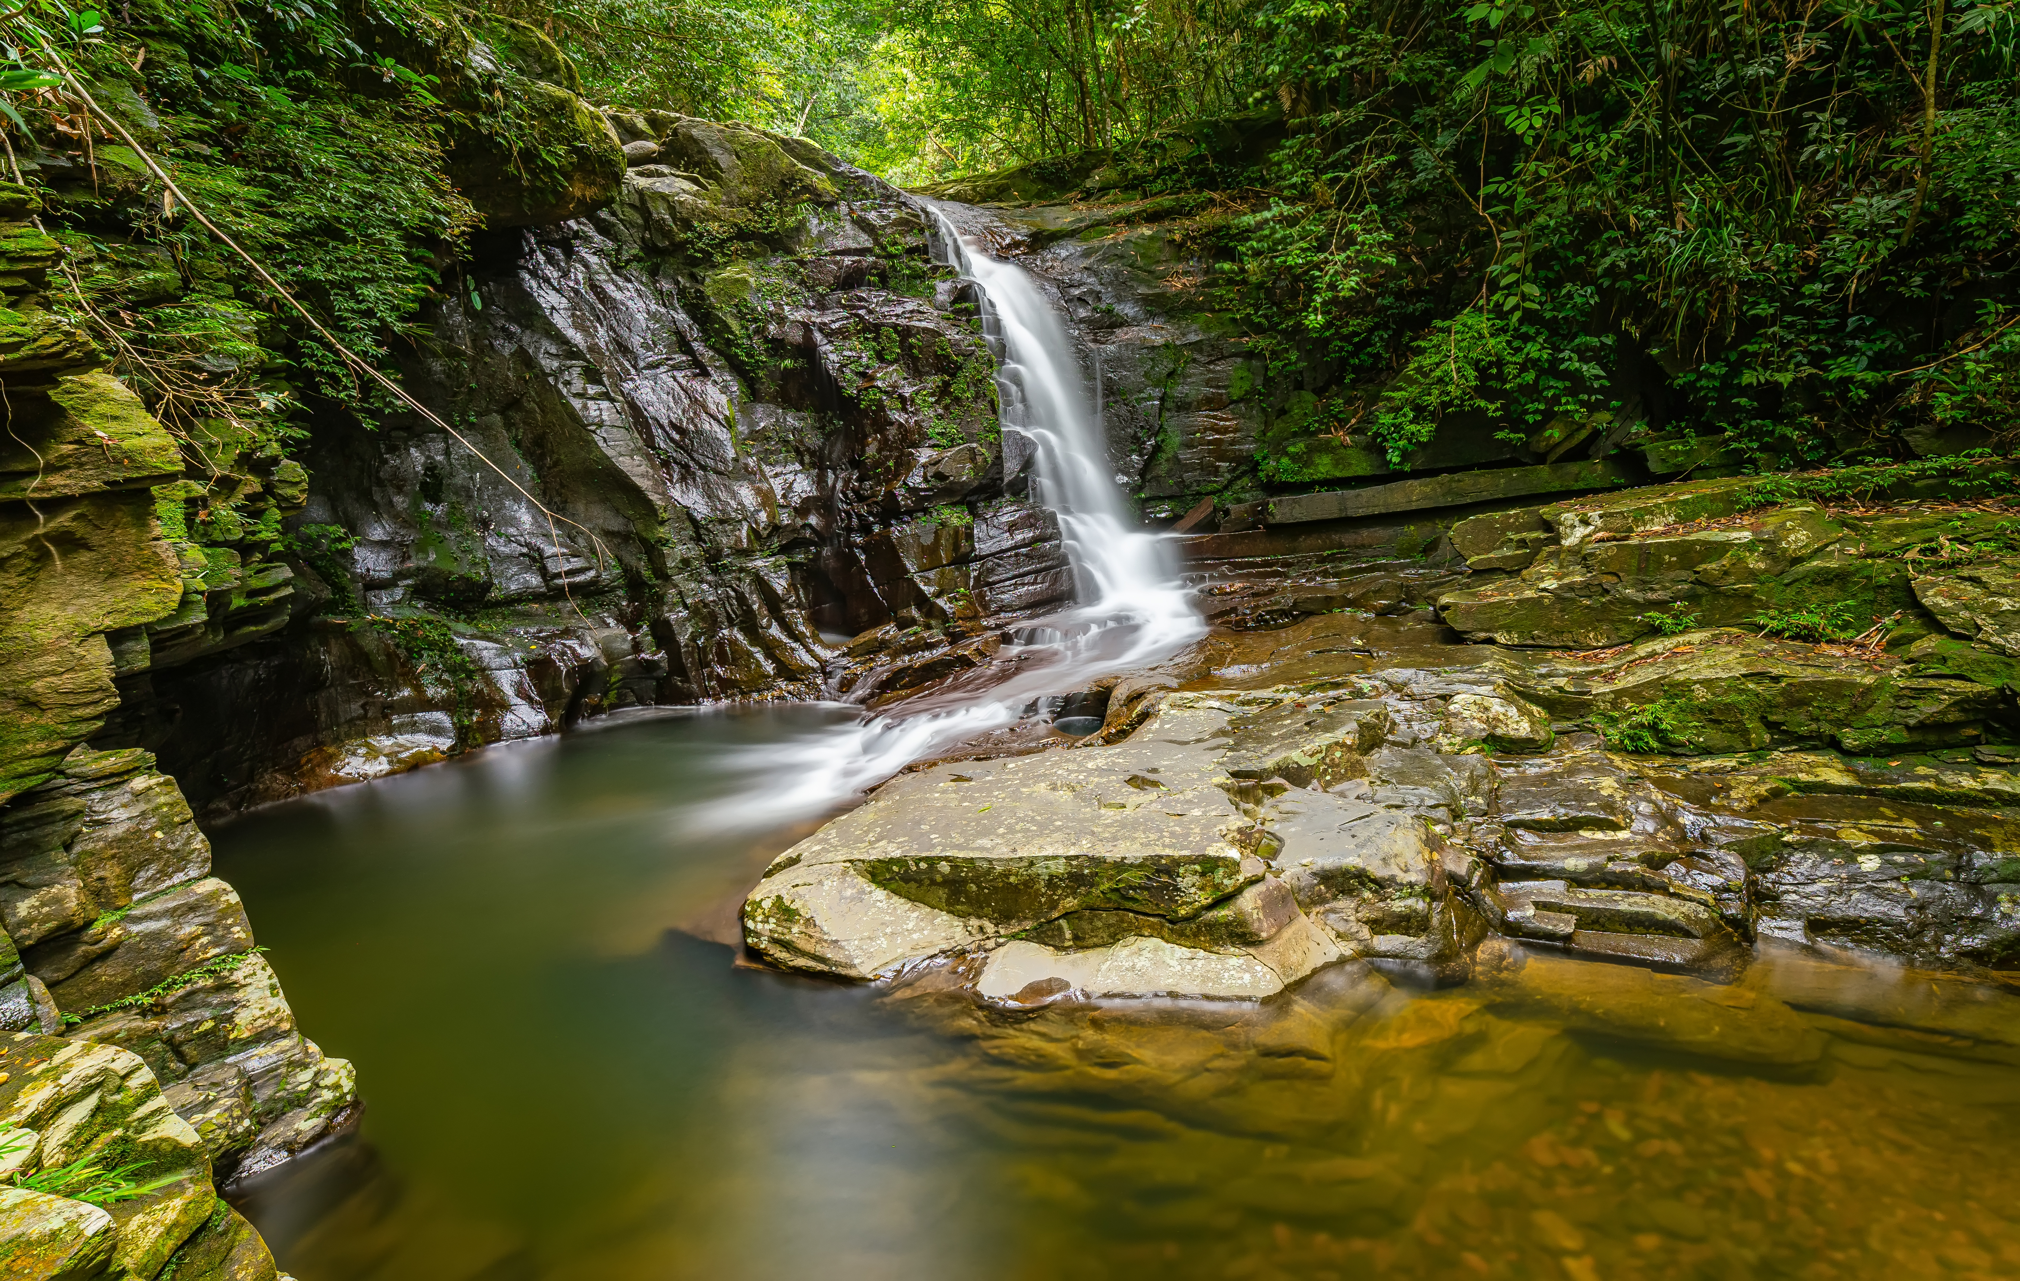
national park

Slide 9






1. Listen and point. Repeat. TR.10.1
bay
hill
island
national park

Slide 10

3. Practice

Slide 11
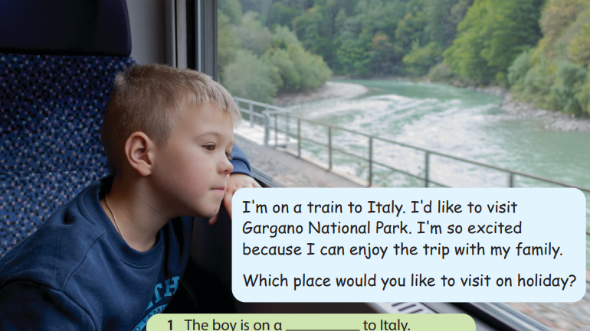
2. Listen and read. Write. Tr.10.2
The boy is on a ___________ to Italy.
He’d like to visit ______________
train
Gargano National Park.

Slide 12
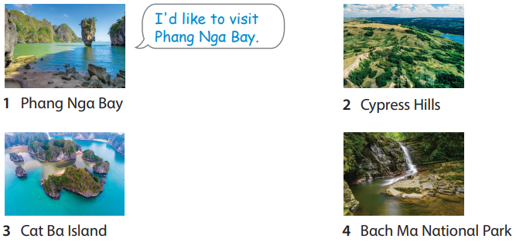
3. Look and say.

Slide 13
4. Production

Slide 14



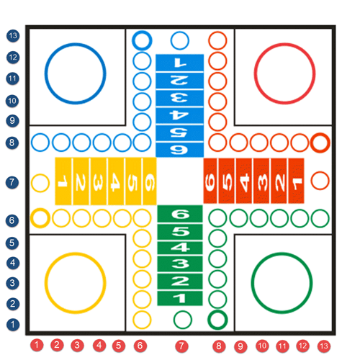




1
1
2
2
3
4
1
2
2
1
5
6
2
7
8
1
Next

Slide 15
Back
a
national park
b
hill
c
bay

Slide 16



5
Assessment

Slide 17

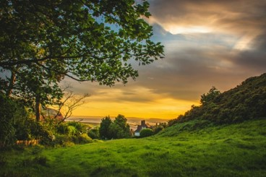
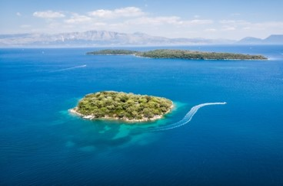
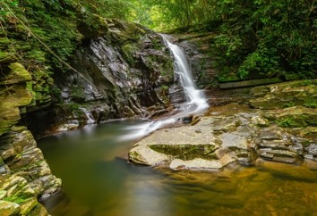
Look and match.
1
2
3
4
hill
island
bay
national
park

Slide 18
UNIT 10: On holiday
LESSON 1 – Task 1, 2, 3
What we learnt today
Vocabulary: bay, hill, island, national park.
Structure: I’d like to visit……………………

Slide 19






