Slide 1









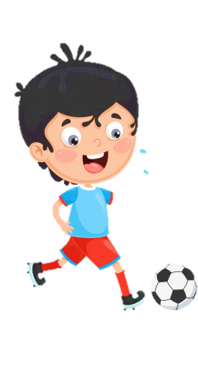
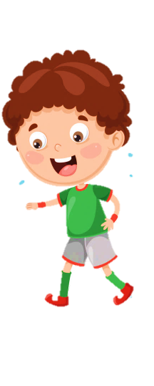












Slide 2


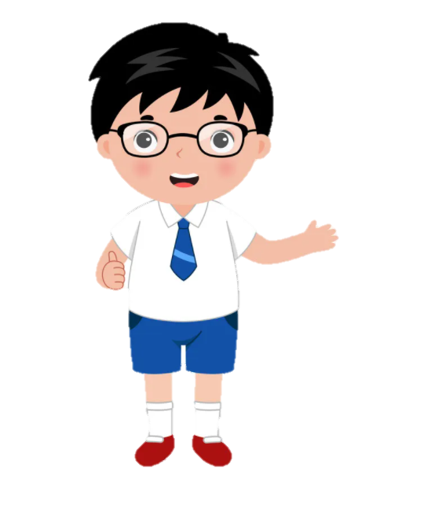



Unit 10
Our World
Lesson 1 – Task 1,2,3

Slide 3

1
Warm Up
Listen to the song

Slide 4

Where do you see?

Slide 5
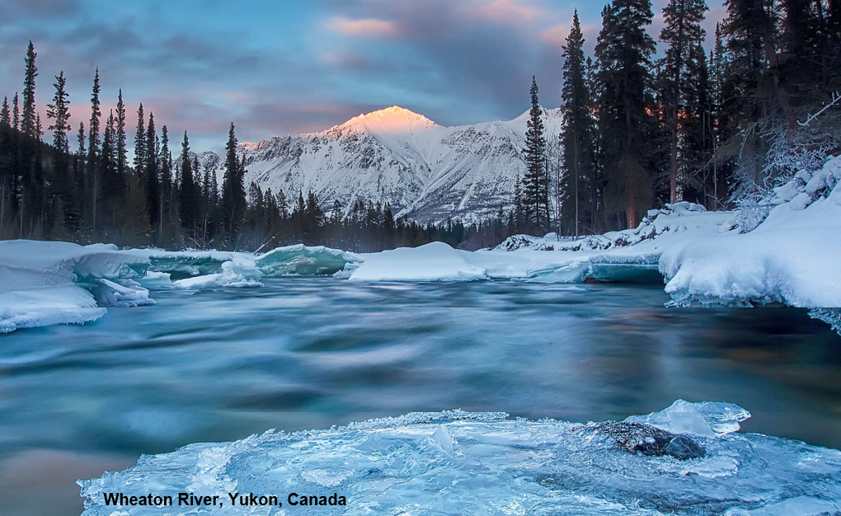
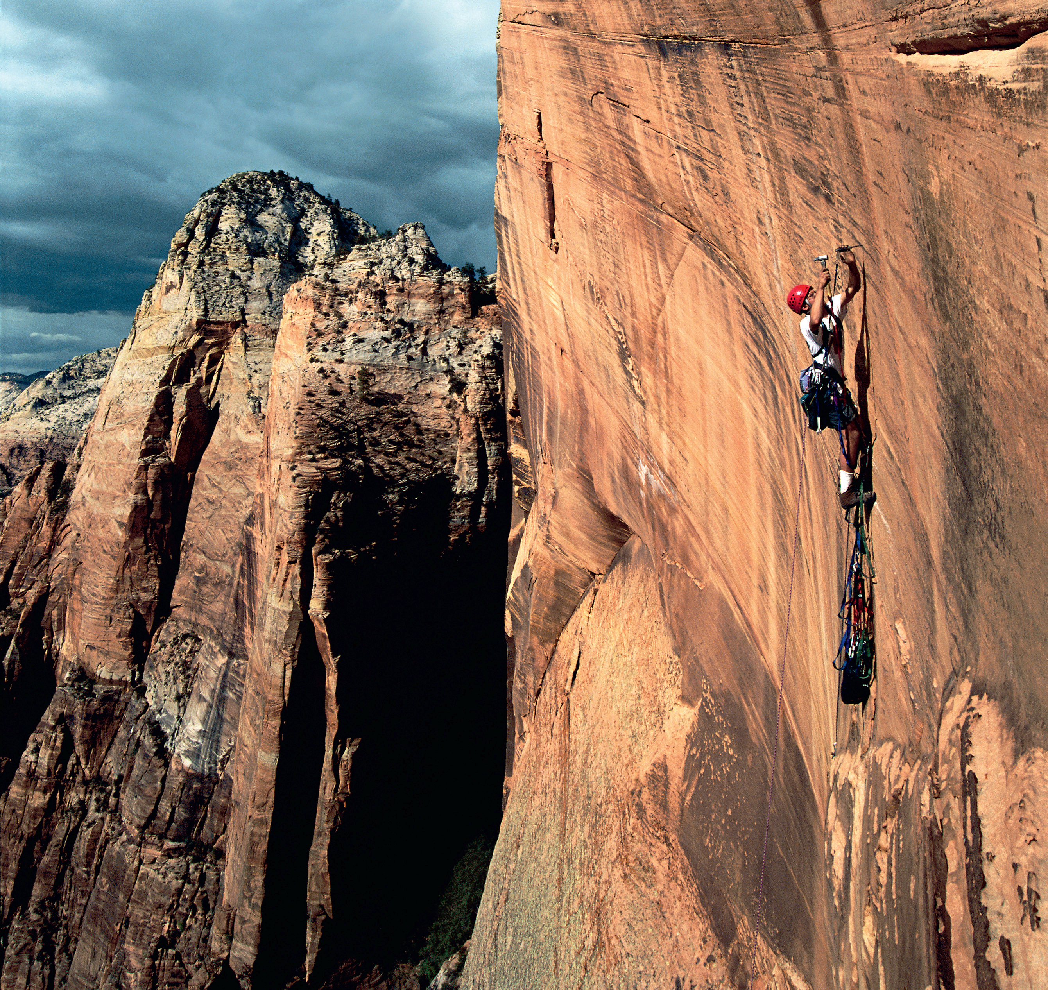
I love skiing. So, where can I go ?
Can you see them in the song ?
river
mountain

Slide 6


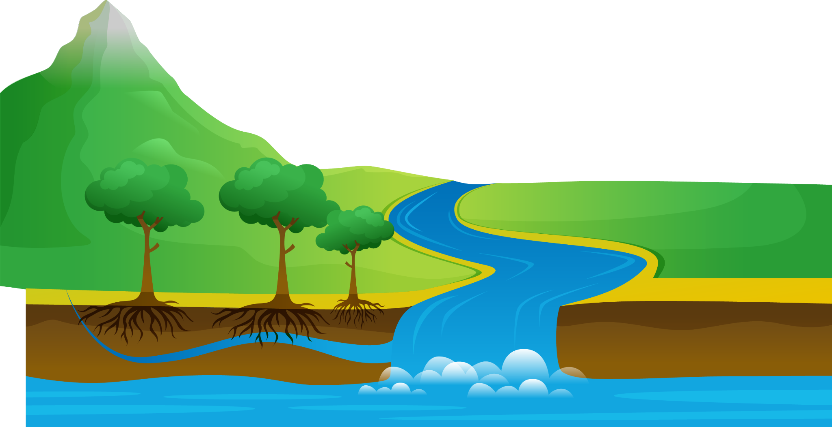

Presentation
2
1
Listen and point. Repeat.

Slide 7

Look at the photo. Tick
✓
nice
ugly
funny
great
Wheaton River , Yukon, Canada

Slide 8


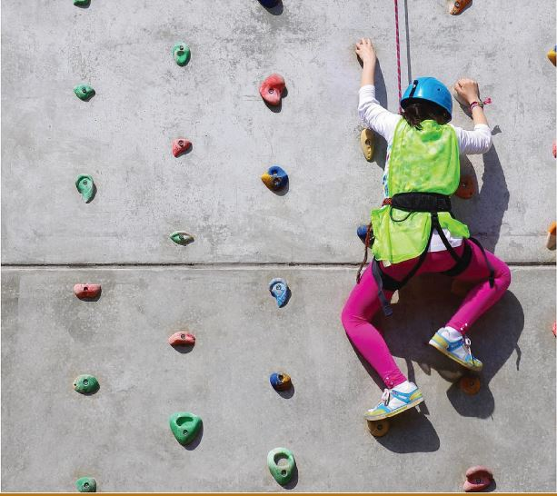
1
Listen and point. Repeat.
climb

Slide 9
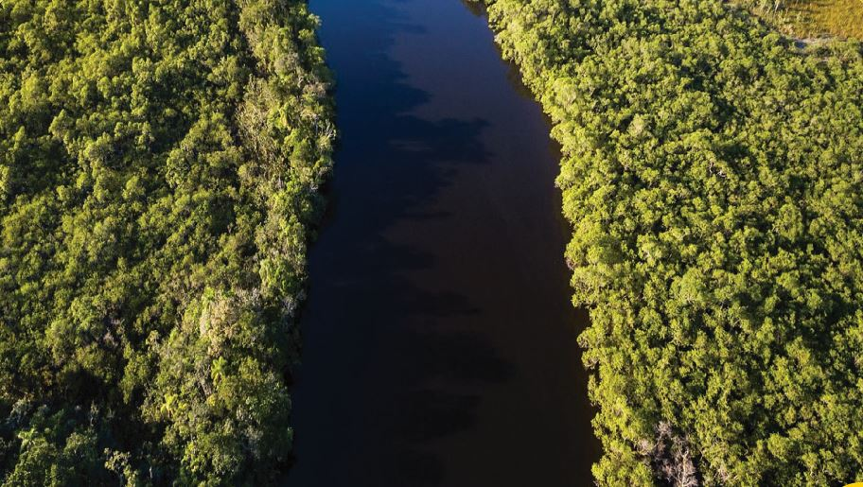
river

Slide 10
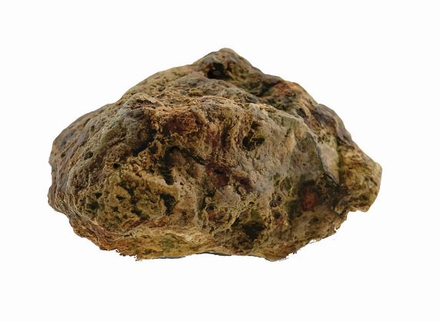
rock

Slide 11
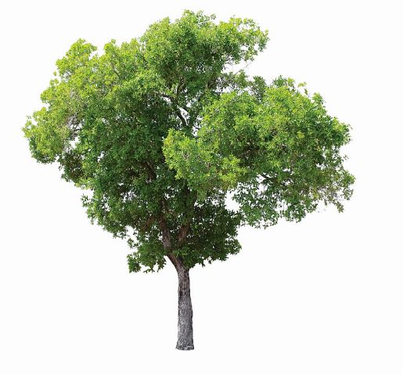
tree

Slide 12

water

Slide 13
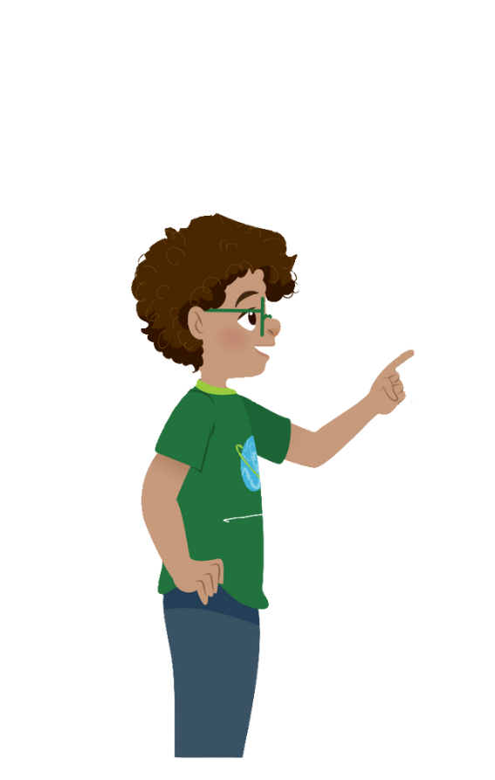
climb
river
rock
tree
water

Slide 14

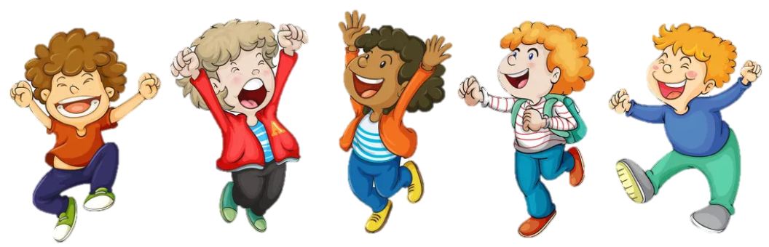
VOCABULARY CHECKING
PASS THE BALL GAME
Notes:
Pass the ball. When the music stops – whoever has the ball must answer the question

Slide 15


Pass the BALL!

Slide 16
It’s a rock.

Slide 17
Pass the BALL!

Slide 18
tree

Slide 19
Pass the BALL!

Slide 20
water

Slide 21
Pass the BALL!

Slide 22
river

Slide 23
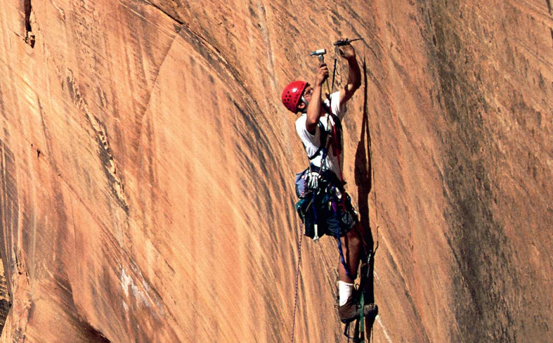

1. Listen and point. Repeat.
nature
climb
river
rock
tree
water

Slide 24


3
Practice
2
Listen and tick

Slide 25
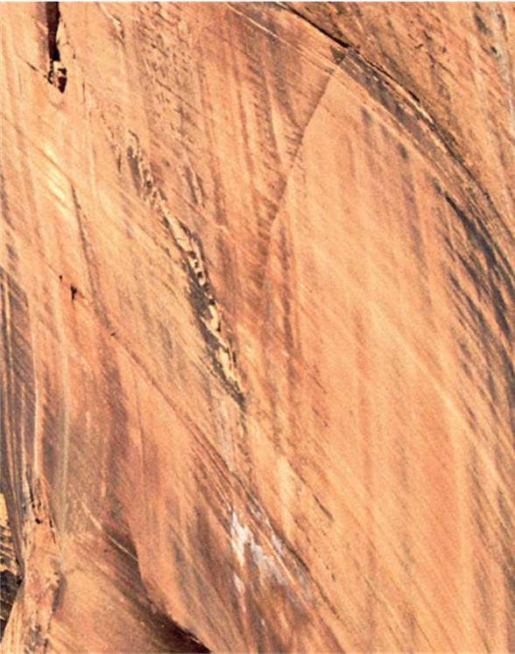


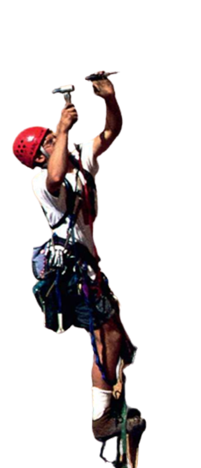
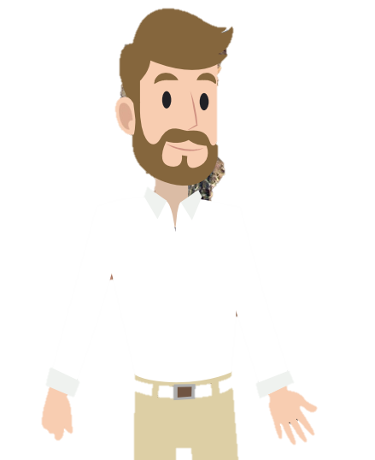
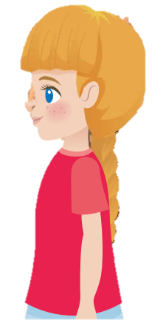
2. Listen and tick.

Slide 26
2. Listen and tick.

Slide 27
2. Listen and tick.
Yes, Uncle John. Wow! You can climb the rock!
Look! Can you see me in the photo?
Yes. And I climb big rocks with my friends!

Slide 28
2. Listen and tick.
Yes, Uncle John. Wow! You can climb the rock!
Look! Can you see me in the photo?
Yes. And I climb big rocks with my friends!
Can Uncle John climb the rock?
✓
Yes, he can.
No, he can’t.

Slide 29
Look and Match

Slide 30

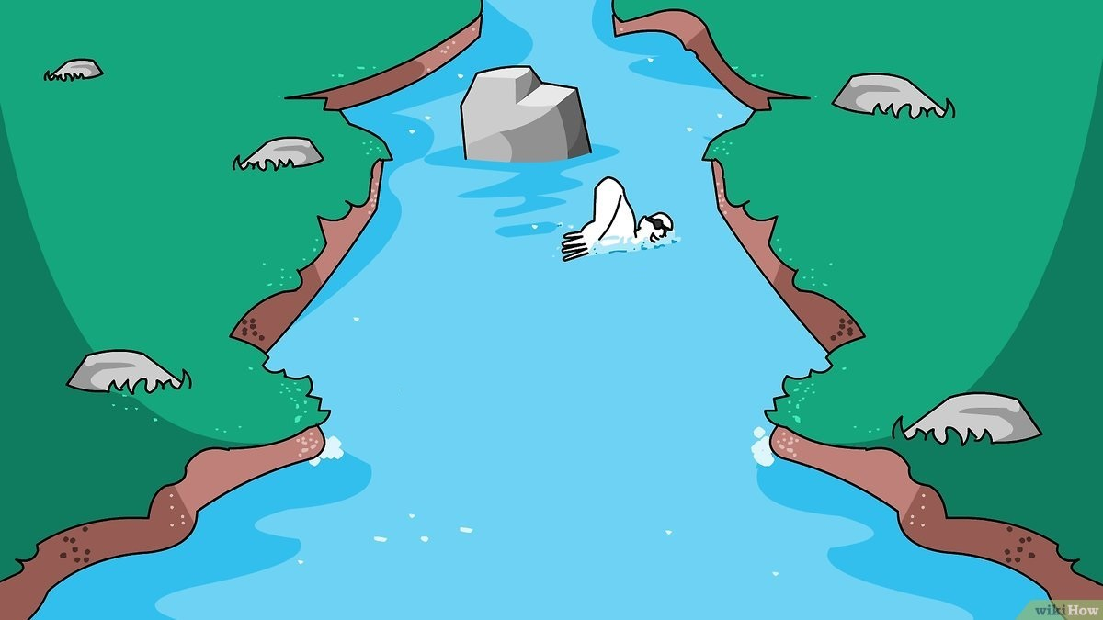
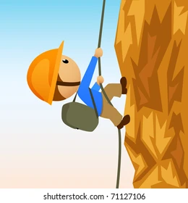
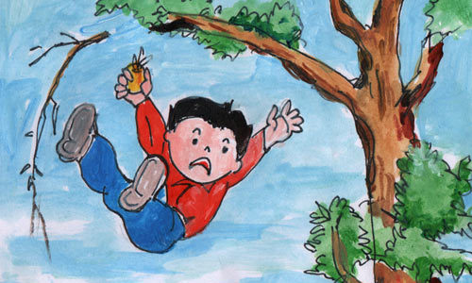
a. Yes, I can.
1.
b. Yes, I can.
2.
c. No, I can’t.
3.
d. No, I can’t.
4.

Slide 31
Can you drink cold water?

Slide 32
Can you swim in the river?

Slide 33
Can you climb the rock?

Slide 34
Can you climb the tree?

Slide 35
4
Production
3
Ask and answer. Tick.

Slide 36
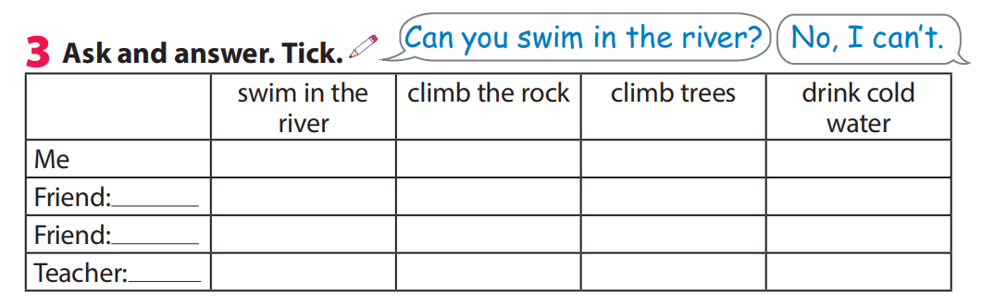

3 Ask and answer. Tick .

Slide 37



5
Assessment
Match

Slide 38
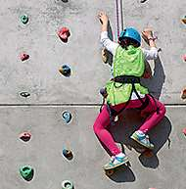
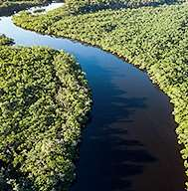
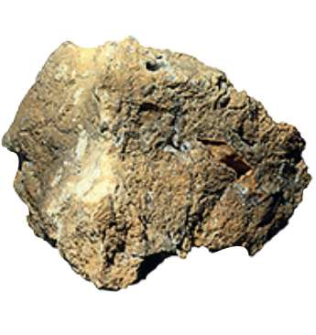
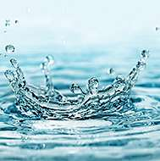
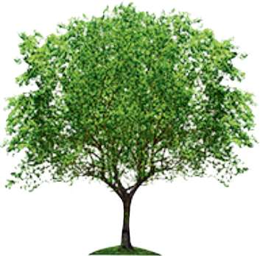
Match
1.climb
2.rock
a
b
3.river
4.tree
c
d
e
5.water
Notes:
HOẠT ĐỘNG TƯƠNG TÁC

Slide 39



See you next time!

