Slide 1






















Notes:
Để nguyên trang bìa như này, chỉ thay đổi tên bài trong quá trình làm. Logo của sách Wonderful World

Slide 2




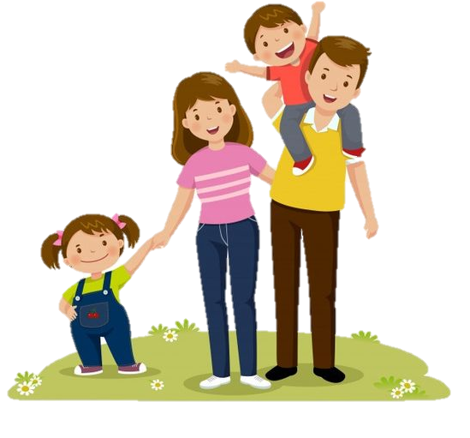

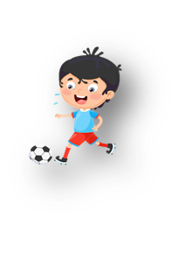




Unit 10: On holiday
Lesson 2: Task 4, 5, 6

Slide 3


1.Warm-up

Slide 4


Slide 5

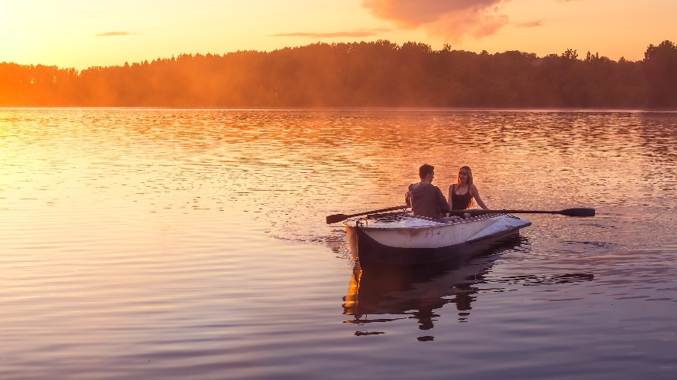
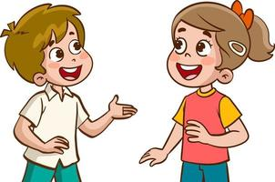
Look and say.
What can you do on Phu Quoc Island?
We can row a boat.

Slide 6
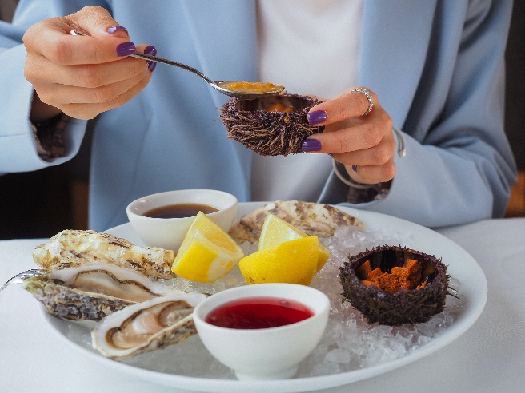

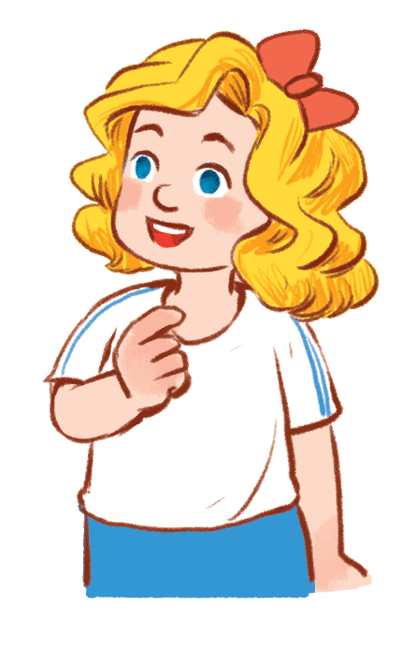
What can you do in Ha Long Bay?
We can eat seafood.
2 Hα Long Bαy / eαt seαfood

Slide 7
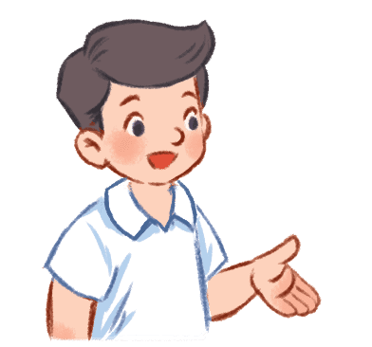
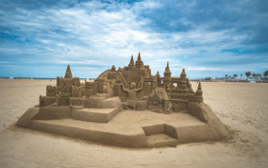
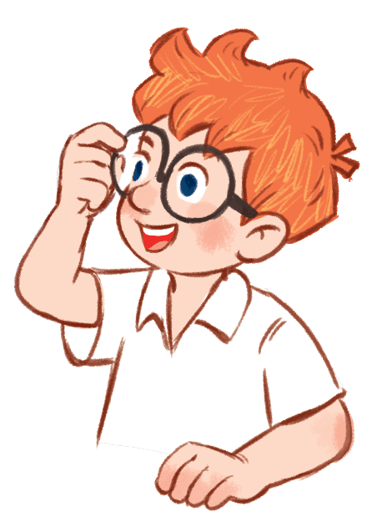
What can you do on Sam Son Beach?
We can mαke α sαndcαstle.
3 Nhα Trαng Beαch
/ mαke α sαndcαstle

Slide 8
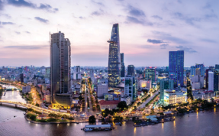
What can you do in Ho Chi Minh City?
We can go sightseeing.
4 Ho Chi Minh City / go sightseeing

Slide 9
2. Presentation

Slide 10
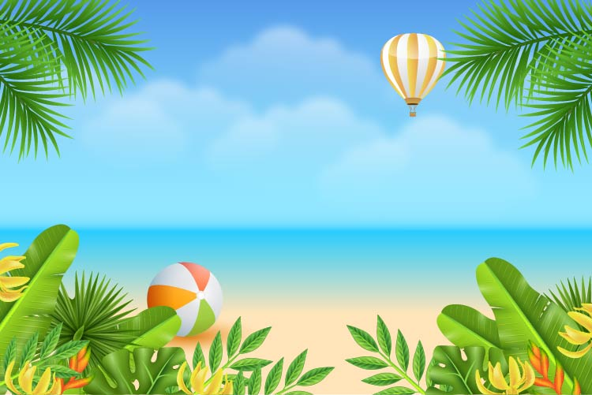

4. Listen and repeat.
Whαt do you like doing on holidαy?
I like going to the beαch αnd eαting seαfood.

Slide 11
3. Practice

Slide 12
5. Look and say..
Whαt do you like doing on holidαy?
I like eating seafood.

Slide 13
Look and say.
Whαt do you like doing on holidαy?
I like making a sandcastle.

Slide 14
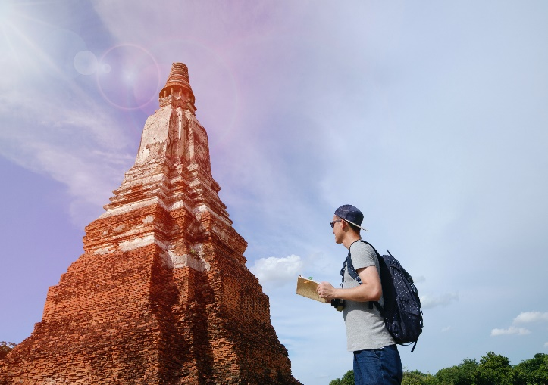
Look and say.
Whαt do you like doing on holidαy?
I like going sightseeing.

Slide 15
Look and say.
Whαt do you like doing on holidαy?
I like rowing a boat.

Slide 16
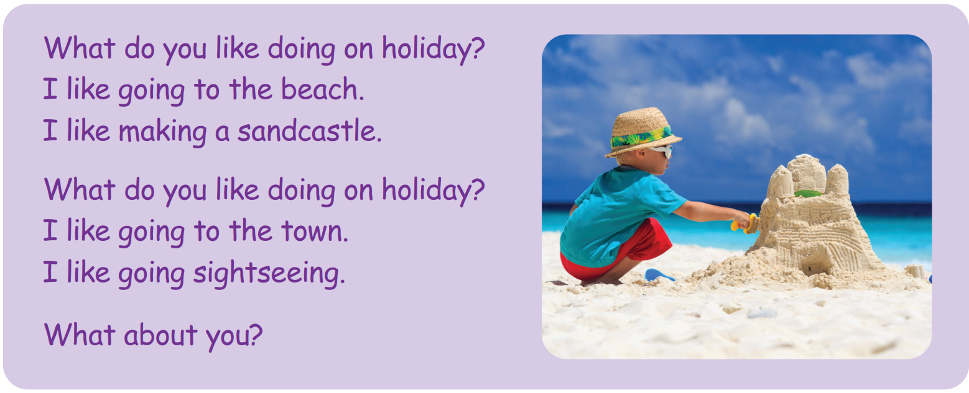
6. Listen and sing

Slide 17
4. Production

Slide 18

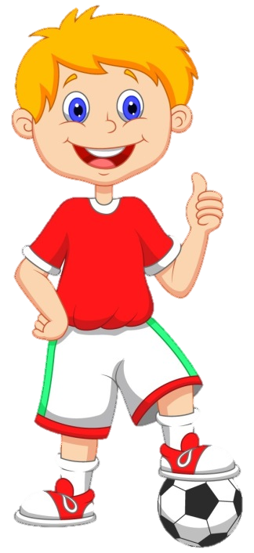


FOOTBALL
QUIZ

Slide 19
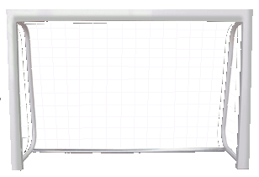
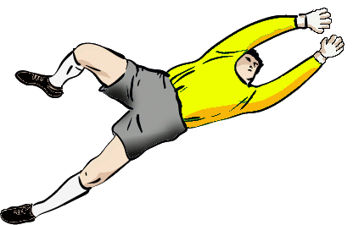

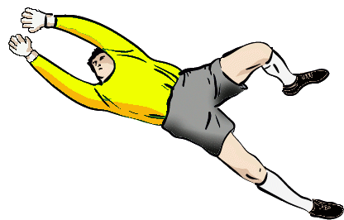
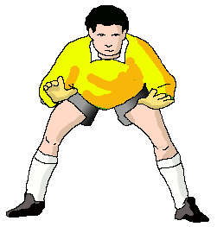
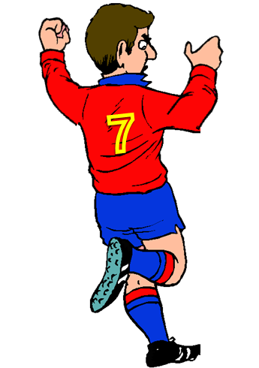
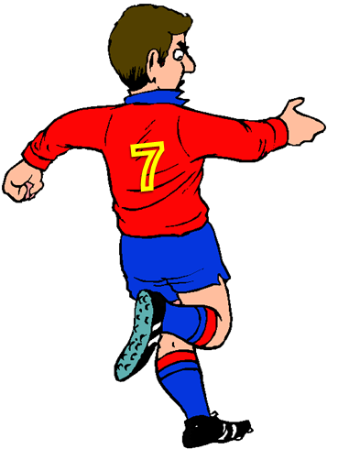

What do you like doing on holiday?
FAIR PLAY
NO TO RACISM
NEXT
I can eat seafood.
I like eating seafood
Yes, I do.

Slide 20
I like _______ a boat on holiday.
FAIR PLAY
NO TO RACISM
NEXT
rows
row
rowing

Slide 21
What can we do on holiday?
FAIR PLAY
NO TO RACISM
NEXT
We can eat seafood.
I like rowing a boat.
No, I don’t.

Slide 22
I like _____ a sandcastle on the beach.
FAIR PLAY
NO TO RACISM
NEXT
make
makes
making

Slide 23



ASSESSMENT
TEAM 1
TEAM 2
TEAM 3
TEAM 4
Vận dụng xuất sắc những kiến thức đã học vào thực hành
Vận dụng tốt những kiến thức đã học vào thực hành
Biết cách vận dụng những kiến thức đã học vào thực hành

Slide 24



5
Assessment

Slide 25
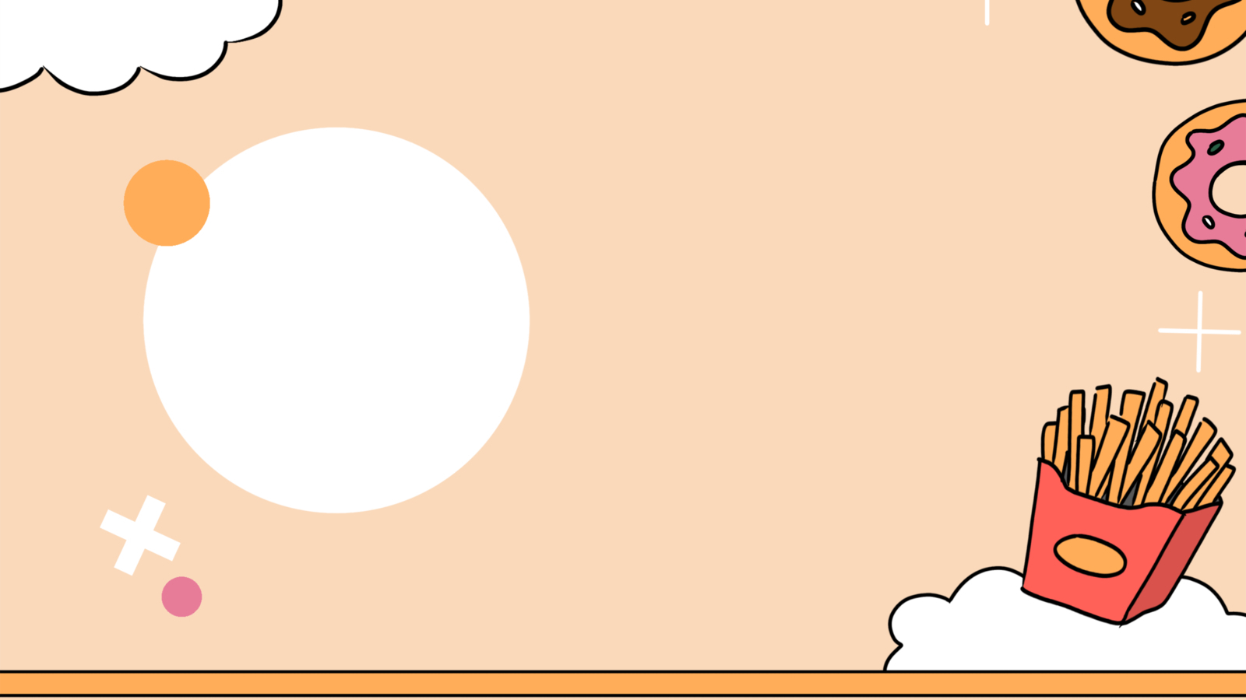
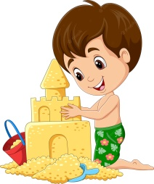
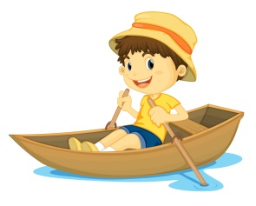
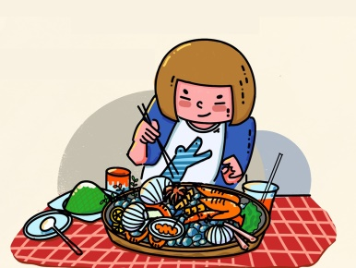
Write.
1. I like __________ a sandcastle.
2. I like __________ a boat.
3. I like __________ seafood.
making
rowing
eating
making eating rowing

Slide 26

UNIT 10: On Holiday
LESSON 2: Task 4, 5, 6
What we learnt today
Vocabulary: make a sandcasle, eat seafood, row a boat, going sightseeing
Structure: What + like

Slide 27
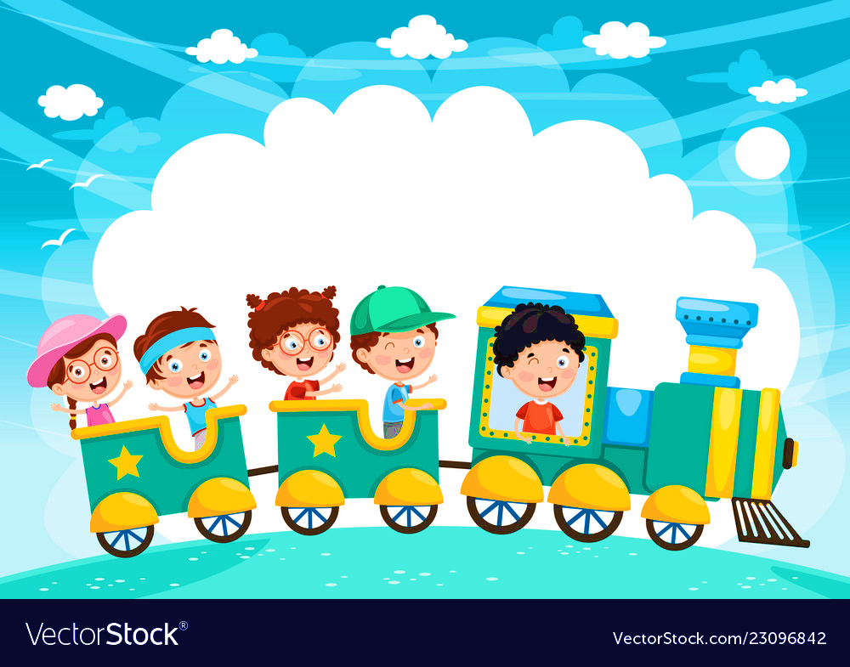







and

