Slide 1






















Notes:
Để nguyên trang bìa như này, chỉ thay đổi tên bài trong quá trình làm. Logo của sách Wonderful World

Slide 2






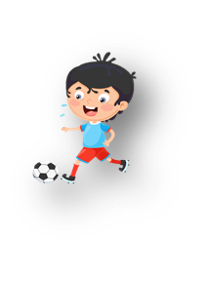




Unit 10: On holiday
Lesson 2: Task 7, 8, 9

Slide 3


Warm up
Sing a song

Slide 4

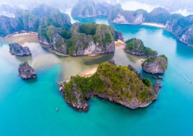
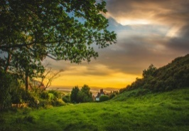
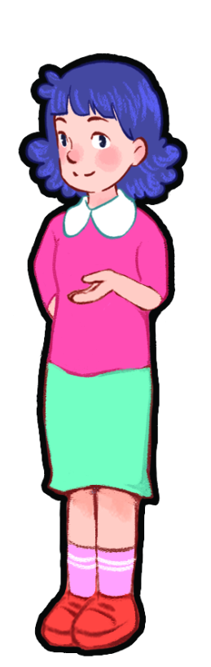
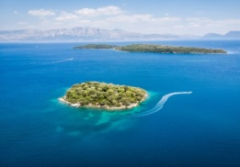
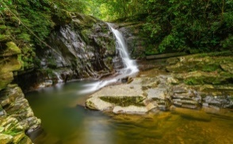
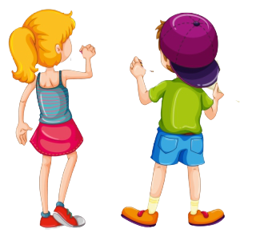
Slap the board
Goodjob!
1.Warm-up

Slide 5
2. Presentation

Slide 6
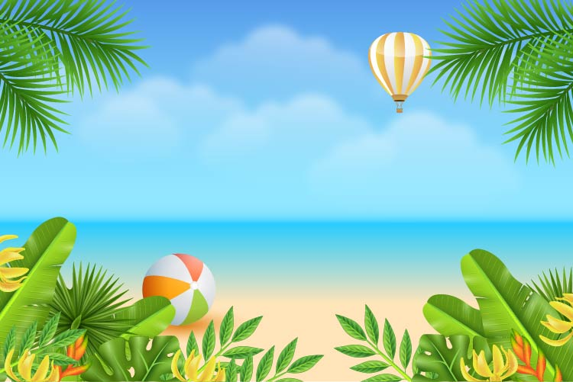
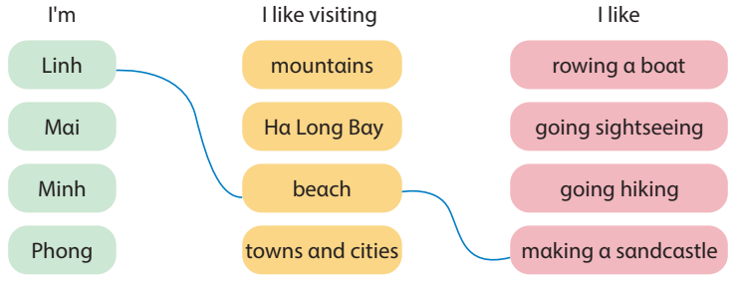
7. Listen and match. Track 10.8

Slide 7
3. Practice

Slide 8

8. Complete the table.
Places Activities
_________ __________
_________ __________
_________ __________
_________ __________
_________ __________

Slide 9

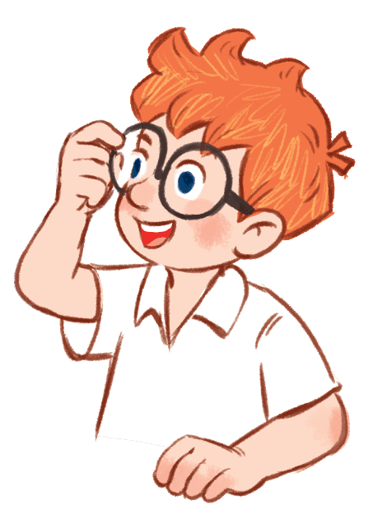
9. Let’s talk.
Which plαce would you like to visit on holidαy?
I'd like to visit Sαm Son beαch.
Whαt do you like doing at Sam Son Beach?
I like making a sandcastle.

Slide 10
Name Places Activities
Linh Sam Son Beach make a sandcastle
2. ____ _________ _________
3. ____ _________ _________
4. ____ _________ _________

Slide 11
4. Production

Slide 12




Slide 13
Game rules
- The teacher gets students to choose numbers.
- After reading the question, the team captain raises a hand to take a turn to answer.
- Student answers by speaking and spelling.
- Winners get stickers.

Slide 14


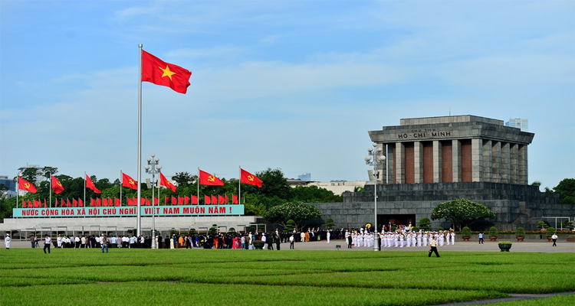


















Flip puzzle
Go to next part

Slide 15


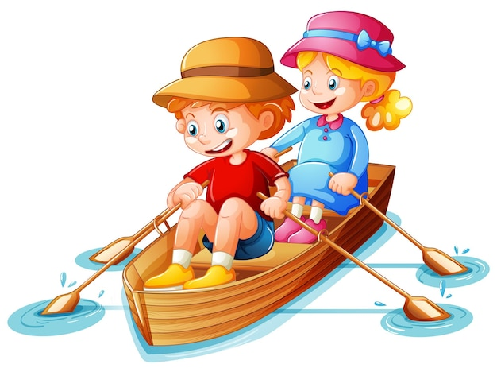

1. Phu Quoc Island/ row a boat

Slide 16



1. Phu Quoc Island/ row a boat
Which place would you like to visit on holiday?
I’d like to visit Phu Quoc Island.
What do you like doing on holiday?
I like rowing a boat.

Slide 17

2. mountain/ go hiking

Slide 18
2. mountain/ go hiking
Which place would you like to visit on holiday?
I’d like to visit Fansipan Mountain.
What do you like doing on the Fansipan Mountain?
I like going hiking.

Slide 19

3. Ho Chi Minh City/ going sightseeing

Slide 20
3. Ho Chi Minh City/ going sightseeing
Which place would you like to visit on holiday?
I’d like to visit Ho Chi Minh City.
What do you like doing in Ho Chi Minh City?
I like going sightseeing.

Slide 21

4. Ha Long Bay/ row a boat

Slide 22
4. Ha Long Bay/ row a boat
Which place would you like to visit on holiday?
I’d like to visit Ha Long Bay.
What do you like doing on holiday?
I like rowing a boat.

Slide 23

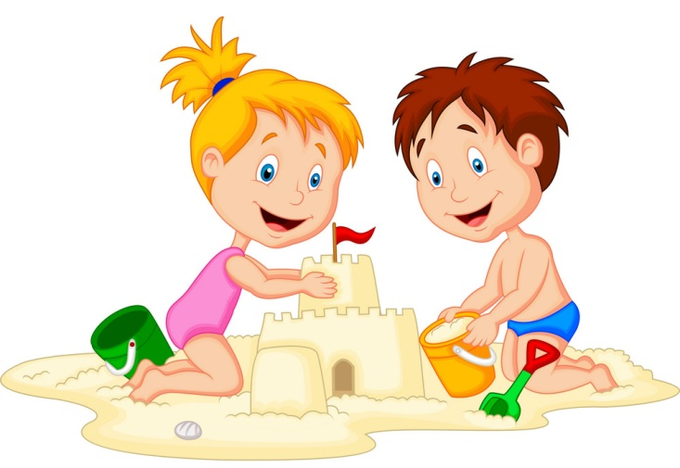

5. Nha Trang beach/ make a sandcastle

Slide 24
5. Nha Trang beach/ make a sandcastle
Which place would you like to visit on holiday?
I’d like to visit Nha Trang beach.
What do you like doing on holiday?
I like making a sandcastle.

Slide 25
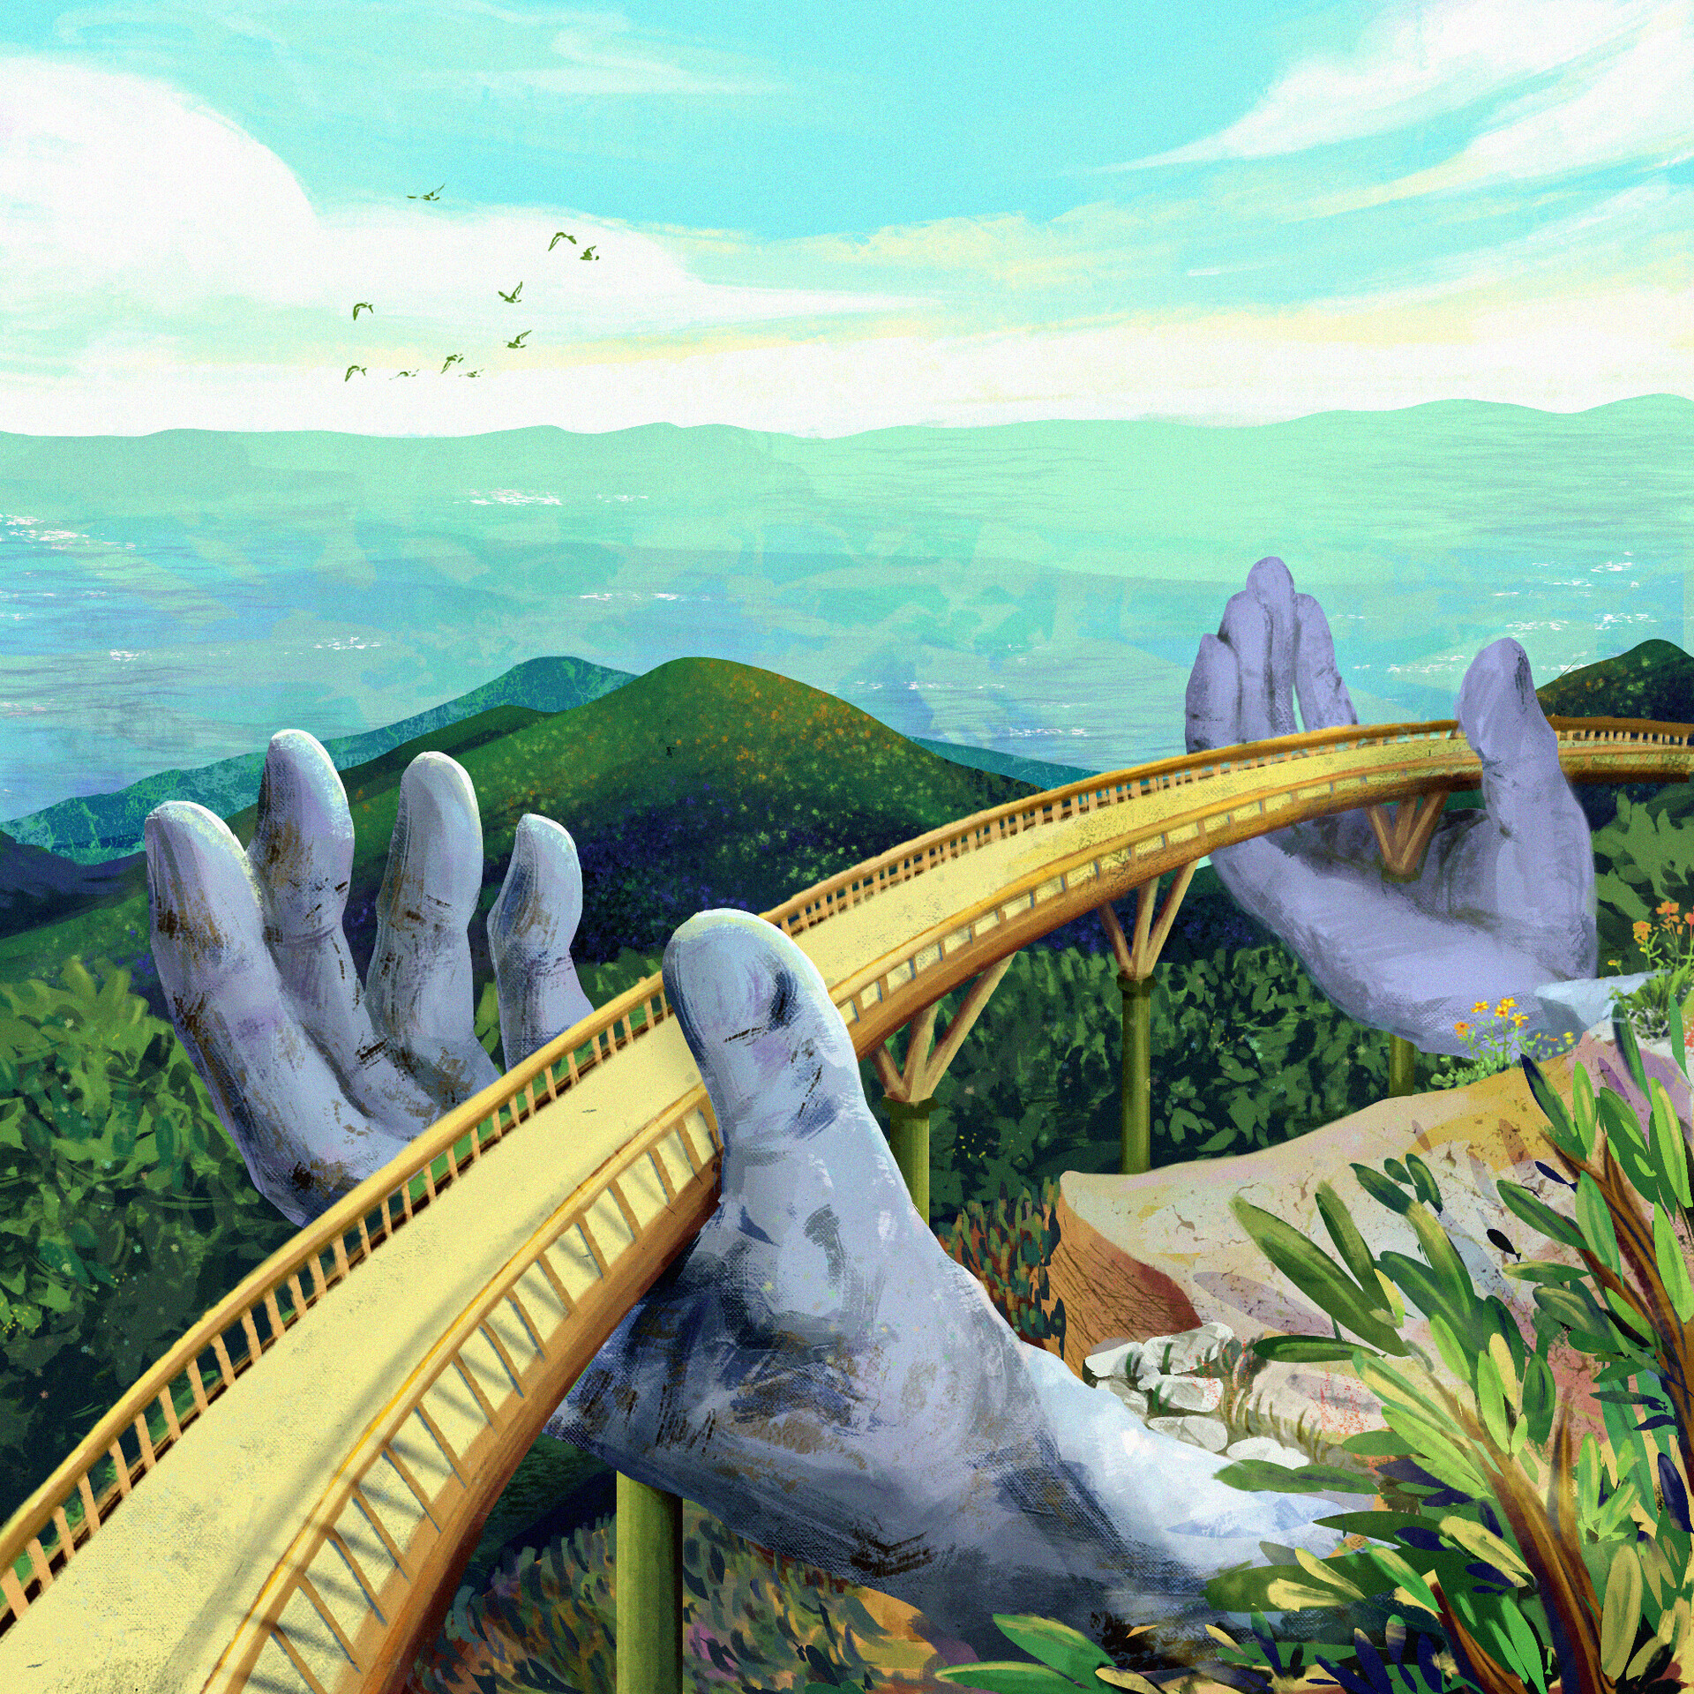

6. Ba Na Hills / take photos

Slide 26
6. Ba Na Hills / take photos
Which place would you like to visit on holiday?
I’d like to visit Ba Na Hills .
What do you like doing on holiday?
I like taking photos.

Slide 27



Slide 28



ASSESSMENT
TEAM 1
TEAM 2
TEAM 3
TEAM 4
Vận dụng xuất sắc những kiến thức đã học vào thực hành
Vận dụng tốt những kiến thức đã học vào thực hành
Biết cách vận dụng những kiến thức đã học vào thực hành

Slide 29



5
Assessment

Slide 30

Look and say.
Which place would you like to visit on holiday?
I’d like to visit Island.
What do you like doing on holiday?
I like rowing a boat.

Slide 31

Look and say.
Which place would you like to visit on holiday?
I’d like to visit National Park.
What do you like doing on holiday?
I like going sightseeing.

