Slide 1






















Notes:
Để nguyên trang bìa như này, chỉ thay đổi tên bài trong quá trình làm. Logo của sách Wonderful World

Slide 2






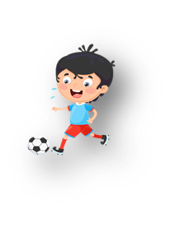




Unit 10: On holiday
Lesson 3: Task 4, 5, 6

Slide 3


Warm up
Listen and Slap The Board!

Slide 4

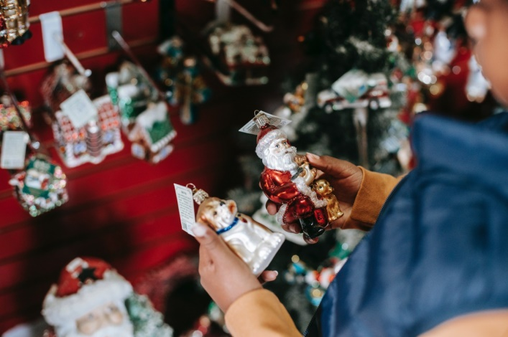


Slide 5
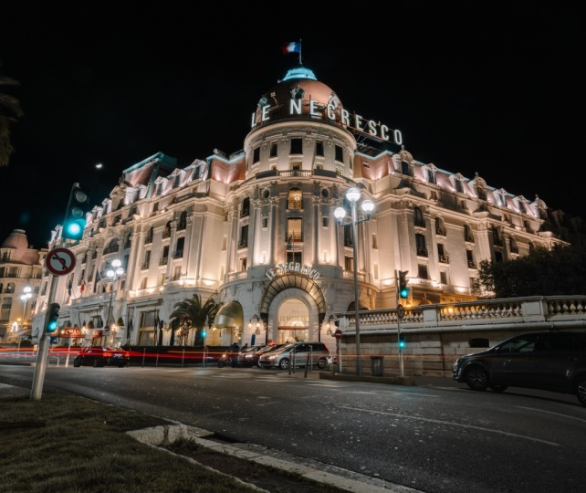


Slide 6


Slide 7



Slide 8
2. Presentation

Slide 9
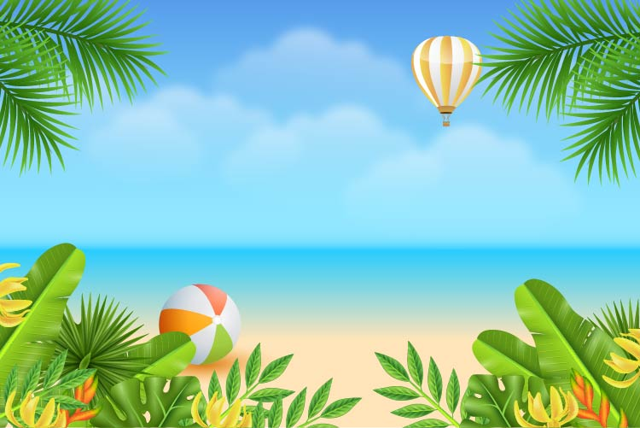

4 Listen αnd repeαt. Tr 10.11
I like flying to new plαces on holidαy,
but I don't like going to the αirport.

Slide 10
3. Practice

Slide 11
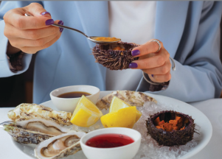

5. Look and say.
I like going to the
beαch on holidαy,
but I don't like
eαting seαfood.
go to the beach (✓)
/ eat seafood (✗)

Slide 12

5. Look and say.
I like visiting an island on holidαy, but I don't like rowing a boat.
2.visit an island(✓)
/ row a boat(✗)

Slide 13
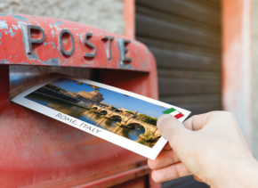
5. Look and say.
I like buying presents on holidαy, but I don't like sending a postcard.
3. buy presents (✓)
/ send a postcard (✗)

Slide 14

5. Look and say.
I like writing in my diary on holidαy,
but I don't like
writing about food.
4. write in my diary (✓)
/ write about food (✗)

Slide 15



6. Let’s talk.
I like going to the beach on holiday, …
… but I don’t like making a sandcastle.

Slide 16
4. Production

Slide 17


Quiz Game
Notes:
Click start to go to the rules slide.

Slide 18




Rules
Steal points from another team.
Ask for help from another team.
Both teams get points.
Give up!
If you can’t
Notes:
Explain all the rules. All teams should start with 500 points each.
The sabotage button- Throughout the presentation, there are random sabotage slides. If a team enables a sabotage, they can steal the respective number of points from a team of their choice. The point intervals are 100, 200, 300, 400, 600, 800, 900. The questions difficulty should be respective to the point value. The point value can be changed to the desired amounts.
Report button: Doesn`t appear again in the presentation. Just remind the students to not shout out the answers.
Use button: Try to answer the question again after making a mistake. Each team gets a revenge chance to answer a question. Click this button to eliminate their team color from the colors available.
Quit button: If clicked, the all teams lose the chance to answer the question. Use this button if all teams cannot answer the question correctly.
!! button: Phone a friend. If this button is clicked, the sabotage sound plays on repeat until the green return arrow is clicked. To enable a 20 second timer, click the sand dial. The sand dial will slowly make a full rotation. When it returns to the original position, the time is up. The helping team must answer the question within 20 seconds. If they answer correctly, both teams will split the question`s points evenly. Keep track of which team has used this ability on a piece of paper or the white/blackboard. Each team can use this ability once per game.

Slide 19






Choose the question
100
200
300
200
100
300
Notes:
Ideally for 4-6 teams. The order is chosen by having the first student in the first group do rock, paper, scissors with the last student in the last team. Whoever wins RPS, determines the order of the game.
Keep track of the teams by writing each team on the board to keep score also write the order. Team one (orange) Write the color below the team order number.

Slide 20





Question 1
I like ______ in a diary every day.
a.
sending
b.
buying
c.
writing

Slide 21
Question 2
I like ______ in a hotel on holiday.
a. writing
b. staying
c. sending

Slide 22


Maps Sabotage
Steal 20 points from another team.
Notes:
Steal 300 points from any team.

Slide 23



Question4
Question 3
I’ d like ______ shopping on holiday.
a.
go
b.
going
c.
to go

Slide 24

Question 5
Question 4
I like _____ in the sea.
a.
to swim
b. swimming
c.
swim

Slide 25

Question 6
Question 5
She likes writing in her diαry, but she _____like writing αbout her friends.
a.
doesn’t
b.
don’t
c.
like

Slide 26


Question 7
Question 6
Tom likes ______
α postcαrd.
a. doing
b. sending
c. going

Slide 27
Sabotage
Steal points from another team.
Notes:
Steal 400 points from any team.

Slide 28

GAME OVER
Notes:
The emergency sound plays on loop until the green arrow is clicked. Click the sand dial to make it spin. It is set on a 20 second timer. This gives the teams 20 seconds to discuss an answer and then when the sand dial timer is up, they must give an answer.
If the answer is correct, both teams split the points.

Slide 29



ASSESSMENT
TEAM 1
TEAM 2
TEAM 3
TEAM 4
Vận dụng xuất sắc những kiến thức đã học vào thực hành
Vận dụng tốt những kiến thức đã học vào thực hành
Biết cách vận dụng những kiến thức đã học vào thực hành

Slide 30



5
Assessment

Slide 31
Order the sentences
1. shopping / do / go / Where / we / town / this / in ?
______________________________________ 2. postcαrds / send / We / post office / the / αt.
______________________________________ 3. like / I / going shopping / buying / don’t / like / things / mαny / but / I ___________________________________________ 4. visit / like / to / I’d / pαrk / holidαy / on / nαtionαl
______________________________________
Where do we go shopping in this town?
We send postcards at the post office.
I like buying many things but I don’t like going shopping.
I’d like to visit national park on holiday.

Slide 32

UNIT 10: On Holiday
LESSON 3: Task 4, 5, 6
What we learnt today
Review vocabulary: buy presents, stay in a hotel, send a postcard, write in a diary.
Structure: What + like

Slide 33








and

