Slide 1




















Notes:
Để nguyên trang bìa như này, chỉ thay đổi tên bài trong quá trình làm. Logo của sách Wonderful World

Slide 2







Unit 10:
On Holiday
Fun time & Project

Slide 3

1
WARM-UP

Slide 4

Listen and sing!

Slide 5
2
PRESENTATION

Slide 6
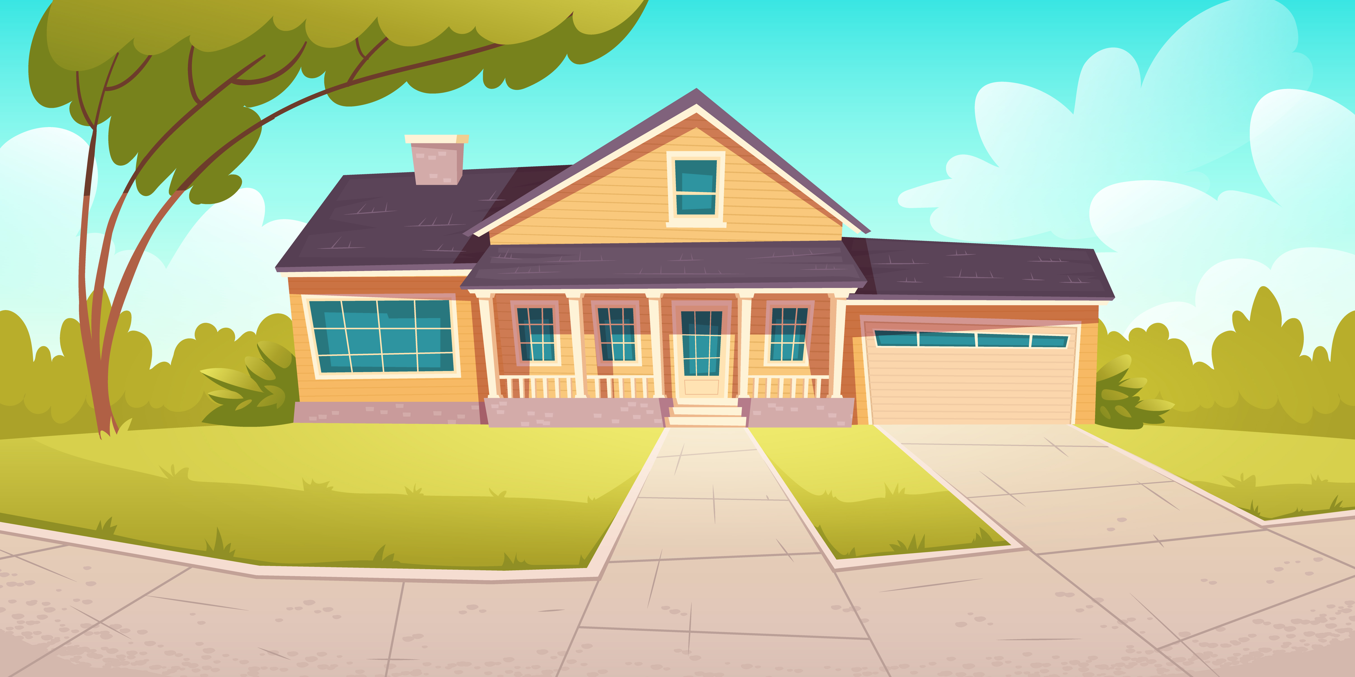
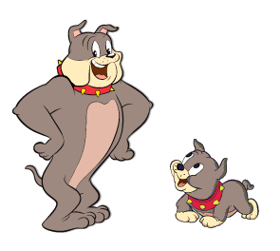
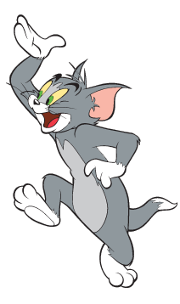
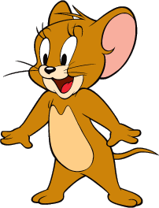
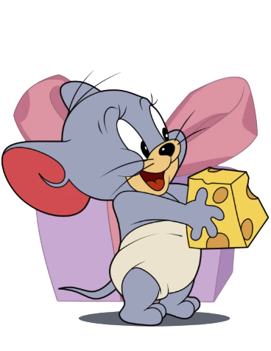
Tom and Jerry Puzzle!

Slide 7
Pick A Character!
Next

Slide 8
y b a
bay
back

Slide 9
s i d n a l
island
back

Slide 10
i h l l
hill
back

Slide 11
r a p k
l a n o i t n a
national park
back

Slide 12
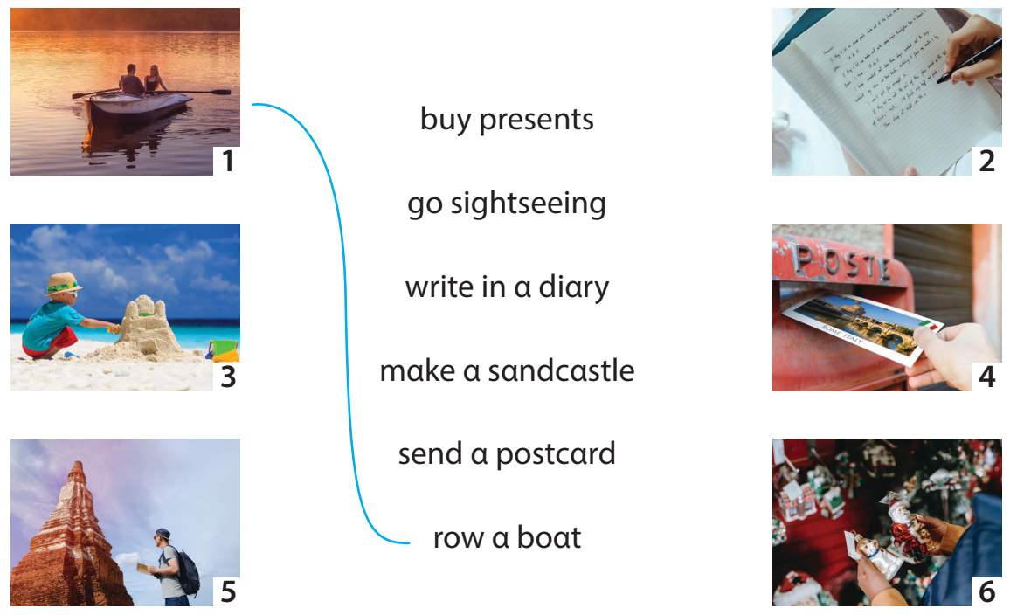
1. Match!

Slide 13
3
PROJECT

Slide 14
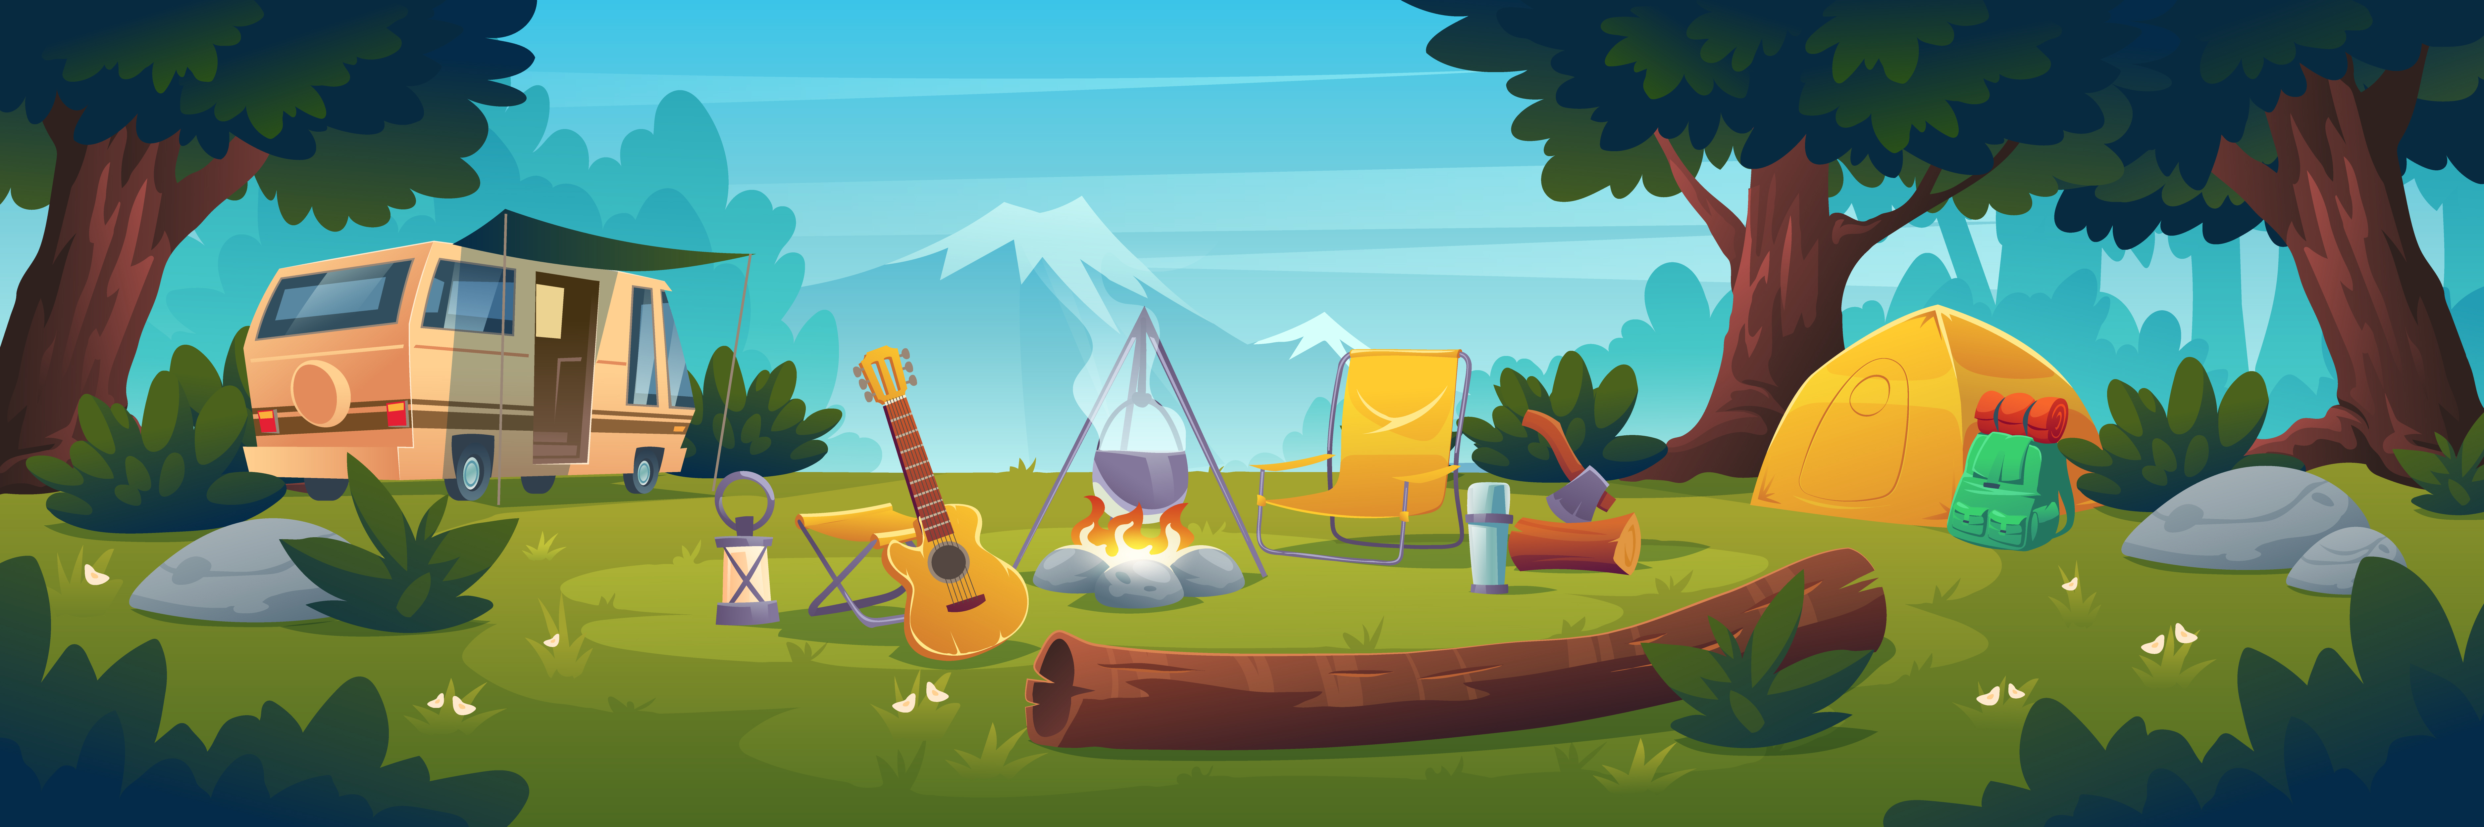
Project: Your travel plan

Slide 15
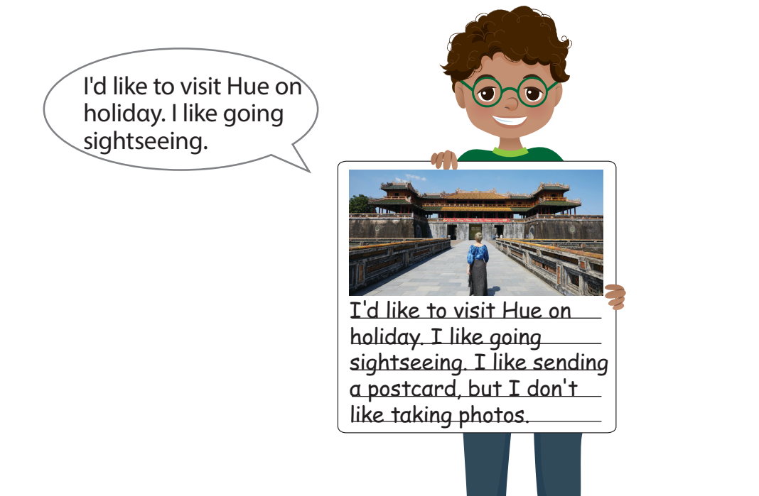
Take out the photo that they have prepared

Slide 16
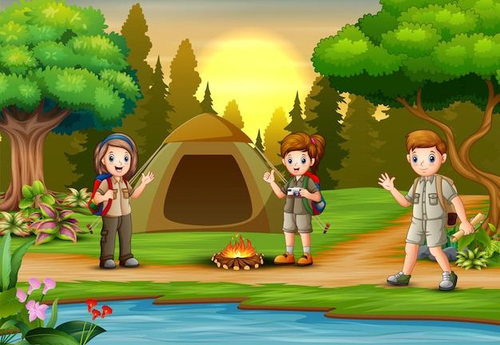
Describe their plan.
I'd like to visit Hue on holidαy. I like going
Sightseeing.

Slide 17
04
ASSESSMENT

Slide 18
Circle the correct answer
We cαn go to Hα Long Bαy / Hill in summer.
There αre α lot of trees αnd birds in Cuc Phuong Islαnd / Nαtionαl Pαrk.
Phu Quoc Islαnd / Bαy hαs got mαny beαutiful beαches.

Slide 19


Thank you
& goodbye!

