Slide 1























Slide 2




Unit 10
Our World
Lesson 2 – Task 7,8,9

Slide 3




01
Name of the section
1
WARM UP
You can enter a subtitle here if you need it

Slide 4



RAINBOW GAME
5
3
4
1
2
Notes:
Nhấn số lần lượt để đi đến và trả lời câu hỏi.
Sau khi trả lời được quay lại và nhấn vào khinh khí cầu để di chuyển. Lần lượt đến khi khinh khí cầu chạm đến cầu vồng.

Slide 5


Click on the right word
rainy
sunny
cold

Slide 6







Click on the right icon
It’s SUNNY.
WEATHER REPORT
Well done!
Try again !

Slide 7



sunny
summer
winter
winter
It’s winter.

Slide 8


Look and fill in the blank .
It’s………………
cold

Slide 9
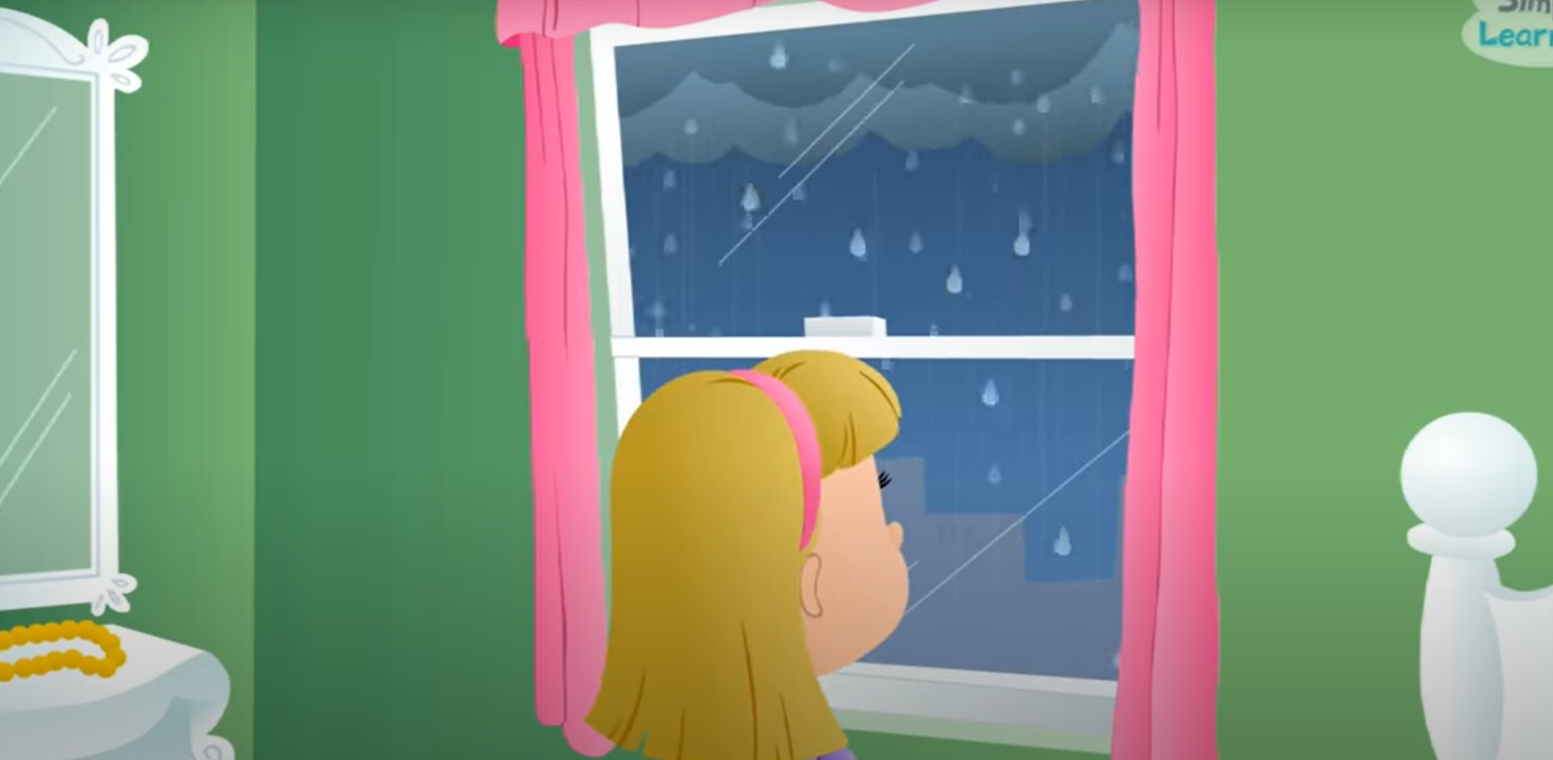

Is it rainy ?
Yes. It’s rainy

Slide 10
01
Name of the section
2
Presentation
You can enter a subtitle here if you need it

Slide 11

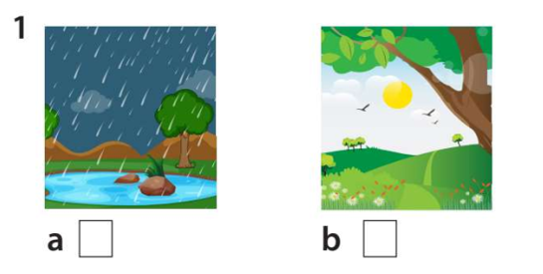
7. Listen and tick.

Slide 12
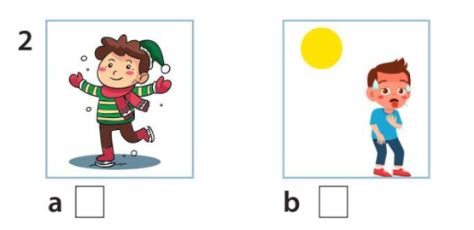
Listen and tick

Slide 13
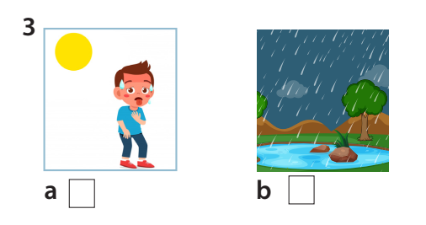
Listen and tick

Slide 14
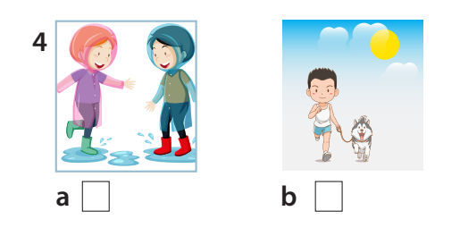
Listen and tick

Slide 15

Fastest Pen Game

Slide 16
01
Name of the section
3
Writing
You can enter a subtitle here if you need it

Slide 17
8. Write and say.
1. It’s / summer./ hot / the / in
→ It’s hot in the summer.
2. winter. / It’s / in / the / cold
→ It’s cold in the winter.
3. I / hot / go /weather. / in / swimming
→ I go swimming in hot weather.
4. My / winter. / play / the / chess/ friends / in
→ My friends play chess in the winter.
5. My / shopping/ summer. /family / go / and / I / in hot
→ My family and I go shopping in hot summer.

Slide 18
01
Name of the section
4
Production
You can enter a subtitle here if you need it

Slide 19

Season talking

Slide 20





9. Let’s talk.
It’s cold and rainy in winter. Do you go to the park ?
No, I don’t. I play games in the living room.

Slide 21

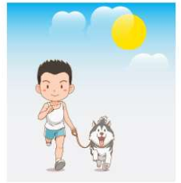

Choose the sentences to describe the picture :
It’s hot in summer. I swim in the river.
It’s sunny and dry in my town. I walk my dog.

Slide 22

Choose the sentences to describe the picture.
It’s hot in summer. I swim in the pool.
It’s sunny and dry in my town . I walk my dog.

Slide 23





Draw the picture and say.
It’s sunny.
I and my friends go to the park.

Slide 24
01
Name of the section
5
Assessment
You can enter a subtitle here if you need it

Slide 25
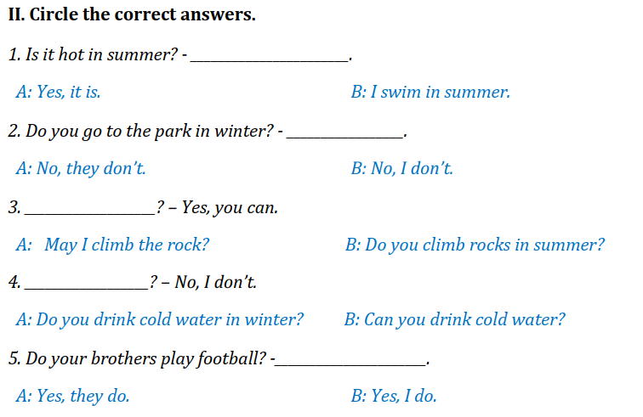
Circle the correct answers
Notes:
HOẠT ĐỘNG TƯƠNG TÁC

Slide 26




Thank you & goodbye!

