Slide 1






















Notes:
Để nguyên trang bìa như này, chỉ thay đổi tên bài trong quá trình làm. Logo của sách Wonderful World

Slide 2











Unit 11: Before our time
Lesson 1: Task 1, 2, 3

Slide 3
1
Warm up
Answer the questions
Guess “ Weather“
Notes:
Warm-up:
Lead in: Photo time!
-T shows the picture about a rock which is drawn a lot of different shapes and gives students some questions: What can you see? Is it in the past or nowsaday?
- T calls SS to answer and check their answers.
- T asks SS to look at 4 squares and tick what they can see.
- T introduces that they will learn about “ some past time” today.
- Write on the board “Before our time” and introduce the lesson.

Slide 4

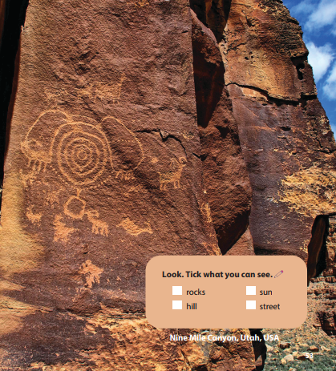
Look. Tick what you can see.

rocks
sun
hill
street
Notes:
Lead in: Photo time!
-T shows the picture about a rock which is drawn a lot of different shapes and gives students some questions: What can you see? Is it in the past or nowsaday?
- T calls SS to answer and check their answers.
- T asks SS to look at 4 squares and tick what they can see.
- T introduces that they will learn about “ some past time” today.
- Write on the board “Before our time” and introduce the lesson.

Slide 5
2
Presentation

Slide 6

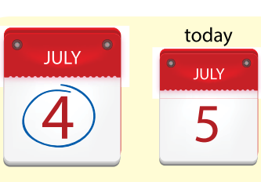


yesterday
Notes:
Task 1: Listen and point. Repeat. (Track 11.1)
- Use flashcards to introduce the vocabulary of the lesson.
- Say the words for students to repeat in the chorus.
- Say a word for students to repeat then point.

Slide 7
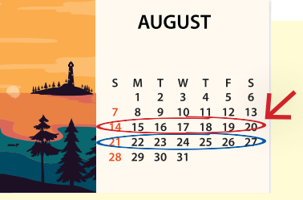
last week

Slide 8
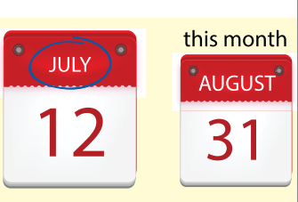
last month

Slide 9
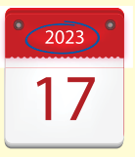
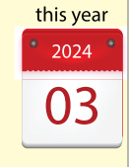
last year

Slide 10
What’s it?
PHONICS FAN
Start
Notes:
VOCABULARY CHECKING :
Play a game “What’s it?”
- Show a fan with three inside.
- Ask students to read aloud all the words in the fan by clicking “on” on the fan.
- Ask Ss to look at the picture and choose the correct word.
- Ask SS to say the words again.
(GV nhấn “on” trên quạt để quạt quay và đọc các cụm từ trên đó. Gv yêu cầu học sinh nhìn tranh và đoán từ thiếu ở tâm quạt.)

Slide 11
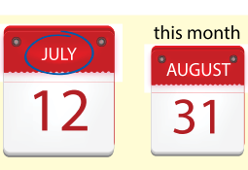

year
month
last __
week
last month
on

Slide 12
year
month
last __
week
last week
on

Slide 13
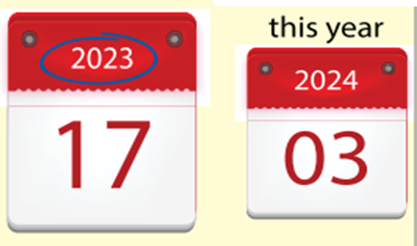
year
month
last __
week
last year
on

Slide 14
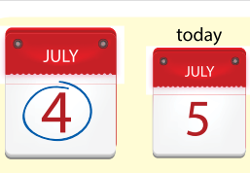
last year
_____
yesterday
last week
yesterday
on

Slide 15

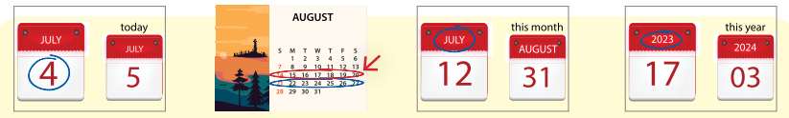
1. Listen αnd point. Repeαt. Tr. 11.1
yesterday
last week
last month
last year
Notes:
- Play track 11.1 for the students to listen to, point to, and repeat the words in chorus and groups.

Slide 16
3
Practice

Slide 17
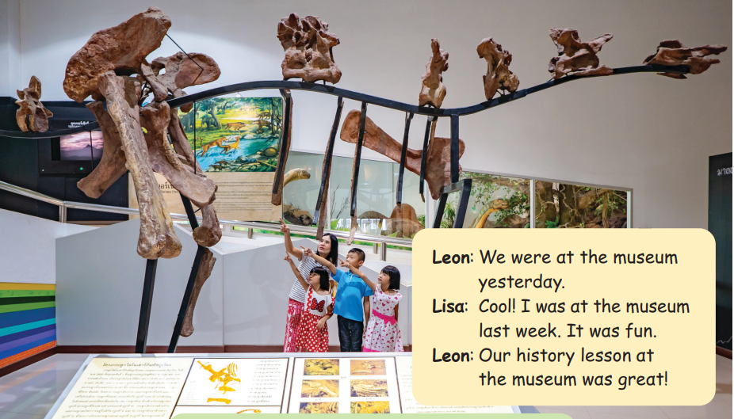
2. Listen αnd reαd. Circle. TR.11.2
Notes:
Task 2: Listen and read. Circle. Track 11.2
- Ask SS to look at the picture and answer some questions: Where are they?/ How many people can you see? What are they doing?/ What can you see in the museum?
- Ask SS to look at the dialogue and identify names of charaters in the dialogue.
- Play track 11.2 and let SS listen to the dialogue, then repeat each sentence.
- Ask SS to and read again, then circle the correct answers.
- Let SS read the dialogue by Role-play “Leon and Lisa” to practice the words and the sentences.

Slide 18


2 Listen αnd reαd. Circle. TR.11.2
Leon: We were at the museum yesterday.
Lisa: Cool! I was at the museum last week. It was fun.
Leon: Our history lesson at the museum was great!
Leon was at the museum yesterday./ last week.
Lisa was at the museum yesterday./ last week.
Notes:
Sldie này ko có phần nghe, It was fun

Slide 19

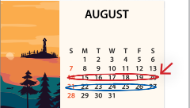
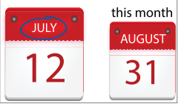
3. Write αnd sαy.
s
t
r
d
y
1. _ e _ _ e _ _ a _
y
2. l _ _ _ w _ _ k
a
s
t
e
e
l
l
r
s
4. _ _ s _ _ e a _
t
a
t
3. _ a _ _ _ _ _ t h
m
o
n
y
Notes:
Task 3: Write and say :
- Look at the picture and let SS spell the letters which are missing and say the word.
- Call SS to say aloud in front of the class.

Slide 20
4
Production

Slide 21







Lucky number
Notes:
- Work in groups.
- Ask SS to play a small game “ Lucky number”.
- Introduce the rule of the game:
(2 teams choose the number and answer, then T can ask SS to make a sentence with this word. Then they move the board with the numbers and letters to choose the points for their team. No point for bomb. Which team has more points will be a winner.)
- Check and give feedback.

Slide 22



Look and answer
a
yesterday
b
last year
c
last month

Slide 23

Look and answer
a
yesterday
b
last year
c
last month

Slide 24
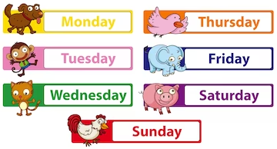
Look and answer
a
last year
b
last week
c
last month

Slide 25

Look and answer
a
last week
b
last year
c
last month

Slide 26


1
2
3
4
5
a
+1
+2
+3
+2
b
+5
+2
+4
c
+3
+1
+5
+3
+5
d
+1
+5
+4
+3
e
+2
+4
+1
+4

Slide 27
5
Assessment

Slide 28

4. Mαtching
1
last week
2
last month
3
last year
4
yesterday

Slide 29
UNIT 11: BEFORE OUR TIME
LESSON 1 – PERIOD 1
What we learnt today
yesterday
last week
last month
last year
Vocaburary

Slide 30




Thank you & goodbye!

