Slide 1











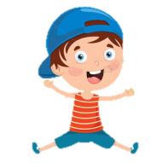
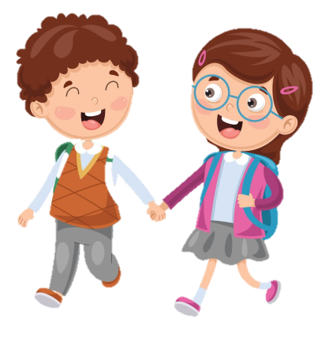
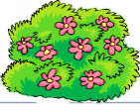
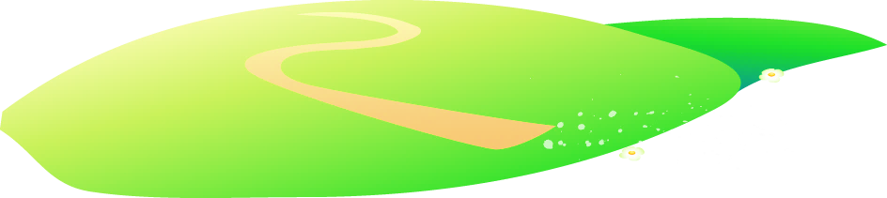

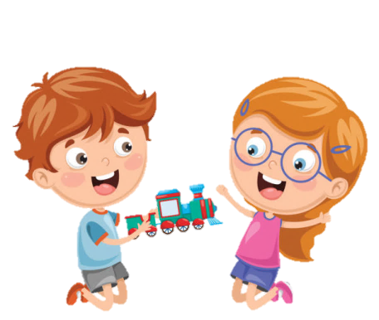





Notes:
Để nguyên trang bìa như này, chỉ thay đổi tên bài trong quá trình làm. Logo của sách Wonderful World

Slide 2




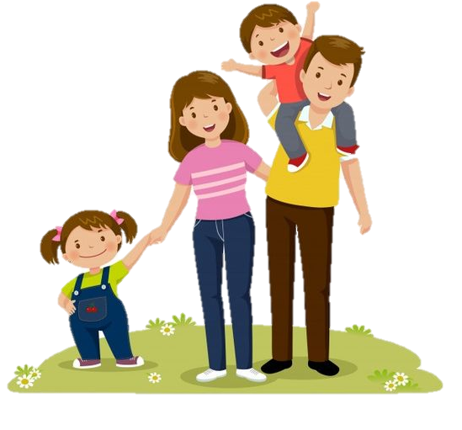
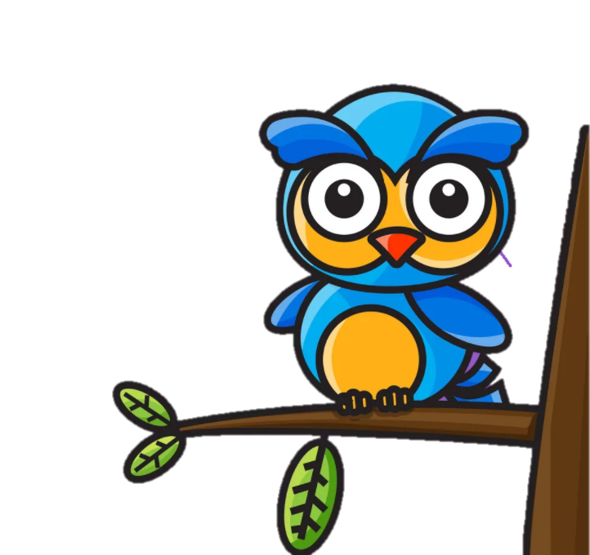
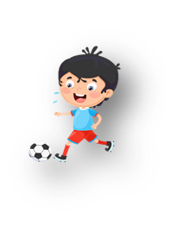

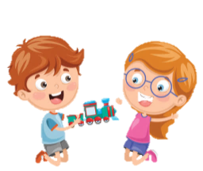


Unit 11: Before our time
Lesson 2: Task 1, 2, 3

Slide 3
1
Warm up
Guess what?
Guess “ Weather“
Notes:
Warm-up: Play a small game “ Guess what”
T divides the class into 2 teams.
The teacher asks SS to look at the picture and time in the past to make a sentence where someone was. If he/she can answer, he/she can get the points for his/her team.
T asks Ss to repeat full sentences after each picture.

Slide 4

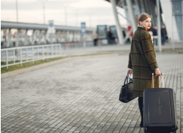


last week
+4
+4
She was at the airport last week.

Slide 5


last year
+3
+3
My family was at the shopping center last year.

Slide 6
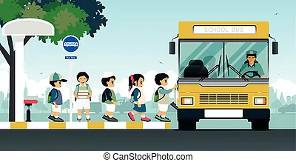

last month
+3
+3
The students were at the bus stop last month.

Slide 7
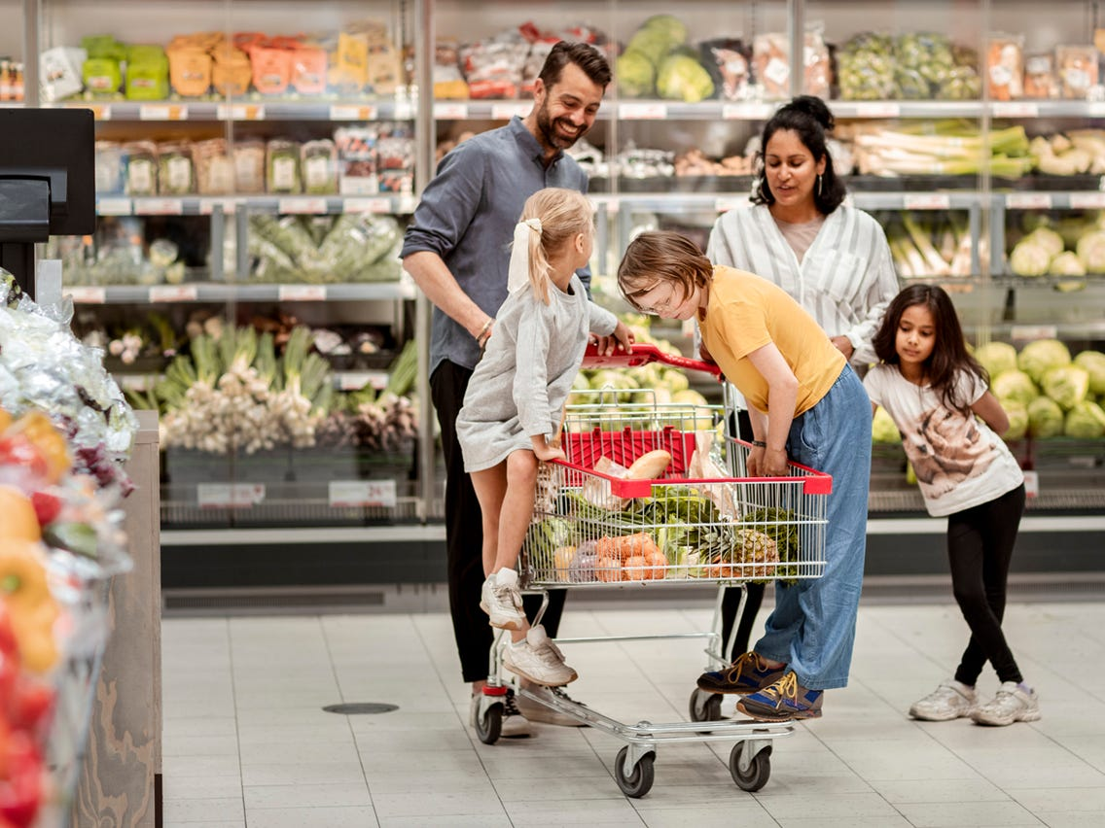

yesterday
+4
+4
They were at the supermaket yesterday.

Slide 8
2
Presentation

Slide 9
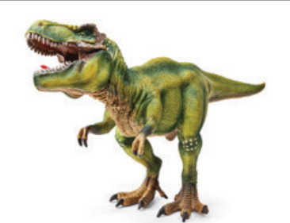

dinosaur
Notes:
Task 1: Listen and point. Repeat. (Track 11.4)
- Use flashcards to introduce the vocabulary of the lesson.
- Say the words for students to listen and repeat in the chorus.
- Say a word for students to repeat then point.

Slide 10
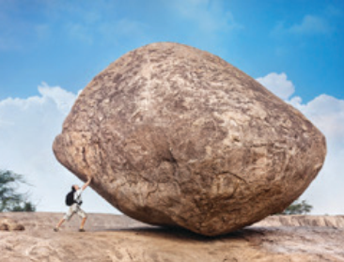
huge

Slide 11
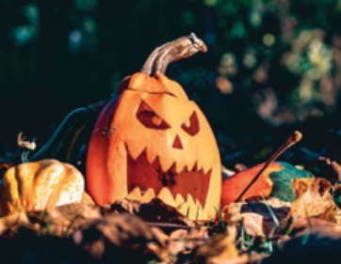
scary

Slide 12
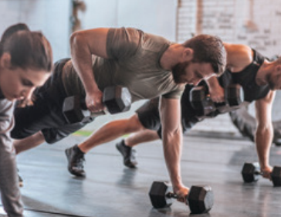
strong

Slide 13
Vocabulary checking
What’s missing?
strong
Notes:
Checking vocabulary: What’s missing?
- T asks SS to look at the pictures and guess which picture is missing.
- T calls SS to say the words which’s missed.
- T calls SS to repeat the word.

Slide 14
Vocabulary checking
What’s missing?
huge

Slide 15
Vocabulary checking
What’s missing?
dinosaur

Slide 16
Vocabulary checking
What’s missing?
scary

Slide 17

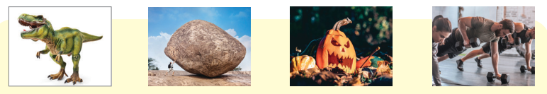

1. Listen and point. Repeat. Tr.11.4.
dinosaur
huge
scary
strong
Notes:
- Play track 11.4 for the students to listen to, point to, and repeat the words in chorus and groups.

Slide 18
3
Practice

Slide 19
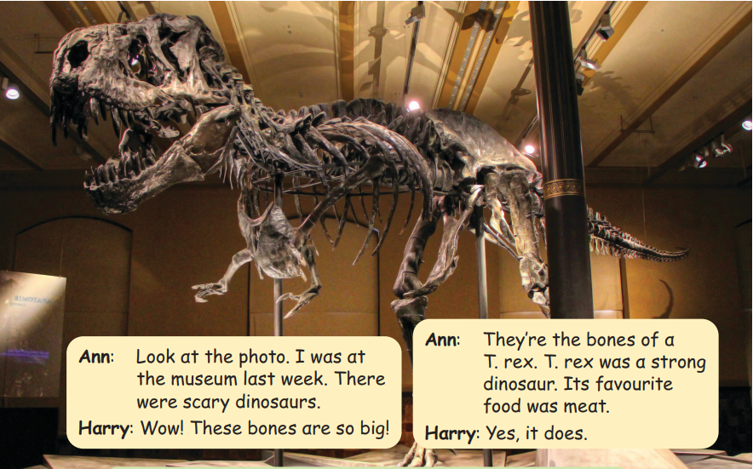
2. Listen αnd reαd. Tick. Tr.11.5.

Slide 20


2. Listen αnd reαd. Tick. Tr.11.5.
Ann: Look at the photo. I was at the museum last week. There were scary dinosaurs.
Ann: They’re the bones of a T.rex. T.rex was a strong dinosaur. Its favourite food was meat.
Harry: Wow! These bones are so big!
Harry: Yes, it does.
T.rex was a scary dinosaur. Yes No
Its favourite food was meat. Yes No

Slide 21

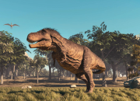
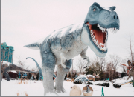
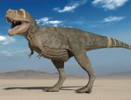
3. Look and say.
Sth was/were + adj.
1 T. rex / scαry
2 T. rex / strong
3 T. rex / huge
T. rex was scαry.
T. rex was strong.
T. rex was huge.

Slide 22
4
Production

Slide 23

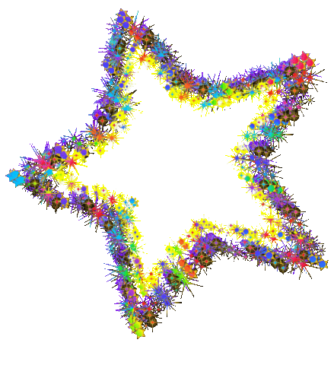

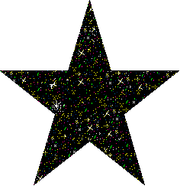

Lucky letters
= 1 point
Rules
= -2 points
= swap
Notes:
- Work in groups.
- T asks SS to introduce “Lucky letters” game.
(The rule of the game:
- T divides the class into 2 teams.
- 2 teams choose letters and answer the question. Ss have to make full sentences with the suggestion which can be suitable to the picture. Which team can get more points will be a winner. )
- Call SS to read aloud in front of the class.
- Check and give feedback.

Slide 24








Slide 25
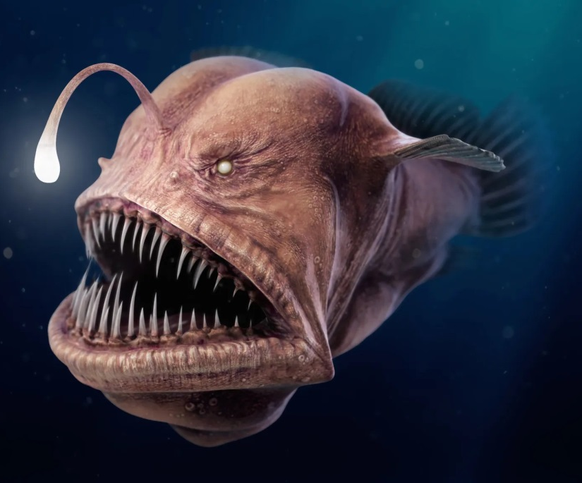

scary
Anglerfish was scary.
Anglerfish

Slide 26
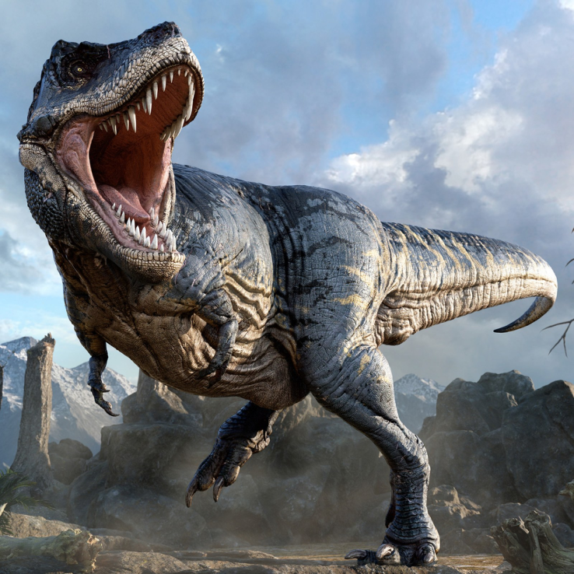
dinosaur
The dinosaur was scary.

Slide 27
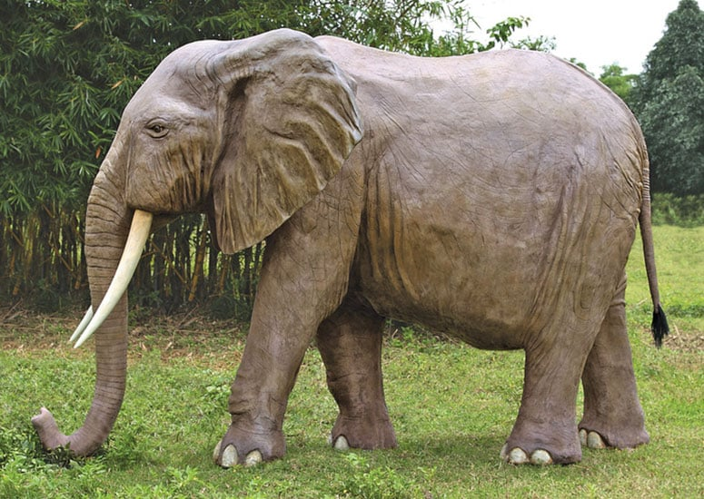
huge
The elephant was huge.

Slide 28
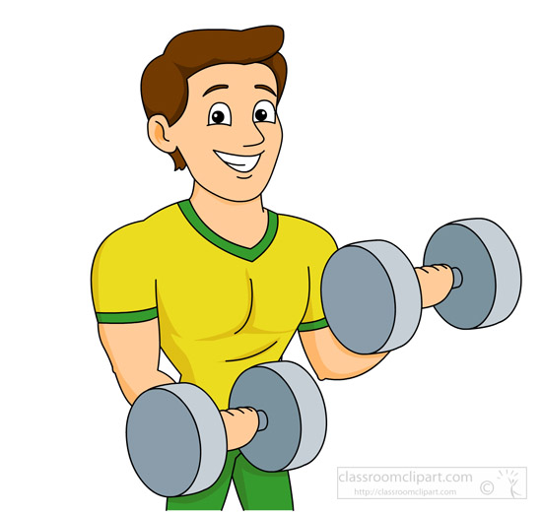
strong - was
He was a strong man.

Slide 29
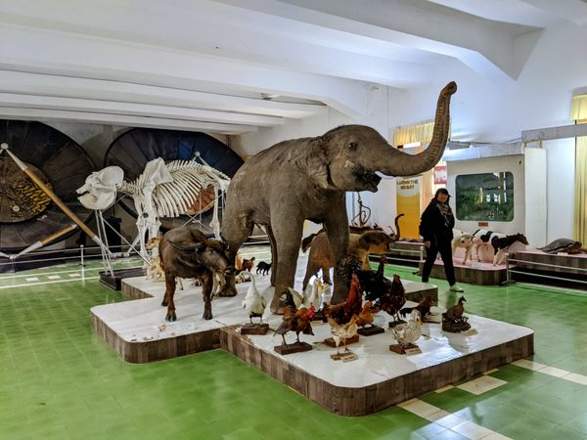
museum
He was at the museum.

Slide 30
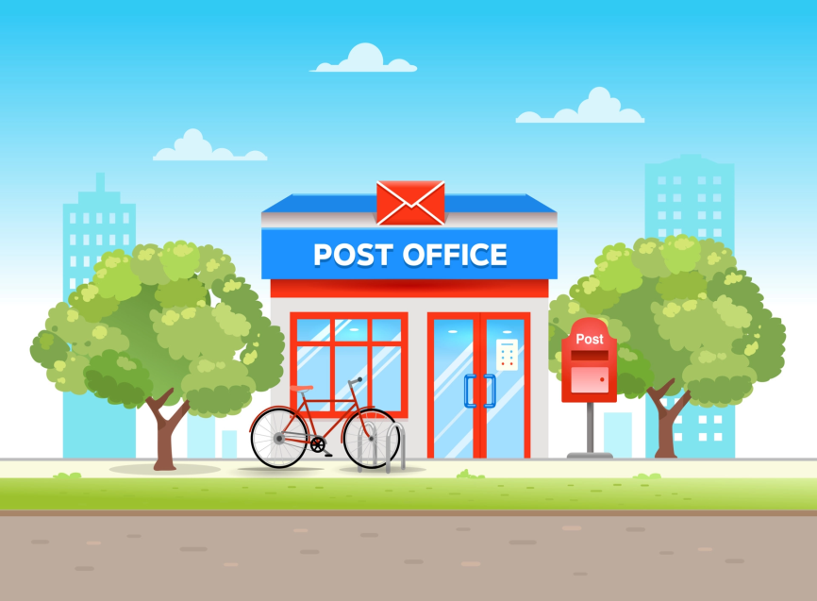
last month
I was at the post office last month.

Slide 31
5
Assessment

Slide 32
4. Order and write.
was/ T-rex/ strong/./
2. scary/ There/ dinosaurs/ were/./
3. favourite/ Its/ was/ food/ meat/ ./
4. The/ were/ dinosaurs/ huge/./
5. strong/ was/ T-rex/ a/ dinosaur/./
T-rex was strong.
There were scary dinosaurs.
Its favourite food was meat.
The dinosaurs were huge.
T-rex was a strong dinosaur.

Slide 33
UNIT 11: BEFORE OUR TIME
LESSON 2 – PERIOD 1
What we learnt today
dinosaur
huge
Vocabulary
scary
strong

Slide 34




Thank you & goodbye!

