Slide 1











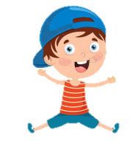
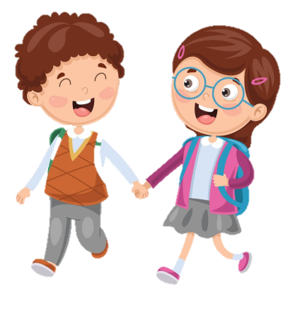

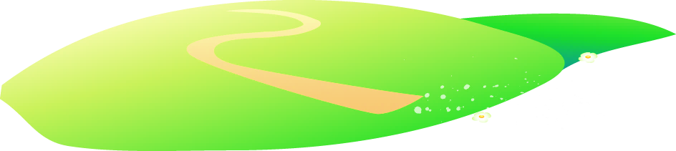


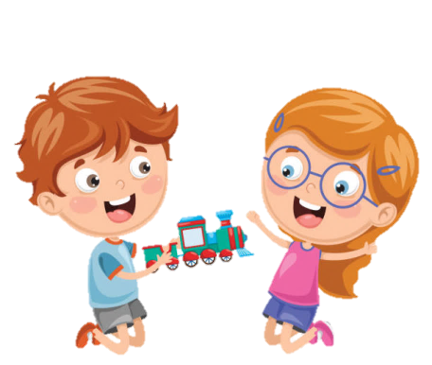




Notes:
Để nguyên trang bìa như này, chỉ thay đổi tên bài trong quá trình làm. Logo của sách Wonderful World

Slide 2
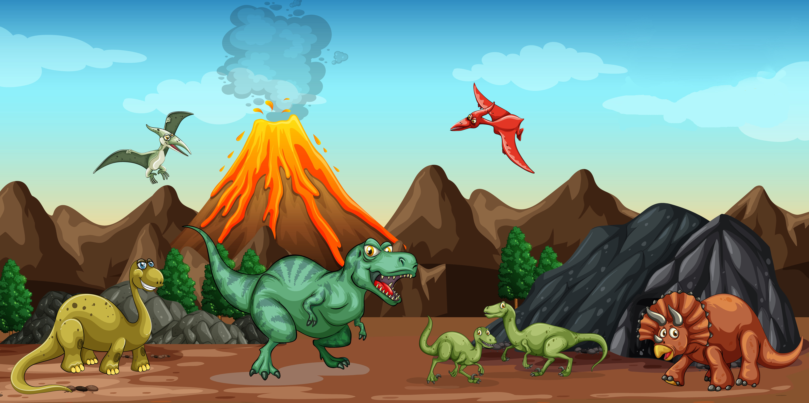
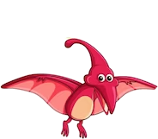
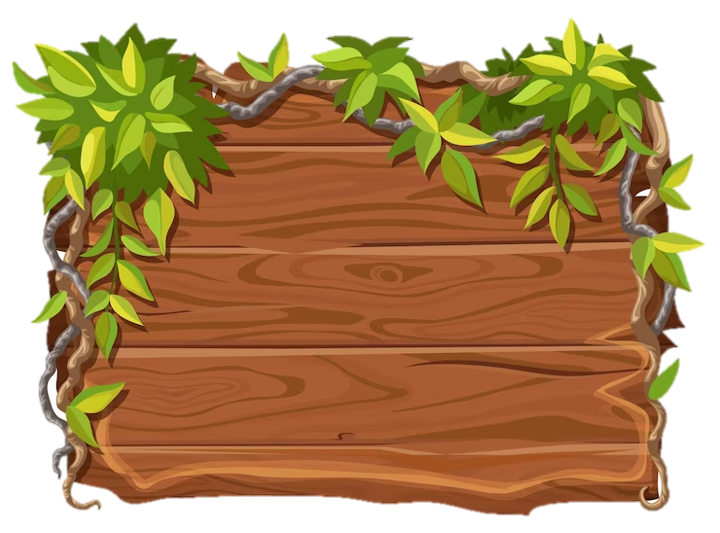
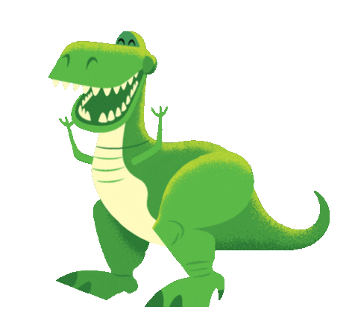
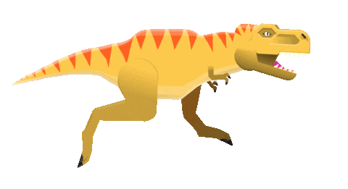
Unit 11: Before our time
Lesson 2
Task 4, 5, 6

Slide 3
1.WARM-UP
What’s missing?
Notes:
Warm up by playing the game

Slide 4
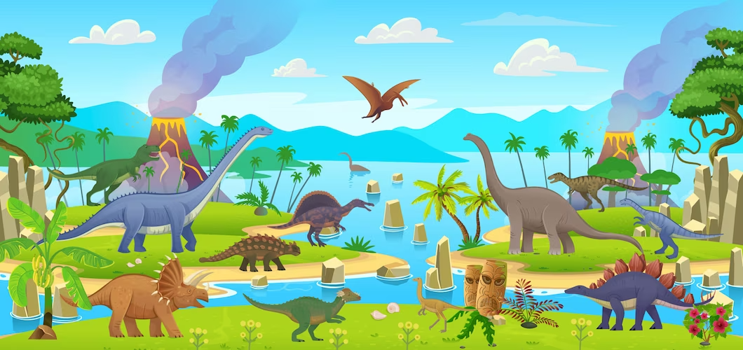
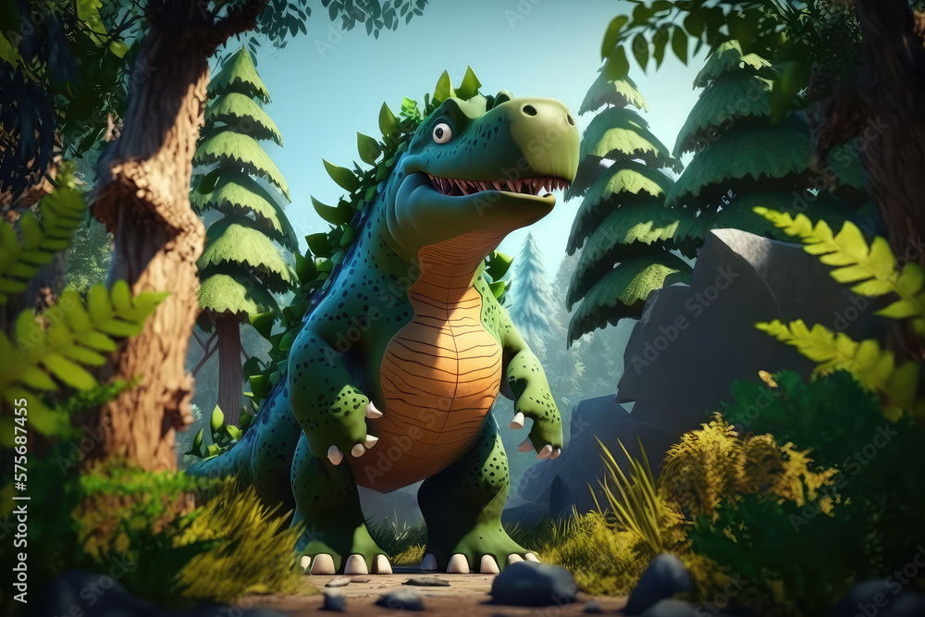
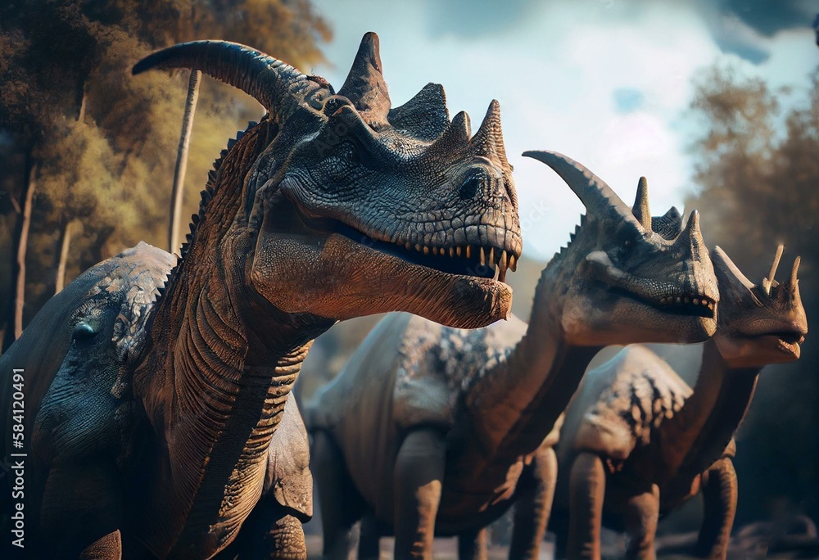
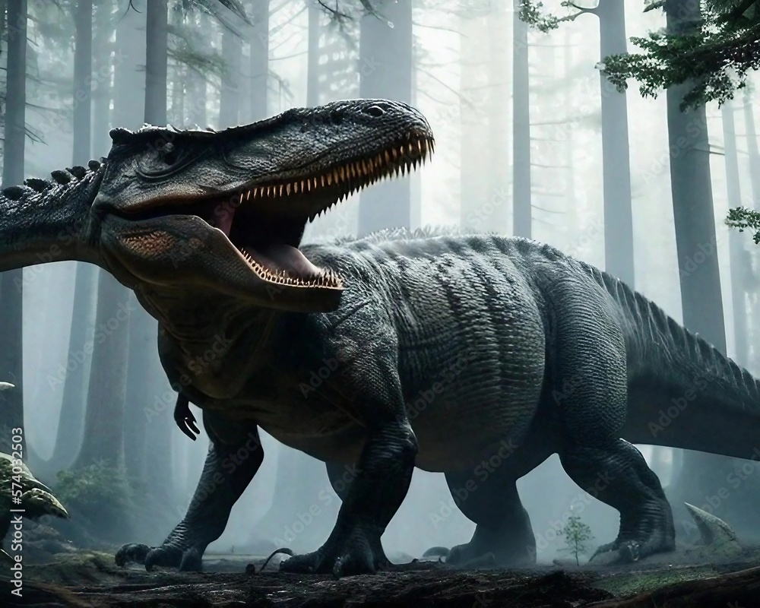
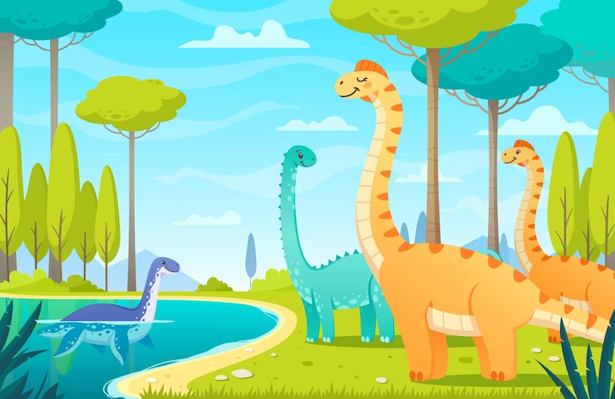
ong
were
dinosaurs
Str____
They _____ scary __________.
was
uge
The T.rex _____ a dinosaur.
H_____
Notes:
Teacher shows the pictures and the words. The 4 groups will work in group and the fastest one will raise their hands to read their answers outloud.

Slide 5
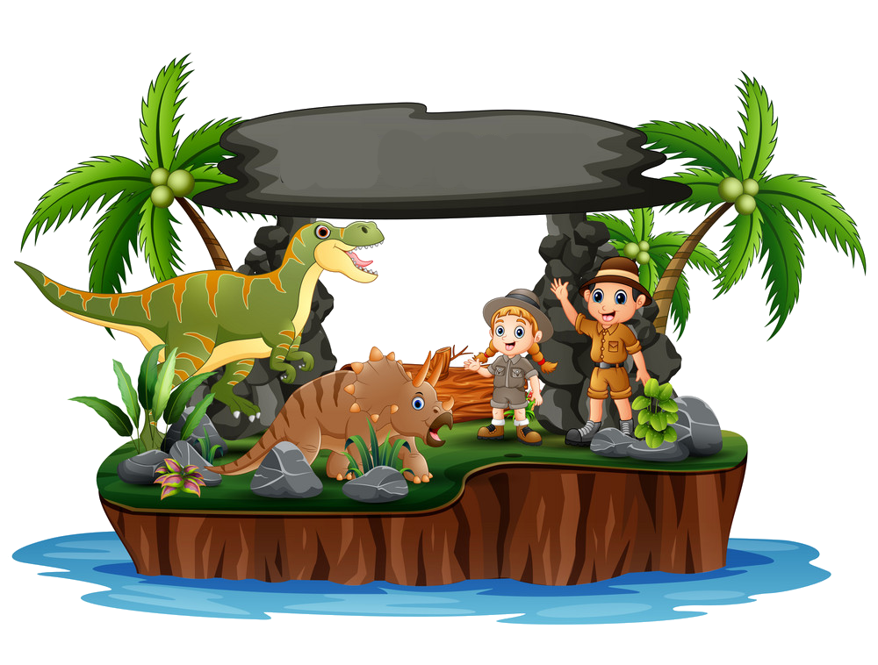
2. PRESENTATION

Slide 6
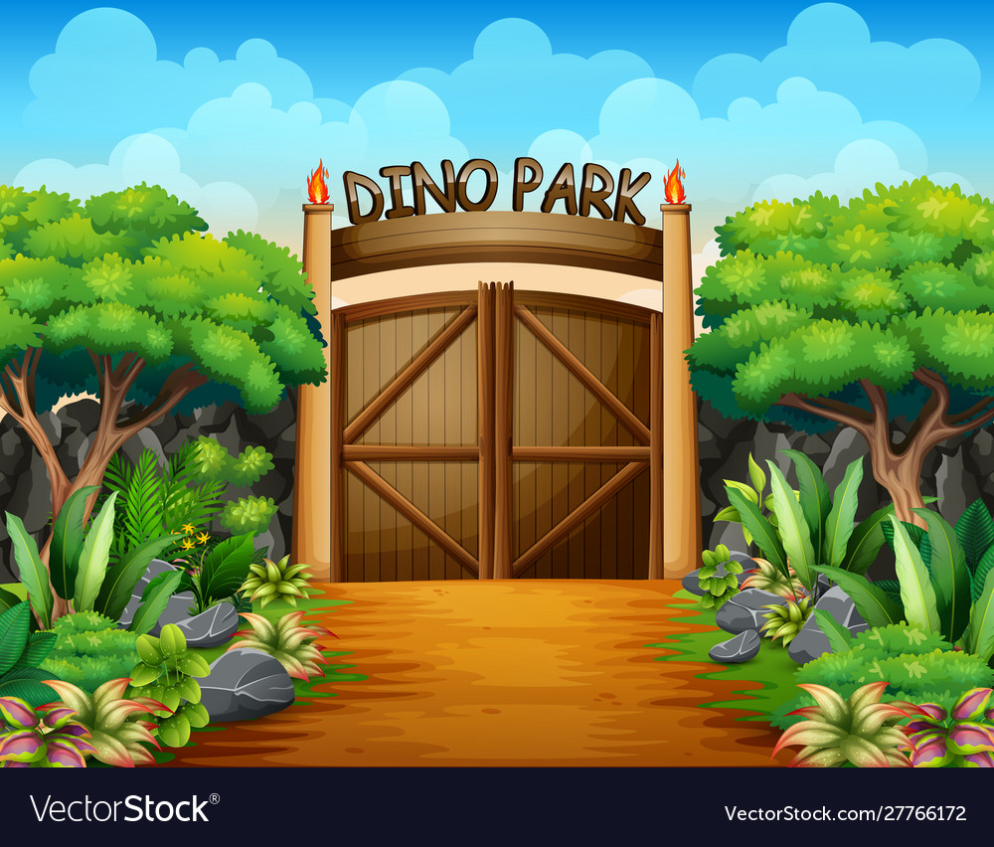
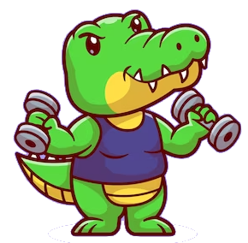
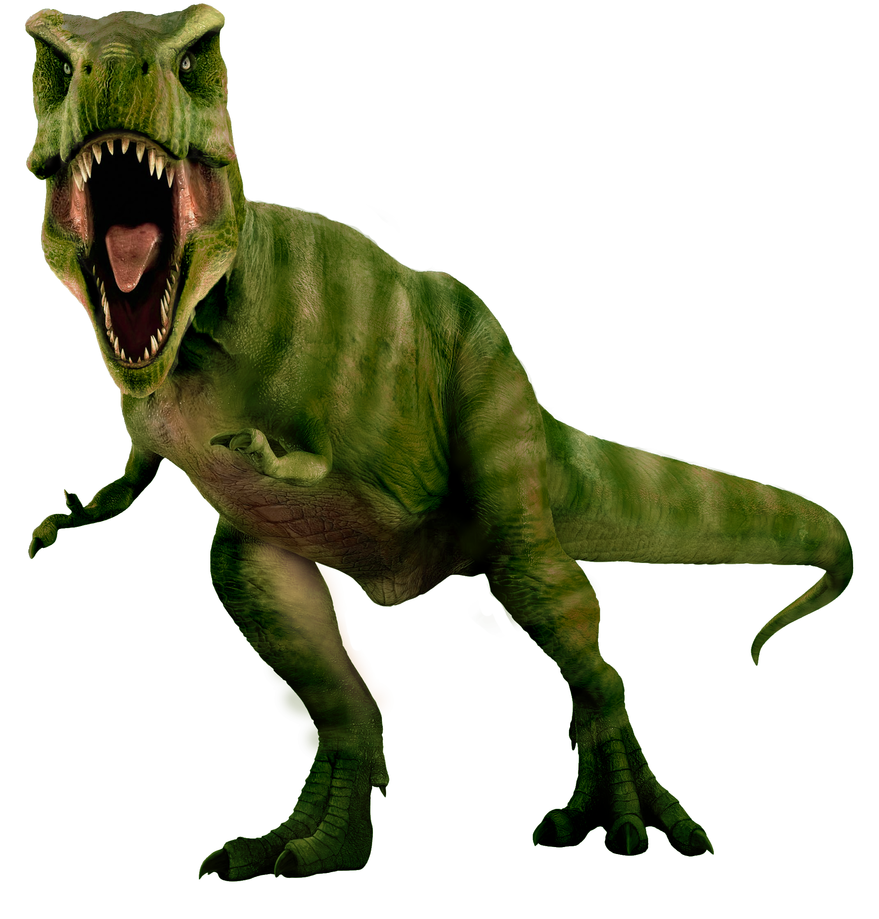
Review. Listen and repeat.
dinosaur
huge
strong
scary

Slide 7
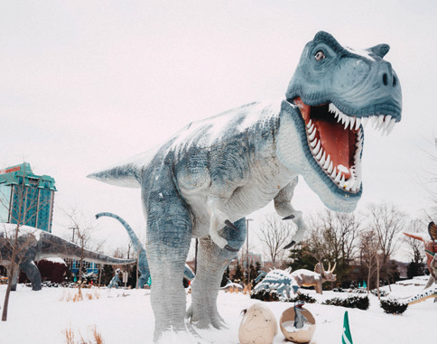
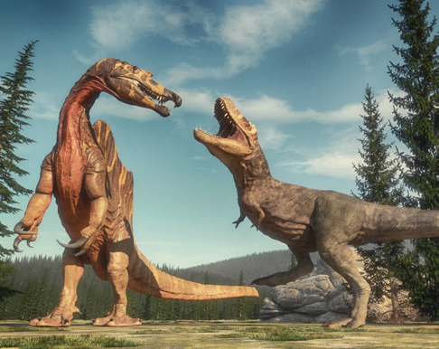
Look, listen and repeat.
1. T. rex wαs α strong dinosαur.
2. They were scαry dinosαurs.

Slide 8
3. PRACTICE

Slide 9
4. Listen and repeat. TR 11.6
1. T. rex wαs α strong dinosαur.
2. They were scαry dinosαurs.

Slide 10
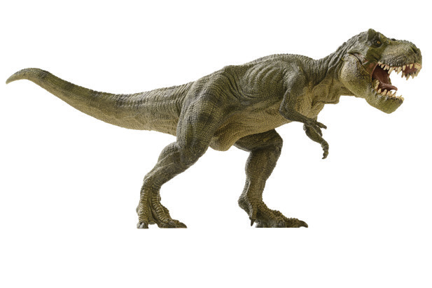
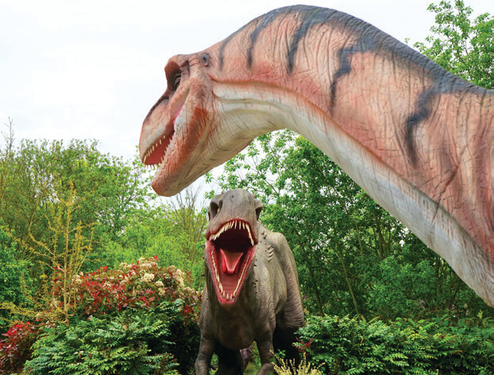
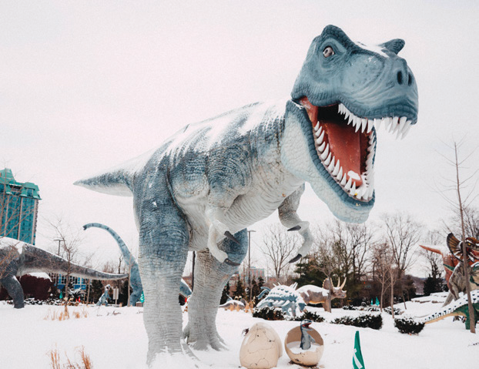
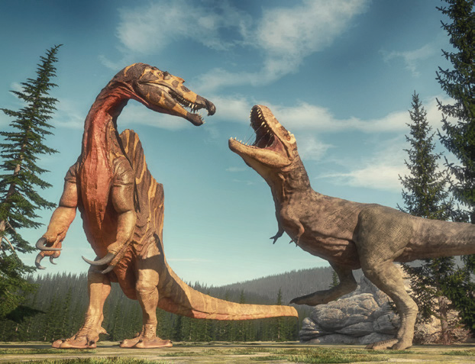
5. Look and sαy.
1. T.rex was a big dinosaur.
2. They were scary dinosaurs.
3. T.rex was a strong dinosaur.
1. T. rex / big dinosaur
4. They were huge dinosaurs.
2. They / scary dinosaurs
3. T. rex / strong dinosaur
4. They / huge dinosaurs

Slide 11
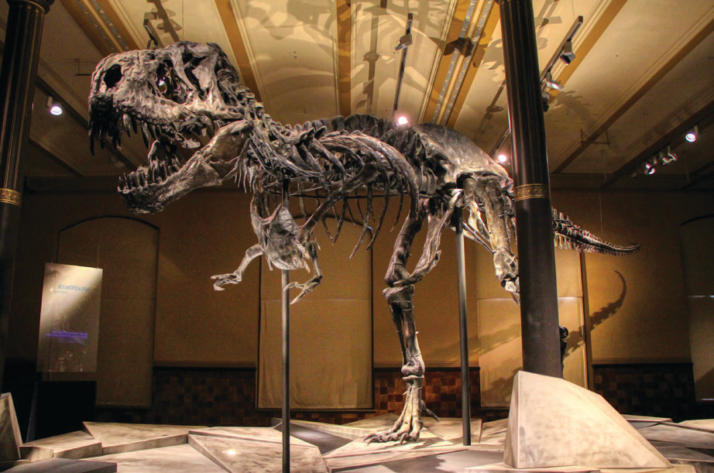
6. Listen and chant. TR: 11.7
T. rex wαs α big dinosaur.
Big, big dinosaur!
Its fαvourite food wαs meαt.
Meαt, meαt, meαt!

Slide 12
4. PRODUCTION

Slide 13
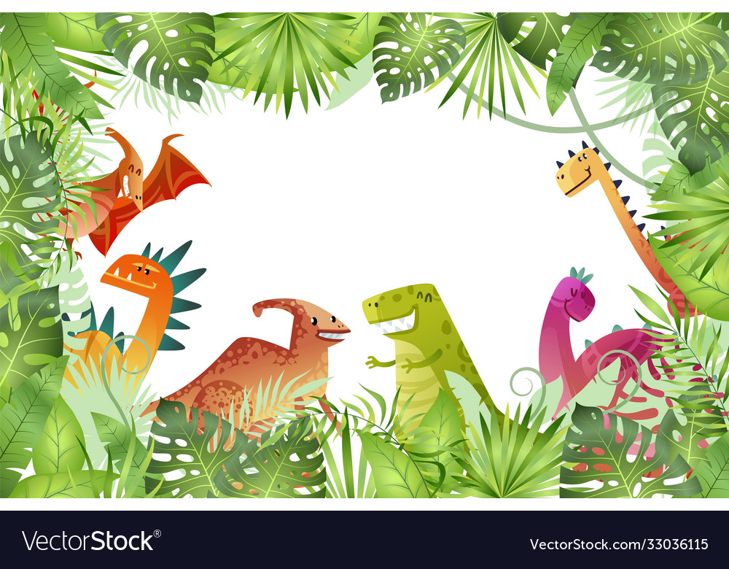




LUCKY
WHEEL
3
2
1
2
3
4
1
5
8
4
5
6
6
7
7
8
9
NEXT
SPIN
Notes:
Click on spin to spin the wheel
Click on the wheel to stop
Groups will take turns to choose a question and answer

Slide 14






1. What is this?
A. It’s a dinosaur.
B. It’s a horse.
C. It’s a buffalo.
D. It’s an elephant.
BACK

Slide 15

2. Are dinosaurs strong?
A. Some of them
B. Yes, they are.
C. No, they aren’t.
D. A few of them.
BACK

Slide 16
3. Choose a word to fill in the blank:
The T.rex is a ___ dinosaur.
A. big
B. small
C. weak
D. friendly
BACK

Slide 17
4. Listen and choose the correct word.
A. hug
B. hurt
C. huge
D. hung
BACK

Slide 18
5. Make a sentence:
They/ scary/ dinosaurs
A. They are scary dinosaurs.
B. They were scary dinosaurs.
C. They is scary dinosaurs.
D. They are a scary dinosaurs.
BACK

Slide 19
6. Choose a correct answer.
A. T.rex was a strong dinosaur.
B. T.rex was a scary dinosaur.
C. T.rex was a big dinosaur.
D. All of A, B, C
BACK

Slide 20
7. Listen and choose the correct answer.
A. They were dinosaurs.
B. They were scary dinosaurs.
C. They were huge dinosaurs.
D. They were strong dinosaurs.
BACK

Slide 21
8. Fill in the blank:
T.Rex favourite food was ___.
A. meat
B. fish
C. fruit
D. vegetable
BACK

Slide 22
9. Is T.rex a dinosaur?
A. Yes, it is.
B. No, it isn’t.
BACK

Slide 23
5. ASSESSMENT

Slide 24
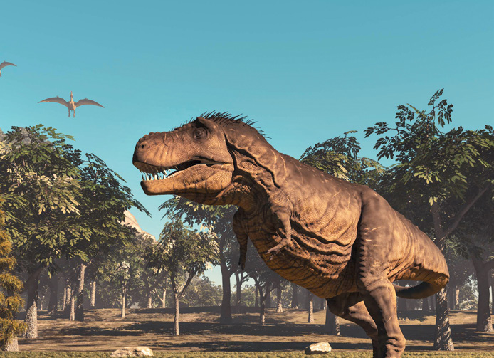
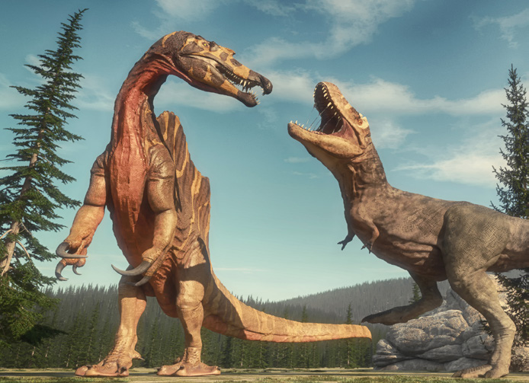
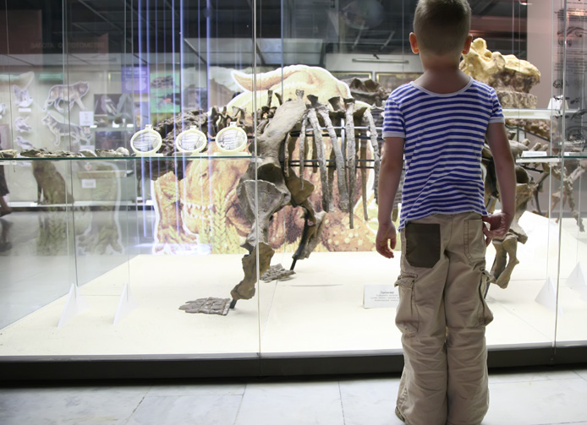
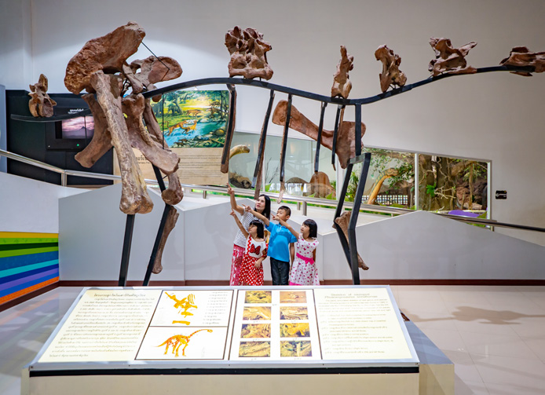
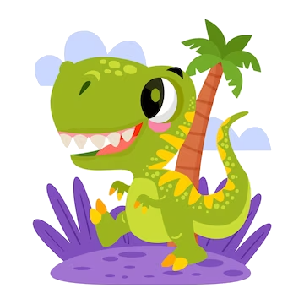
Write
2. Many d ______rs
were big, tall, and
s ____g.
inosau
T. rex wαs
h ___ and
s ___ y .
uge
tron
car
3. I wαs αt the museum yesterday.
The museum wαs
___g__.
4. We were αt the d______r
park last month. The park wαs big.
inosau
hu e

Slide 25
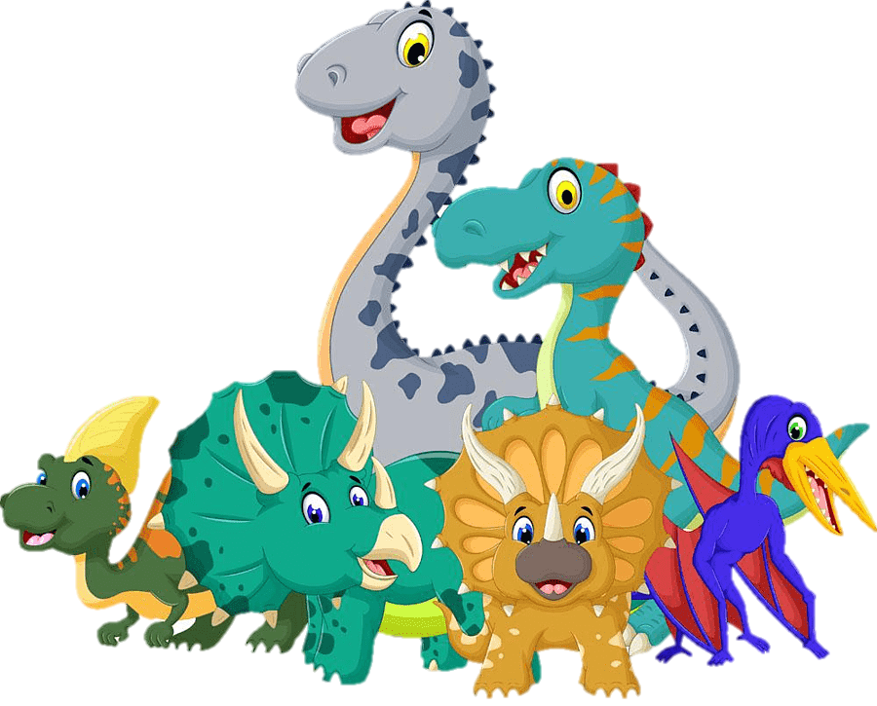
UNIT 11: BEFORE OUR TIME
LESSON 2: PERIOD 2
What we learnt today:
Review vocabulary:
- dinosaur, huge, strong, scary
Structures:
- T.rex was a strong dinosaur.
- They were scary dinosaurs.

Slide 26




Thank you & goodbye!

